Slide 1
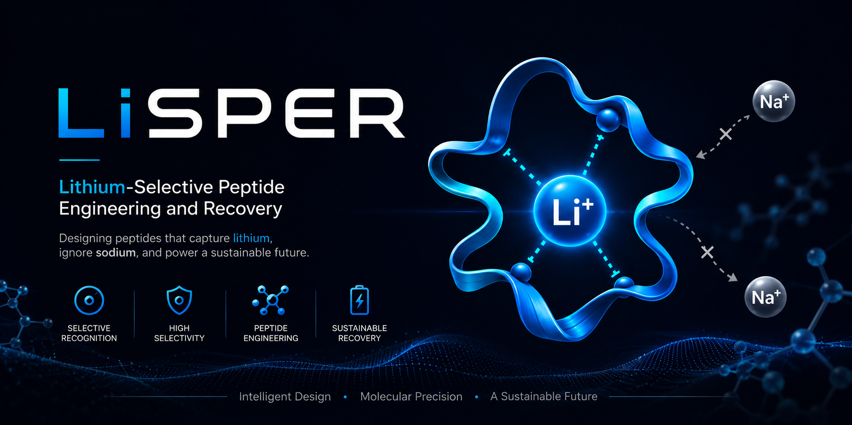
LiSPER Progress Report
Lithium-Selective Peptide Engineering and Recovery
Advisor progress update — computational validation & experimental preparation
Jacky Lin | June 2026
github.com/jackyissocute/LiSPER

Slide 2
Scientific Question
Can engineered peptides prefer Li+ over Na+?
LiSPER designs short, IDP-like peptides with oxygen-donor residues (Asp, Ser) and literature GPGDP/GPGNP motifs.
Goal: measurable Li+/Na+ selectivity in aqueous solution — not just Li+ binding.
Long-term vision: peptide-enabled Bio-DLE for battery recycling and lithium recovery streams.
Selectivity metric: ΔΔG = ΔG(Li+) − ΔG(Na+) (more negative = stronger Li+ preference).
Motif inspiration
GPGDP / GPGNP
IDP flexibility
Gly / Ser / Pro rich
Paired simulation
LiCl vs NaCl MD
Free-energy ranking
Umbrella → PMF
Wet-lab validation
His6-SUMO expression

Slide 3
Three-Phase Program
Discovery → Validation → Translation
Phase I
Phase II
Phase III
ACTIVE
PREPARING
CONCEPT
Computational discovery • 10 candidates • MD + clustering • PMF ranking planned
Experimental validation • His6-SUMO plasmids ready • Expression & assays next
Industrial translation • Host selection report • Packed-bed Bio-DLE architecture
Repository reorganized (June 2026) into stage-based folders for clearer tracking.
Professor-relevant focus today: computational pipeline status + vendor-ready plasmid package.

Slide 4
First-Round Candidate Library
10 peptides — compact enough for simulation and wet-lab follow-through
Rank | Candidate | Sequence (abbrev.) | First subset?
1 | LiD3-1 | GPGDP ×3 repeat | Yes
2 | LiND-1 | GPGNP + GPGDP hybrid | Yes
3 | IDP-Li-1 | Flexible acidic shell | Yes
5 | LowCharge-Li | Lower charge control | Yes
10 | Control-Negative | Weak/neutral control | Yes
4–9 | 4 additional designs | Diversity / affinity variants | Screen later
Wet-lab first subset: LiD3-1, LiND-1, IDP-Li-1, LowCharge-Li, Control-Negative

Slide 5
Computational Pipeline — Completed Stages
ESMFold → CHARMM-GUI → Minimization → Equilibration
Candidate design
Complete
10 sequences in candidates.tsv
ESMFold structures
Complete
PDB + PAE for all 10; starting models only
CHARMM-GUI systems
Complete
10 LiCl + 10 NaCl (CHARMM36m, TIP3P)
GROMACS minimize
Complete
10/10 LiCl and NaCl
GROMACS equilibrate
Complete
10/10 LiCl and NaCl (step4.1)
Ensemble-aware workflow: ESMFold is a starting point; selectivity comes from MD → clustering → PMF.

Slide 6
Project Dashboard
Workstream progress from repository status files
Complete
Candidate design, ESMFold, CHARMM-GUI, equilibration (20/20 systems)
Active (~25%)
20 ns production MD + clustering — LiD3-1 done; IDP-Li-1 running
Planned (~5%)
Umbrella sampling and ΔΔG PMF ranking
Preparing (~95%)
His6-SUMO plasmid package vendor-ready; wet-lab not started

Slide 7
MD Production Status (LiCl)
Remote GROMACS on SeeTACloud — synced 2026-06-15
Candidate | Production | Clustering | Notes
LiD3-1 | ✓ 20 ns complete | Blocked (trjconv) | Trajectory valid; index/atom mismatch at centering
LiND-1 | Blocked (grompp) | — | Missing toppar/forcefield.itp in prod context
IDP-Li-1 | ~43% (8.65/20 ns) | Pending | Active run; T ≈ 295 K, stable constraints
Remaining 7 | Queued | Pending | Sequential CPU-only queue after IDP-Li-1
NaCl (all 10) | Waiting | Pending | Queued behind LiCl production/clustering
Scientific gate: obtain clustered representative structures before umbrella sampling.
LiD3-1 production succeeded — clustering repair is a post-processing fix, not failed MD.
Rough estimate: ~8–10 days remaining LiCl queue + ~10 days NaCl (CPU-only, sequential).

Slide 8
Computational Validation Workflow
Why clustering matters for IDP-like peptides
ESMFold
Starting structure
CHARMM-GUI
Solvated LiCl / NaCl
20 ns MD
Conformational ensemble
Cluster
Top-populated state
Umbrella
PMF windows
ΔΔG rank
Li+ vs Na+ selectivity
→
→
→
→
→
Force field: CHARMM36m + TIP3P | GROMACS 2026.0 | Remote CPU-only runs
We are currently between steps 3 and 4 — first complete trajectory exists (LiD3-1 LiCl).

Slide 9
Experimental Validation — Plasmid Design
His6-SUMO fusion replaces deprecated direct His/T7 constructs
Problem with v1 designs: peptides too small (~1.1–1.6 kDa) for robust expression; vector-derived residues on assay molecule.
Solution: express as His6-Smt3 SUMO fusion (~13.3–13.8 kDa) in pET-28a(+), E. coli BL21(DE3).
SUMO protease cleavage after C-terminal GG releases exact native LiSPER peptide — no His-tag remnant.
All 10 candidates have vendor-ready GenBank maps, FASTA inserts, and order tables.
Expression architecture
T7 → RBS → His6 → SUMO → LiSPER → STOP
vendor_ready_SUMO/
• 10 GenBank plasmid maps
• Synthetic ORF FASTA files
• Construct summary CSV
• Vendor submission report
• Reproducible Python generator

Slide 10
Wet-Lab Plan (Phase II)
Ready to order plasmids — assays designed, not yet executed
Expression
Purification
Peptide recovery
Binding assays
Planned
Planned
Planned
Planned
BL21(DE3), T7 induction, Kan selection Tris-Tricine SDS-PAGE (~14 kDa fusion)
Ni-NTA native conditions SUMO protease cleavage
Second Ni-NTA → untagged peptide in flow-through LC-MS / MALDI identity check
Li+ binding + Na+ competition First subset: 5 candidates
Peptides lack aromatic residues — A280 is not suitable; use mass spec for identity.
Low-MW peptides (~1 kDa) will not be retained on standard 3–30 kDa MWCO devices.
Next experimental gate: vendor synthesis → sequence verification → pilot expression of first subset.

Slide 11
Key Achievements to Date
10
20
20/20
LiSPER candidates designed with literature + IDP rationale
Solvated MD systems built (10 LiCl + 10 NaCl)
Systems minimized & equilibrated
1
10
Complete 20 ns LiCl production trajectory (LiD3-1)
Vendor-ready His6-SUMO plasmid constructs

Slide 12
Next Steps & Timeline
Parallel computational queue + experimental kickoff
Now – 2 weeks
Finish LiCl/NaCl production MD; repair LiD3-1 clustering & LiND-1 grompp
Weeks 2–4
Structural clustering → representative PDBs for all candidates
Weeks 4–8
Umbrella sampling + PMF → ΔΔG Li+/Na+ ranking
Immediate
Submit His6-SUMO plasmids to vendor; begin with 5-candidate subset
After plasmids arrive
Expression → Ni-NTA → SUMO cleavage → Li+/Na+ binding assays
Discussion: prioritize vendor order now vs. wait for computational ranking of first subset?

Slide 13
Thank You
Questions & feedback welcome
Repository: github.com/jackyissocute/LiSPER
LiSPER — Can engineered peptide ensembles make lithium recovery more selective?

