Slide 1
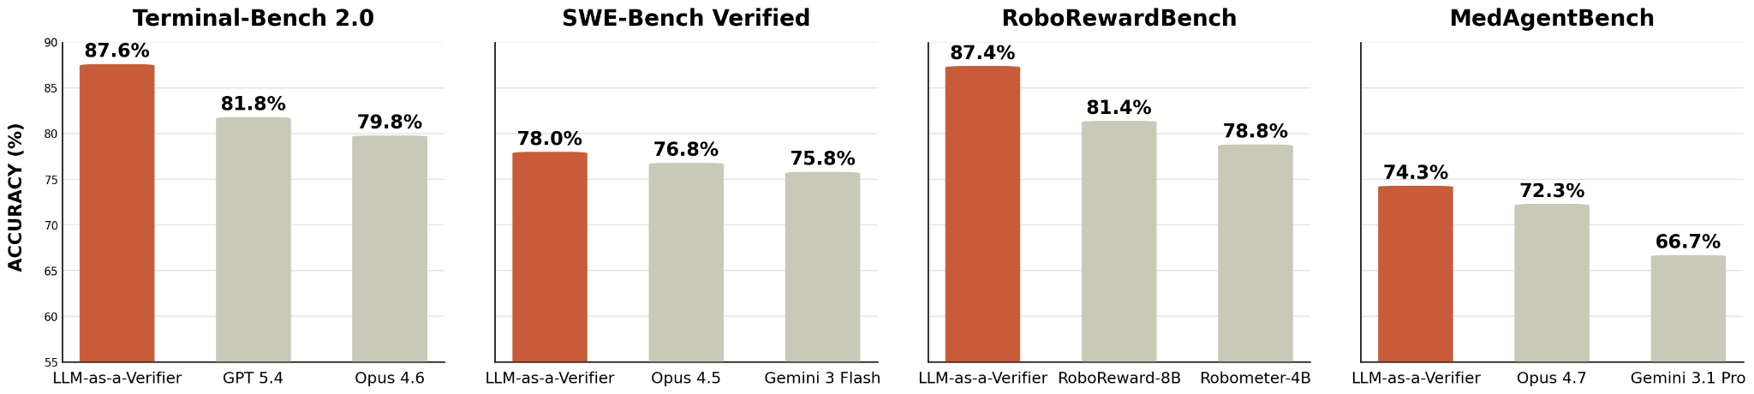

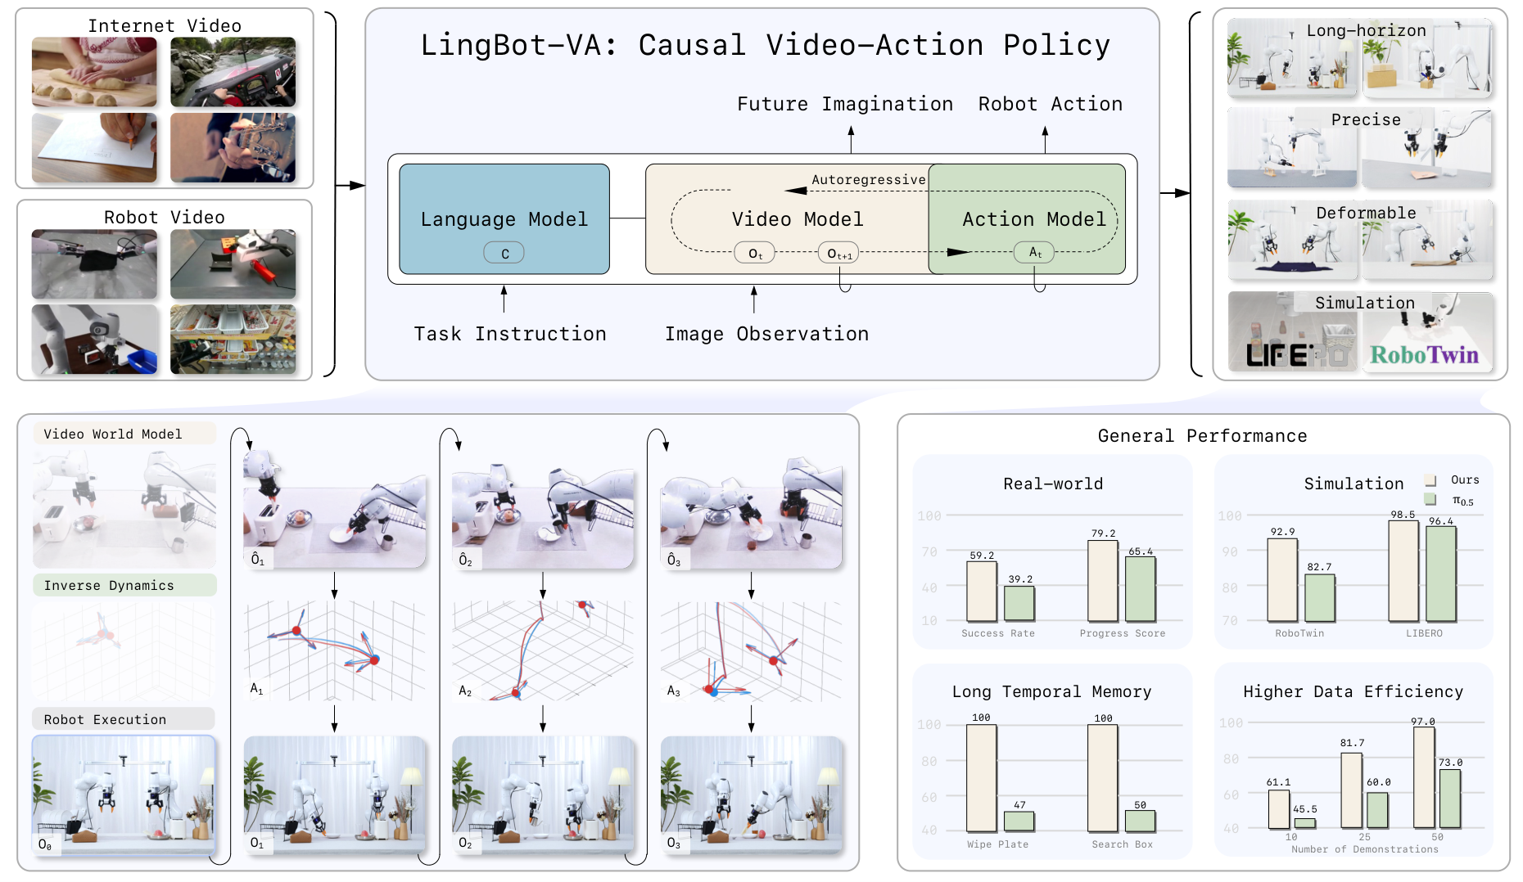


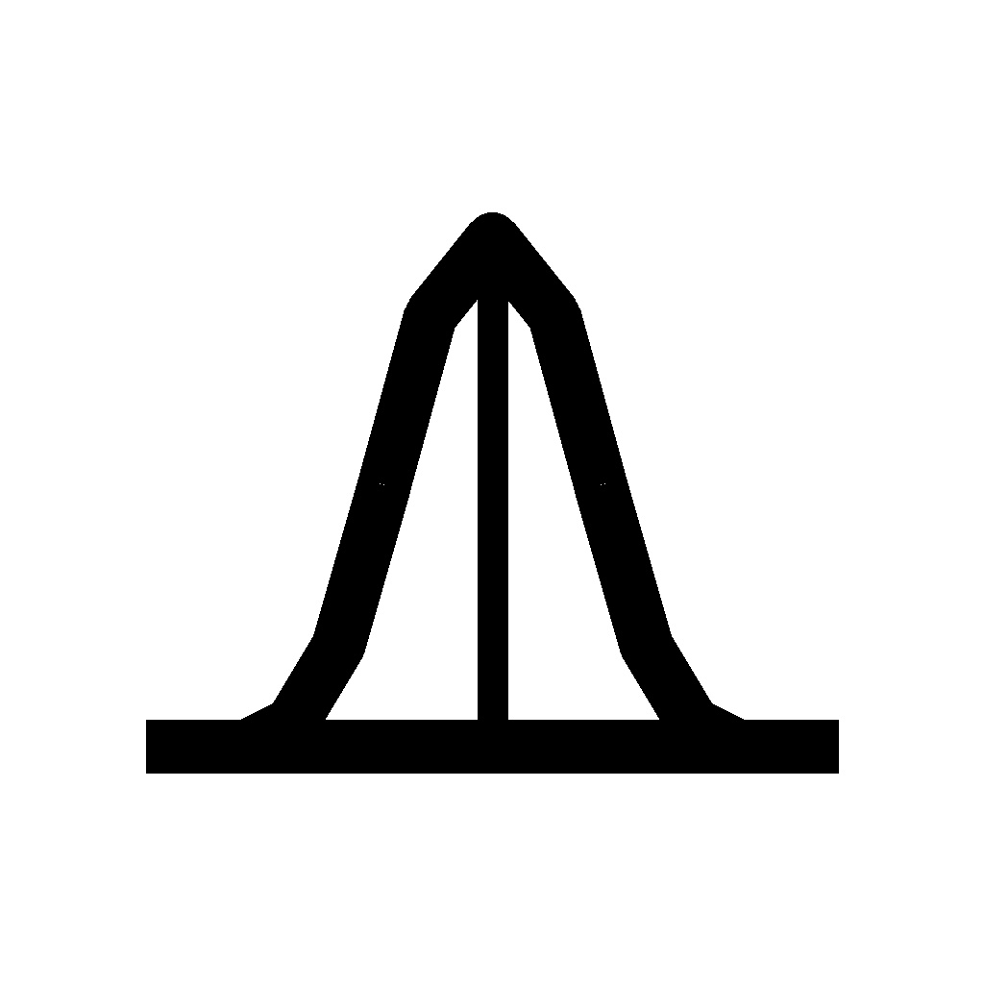




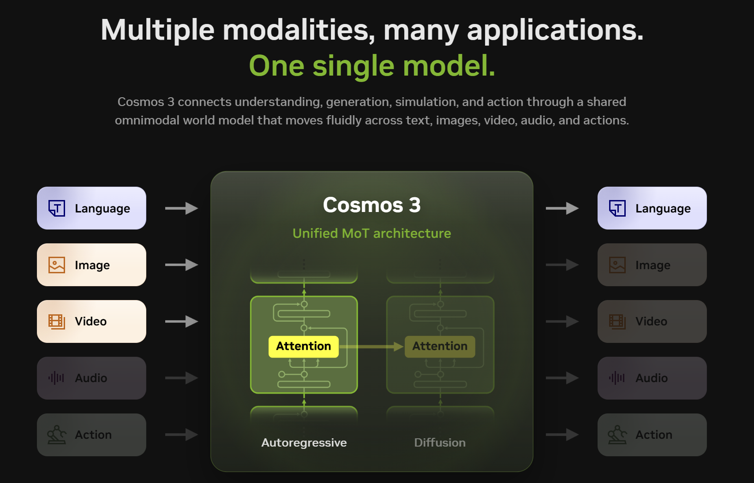




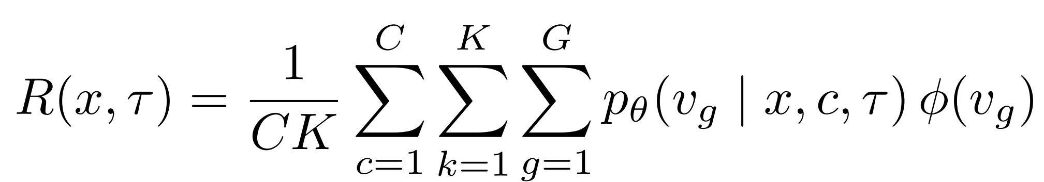
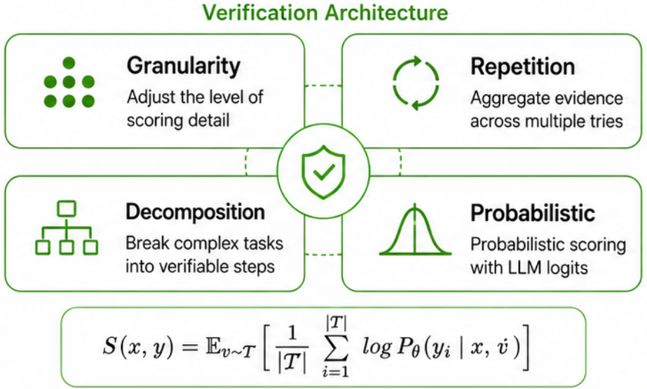



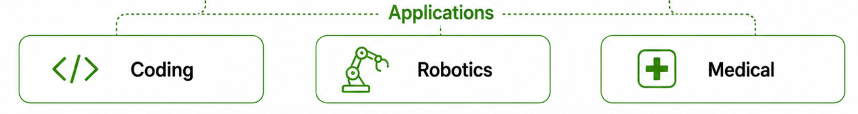
LLM-as-a-Verifier
Verification Scaling Framework
Test-Time Scaling
Text
Uncertainty
Granularity
Probability over LLM logits
Fine-Grained Scoring Token
Progress Tracking
Image
Repetition
Decomposition
Aggregate over multiple signals
Decompose into simpler factors
Reinforcement Learning
Video
Coding
Robotics
Medical
Notes:
Final

