Slide 1
Debate Topic
Expansion
Chieh Kang

Slide 2
Content
Introduction
Model
Overview
Selecting Topics & Building Corpus & Translation
Pattern Extraction
Filter
Input Features
Training
Experiments
Final model
Future works

Slide 3
Content
Introduction
Model
Overview
Selecting Topics & Building Corpus & Translation
Pattern Extraction
Filter
Input Features
Training
Experiments
Final model
Future works

Slide 4
Introduction
Motivation
IBM’s project debater, the first AI system that can
debate on complex topics
One of the very first steps is topic expansion
Given a debate topic, it’s important to first define and
then to extend content

Slide 5
Introduction
Tasks
Extracting possible EC (expansion concept/topic)from sentences containing DC(debate concept/topic)
Debate topic expansion in German through translation
The goal is to build a model recognizing good and bad
expansions

Slide 6
Content
Introduction
Model
Overview
Selecting Topics & building Corpus &Translation
Pattern Extraction
Filter
Input Features
Training
Experiments
Final model
Future works

Slide 7
Overview
Selecting Topics
Building Corpus
Translation
Input Features
Filter
Pattern Extraction
Training

Slide 8
Topics, Corpus and Translation
Selecting Topics:
50 debate topics selected manually
Also wiki topics
Building Corpus:
Extract the wiki pages of the outlinks of these topics
About 500 million characters
Translation:
Use Libretranslate to translate into german

Slide 9
Pattern Extraction
Extract Pattern
Get sentences containing our concepts and patterns with help of regular expression
Use StanzaClientAPI (dependency parsing) to extract EC (detail next page)
Delete duplicates
A ist ein Beispiel für B
Covid-19 ist ein Beispiel für B

Slide 10
Pattern Extraction
Extract Pattern (steps)
Label the last word of the pattern as L
Find the head of L, labeled as H
Check if the next word of H is a genitive case
If not extract the words between L and H
If exists, then find the head of the genitive case and extract the words from L

Slide 11
Pattern Extraction
Extract Pattern (example)
DC
Pattern
Genetive case
Die Schokolade ist ein Weihnachtsgeschenk meines Vaters
L
H
head
head
EC: Weihnachtsgeschenk meines Vaters

Slide 12
Filter
List of filters
Stop words
Substring
Frequency ratio (>0.01)
Cosine similarity (>0.2)
255 pairs left (40 good expansions, 215 bad expansions)
Imbalanced!!

Slide 13
Input Features
List of input features
cosine_similarity
hypernym
hyponym
co-hypernym
synonym
DC_sentiment
EC_sentiment
freq_ratio

Slide 14
Training
Training steps
Labelling
Manually label good and bad expansions
Preprocessing
The features remain and the target is extracted
Split train test data
Use stratified train test split and split-ratio is 0.1
Grid search cross validation
Use grid search cross validation to fine-tune the model
Note: The f1-score is calculated in macro-f1-score, since it is important for us to recognize good topic expansions

Slide 15
Content
Introduction
Model
Overview
Selecting Topics & Building Corpus & Translation
Pattern Extraction
Filter
Input Features
Training
Experiments
Final model
Future works

Slide 16
Statified contextualized vs Fasttext
Objectives and how it’s done
Find out if the types of word embedding effect the performance
Compare the result of fasttext and self-trained embedding (trained with whole german wiki and Bert)
Normally the statified contextualized word embedding should output better result

Slide 17
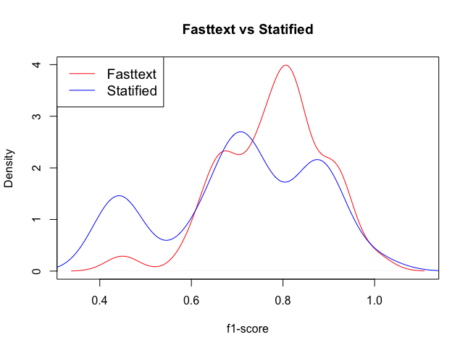
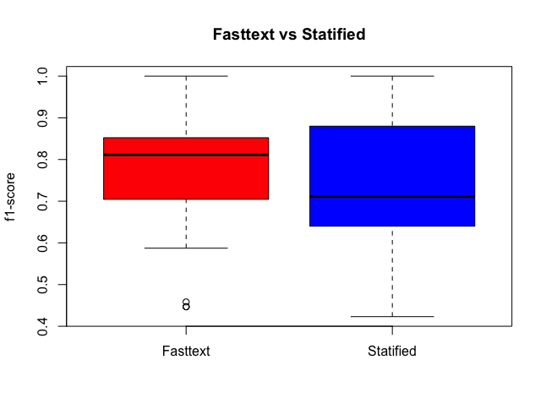
Statified contextualized vs Fasttext
Result
p-value for fasttext == self-trained embedding: 2.074e-05

Slide 18
Statified contextualized vs Fasttext
Result
Fasttext average: 0.7785870
Statified contextualized average: 0.7083629
Assumed reason: There is some word embedding that Statified contextualized do not contain, but on the other hand fasttext can handle them

Slide 19
Translate or Extract first?
Objectives and how it’s done
Two methods:
Translate corpus into german then extract the expansion topics
Extract the expansion topics then translate the extracted expansion topics into german
If ”Extractionfirst” has better performance then there is no need to translate the whole corpus and thus less computational cost

Slide 20
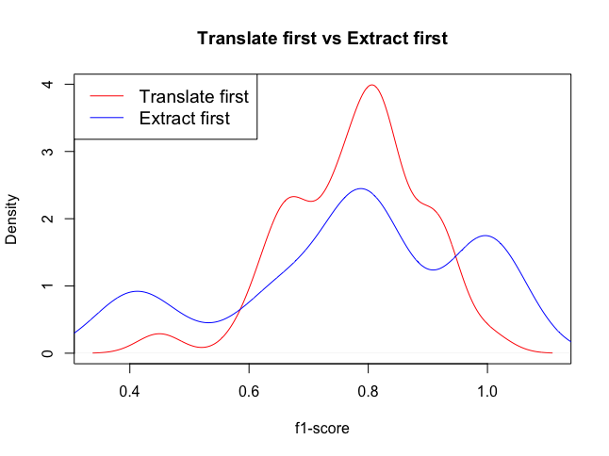
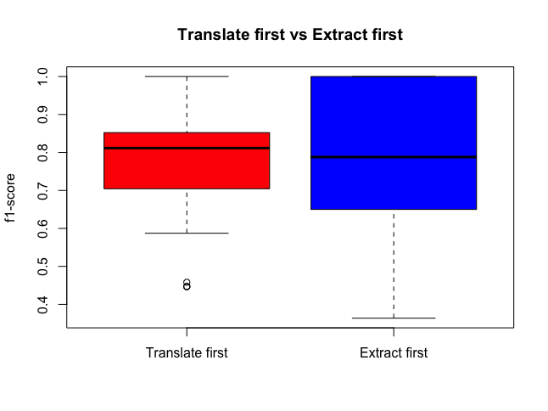
Translate or Extract first?

Slide 21
Translate or Extract first?
Result
Translate first: 0.7785870
Extract first: 0.7672677
”Translate first” has more than 250 pairs, whereas ”Extract first” has only a little bit more than 60 pairs

Slide 22
Logistic regression vs Decision trees
Objectives and how it’s done
Determine which of machine learning methods fit our data better
Differences between two models:
The ways they separate data are different. Logistic regression is a linear classifier, whereas decision trees are a non-linear classifier
Decision trees have normally a higher computational cost than logistic regression.

Slide 23
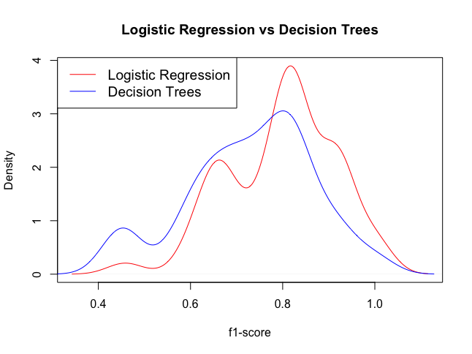
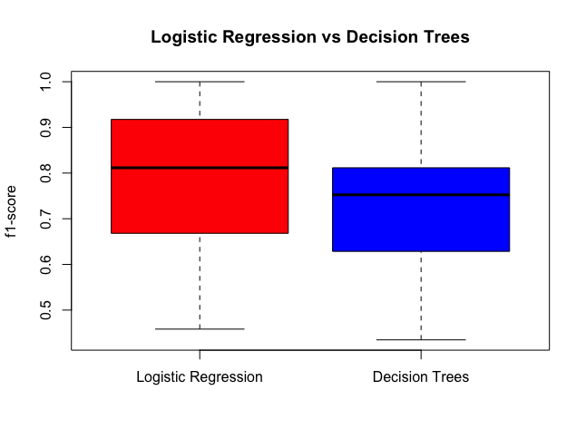
Logistic regression vs Decision trees
Decision trees: 0.7310355
Logistic: 0.7974715

Slide 24
Content
Introduction
Model
Overview
Selecting Topics & Building Corpus & Translation
Pattern Extraction
Filter
Input Features
Training
Experiments
Final model
Future works

Slide 25
Final model
 | F1-score
Fasttext | 0.7785870
Statified contextualized | 0.7083629
Translate first | 0.7785870
Extract first | 0.7672677
Logistic regression | 0.7974715
Decision trees | 0.7310355

Slide 26
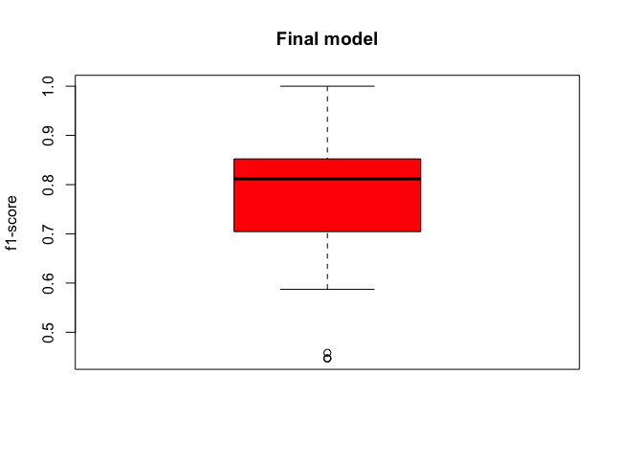
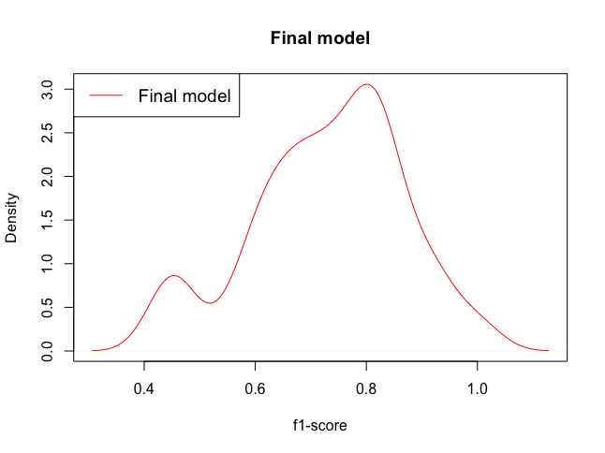
Final model
Final f1-score: 0.7974715

Slide 27
Content
Introduction
Model
Overview
Selecting Topics & Building Corpus & Translation
Pattern Extraction
Filter
Input Features
Training
Experiments
Final model
Future works

Slide 28
Future works
Corpus size-translation tradeoff
Word embedding: How to deal with words out of vocabulary
Filter and feature selection

Slide 29
Thank you

