Slide 1
Electric Caviar Racers
Kuhn Poker Agent
Eduardo Porto
Lester Hernandez Alfonso

Slide 2
1. Intro
The game:
3 player Kuhn poker, a simplified 4 card (1 card per hand) version of poker
Our agent:
Electric Caviar is actually a heavily modified version of the “example_player” agent from computer poker competition code download package.
Objective:
Have our agent compete against other student's agents, who will probably implement similar approaches.

Slide 3
2. Approach
Our agent always plays a Nash Equilibrium strategy as described by “A Parameterized Family of Equilibrium Profiles for Three-Player Kuhn Poker” (Szafron, Duane, et al.)
The Fictitious Play algorithm is used to learn about opponents strategies.
Our agents keeps a scoreboard so that it can choose to transfer utility from an opponent to another, if necessary.

Slide 4
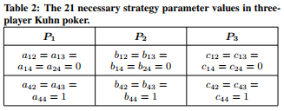
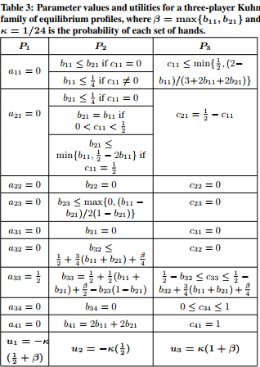
3. Implementation
“example_player” agent was modified to implement all equilibria from table 2 & 3 from the article (Szafron, Duane, et al.)
This was done by saving all values {ajk, bjk, cjk | j, k = 1..4} in variables and setting them before playing an action (every round). Note some values needed to be randomized.
Learning was then implemented by by gathering data on how opponents conformed to our initially randomized variables and adjusting these probabilities to reflect their actual behaviour.

Slide 5
4. Further Improvements
-Fictitious play could be replaced by a more robust, and efficient algorithm to help predict a dynamic opponent’s move.
-In addition to predicting its opponents’ moves our agent could also be modified to identify what its opponents believe its strategy is. Then deviate from its current strategy to make itself more unpredictable, while remaining within the families of equilibria.

Slide 6
Sources
1- Szafron, Duane, et al. “A Parameterized Family of Equilibrium Profiles for Three-Player Kuhn Poker.” poker.cs.ualberta.ca/publications/AAMAS13-3pkuhn.pdf.
2- Annual Computer Poker Competition Website. http://www.computerpokercompetition.org/. (Protocol, Rules, and sample code)

