Slide 1
WHERE
Yongyi Yang

Slide 2
Mobile Phone Application
Project Structure
Function Realization

Slide 3
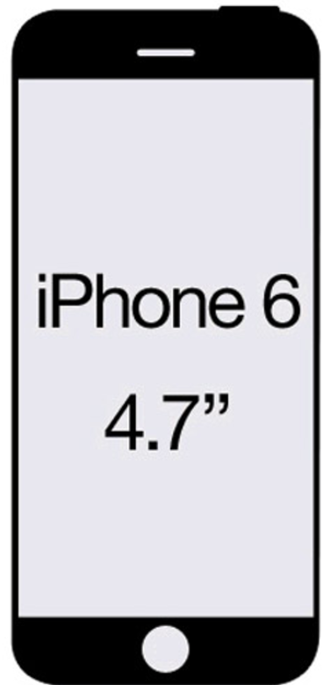
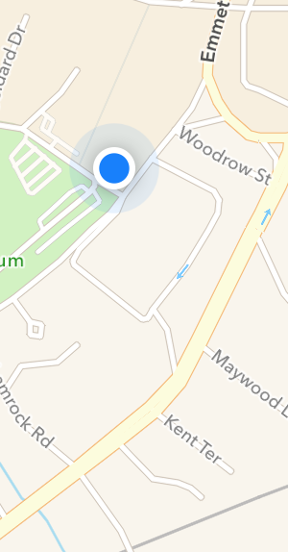
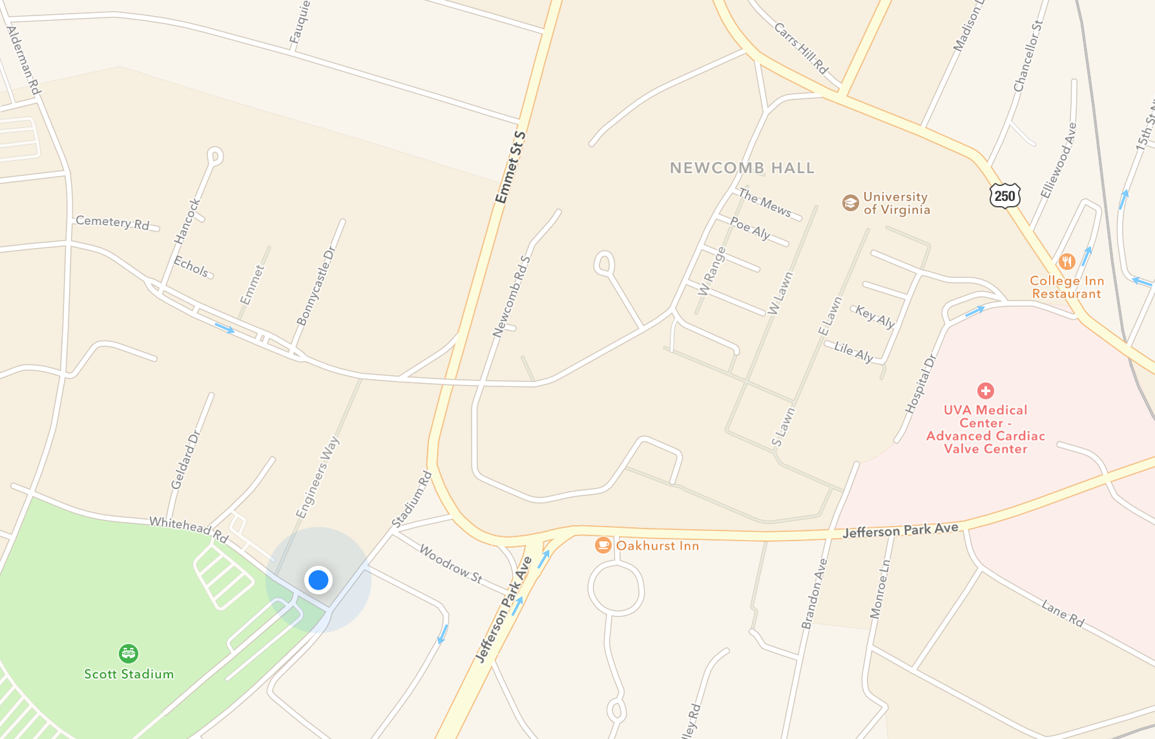

1. Mobile Phone Application
Hi~ ☺
Location:
UVA Medical Center
Num. of people:
23
User name:
Jazz_z
My name:
Jazz_z
My location:
Rice Hall

Slide 4
2. Project Structure
Login —— Amazon Cognito
Location —— SQS, SNS, Redis, EC2
Post —— SQS, SNS, Redis, EC2

Slide 5



3.1 Location
Send Update location request
Fetch from queue
Consumer
(on EC2)
Send Pull location request
PULL location
Push location to
user queues
from queue

Slide 6


3.2 Post
Consumer
(micro-service on EC2 container)
Send send post
Fetch from queue
Request
Notify
Get notified
Update posts
Notify subscripted queues

