Slide 1
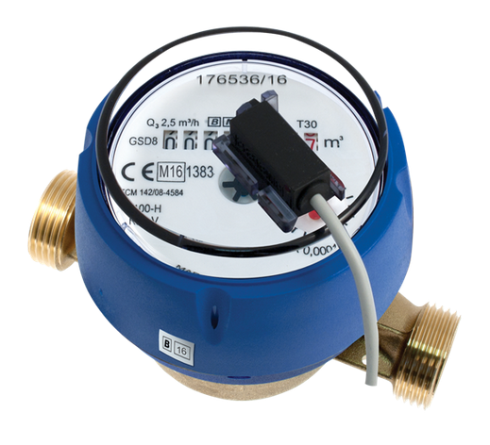
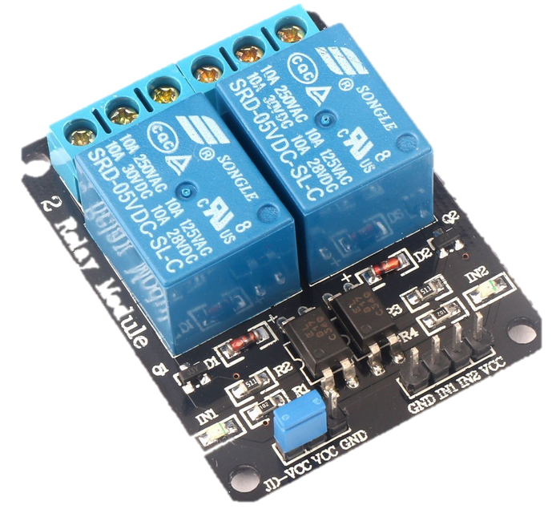
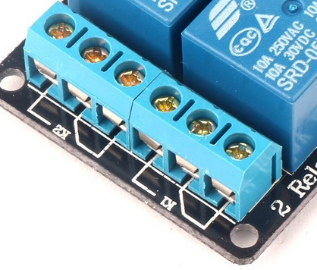
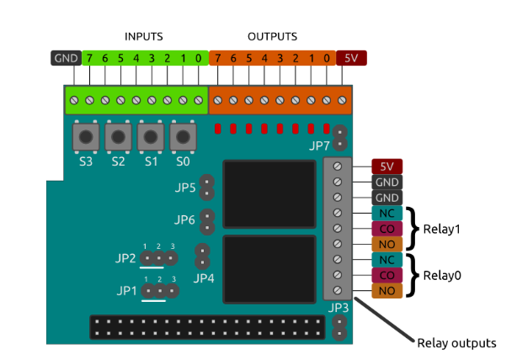
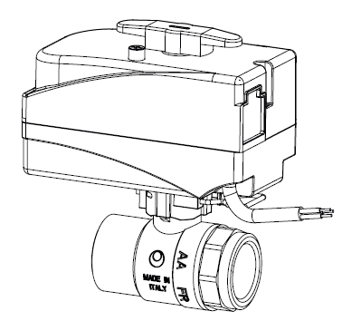
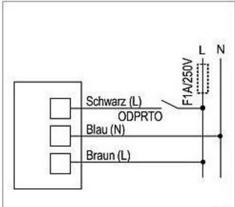
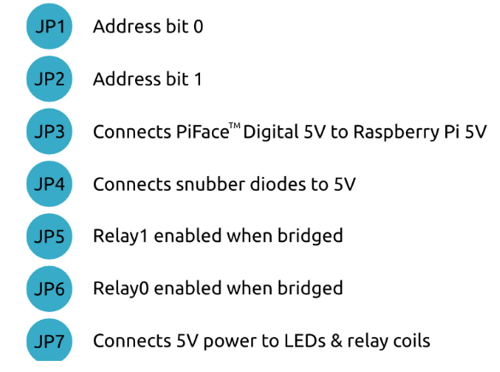
IP65- Sicherungskasten
N | GND | L1 - 220V
NC
VCC
NO
F1A/250V
NC
VCC
NO
GND
IN1
IN2
5V
2-Wire Reed contact
Raspberry Pi
WiFi
→ MQTT -> AWS IoT → InfluxDB
Close main water ← Relais ← MQTT ← Anomaly

