Slide 1
Cloud-based IoT Server for energy savings
W205-3 | Matthew Burke, Jan Forslow, Vyas Swaminathan, Xiao Wu

Slide 2
Current Industry Status and Main Goal of Project
Legacy Smart Meter systems were developed 7+ years ago
Optimized for once-a-day reading of Smart Meter data for billing purposes
The use of Cloud-based IoT Server opens up for new possibilities:
Infinitely scalable
Handling of real-time streaming data
This opens up for new ways for energy savings and power grid control:
Voltage optimization, community energy sharing/sales, etc.

Slide 3
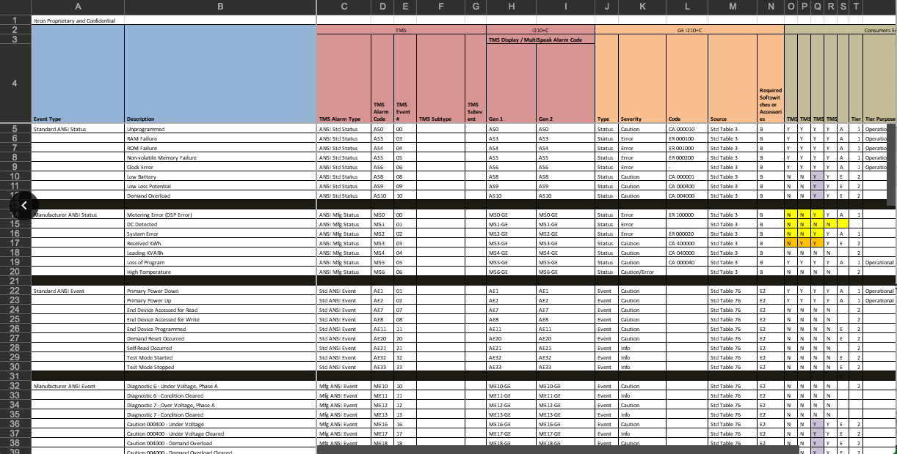
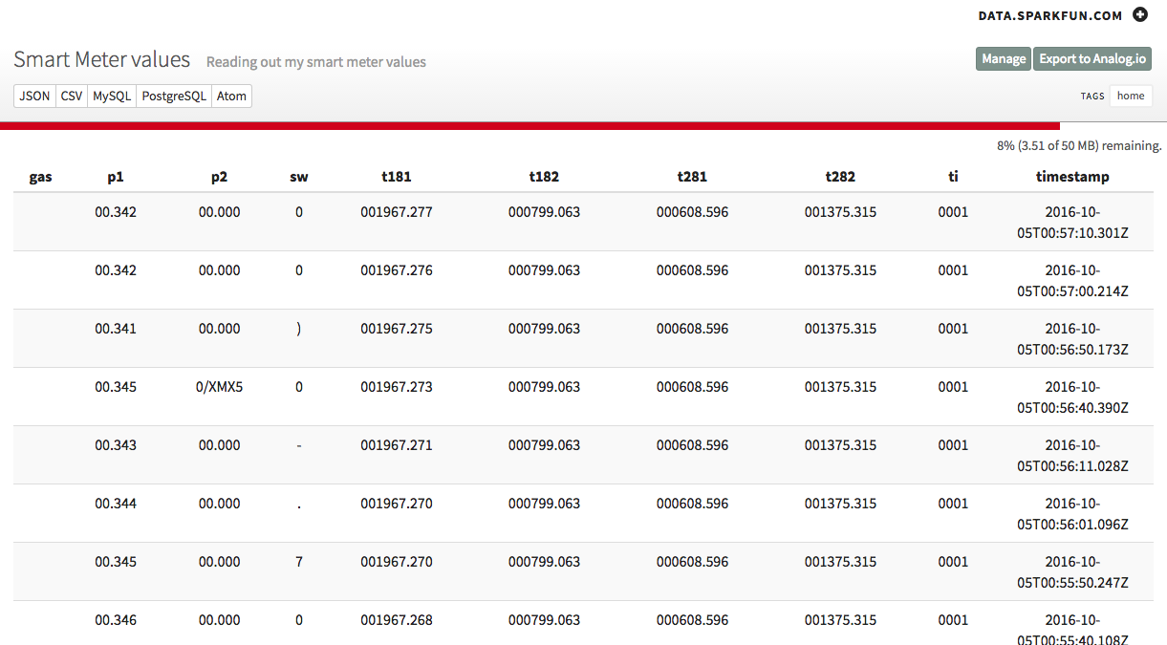
Potential Data Sources
Example Data from Private Firms
Public Streamed Data

Slide 4
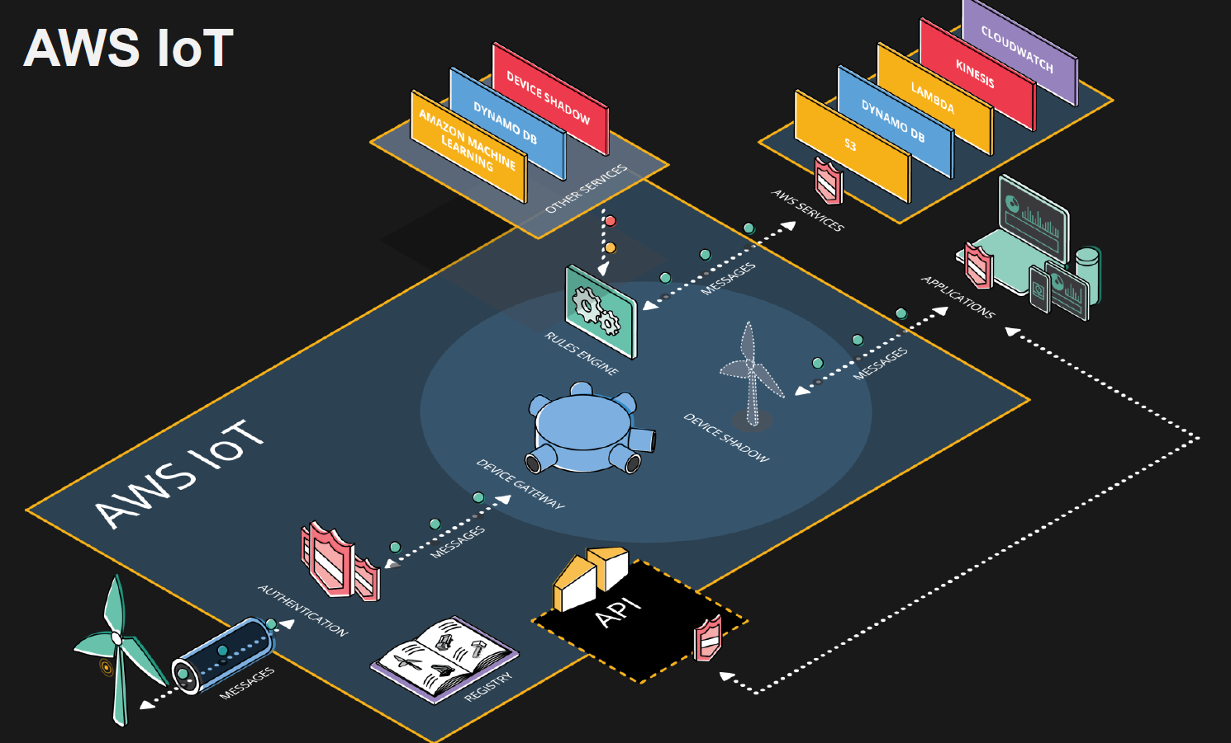
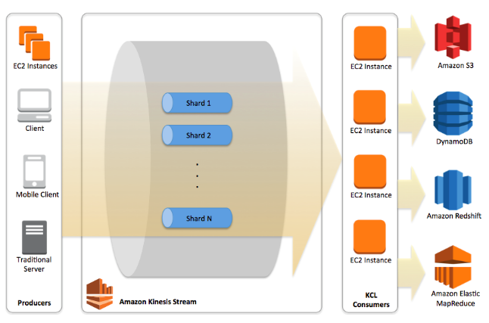
Potential Architecture
AWS IoT
Amazon Kinesis
AWS Lamba

Slide 5
Looking Forward
Challenges:
We may have to use static log data to simulate real-time streamed traffic at scale
Difficulties ensuring simulations to be as realistic as possible
Initial Plan:
Develop data simulation algorithm
Create high-level architecture (components, DAGs etc)
Testing and scale out
MapReduce and analytics

