Slide 1
Cloud-based IoT Server for energy savings
Jan
W205-3 | Matthew Burke, Jan Forslow, Vyas Swaminathan, Xiao Wu

Slide 2
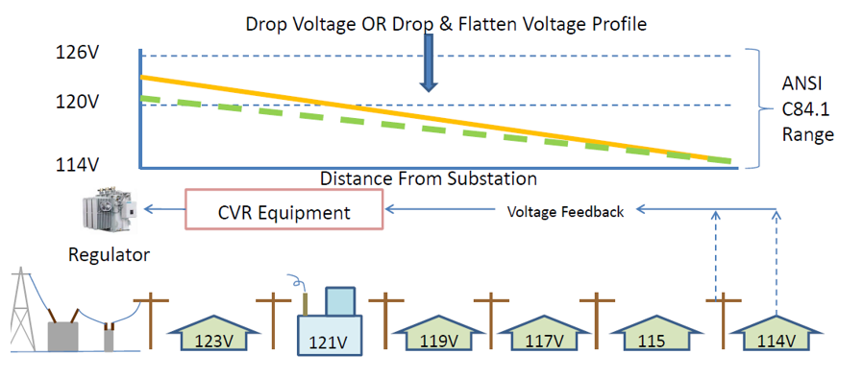
Use Case/Scope
Jan
CVR (Conservation Voltage Reduction) AWS IOT Server
Replace on-premise RDBMS systems that do not scale with frequent input data streams
300-600 households per feeder line of which ~ 40 SmartMeters are used as sensors (also called bellwether meters).
These bellwether meters will report back voltage levels every 5 minutes.
Voltage on the feeder should not exceed 3% of 120V (123 – 117V).
Ref. 1: Tenessee Valley Authority Voltage Optimization Program

Slide 3
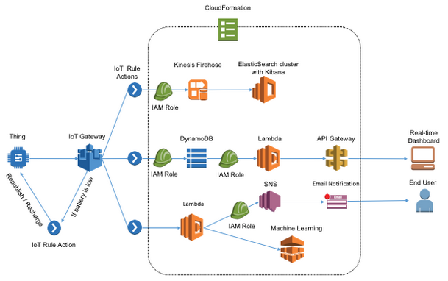
Leverage AWS IoT Architecture
Xiao
Data Ingestion:
IOT Gateway
Data Storage:
DynamoDB
Stream Processing
Kinesis/ElasticSearch
Data Exploration:
Kibana and AWS ML
Ref. 2: AWS IoT Pilot Light Hack Day

Slide 4
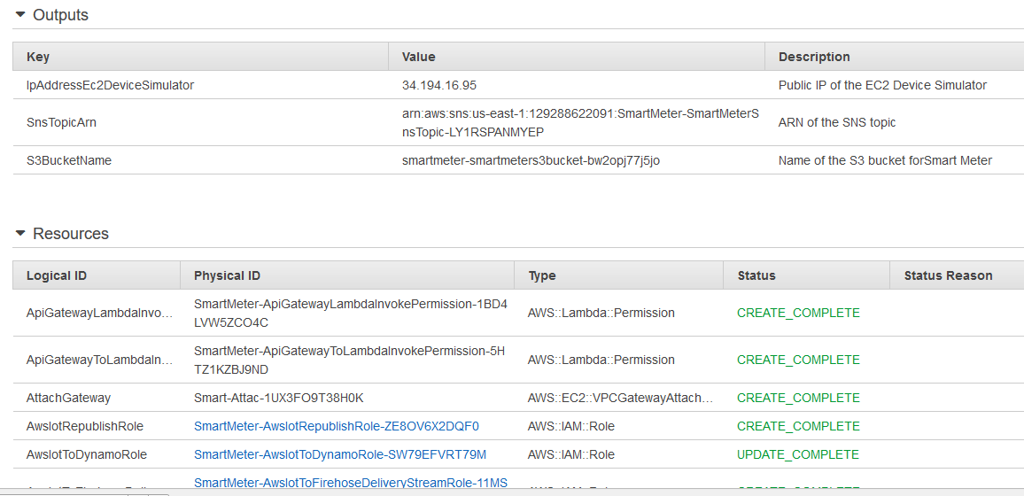
Repeatable System Setup
Vyas
AWS CloudFormation:
1,000+ lines of JSON statements
Creates a new IOT Server instance in 15-20 minutes

Slide 5
Data Sources/Data Generation
Matt
External SmartMeter data was not available with necessary Voltage information
Created Simulator in Python using MQTT for message push
Test config had 20 Feeder Lines with 40 Bellwether meters each
Messages sent every 500 msec ( i.e. 6.67 minutes for a single meter)
Stepdown of Voltage data per hop on Feeder Line with some randomization
Inserting anomaly Voltage value with a possibility of 0.1%
Test runs were done for approx. 25 minutes each

Slide 6
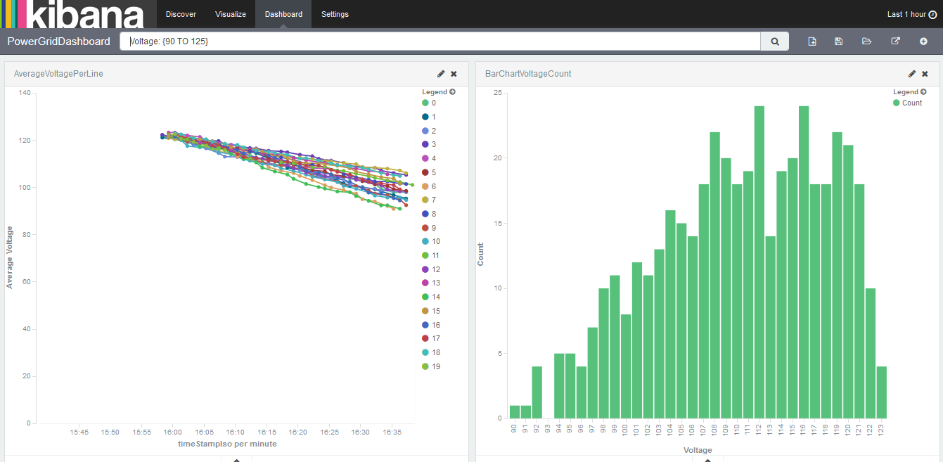
Streaming Analytics with ElasticSearch & Kibana
Jan
Anomalies Dashboard:
Anomalies Count per Feeder
DrillDown by Timestamp
PowerGrid Dashboard:
Voltage per Line over Time
Voltage Measurement Count
Voltage Statistics Table

Slide 7
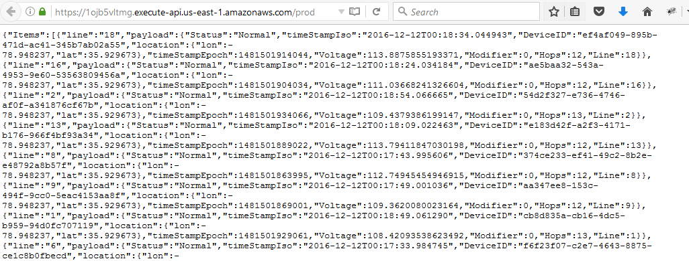
Storing Data and Making it Available through API
Xiao
DynamoDB:
TimeSeriesTable
DeviceStatusTable
API Gateway:
Device data in JSON format
Future Web Dashboard

Slide 8
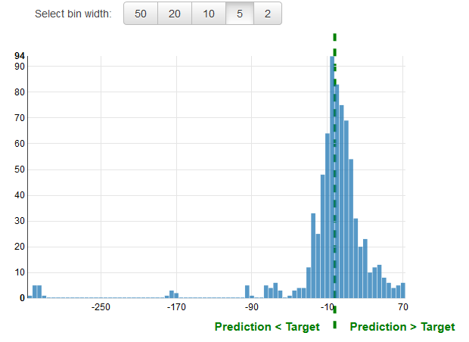
Anomaly Detection using Machine Learning
Vyas
AWS ML:
25 min and 2,500 training data
Numerical Regression
SNS Notification Service:
Email alert based on deviation to deviation to prediction

Slide 9
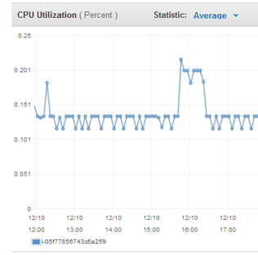
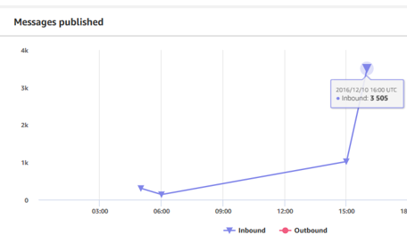
Data Processing and Cost Assessment
Jan
EC2 t2 Medium:
Only DynamoDB, S3
Less than 0.2% CPU utilization
AWS IOT Gateway:
$300/year (6 million messages)
Lambda functions:
Server-less; on any AWS resource when executed

Slide 10
Future Extensions
Matt
Data Acquisition:
Finetuning the Simulator to have less Voltage swings
Add location information
Enable automatic control loop from IOT Server
Validate with real SmartMeters and Voltage Regulators
IOT Server:
Enable DR and Elastic Instance Scaling using AWS Autoscaling Groups
Run system with 100,000 of bellwether meters
More advanced control algorithms
Complete a web dashboard

Slide 11
References
Jan
Tenessee Valley Authority Voltage Optimization Program
AWS IoT Pilot Light Hack Day

