Slide 1
Predictive Modeling of Equity Trends via Data-Driven
Media Weighting and Nonlinear Interaction Analysis
Jacky Luo
ST 545 Modern Statistical Learning
Preliminary project presentation | April 1, 2026
Goal: predict next-day stock direction from market data, fundamentals, and financial news
5-minute preliminary update
Slide 1
Notes:
Hi everyone. This project asks a simple question: can we predict next-day stock direction better if we combine market data with financial news, instead of using either one alone?
A second goal is to learn which publishers matter from the data itself, instead of assigning source weights by hand.

Slide 2
Motivation and Research Questions
- Learn publisher-specific weights instead of assigning source importance by hand
- Compare FinBERT against TF-IDF for financial text signal extraction
- Test nonlinear interaction effects between news sentiment and fundamentals
- Use SHAP to separate sentiment signal from market and technical signal
2/7
Notes:
There are really three questions behind the project. First, can publisher importance be learned directly from data?
Second, does FinBERT actually beat a simpler TF-IDF baseline here? Third, when I combine sentiment with market and fundamental variables in a nonlinear model, do I get useful extra signal, and can SHAP still show where that signal is coming from?

Slide 3
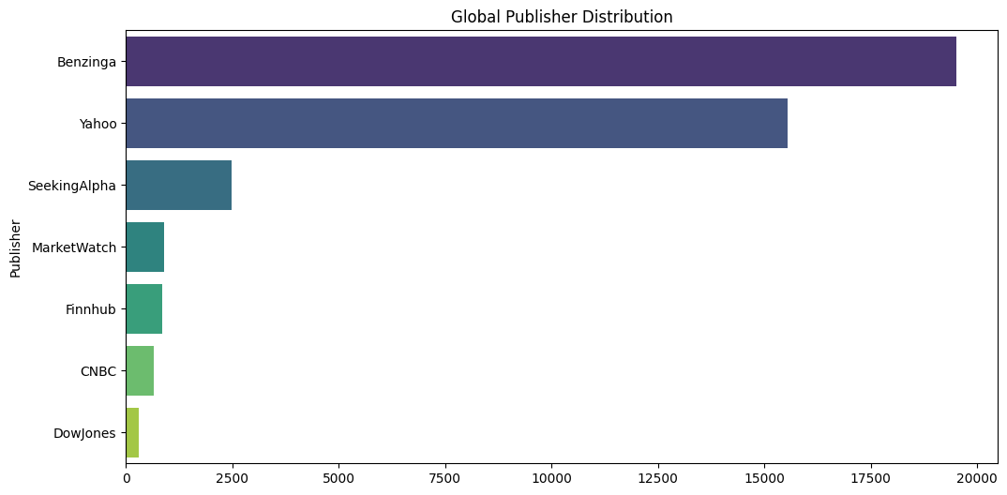
Data Sources and Modeling Target
- Alpaca: daily OHLCV bars and Benzinga news
- Finnhub: PE fundamentals and multi-source company news
- 10 tickers: NVDA, GOOGL, MSFT, AMZN, TSLA, LMT, NEM, AAPL, META, JPM
- Current cache: 46,461 articles and 2,390 merged daily rows
- Prediction target: day t features -> day t+1 direction
Publisher mix in the current news cache
3/7
Notes:
The data pipeline is pretty straightforward. Alpaca gives me daily bars and Benzinga news, and Finnhub adds PE fundamentals plus extra news sources like Yahoo and SeekingAlpha.
Right now the cache has 46,461 articles across 10 U.S. tickers, which becomes 2,390 merged daily observations. The prediction task is: use day t information to predict the direction on day t plus 1.

Slide 4
Current Modeling Pipeline
1. Data pipeline
Alpaca + Finnhub
2. Text models
TF-IDF vs FinBERT
3. Media weights
Lasso / Ridge
4. Tuned models
PCA + XGBoost + SHAP
5. Latest hybrid
DQS gated v13
>
>
>
>
The current implementation moved from simple sentiment scores to a gated hybrid pipeline.
Latest v13 feature fusion: market features + weighted sentiment stats + PCA(8) + top 10 keywords.
4/7
Notes:
The modeling pipeline grew in stages rather than all at once. I started with TF-IDF and FinBERT, then estimated ticker-specific media weights with regularized models.
After that I reduced the FinBERT embeddings with PCA, tuned XGBoost, and used SHAP for interpretation. The latest version, v13, also adds DQS gating so noisy news days get down-weighted before the final hybrid prediction step.

Slide 5
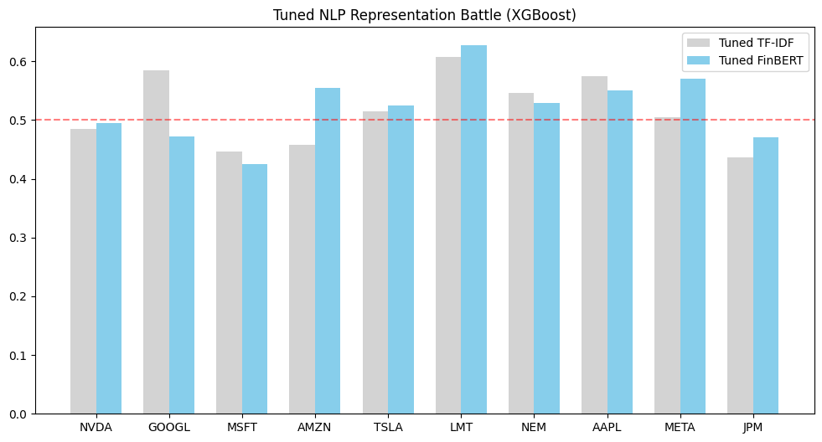
Preliminary Results
- Step 4 mean FinBERT gain over TF-IDF: +0.0063 AUC
- Mean SHAP sentiment attribution: 80.16%
- Best saved hybrid results: LMT v12 = 0.6036, GOOGL v13 = 0.5971
- Strongest standalone feature block so far: keywords-only mean AUC = 0.5564
- Takeaway: news contains signal, but fusion remains uneven across tickers
Tuned NLP battle across the 10-ticker universe
5/7
Notes:
So far the results are mixed, but they are still useful. FinBERT is only a little better than TF-IDF on average, so better text representation alone does not solve the problem.
At the same time, SHAP says sentiment-related features explain about 80 percent of model importance on average, so news is clearly contributing signal. The best saved hybrid AUC is around 0.60, and the strongest single feature block right now is the keyword-based one.

Slide 6
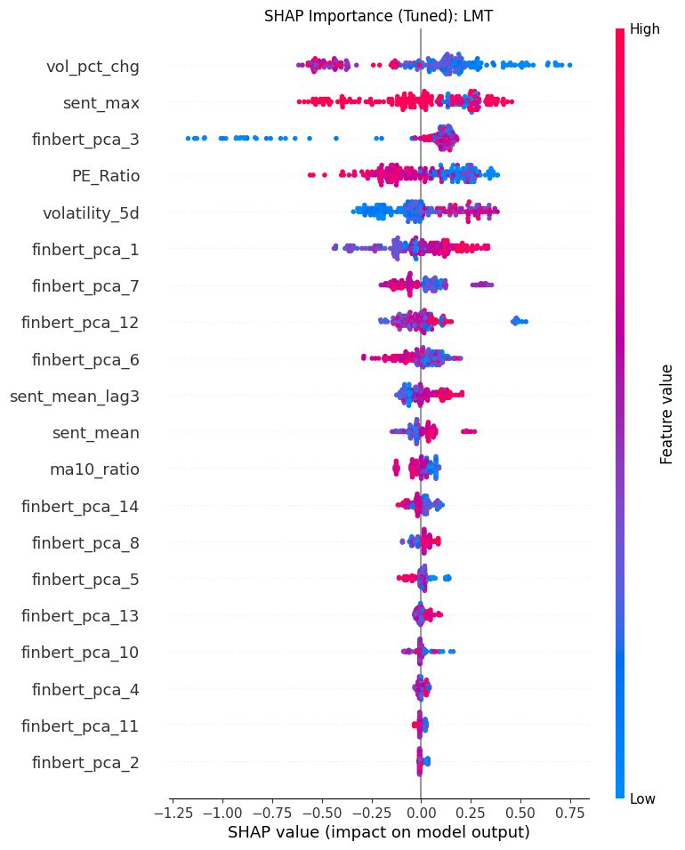
What We Have Learned So Far
- v13 mean hybrid AUC = 0.5362
- Market-only = 0.5431; keywords-only = 0.5564
- Hybrid beats every single baseline for only one ticker: GOOGL
- LMT ablation: MLP 0.6782 > RF 0.5923 > XGBoost 0.5653
- Next shift: modular experts or deeper fusion models
LMT SHAP example from the tuned XGBoost path
6/7
Notes:
The main thing I have learned is that finding signal is easier than fusing signal. In the current v13 results, the full hybrid model is not yet consistently better than the market-only or keyword-only baselines.
But the LMT ablation is encouraging: an MLP reaches 0.6782 AUC and beats the tree-based models by a clear margin. That suggests the next improvement probably needs a more flexible fusion model, or a more modular expert-style approach.

Slide 7
Expected Deliverables and Next Steps
Expected deliverables
Next steps
- Cleaned multimodal daily dataset
- Reproducible end-to-end Python pipeline
- Comparative model evaluation
- SHAP and ablation analysis
- Final report and final presentation
- Test a modular expert strategy by ticker type
- Improve fusion so hybrid beats market-only and keyword-only baselines
- Package artifacts into a final submission workflow
- Optional lightweight dashboard if time permits
The project already shows measurable news signal; the final challenge is making the hybrid model stable and consistently better than simpler baselines.
7/7
Notes:
By the end of the project, I want to deliver a cleaned multimodal dataset, a reproducible pipeline, a comparative evaluation, and interpretation through SHAP and ablation.
If time permits, I may also package the results into a lightweight dashboard. The main next step is to make the hybrid model consistently outperform the simpler baselines, not just occasionally.

