Slide 1
Pokémon Scraper
Jacky

Slide 2
Why Pokémon?
I love gaming, and Pokémon
Machine learning in gaming (because of the youtuber Code Bullet)
AI learns to play Pokémon
Win rate prediction
Pokémon identifier
Pokémon battle AI
More…

Slide 3
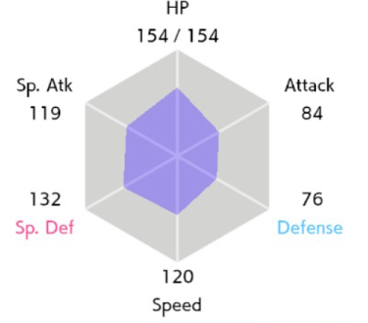
Pokémon 101
Turn-base game, may be suitable for reinforcement learning
Each Pokémon has 6 Stats, higher the better
Much more about Stats, some of them are even (pseudo) random
https://www.pokemon.com/us/strategy/raising-battle-ready-pokemon/

Slide 4
Data – predicting win rates using base stats
What I need:
Base stats (same for each ‘specie’ of Pokémon)
Battle data (which Pokémon wins the most)
Where to find:
pokemondb.net
pokemonshowdown.com
How:
web scraping with selenium and requests in python
Red bull

Slide 5
Why?
Higher base stats, better they are
Why are some Pokémon so famous?
May be I can figure a generalised strategy for battle
A complete data set about each Pokémon is needed for building the Pokémon battle AI
Winning analysis is required

Slide 6
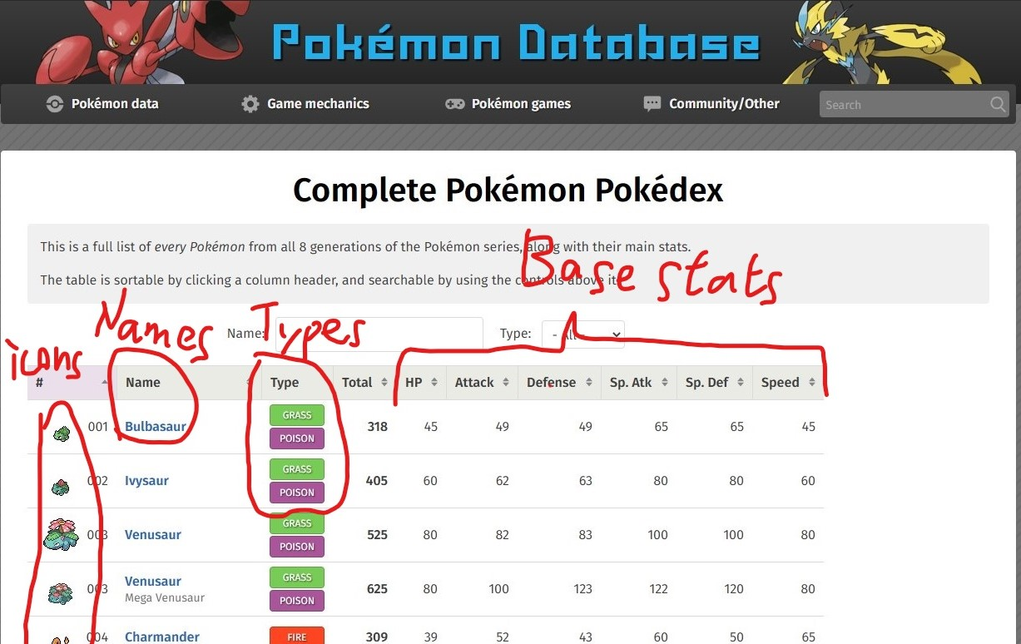
pokemondb.net

Slide 7

pokemonshowdown.com
An open-source online Pokémon battling and emulator
emulator can help simulate battles, would help me a lot for later work on Pokémon battle AI
All recent battles are logged, either .log or .json
Much more data and functionalities
Thanks to John Theocharides

Slide 8
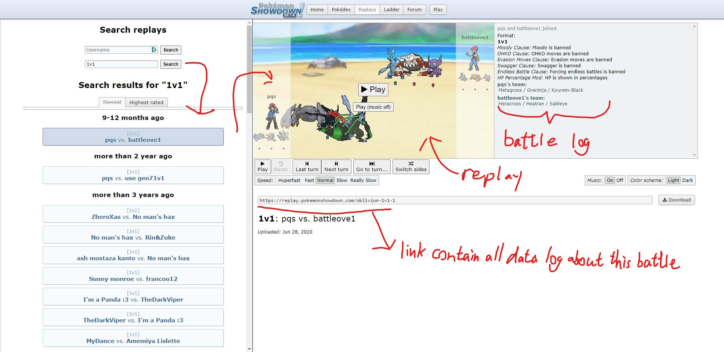
pokemonshowdown.com

Slide 9
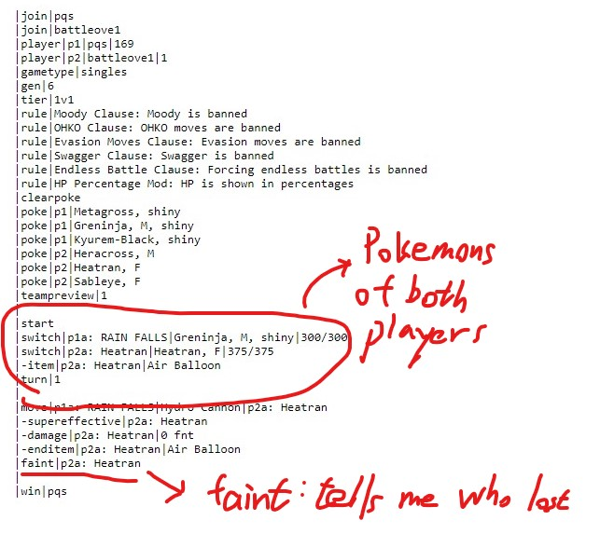
pokemonshowdown.com

Slide 10
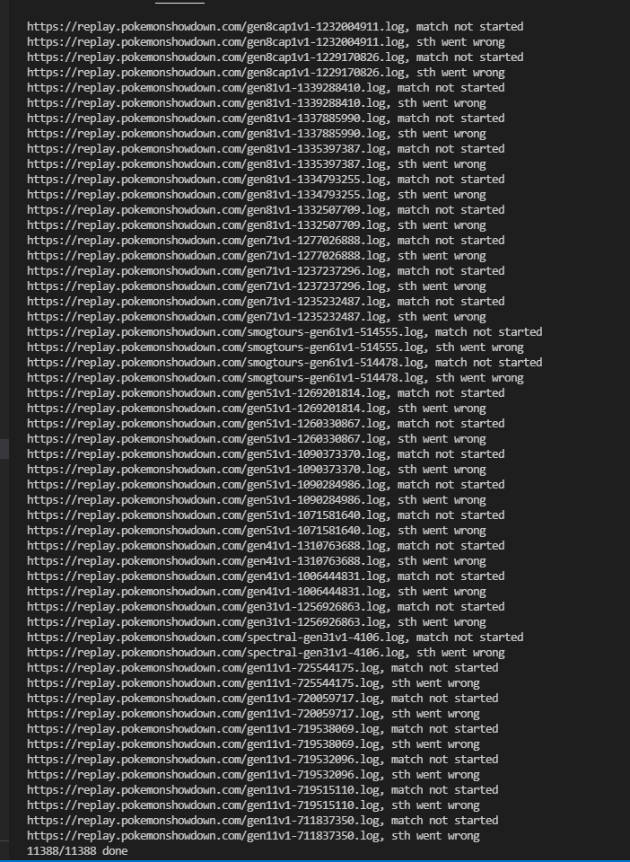
Data Cleaning
Kick out links with invalid data
That’s it

Slide 11
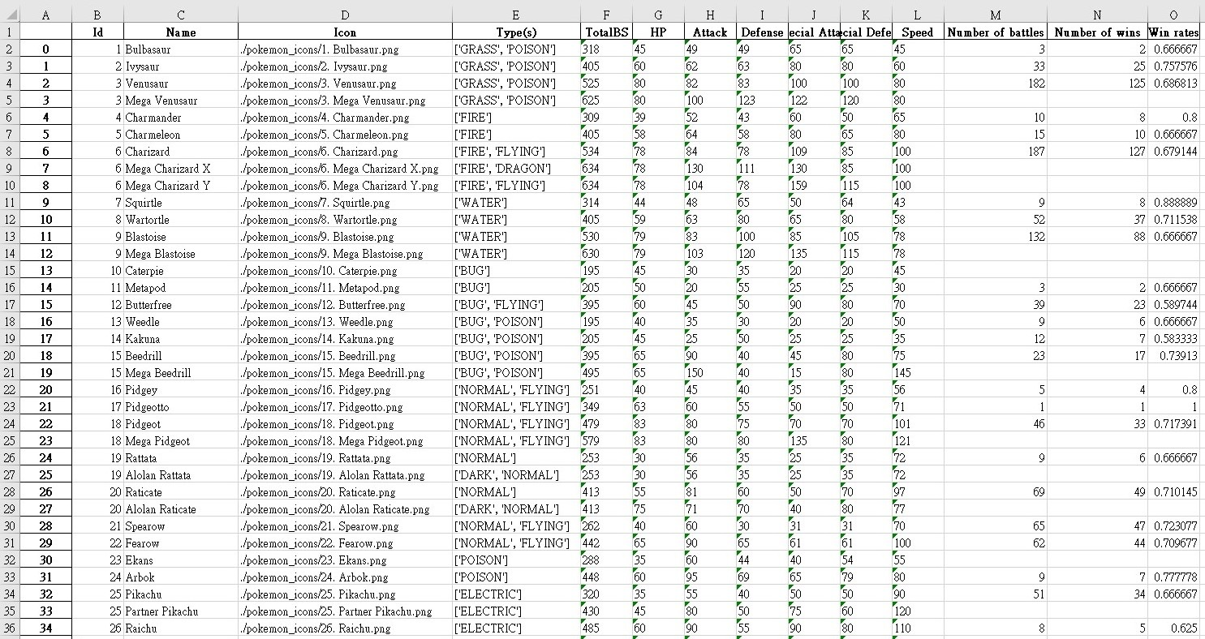
Deadline-fighter style results

Slide 12
Problems and future works
‘nan’ data for number of wins and missing data
Name different from pokemonshowdown.com and pokemondb.net
Some Pokémons never have a chance to go battle
Some fan-made Pokémons those are not recognised by pokemondb.net
Some win rates don’t make sense (100% winning, only 1 battle in record)
I kick them out for data cleaning
Requesting 10k links is slow
Pokémon is a complex game, only base stats might not be enough
Moves sets, items sets, abilities of each Pokémon, NPL on battle log
More in my github

