Slide 1
Linear Regression on Pokémon Battle Performance
Jacky

Slide 2
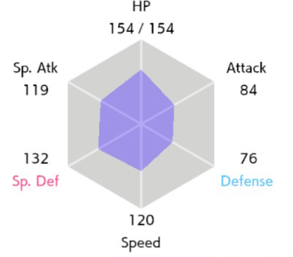
Pokémon 101
Turn-base game, may be suitable for reinforcement learning
Each Pokémon has 6 Stats, each range from 0 to 255
Much more about Stats, some of them are even (pseudo) random
https://www.pokemon.com/us/strategy/raising-battle-ready-pokemon/

Slide 3
Pokémon 102 – Stats explanations
HP – capacity of taking damage
Attack – power of dealing physical damage
Defense – damage reduction on taking physical damage (Attack)
Special Attack - power of dealing “super-power” like damage (including breathing fire, creating thunders etc)
Special Defense - damage reduction on taking “super-power” like damage (Special Attack)
Speed – related to which Pokémon plays first in each turn

Slide 4

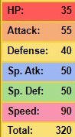


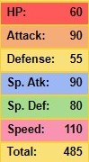
Hypothesis
Higher the stats, better the Pokémon
Should perform better in battles
So, higher the stats, higher the winning rate

Slide 5
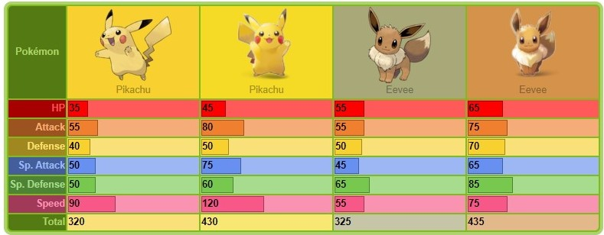
Also, in Pokémon: Let's Go, Pikachu! and Let's Go, Eevee!
Player can choose Partner Pokémon (Partner Pikachu or Partner Eevee) instead of ordinary Pikachu or Eevee
They have higher base stats
But they can’t be used in battle
https://bulbapedia.bulbagarden.net/wiki/Partner_Pok%C3%A9mon_(game)

Slide 6
Data collection
Pokémon stats data, from https://pokemondb.net/
Pokémon 1v1 battle data, from https://pokemonshowdown.com/
898 Pokémons, total 1045 if including form change
Each “species” of Pokémon has 6 base stats [HP, ATK, DEF, Sp.ATK, Sp.DEF, SPD]
Total of 8895 valid 1v1 battles
Win rates are calculated directly from here by counting number of wins and dividing by the number of battles the Pokémon taken

Slide 7
Assumptions
Only Base stats are considered and applied into the model
Trainers’ (players’) skills, strategies, decisions, knowledge and experience are not taking into account
All effect on breeding (Individual values (IV)) and training (Effort Value (EV)) are not considered
Pokémons’ abilities, natures and weaknesses are not considered
Items and battle interactions (moves) are not considered
Pokémons that can change their form during battle are kicked out
Fan-made Pokémons are kicked out too (due to lack of data)
Since only 1v1 battles are collected, team building and its effect are not considered

Slide 8
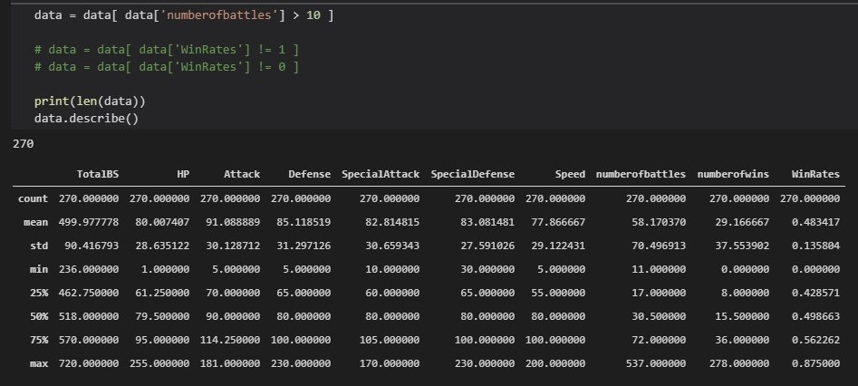
Data Cleaning
Only Pokémons recognised by https://pokemondb.net/
“Form change during battle” Pokémons are out
Number of battle < 10 are kicked out

Slide 9
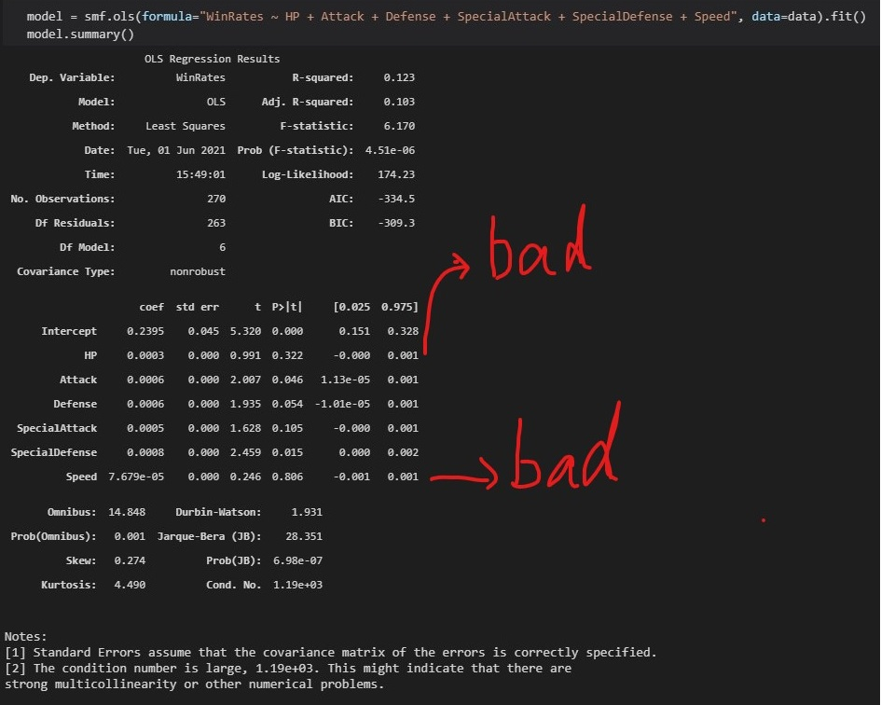

Slide 10
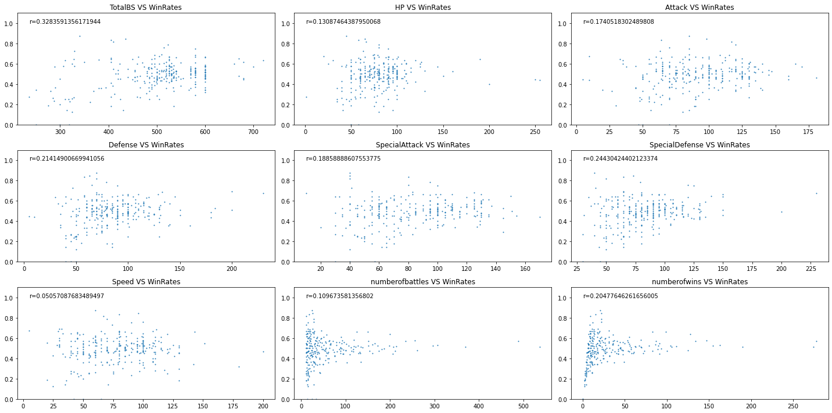

Slide 11
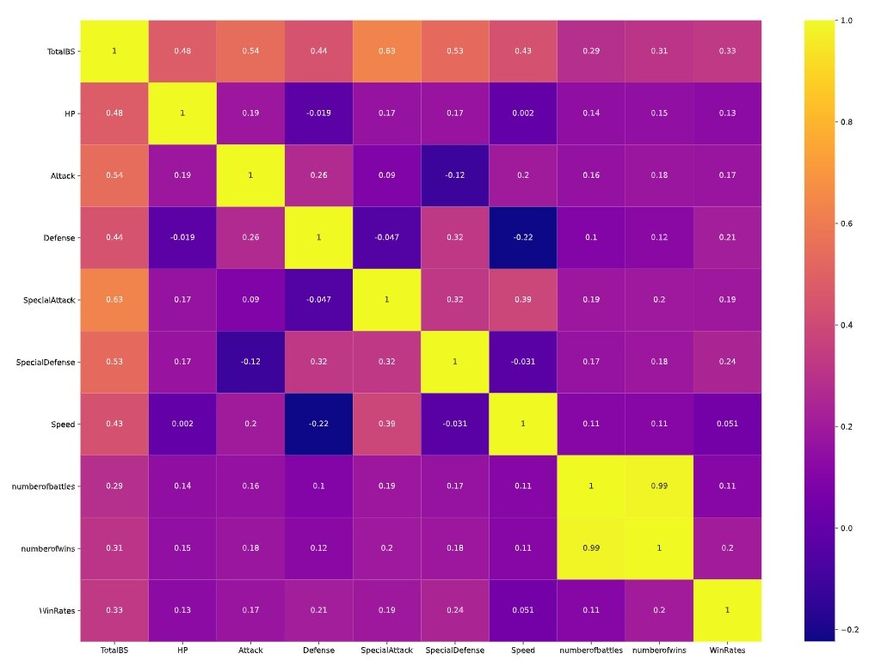

Slide 12
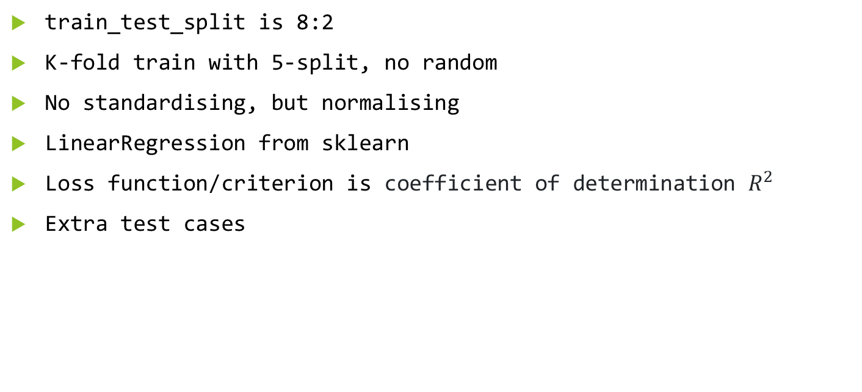
Model
train_test_split is 8:2
K-fold train with 5-split, no random
No standardising, but normalising
LinearRegression from sklearn
Loss function/criterion is coefficient of determination $R^{2}$
Extra test cases

Slide 13
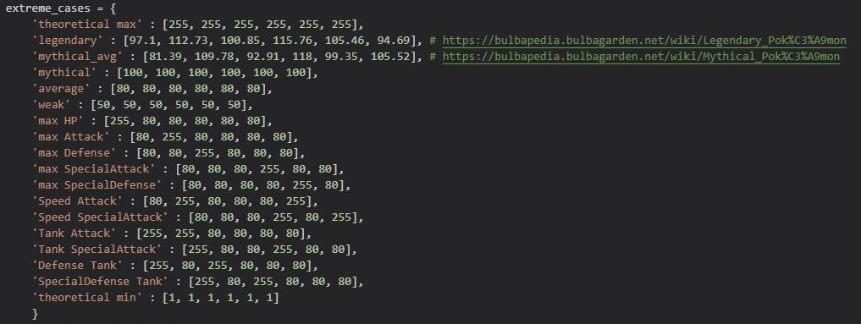
Extra test cases
[HP, Attack, Defense, Special Attack, Special Defense, Speed]

Slide 14
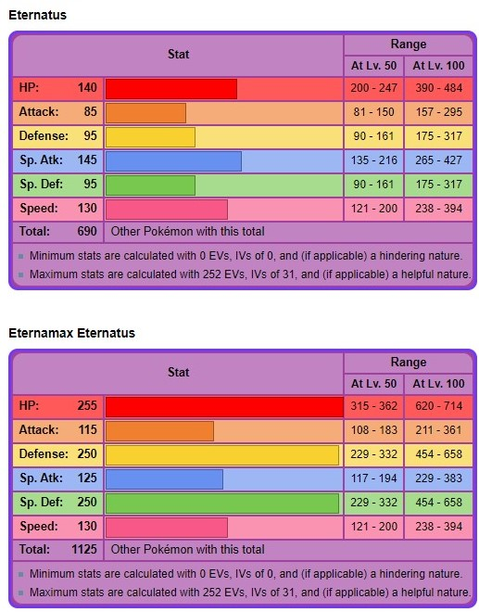


Theoretical maximum
All stats = 255
Eternamax Eternatus is by far the closest Pokémon to Theoretical maximum
Which has 1125 total base stats
But there is no official way you can obtain this Pokémon
Even the ordinary form Eternatus is banned

Slide 15
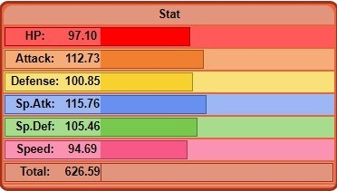
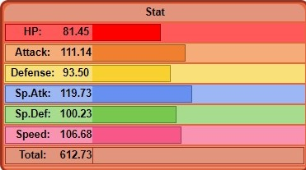
Legendary and Mythical Average
They are powerful and popular Pokémons
Legendary
Mythical
https://bulbapedia.bulbagarden.net/wiki/Legendary_Pok%C3%A9mon
https://bulbapedia.bulbagarden.net/wiki/Mythical_Pok%C3%A9mon

Slide 16




Pokémon battling Style
Players develop playing styles base on Pokémons’ stats distribution
If a Pokémon has a high speed and attack or special attack, it could be trained as a “speed attacker”
Aiming for taking advantage of playing first and hoping to 1-turn-kill the opponent
But usually they are low on HP and defense
135. Jolteon
(AKA thunder eevee)
Alternatively, a Pokémon with high defense could be trained as a “tanker”
Aiming for not getting 1-turn-kill, surviving as long as they can and using nasty moves
But usually they are low on attack and speed
227. Skarmory

Slide 17
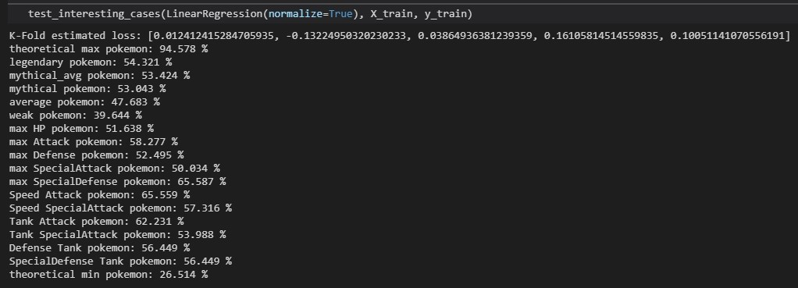
Results

Slide 18
Conclusions
Not enough data points (~ 270, should aim for > 400)
Model does explain the trend between 6 base stats and win rates, but generalising power is believed to be limited
Noticeably, Pokémons with max special defense, speed attack and tank attack have an over 60% win rate, predicted by the model
Relatively low r-coefficient suggests win rates depend not only the base state but some other factors

Slide 19
Suggested explanations
Low generalising power and r-value suggest Pokémon game is not solely depend on base stats but also other factors, maybe from the assumption part
Making Pokémon battle a “balanced” game
Every Pokémon has a chance to win, even the weak ones
No “Too Over Power” Pokémons, or they got banned
Trainers’ (players’) efforts on breeding and training matter, as well as their decisions and Pokémons’ interactions during battle
Players’ strategies evolve

Slide 20
Why Special Defense?
Players’ strategies evolve
Initially, legendary and mythical Pokémons are known to be powerful
If they are not banned from battling, players tend to train and use them in battle
Since those Pokémons are legendary and mythical, they grant control of “super-power” more than ordinary Pokémons, hence tend to have a higher Special Attack power
Later a portion of players start thinking on Pokémons that can play against them
Pokémons with higher Special Defense are favorable
This iteration can go over and over again, Pokémons with higher Attack could be an existing or future trend

Slide 21
What about other stats
Speed: not so significant any more
Moves that can absolutely be played first
Moves that invert the effect of speed (lower speed Pokémons play first)
Items that can increase the chance to play first regardless to speed
Many…
HP
Items and abilities that can keep you alive once after taking “1 hit KO” damage
Moves that can dodge opponents’ move or recover HP
Higher HP or Higher defense is a debate
Special Attack and Defense
Special Attack falls because of the rise of Special Defense
Attack rises after the rise of Special Defense
Defense should rise but could be lagged

Slide 22
Future Work
Polynomial features
Use difference from the average win rates as label
A classifier rather than regressor, as more data available
Unsupervise learning on finding base stats distribution pattern

Slide 23
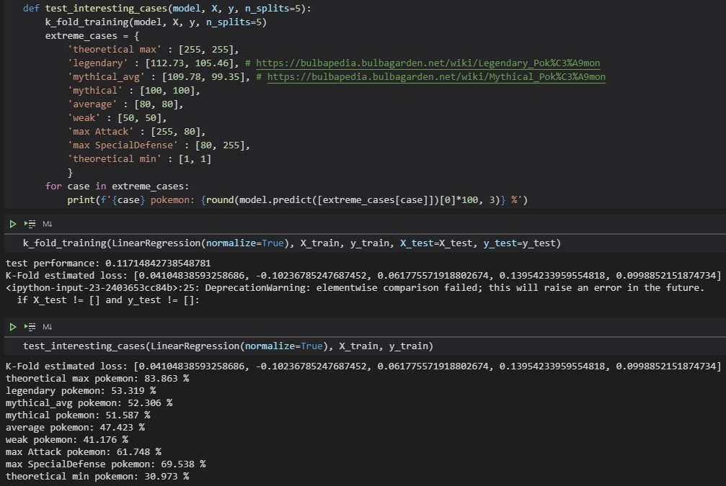
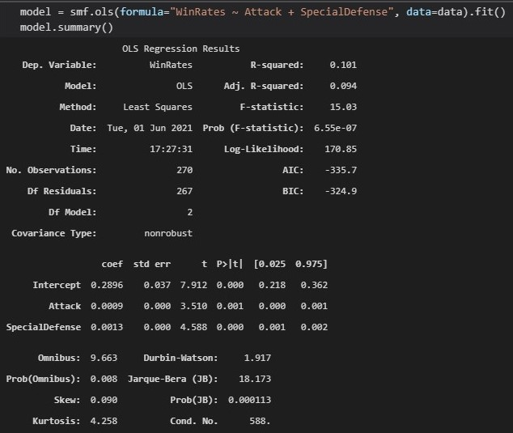
Current iteration

Slide 24
Last words
Pokémon is a complex game; battle is not the only thing interesting
This dataset and model might be imperfect, but the process may help game developers/designers design better play style and new Pokémons, as well as a “balanced” and “sustainable” game
Education use, kids would love this (I think)

