Slide 1


CSCI334: SOFTWARE DESIGN
Group 14:
Muhammad adam bin yazid(Leader)
Yap Kah Wee
Cheah Shao Qi
Jacky Su leh hong

Slide 2
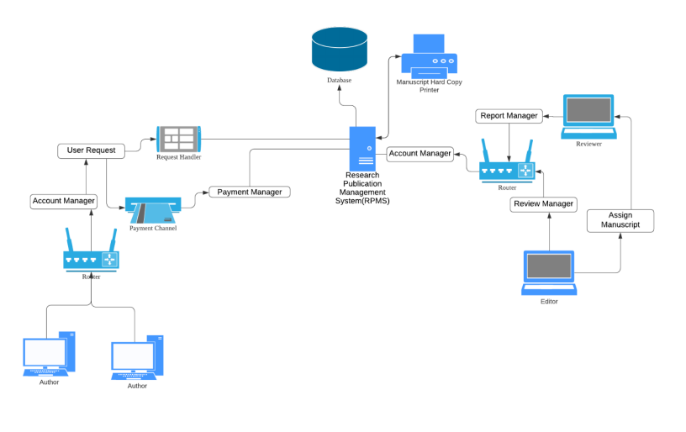
Conceptual Diagram

Slide 3
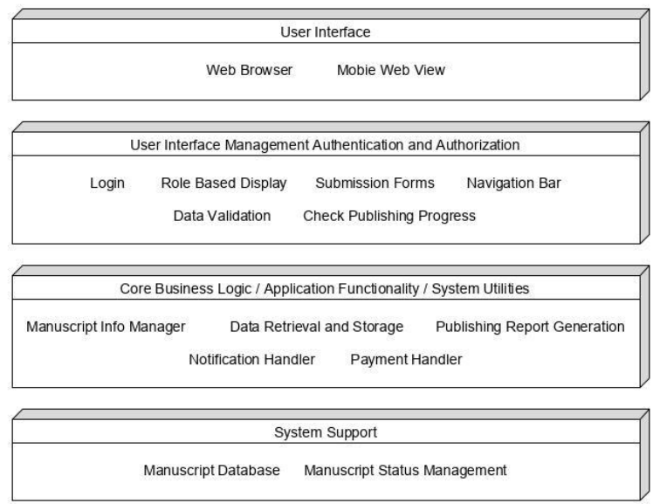
Layered Architecture Design

Slide 4
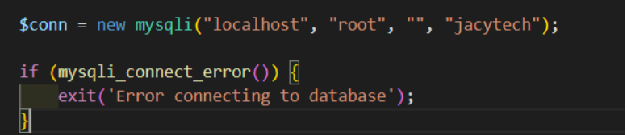
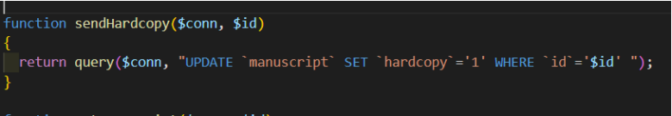
DESIGN PATTERN
1.Singleton
Before Implement

Slide 5
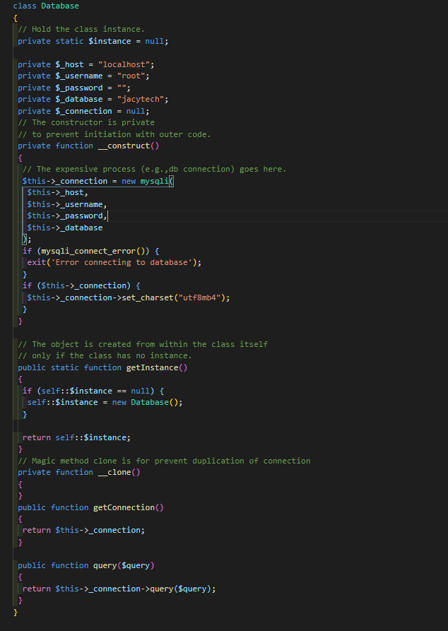
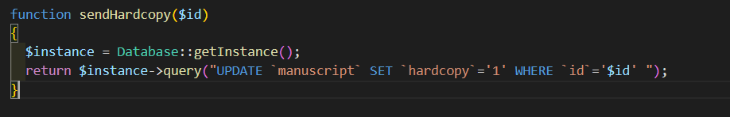
DESIGN PATTERN
After Implement

Slide 6
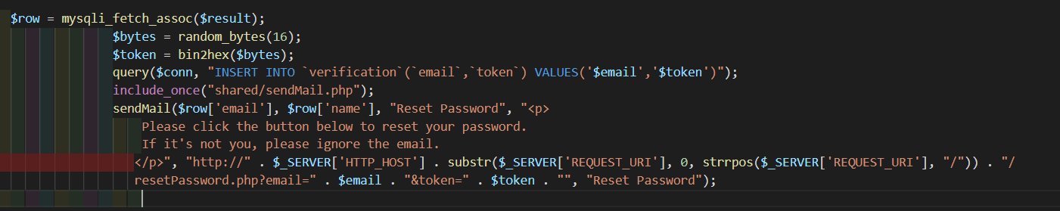
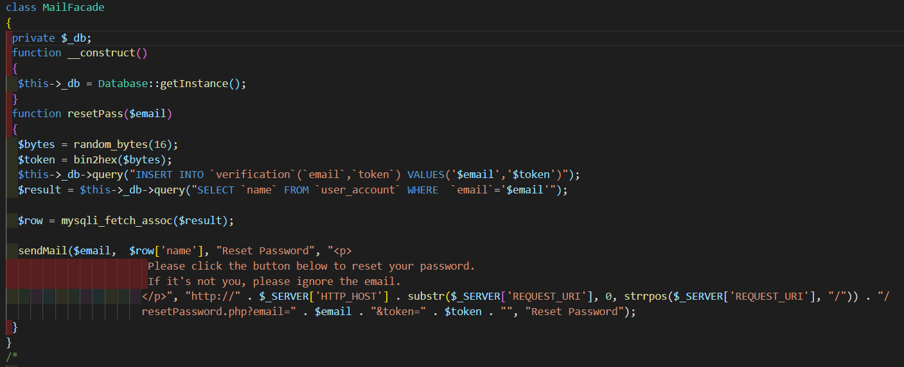

DESIGN PATTERN
2.Façade
Before Implement
After implementation

Slide 7
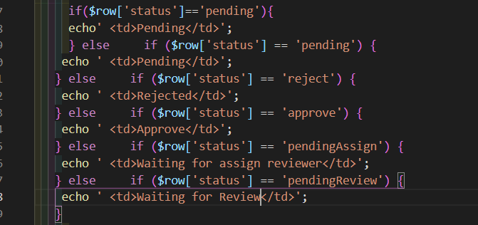
REFACTORING PATTERN
1.Decompose Conditional
Before
Old source code from listManuscript.php

Slide 8
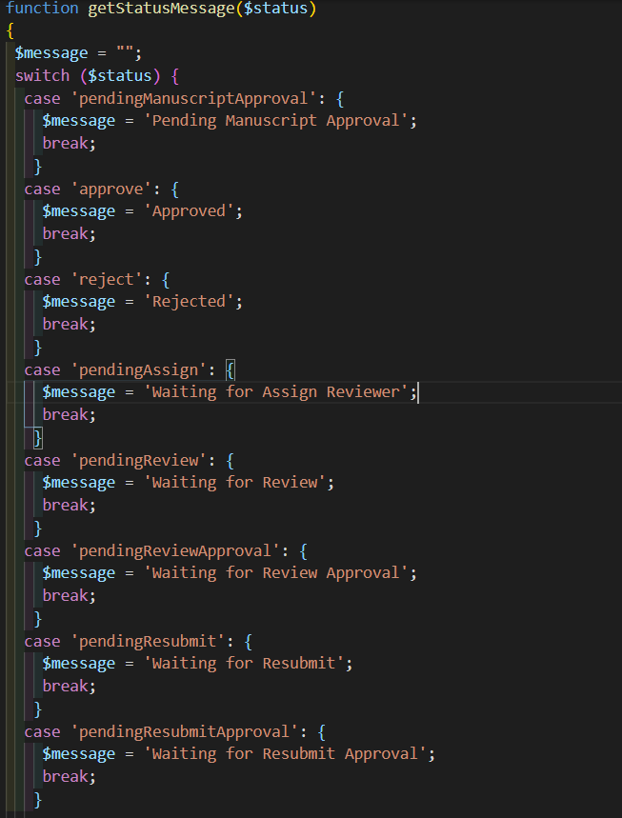
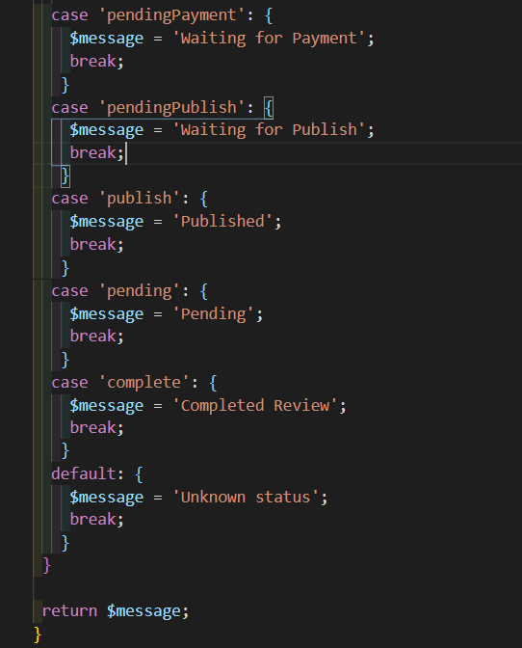
REFACTORING PATTERN
1.Decompose Conditional
Usage of getStatusMessage in listManuscript.php and other list files
After

Slide 9
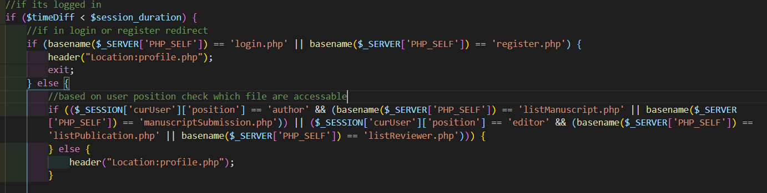
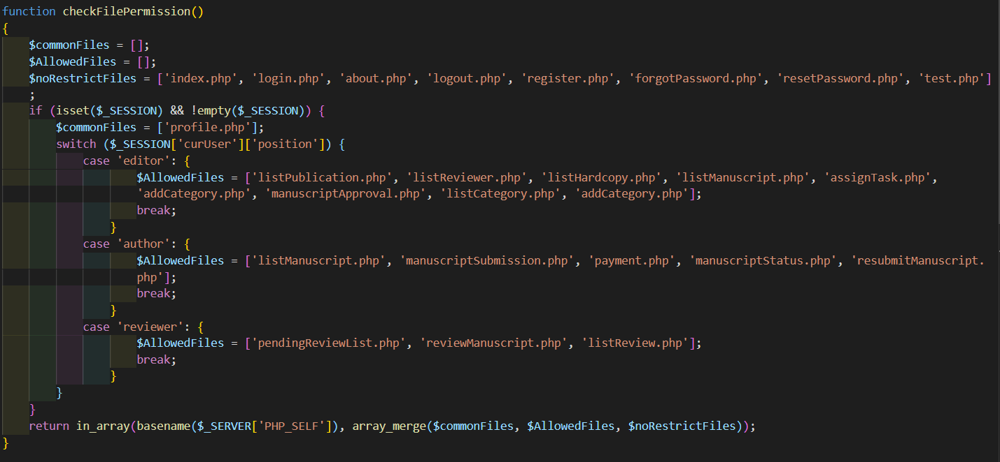
REFACTORING PATTERN
2. Substitute Algorithm
Before
After
Old source code from userSession.php
New source code from userSession.php

Slide 10
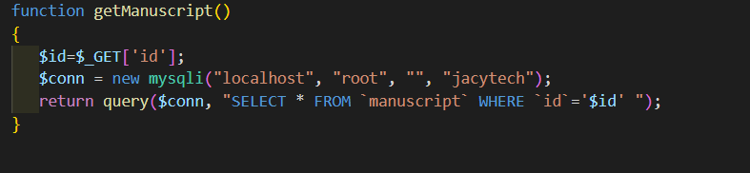
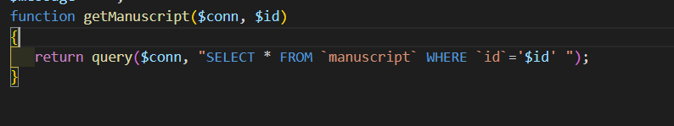
REFACTORING PATTERN
3. Add Parameter
Before
old source code from resubmitManuscript.php
After
New source code from resubmitManuscript.php

Slide 11
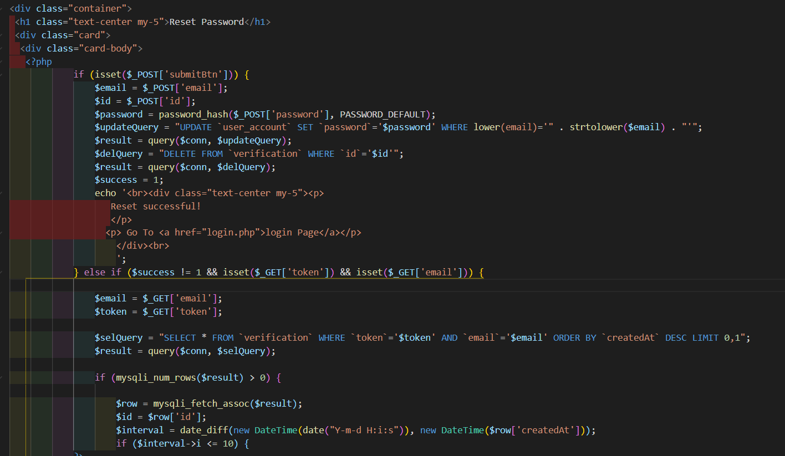
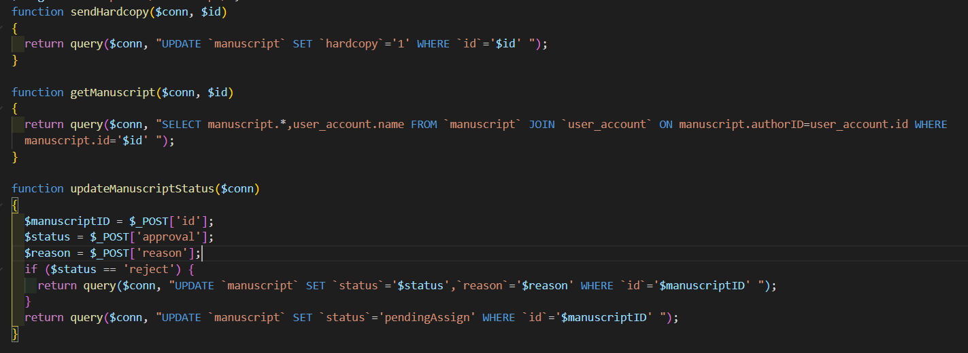
REFACTORING PATTERN
4. Extract Method
Fragment of processing code in resetPassword.php
Fragment of code consists of query method in manuscriptApproval.php

Slide 12
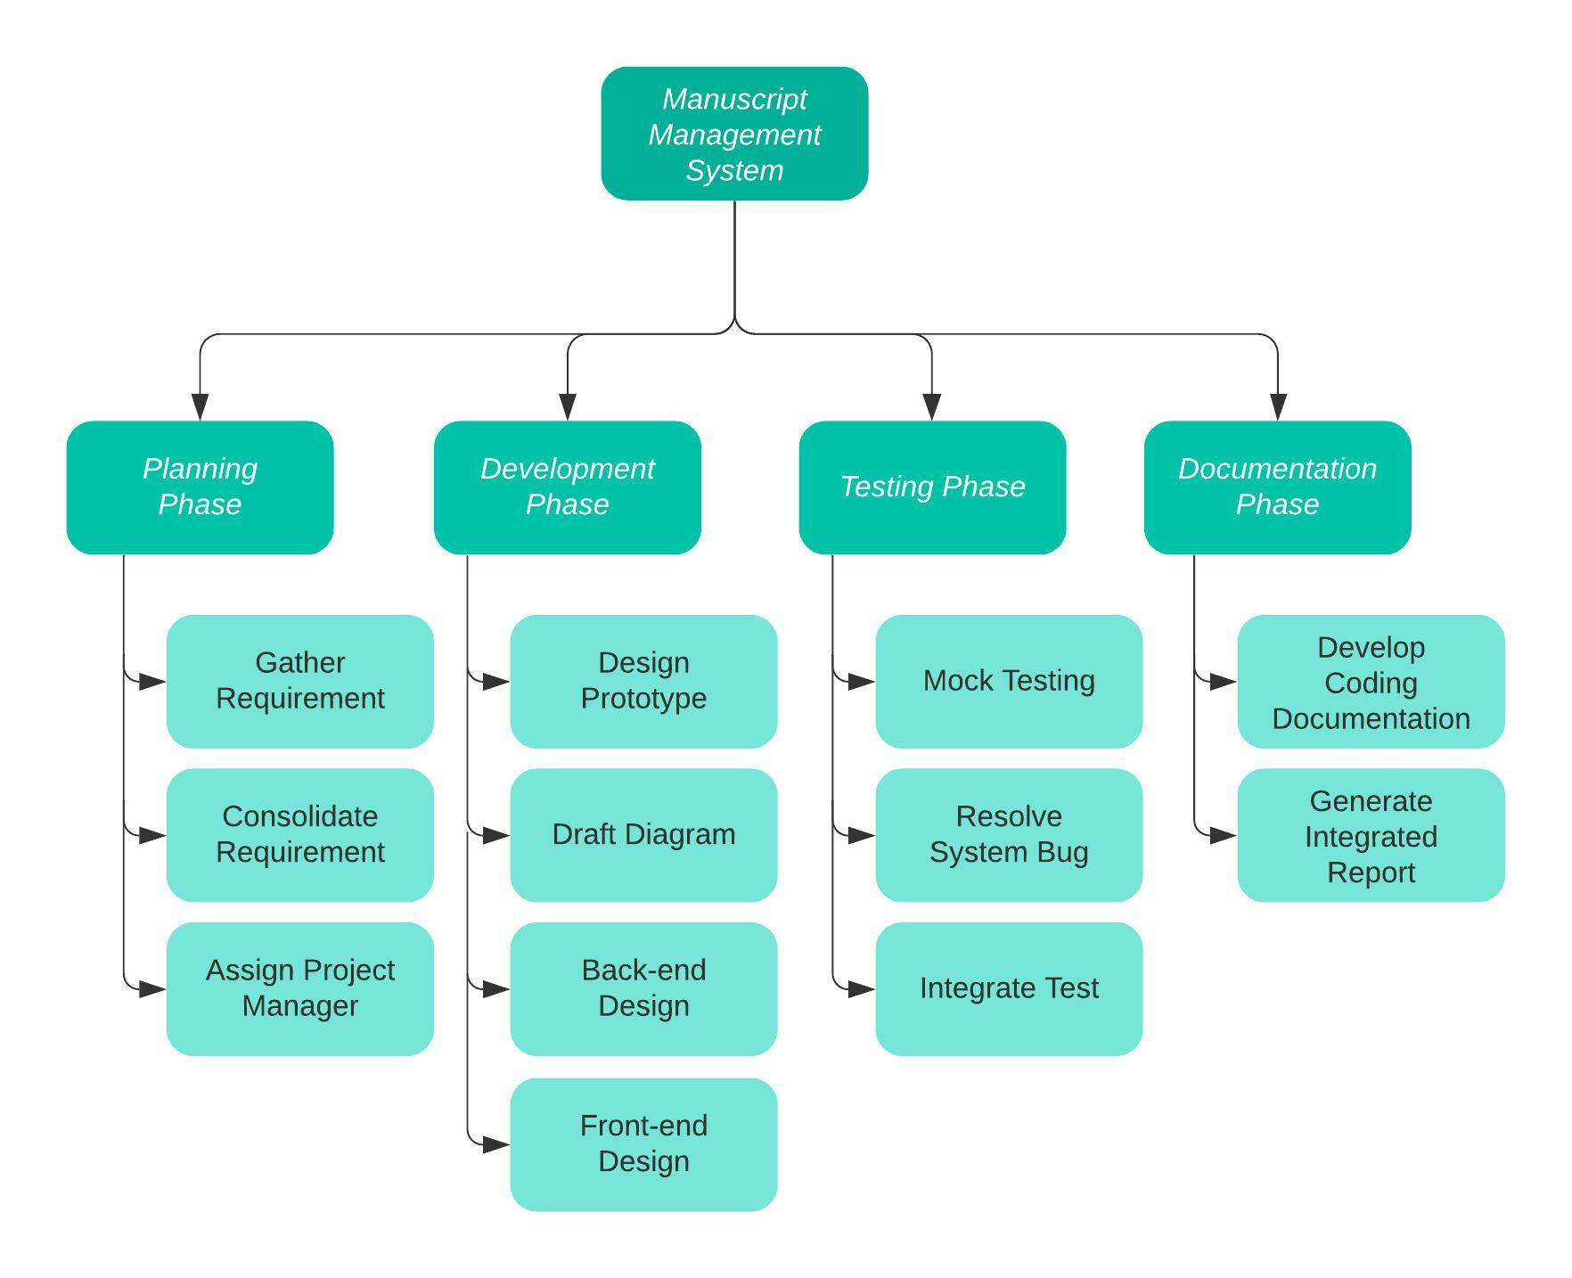
WORK BREAKDOWN STRUCTURE
Members | Task 1: Planning | Task 2: Backend | Task 3: Frontend | Task 4: Documentation
Muhammad Adam Bin Md Yazid | ✓ | ✓ | ✓ | ✓
Cheah Shao Qi |  | ✓ | ✓ | ✓
Yap Kah Wee | ✓ | ✓ |  | ✓
Jacky Su Leh Hong |  |  | ✓ | ✓

Slide 13
Detailed Work Delegation
Planning Muhammad Adam bin Md Yazid and Yap Kah Wee understood and compiled the requirements needed for the system. The discussed requirements were then delegated fairly based on group members expertise for the project.
Development of Back-end Cheah Shao Qi and Yap Kah Wee were assigned to be in charge of developing the system backend.
Development of Front-end Muhammad Adam and Jacky Su alongside Main Programmer Cheah were assigned to discuss and develop the overall design implemented for the system.
Documentation The details surrounding the processes in the project have to be documented and compiled into a report by the end of the project. Which all members are involved in doing it.

Slide 14
PEER REVIEW
Name: Muhammad Adam Bin Md Yazid
Name: Jacky Su Leh Hong
Member Name | Participated in group discussions | Contributed useful ideas | How much work was done | Quality of work done
Jacky Su Leh Hong | 5 | 5 | 5 | 5
Cheah Shao Qi | 5 | 5 | 5 | 5
Yap Kah Wee | 5 | 5 | 5 | 5
Member Name | Participated in group discussions | Contributed useful ideas | How much work was done | Quality of work done
Muhammad Adam Bin Md Yazid | 5 | 5 | 5 | 5
Cheah Shao Qi | 5 | 5 | 5 | 5
Yap Kah Wee | 5 | 5 | 5 | 5
Name: Cheah Shao Qi
Name: Yap Kahwee
Member Name | Participated in group discussions | Contributed useful ideas | How much work was done | Quality of work done
Muhammad Adam Bin Md Yazid | 5 | 5 | 5 | 5
Jacky Su Leh Hong | 5 | 5 | 4 | 5
Yap Kah Wee | 5 | 5 | 5 | 5
Member Name | Participated in group discussions | Contributed useful ideas | How much work was done | Quality of work done
Muhammad Adam Bin Md Yazid | 5 | 5 | 5 | 5
Jacky Su Leh Hong | 5 | 5 | 5 | 5
Cheah Shao Qi | 5 | 5 | 5 | 5

Slide 15
PROJECT MEETING MINUTE
Meeting No: | Time | Date | Attendees | Meeting Purpose
1 | 10.00 PM | 16/8/2021 | All attended | Assignment of role delegations and discussion on use case diagram.
2 | 2.00 PM | 24/8/2021 | All attended | Discuss the design principles and UI used for the Prototype design.
3 | 6.00 PM | 28/8/2021 | All attended | Discussing on scoring matrix and alternate system design.
4 | 8.00 PM | 9/9/2021 | 3 attended – Jacky had family dinner | A group discussion to finalize on mid deliverable progress report.
5 | 8.00 PM | 23/9/2021 | All attended | Check Software Progress and confirm final design.
6 | 8.00 PM | 30/9/2021 | All attended | Discuss New Project Report Requirements and delegate task.
7 | 8.00 PM | 7/10/2021 | Kahwee and Adam | Discuss System flow for Sequence Diagram.
8 | 8.00 PM | 14/10/2021 | Jacky and Adam | Sort out the Work Breakdown Structure and Class Diagram.
9 | 8.00 PM | 21/10/2021 | All attended | Discuss and update mistakes made in the Mid Deliverable Progress Report.
10 | 8.00 PM | 28/10/2021 | All attended | Test the Software prototype.
11 | 8.00 PM | 4/11/2021 | All attended | Compile the final progress report and Check on the Project Deliverables.

Slide 16

Q&A Session

Slide 17


