Slide 1
Individualized generation of young women’s crotch curve based on body images
Problem:
The traditional manual measuring method:
High technical requirements
Embarrassment of direct body contact
Technique:
Generate the crotch curve of the human body based on image measurements
Methods:
parameter-point-curve fitting rules
11 key points
Thicknesses and heights related crotch parameters extracted by feature points based on the human contour
Correlation and regress analysis among key points and crotch parameters.
Results:
The errors of H_3 , T_H , T_A and T_W are mainly between −5 and 5 mm
79% of the errors at each point is ±15 mm
Further study focus:
Distinguish different human body types
Make the modifications of the pattern crotch curves based on the body crotch curve

Slide 2
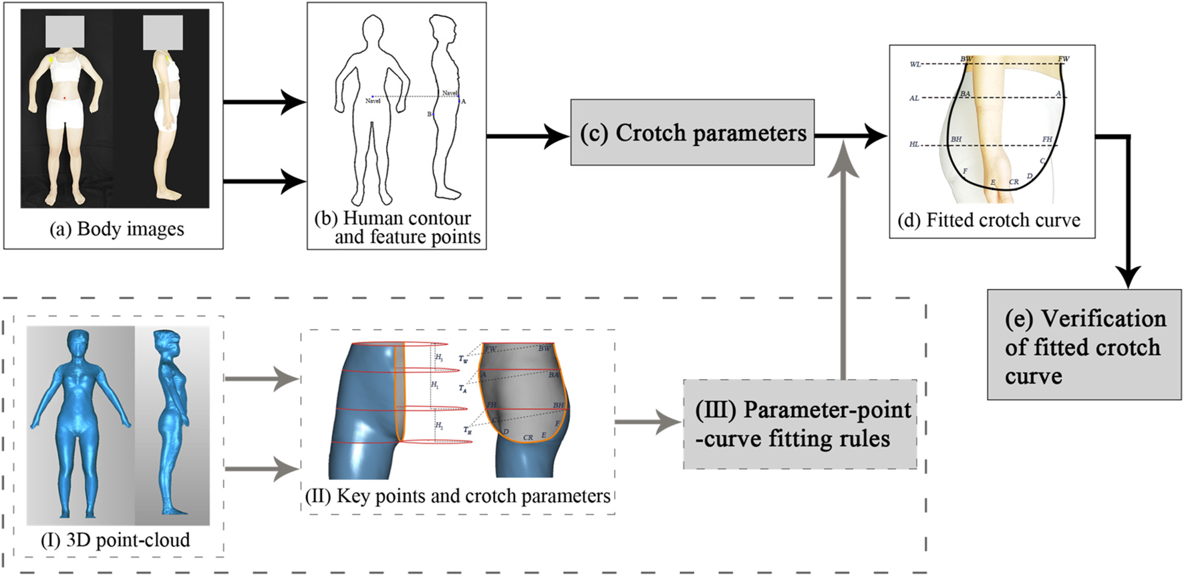

Slide 3
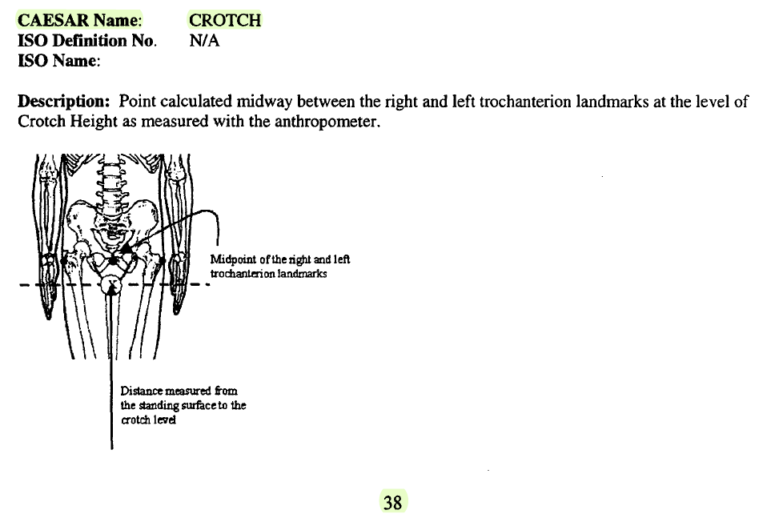
“Description: Point calculated midway between the right and left trochanterion landmarks at the level of Crotch Height as measured with the anthropometer.” (p.38)

Slide 4
CAESAR-Landmarks- ADA408374
This is Civilian American and European Surface Anthropometry Resource (CAESAR), Final Report, Volume II: Descriptions, which provides a general description of the methods used for the demographics, the measurements (both 3-D and 1-D), and the landmarks.
We take out page 38 which refers to the description of the crotch.

Slide 5
An image-based shape analysis approach and its application to young women’s waist-hip-leg position
Problem:
Pants' fit is mainly influenced by the body measurements, shape, and postures of the wear’s waist-hip-leg part
Technique:
Image-based shape analysis (ISA)
Realize the quick automatic shape identification of the waist-hip-leg position based on body images
Apply to pants’ pattern for different body types by analyzing the relationship between the waist-hip-leg shape and pants
Methods:
Factor Analysis
Clustering (K-means)
Results:
The image-based shape analysis approach (ISA) was finally verified with an accuracy rate of over 90% with 30 new subjects
The body classification results were demonstrated by the alteration of pants’ patterns, and the patterns could be adjusted according to different shapes
Further study focus:
Pants’ pattern differences of various body types to meet the needs of clothing fit.

Slide 6
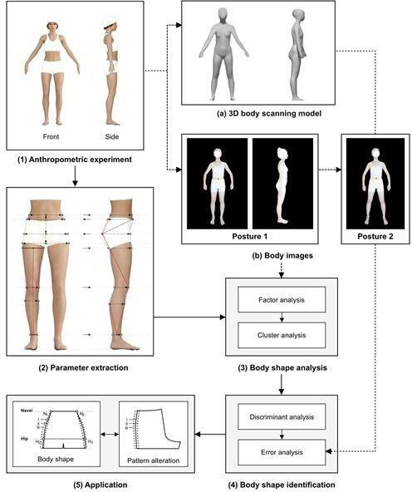

Slide 7
Categorization of lower body shapes for adult females based on multiple view analysis
Problem:
Approximately 50% of women and 62% of men cannot find good fit of ready-to-wear apparel
Technique:
Categorization method for the lower body shapes of women
Methods:
PCA (Principal component Analysis)
Five PCs were extracted, first three components were strong
Clustering (K-means)
Three body shape groups
Two Discriminant functions
Results:
Quite accurate but need more clusters.
Further study focus:
conducted using these methods to develop body shape categories for the upper body, for larger women, for older women, and for women of different ethnicities. Similar studies can also be conducted for men

Slide 8
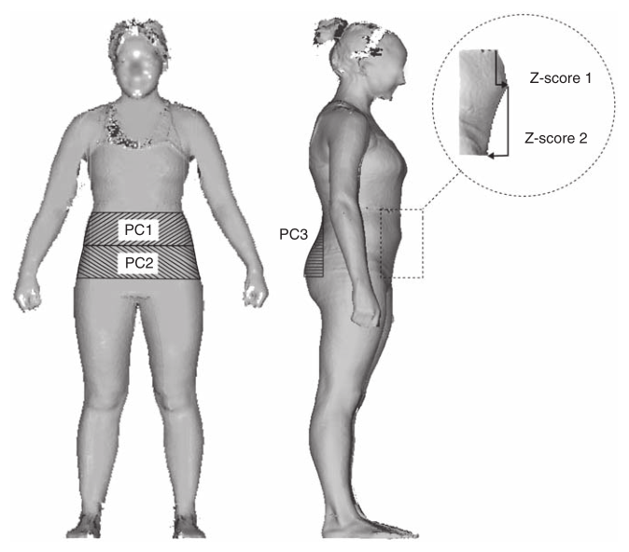

Slide 9
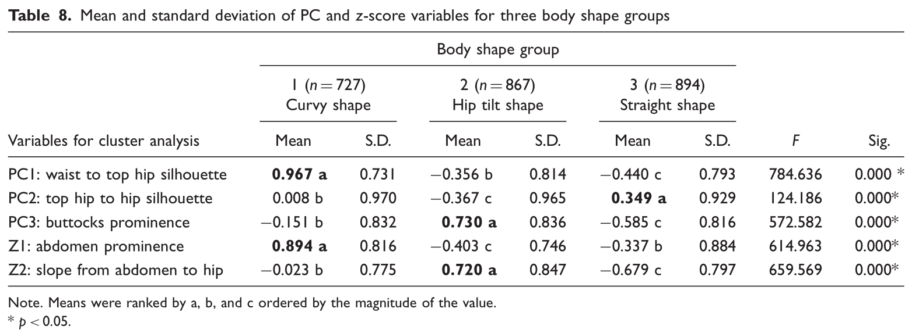

Slide 10
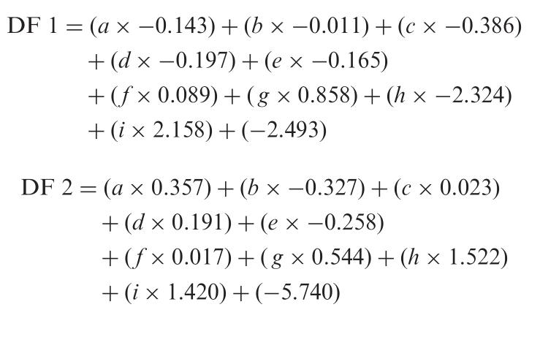
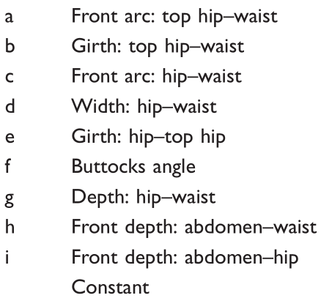

Slide 11
