Slide 1
FINANCIAL OVERVIEW · FISCAL 2021 & H1 FY2022
The Financial Story of Take-Two Interactive
Record fiscal 2021 results and the first half of fiscal 2022 — a publisher of owned, iconic franchises (Nasdaq: TTWO).
Fiscal year ended March 31, 2021, and the six months ended September 30, 2021.
Sources: Take-Two FY2021 Form 10-K · Q2 FY2022 earnings release & Form 10-Q
01 · COVER

Slide 2
02 · CONTEXT
TAKE-TWO INTERACTIVE · TTWO
CONTEXT FOR THIS OVERVIEW
A snapshot of Take-Two's performance, structure, and franchises — drawn from three lenses across SEC filings.
WHAT THIS COVERS
HOW TAKE-TWO IS BUILT
This overview summarizes Take-Two's financial performance across revenue, profitability, revenue mix, and capital position.
Five publishing labels: Rockstar Games, 2K, Private Division, Social Point, and Playdots.
27 proprietary franchises, internally owned across action, sports, strategy, and mobile genres.
It draws on three lenses: the multi-year growth trend, the FY2021 record year in detail, and the early-FY2022 trajectory.
Grand Theft Auto is the cornerstone IP — GTA V alone has sold in over 155 million units since launch.
All figures are as reported in SEC filings; net bookings is the company's key operational (non-GAAP) metric and is shown alongside GAAP net revenue.
6,495 full-time employees as of March 31, 2021, with 77% in product development.
¹ Net bookings is a non-GAAP measure defined as the net amount of products and services sold digitally or physically in the period. ² Headcount figure as of March 31, 2021 per FY2021 10-K.
Source: Take-Two FY2021 Form 10-K; Q2 FY2022 earnings release & Form 10-Q.
TAKE-TWO INTERACTIVE · FINANCIAL OVERVIEW
02 / 15

Slide 3
03 · HEADLINE KPIS
FISCAL YEAR ENDED MARCH 31, 2021
FISCAL 2021 HEADLINE PERFORMANCE
Fiscal 2021 set company records across every headline metric — revenue, earnings, and bookings.
NET REVENUE
NET INCOME
DILUTED EPS
NET BOOKINGS
$3,373M
$589M
$5.09
$3,553M
▲ 9% YoY · company record
▲ 46% YoY · highest ever
▲ vs. prior year
▲ 19% YoY · non-GAAP
Net revenue rose 9% year over year to a company record $3.37 billion.
Net income grew 46% to $589 million, the highest in company history.
Net bookings — the forward-looking demand metric — reached $3.55 billion, up 19%.
¹ Net bookings is a non-GAAP operational metric; GAAP net revenue is the headline reported figure. ² All FY2021 figures are audited per the Consolidated Statements of Operations.
Source: FY2021 10-K, Consolidated Statements of Operations; FY2021 earnings release (Net Bookings).
TAKE-TWO INTERACTIVE · FINANCIAL OVERVIEW
03 / 15

Slide 4
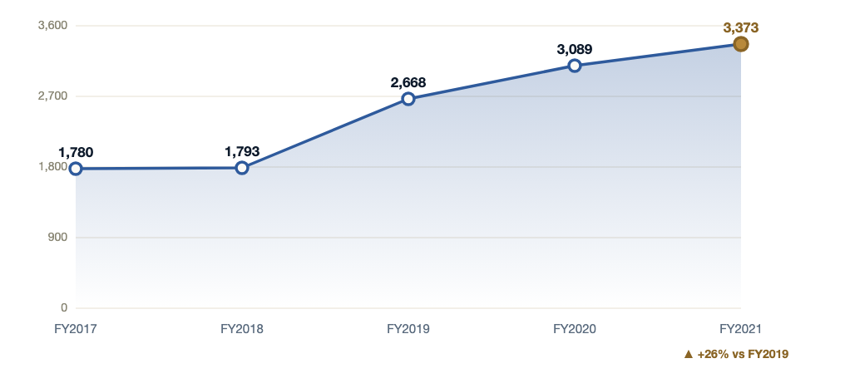
04 · REVENUE TREND
FY2017 – FY2021
TOP-LINE TRAJECTORY
Net revenue has grown every year, up 26% over three years to a record $3.4B.
Net revenue, fiscal years ended March 31 ($M)
SO WHAT
Five straight years of top-line expansion, accelerating sharply from FY2019 onward.
FY2021's $3.37B is an all-time high, +9% over FY2020 and +26% over FY2019.
Growth has been driven by the shift to recurrent consumer spending (see next section).
Net revenue (GAAP, $M)
¹ Net revenue is GAAP and differs from net bookings (non-GAAP). ² FY2017–FY2018 are sourced from stockanalysis.com; FY2019–FY2021 are exact figures from the 10-K.
Source: FY2021 10-K (FY2019–FY2021 exact); stockanalysis.com (FY2017–FY2018). Note: net revenue is GAAP; differs from net bookings.
TAKE-TWO INTERACTIVE · FINANCIAL OVERVIEW
04 / 15

Slide 5
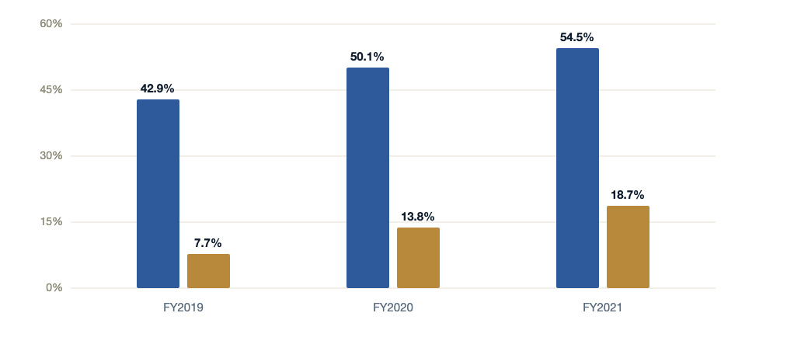
05 · PROFITABILITY
FY2019 – FY2021
MARGIN EXPANSION
Margins expanded sharply: gross margin reached 54.5% and operating margin 18.7%.
Gross margin and operating margin, FY2019–FY2021 (% of net revenue)
SO WHAT
Gross margin climbed nearly 12 points in two years as higher-margin digital and recurrent revenue grew.
Income from operations more than tripled, from $207M (FY2019) to $629M (FY2021).
Net income margin reached 17.5% in FY2021, up from 12.5% in FY2019.
Gross margin
Operating margin
¹ Margins computed on GAAP net revenue. ² Income from operations = $629M in FY2021 (10-K Statements of Operations).
Source: FY2021 10-K, Statements of Operations. Margins computed on GAAP net revenue.
TAKE-TWO INTERACTIVE · FINANCIAL OVERVIEW
05 / 15

Slide 6
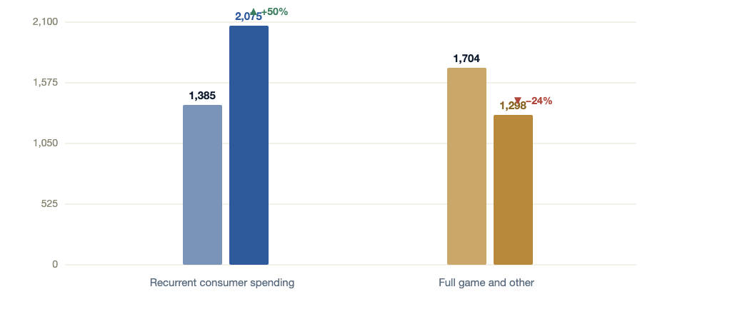
06 · REVENUE MIX
FY2020 VS FY2021
THE MODEL FLIPS
Recurrent consumer spending became the majority of revenue, flipping the model.
Net revenue by type, FY2020 vs FY2021 ($M)
SO WHAT
RCS grew 50% year over year and became the majority of revenue for the first time.
RCS reached 62% of net revenue in FY2021 (and 63% of net bookings), up from 45% a year earlier.
The shift de-risks the model: revenue is increasingly recurring rather than tied to new-title launches.
FY2020
FY2021 (RCS)
FY2020
FY2021 (Full game)
¹ RCS = recurrent consumer spending (in-game purchases, virtual currency, add-on content). ² FY2021 shares: RCS 62%, Full game 38% of net revenue.
Source: FY2021 10-K, net revenue by type. RCS = recurrent consumer spending (in-game purchases, virtual currency, add-on content).
TAKE-TWO INTERACTIVE · FINANCIAL OVERVIEW
06 / 15

Slide 7
07 · CHANNEL & GEOGRAPHY
FY2021 NET REVENUE
WHERE REVENUE COMES FROM
Revenue is overwhelmingly digital and led by the U.S., with 40% from abroad.
BY DISTRIBUTION CHANNEL — FY2021
BY GEOGRAPHY — FY2020 VS FY2021
CHANNEL
FY2021 ($M)
SHARE
GEOGRAPHY
FY2020 ($M)
FY2021 ($M)
GROWTH
Digital online
2,919
86.6%
United States
1,776
2,016
+14%
Physical retail & other
453
13.4%
International
1,313
1,357
+3%
Total
3,372
100%
Total
3,089
3,373
+9%
Digital delivery reached 86.6% of net revenue (87% of net bookings), up from 63% just two years earlier.
The U.S. drove growth at +14%; international held 40% of revenue, with Asia ~7% of net bookings — a stated expansion opportunity.
Digital's structural dominance reflects the recurrent-consumer-spending shift and the move away from physical retail.
¹ Channel total ($3,372M) reflects rounding against net revenue of $3,373M. ² Asia ~7% of net bookings per management commentary; geography growth computed on reported figures.
Source: FY2021 10-K, net revenue by distribution channel and by geography.
TAKE-TWO INTERACTIVE · FINANCIAL OVERVIEW
07 / 15

Slide 8
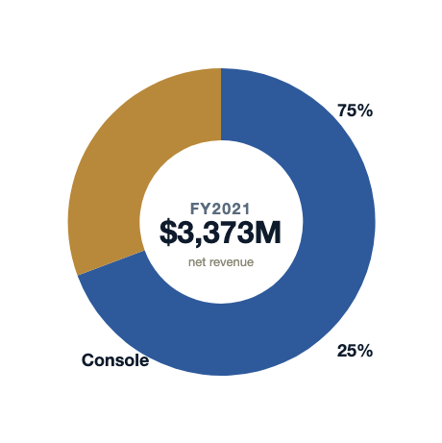
08 · PLATFORM MIX
FY2021
PLATFORM COMPOSITION
Console anchors the business while PC and mobile broaden the base.
FY2021 net revenue by platform ($M)
SO WHAT
Console delivered 75% of FY2021 net revenue, led by the GTA and NBA 2K franchises.
PC and other contributed $856M (25%), including a growing mobile and PC-digital base.
Console — $2,517M
Grand Theft Auto products alone represented 29.2% of total net revenue.
75% of FY2021 net revenue
PC and other — $856M
25% of FY2021 net revenue
Grand Theft Auto products alone represented 29.2% of total net revenue.
¹ Platform breakdown per 10-K "net revenue by platform." ² "PC and other" includes mobile, reported within the same line. ³ GTA share per FY2021 10-K disclosure.
Source: FY2021 10-K, net revenue by platform.
TAKE-TWO INTERACTIVE · FINANCIAL OVERVIEW
08 / 15

Slide 9
09 · BALANCE SHEET
AS OF MARCH 31, 2021
FINANCIAL POSITION
A fortress balance sheet: $2.7B in cash and investments funds the pipeline.
CASH & EQUIVALENTS
SHORT-TERM INVESTMENTS
OPERATING CASH FLOW
STOCKHOLDERS' EQUITY
$1,423M
$1,309M
$912M
$3,332M
highly liquid
+$2.7B combined
▲ 33% YoY
total assets $6.0B
Take-Two held $2.7 billion in cash and short-term investments at fiscal year-end, against modest liabilities.
Operating cash flow rose 33% to $912 million, funding development of the multi-year slate internally.
Total assets were $6.0 billion with $3.3 billion of stockholders' equity — ample capacity for content investment and M&A.
¹ Cash & equivalents + short-term investments = $1,423M + $1,309M = $2,732M. ² Operating cash flow change per Statement of Cash Flows.
Source: FY2021 10-K, Balance Sheet and Statement of Cash Flows.
TAKE-TWO INTERACTIVE · FINANCIAL OVERVIEW
09 / 15

Slide 10
II
PART TWO
The first half of fiscal 2022
Investing through a transition year while recurrent spending deepens.
SOURCE: Q2 FY2022 EARNINGS RELEASE & FORM 10-Q
10 / 15

Slide 11
11 · Q2 FY2022
QUARTER ENDED SEPTEMBER 30, 2021
QUARTERLY HEADLINE
Q2 FY2022 revenue held steady as the company invested for its largest-ever pipeline.
Q2 NET REVENUE
Q2 OPERATING INCOME
Q2 DILUTED EPS
Q2 NET BOOKINGS
$858M
$20M
$0.09
$985M
held steady YoY
▼ vs. $115M prior year
lower on investment
▲ 3% YoY · non-GAAP
Net bookings grew 3% to $985M; recurrent consumer spending rose to 69% of net bookings.
Operating income was $20M (down from $115M a year earlier) as Take-Two stepped up investment in development.
Gross margin was 46.8%; the quarter reflects a deliberate build-up ahead of a record forward slate.
¹ Q2 FY2022 = three months ended September 30, 2021. ² Operating income decline reflects higher R&D and development spend, not demand weakness.
Source: Q2 FY2022 earnings release and Form 10-Q (quarter ended September 30, 2021).
TAKE-TWO INTERACTIVE · FINANCIAL OVERVIEW
11 / 15

Slide 12
12 · Q2 MIX
QUARTER ENDED SEPTEMBER 30, 2021
Q2 GEOGRAPHY & CHANNEL
In Q2, digital and recurrent spending deepened across both geography and channel.
BY GEOGRAPHY — Q2 FY22 NET REVENUE
BY CHANNEL — Q2 FY22 NET REVENUE
GEOGRAPHY
Q2 FY22 ($M)
SHARE
CHANNEL
Q2 FY22 ($M)
SHARE
United States
515
60%
Digital online
779
91%
International
343
40%
Physical & other
79
9%
Total
858
100%
Total
858
100%
Digital reached 91% of quarterly net revenue (89% of net bookings) — the structural shift continues.
The U.S./international split held near 60/40, consistent with the full-year FY2021 mix.
Recurrent consumer spending rose to 69% of net bookings in the quarter, extending the FY2021 flip.
¹ Q2 FY22 net revenue $858M; totals may not foot due to rounding. ² Digital share of net bookings = 89% per Q2 FY2022 release.
Source: Q2 FY2022 earnings release (quarter ended September 30, 2021).
TAKE-TWO INTERACTIVE · FINANCIAL OVERVIEW
12 / 15

Slide 13
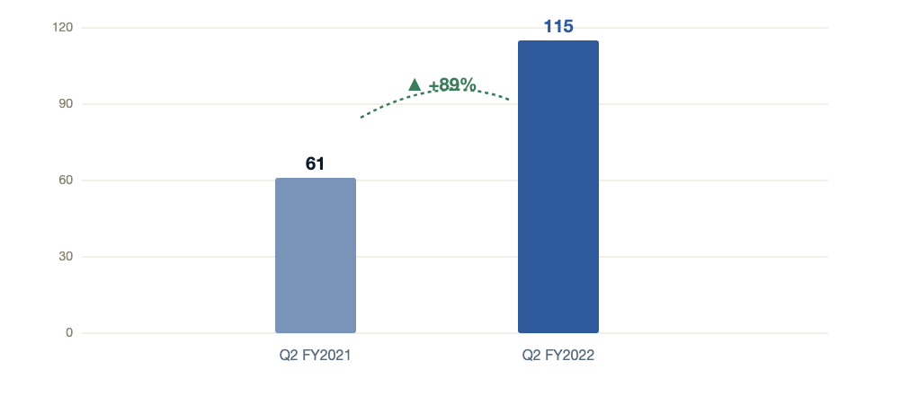
13 · MOBILE
Q2 FY2021 VS Q2 FY2022
FASTEST-GROWING PLATFORM
Mobile net revenue nearly doubled, led by Social Point's live-service titles.
Mobile net revenue, Q2 FY2021 vs Q2 FY2022 ($M)
SO WHAT
Mobile net revenue grew 89% year over year, the fastest-growing platform in the quarter.
Growth was led by Social Point's live-service mobile portfolio and continued in-game spending.
Mobile deepens the recurrent-revenue mix and broadens reach beyond console and PC.
Q2 FY2021
Q2 FY2022
¹ Mobile is reported within the "PC and other" platform line in the 10-Q. ² Growth computed on reported mobile net revenue: ($115M − $61M) / $61M ≈ 89%.
Source: Q2 FY2022 Form 10-Q. Mobile is reported within "PC and other."
TAKE-TWO INTERACTIVE · FINANCIAL OVERVIEW
13 / 15

Slide 14
MANAGEMENT PERSPECTIVE
“
We are entering our strongest development pipeline ever.
— Strauss Zelnick, Chairman & CEO, on Take-Two's multi-year slate
TAKE-TWO INTERACTIVE · FINANCIAL OVERVIEW
14 / 15

Slide 15
CLOSING SUMMARY
A record year and a deliberate investment phase.
01
FY2021 delivered record results — revenue of $3.37B, net income of $589M, and expanded margins, on a model now majority-recurrent.
02
The balance sheet — $2.7B in cash and investments, $912M operating cash flow — funds growth internally without external dependence.
03
H1 FY2022 reflects deliberate investment ahead of the strongest development pipeline in company history.
Take-Two Interactive Software, Inc. · Nasdaq: TTWO
15 / 15
Source: FY2021 10-K; Q2 FY2022 earnings release.

