Slide 1

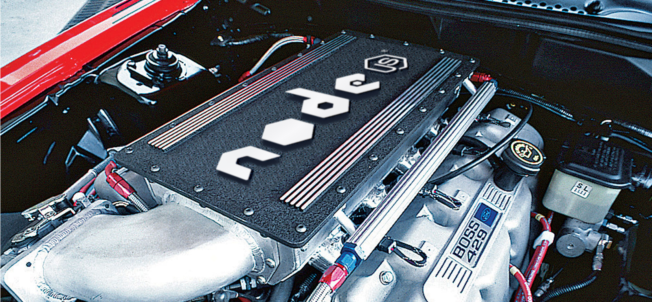
under the hood

Slide 2
The C10K problem (http://www.kegel.com/c10k.html)
“It's time for web servers to handle ten thousand clients simultaneously, don't you think? After all, the web is a big place now.”
“In 1999 one of the busiest ftp sites, cdrom.com, actually handled 10000 clients simultaneously through a Gigabit Ethernet pipe.”
Possible solutions:
Non-Blocking
Blocking (one thread per client)
Asynchronous

Slide 3




Node.js
“...node.js combined a model of I/O – evented – with a language that was well suited to the style of programming (Javascript)” By John-Babak

Slide 4
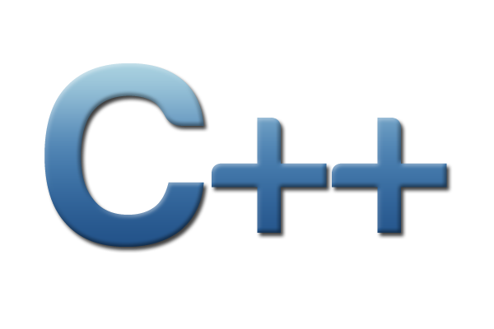

Node.js
J
A
V
A
S
C
R
I
P
T
N
O
D
E
S
O
V
8
C
O
R
E
A
P
I
B
I
N
D
I
N
G
S
Event queue
cb | cb | cb | ... | ...
FS
NET
DNS
NAN
Node-gyp
libev
libeio
IOCP
os services (threads)
FreeBSD / Linux / Unix
windows

Slide 5
Node.js
J
A
V
A
S
C
R
I
P
T
N
O
D
E
S
O
Event queue
cb | cb | cb | ... | ...
request (fs, net, etc)
push cb
record cb
FS
NET
DNS
libev
libeio
IOCP
os services (threads)
FreeBSD / Linux / Unix
windows

