Slide 1
FDA on Visual ERPs
Jacopo Lazzari

Slide 2
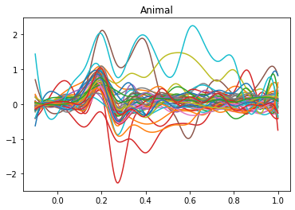
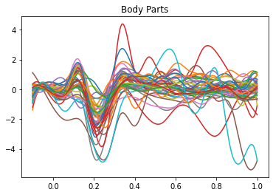
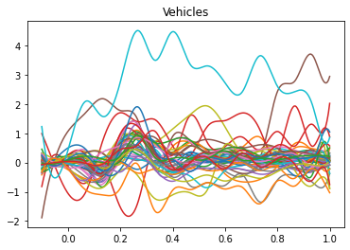
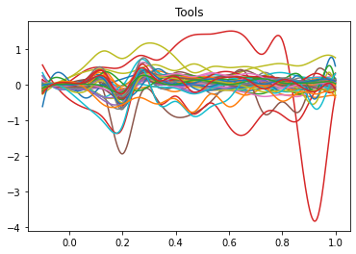
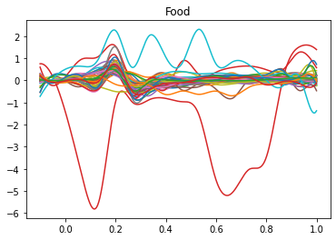
Basis Representation

Slide 3
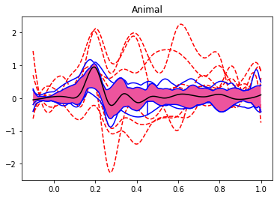
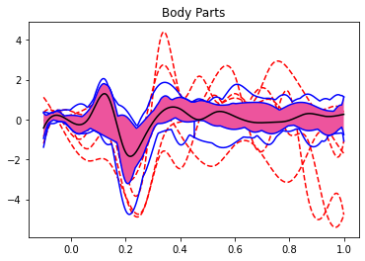
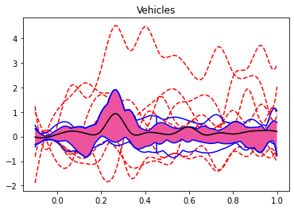
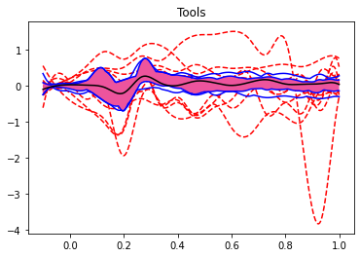
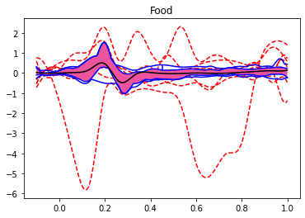
Functional Boxplots

Slide 4
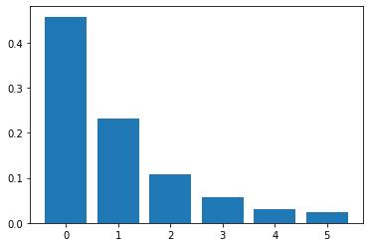
Functional PCA
N° Components | Cumulative Explained Variance (%)
6 | 91,11
5 | 88,64
4 | 85,53
3 | 79,79
2 | 69,04
1 | 45,83

Slide 5
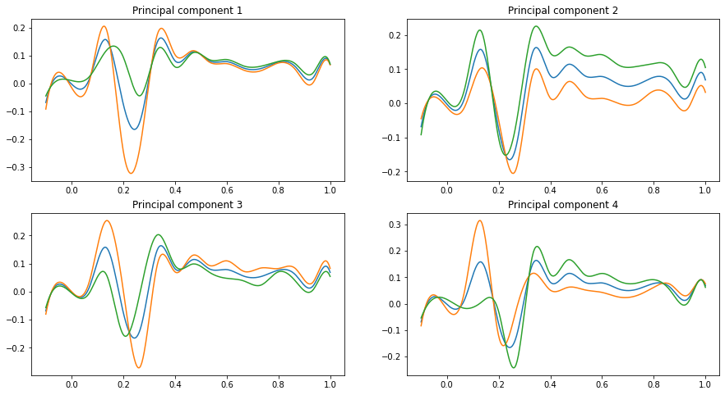
Functional PCA

Slide 6
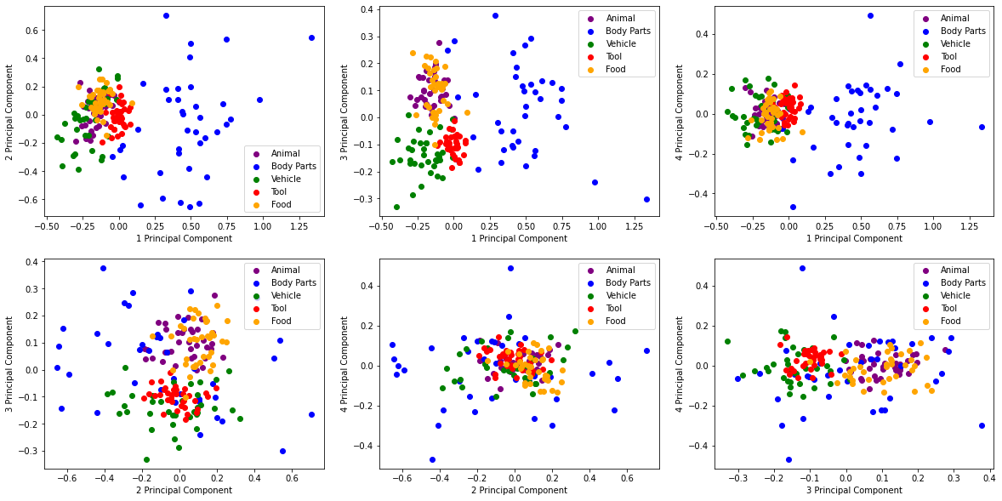

Slide 7
Discrete Measures
Signed Area Amplitude
Fractional Area Latency -> Fractional Peak Latency
No jacknife approach

Slide 8
Linear Correlation between FPCs and Discrete Measures
 | Area P1 | Lat P1 | Area N1 | Lat N1 | Area N2 | Lat N2 | Area P3 | Lat P3
1 | ** | * | *** | *** | *** | * | *
2 | ** |  |  | * |  | * | *** | *
3 | * | * | * | * | * | ** |  | **
4 | ** | * | * | * |  |  | *
* -> α < 0,05
**-> α < e-10
**-> α < e-20

Slide 9
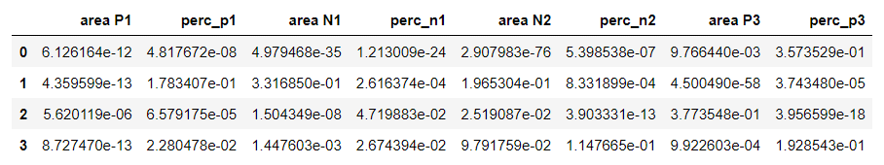
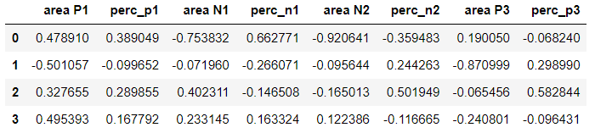
P-values:
r:

Slide 10
+ Bonferroni Correction
 | Area P1 | Latency P1 | Area N1 | Latency N1 | Area N2 | Latency N2 | Area P3 | Latency P3
PCF 1 | ** | * | *** | *** | *** | *
PCF 2 | ** |  |  | * |  | * | *** | *
PCF 3 | * | * | * |  |  | ** |  | **
PCF 4 | ** |  | * |  |  |  | *
* -> α < 0,05/32
**-> α < e-10
**-> α < e-20

Slide 11
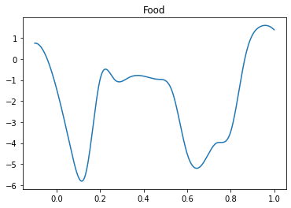
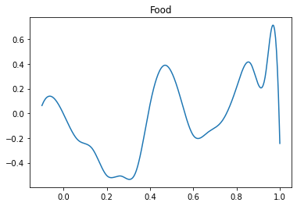
Some problems with areas

