Slide 1
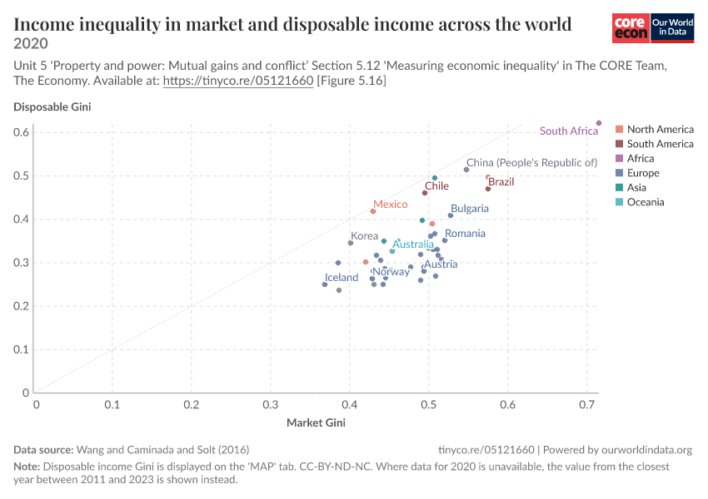
STATS 401 INDIVIDUAL PROJECT
Aligned values make the redistribution gap easier to compare
Income inequality before and after taxes and transfers
ORIGINAL
REDESIGN TOP EIGHT ABSOLUTE REDUCTIONS
Country
0.2
0.3
0.4
0.5
Finland
Belgium
France
Ireland
Austria
Greece
Germany
Portugal
Disposable Gini
Market Gini
1
Direct comparison
2
Complete identification
3
Visible limitation
Connector length shows the Gini reduction on one shared scale.
Every country receives a label and can be sorted or filtered.
The interface reports each observation year, which ranges from 2011 to 2020.
Source: Our World in Data, based on Wang, Caminada, and Solt (2016).
Notes:
This Our World in Data scatterplot compares inequality before and after taxes and transfers. Its shared scales and equality line are useful, but the main question is harder than it needs to be: how much does inequality fall in each country? The viewer must estimate diagonal distance, many countries are not labeled, and region colors compete with that comparison.
My redesign uses a dumbbell plot. Each country has two points on the same Gini scale, and the connector directly shows the reduction. Every country is labeled, the list can be sorted or filtered, and the tooltip reports the actual observation year because the source combines data from 2011 to 2020. The redesign takes more vertical space, but it makes ranking countries and comparing before-and-after values much faster and more precise.
Sources: https://ourworldindata.org/grapher/income-inequality-in-market-and-disposable-income-across-the-world; Wang, Caminada, and Solt (2016).

