Slide 1
Electromagnetic Field Theory
(UE20EC303)
A review of Vector Calculus
Unit 1 Electrostatics
Dr. Raghavendra G. Kulkarni
Distinguished Professor
Department of Electronics and Communication Engineering
PES University
Bengaluru – 560085.
Lecture notes of Dr. Raghavendra G. Kulkarni, Distinguished Professor, PES University, Bengaluru, INDIA.

Slide 2
z
Position vectors and unit vectors in Cartesian coordinates
r = x + y + z,
r = x a_{x} + y a_{y} + z a_{z},
where x = x a_{x} , y = y a_{y} , z = z a_{z} ,
(Vector quantities are in bold letters)
r, x, y, z are position vectors, which originate from origin;
a_{x}, a_{y}, a_{z} are unit vectors in x, y, z directions
z
r
y
y
x
x
a_{z}
a_{y}
a_{x}
Lecture notes of Dr. Raghavendra G. Kulkarni, Distinguished Professor, PES University, Bengaluru, INDIA.

Slide 3
Distance vectors in Cartesian coordinates
Let P (x₁, y₁, z₁) and Q (x₂, y₂, z₂) be two points in Cartesian coordinate system. The position vectors of P and Q are
r_{P} = x₁ a_{x} + y₁ a_{y} + z₁ a_{z} and r_{Q} = x₂ a_{x} + y₂ a_{y} + z₂ a_{z}
and the distance vector starting from P to Q is R_{PQ}
R_{PQ} = r_{Q} – r_{P} = (x₂ - x₁)a_{x} + (y₂ - y₁)a_{y} + (z₂ - z₁)a_{z}
Example: Find distance vector, R_{PQ}, if the points are P(1, 2 , 3) and Q(2, -2, 1)
Solution: r_{P} = 1 a_{x} + 2 a_{y} + 3 a_{z} , r_{Q} = 2 a_{x} - 2 a_{y} + 1 a_{z}
R_{PQ} = r_{Q} – r_{P} = a_{x} – 4 a_{y} – 2 a_{z}
z
R_{PQ}
Q
P
r_{Q}
r_{P}
y
x
Lecture notes of Dr. Raghavendra G. Kulkarni, Distinguished Professor, PES University, Bengaluru, INDIA.

Slide 4
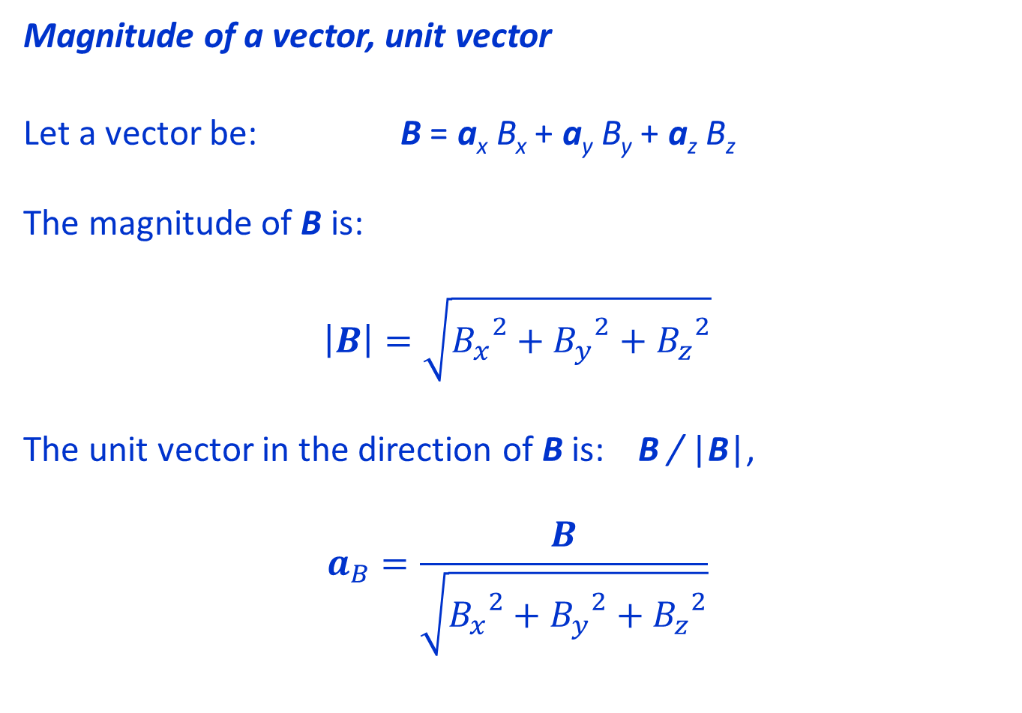
Magnitude of a vector, unit vector
Let a vector be: B = a_{x} B_{x} + a_{y} B_{y} + a_{z} B_{z}
The magnitude of B is:
$$\left|B\right|=\sqrt{{B_{x}}^{2}+{B_{y}}^{2}+{B_{z}}^{2}}$$
The unit vector in the direction of B is: B / |B|,
$$a_{B}=\frac{B}{\sqrt{{B_{x}}^{2}+{B_{y}}^{2}+{B_{z}}^{2}}}$$
Lecture notes of Dr. Raghavendra G. Kulkarni, Distinguished Professor, PES University, Bengaluru, INDIA.

Slide 5
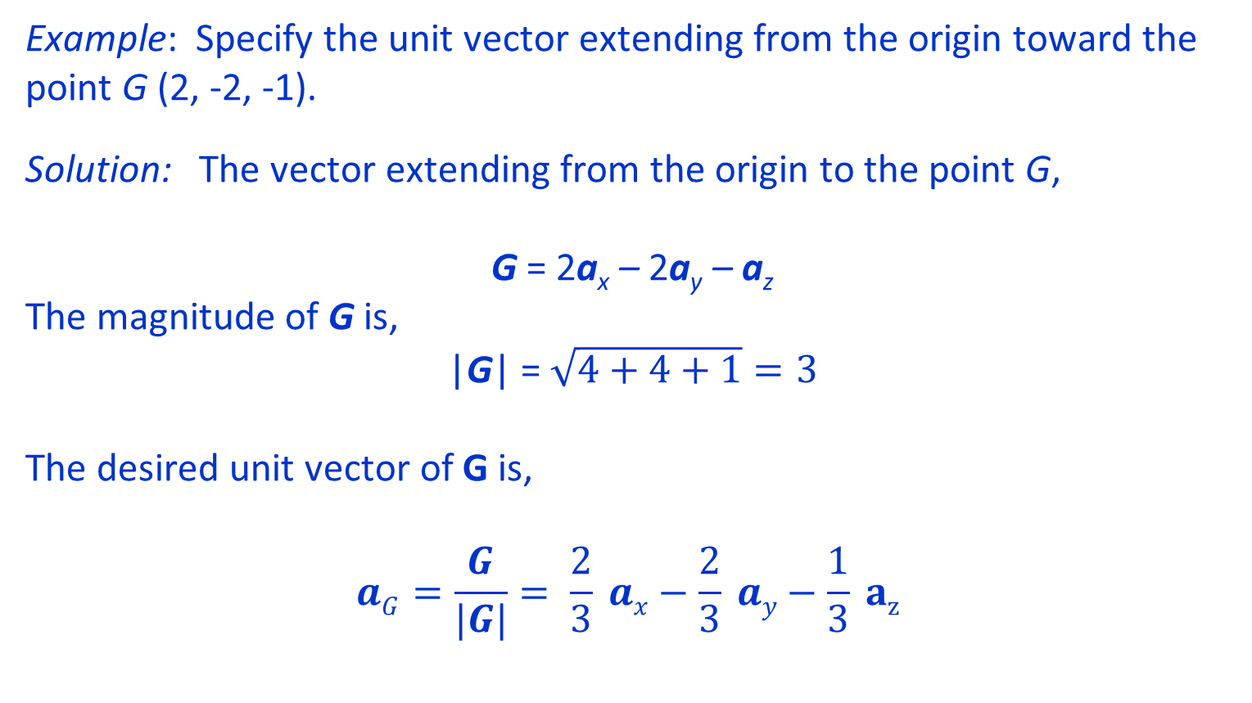
Example: Specify the unit vector extending from the origin toward the point G (2, -2, -1).
Solution: The vector extending from the origin to the point G,
G = 2a_{x} – 2a_{y} – a_{z}
The magnitude of G is,
|G| = $\sqrt{4+4+1}=3$
The desired unit vector of G is,
$$aG=\frac{G}{|G|}= \frac{2}{3} ax−\frac{2}{3} ay−\frac{1}{3} az$$
Lecture notes of Dr. Raghavendra G. Kulkarni, Distinguished Professor, PES University, Bengaluru, INDIA.

Slide 6
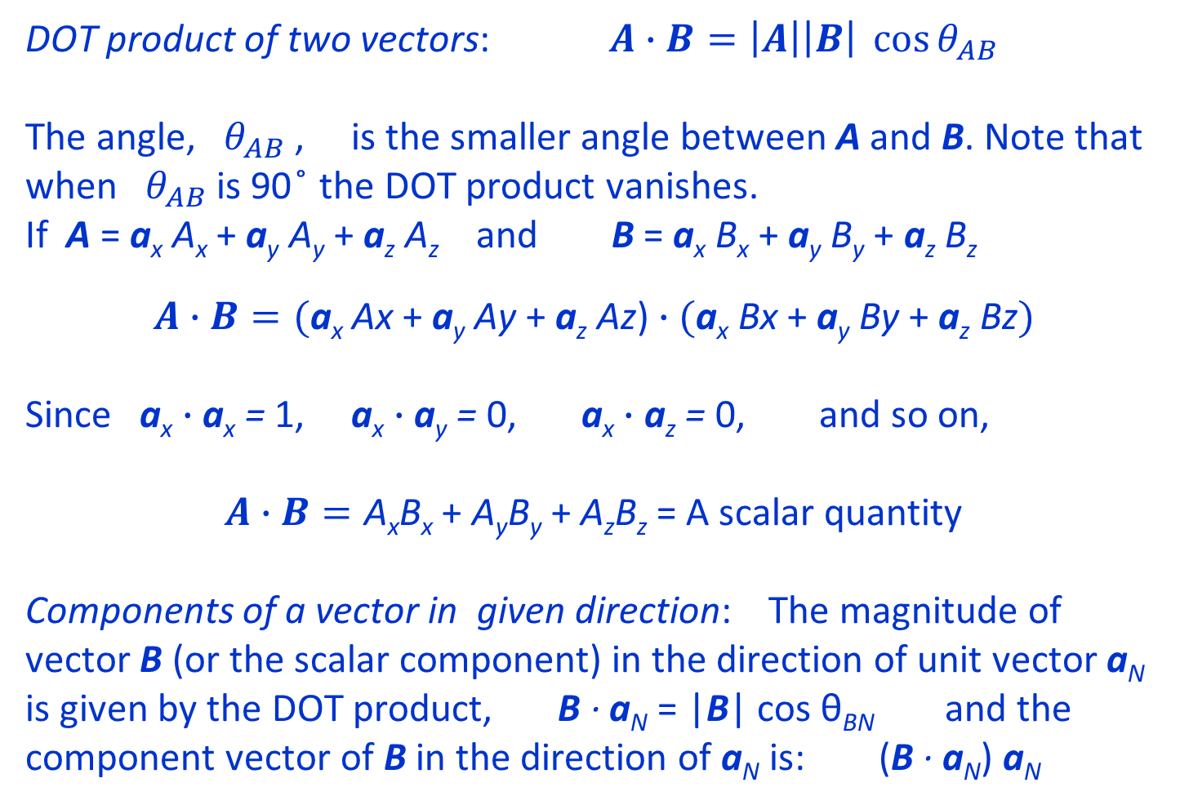
DOT product and its application
A
DOT product of two vectors: $A∙B=\left|A\right|\left|B\right| \cos{θ_{AB}}$
The angle, $θ_{AB}$ , is the smaller angle between A and B. Note that when $θ_{AB}$ is 90 ̊ the DOT product vanishes.
If A = a_{x} A_{x} + a_{y} A_{y} + a_{z} A_{z} and B = a_{x} B_{x} + a_{y} B_{y} + a_{z} B_{z}
$$A∙B=(\text{a}\text{x} \text{Ax}\text{ + }\text{a}\text{y} \text{Ay}\text{ + }\text{a}\text{z} \text{Az}\text{)}∙(\text{a}\text{x} \text{Bx}\text{ + }\text{a}\text{y} \text{By}\text{ + }\text{a}\text{z} \text{Bz})$$
Since $\text{a}\text{x}∙\text{a}\text{x} \text{=} \text{1}$, $\text{a}\text{x}∙\text{a}\text{y}\text{ =} \text{0}$, $\text{a}\text{x}∙\text{a}\text{z}\text{ =} \text{0}$, and so on,
$A∙B=\text{A}\text{x}\text{B}\text{x}\text{ + }\text{A}\text{y}\text{B}\text{y}\text{ + }\text{A}\text{z}\text{B}\text{z}$ = A scalar quantity
Components of a vector in given direction: The magnitude of vector B (or the scalar component) in the direction of unit vector a_{N} is given by the DOT product, B · a_{N} = |B| cos θ_{BN} and the component vector of B in the direction of a_{N} is: (B · a_{N}) a_{N}
θ_{AB}
B
B
θ_{BN}
a_{N}
|B|cos θ_{BN}
Lecture notes of Dr. Raghavendra G. Kulkarni, Distinguished Professor, PES University, Bengaluru, INDIA.

Slide 7

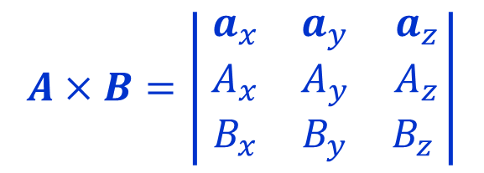
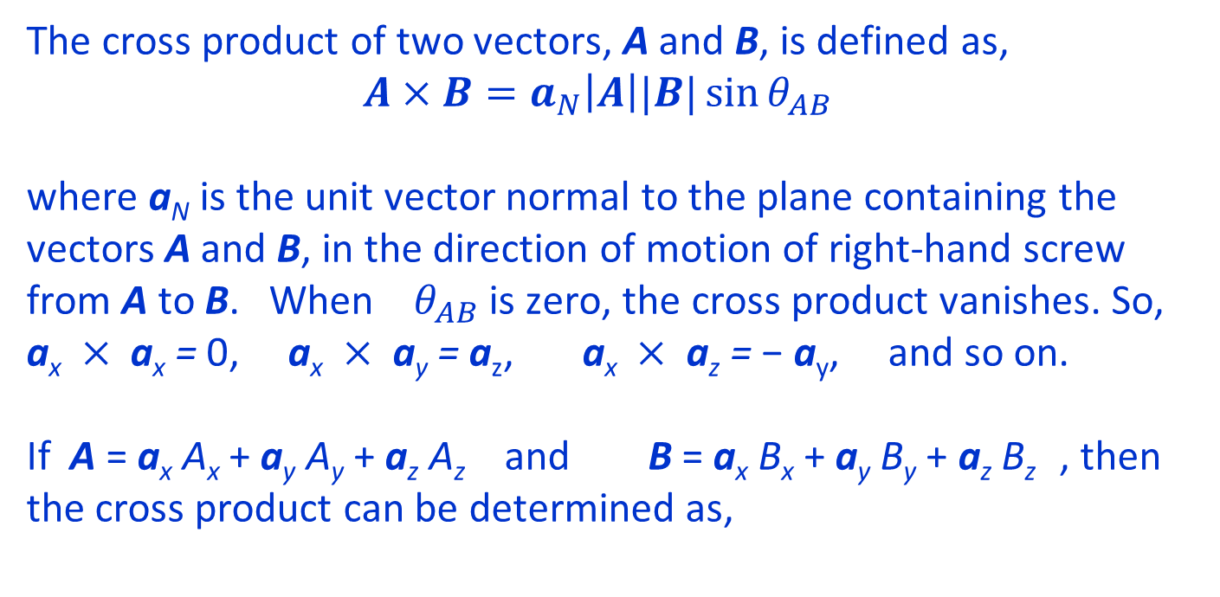
The cross product of two vectors
The cross product of two vectors, A and B, is defined as,
$$A×B=a_{N}\left|A\right||B|\sin{θ_{AB}}$$
where a_{N} is the unit vector normal to the plane containing the vectors A and B, in the direction of motion of right-hand screw from A to B. When $θ_{AB}$ is zero, the cross product vanishes. So, $\text{a}\text{x} × \text{a}\text{x}\text{ =} \text{0}$, $\text{a}\text{x} × \text{a}\text{y}\text{ =} \text{a}\text{z}$, $\text{a}\text{x} × \text{a}\text{z}\text{ =} \text{−}$ a_{y}, and so on.
If A = a_{x} A_{x} + a_{y} A_{y} + a_{z} A_{z} and B = a_{x} B_{x} + a_{y} B_{y} + a_{z} B_{z} , then
the cross product can be determined as,
A
$$θAB$$
B
a_{N}
$$A×B=\left| \begin{matrix}a_{x} & a_{y} & a_{z} \\ A_{x} & A_{y} & A_{z} \\ B_{x} & B_{y} & B_{z} \end{matrix}\right|$$
Lecture notes of Dr. Raghavendra G. Kulkarni, Distinguished Professor, PES University, Bengaluru, INDIA.

Slide 8
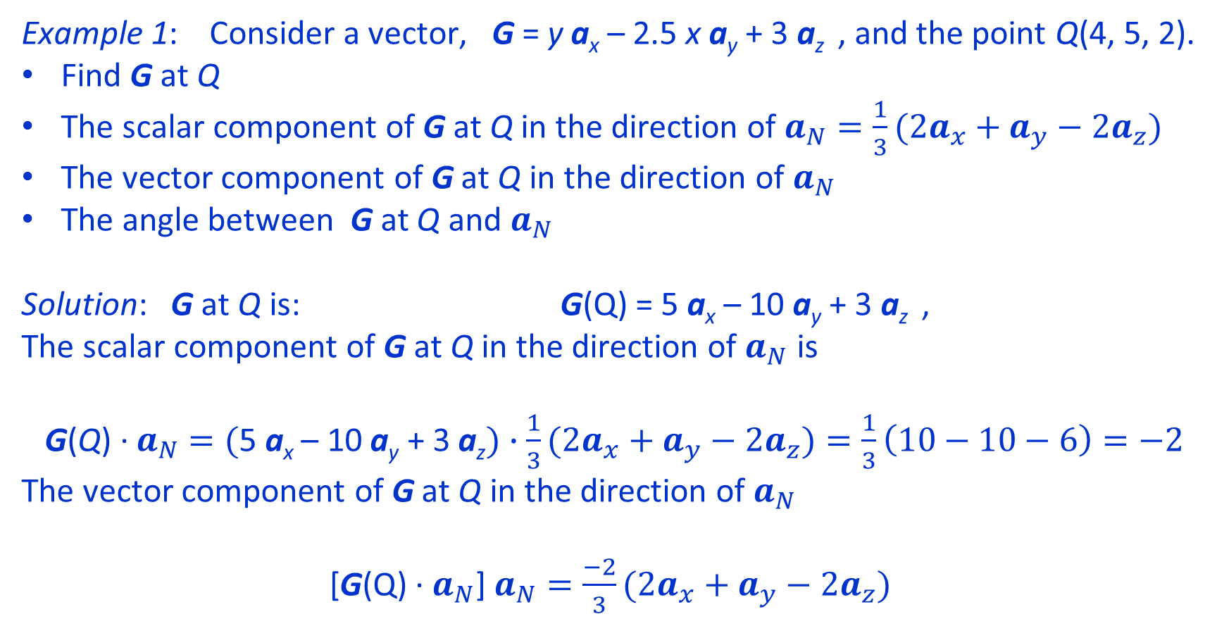
Examples using DOT product and cross product
Example 1: Consider a vector, G = y a_{x} – 2.5 x a_{y} + 3 a_{z} , and the point Q(4, 5, 2).
Find G at Q
The scalar component of G at Q in the direction of $a_{N}=\frac{1}{3}(2a_{x}+a_{y}−2a_{z})$
The vector component of G at Q in the direction of $a_{N}$
The angle between G at Q and $a_{N}$
Solution: G at Q is: G(Q) = 5 a_{x} – 10 a_{y} + 3 a_{z} ,
The scalar component of G at Q in the direction of $a_{N}$ is
G(Q) · $a_{N}$ $=(\text{5 }\text{a}\text{x} \text{–} \text{10 }\text{a}\text{y} \text{+ }\text{3} \text{a}\text{z})∙\frac{1}{3}(2a_{x}+a_{y}−2a_{z})=\frac{1}{3}\left(10−10−6\right)=−2$
The vector component of G at Q in the direction of $a_{N}$
[G(Q) · $a_{N}$] $a_{N}=\frac{−2}{3}(2a_{x}+a_{y}−2a_{z})$
Lecture notes of Dr. Raghavendra G. Kulkarni, Distinguished Professor, PES University, Bengaluru, INDIA.

Slide 9
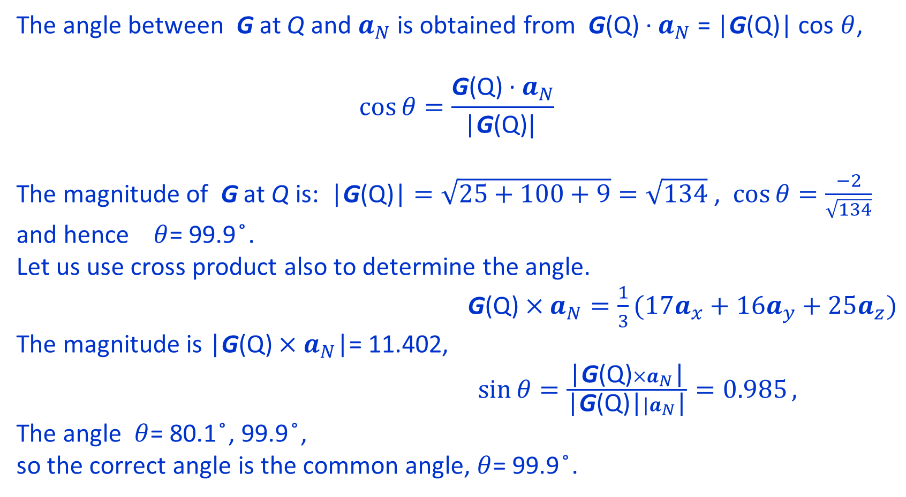
The angle between G at Q and $a_{N}$ is obtained from G(Q) · $a_{N}$ = |G(Q)| cos $θ$,
$$\cos{θ=\frac{\text{G}\text{(}\text{Q}\text{) · }a_{N}}{\text{|}\text{G}\text{(}\text{Q}\text{)}| }}$$
The magnitude of G at Q is: $\text{|}\text{G}\text{(}\text{Q}\text{)|}=\sqrt{25+100+9}=\sqrt{134}$ , $\cos{θ=\frac{−2}{\sqrt{134}} }$ and hence $θ$= 99.9 ̊.
Let us use cross product also to determine the angle.
$\text{G}\text{(}\text{Q}\text{)}×a_{N}=\frac{1}{3}(17a_{x}+16a_{y}+25a_{z})$
The magnitude is |$\text{G}\text{(}\text{Q}\text{)}×a_{N}$|= 11.402,
$\sin{θ=\frac{\text{|}\text{G}\text{(}\text{Q}\text{)}×a_{N}\text{|}}{\text{|}\text{G}\text{(}\text{Q}\text{)|}|a_{N}\text{|}}=0.985},$
The angle $θ$= 80.1 ̊, 99.9 ̊,
so the correct angle is the common angle, $θ$= 99.9 ̊.
Lecture notes of Dr. Raghavendra G. Kulkarni, Distinguished Professor, PES University, Bengaluru, INDIA.

Slide 10
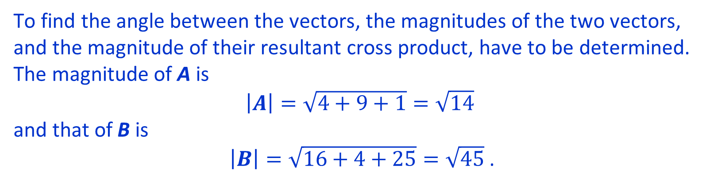
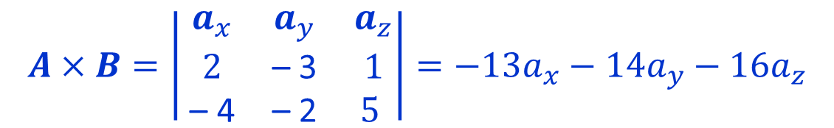
Examples using DOT product and cross product
Example 2: Find the cross product of two vectors, A = 2 a_{x} – 3 a_{y} + a_{z} and
B = – 4 a_{x} – 2 a_{y} + 5 a_{z} and determine the angle between them.
$$A×B=\left| \begin{matrix}a_{x} & a_{y} & a_{z} \\ 2 & \text{– }\text{3} & 1 \\ \text{– }\text{4} & \text{– }\text{2} & 5 \end{matrix}\right|=−13a_{x}−14a_{y}−16a_{z}$$
To find the angle between the vectors, the magnitudes of the two vectors, and the magnitude of their resultant cross product, have to be determined. The magnitude of A is
$\left|A\right|=\sqrt{4+9+1}=\sqrt{14}$
and that of B is
$\left|B\right|=\sqrt{16+4+25}=\sqrt{45}$ .
Lecture notes of Dr. Raghavendra G. Kulkarni, Distinguished Professor, PES University, Bengaluru, INDIA.

Slide 11
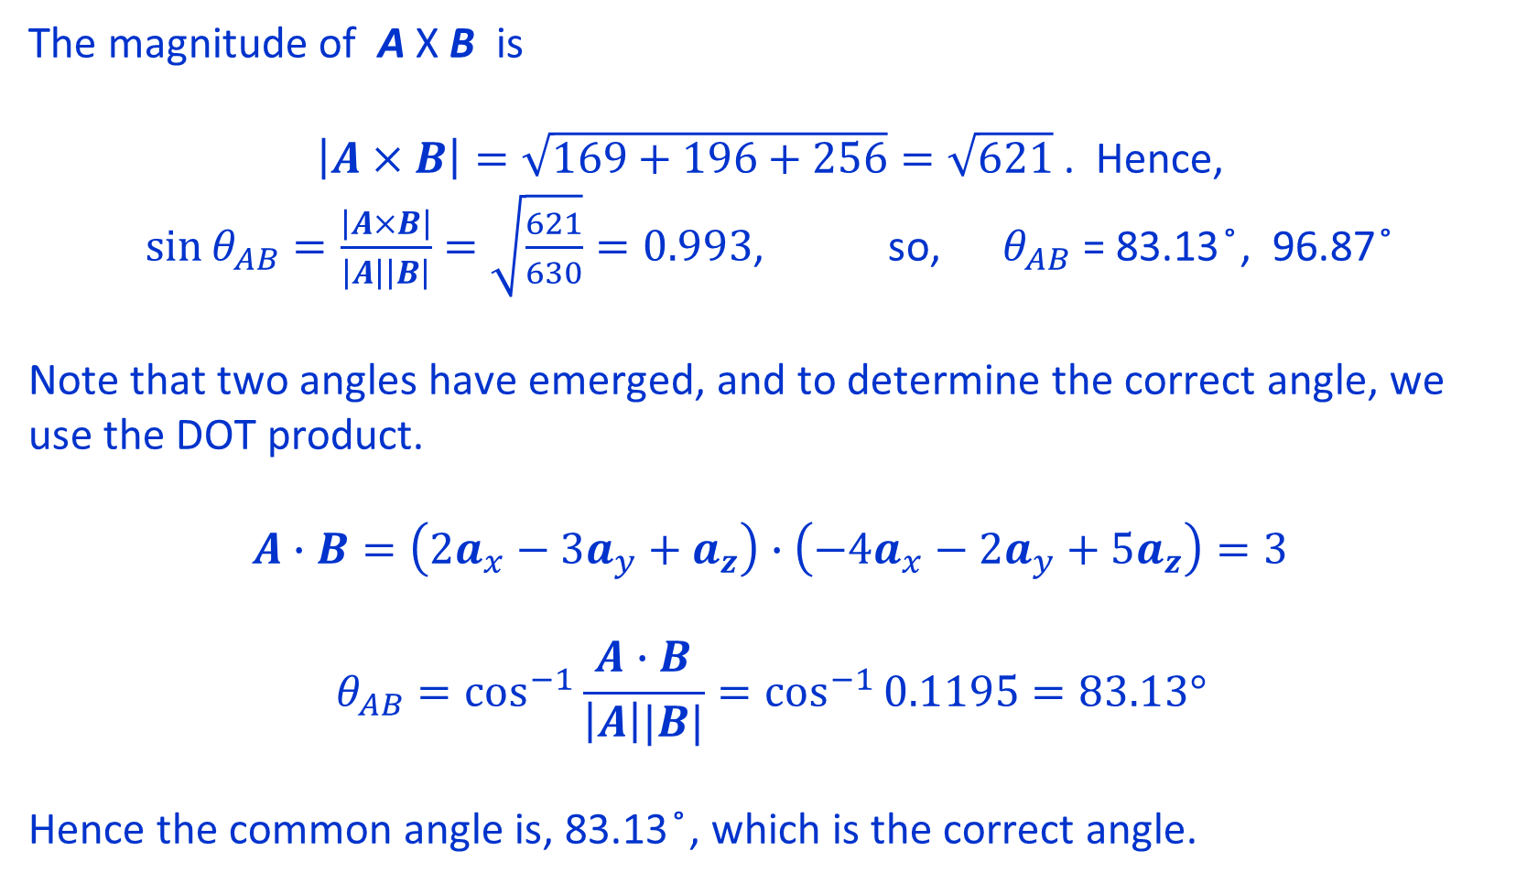
The magnitude of A X B is
$\left|A×B\right|=\sqrt{169+196+256}=\sqrt{621}$ . Hence, $\sin{θ_{AB}=\frac{\left|A×B\right|}{\left|A\right|\left|B\right|}=\sqrt{\frac{621}{630}}=0.993}$, so, $θ_{AB}$ = 83.13 ̊, 96.87 ̊
Note that two angles have emerged, and to determine the correct angle, we use the DOT product.
$$A∙B=\left(2a_{x}−3a_{y}+a_{z}\right)∙\left(−4a_{x}−2a_{y}+5a_{z}\right)=3$$
$$θ_{AB}=\cos^{−1}{\frac{A∙B}{\left|A\right||B|}}=\cos^{−1}{0.1195}=83.13°$$
Hence the common angle is, 83.13 ̊, which is the correct angle.
Lecture notes of Dr. Raghavendra G. Kulkarni, Distinguished Professor, PES University, Bengaluru, INDIA.

Slide 12
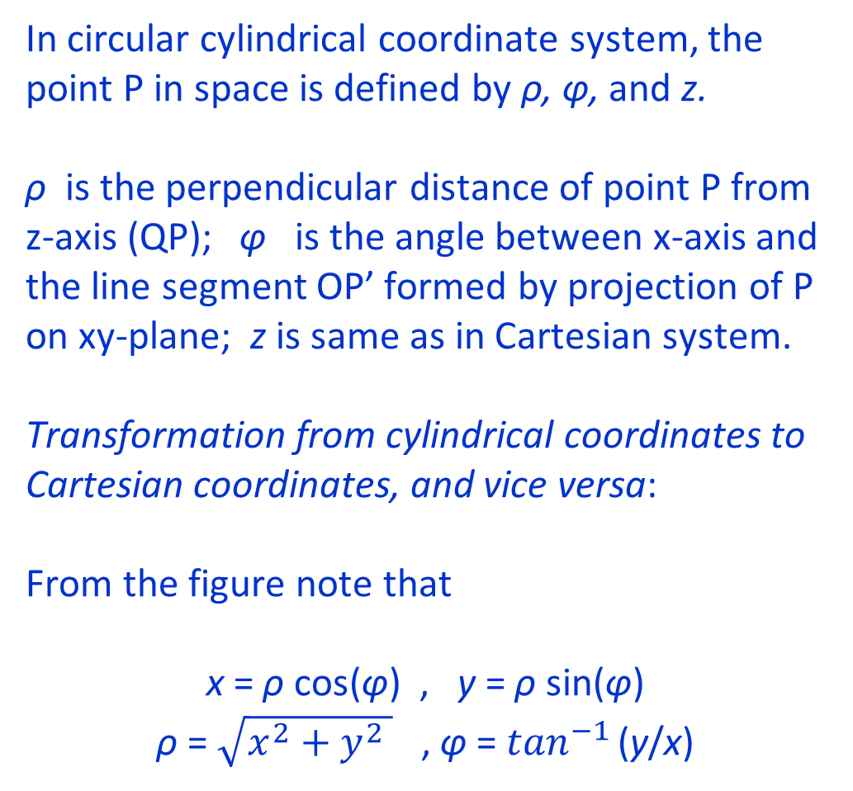
Circular cylindrical coordinate system
In circular cylindrical coordinate system, the point P in space is defined by ρ, φ, and z.
ρ is the perpendicular distance of point P from z-axis (QP); φ is the angle between x-axis and the line segment OP’ formed by projection of P on xy-plane; z is same as in Cartesian system.
Transformation from cylindrical coordinates to Cartesian coordinates, and vice versa:
From the figure note that
x = ρ cos(φ) , y = ρ sin(φ)
ρ = $\sqrt{x^{2}+y^{2} }$ , φ = $\tan^{−1 }$(y/x)
z
a_{z}
a_{φ}
Q
ρ
z
P (ρ, φ, z)
a_{ρ}
y
O
y
φ
ρ
x
x
P’
Lecture notes of Dr. Raghavendra G. Kulkarni, Distinguished Professor, PES University, Bengaluru, INDIA.

Slide 13
Circular cylindrical coordinate system
a_{z}
The Unit vectors in cylindrical coordinate system are: a_{ρ}, a_{φ}, a_{z} and they are mutually perpendicular, and their cross products are as below.
a_{ρ} x a_{φ} = a_{z} , a_{φ} x a_{z} = a_{ρ} , a_{z} x a_{ρ} = a_{φ}
Note that a_{ρ} is in the direction of outward normal to the constant- ρ cylindrical surface (normal to z-axis, see figure);
a_{φ} is normal to the constant-φ plane (OQPP’ in the figure), towards increasing φ angle.
z
a_{φ}
Q
ρ
z
P (ρ, φ, z)
a_{ρ}
O
y
φ
ρ
P’
x
Lecture notes of Dr. Raghavendra G. Kulkarni, Distinguished Professor, PES University, Bengaluru, INDIA.

Slide 14
Circular cylindrical coordinate system
a_{φ}
DOT products between unit vectors of cylindrical and Cartesian systems
a_{ρ} · a_{x} = | a_{ρ} || a_{x} |cos(φ) = cos(φ)
a_{ρ} · a_{y} = | a_{ρ} || a_{y} |cos(90 – φ) = sin(φ)
a_{ρ} · a_{z} = | a_{ρ} || a_{z} |cos(90) = 0
a_{φ} · a_{x} = | a_{φ}|| a_{x} |cos(90 + φ) = – sin(φ)
a_{φ} · a_{y} = | a_{φ}|| a_{y} |cos(φ) = cos(φ)
a_{φ} · a_{z} = | a_{φ}|| a_{z} |cos(90) = 0
a_{y}
a_{z}
●
90 - φ
φ
a_{ρ}
a_{x}
Note that + z-axis is coming out from the screen
Lecture notes of Dr. Raghavendra G. Kulkarni, Distinguished Professor, PES University, Bengaluru, INDIA.

Slide 15
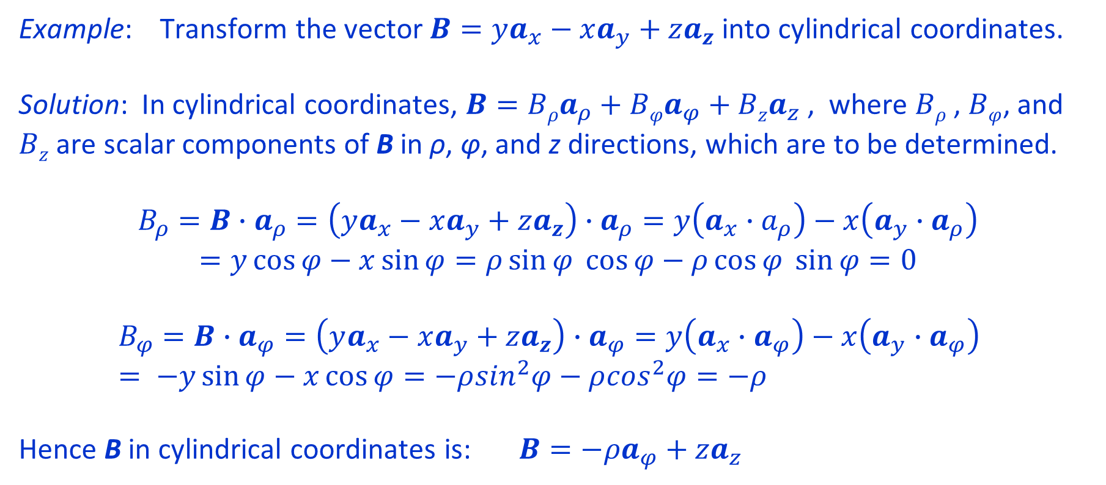
Circular cylindrical coordinate system
Example: Transform the vector $B=ya_{x}−xa_{y}+za_{z}$ into cylindrical coordinates.
Solution: In cylindrical coordinates, $B=Bρa_{ρ}+Bφa_{φ}+Bza_{z}$ , where $Bρ$ , $Bφ$, and $Bz$ are scalar components of B in ρ, φ, and z directions, which are to be determined.
$$B_{ρ}=B∙a_{ρ}=\left(ya_{x}−xa_{y}+za_{z}\right)∙a_{ρ}=y\left(a_{x}∙a_{ρ}\right)−x\left(a_{y}∙a_{ρ}\right)$$
$$=y\cos{φ−x\sin{φ}{=ρ\sin{φ \cos{φ−ρ\cos{φ \sin{φ=0}}}}}}$$
$$B_{φ}=B∙a_{φ}=\left(ya_{x}−xa_{y}+za_{z}\right)∙a_{φ}=y\left(a_{x}∙a_{φ}\right)−x\left(a_{y}∙a_{φ}\right) = −y\sin{φ−x\cos{φ=−ρ\sin^{2}φ−ρ\cos^{2}φ=−ρ}}$$
Hence B in cylindrical coordinates is: $B=−ρa_{φ}+za_{z}$
Lecture notes of Dr. Raghavendra G. Kulkarni, Distinguished Professor, PES University, Bengaluru, INDIA.

Slide 16
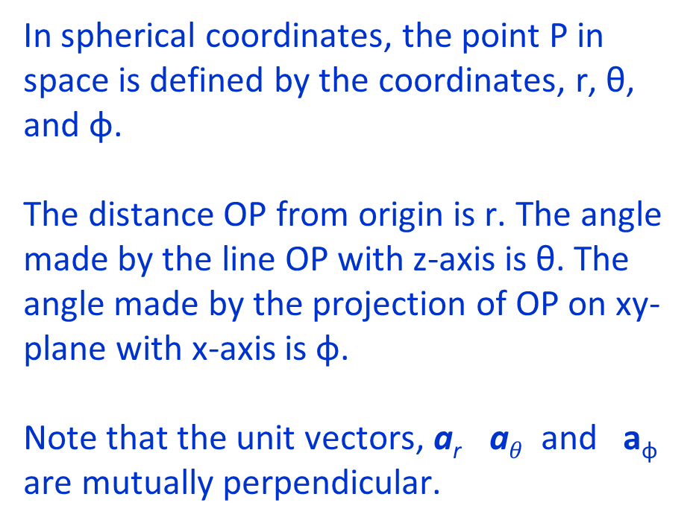
Spherical coordinate system
z
z’
a_{r}
In spherical coordinates, the point P in space is defined by the coordinates, r, θ, and φ.
The distance OP from origin is r. The angle made by the line OP with z-axis is θ. The angle made by the projection of OP on xy-plane with x-axis is φ.
Note that the unit vectors, a_{r} a$θ$ and a_{φ} are mutually perpendicular.
a_{φ}
P (r, θ, φ)
r
θ
θ
a_{θ}
O
φ
y
x
Lecture notes of Dr. Raghavendra G. Kulkarni, Distinguished Professor, PES University, Bengaluru, INDIA.

Slide 17
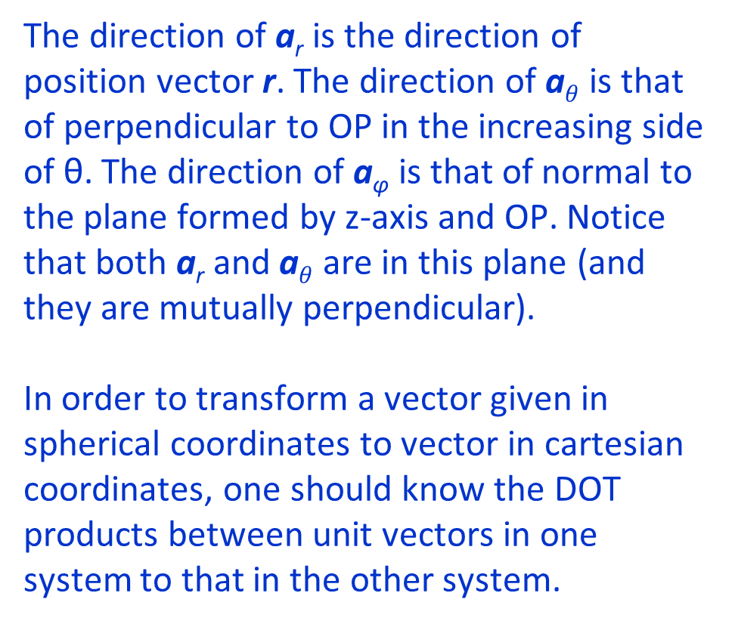
Spherical coordinate system
The direction of a_{r} is the direction of position vector r. The direction of a$θ$ is that of perpendicular to OP in the increasing side of θ. The direction of a_{φ} is that of normal to the plane formed by z-axis and OP. Notice that both a_{r} and a$θ$ are in this plane (and they are mutually perpendicular).
In order to transform a vector given in spherical coordinates to vector in cartesian coordinates, one should know the DOT products between unit vectors in one system to that in the other system.
z
z’
a_{r}
a_{φ}
P (r, θ, φ)
r
P’
θ
θ
a_{θ}
O
φ
y
O’
x
Lecture notes of Dr. Raghavendra G. Kulkarni, Distinguished Professor, PES University, Bengaluru, INDIA.

Slide 18
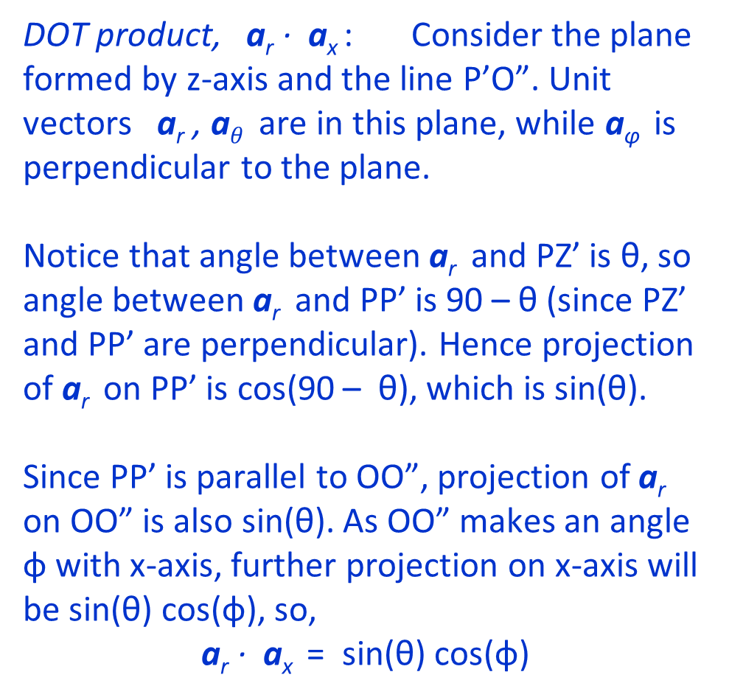
Spherical coordinate system
DOT product, a_{r} · a_{x} : Consider the plane formed by z-axis and the line P’O”. Unit vectors a_{r} , a$θ$ are in this plane, while a_{φ} is perpendicular to the plane.
Notice that angle between a_{r} and PZ’ is θ, so angle between a_{r} and PP’ is 90 – θ (since PZ’ and PP’ are perpendicular). Hence projection of a_{r} on PP’ is cos(90 – θ), which is sin(θ).
Since PP’ is parallel to OO”, projection of a_{r} on OO” is also sin(θ). As OO” makes an angle φ with x-axis, further projection on x-axis will be sin(θ) cos(φ), so,
a_{r} · a_{x} = sin(θ) cos(φ)
z
Z’
a_{r}
θ
a_{φ}
P
P’
θ
θ
a_{θ}
O
φ
y
O’
x
O”
Lecture notes of Dr. Raghavendra G. Kulkarni, Distinguished Professor, PES University, Bengaluru, INDIA.

Slide 19
Spherical coordinate system
DOT products, a_{r} · a_{y} ; a_{r} · a_{z}
We know from the previous slide that projection of a_{r} on OO” is sin(θ). As OO” makes an angle 90 – φ with y-axis, further projection on y-axis will be sin(θ) cos(90 – φ). Thus,
a_{r} · a_{y} = sin(θ) sin(φ)
Since angle between a_{r} and a_{z} is θ, we get,
a_{r} · a_{z} = cos(θ)
z
Z’
a_{r}
a_{φ}
P
P’
θ
θ
a_{θ}
O
φ
y
O’
x
O”
Lecture notes of Dr. Raghavendra G. Kulkarni, Distinguished Professor, PES University, Bengaluru, INDIA.

Slide 20

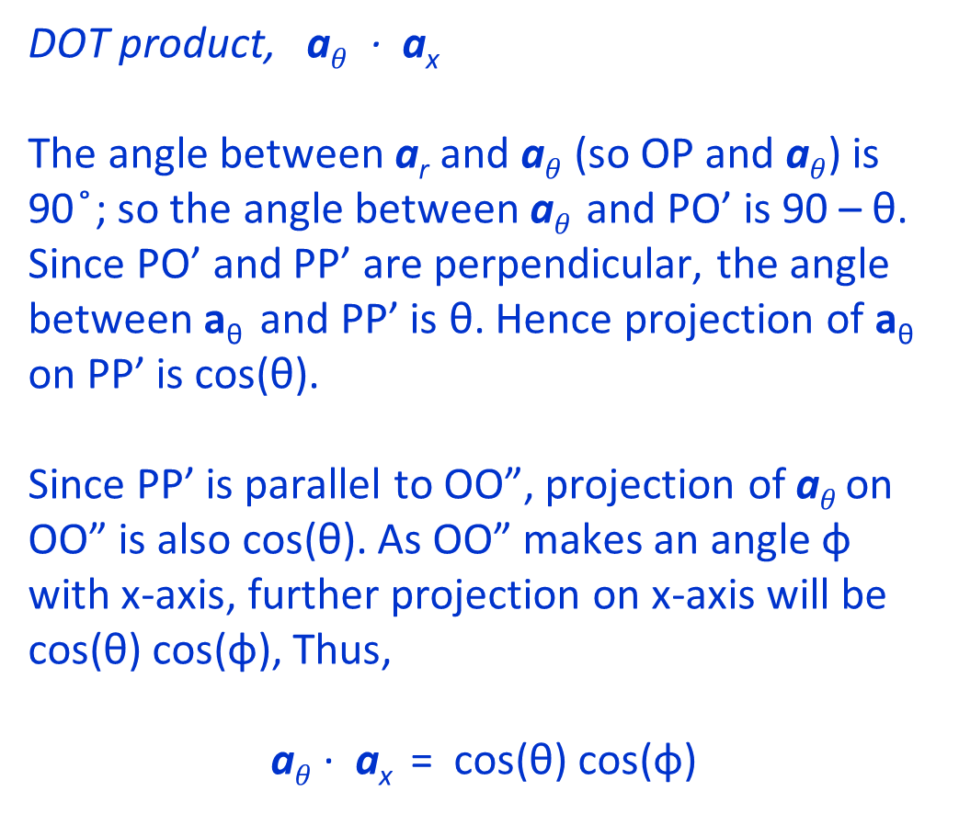



Spherical coordinate system
DOT product, a$θ$ · a_{x}
The angle between a_{r} and a$θ$ (so OP and a$θ$) is 90 ̊; so the angle between a$θ$ and PO’ is 90 – θ. Since PO’ and PP’ are perpendicular, the angle between a_{θ} and PP’ is θ. Hence projection of a_{θ} on PP’ is cos(θ).
Since PP’ is parallel to OO”, projection of a$θ$ on OO” is also cos(θ). As OO” makes an angle φ with x-axis, further projection on x-axis will be cos(θ) cos(φ), Thus,
a$θ$ · a_{x} = cos(θ) cos(φ)
z
Z’
a_{r}
$$θ$$
a_{φ}
P
$$θ$$
P’
$$θ$$
$$θ$$
a_{θ}
O
φ
y
O’
x
O”
Lecture notes of Dr. Raghavendra G. Kulkarni, Distinguished Professor, PES University, Bengaluru, INDIA.

Slide 21
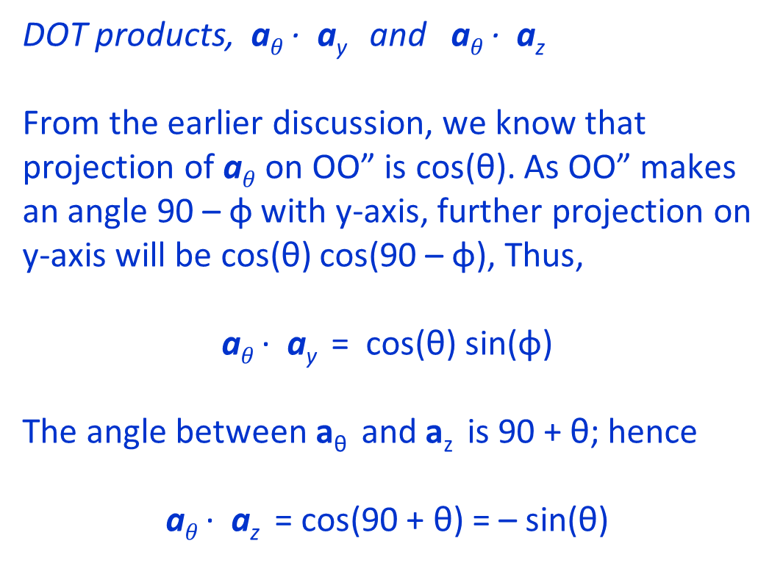
Spherical coordinate system
DOT products, a$θ$· a_{y} and a$θ$· a_{z}
From the earlier discussion, we know that projection of a$θ$ on OO” is cos(θ). As OO” makes an angle 90 – φ with y-axis, further projection on y-axis will be cos(θ) cos(90 – φ), Thus,
a$θ$· a_{y} = cos(θ) sin(φ)
The angle between a_{θ} and a_{z} is 90 + θ; hence
a$θ$· a_{z} = cos(90 + θ) = – sin(θ)
z
Z’
a_{r}
θ
a_{φ}
P
θ
P’
θ
θ
a_{θ}
O
φ
y
O’
x
O”
Lecture notes of Dr. Raghavendra G. Kulkarni, Distinguished Professor, PES University, Bengaluru, INDIA.

Slide 22
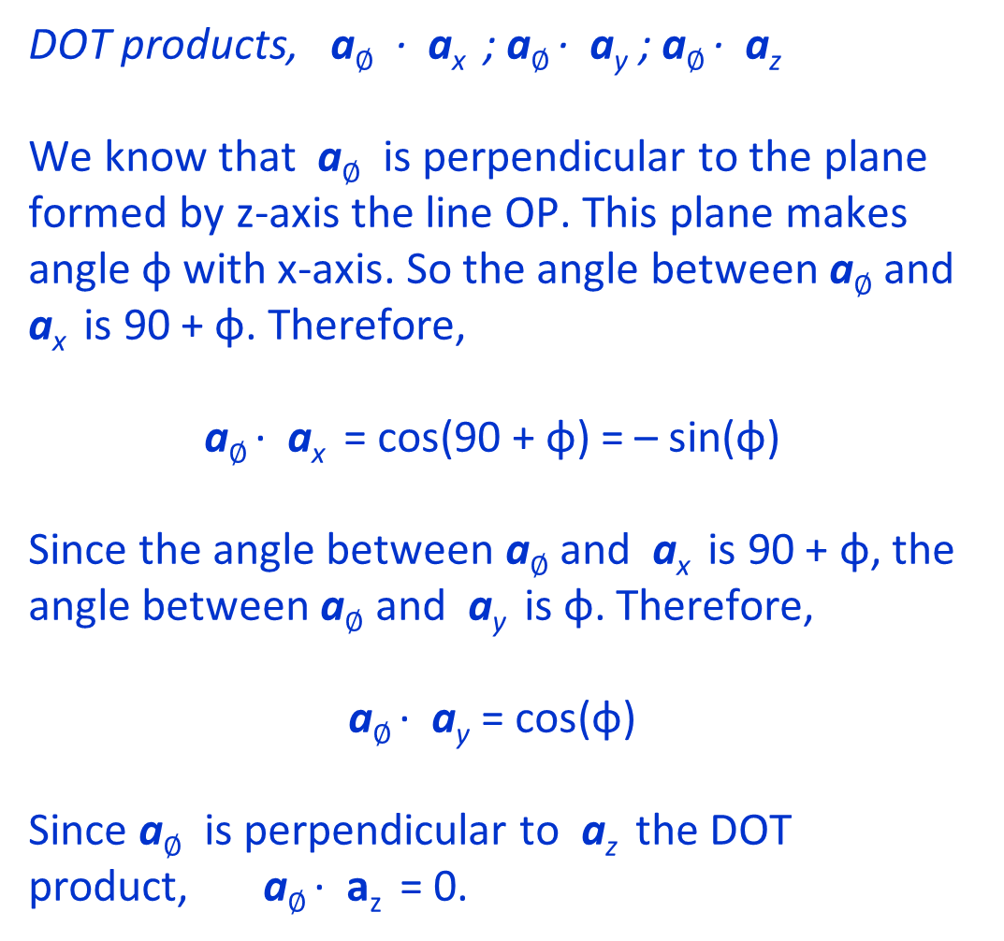
Spherical coordinate system
DOT products, a$∅$ · a_{x} ; a$∅$· a_{y} ; a$∅$· a_{z}
We know that a$∅$ is perpendicular to the plane formed by z-axis the line OP. This plane makes angle φ with x-axis. So the angle between a$∅$ and a_{x} is 90 + φ. Therefore,
a$∅$· a_{x} = cos(90 + φ) = – sin(φ)
Since the angle between a$∅$ and a_{x} is 90 + φ, the angle between a$∅$ and a_{y} is φ. Therefore,
a$∅$· a_{y} = cos(φ)
Since a$∅$ is perpendicular to a_{z} the DOT product, a$∅$· a_{z} = 0.
z
Z’
a_{r}
θ
a_{φ}
P
θ
P’
θ
θ
a_{θ}
O
φ
y
O’
x
O”
Lecture notes of Dr. Raghavendra G. Kulkarni, Distinguished Professor, PES University, Bengaluru, INDIA.

Slide 23
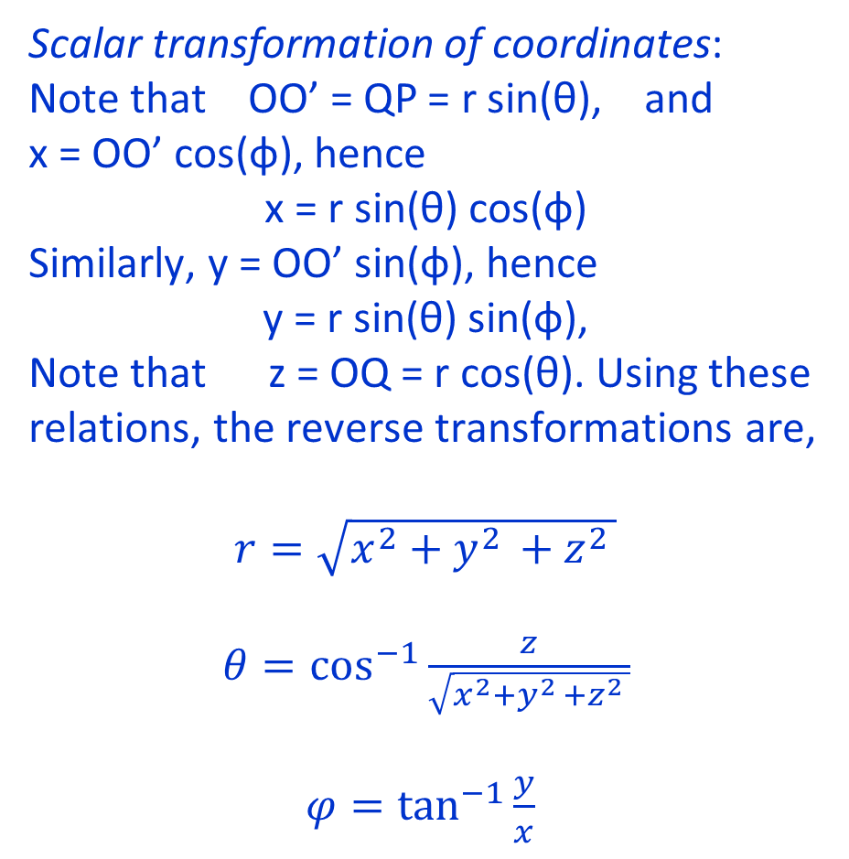
Spherical coordinate system
Scalar transformation of coordinates:
Note that OO’ = QP = r sin(θ), and
x = OO’ cos(φ), hence
x = r sin(θ) cos(φ)
Similarly, y = OO’ sin(φ), hence
y = r sin(θ) sin(φ),
Note that z = OQ = r cos(θ). Using these relations, the reverse transformations are,
$r=\sqrt{x^{2}+y^{2 }+z^{2 }}$
$θ=\cos^{−1}{\frac{z}{\sqrt{x^{2}+y^{2 }+z^{2 }}}}$
$φ=\tan^{−1}{\frac{y}{x} }$
z
z’
a_{r}
a_{φ}
Q
P
r
θ
θ
a_{θ}
O
φ
y
O’
x
Lecture notes of Dr. Raghavendra G. Kulkarni, Distinguished Professor, PES University, Bengaluru, INDIA.

Slide 24
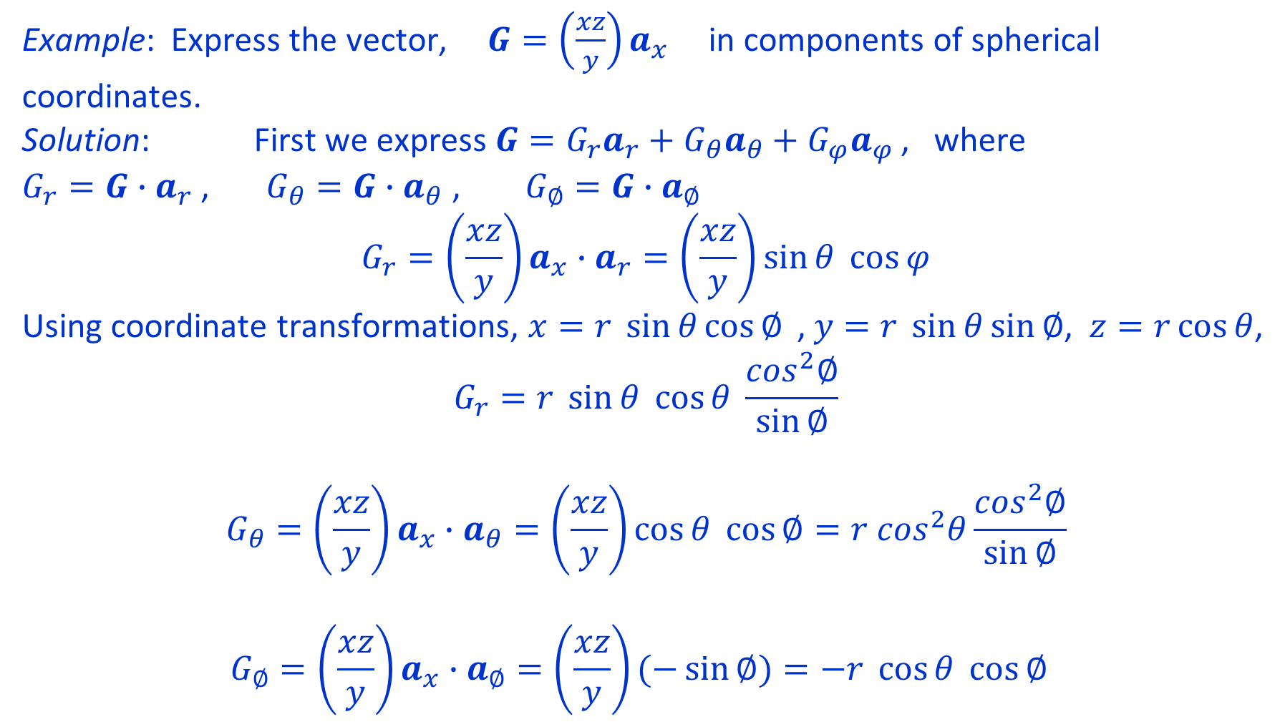
Example: Express the vector, $G=\left(\frac{xz}{y}\right)a_{x}$ in components of spherical coordinates.
Solution: First we express $G=G_{r}a_{r}+G_{θ}a_{θ}+G_{φ}a_{φ}$ , where
$G_{r}=G∙a_{r}$ , $G_{θ}=G∙a_{θ}$ , $G_{∅}=G∙a_{∅}$
$$G_{r}=\left(\frac{xz}{y}\right)a_{x}∙a_{r}=\left(\frac{xz}{y}\right)\sin{θ \cos{φ}}$$
Using coordinate transformations, $x=r \sin{θ}\cos{∅}{ }$, $y=r \sin{θ\sin{∅}}$, $z=r\cos{θ}$,
$$G_{r}=r \sin{θ \cos{θ }}\frac{\cos^{2}∅}{\sin{∅}}$$
$$G_{θ}=\left(\frac{xz}{y}\right)a_{x}∙a_{θ}=\left(\frac{xz}{y}\right)\cos{θ \cos{∅}}=r \cos^{2}θ\frac{\cos^{2}∅}{\sin{∅}}$$
$$G_{∅}=\left(\frac{xz}{y}\right)a_{x}∙a_{∅}=\left(\frac{xz}{y}\right)(−\sin{∅)}=−r \cos{θ }\cos{∅}{ }$$
Lecture notes of Dr. Raghavendra G. Kulkarni, Distinguished Professor, PES University, Bengaluru, INDIA.

Slide 25
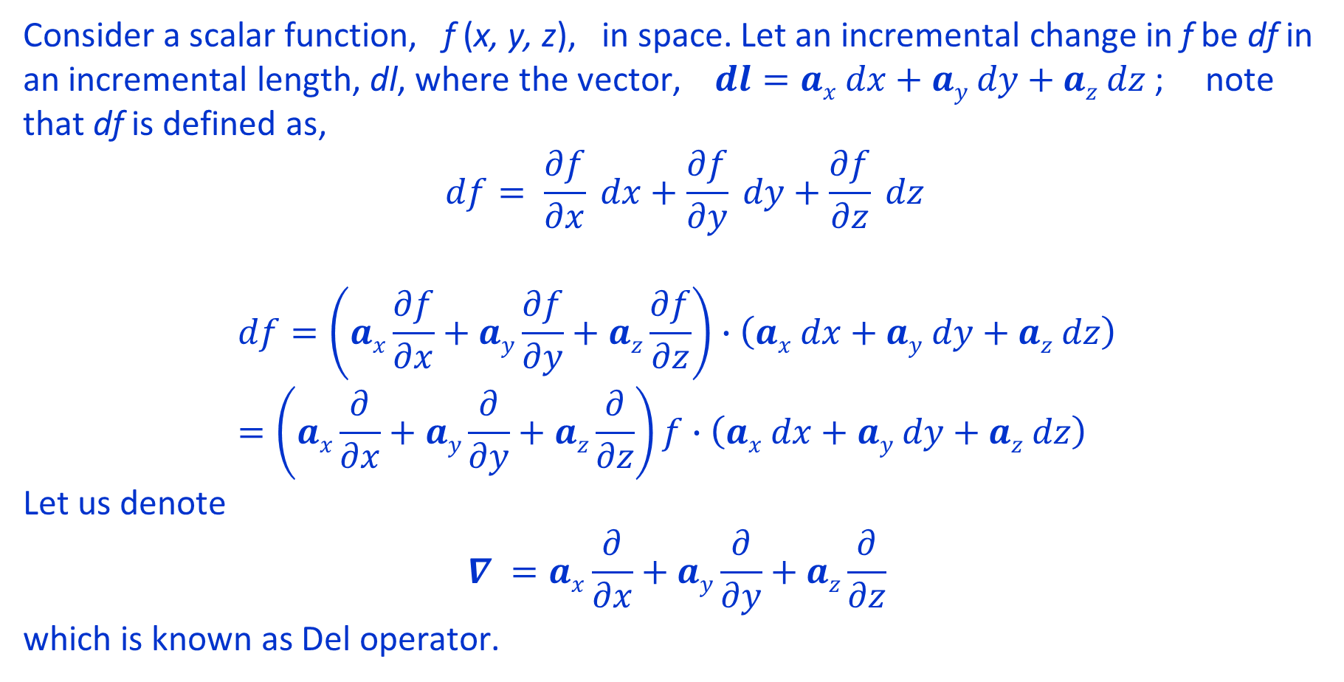
Introducing the concept of the ‘Del’ operation
Consider a scalar function, f (x, y, z), in space. Let an incremental change in f be df in an incremental length, dl, where the vector, $dl=ax dx+ay dy+az dz$; note that df is defined as,
$$df= \frac{∂f}{∂x} dx+\frac{∂f}{∂y} dy+\frac{∂f}{∂z} dz$$
$$df=\left(ax\frac{∂f}{∂x}+ay\frac{∂f}{∂y}+az\frac{∂f}{∂z}\right)∙\left(ax dx+ay dy+az dz\right)=\left(ax\frac{∂}{∂x}+ay\frac{∂}{∂y}+az\frac{∂}{∂z}\right)f∙\left(ax dx+ay dy+az dz\right)$$
Let us denote
$$∇ =ax\frac{∂}{∂x}+ay\frac{∂}{∂y}+az\frac{∂}{∂z}$$
which is known as Del operator.
Lecture notes of Dr. Raghavendra G. Kulkarni, Distinguished Professor, PES University, Bengaluru, INDIA.

Slide 26
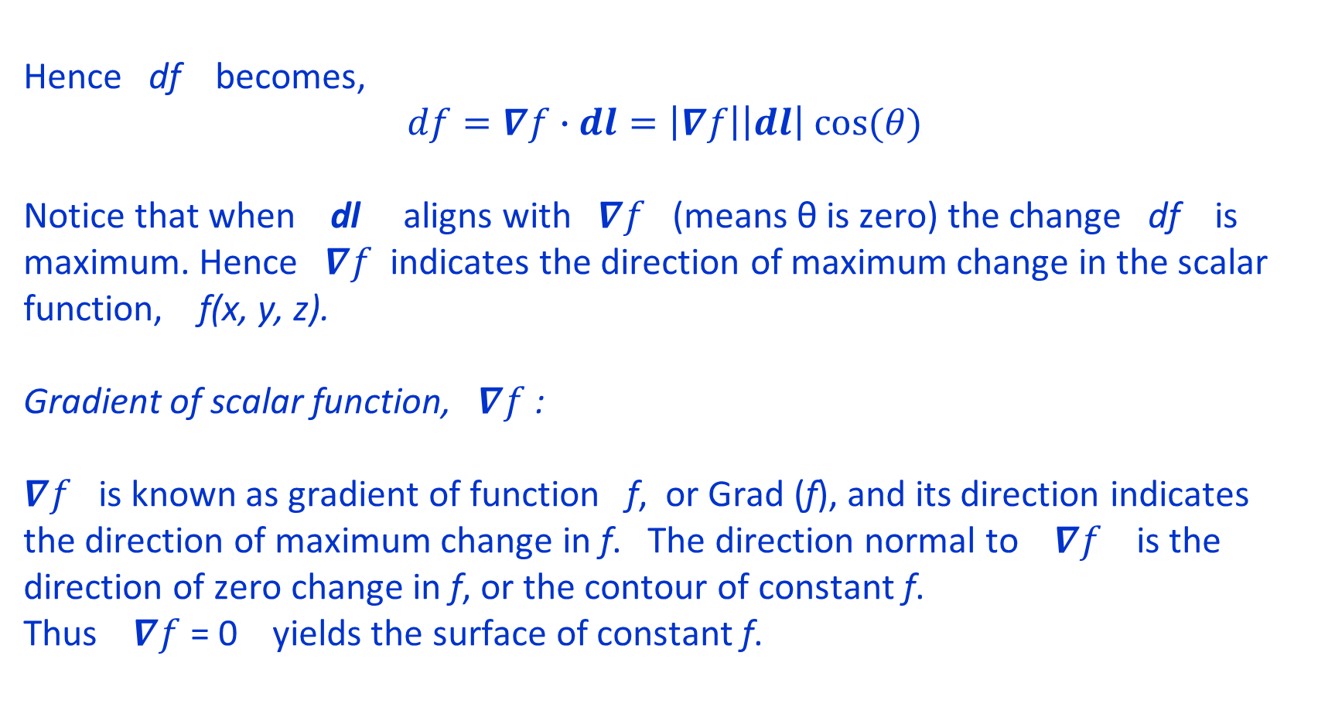
Hence df becomes,
$$df=∇f∙dl=\left|∇f\right|\left|dl\right| cos(θ)$$
Notice that when dl aligns with $∇f$ (means θ is zero) the change df is maximum. Hence $∇f$ indicates the direction of maximum change in the scalar function, f(x, y, z).
Gradient of scalar function, $∇f$ :
$∇f$ is known as gradient of function f, or Grad (f), and its direction indicates the direction of maximum change in f. The direction normal to $∇f$ is the direction of zero change in f, or the contour of constant f.
Thus $∇f$ = 0 yields the surface of constant f.
Lecture notes of Dr. Raghavendra G. Kulkarni, Distinguished Professor, PES University, Bengaluru, INDIA.

Slide 27
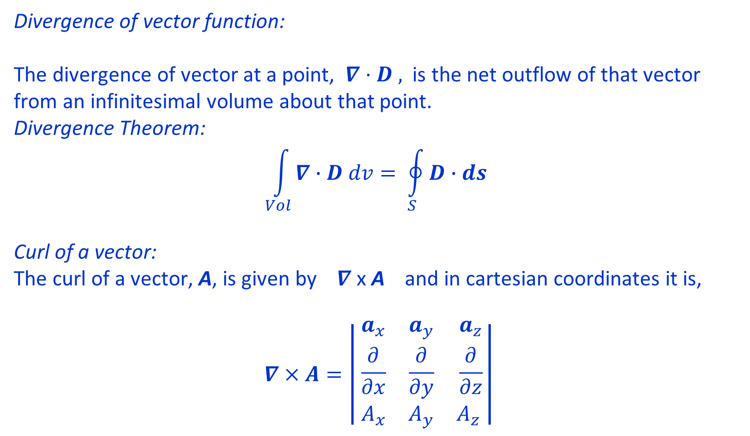
Divergence of vector function:
The divergence of vector at a point, $∇·D ,$ is the net outflow of that vector from an infinitesimal volume about that point.
Divergence Theorem:
$$\int_{Vol}^{ }{∇∙D dv= \oint_{S}^{ }{D∙ds} }$$
Curl of a vector:
The curl of a vector, A, is given by $∇$ x A and in cartesian coordinates it is,
$$∇×A=\left| \begin{matrix}a_{x} & a_{y} & a_{z} \\ \frac{∂}{∂x} & \frac{∂}{∂y} & \frac{∂}{∂z} \\ A_{x} & A_{y} & A_{z} \end{matrix}\right|$$
Lecture notes of Dr. Raghavendra G. Kulkarni, Distinguished Professor, PES University, Bengaluru, INDIA.

Slide 28
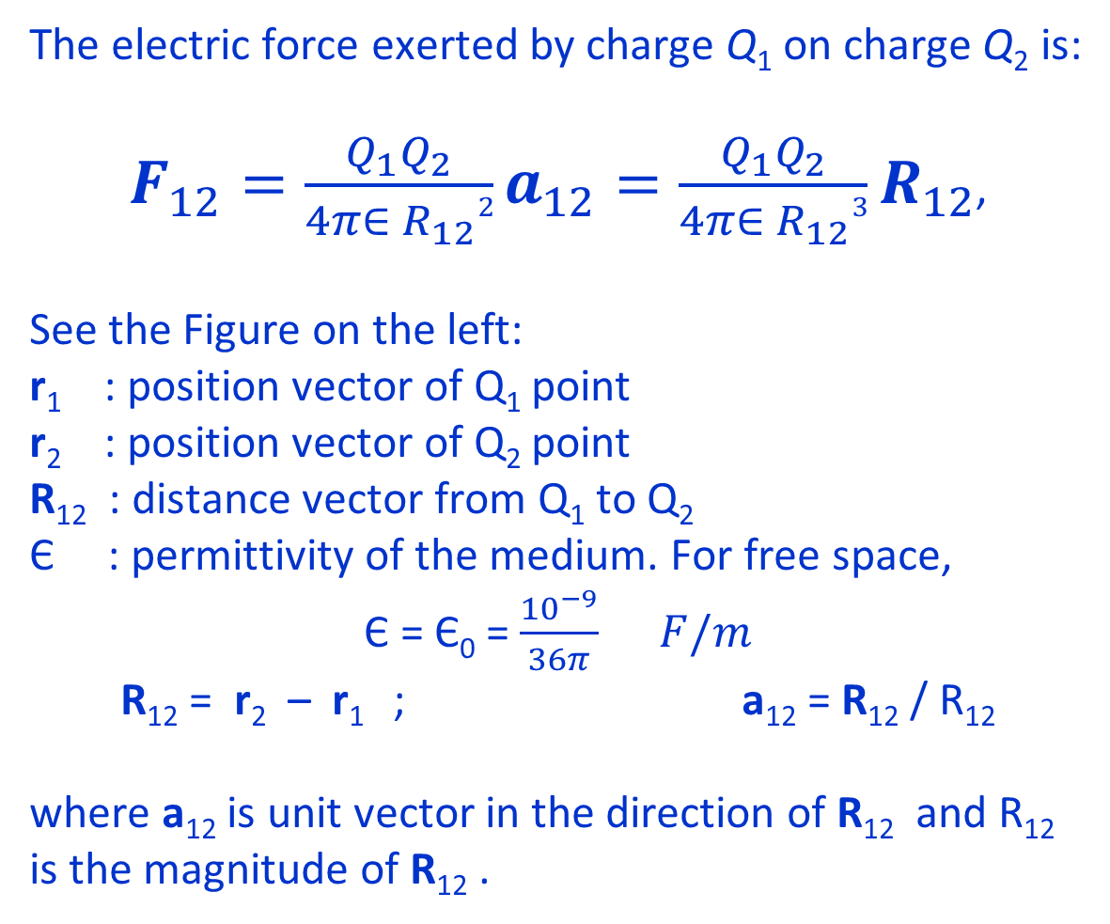
Electrostatics
The electric force exerted by charge Q₁ on charge Q₂ is:
$F_{12}=\frac{Q_{1}Q_{2}}{4π∈ R_{12}2}a_{12}=\frac{Q_{1}Q_{2}}{4π∈ R_{12}3}R_{12}$,
See the Figure on the left:
r₁ : position vector of Q₁ point
r₂ : position vector of Q₂ point
R₁₂ : distance vector from Q₁ to Q₂
Є : permittivity of the medium. For free space,
Є = Є₀ = $\frac{{10}^{−9}}{36π} F/m$
R₁₂ = r₂ – r₁ ; a₁₂ = R₁₂ / R₁₂
where a₁₂ is unit vector in the direction of R₁₂ and R₁₂ is the magnitude of R₁₂ .
z
F₁₂
Q₂
Q₁
R₁₂
r₂
r₁
y
O
x
Lecture notes of Dr. Raghavendra G. Kulkarni, Distinguished Professor, PES University, Bengaluru, INDIA.

Slide 29
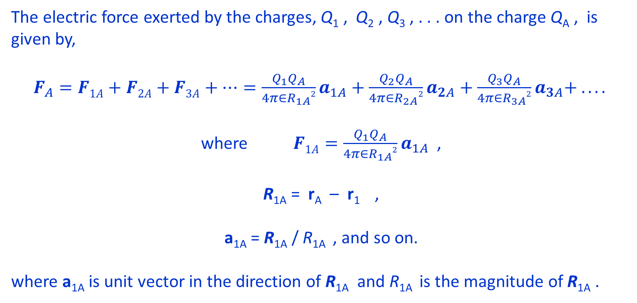
Electrostatics
The electric force exerted by the charges, Q₁ , Q₂ , Q₃ , . . . on the charge Q_{A} , is given by,
$F_{A}=F1A+F2A+F3A+…=\frac{Q_{1}Q_{A}}{4π∈R_{1A}2}a_{1A}+\frac{Q_{2}Q_{A}}{4π∈R_{2A}2}a_{2A}+\frac{Q_{3}Q_{A}}{4π∈R_{3A}2}a_{3A}+ . . . .$
where $F1A=\frac{Q_{1}Q_{A}}{4π∈R_{1A}2}a_{1A}$ ,
R_{1A} = r_{A} – r₁ ,
a_{1A} = R_{1A} / R_{1A} , and so on.
where a_{1A} is unit vector in the direction of R_{1A} and R_{1A} is the magnitude of R_{1A} .
Lecture notes of Dr. Raghavendra G. Kulkarni, Distinguished Professor, PES University, Bengaluru, INDIA.

Slide 30
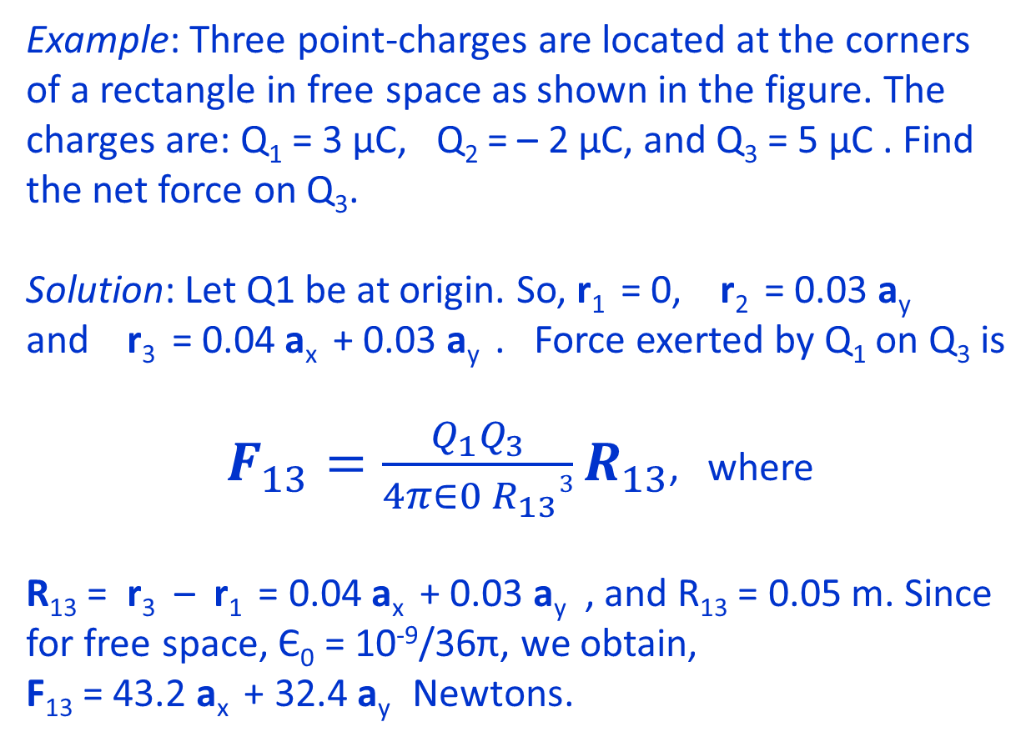
Electrostatics
Example: Three point-charges are located at the corners of a rectangle in free space as shown in the figure. The charges are: Q₁ = 3 µC, Q₂ = – 2 µC, and Q₃ = 5 µC . Find the net force on Q₃.
Solution: Let Q1 be at origin. So, r₁ = 0, r₂ = 0.03 a_{y}
and r₃ = 0.04 a_{x} + 0.03 a_{y} . Force exerted by Q₁ on Q₃ is
$F_{13}=\frac{Q_{1}Q_{3}}{4π∈0{ R}_{13}3}R_{13}$, where
R₁₃ = r₃ – r₁ = 0.04 a_{x} + 0.03 a_{y} , and R₁₃ = 0.05 m. Since for free space, Є₀ = 10⁻⁹/36π, we obtain,
F₁₃ = 43.2 a_{x} + 32.4 a_{y} Newtons.
Q₃
Q₂
3 cm
Q₁
y
4 cm
x
Lecture notes of Dr. Raghavendra G. Kulkarni, Distinguished Professor, PES University, Bengaluru, INDIA.

Slide 31
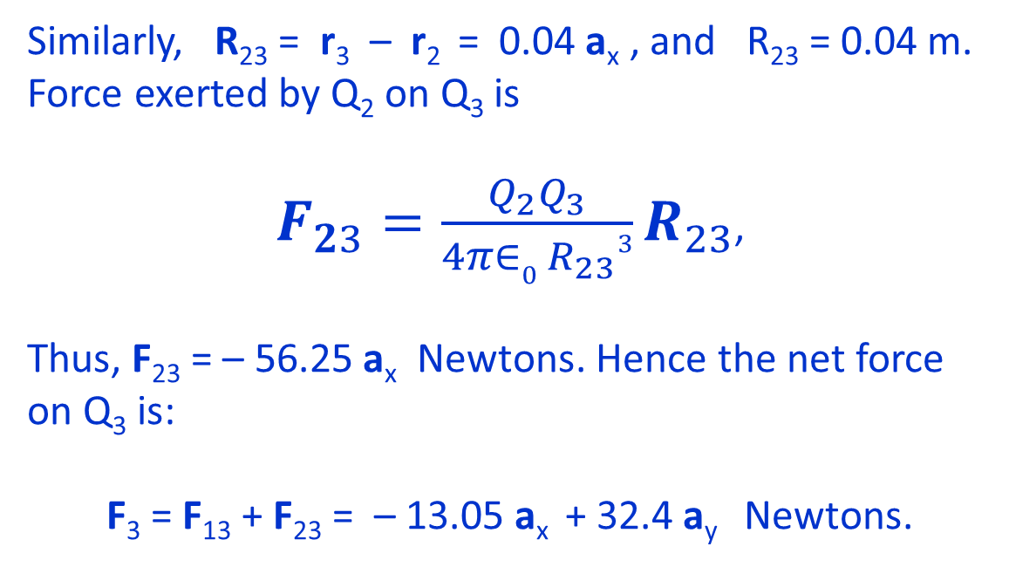
Electrostatics
Similarly, R₂₃ = r₃ – r₂ = 0.04 a_{x} , and R₂₃ = 0.04 m. Force exerted by Q₂ on Q₃ is
$F_{23}=\frac{Q_{2}Q_{3}}{4π∈0{ R}_{23}3}R_{23}$,
Thus, F₂₃ = – 56.25 a_{x} Newtons. Hence the net force on Q₃ is:
F₃ = F₁₃ + F₂₃ = – 13.05 a_{x} + 32.4 a_{y} Newtons.
F₁₃
Q₂
F₂₃
Q₃
3 cm
Q₁
4 cm
y
x
Lecture notes of Dr. Raghavendra G. Kulkarni, Distinguished Professor, PES University, Bengaluru, INDIA.

Slide 32
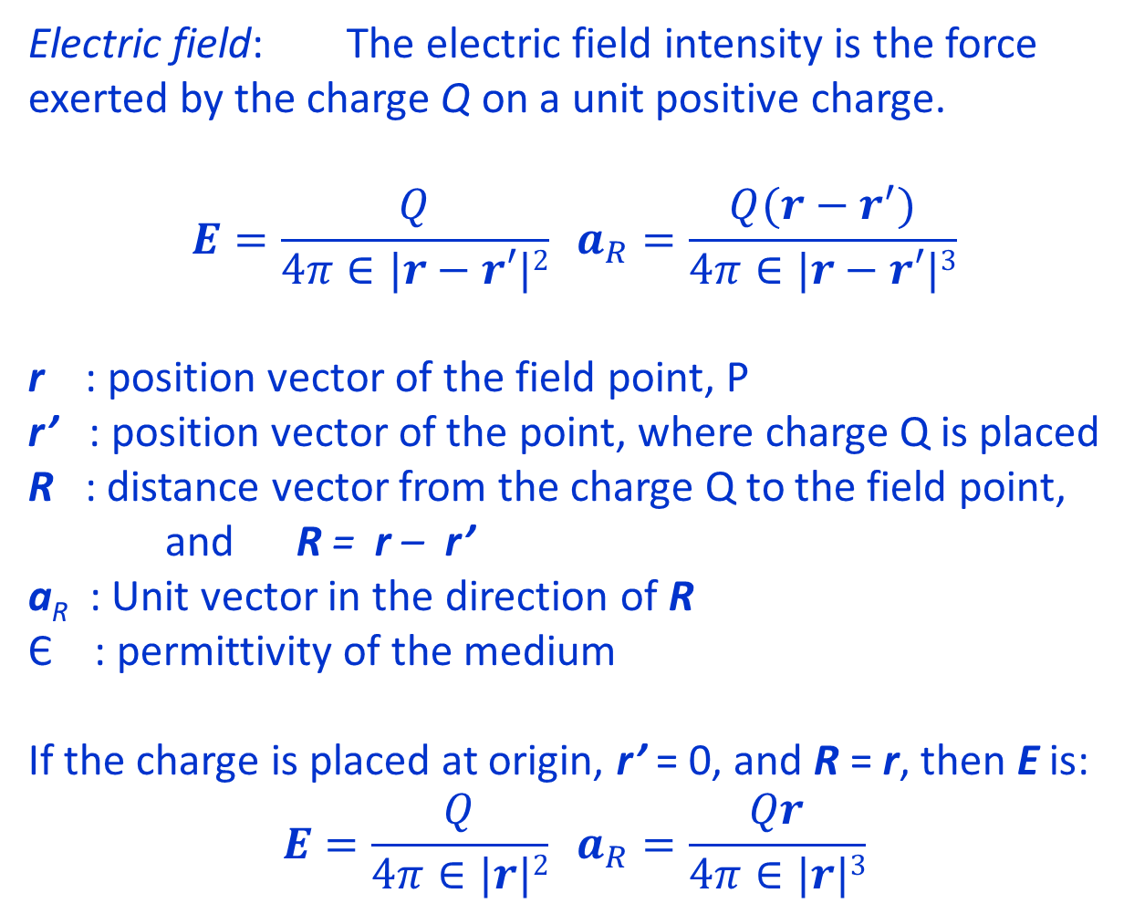
Electrostatics
Electric field: The electric field intensity is the force exerted by the charge Q on a unit positive charge.
$$E=\frac{Q}{4π∈|r−r′|2} a_{R}=\frac{Q(r−r^{′})}{4π∈|r−r′|3}$$
r : position vector of the field point, P
r’ : position vector of the point, where charge Q is placed
R : distance vector from the charge Q to the field point, and R = r – r’
a_{R} : Unit vector in the direction of R
Є : permittivity of the medium
If the charge is placed at origin, r’ = 0, and R = r, then E is:
$$E=\frac{Q}{4π∈|r|2} a_{R}=\frac{Qr}{4π∈|r|3}$$
z
E
P
Q
R
r
r’
y
O
x
Lecture notes of Dr. Raghavendra G. Kulkarni, Distinguished Professor, PES University, Bengaluru, INDIA.

Slide 33
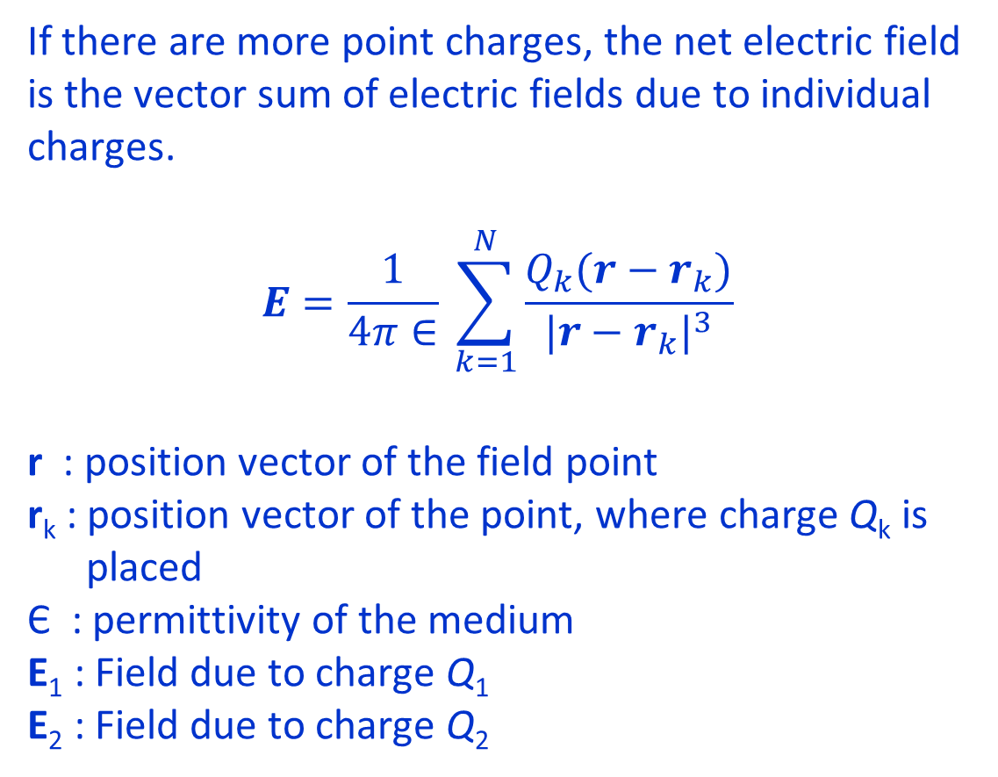
Electrostatics
If there are more point charges, the net electric field is the vector sum of electric fields due to individual charges.
$$E=\frac{1}{4π∈} \sum_{k=1}^{N}{\frac{Q_{k}(r−r_{k})}{{|r−r_{k}|}^{3}}}$$
r : position vector of the field point
r_{k} : position vector of the point, where charge Q_{k} is
placed
Є : permittivity of the medium
E₁ : Field due to charge Q₁
E₂ : Field due to charge Q₂
Q₂
z
E₁
P
Q₁
E₂
r₂
r
r₁
y
O
x
Lecture notes of Dr. Raghavendra G. Kulkarni, Distinguished Professor, PES University, Bengaluru, INDIA.

Slide 34
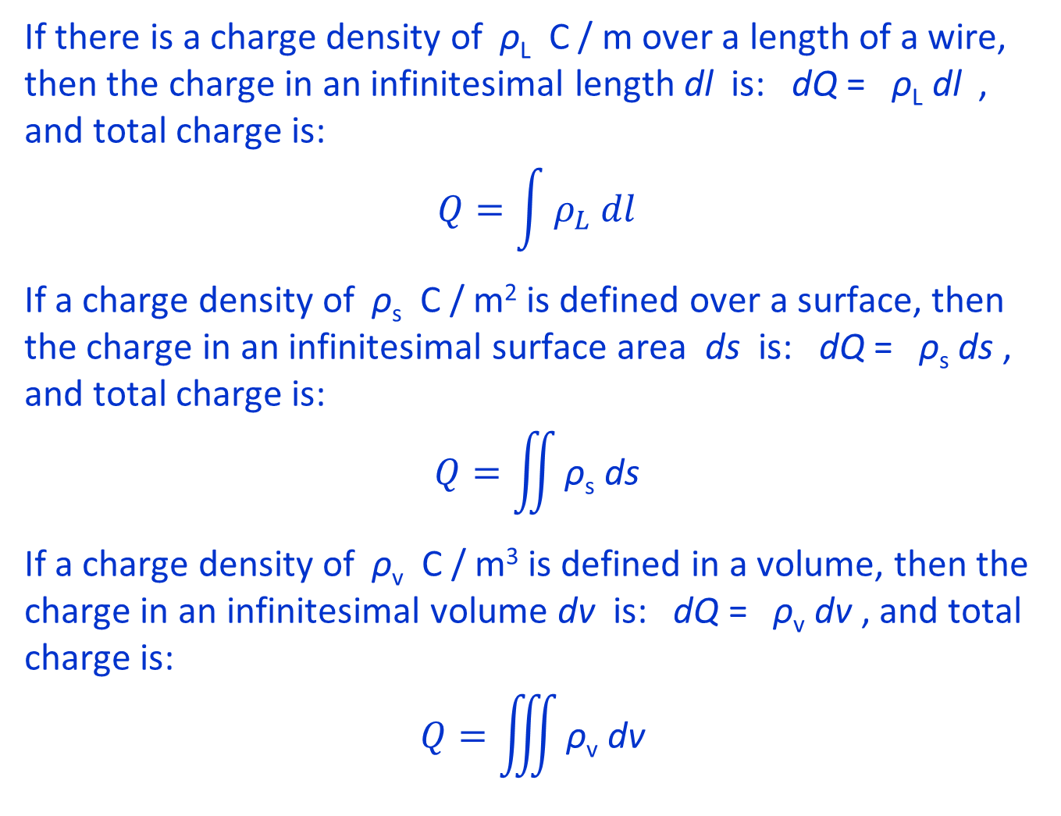
Electrostatics
If there is a charge density of ρ_{L} C / m over a length of a wire, then the charge in an infinitesimal length dl is: dQ = ρ_{L} dl , and total charge is:
$$Q=\int{ρ_{L} dl}$$
If a charge density of ρ_{s} C / m² is defined over a surface, then the charge in an infinitesimal surface area ds is: dQ = ρ_{s} ds , and total charge is:
$$Q=\iint{\text{ρ}\text{s} \text{ds}}$$
If a charge density of ρ_{v} C / m³ is defined in a volume, then the charge in an infinitesimal volume dv is: dQ = ρ_{v} dv , and total charge is:
$$Q=\iiint{\text{ρ}\text{v} \text{dv}}$$
+
+
+
+
+
+
+
+
+
+
+
+
+
+
+
+
+
+
+
+
+
+
+
+
+
+
+
+
Lecture notes of Dr. Raghavendra G. Kulkarni, Distinguished Professor, PES University, Bengaluru, INDIA.

Slide 35
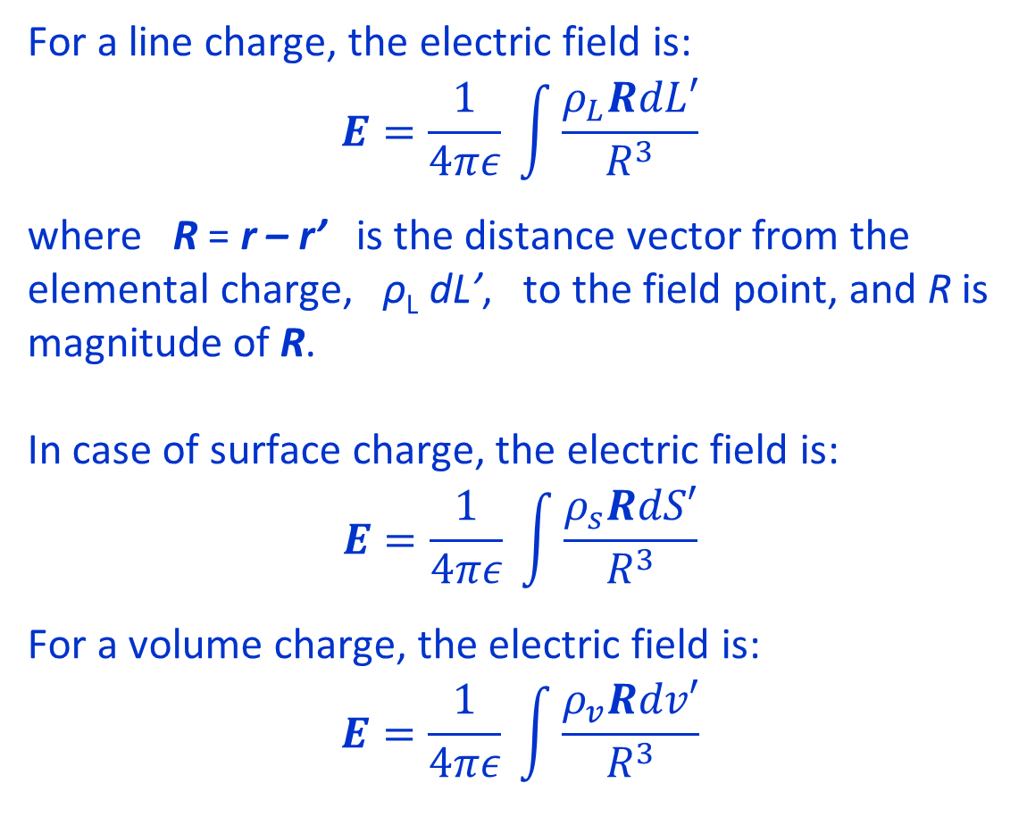
Electrostatics
+
For a line charge, the electric field is:
$$E=\frac{1}{4πε} \int{\frac{ρ_{L}RdL′}{R^{3}}}$$
where R = r – r’ is the distance vector from the elemental charge, ρ_{L} dL’, to the field point, and R is magnitude of R.
In case of surface charge, the electric field is:
$$E=\frac{1}{4πε} \int{\frac{ρ_{s}RdS′}{R^{3}}}$$
For a volume charge, the electric field is:
$$E=\frac{1}{4πε} \int{\frac{ρ_{v}Rdv′}{R^{3}}}$$
+
+
+
+
+
+
+
R = r - r’
P
dL’
r’
r
+
P
+
R
+
+
+
dS’
+
+
+
+
+
+
P
+
+
R
+
+
+
+
+
+
dv’
+
Lecture notes of Dr. Raghavendra G. Kulkarni, Distinguished Professor, PES University, Bengaluru, INDIA.

Slide 36
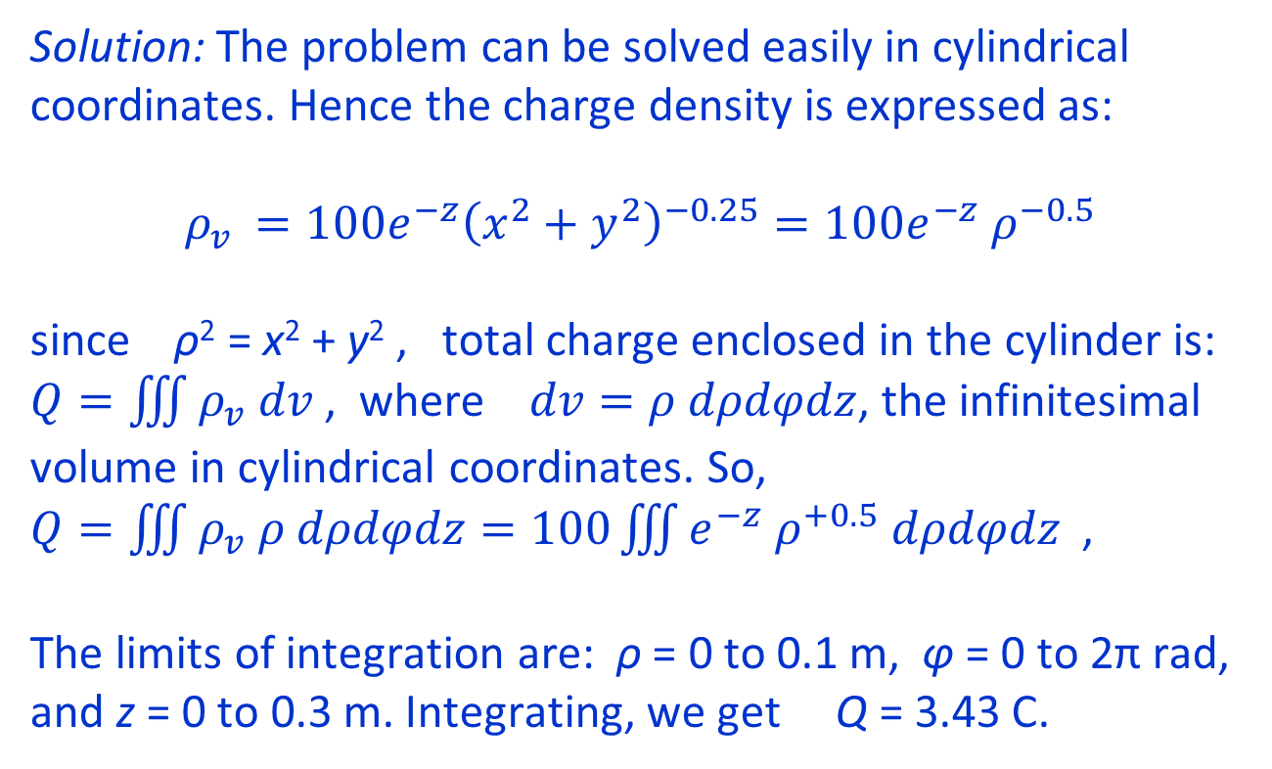
Electrostatics
Example: Find the total charge in the cylinder of height 30 cm and radius 10 cm, if the charge density inside the cylinder is given by: $ρ_{v }=100e^{−z}{\left(x^{2}+y^{2}\right)}^{−0.25}$ C/m³
Solution: The problem can be solved easily in cylindrical coordinates. Hence the charge density is expressed as:
$ρ_{v }=100e^{−z}{\left(x^{2}+y^{2}\right)}^{−0.25}=100e^{−z}{ ρ}^{−0.5}$
since ρ² = x² + y² , total charge enclosed in the cylinder is:
$Q=\iiint{ρ_{v} dv}$, where $dv=ρ dρdφdz$, the infinitesimal volume in cylindrical coordinates. So,
$Q=\iiint{ρ_{v} ρ dρdφdz=100\iiint{e^{−z}{ ρ}^{+0.5} dρdφdz} }$,
The limits of integration are: ρ = 0 to 0.1 m, φ = 0 to 2π rad, and z = 0 to 0.3 m. Integrating, we get Q = 3.43 C.
z
ρ
z
y
φ
x
Lecture notes of Dr. Raghavendra G. Kulkarni, Distinguished Professor, PES University, Bengaluru, INDIA.

Slide 37
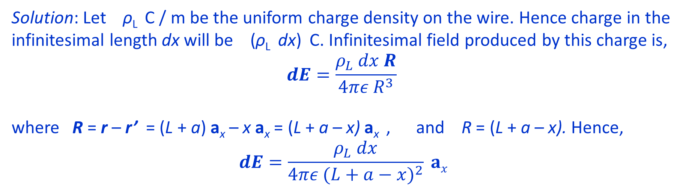
Electrostatics
Example: A charge of Q is uniformly distributed over a thin wire of length L. Determine the field at the point P shown in the figure.
y
L
a
P
x
x
dx
Solution: Let ρ_{L} C / m be the uniform charge density on the wire. Hence charge in the infinitesimal length dx will be (ρ_{L} dx) C. Infinitesimal field produced by this charge is,
$$dE=\frac{ρ_{L} dx R}{4πε R^{3}}$$
where R = r – r’ = (L + a) a_{x} – x a_{x} = (L + a – x) a_{x} , and R = (L + a – x). Hence,
$$dE=\frac{ρ_{L} dx}{4πε {(L+a−x)}^{2}} ax$$
Lecture notes of Dr. Raghavendra G. Kulkarni, Distinguished Professor, PES University, Bengaluru, INDIA.

Slide 38
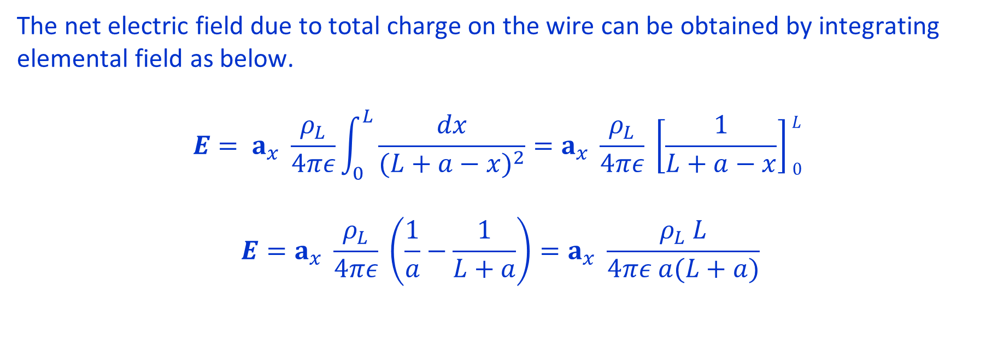
Electrostatics
The net electric field due to total charge on the wire can be obtained by integrating elemental field as below.
$$E= a_{x} \frac{ρ_{L}}{4πε}\int_{0}^{L}{\frac{dx}{{(L+a−x)}^{2}}=a_{x} \frac{ρ_{L}}{4πε} \left[\frac{1}{L+a−x}\right]\begin{matrix}L \\ 0\end{matrix} }$$
$$E=a_{x} \frac{ρ_{L}}{4πε} \left(\frac{1}{a}−\frac{1}{L+a}\right)=a_{x} \frac{ρ_{L} L}{4πε a(L+a)}$$
Lecture notes of Dr. Raghavendra G. Kulkarni, Distinguished Professor, PES University, Bengaluru, INDIA.

Slide 39
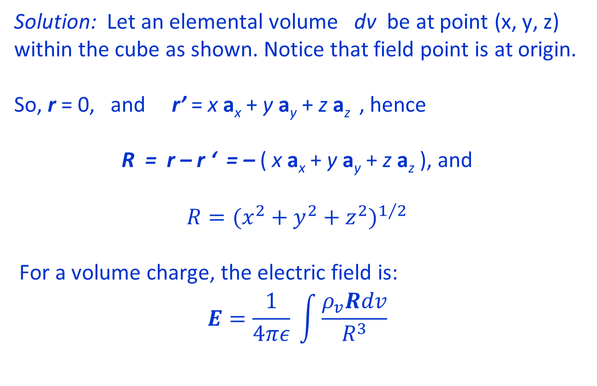
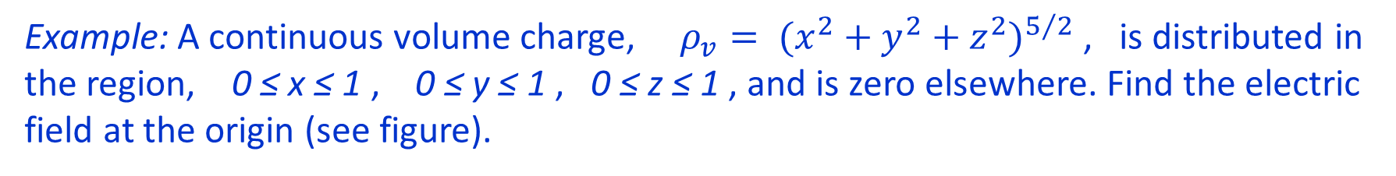
Electrostatics
Example: A continuous volume charge, $ρ_{v}= {(x^{2}+y^{2}+z^{2})}^{5/2}$, is distributed in the region, 0 ≤ x ≤ 1 , 0 ≤ y ≤ 1 , 0 ≤ z ≤ 1 , and is zero elsewhere. Find the electric field at the origin (see figure).
Solution: Let an elemental volume dv be at point (x, y, z) within the cube as shown. Notice that field point is at origin.
So, r = 0, and r’ = x a_{x} + y a_{y} + z a_{z} , hence
R = r – r ‘ = – ( x a_{x} + y a_{y} + z a_{z} ), and
$$R={(x^{2}+y^{2}+z^{2})}^{1/2}$$
For a volume charge, the electric field is:
$$E=\frac{1}{4πε} \int{\frac{ρ_{v}Rdv}{R^{3}}}$$
z
(x, y, z)
R
●
y
●
x
Lecture notes of Dr. Raghavendra G. Kulkarni, Distinguished Professor, PES University, Bengaluru, INDIA.

Slide 40
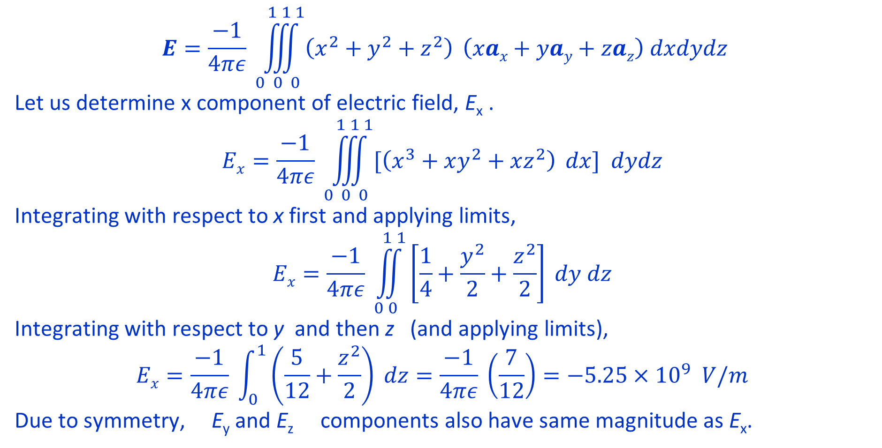
Electrostatics
$$E=\frac{−1}{4πε} \iiint_{0 0 0}^{1 1 1}{\left(x^{2}+y^{2}+z^{2}\right)} \left(xax+yay+zaz\right) dxdydz$$
Let us determine x component of electric field, E_{x} .
$$Ex=\frac{−1}{4πε} \iiint_{0 0 0}^{1 1 1}{[\left(x^{3}+xy^{2}+xz^{2}\right)} dx] dydz$$
Integrating with respect to x first and applying limits,
$$Ex=\frac{−1}{4πε} \iint_{0 0}^{1 1}{\left[\frac{1}{4}+\frac{y^{2}}{2}+\frac{z^{2}}{2}\right]} dy dz$$
Integrating with respect to y and then z (and applying limits),
$$Ex=\frac{−1}{4πε} \int_{0}^{1}{\left(\frac{5}{12}+\frac{z^{2}}{2}\right) dz=\frac{−1}{4πε} \left(\frac{7}{12}\right)}=−5.25×{10}^{9} V/m$$
Due to symmetry, E_{y} and E_{z} components also have same magnitude as E_{x}.
Lecture notes of Dr. Raghavendra G. Kulkarni, Distinguished Professor, PES University, Bengaluru, INDIA.

Slide 41
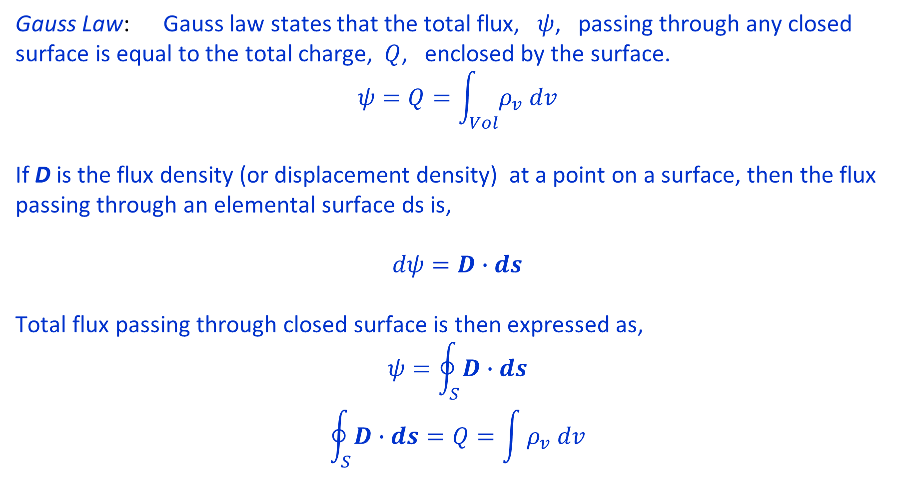
Electrostatics
Gauss Law: Gauss law states that the total flux, $ψ$, passing through any closed surface is equal to the total charge, $Q$, enclosed by the surface.
$$ψ=Q=\int_{Vol}^{ }{ρ_{v} dv}$$
If D is the flux density (or displacement density) at a point on a surface, then the flux passing through an elemental surface ds is,
$$dψ=D∙ds$$
Total flux passing through closed surface is then expressed as,
$$ψ=\oint_{S}^{ }{D∙ds}$$
$$\oint_{S}^{ }{D∙ds}=Q=\int{ρ_{v} dv}$$
Lecture notes of Dr. Raghavendra G. Kulkarni, Distinguished Professor, PES University, Bengaluru, INDIA.

Slide 42
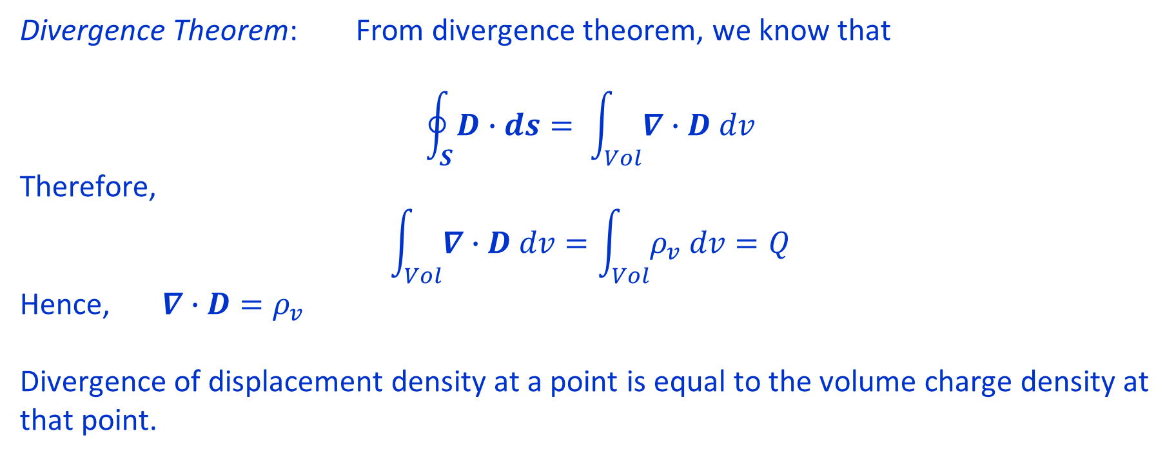
Electrostatics
Divergence Theorem: From divergence theorem, we know that
$$\oint_{S}^{ }{D∙ds}= \int_{Vol}^{ }{∇∙D dv}$$
Therefore,
$$\int_{Vol}^{ }{∇∙D dv}=\int_{Vol}^{ }{ρ_{v} dv}=Q$$
Hence, $∇∙D=ρ_{v}$
Divergence of displacement density at a point is equal to the volume charge density at that point.
Lecture notes of Dr. Raghavendra G. Kulkarni, Distinguished Professor, PES University, Bengaluru, INDIA.

Slide 43
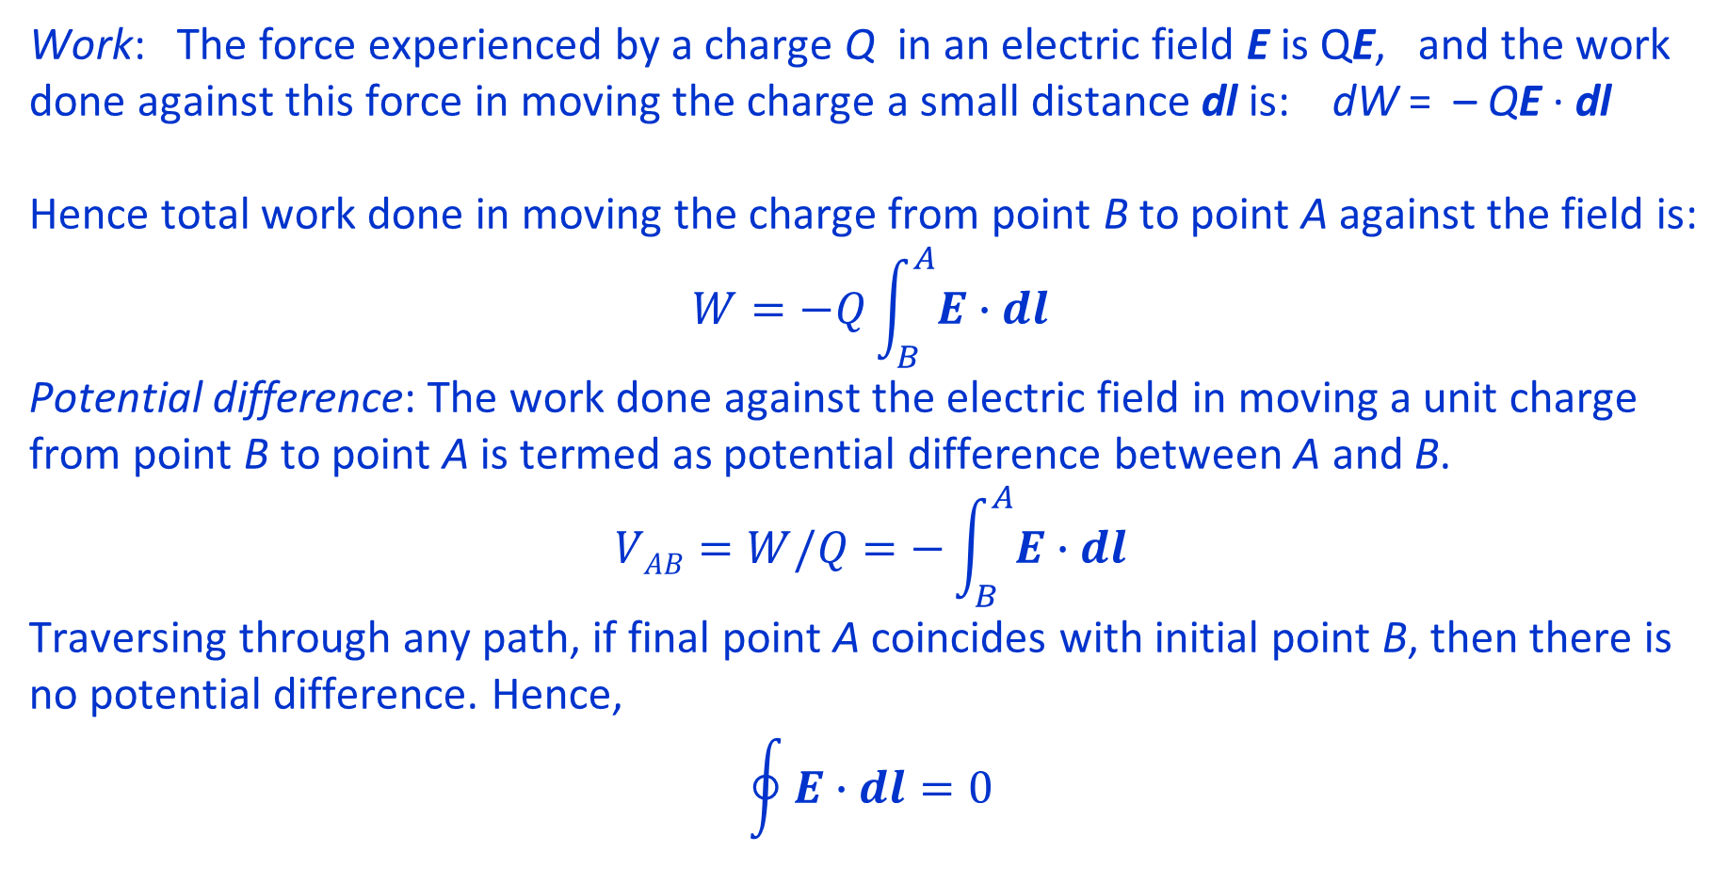
Electrostatics
Work: The force experienced by a charge Q in an electric field E is QE, and the work done against this force in moving the charge a small distance dl is: dW = – QE · dl
Hence total work done in moving the charge from point B to point A against the field is:
$$W=−Q\int_{B}^{A}{E∙dl}$$
Potential difference: The work done against the electric field in moving a unit charge from point B to point A is termed as potential difference between A and B.
$$VAB=W/Q=−\int_{B}^{A}{E∙dl}$$
Traversing through any path, if final point A coincides with initial point B, then there is no potential difference. Hence,
$$\oint{E∙dl}=0$$
Lecture notes of Dr. Raghavendra G. Kulkarni, Distinguished Professor, PES University, Bengaluru, INDIA.

Slide 44
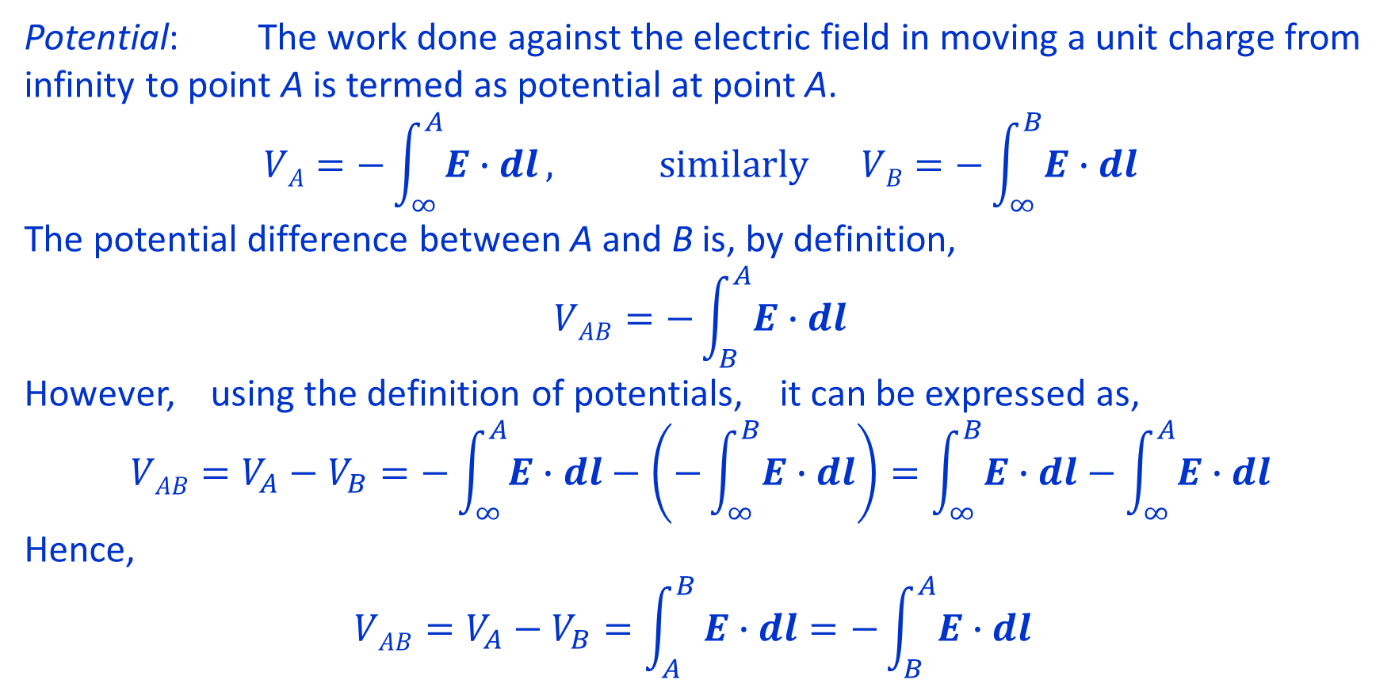
Electrostatics
Potential: The work done against the electric field in moving a unit charge from infinity to point A is termed as potential at point A.
$$VA=−\int_{∞}^{A}{E∙dl}, similarly VB=−\int_{∞}^{B}{E∙dl}$$
The potential difference between A and B is, by definition,
$$VAB=−\int_{B}^{A}{E∙dl}$$
However, using the definition of potentials, it can be expressed as,
$$VAB=V_{A}−V_{B}=−\int_{∞}^{A}{E∙dl}−\left(−\int_{∞}^{B}{E∙dl}\right)=\int_{∞}^{B}{E∙dl}−\int_{∞}^{A}{E∙dl}$$
Hence,
$$VAB=V_{A}−V_{B}=\int_{A}^{B}{E∙dl=−\int_{B}^{A}{E∙dl} }$$
Lecture notes of Dr. Raghavendra G. Kulkarni, Distinguished Professor, PES University, Bengaluru, INDIA.

Slide 45
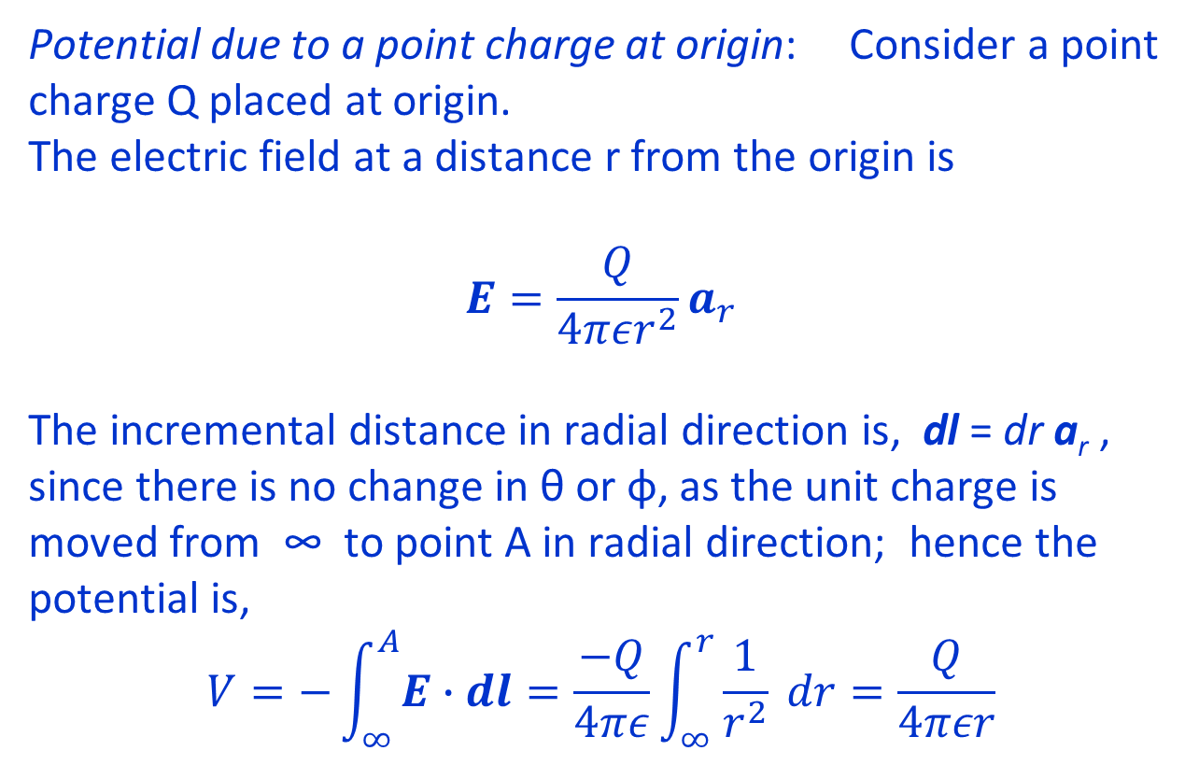
Electrostatics
Potential due to a point charge at origin: Consider a point charge Q placed at origin.
The electric field at a distance r from the origin is
$$E=\frac{Q}{4πεr^{2}}a_{r}$$
The incremental distance in radial direction is, dl = dr a_{r} , since there is no change in θ or φ, as the unit charge is moved from ∞ to point A in radial direction; hence the potential is,
$$V=−\int_{∞}^{A}{E∙dl}=\frac{−Q}{4πε}\int_{∞}^{r}{\frac{1}{r^{2}}} dr=\frac{Q}{4πεr}$$
z
a_{r}
r
●
Q
y
●
x
Lecture notes of Dr. Raghavendra G. Kulkarni, Distinguished Professor, PES University, Bengaluru, INDIA.

Slide 46
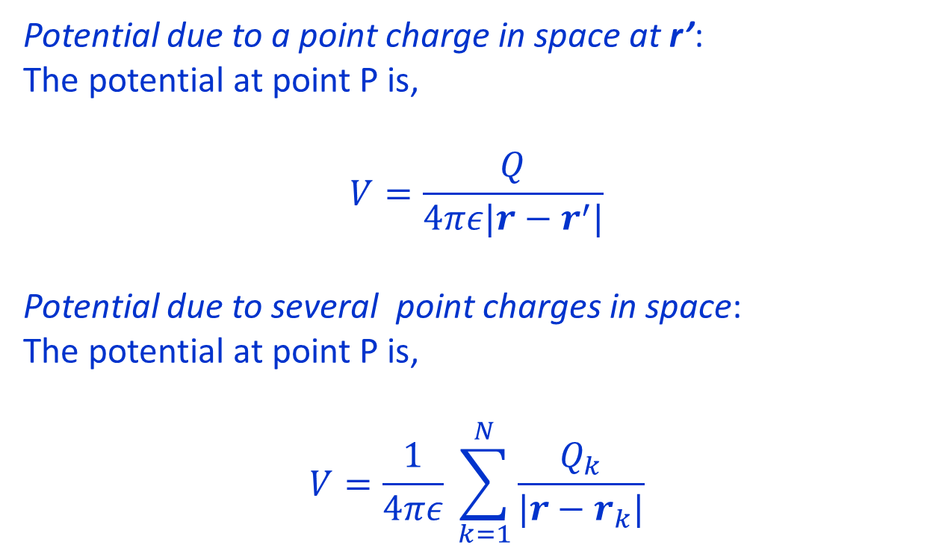
Electrostatics
Potential due to a point charge in space at r’:
The potential at point P is,
$$V=\frac{Q}{4πε|r−r^{′}|}$$
Potential due to several point charges in space:
The potential at point P is,
$$V=\frac{1}{4πε} \sum_{k=1}^{N}{\frac{Q_{k}}{|r−r_{k}|}}$$
Q
z
r - r’
P
●
●
r’
r
y
x
Lecture notes of Dr. Raghavendra G. Kulkarni, Distinguished Professor, PES University, Bengaluru, INDIA.

Slide 47
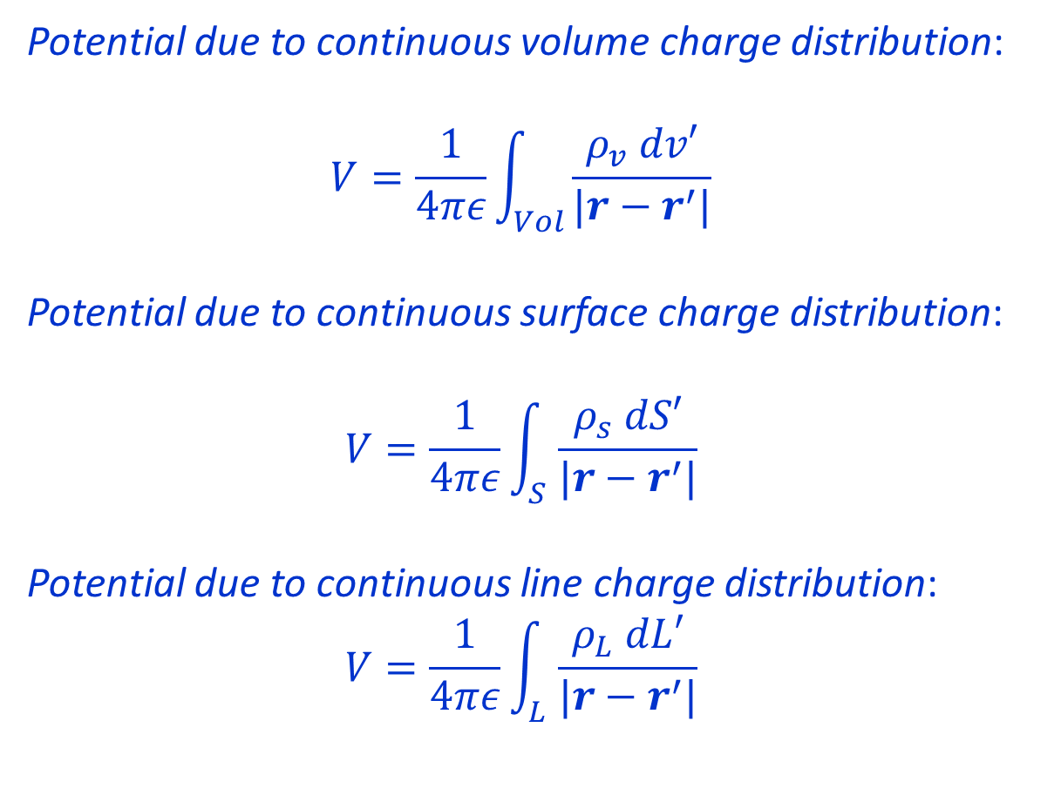
Electrostatics
●
r - r’
dv’
●
Potential due to continuous volume charge distribution:
$$V=\frac{1}{4πε}\int_{Vol}^{ }{\frac{ρ_{v} dv′}{|r−r^{′}|}}$$
Potential due to continuous surface charge distribution:
$$V=\frac{1}{4πε}\int_{S}^{ }{\frac{ρ_{s} dS′}{|r−r^{′}|}}$$
Potential due to continuous line charge distribution:
$$V=\frac{1}{4πε}\int_{L}^{ }{\frac{ρ_{L} dL′}{|r−r^{′}|}}$$
r’
r
y
x
dS’
r - r’
●
r’
r
y
x
r - r’
dL’
●
r’
r
y
x
Lecture notes of Dr. Raghavendra G. Kulkarni, Distinguished Professor, PES University, Bengaluru, INDIA.

Slide 48
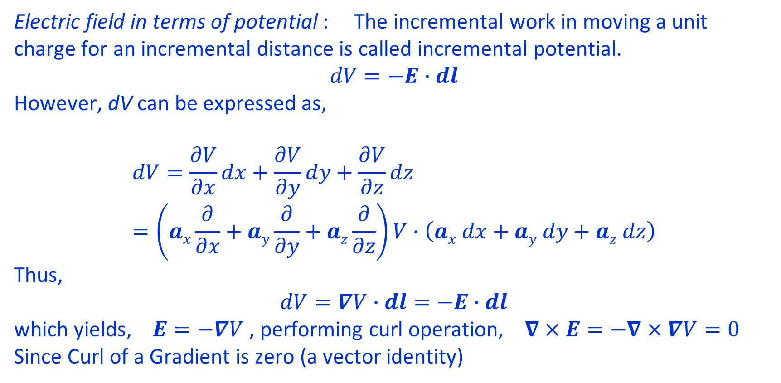
Electrostatics
Electric field in terms of potential : The incremental work in moving a unit charge for an incremental distance is called incremental potential.
$$dV=−E∙dl$$
However, dV can be expressed as,
$$dV=\frac{∂V}{∂x}dx+\frac{∂V}{∂y}dy+\frac{∂V}{∂z}dz=\left(ax\frac{∂}{∂x}+ay\frac{∂}{∂y}+az\frac{∂}{∂z}\right)V∙\left(ax dx+ay dy+az dz\right)$$
Thus,
$$dV=∇V∙dl=−E∙dl$$
which yields, $E=−∇V$ , performing curl operation, $∇×E=−∇×∇V=0$
Since Curl of a Gradient is zero (a vector identity)
Lecture notes of Dr. Raghavendra G. Kulkarni, Distinguished Professor, PES University, Bengaluru, INDIA.

Slide 49
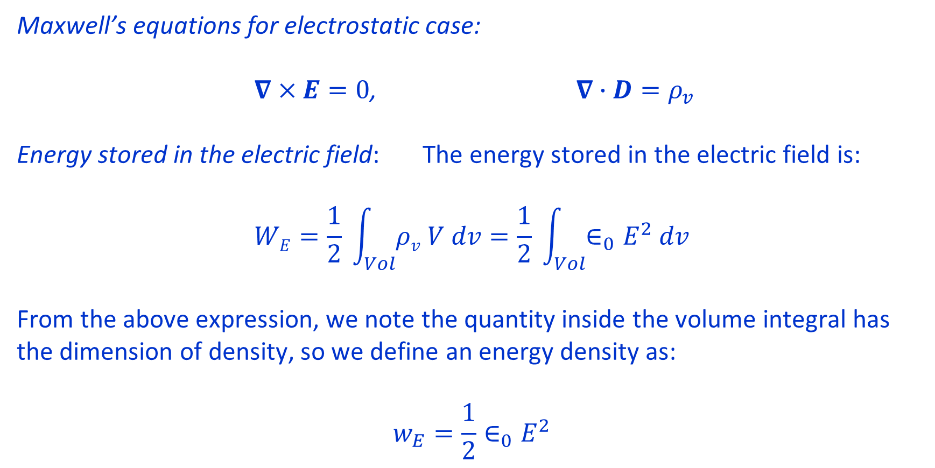
Electrostatics
Maxwell’s equations for electrostatic case:
$∇×E=0$, $∇∙D=ρ_{v}$
Energy stored in the electric field: The energy stored in the electric field is:
$$WE=\frac{1}{2} \int_{Vol}^{ }{ρv V dv}=\frac{1}{2} \int_{Vol}^{ }{∈_{0}E^{2} dv}$$
From the above expression, we note the quantity inside the volume integral has the dimension of density, so we define an energy density as:
$$w_{E}=\frac{1}{2}∈_{0}E^{2}$$
Lecture notes of Dr. Raghavendra G. Kulkarni, Distinguished Professor, PES University, Bengaluru, INDIA.

Slide 50
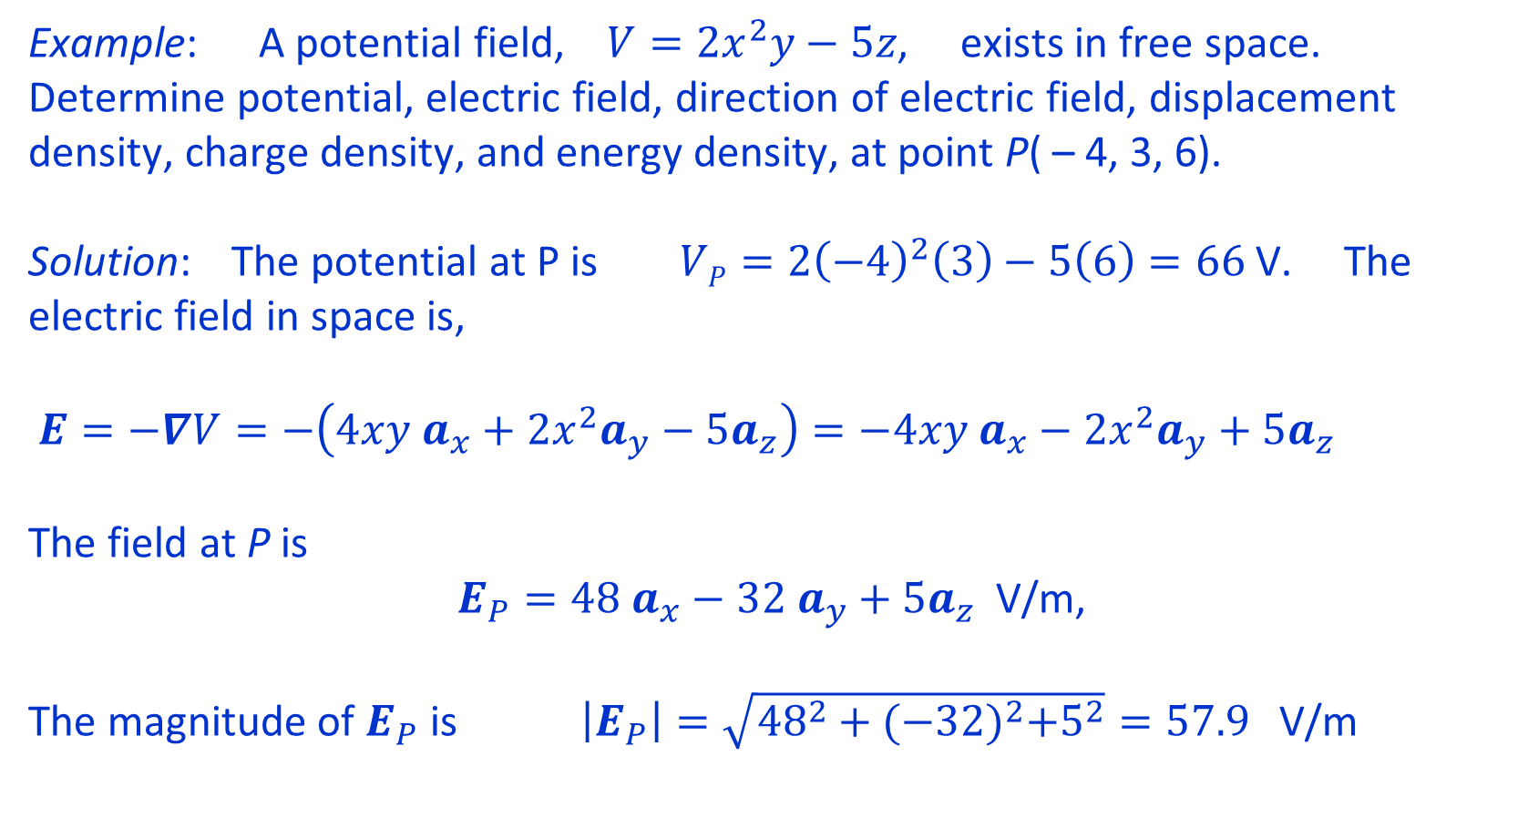
Electrostatics
Example: A potential field, $V=2x^{2}y−5z$, exists in free space. Determine potential, electric field, direction of electric field, displacement density, charge density, and energy density, at point P( – 4, 3, 6).
Solution: The potential at P is $VP=2{\left(−4\right)}^{2}\left(3\right)−5\left(6\right)=66$ V. The electric field in space is,
$E=−∇V=−\left(4xy a_{x}+2x^{2}a_{y}−5a_{z}\right)=−4xy a_{x}−2x^{2}a_{y}+5a_{z}$
The field at P is
$E_{P}=48 a_{x}−32 a_{y}+5a_{z}$ V/m,
The magnitude of $E_{P}$ is $\left|E_{P}\right|=\sqrt{{48}^{2}+{(−32)}^{2}+5^{2}}=57.9$ V/m
Lecture notes of Dr. Raghavendra G. Kulkarni, Distinguished Professor, PES University, Bengaluru, INDIA.

Slide 51
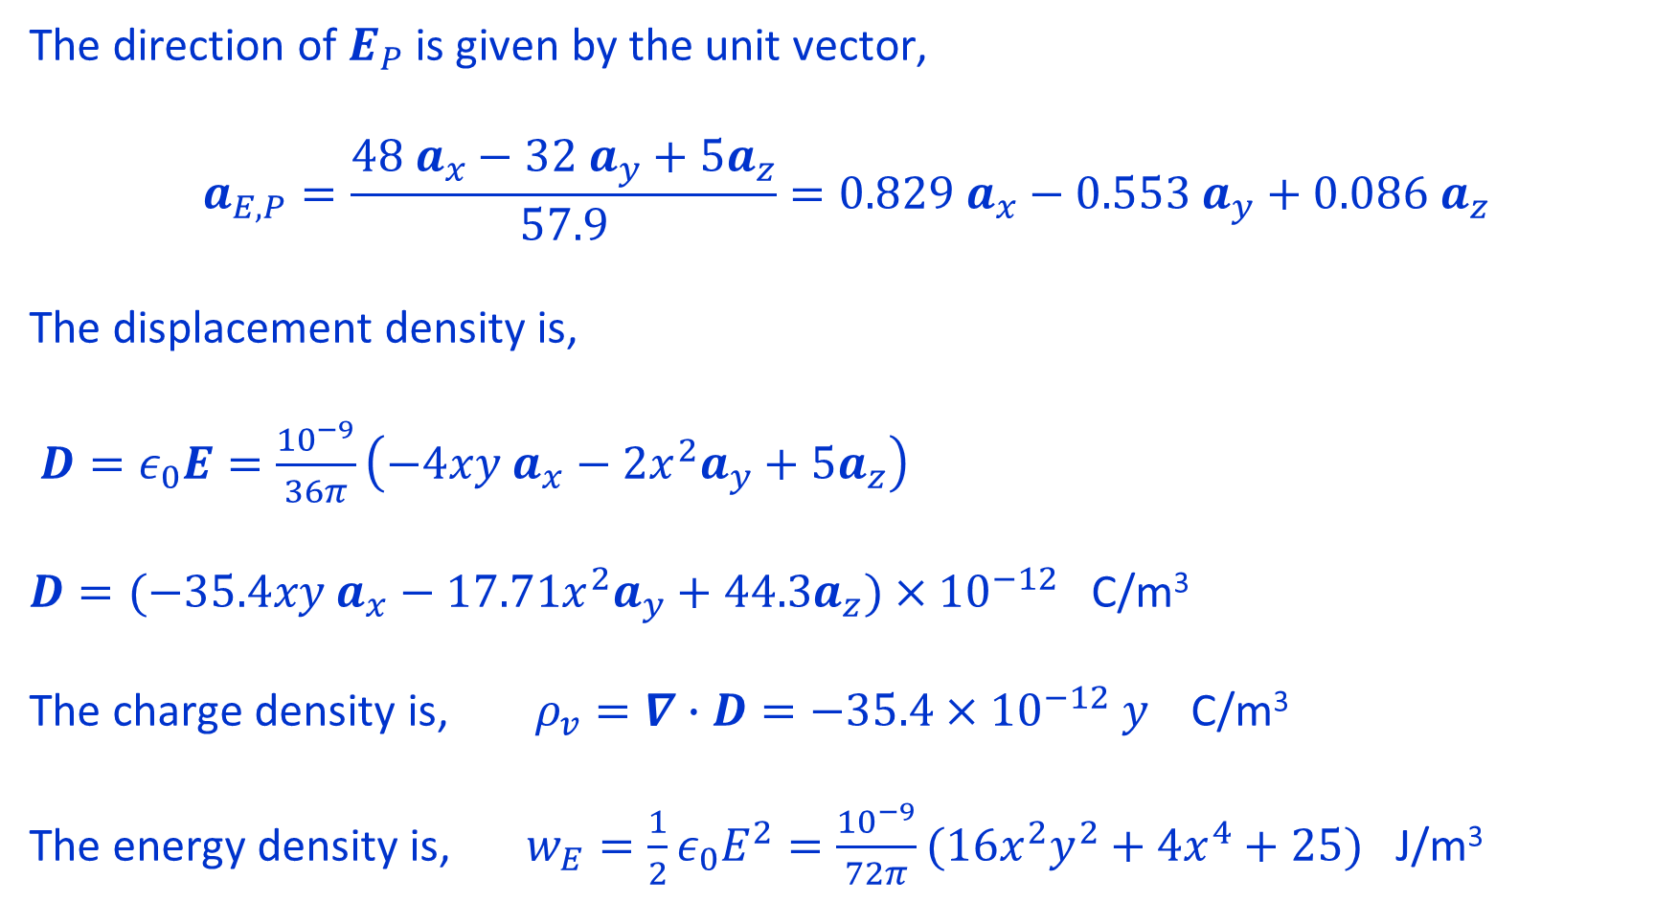
The direction of $E_{P}$ is given by the unit vector,
$$a_{E,P}=\frac{48 a_{x}−32 a_{y}+5a_{z}}{57.9}=0.829 a_{x}−0.553 a_{y}+0.086 a_{z}$$
The displacement density is,
$D=ε_{0}E=\frac{{10}^{−9}}{36π}\left(−4xy a_{x}−2x^{2}a_{y}+5a_{z}\right)$
$D=(−35.4xy a_{x}−17.71x^{2}a_{y}+44.3a_{z})×{10}^{−12}$ C/m³
The charge density is, $ρ_{v}=∇∙D=−35.4×{10}^{−12} y$ C/m³
The energy density is, $w_{E}=\frac{1}{2}ε_{0}E^{2}=\frac{{10}^{−9}}{72π}(16x^{2}y^{2}+4x^{4}+25)$ J/m³
Lecture notes of Dr. Raghavendra G. Kulkarni, Distinguished Professor, PES University, Bengaluru, INDIA.

Slide 52
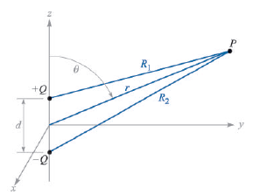

Potential and field due to dipole
Dipole is a pair of charges of equal magnitude, but with opposite polarity, separated by a small distance.
In the figure shown, two charges, +Q and –Q, are separated by a small distance, d, compared to the distance, r, of the field point. The potential, V, at point P is given by scalar sum of potentials at P due to charges, +Q and –Q,
Lecture notes of Dr. Raghavendra G. Kulkarni, Distinguished Professor, PES University, Bengaluru, INDIA.

Slide 53
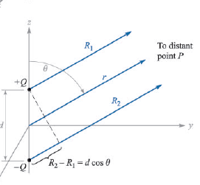




Potential and field due to dipole
When r >> d,
R₂ ≈ R₁ + d cos θ, and R₁R₂ = r², hence
Lecture notes of Dr. Raghavendra G. Kulkarni, Distinguished Professor, PES University, Bengaluru, INDIA.

Slide 54


Potential and field due to dipole
Let us define a vector length d which starts at - Q and ends at + Q, and then define a dipole moment p = Qd ; the potential is then
In general, potential due to dipole placed any where is given by,
where r’ is the position vector of dipole centre, and r is the position vector of the field point.
Lecture notes of Dr. Raghavendra G. Kulkarni, Distinguished Professor, PES University, Bengaluru, INDIA.

Slide 55


Potential and field due to dipole
Example: Given a dipole moment $p=3ax−2ay+az$ nC m in free space, find potential at (2, 3, 4).
Solution: The position vector of field point is $r=2ax+3ay+4az$ and its magnitude is $r=\sqrt{4+9+16}=5.385$ , and r² = 29.
Unit vector of r is
$ar=\frac{1}{5.385}(2ax+3ay+4az$)
The potential at (2, 3, 4) is
where $p∙a_{r}=\frac{{10}^{−9}}{5.385} (3ax−2ay+a_{z})$ $∙(2ax+3ay+4az \text{)}\text{ = }0.7428×{10}^{−9}$
and $4πε_{0}r^{2}=4π\left(\frac{{10}^{−9}}{36π}\right)29=3.222×{10}^{−9}$ , hence V = 0.2305 volts.
Lecture notes of Dr. Raghavendra G. Kulkarni, Distinguished Professor, PES University, Bengaluru, INDIA.

Slide 56



Continuity Equation
If a current density, J, is passing through an infinitesimal surface area, dS, then the infinitesimal current is, J · dS, and the total current passing out of a closed surface is
This current is result of rate of decrease of charge, Q_{i}, inside the closed surface.
By divergence theorem, we know that
Lecture notes of Dr. Raghavendra G. Kulkarni, Distinguished Professor, PES University, Bengaluru, INDIA.

Slide 57



Continuity Equation
If the volume inside the closed surface has a volume charge density ρ_{v} then the charge Qi can be replaced by the volume integral of charge density.
Interchanging the order of differentiation and integration yields,
Thus, divergence of current density is equal to the rate of decrease of charge density.
Lecture notes of Dr. Raghavendra G. Kulkarni, Distinguished Professor, PES University, Bengaluru, INDIA.

Slide 58



Boundary conditions
Metal (conductor) to free space boundary: Consider a closed path, abcda; we know that line integral of electric field around a closed path is zero. Since electric field inside the conductor is zero, we need to consider the fields (both tangential and normal) in the free space only. Hence,
Lecture notes of Dr. Raghavendra G. Kulkarni, Distinguished Professor, PES University, Bengaluru, INDIA.

Slide 59




Boundary conditions
We let ∆h to approach zero, while keeping ∆w small but finite; this results in
Now consider the small volume in the figure. If Q is the charge inside this volume, then by Gauss law,
Integrating over the three surfaces yields,
Lecture notes of Dr. Raghavendra G. Kulkarni, Distinguished Professor, PES University, Bengaluru, INDIA.

Slide 60




Boundary conditions
Since fields inside the conductor are zero, the integration over the bottom surface is zero. As we let ∆h to approach zero, the integration over the side surface is also zero. If there exists a surface charge with density ρ_{S} then,
Therefore, the boundary conditions for conductor-to-free space boundary are, the tangential components of electric field and displacement density are zero; and the normal component of displacement density is equal to the surface charge density.
and
Lecture notes of Dr. Raghavendra G. Kulkarni, Distinguished Professor, PES University, Bengaluru, INDIA.

Slide 61



Boundary conditions
Example: Given the potential, $V=100\left(x^{2}−y^{2}\right),$ and a point P (2, - 1, 3), which is on conductor-free space boundary, determine potential, electric field, displacement density, and surface charge density at P.
Solution: The potential at P is, $VP=100\left(2^{2}−{(−1)}^{2}\right)=300 V,$ and since conductor surface is an equipotential surface, the potential every where on conductor-free space boundary is 300 V. Hence equation for this boundary is
$$300=100\left(x^{2}−y^{2}\right) \underset{⇒}{ } x^{2}−y^{2}=3$$
The electric field is, $E=−∇V,$ hence
Lecture notes of Dr. Raghavendra G. Kulkarni, Distinguished Professor, PES University, Bengaluru, INDIA.

Slide 62


Boundary conditions
The displacement density, D = Є₀ E,
Since there can not be tangential component of D at point P, the normal component of D is given by,
The surface charge density at P is obtained as,
Lecture notes of Dr. Raghavendra G. Kulkarni, Distinguished Professor, PES University, Bengaluru, INDIA.

Slide 63



Boundary conditions
Dielectric to dielectric boundary:
Using
around the closed path shown, note that as ∆h goes to zero we obtain,
Lecture notes of Dr. Raghavendra G. Kulkarni, Distinguished Professor, PES University, Bengaluru, INDIA.

Slide 64



Boundary conditions
The tangential displacement densities across the boundary are related as,
Consider the small volume shown in the figure. Applying Gauss law, the flux coming out of the closed surface is equal to the charge inside that surface. Hence,
Lecture notes of Dr. Raghavendra G. Kulkarni, Distinguished Professor, PES University, Bengaluru, INDIA.

Slide 65


Boundary conditions
However, at the boundary of two perfect dielectrics surface charges do not exist, therefore ρ_{S} is zero. Therefore,
Conclusion:
At the boundary of two perfect dielectrics, the tangential component of electric field is continuous, while the tangential component of displacement density is discontinuous; the normal component of displacement density is continuous, while the normal component of electric field is discontinuous.
Lecture notes of Dr. Raghavendra G. Kulkarni, Distinguished Professor, PES University, Bengaluru, INDIA.

Slide 66




Boundary conditions
Dielectric to dielectric boundary: Expressions for D₂ and E₂ in terms of D₁ and E₁
Lecture notes of Dr. Raghavendra G. Kulkarni, Distinguished Professor, PES University, Bengaluru, INDIA.

Slide 67



Boundary conditions
Dielectric to dielectric boundary: Expressions for D₂ and E₂ in terms of D₁ and E₁
Lecture notes of Dr. Raghavendra G. Kulkarni, Distinguished Professor, PES University, Bengaluru, INDIA.

Slide 68
Thank you
Lecture notes of Dr. Raghavendra G. Kulkarni, Distinguished Professor, PES University, Bengaluru, INDIA.

