Slide 1

COMPUTER COMMUNICATION NETWORKS
Department of Electronics and Communication Engineering

Slide 2

COMPUTER COMMUNICATION NETWORKS
Unit 2 – Numerical Problems
Dr. Arpita Thakre
Department of Electronics and Communication Engineering

Slide 3
COMPUTER COMMUNICATION NETWORKS
Consider Stop & Wait Protocol. Host A is sending packets to host B where round trip time is 30 msec. The host A to host B link supports data transmission at 1 Gbps. Suppose the size of a packet is 1500 bytes. Calculate the link utilization.
Ans : {30 + (1500*8/10⁶)} = 30.012 msec is needed to reliably send 1 packet from host A to host B, assuming transmission delay for ACK (from B to A) is negligible. Therefore link utilization is 0.012 msec/(30.012 msec) = 0.00039

Slide 4
COMPUTER COMMUNICATION NETWORKS
(2) Consider Pipelining Protocol that uses a window of size N. Host A is sending packets to host B where round trip time is 30 msec. The host A to host B link supports data transmission at 1 Gbps. Suppose the size of a packet is 1500 bytes. What should be N such that the link utilization becomes 0.98 ?
Ans : {30 + (1500*8/10⁶)} = 30.012 msec is needed to reliably send 1 packet from host A to host B, assuming transmission delay for ACK (from B to A) is negligible. However withing 30.012 msec, N packets are already out in the channel. Transmission delay of N packets is N*0.012 msec.
Therefore, link utilization = (N*0.012) /(30+ 0.012) = 0.98
i.e., N = (.98*30.012)/(0.012) = 2450.98 = 2451

Slide 5
COMPUTER COMMUNICATION NETWORKS
(3) Consider the GBN protocol with a sender window size of 4 and a sequence number range of 1,024. Suppose that at time t, the next in-order packet that the receiver is expecting has a sequence number of k. Assume that the medium does not reorder messages. Answer the following questions:
What are the possible sets of sequence numbers inside the sender’s window at time t? Justify your answer.
b. What are all possible values of the ACK field in all possible messages currently propagating back to the sender at time t? Justify your answer.

Slide 6
COMPUTER COMMUNICATION NETWORKS
(3a) We have a window size of 4. Suppose the receiver has received packet k-1, and has ACKed all other preceding packets. If all of these ACK's have been received by sender, then sender's window is [k,k+1, k+2, k+3].
Suppose next that none of the ACKs have been received by the sender. In this second case, the sender's window contains k-1 and the N packets up to and including k-1. The sender's window is thus [k-4,k-3,k-2,k-1].

Slide 7
COMPUTER COMMUNICATION NETWORKS
(3b) If the receiver is waiting for packet k, then it has received (and ACKed) packet k-1 and the N-1 packets before that. If all of these ACK's have been received by sender, it means there are no ACKs propagating back.
However, if none of those N ACKs have been yet received by the sender, then ACK messages with values of [k-N,k-1] may still be propagating back. Because the sender has sent packets [k-N, k-1], it must be the case that the sender has already received an ACK for k-N-1. Once the receiver has sent an ACK for packet k-N-1 it will never send an ACK that is less that k-N-1. Thus the range of in-flight ACK values can range from k-N-1 to k-1.

Slide 8
COMPUTER COMMUNICATION NETWORKS
(4). Consider the GBN and SR protocols. Suppose the sequence number space is of size k. What is the largest allowable sender window that will avoid the occurrence of problems such as that in Figure 3.27 for each of these protocols?
For SR protocol, N <= k/2
For GBN protocol, N <= (k-1)

Slide 9
COMPUTER COMMUNICATION NETWORKS
(5) Host A and B are communicating over a TCP connection, and Host B has already received from A all bytes up through byte 126. Suppose Host A then sends two segments to Host B back-to-back. The first and second segments contain 80 and 40 bytes of data, respectively. In the first segment, the sequence number is 127, the source port number is 302, and the destination port number is 80. Host B sends an acknowledgment whenever it receives a segment from Host A.
In the second segment sent from Host A to B, what are the sequence number, source port number, and destination port number?
Sequence number = 207
Source port = 302
Destination port = 80

Slide 10
COMPUTER COMMUNICATION NETWORKS
If the first segment arrives before the second segment, in the acknowledgment of the first arriving segment, what is the acknowledgment number, the source port number, and the destination port number?
acknowledgement number = 207
Source port = 80
Destination port = 302

Slide 11
COMPUTER COMMUNICATION NETWORKS
(6) Consider transferring an enormous file of L bytes from Host A to Host B.
Assume an MSS of 536 bytes.
a. What is the maximum value of L such that TCP sequence numbers are not
exhausted? Recall that the TCP sequence number field has 4 bytes.
b. For the L you obtain in (a), find how long it takes to transmit the file.
Assume that a total of 66 bytes of transport, network, and data-link header
are added to each segment before the resulting packet is sent out over a
155 Mbps link. Ignore flow control and congestion control so A can pump
out the segments back to back and continuously

Slide 12
COMPUTER COMMUNICATION NETWORKS
4 byte = 32 bits. There are 2³² possible sequence numbers.
The sequence number does not increment by one with each segment. It increments by the number of bytes in each segment. Therefore, MSS is irrelevant. The maximum size of the file that can be sent from A to B is equal to 2³² bytes = 4.19 Gbytes
MSS = 536. Therefore, number of segments = 2³² / 536 = 8012999. Each segment has a header of 66 bytes. Therefore total number of bytes from A to B is (8012999+66)*536 = 4.824*10⁹ bytes.
It takes 249 seconds to transmit the file of size 4.19GBytes over a 1 Mbps link

Slide 13
COMPUTER COMMUNICATION NETWORKS
(7) Suppose 100 and 200 are the initial values of client_seq and serv_seq respectively. Suppose a client sends a HTTP request of 300 bytes, and server replies with HTTP reply of 1000 bytes, then show the timing diagram which starts with the TCP connection initiation to the acknowledgement sent by the client for the HTTP reply

Slide 14
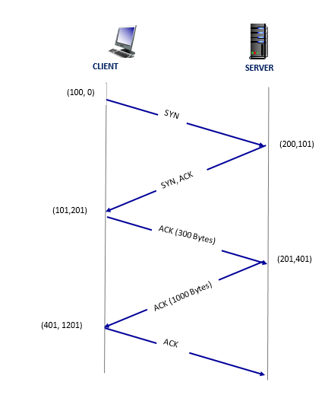
COMPUTER COMMUNICATION NETWORKS
(seq. no, ack no)

Slide 15
COMPUTER COMMUNICATION NETWORKS
(8) Host A and B are directly connected with a 100 Mbps link. There is one TCP connection between the two hosts, and Host A is sending to Host B an enormous file over this connection. Host A can send its application data into its TCP socket at a rate as high as 120 Mbps but Host B can read out of its TCP receive buffer at a maximum rate of 50 Mbps. Describe the effect of TCP flow control.
Since the link capacity is only 100 Mbps, so host A’s sending rate can be at most 100Mbps. Still, host A sends data into the receive buffer faster than Host B can remove data from the buffer. The receive buffer fills up at a rate of 50Mbps. When the buffer is full, Host B signals to Host A to stop sending data by setting RcvWindow = 0. Host A then stops sending until it receives a TCP segment with RcvWindow > 0. Host A will thus repeatedly stop and start sending as a function of the RcvWindow values it receives from Host B. On average, the long-term rate at which Host A sends data to Host B as part of this connection is no more than 50Mbps

Slide 16
COMPUTER COMMUNICATION NETWORKS
(9) Suppose that the five measured SampleRTT values (see Section 3.5.3) are 106 ms, 120 ms, 140 ms, 90 ms, and 115 ms. Compute the EstimatedRTT after each of these SampleRTT values is obtained, using a value of α = 0.125 and assuming that the value of EstimatedRTT was 100 ms just before the first of these five samples were obtained. Compute also the DevRTT after each sample is obtained, assuming a value of β = 0.25 and assuming the value of DevRTT was 5 ms just before the first of these five samples was obtained. Last, compute the TCP TimeoutInterval after each of these samples is obtained.

Slide 17
COMPUTER COMMUNICATION NETWORKS
SampleRTT₁ = 106 msec
SampleRTT₂ = 120 msec
SampleRTT₃ = 140 msec
SampleRTT₄ = 90 msec
SampleRTT₅ = 115 msec
EstimatedRTT₀ = 100 msec
DevRTT₀= 5 msec,
α = 0.125, β=0.25
For i = 1,2,3,4,5
EstimatedRTT_{i} = (1-α)*EstimatedRTT_{i-1} +α*SampleRTT_{i}
DevRTT_{i} = (1-β)*DevRTT_{i-1} + β*|SampleRTT_{i}-EstimatedRTT_{i}|
TimeOutInterval_{i} = EstimatedRTT_{i} + 4*DevRTT_{i}

Slide 18
COMPUTER COMMUNICATION NETWORKS
(10) Consider sending a large file from a host to another over a TCP connection that has no loss. Suppose TCP uses AIMD for its congestion control without slow start. Assuming cwnd increases by 1 MSS every time a batch of ACKs is received and assuming approximately constant round-trip times, how long does it take for cwnd to increase from 6 MSS to 12 MSS (assuming no loss events)?
(part B) How long did it take to transmit from the 6th segment to 12th segment?
After i RTTs, cwnd = 6 MSS
i+1 RTTs, cwnd = 7 MSS
…………….
After i+6 RTTs, cwnd = 12 MSS
It takes 6 RTT for cwnd to increase from 6 MSS to 12 MSS
Notes:
Assuming successful transmissions in each timeout interval, under the AIMD (excluding slow start), the cwnd grows by 1 MSS after each transmission round. When a packet loss occurs, the cwnd is halved and again grows linearly until next packet loss event. Assuming no packet loss, the cwnd grows linearly without dropping to half the cwnd value anytime.
The time taken by cwnd to increase from 6 MSS to 12 MSS is given by 6RTT (here RTT in each round is approximately constant value).
To know how long it takes to transmit 12th packet having transmitted the 6th packet:
6th packet is transmitted in round 3 whereas 12th packet is transmitted in round 5, so time taken is 2 RTT.
Express the answers in seconds

Slide 19
COMPUTER COMMUNICATION NETWORKS
(part B)
At beginning, cwnd = 1 MSS, 1st segment sent
After 1 RTT, cwnd = 2 MSS, 2nd and 3rd segments sent
After 2 RTTs, cwnd = 3 MSS, 4th and 5th segments sent
After 3 RTTs, cwnd = 4 MSS, 6th, 7th, 8th, 9th segments sent
After 4 RTTs, cwnd = 5 MSS, 10th, 11th, 12th, 13^{th,} 14th segments sent
…………….
It took 1 RTT to transmit from the 6th segment to 12th segment
Notes:
Assuming successful transmissions in each timeout interval, under the AIMD (excluding slow start), the cwnd grows by 1 MSS after each transmission round. When a packet loss occurs, the cwnd is halved and again grows linearly until next packet loss event. Assuming no packet loss, the cwnd grows linearly without dropping to half the cwnd value anytime.
The time taken by cwnd to increase from 6 MSS to 12 MSS is given by 6RTT (here RTT in each round is approximately constant value).
To know how long it takes to transmit 12th packet having transmitted the 6th packet:
6th packet is transmitted in round 3 whereas 12th packet is transmitted in round 5, so time taken is 2 RTT.
Express the answers in seconds

Slide 20
COMPUTER COMMUNICATION NETWORKS
(11) Consider 4 packets, each having 100 bytes, are transmitted by host A to host B using TCP Reno. Assume TCP connection was already complete. Let the sequence numbers of host A and host B to be 1 and 1000 respectively, for subsequent communication. Sequence numbers from B to A can be ignored.
Suppose second packet is corrupted during transmission but others are received correctly by host B. Draw a timing diagram including the retransmissions. Assume retransmissions are successful. Timing diagram must depict sequence number and acknowledgement number for each packet transaction.

Slide 21
COMPUTER COMMUNICATION NETWORKS
Solution:
Host A
Host B
(seq. no, ack no)
(1,1000)
(101,1000)
Store Seg1, send ACK
CWND = 4 MSS
(nth round)
(201,1000)
Corrupt, discard, send last in-order ACK
(301,1000)
Store Seg3, send last in-order ACK
(1000,101)
(1000,101)
Store Seg4, send last in-order ACK
(1000,101)
Terminate timer and start fast -retransmit
(1000,101)
(101,1000)
Store Seg2, send last in-order ACK
(1000,401)
Cumulative ACK

Slide 22
COMPUTER COMMUNICATION NETWORKS
(12): Let 100 and 200 be the Sequence numbers of Hosts A and B at the start of the TCP connection. Let A send a HTTP request of 300 bytes and let B reply the object in 15 segments of 500 bytes each. Let all transmissions be successful. Let MSS= 500 bytes. Show the timing diagram under TCP (TCP Reno / Taho).
Case1: No congestion
Case 2: Maximum number of segments = 5 MSS.

Slide 23
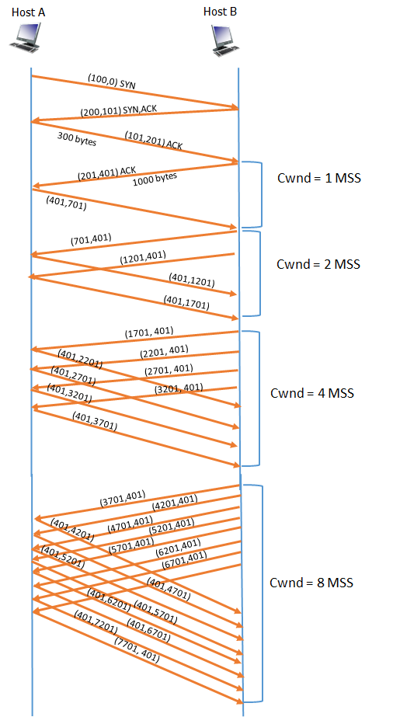
COMPUTER COMMUNICATION NETWORKS
(seq. no, ack no)
Solution for Case 1:
No Congestion
500 bytes

Slide 24
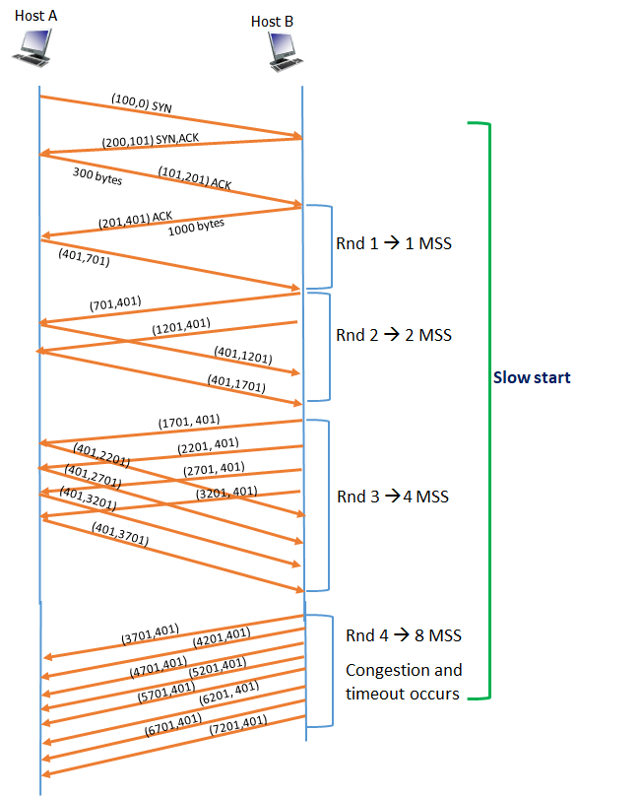
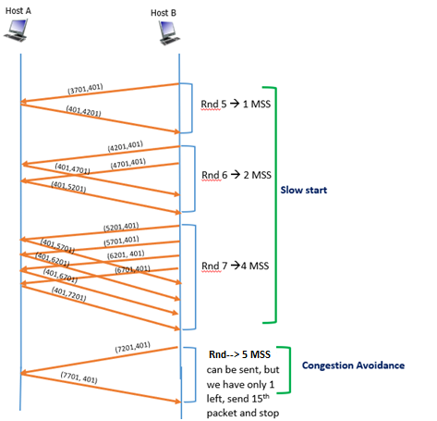
COMPUTER COMMUNICATION NETWORKS
Solution for Case 2:
Maximum number of segments = 5 MSS.
ssthresh = 8/2 = 4
500 bytes

Slide 25
THANK YOU
Dr. Arpita Thakre
Department of Electronics and Communication Engineering

