Slide 1

MODULE 3
Switching Characteristics and Interconnect Effects
Dr. Rashmi Seethur
Assistant Professor
Department of Electronics & Communication Engineering

Slide 2
Contents:
R1: Chap 6 (6.1 -6.7) | Introduction, Delay-Time Definitions (6.1,6.2)
 | Calculation of Delay Times (6.3)
 | Calculation of Delay Times (6.4)
 | Estimation of Interconnect Parasitic (6.5)
 | Calculation of Interconnect Delay (6.6)
 | Switching Power Dissipation of CMOS Inverters (6.7)

Slide 3
CMOS Switching Characteristics
CMOS Switching Characteristics
- we studied the DC (or Static) characteristics of the CMOS inverter
- we learned how to calculate: V_{OH}, V_{OL}, V_{IL}, V_{IH}, V_{th}, NM_{L}, NM_{H},
- we learned that we can modify some of these parameters using the W/L ratios of the inverter
- specifically, we say that the V_{th} is solely dependant on W/L and is usually the most important
and most commonly controlled parameter
- we now turn to the Switching (or AC or Dynamic) behavior of the inverter
- the switching characteristics give us how fast the circuit will run
- when designing, we must meet both DC and AC specs

Slide 4
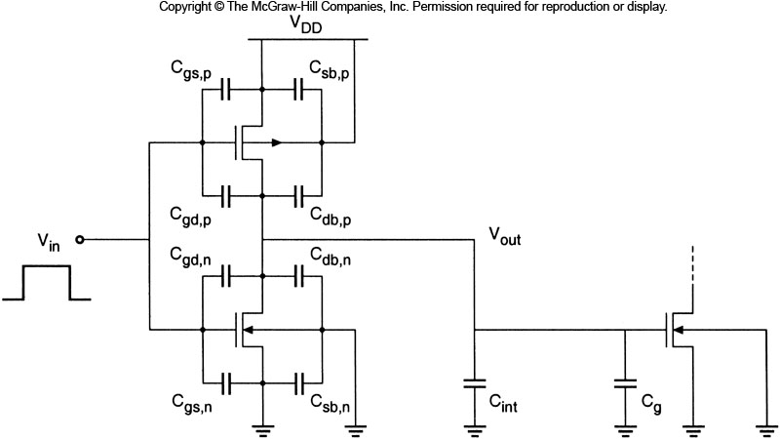
CMOS Switching Characteristics
CMOS Switching Characteristics
- in an AC analysis, we need to consider the capacitance in the circuit
- note that the parasitic inductance tends to be small enough to be ignored (for now!)
- we consider an inverter that is driving another CMOS device or multiple CMOS devices in parallel

Slide 5
CMOS Switching Characteristics
CMOS Switching Characteristics
- there are 4 main groups of capacitance in the circuit
1) Driver's Oxide Capacitance
2) Driver's Junction Capacitance
3) Interconnect Capacitance
4) Receiver Oxide Capacitance

Slide 6
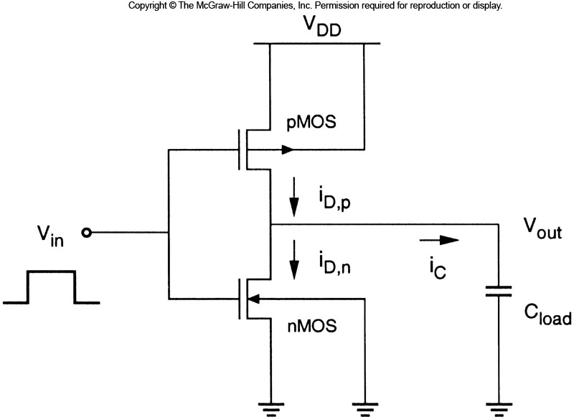
CMOS Switching Characteristics
CMOS Switching Characteristics
- we know that all of these capacitances vary as the dimensions of the inverter are altered
and for various interconnect configurations
- in order to get a feel for how the capacitance effects performance, we assume that we can
lump all of the capacitances into a fixed load capacitance (C_{load})

Slide 7
CMOS Switching Characteristics
CMOS Switching Characteristics
- in this expression we eliminate some of the capacitances:
C_{sb,n}, C_{sb,p} : There is no voltage change from V_{sb,n} or V_{sb,p} so there is no net capacitance
C_{gs,n}, C_{gs,p} : Since these are connected between V_{in} and V_{DD}/V_{SS,} the input drives these
capacitances. It is not part of the capacitance that the device output drives.
- this expression does include the interconnect and gate capacitance of the circuits that this
inverter is driving
Oxides of
Driver
Junctions
of Driver
Interconnect
Oxide of
Receiver

Slide 8
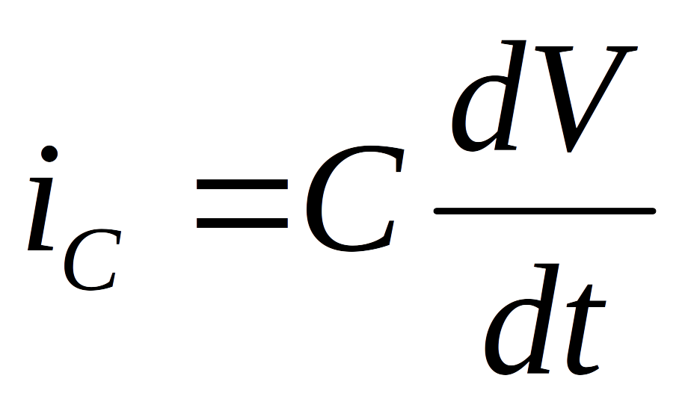
CMOS Switching Characteristics
CMOS Switching Characteristics
- the speed of the device describes how fast we can charge or discharge the load capacitor
V_{DD}
V_{DD}
S
PMOS = ON
S
PMOS = OFF
G
G
D
1
D
0
I_{c}
0
1
I_{c}
D
Cload
D
Cload
G
G
S
NMOS = OFF
S
NMOS = ON
GND
GND

Slide 9
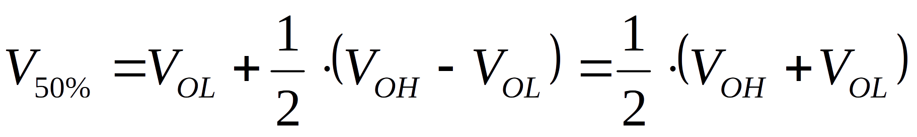
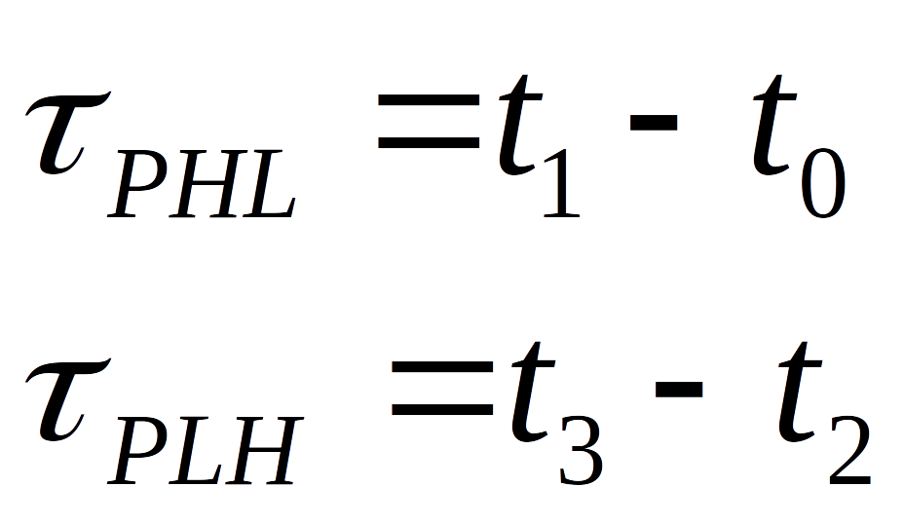
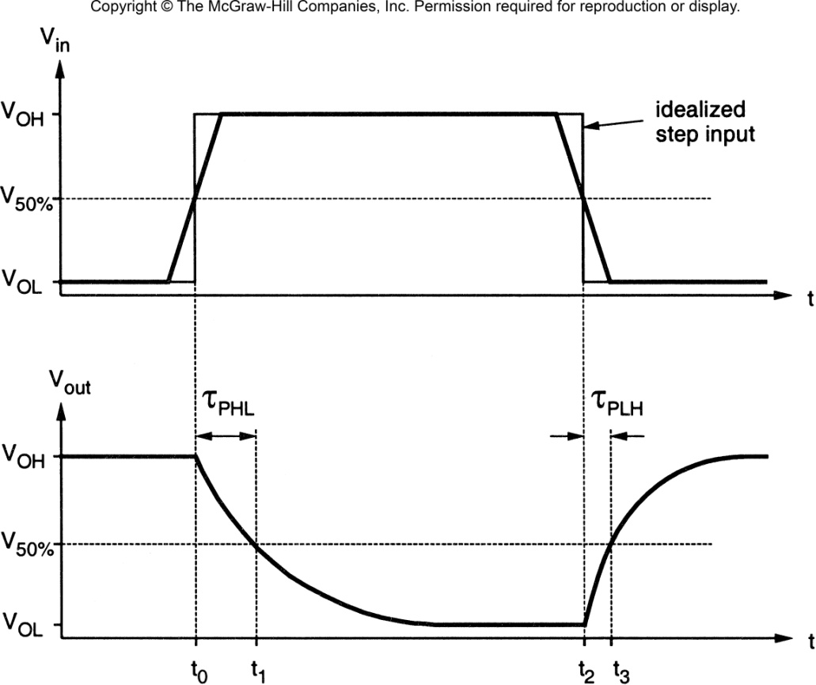
CMOS Switching Characteristics
Delay Time Definition
- the delay is the time it takes to switch from the steady state level to the 50% level
- Note that in CMOS:
V_{OH}=V_{DD}
V_{OL}=V_{SS}
So V_{50%}=V_{DD}/2

Slide 10
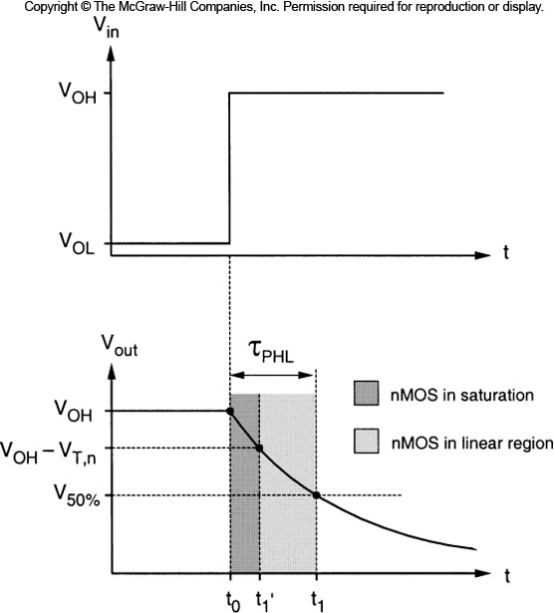
CMOS Switching Characteristics
Delay Time Derivation (τ_{PHL})
- The current that is used to discharge C_{load} is dictated by the region of operation that the NMOS is in.
- There are two distinct regions of operation that the NMOS operates in during the transition:
1) V_{OH} to (V_{OH} – V_{T,n}) NMOS in Saturation
2) (V_{OH} – V_{T,n}) to V_{50%} NMOS in Linear

Slide 11
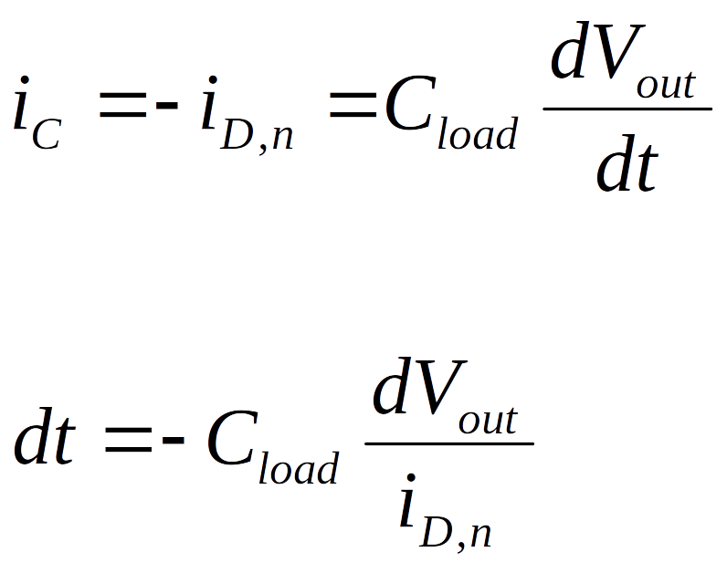
CMOS Switching Characteristics
Delay Time Derivation (τ_{PHL})
“Differential Equation Method”
- we can re-arrange the current expression in the capacitor to be:
- now we can integrate to solve for dt
- we need to perform two integrals, one for
each of the two regions of operation

Slide 12
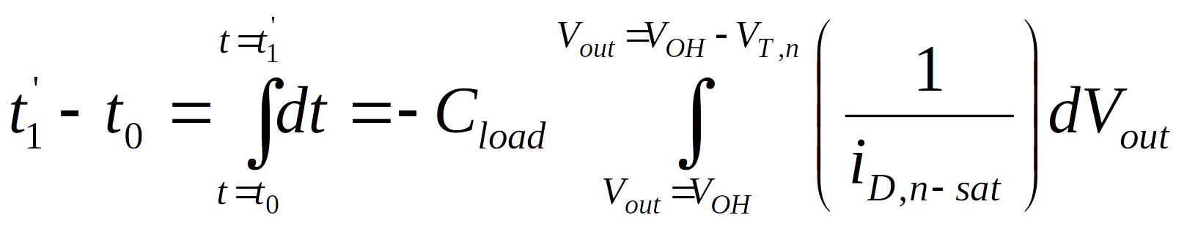
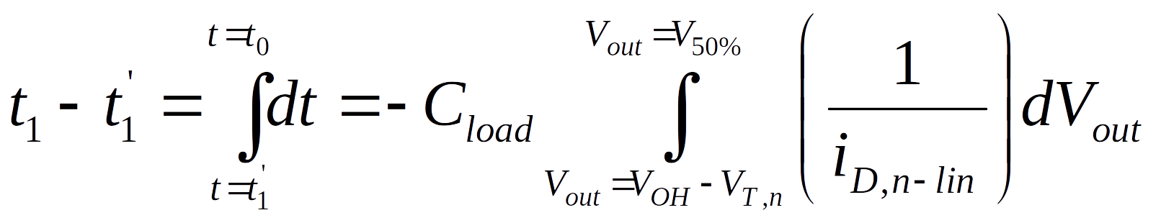
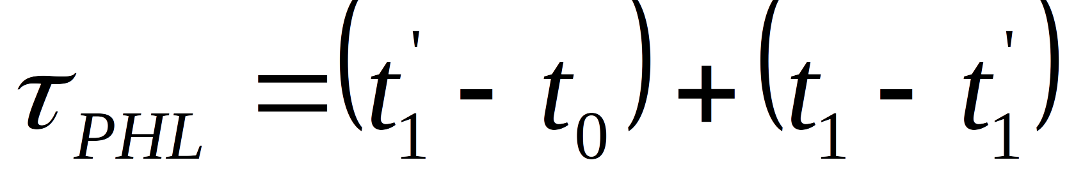
CMOS Switching Characteristics
Delay Time Derivation (τ_{PHL})
“Differential Equation Method”
- For the saturation region, our integral is:
- For the linear region, our integral is:
- The delay is simply the sum of these two solutions:

Slide 13
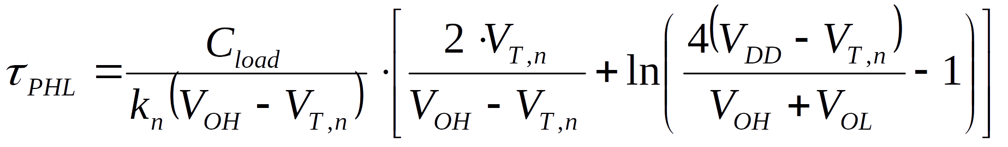
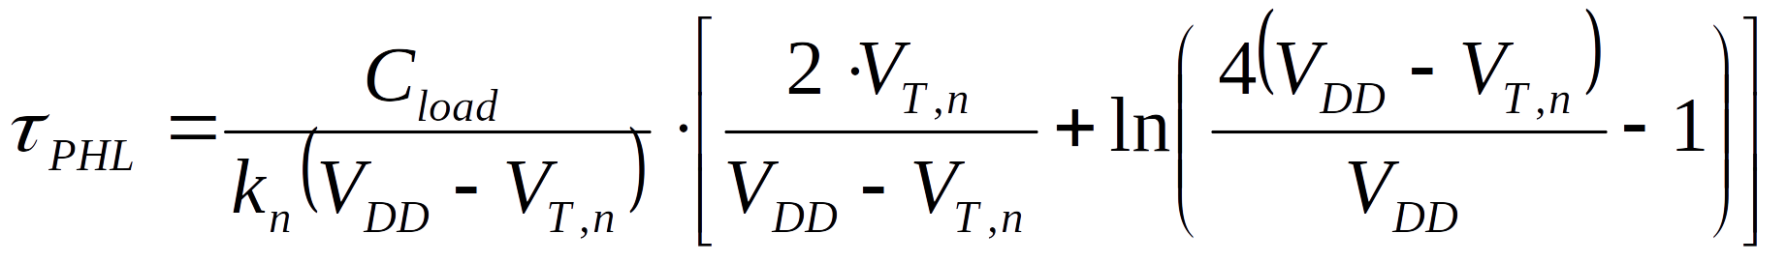
CMOS Switching Characteristics
Delay Time Derivation (τ_{PHL})
“Differential Equation Method”
- evaluating these integrals and adding the two delays together, we get:
- we can simplify this further by substituting in V_{OH}=V_{DD} and V_{OL}=0

Slide 14
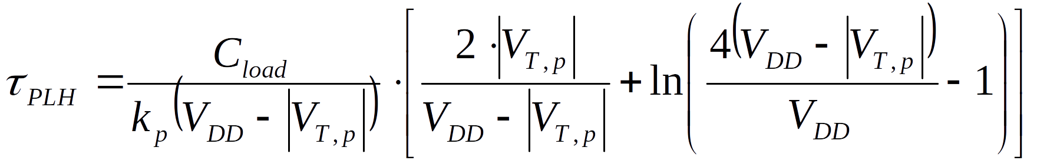
CMOS Switching Characteristics
Delay Time Derivation (τ_{PLH})
“Differential Equation Method”
- we can follow the same process to find τ_{PLH} using the current equations for the PMOS:
- these solutions are accurate from the standpoint that we use the exact current in the
transistors in our derivation of delay.
- these are still estimates and don’t include channel-length-modulation or small-geometry effects

Slide 15
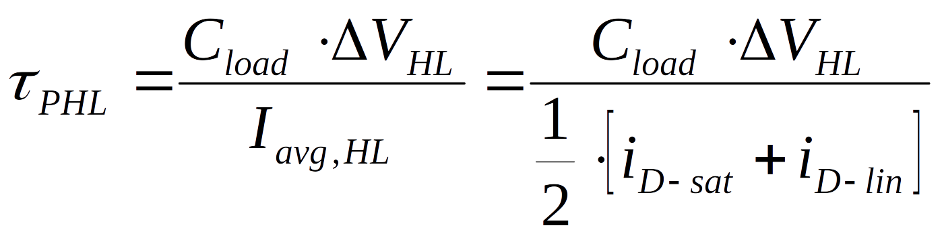
CMOS Switching Characteristics
Delay Time Derivation (τ_{PHL})
“Average Current Method”
- a simpler technique to estimate the delay is to use the average current in the capacitor
during the transition.
- this is accomplished by solving for the current at the beginning of the transition and the
current at the end of the transition and then averaging the two.
- at the beginning of the High-to-Low transition, the NMOS is in saturation
- at the end of the High-to-Low transition, the NMOS is in the linear region

Slide 16
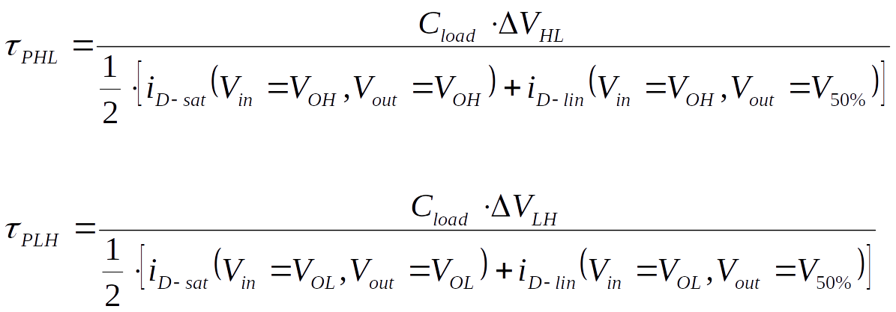
CMOS Switching Characteristics
Delay Time Derivation (τ_{PHL} & τ_{PLH})
“Average Current Method”
- we can write the expression in terms of the voltages at V_{in} (V_{gs,n}) and V_{out} (V_{ds,n}):
- this technique tends to be faster and easier to use than the differential equation method.

Slide 17
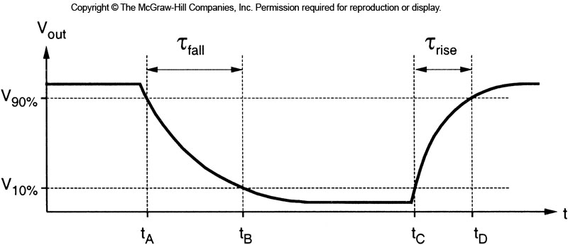
CMOS Switching Characteristics
Rise & Fall Time Definitions (τ_{rise} & τ_{fall})
- rise time (τ_{rise} ) is the time it takes to transition from V_{10%} to V_{90%}
- fall time (τ_{fall} ) is the time it takes to transition from V_{90%} to V_{10%}
- we can use either the (1) differential equation or the (2) average current technique to solve for these
- in these transitions, the transistors again operate in both the saturation and linear regions
- the only difference is that the limits of the transition are V_{10%} and V_{90%}

Slide 18
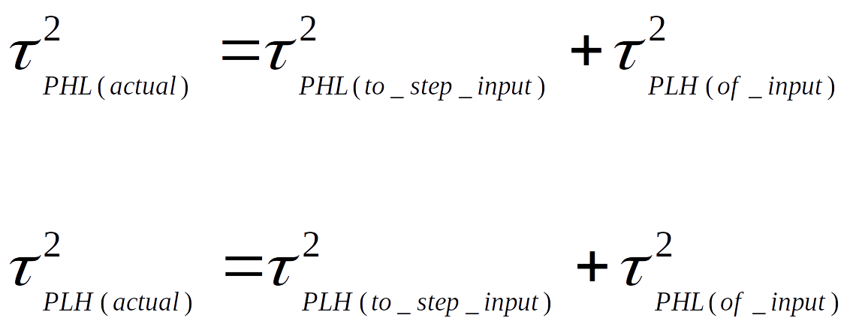
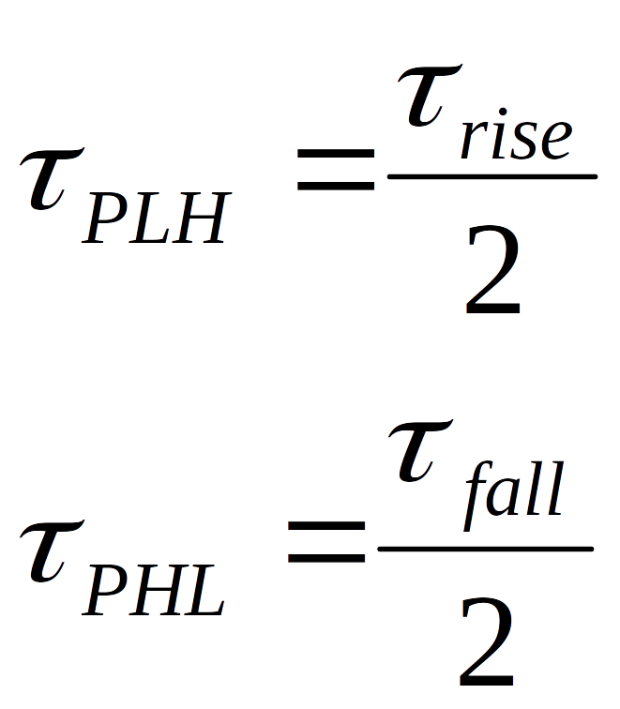
CMOS Switching Characteristics
Non-ideal Inputs
- in all of these derivations, we have assumed a perfect step input.
- if the input is not a perfect step (i.e., it has a finite delay or rise time), it will
increase the delay of the gate
- we can use an RMS estimation to account for the non-ideal input:
- we can also estimate the delay of the input if we are only given its rise/fall time by using:

Slide 19
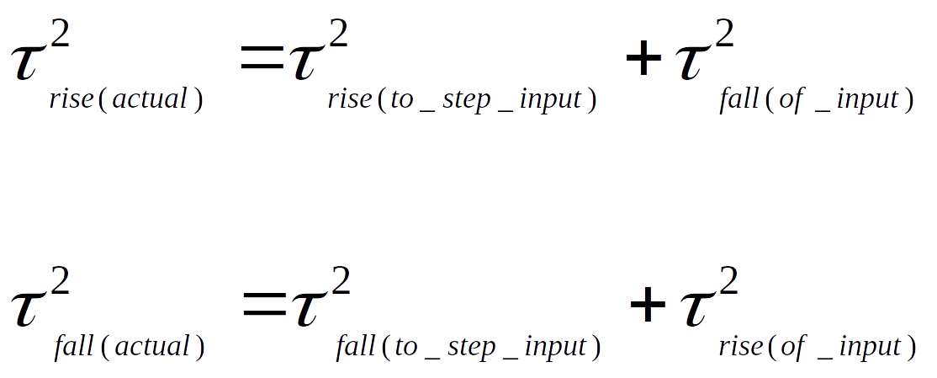
CMOS Switching Characteristics
Non-ideal Inputs
- we can apply this technique to the rise and fall times also:

Slide 20
CMOS Switching Characteristics
Designing for Constraints
- when we begin a design, we typically start with specification
- we then size the transistors to achieve the desired performance
- we saw how the sizes of the transistor effect the DC specs, specifically V_{th}
- we also need to size the transistors so that for a given load capacitance, the gate can
achieve a designed delay or rise/fall time.
- we can use the expressions for delay and rise/fall time that we derived to calculate the
necessary transistor sizes.

Slide 21
CMOS Switching Characteristics
Designing for Constraints
- the average current method is the simplest technique to use:
- in this expression, we can insert our timing spec in for τ_{PHL} or τ_{PLH}
- the RHS of the expression must evaluate to be less than or equal to the timing spec

Slide 22
CMOS Switching Characteristics
Designing for Constraints
- in the timing expression, notice that k_{n} and k_{p} are parameters under our control
- these parameters are in the denominator of the timing expression, meaning that as k_{n} and k_{p}
increase, the delay of the circuit will decrease.
- this means that larger = faster
- we typically leave the lengths of the NMOS and PMOS transistors equal to each other
- we also typically set the lengths to the smallest possible dimension for a given process.
- this gives us the highest transconductance for a given Length and also minimizes the area.
- a given design process consists of the following steps:
1) set L_{p}=L_{n}=L_{min}
2) find the W_{p}/W_{n} ratio that will yield the desired V_{th}
3) find the minimum values for W_{p} and W_{n} to achieve timing
4) combine the minimum sizes and the W_{p}/W_{n} ratio to select final sizes
5) round up the dimensions to give additional margin and standard sizes
(i.e., 4.927um rounds up to 5um)

Slide 23
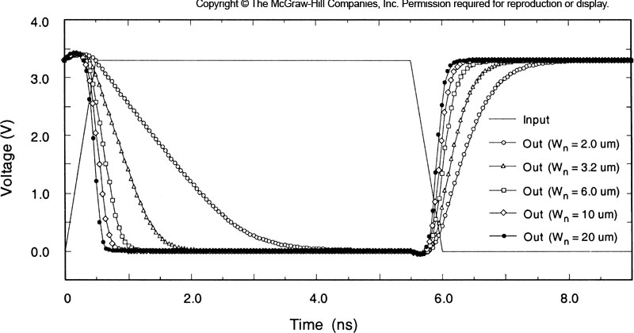
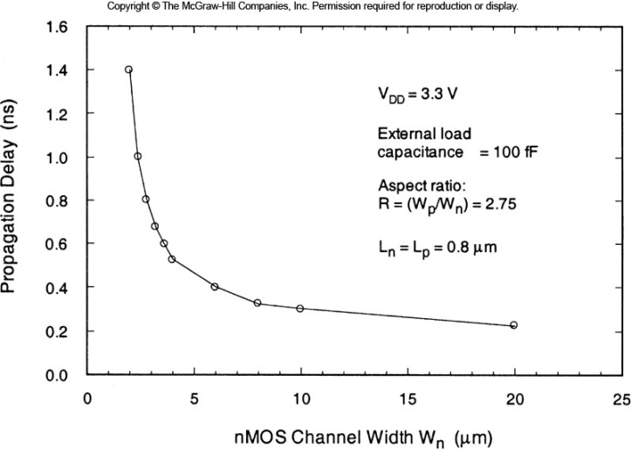
CMOS Switching Characteristics
Area vs. Delay
- we’ve seen that larger = faster for a given inverter
- however, we have made an assumption that the load capacitance is independent of transistor size
- we know what a portion of the load capacitance comes from the driver oxide and driver junctions
- this means that as the inverter gets larger, so does the capacitance
- this leads to a point of diminishing returns with regards to reducing delay

Slide 24
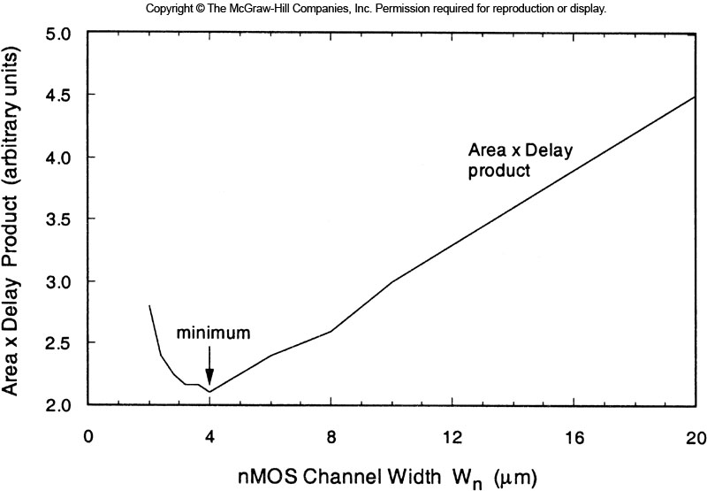
CMOS Switching Characteristics
Area vs. Delay
- we can look at the Area X Delay Product to gauge the quality of a design with regards to efficient
area usage.
- typically we will see an inflection point which indicates the point at which increasing the size of the
transistors to decrease delay is out-weighed by the negative impact of increasing the area used on
the silicon.
- if a timing specifications requires an excessively large sized gate, it typically means that the
process is not sufficient to meet timing.

Slide 25
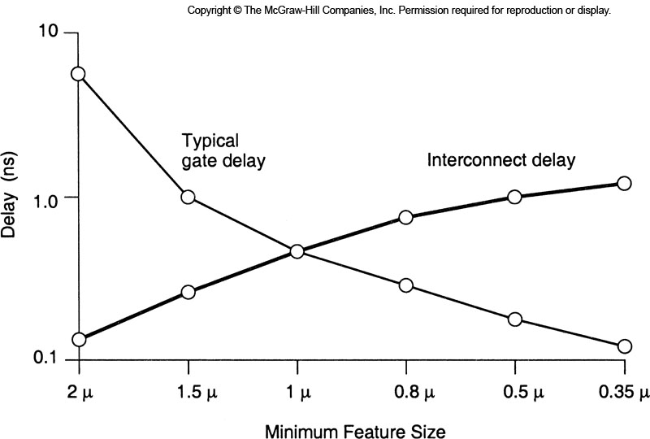
CMOS Switching Characteristics
Interconnect
- one of the components in the load capacitance is the interconnect.
- the interconnect refers to the polysilicon and metal layers that are used to connect
the gates together.
- as sizes on-chip shrink, we’ve seen that the scaling of interconnect is a big problem because the
delay actually increases as you get smaller.
- in addition, the delay scales quadradically
with length meaning that intra-module traces
and global interconnect can create
significant timing challenges.
- in modern processes, the delay of the
interconnect is actually more than the
switching delay of the transistors.

Slide 26
CMOS Switching Characteristics
Interconnect Modeling
- modeling of the interconnect describes the equivalent circuits we use to describe the electrical
behavior of the materials.
- the type of model we use is a trade-off between accuracy and simulation time
- we typciall use 1 of the 3 following models:
Typical Uses
1) Lumped Capacitance inter-module
2) RC network intra-module and global
3) Transmission Line global and off-chip

Slide 27
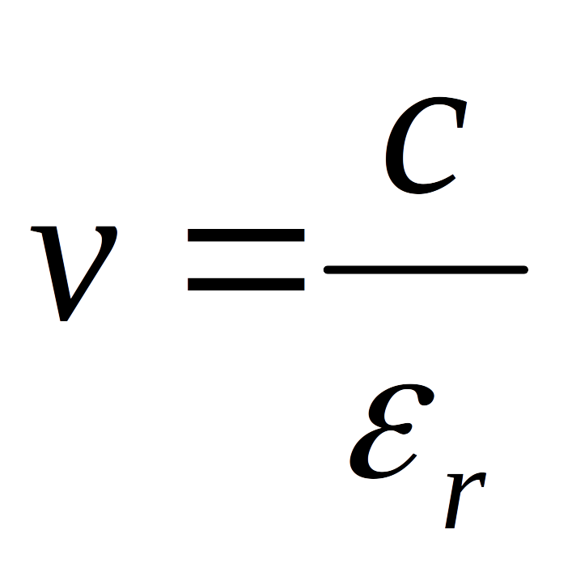
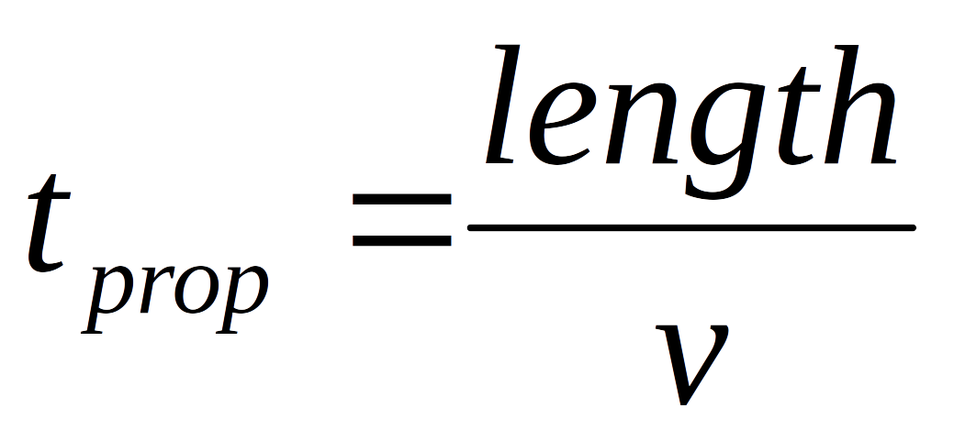
CMOS Switching Characteristics
Interconnect Modeling
- we choose the appropriate model based on the rise/fall time of the driver relative to the
prop delay of the interconnect
- the prop delay (t_{prop}) is the time it takes for the wave to travel down the length of the interconnect:
- the velocity of a wave in a dielectric is given by:
- the prop delay can then be given by:

Slide 28
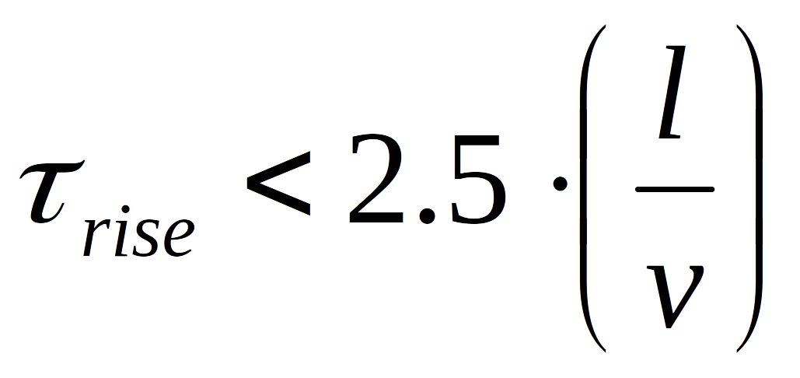
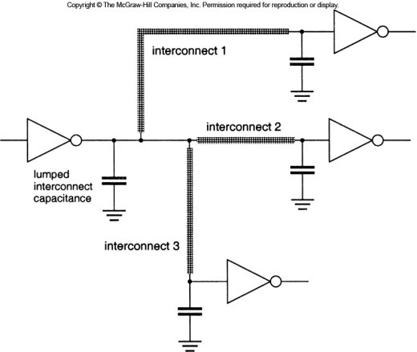
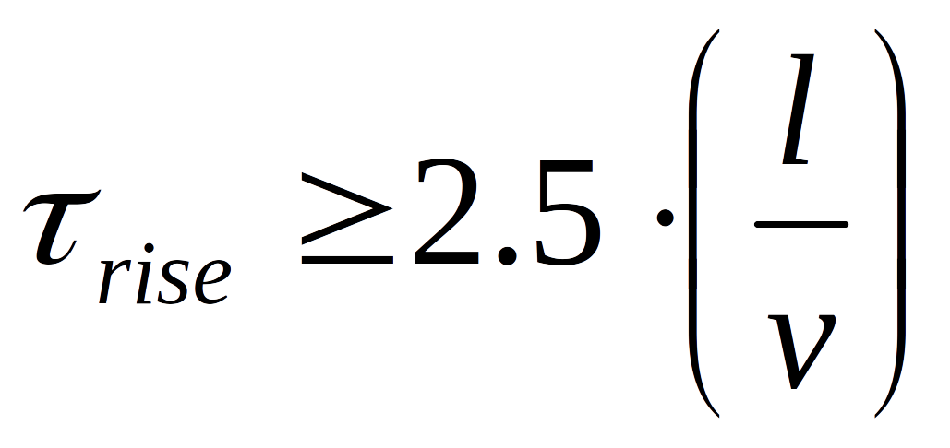
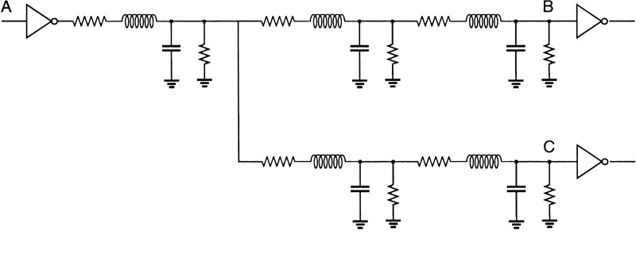
CMOS Switching Characteristics
Interconnect Modeling
- we move between a lumped (C or RC) and a distributed (transmission line) model as follows:
“Lumped”
“Distributed”

Slide 29
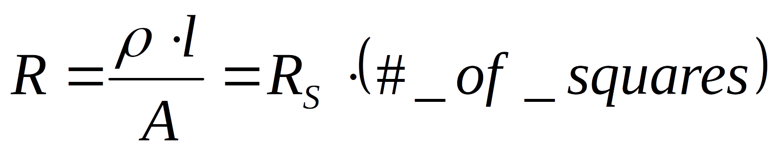
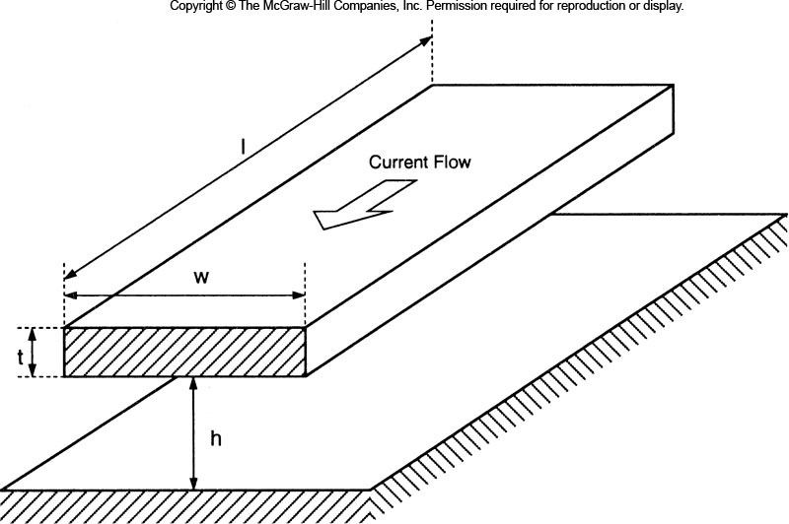
CMOS Switching Characteristics
Interconnect Resistance
- resistance is based on the geometry and materials of the interconnect

Slide 30
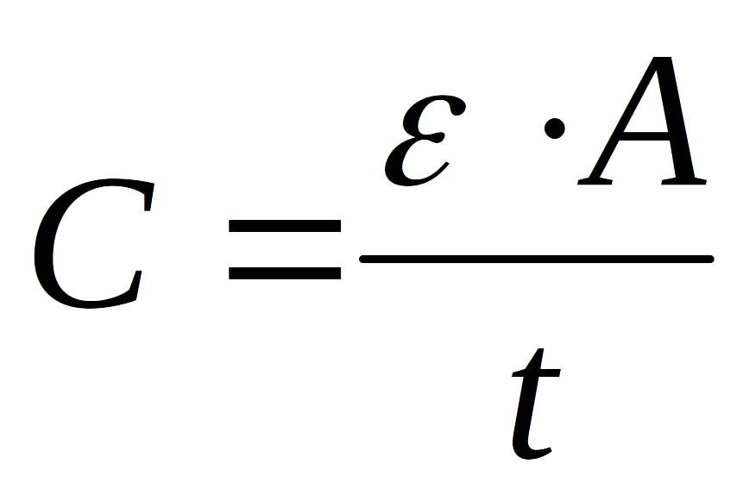
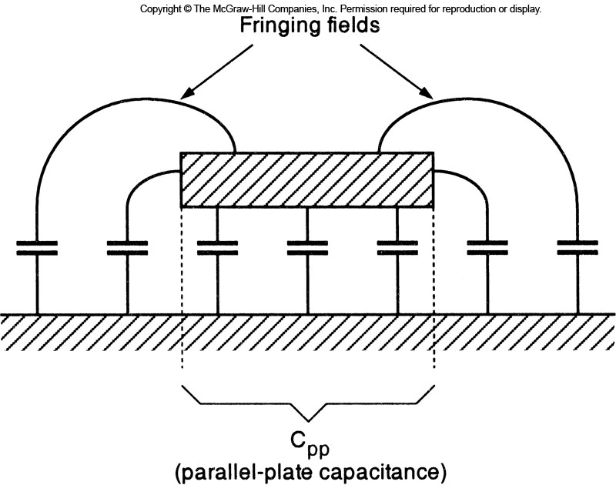
CMOS Switching Characteristics
Interconnect Capacitance
- capacitance depends on the surface area of the conductor, the insulating materials between
the conductors, and the distance between the conductors.

Slide 31
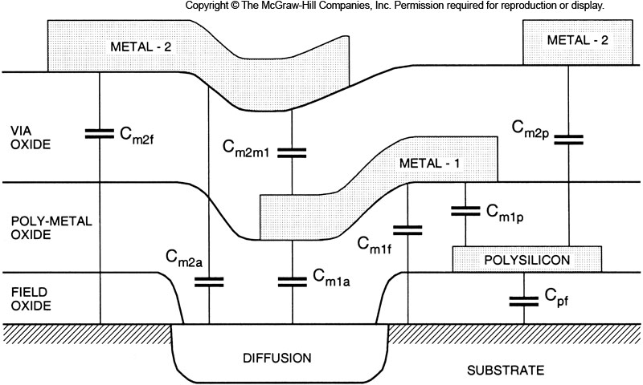
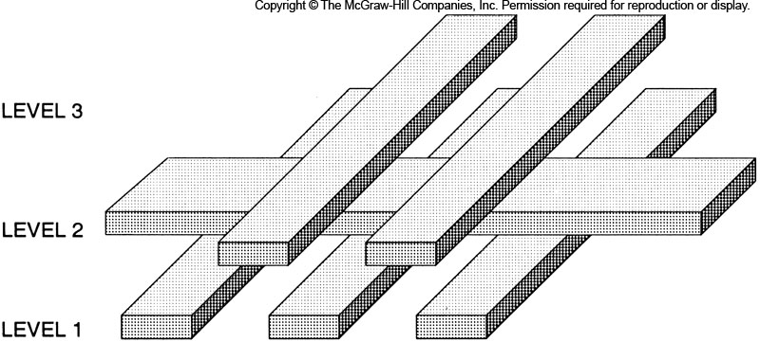
CMOS Switching Characteristics
Interconnect Capacitance
- interconnect modeling becomes a complex problem due to the 3D geometries present on-chip
- we typically take a guess at the capacitance of the interconnect for initial simulations.
- once we start physically laying out our design, we can use the CAD tool to extract the actual
capacitance and back annotate it into our simulation.
- we then run a new simulation with accurate capacitance models to
verify timing is still met post-layout.

Slide 32
CMOS Switching Characteristics
Interconnect Capacitance
- Cross-talk refers to the noise that is generated on a line due to capacitive coupling from
neighboring lines that are switching.
- as geometries get smaller, lines are closer together so capacitance goes up.
- we can reduce cross-talk by separating the traces or inserting ground lines between the
signals, but this takes area.

Slide 33
CMOS Switching Characteristics
Elmore Delay
- when we model interconnect using RC networks, it doesn’t take many branches in the net
before the KVL/KCL solution for the delay gets complex.
- Elmore Delay is a technique to estimate the overall delay between two nodes of an RC network
tree.
- in Elmore Delay, we find the equivalent RC network of the path between two nodes by:
- summing the delay of each segment in our path-of-interest
- we construct a set of RC networks as seen by our path-of-interest and then sum them together
- we walk through the series resistance in our path-of-interest.
- for each resistor node in our path-of interest, we include RC’s in our expression as follows:
- C’s NOT in our path-of-interest are included as (R_{seg}∙C_{x})
- C’s that ARE in our path-of-interest can’t be seen if they are on the far side
of a resistor in our path-of-interest
- as we get to the end of our path-of-interest, we can see all of the downstream
Capacitances past our end-node.

Slide 34
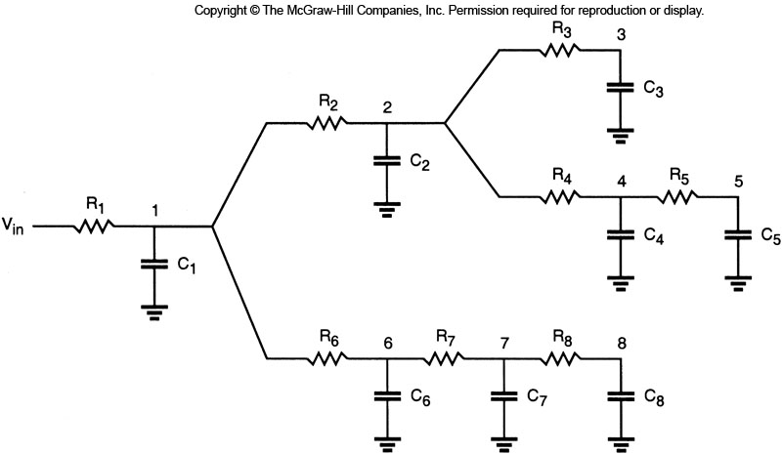
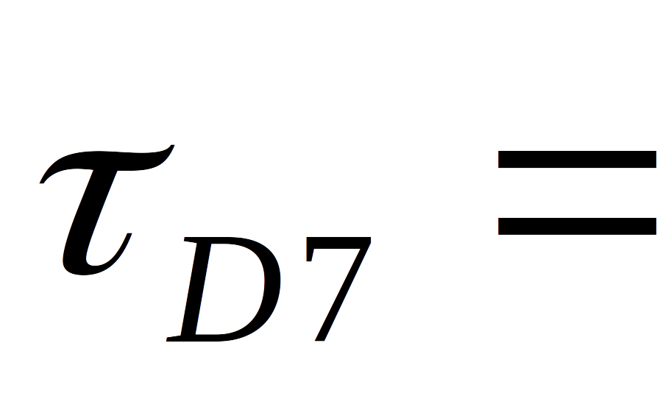
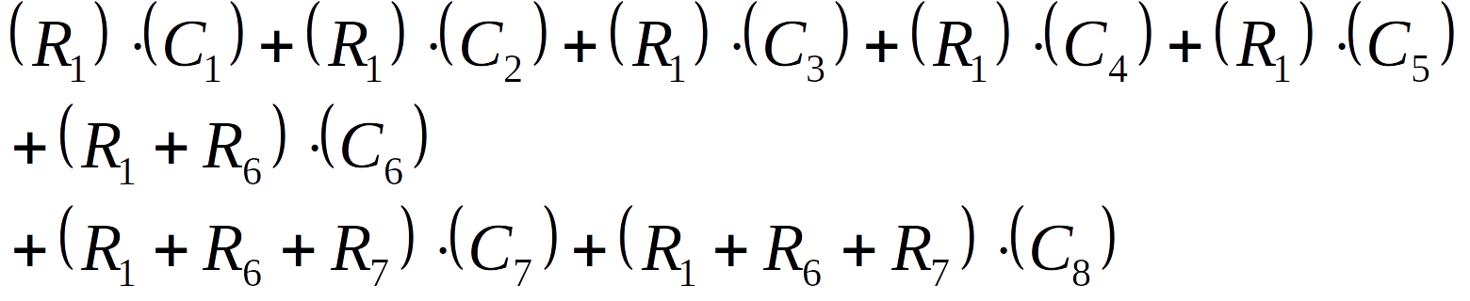
CMOS Switching Characteristics
Elmore Delay
- example: Find the expression for the equivalent RC from V_{in} to node 7:

Slide 35
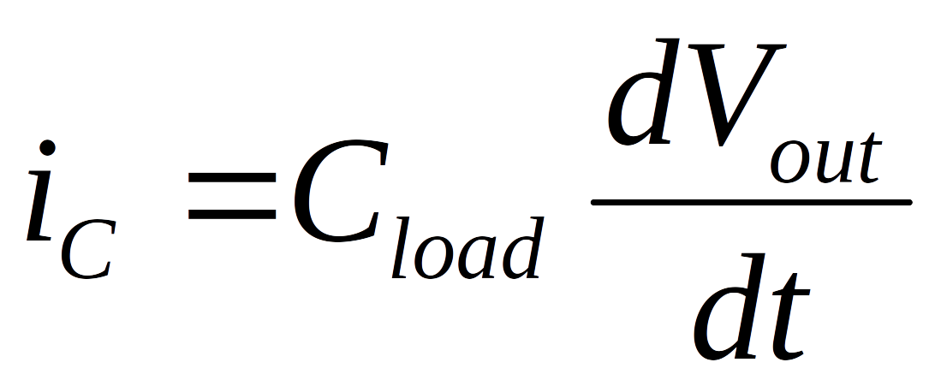
CMOS Switching Characteristics
Dynamic Power Consumption
- in theory, a CMOS gate does not consume any Static Power because the NMOS and PMOS
transistors are in the cut-off regions when driving V_{OH} or V_{OL}
- we know what there is leakage current in cut-off, however to the first order we neglect it.
- the majority of the power is due to the charging and discharging of C_{load}
- this is called Dynamic Power because it is AC in nature and only occurs when the gate switches
- this current is described as:
- since the current consumed is proportional to the number of times that the gate switches, we
need to make an assumption to the number of times per second that V_{out} switches
- since we have a binary system, we can assume that the output will be a ‘0’ 50% of the time
and a ‘1’ 50% of the time.
- we can model the voltage on V_{out} as a periodic square wave

Slide 36
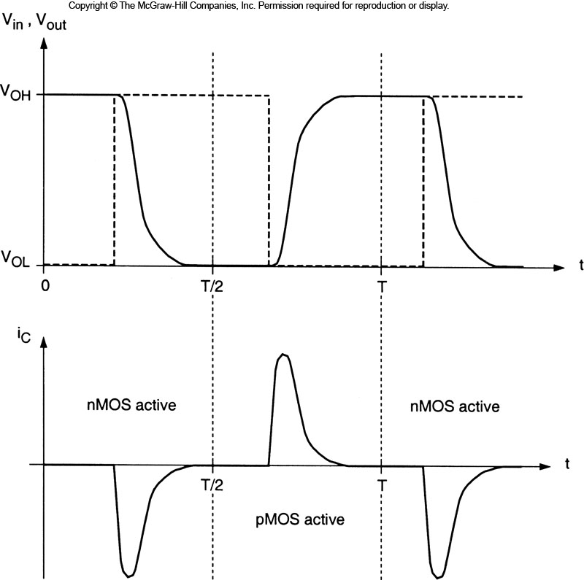
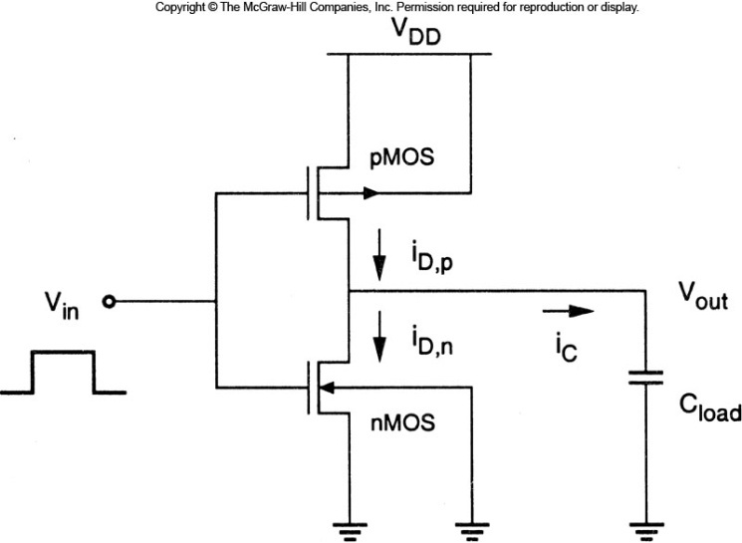
CMOS Switching Characteristics
Dynamic Power Consumption
- current will be drawn from V_{DD} and sunk into V_{SS} during a transition

Slide 37
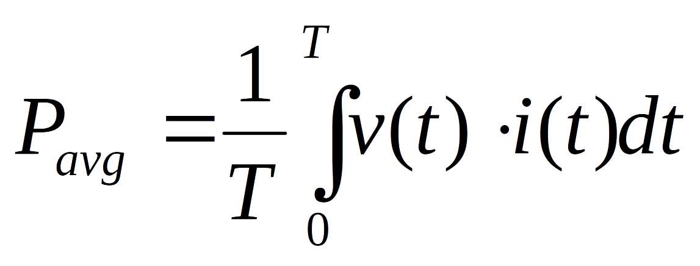
CMOS Switching Characteristics
Dynamic Power Consumption
- assuming a periodic input and output waveform, the average power dissipated by a device
over one period is given as:
- we split up the period into two sections:
0 →T/2 V_{in} transitions from a 0 to a 1, the NMOS discharges C_{load}
T/2 →T V_{in} transitions from a 1 to a 0, the PMOS charges C_{load}

Slide 38
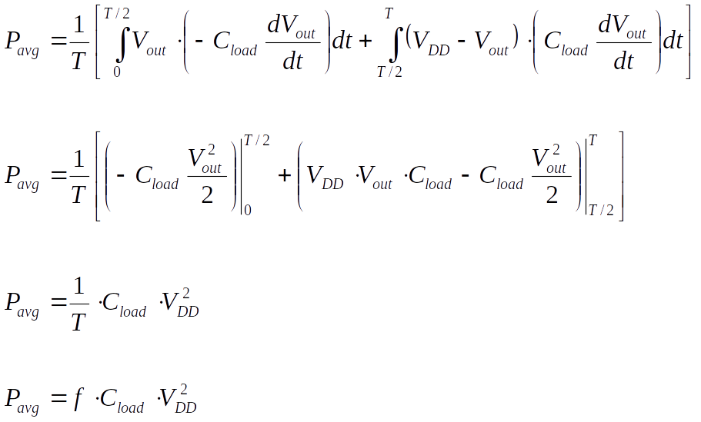
CMOS Switching Characteristics
Dynamic Power Consumption
- we can now re-write our average power expression as:

Slide 39
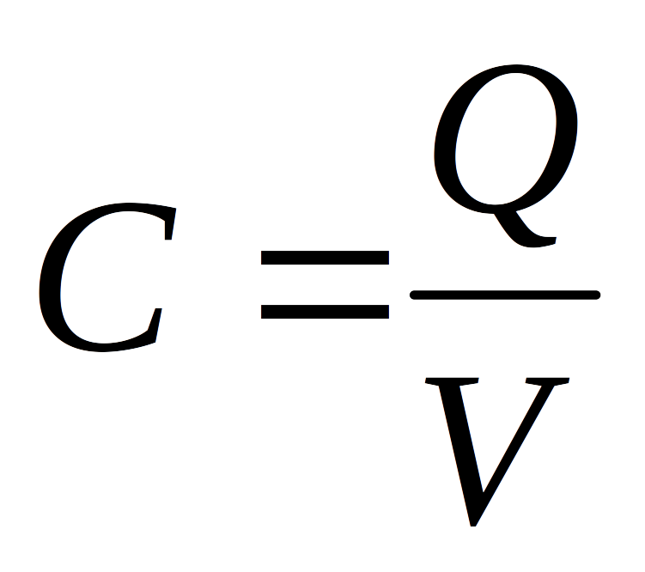
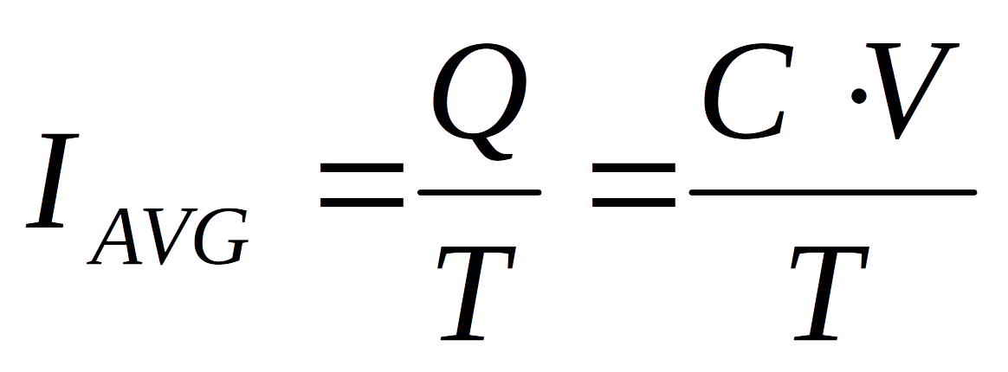
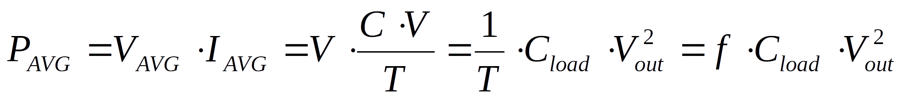
CMOS Switching Characteristics
Dynamic Power Consumption
- a more qualitative view of this power consumption is as follows:
Capacitance is defined as:
Each cycle, the average current in the capacitor is:
Power is I∙V, which gives:

Slide 40
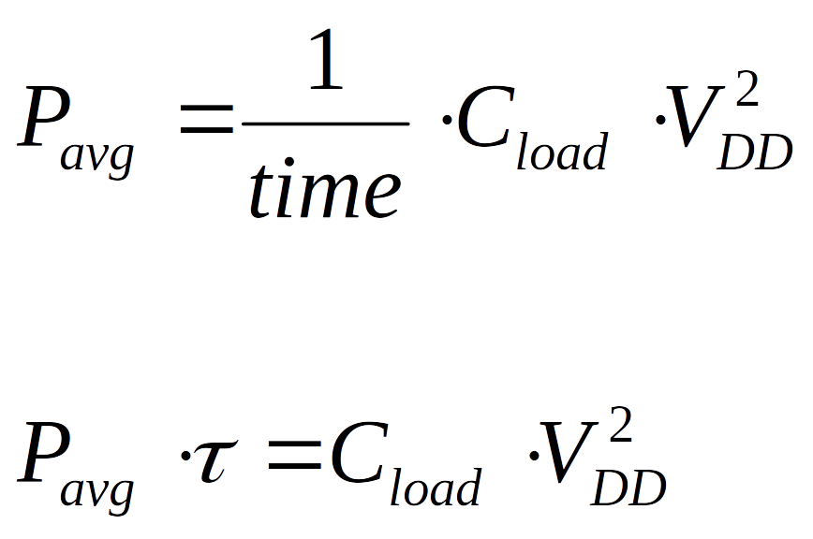
CMOS Switching Characteristics
Power Delay Product (PDP)
- another quality measure of a design is the PDP
- this is a measure of the energy required to switch logic levels in a given period.
- qualitatively, Power x Time is:

Slide 41
CMOS Switching Characteristics
Power Delay Product (PDP)
- as the delay goes down, the power goes up.
- the power going up is due to the increase in intrinsic junction capacitance of the driver.
- the delay reaches an ~asymptotic limit as the size is increased.
- the power increases as the size is increased.
- looking at the PDP can give an estimate of when you are optimally sized to deliver energy
in the most effective manner.
PDP=(C * V*V)

Slide 42
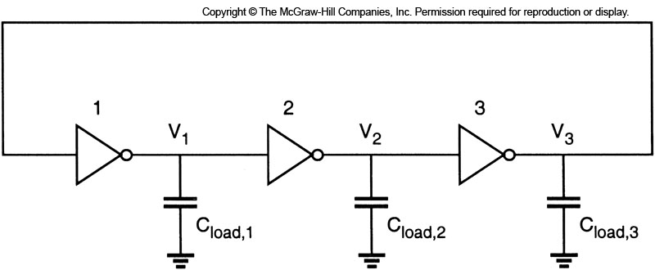
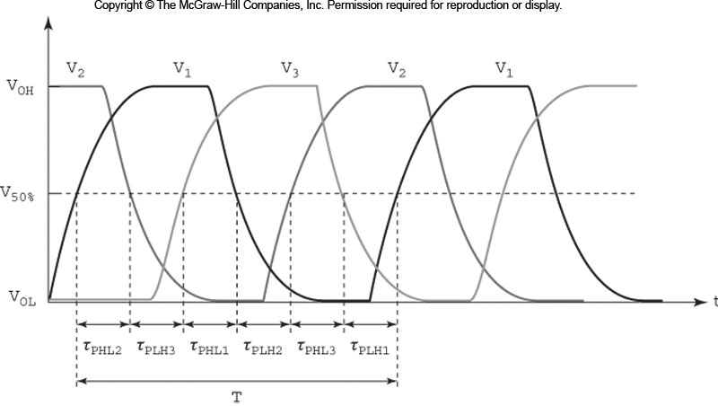

Ring Oscillator
Ring Oscillator
- if we connect a chain of inverters in a loop
and have an ODD number of inverters,
the circuit is inherently unstable.
- the circuit will oscillate between a
0 and 1 indefinitely.
- the frequency of the oscillation depends
on the gate delay of the inverter.
- this type of circuit is commonly used
to test the device delay of a given
process.
- this can also be used to create a clock.
- the clock frequency of the ring oscillator
is not typically controlled tight enough to be
used as the system clock.

