Slide 1

DIGITAL VLSI DESIGN
Dr. Rashmi Seethur
Department of Electronics and Communication Engg.

Slide 2

DIGITAL VLSI DESIGN
MODULE 4
Sequential MOS Logic circuits
Dr. Rashmi Seethur
Department of Electronics and Communication Engineering

Slide 3
Introduction
Sequential Circuit
Behavior of Bistable Elements
SR Latch Circuit
Clocked Latch and Flip Flop Circuits
CMOS D-Latch and Edge-Triggered Flip-Flop

Slide 4
Classification of logic circuits based on temporal behaviour

Slide 5
Sequential circuit

Slide 6
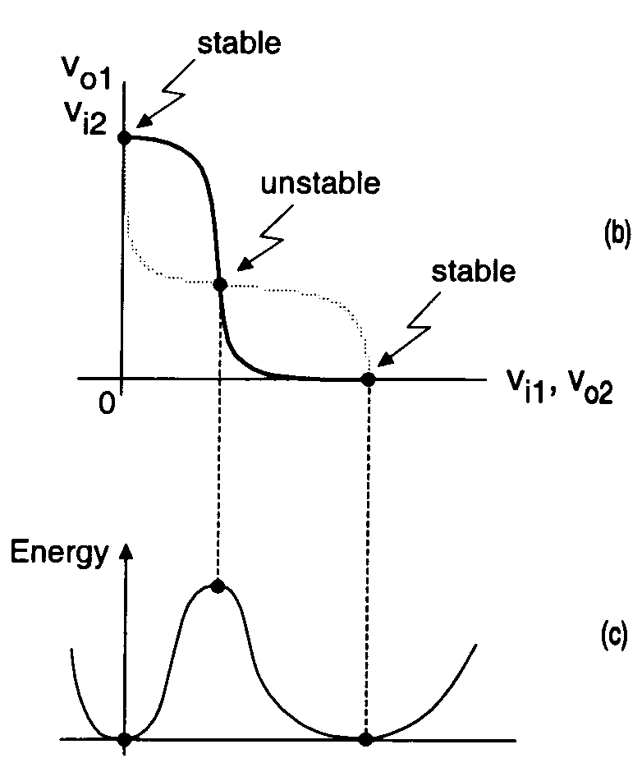
BiStable
Voltage gain of
inverters is larger
than unity at unstable Point,
a small voltage perturbation
at the input of any of the
inverters will be amplified,
causing the operation point
to move
to one of the stable points.
simple analogy the energy function
P ( x ) could be the potential energy of some one-dimensional
mechanical system. The gradient of P ( x ) is a “force”

Slide 7
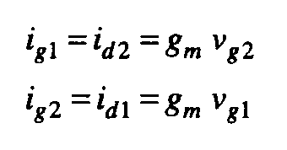
Bistable
At V₀₁ = V₀₂
Unstable
condition
where g_{m} = (g_{mN} + g_{mP} ) : All four
Transistor are in saturation
Direction
is determined
by initial
perturbation
polarity.
Output Expectation
(exponential!!!)

Slide 8
Continue…
Gate Capacitance >>> Drain Capacitance
Gate Charges
Derivative of small-signal gate voltages

Slide 9
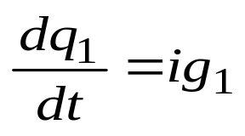

Continue…
Combination above three equations

Slide 10
Continue…
Combination of two equation yields 2nd order differential equation
Time behaviour of gate charge q1

Slide 11
Continue…

Slide 12
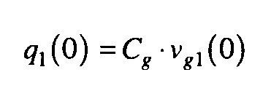
Continue…

Slide 13
Continue…
Assume ~ Large t

Slide 14
SR Latch Circuit

Slide 15
Gate-level Schematic/Block Diagram.

Slide 16
Truth Table

Slide 17
Operation Mode

Slide 18
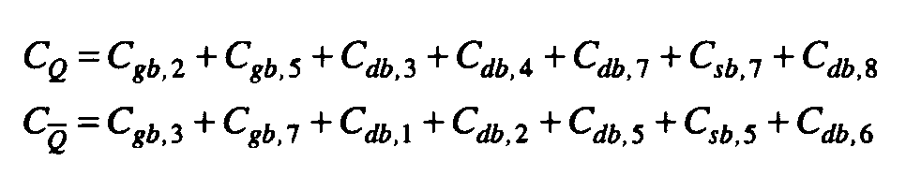
Capacitance

Slide 19
Circuit with Capacitance

Slide 20
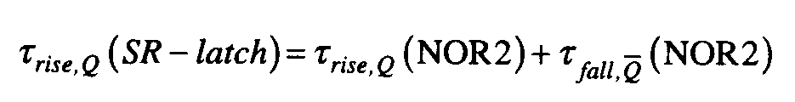
Rise Time

Slide 21
Depletion Load nMOS
(NOR2)

Slide 22
CMOS SR Latch circuit (NAND2)

Slide 23
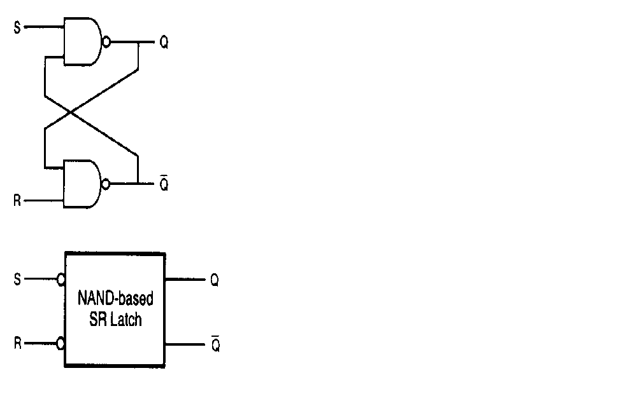
Gate Schematic(NAND)

Slide 24
Truth Table

Slide 25
Depletion Load nMOS (NAND)

Slide 26
Clocked Latch and Flip-Flop Circuits

Slide 27
Sample Input-Output Waveforms

Slide 28
AOI Implementation (NOR)

Slide 29
Gate Schematic (NAND), active low

Slide 30
Gate Schematic (NAND), active high

Slide 31
Partial Block Diagram

Slide 32
Gate Schematic

Slide 33
Block Diagram

Slide 34
All NAND Implementation

Slide 35
Detailed Truth Table
J, K Compliments Q will go to J value at the next clock edge. J, K HIGH, the output will reverse its state after each clock pulse.

Slide 36
NOR-based JK Latch

Slide 37
AOI Realization(NOR)

Slide 38
Toggle Switch

Slide 39
Master-Slave Flip Flop

Slide 40
Master-Slave Flip Flop

Slide 41
Master-Slave Flip Flop (NOR)
CLK is HIGH MASTER is enable. Slave is disable and retains its previous state.
CLK is LOW is disconnected while input of slaves are simultaneously coupled to the output of the slaves.

Slide 42
CMOS D-Latch and Edge-Triggered Flip Flop

Slide 43
CMOS Implementation

Slide 44
Simplified Schematic View

Slide 45
Timing Diagram

Slide 46
2nd CMOS Implementation

Slide 47
CMOS –ve Edge-triggered

Slide 48
Simulated Input-Output

Slide 49
Timing Violation

Slide 50
Layout

Slide 51
CMOS +ve Edge-triggered

Slide 52
Timing Diagram

Slide 53
References
S-M. Kang and Y. Leblebici ,CMOS Digital Integrated Circuits: Analysis and Design,, 3rd edition

