Slide 1

UE20EC254
DIGITAL COMMUNICATION
Department of Electronics and Communication Engg

Slide 2

Course Objectives
Understand the principles of amplitude and angle modulation
Learn the different sampling techniques
Understand the performance of different waveform coding techniques
Understand the idea of signal space
Learn the different digital modulation techniques

Slide 3
Course Outcomes
Students completing the course should be able to
Analyze the different analog modulation techniques
Analyze the different sampling techniques
Design quantization and pulse shaping systems
Develop detection rules for the given transmission scheme
Analyze the different coherent and non-coherent digital modulation techniques

Slide 4
Units
Amplitude and Angle Modulation
FM and Sampling
Quantization and Pulse Shaping
Intersymbol Interference and Signal Space Representation
Digital Modulation

Slide 5
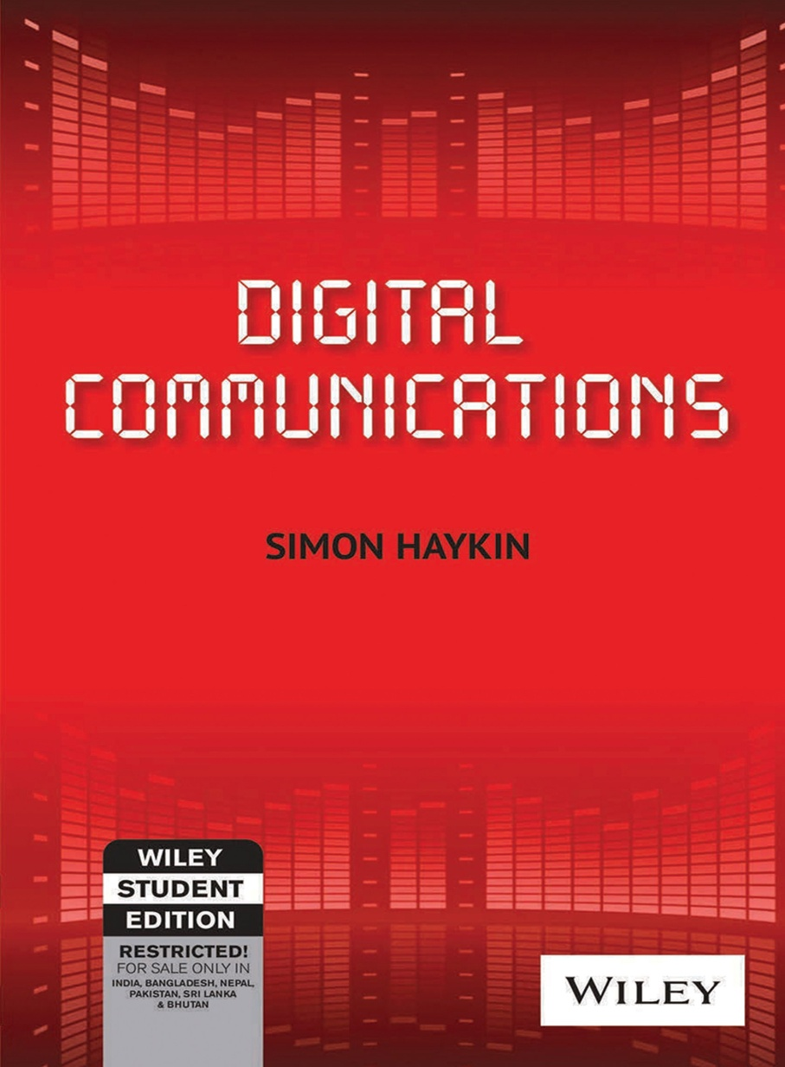
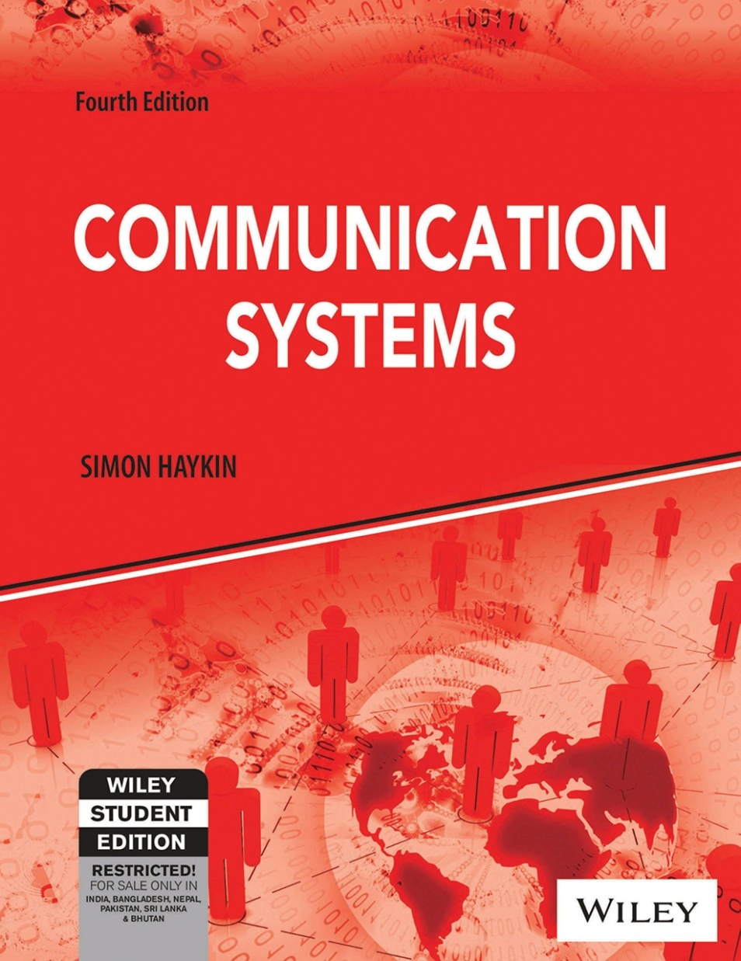
Text Books

Slide 6
INTRODUCTION
Motivation
Idea of communication : Transfer of information
Electrical Communication : How did it develop?
1. Telegraph
2. Telephone
3. Triode
4. TV
5. Shannon's Idea
6. transistor

Slide 7
INTRODUCTION
Basic Block Diagram of A Communication System
Source
Transmitter
Channel
Receiver
Destination

Slide 8
INTRODUCTION
Why Analog Communication?
Many communication systems still in use are analog
e.g.: Broadcast Systems
Helps in understanding digital communication
Real time operations
At very high frequencies ADC/DAC operations become difficult
Analog communication is useful in such situations
e.g.: 5G systems where hybrid analog/digital techniques are used

Slide 9
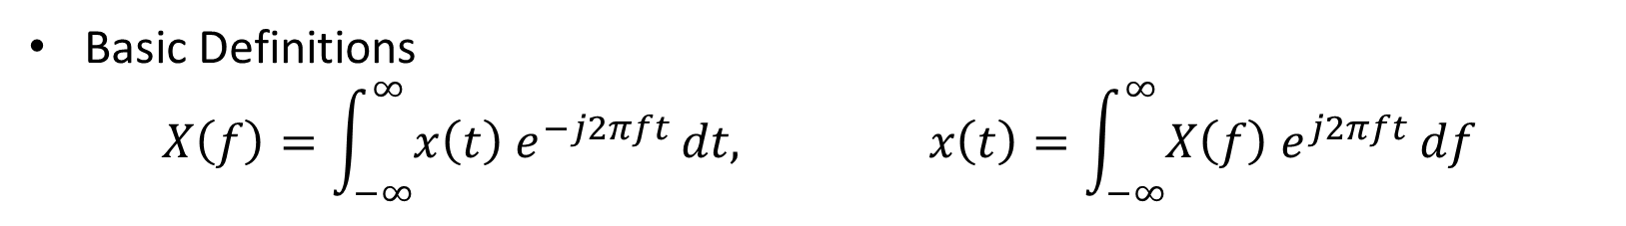
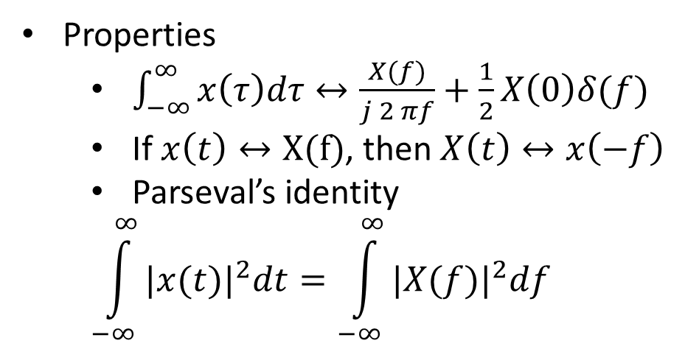
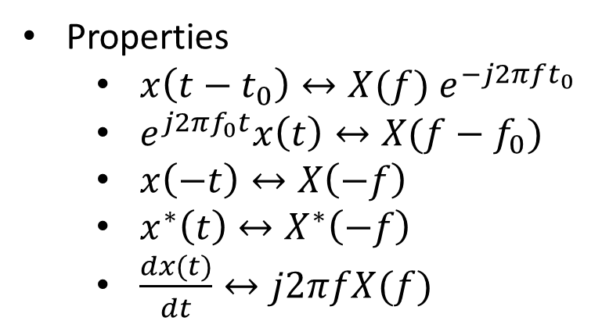
FOURIER TRANSFORM
Review
Basic Definitions
$$X\left(f\right)=\int_{−∞}^{∞}{x\left(t\right){ e}^{−j2πft}}dt, x\left(t\right)=\int_{−∞}^{∞}{X\left(f\right) e^{j2πft}}df$$
Properties
$x\left(t−t_{0}\right)↔X(f){ e}^{−j2πft_{0}}$
$e^{j2πf_{0}t}x\left(t\right)↔X(f−f_{0})$
$x\left(−t\right)↔X\left(−f\right)$
$x^{∗}\left(t\right)↔X^{∗}\left(−f\right)$
$\frac{dx(t)}{dt}↔j2πfX(f)$
Properties
$\int_{−∞}^{∞}{x\left(τ\right)dτ↔\frac{X(f)}{j 2 πf}+\frac{1}{2}X\left(0\right)δ(f)}$
If $x\left(t\right)↔X(f)$, then $X\left(t\right)↔x\left(−f\right)$
Parseval’s identity
$$\int_{−∞}^{∞}{{|x(t)|}^{2}dt}=\int_{−∞}^{∞}{{|X(f)|}^{2}df}$$

Slide 10
MODULATION
What and Why?
The information bearing signal is called message signal / modulating signal / baseband signal
The term baseband refers to band of frequencies occupied by the message signal
Modulation is a process by which some characteristic of carrier wave is varied in accordance with message signal
The carrier is typically a sinusoid, the result of modulation is called the modulated signal
Antenna height
To avoid interference from other baseband sources, since ”separation in time” is not practical , so we employ “separation in frequencies”
Efficient utilization of the available spectrum
To avoid man made noise in baseband frequencies

Slide 11
MODULATION
Types
Depending on the varied parameter of the carrier wave
1. Amplitude modulation
2. Frequency modulation
3. Phase modulation

Slide 12
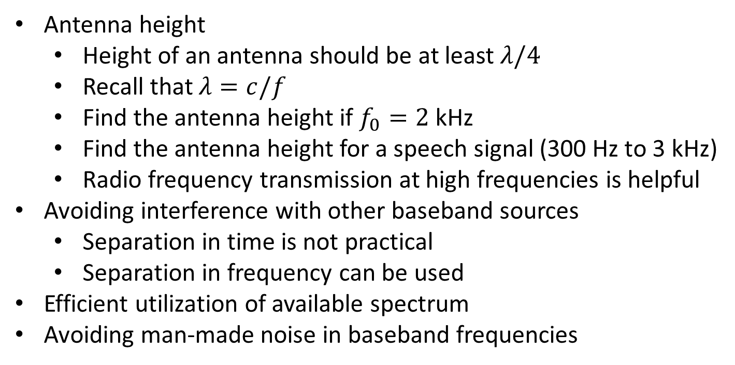
MODULATION
Need
Antenna height
Height of an antenna should be at least $λ/4$
Recall that $λ=c/f$
Find the antenna height if $f_{0}=2$ kHz
Find the antenna height for a speech signal (300 Hz to 3 kHz)
Radio frequency transmission at high frequencies is helpful
Avoiding interference with other baseband sources
Separation in time is not practical
Separation in frequency can be used
Efficient utilization of available spectrum
Avoiding man-made noise in baseband frequencies

Slide 13
Amplitude Modulation
Types
Standard Amplitude Modulation (AM)
Also called as Double-sideband full carrier (DSBFC) modulation
Transmit power is “wasted”
Channel bandwidth is “wasted”
Double-sideband suppressed carrier (DSBSC) modulation
Transmit power is saved due to suppression of carrier wave

Slide 14
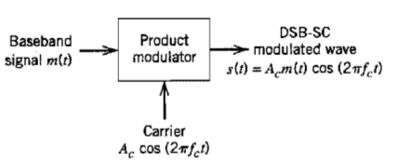
DSBSC
Modulation
This technique is the direct application of frequency shift property of Fourier transform

Slide 15


DSBSC
Modulation
The message signal m(t) is multiplied with the carrier to obtain the modulated waveform s(t).
By frequency shift property of FT

Slide 16
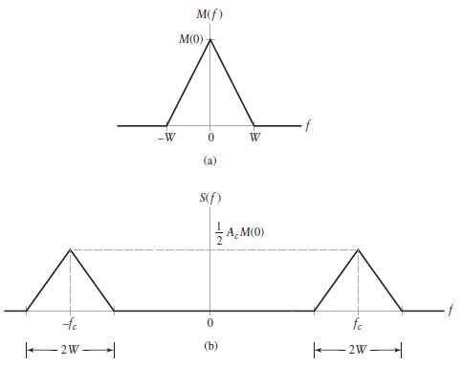
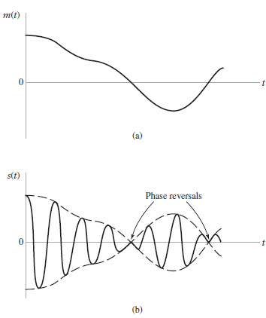
DSBSC
Frequency and Time Domain Representations

Slide 17
DSBSC
Side Note
Deterministic signals do not contain information
Only “Random” signals do
Hence, we need to consider random process and their power spectra
The above deterministic example is for illustration purpose only
Eventually, we consider random signals and their spectra

Slide 18
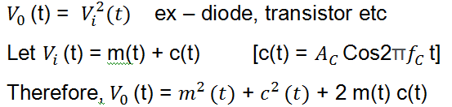
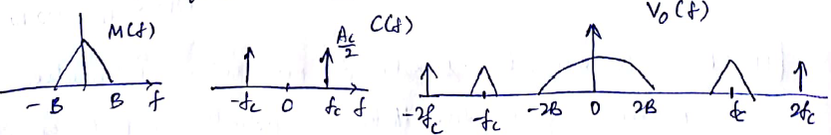
DSBSC
Generation: Method 1 – Using Non-Linearity
Consider a device with characteristic

Slide 19
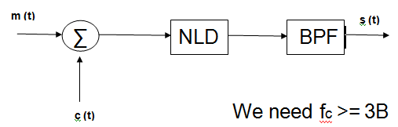

DSBSC
Generation: Method 1 – Using Non-Linearity
A BPF can be used to recover $m\left(t\right) c(t)$

Slide 20
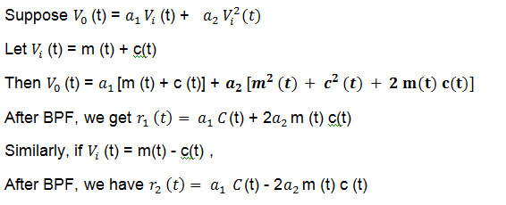
DSBSC
Generation: Method 1 – Using Non-Linearity

Slide 21
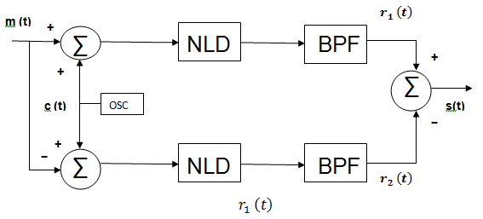
DSBSC
Generation: Method 1 – Using Non-Linearity
Therefore, we have the following structure

Slide 22
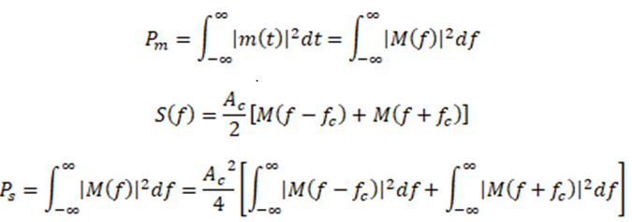

DSBSC
Average Power
Let m(t) have an average power of P_{m} Watts

Slide 23
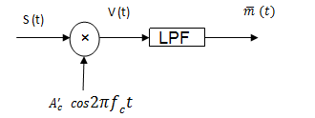
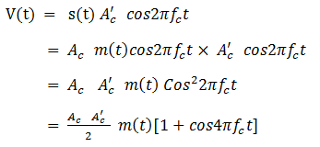
DSBSC
Coherent Demodulation
Coherent => A Local copy of carrier (with the same phase) is used at the receiver

Slide 24
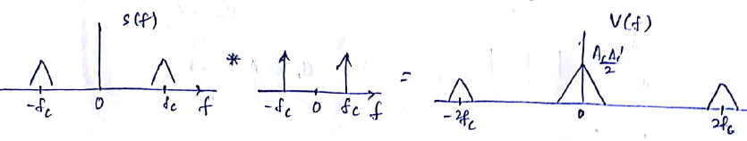

DSBSC
Coherent Demodulation
After LPF,

Slide 25
DSBSC
Example

Slide 26
DSBSC
Example

Slide 27
DSBSC
Example: Single Tone

Slide 28
DSBSC
Example: Single Tone

Slide 29
DSBSC
Example: Single Tone

Slide 30
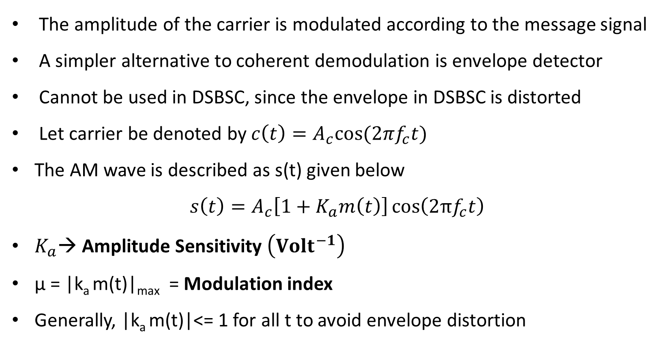
AMPLITUDE MODULATION
Basics
The amplitude of the carrier is modulated according to the message signal
A simpler alternative to coherent demodulation is envelope detector
Cannot be used in DSBSC, since the envelope in DSBSC is distorted
Let carrier be denoted by $c\left(t\right)=A_{c}cos(2πf_{c}t)$
The AM wave is described as s(t) given below
$$s\left(t\right)=A_{c}\left[1+K_{a}m\left(t\right)\right]\cos\left(2πf_{c}t\right)$$
$K_{a}$→ Amplitude Sensitivity $\left({Volt}^{−1}\right)$
µ = |k_{a}m(t)|_{max} = Modulation index
Generally, |k_{a}m(t)|<= 1 for all t to avoid envelope distortion

Slide 31
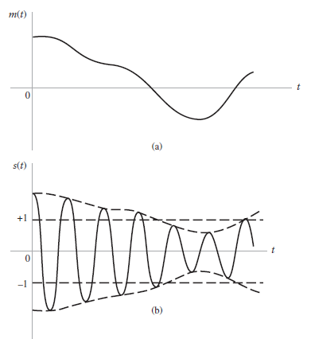
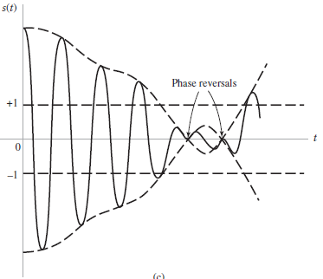
AMPLITUDE MODULATION
Effect of Modulation Index

Slide 32
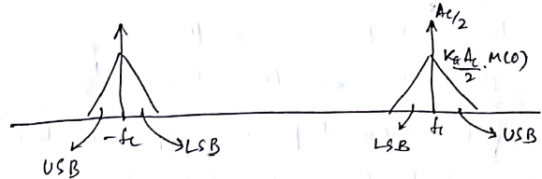
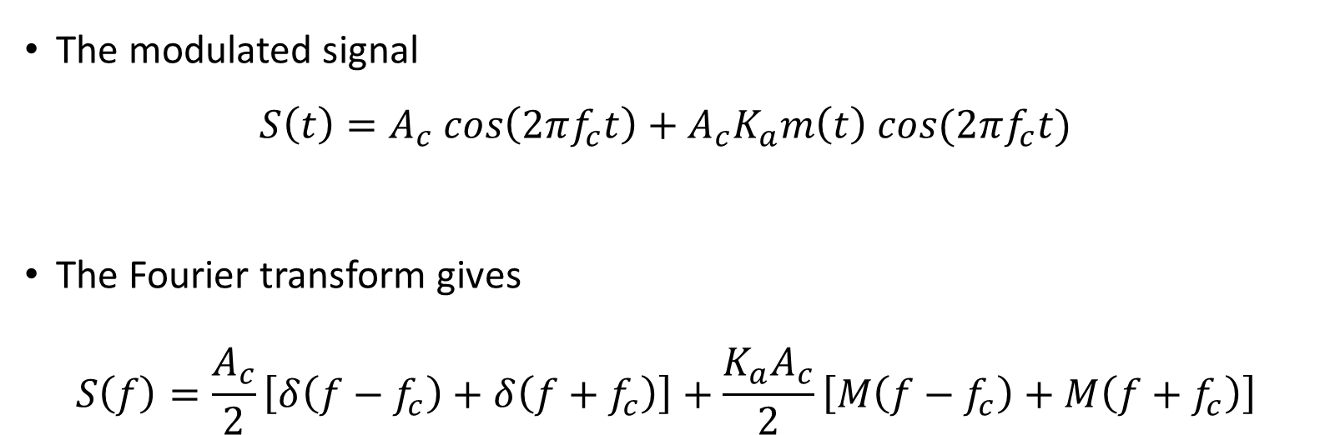
AMPLITUDE MODULATION
In Frequency Domain
The modulated signal
$$S\left(t\right)=A_{c} cos\left(2πf_{c}t\right)+A_{c}K_{a}m\left(t\right) cos(2πf_{c}t)$$
The Fourier transform gives
$$S\left(f\right)=\frac{A_{c}}{2}\left[δ\left(f−f_{c}\right)+δ\left(f+f_{c}\right)\right]+\frac{K_{a}A_{c}}{2}\left[M\left(f−f_{c}\right)+M\left(f+f_{c}\right)\right]$$
Carrier Component
Sidebands

Slide 33

AMPLITUDE MODULATION
Single Tone Modulation
The AM wave is given by

Slide 34
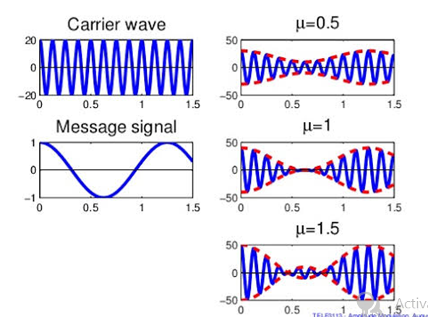

AMPLITUDE MODULATION
Single Tone Modulation
Envelope : a(t) =
amax =
amin =
or
When µ = 1 => 100 % Modulation , amin = 0

Slide 35


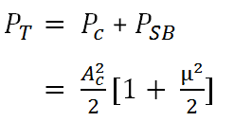
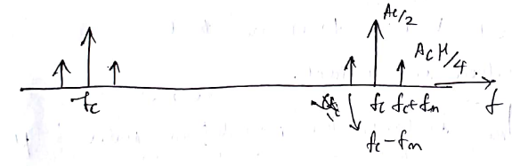
Carrier Power :
Side band Power :
Total Power :
AMPLITUDE MODULATION
Single Tone Modulation

Slide 36


AMPLITUDE MODULATION
Modulation / Power Efficiency
For $0≤$ µ $≤1$ , we have $0≤ƞ≤ \frac{1}{3}$
Most of the transmit power is spent on the carrier, that carries no information.

Slide 37


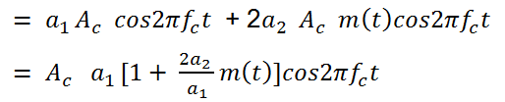

AMPLITUDE MODULATION
Generation: Method 1 – Squaring Generator
Consider the NLD with
After BPF s(t)

Slide 38
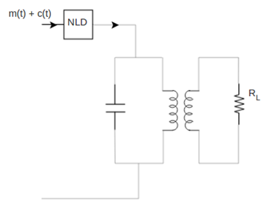
AMPLITUDE MODULATION
Generation: Method 1 – Squaring Generator

Slide 39
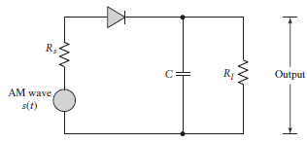
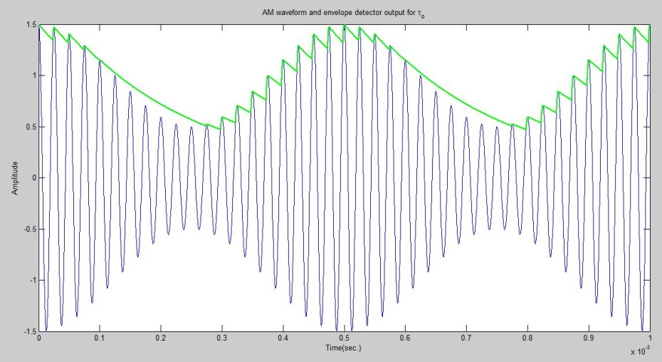
AMPLITUDE MODULATION
Detection: Envelope Detector

Slide 40
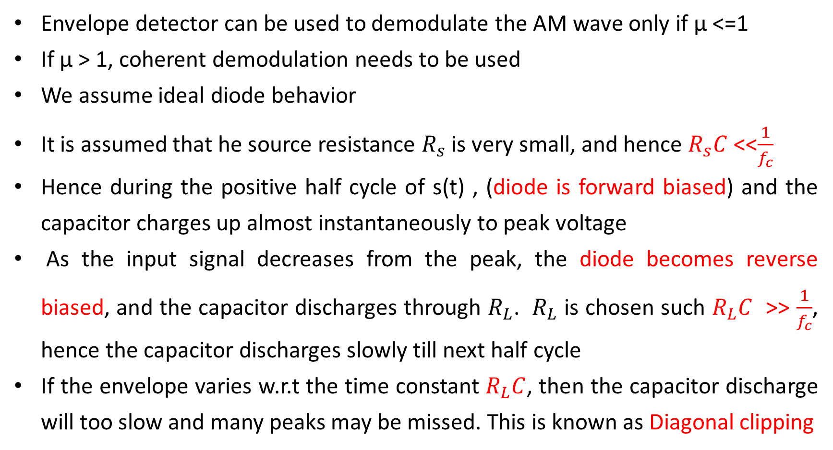
AMPLITUDE MODULATION
Detection: Envelope Detector
Envelope detector can be used to demodulate the AM wave only if µ <=1
If µ > 1, coherent demodulation needs to be used
We assume ideal diode behavior
It is assumed that he source resistance $R_{s}$ is very small, and hence $R_{s}C$<<$\frac{1}{f_{c}}$
Hence during the positive half cycle of s(t) , (diode is forward biased) and the capacitor charges up almost instantaneously to peak voltage
As the input signal decreases from the peak, the diode becomes reverse biased, and the capacitor discharges through $R_{L}$. $R_{L}$ is chosen such $R_{L}C$>>$\frac{1}{f_{c}}$, hence the capacitor discharges slowly till next half cycle
If the envelope varies w.r.t the time constant $R_{L}C$,then the capacitor discharge will too slow and many peaks may be missed. This is known as Diagonal clipping

Slide 41

AMPLITUDE MODULATION
Avoiding Diagonal Clipping
To avoid this we need to ensure ${\text{R}}_{L}$C<<$\frac{1}{B}$
Overall we require $\frac{1}{f_{c}}$<<$R_{L}C$<<$\frac{1}{B}$
The remaining ripple is removed by LPF

Slide 42
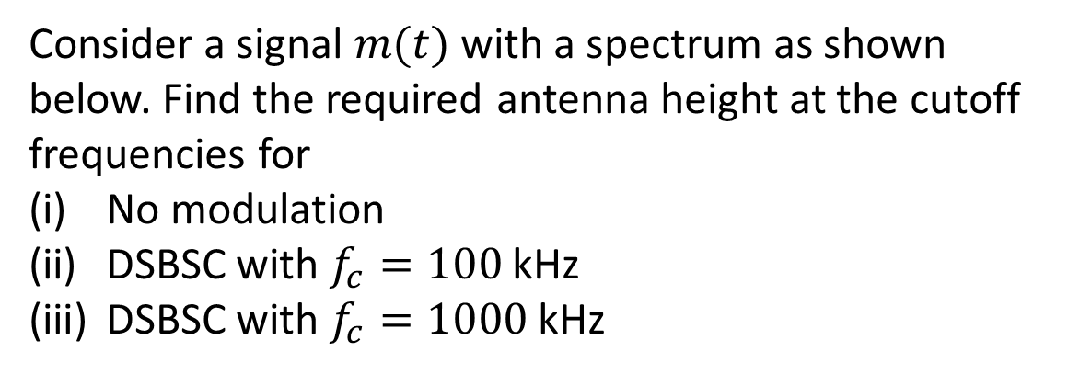
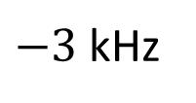
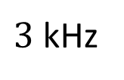


DSBSC
Problem 1 – Antenna Height
Consider a signal $m(t)$ with a spectrum as shown below. Find the required antenna height at the cutoff frequencies for
No modulation
DSBSC with $f_{c}=100$ kHz
DSBSC with $f_{c}=1000$ kHz
$$M(f)$$
$$f$$
$−3$ kHz
$3$ kHz

Slide 43
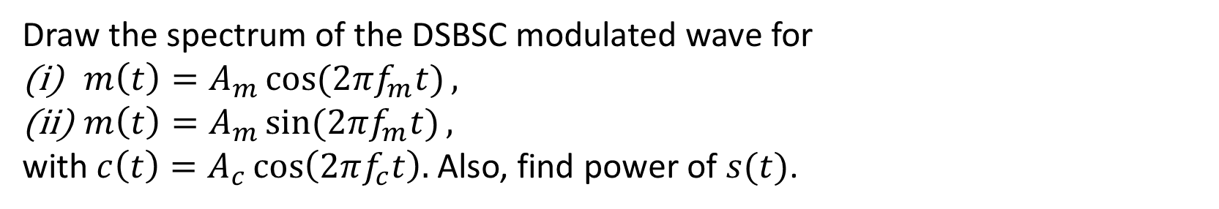
DSBSC
Problem 2 – Single Tone
Draw the spectrum of the DSBSC modulated wave for
$m\left(t\right)=A_{m}\cos{(2πf_{m}t)},$
$m\left(t\right)=A_{m}\sin{(2πf_{m}t)},$
with $c\left(t\right)=A_{c}\cos\left(2πf_{c}t\right).$ Also, find power of $s(t)$.

Slide 44
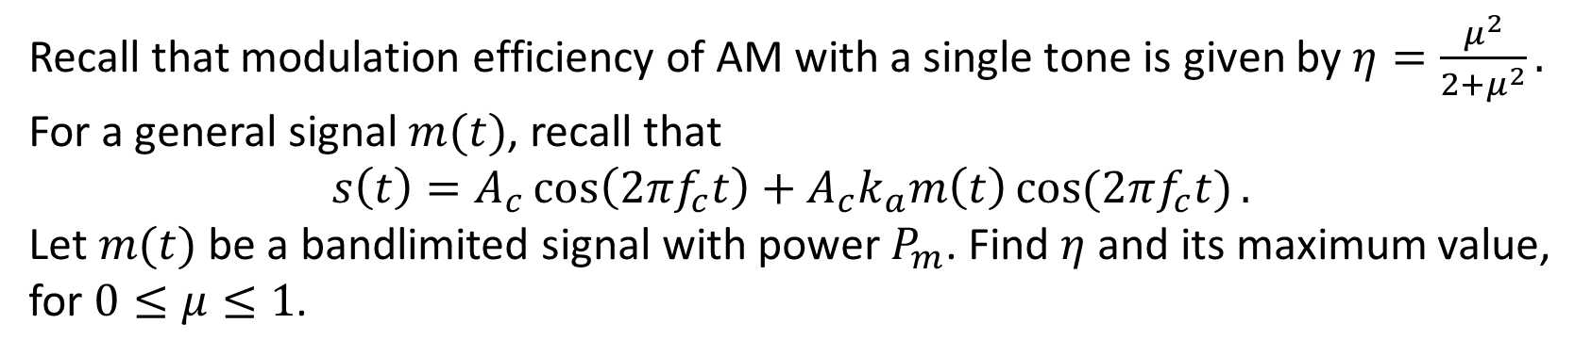
AM
Problem 1 – Modulation Efficiency – Homework Problem
Recall that modulation efficiency of AM with a single tone is given by $η=\frac{μ^{2}}{2+μ^{2}}.$ For a general signal $m(t)$, recall that
$$s\left(t\right)=A_{c}\cos\left(2πf_{c}t\right)+A_{c}k_{a}m\left(t\right)\cos{(2πf_{c}t)}.$$
Let $m(t)$ be a bandlimited signal with power $P_{m}$. Find $η$ and its maximum value, for $0≤μ≤1$.

Slide 45
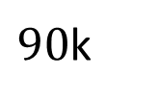

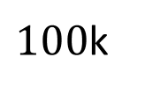



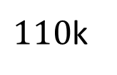
AM
Problem 2 – Modulation Efficiency
From the given spectrum $S(f)$, find $s\left(t\right), μ, η$ and $P_{s}$.
$$S(f)$$
$$0.5$$
$$0.2$$
$$f$$
$90$k
$100$k
$110$k

Slide 46
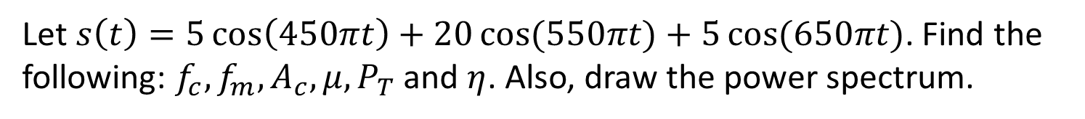
AM
Problem 3 – Modulation Parameters
Let $s\left(t\right)=5\cos\left(450πt\right)+20\cos{(550πt)}+5\cos{(650πt)}$. Find the following: $f_{c},f_{m}, A_{c},μ,P_{T}$ and $η$. Also, draw the power spectrum.

Slide 47




AM
Problem 4 – Modulation Parameters
From the given power spectrum, find $P_{T}, μ,$and $η$.
$$S(f)$$
$$25$$
$$5$$
$$f$$
$$f_{c}$$
$$f_{c}+f_{m}$$

Slide 48
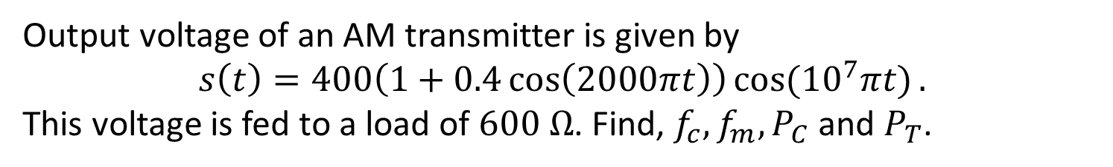
AM
Problem 5 – AM Wave as Voltage
Output voltage of an AM transmitter is given by
$$s\left(t\right)=400\left(1+0.4\cos\left(2000πt\right)\right)\cos{({10}^{7}πt)}.$$
This voltage is fed to a load of $600 Ω$. Find, $f_{c}, f_{m}, P_{C}$ and $P_{T}$.

Slide 49
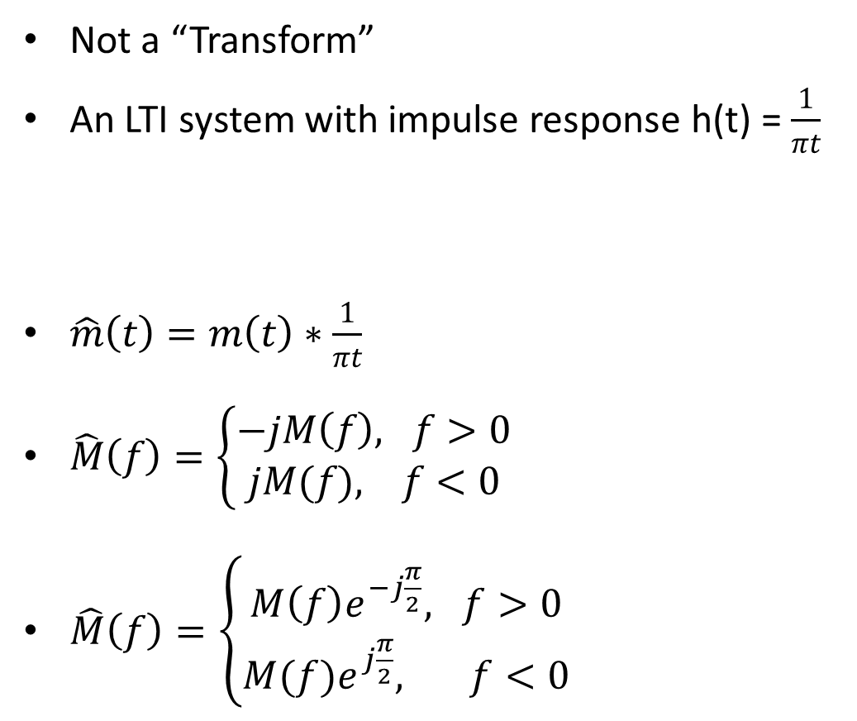
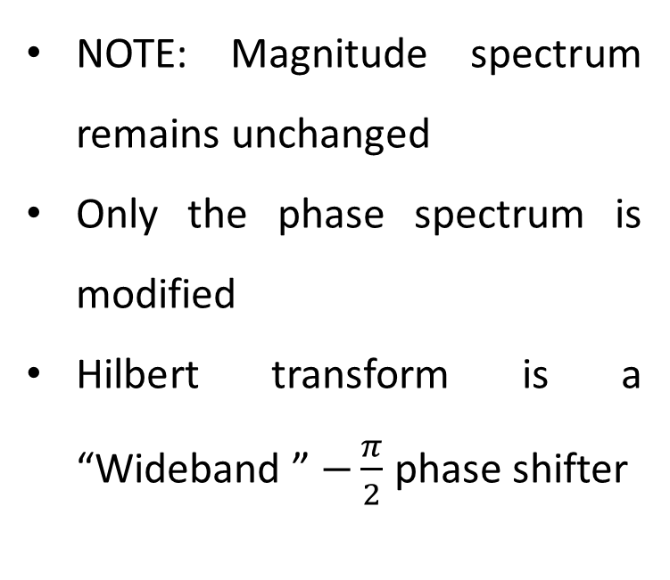

HILBERT TRANFORM
Definition
Not a “Transform”
An LTI system with impulse response h(t) = $\frac{1}{πt}$
$\hat{m}\left(t\right)=m\left(t\right)∗\frac{1}{πt}$
$\hat{M}\left(f\right)=\left\{\begin{aligned}−jM\left(f\right), f>0 \\ jM(f), f<0\end{aligned}\right.$
$\hat{M}\left(f\right)=\left\{\begin{aligned}M\left(f\right)e^{−j\frac{π}{2}}, f>0 \\ &M(f)e^{j\frac{π}{2}}, f<0\end{aligned}\right.$
NOTE: Magnitude spectrum remains unchanged
Only the phase spectrum is modified
Hilbert transform is a “Wideband ” $−\frac{π}{2}$ phase shifter
m(t)
$$\hat{m}(t)$$
h(t)

Slide 50
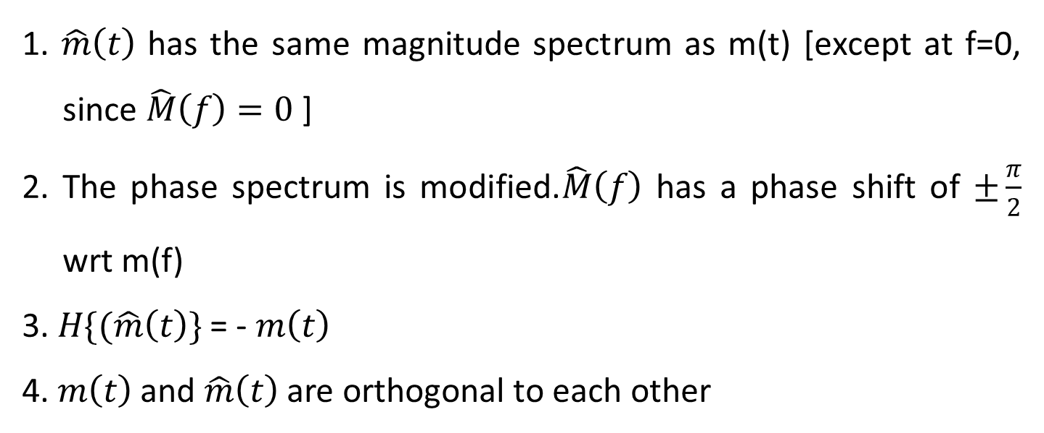
HILBERT TRANFORM
Properties
1. $\hat{m}\left(t\right)$ has the same magnitude spectrum as m(t) [except at f=0, since $\hat{M}\left(f\right)=0$ ]
2. The phase spectrum is modified.$\hat{M}\left(f\right)$ has a phase shift of $±\frac{π}{2}$ wrt m(f)
3. $H\{(\hat{m}\left(t\right)\}$ = - $m\left(t\right)$
4. $m\left(t\right)$ and $\hat{m}\left(t\right)$ are orthogonal to each other

Slide 51
Canonical representation of bandpass signals
Motivation
Directly evaluating the convolution of a bandpass signal with a bandpass system is problematic
For sampling bandpass signals
A single signal processing unit can deal with multiple sources

Slide 52
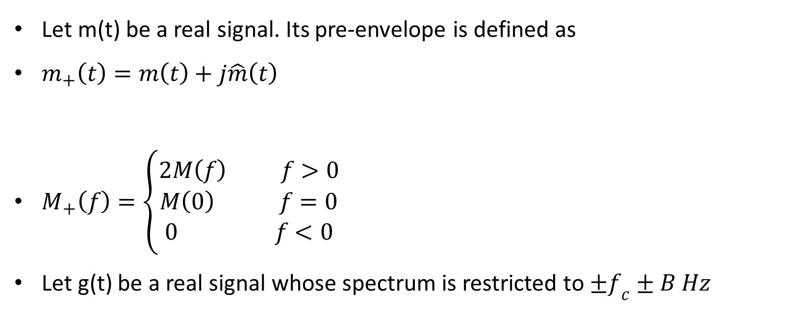
Canonical representation of bandpass signals
Pre-Envelope
Let m(t) be a real signal. Its pre-envelope is defined as
$m_{+}\left(t\right)=m\left(t\right)+j\hat{m}\left(t\right)$
$M_{+}\left(f\right)=\left\{\begin{aligned}2M\left(f\right) f>0 \\ M\left(0\right) f=0 \\ 0 f<0\end{aligned}\right.$
Let g(t) be a real signal whose spectrum is restricted to $±f_{c}±B Hz$

Slide 53
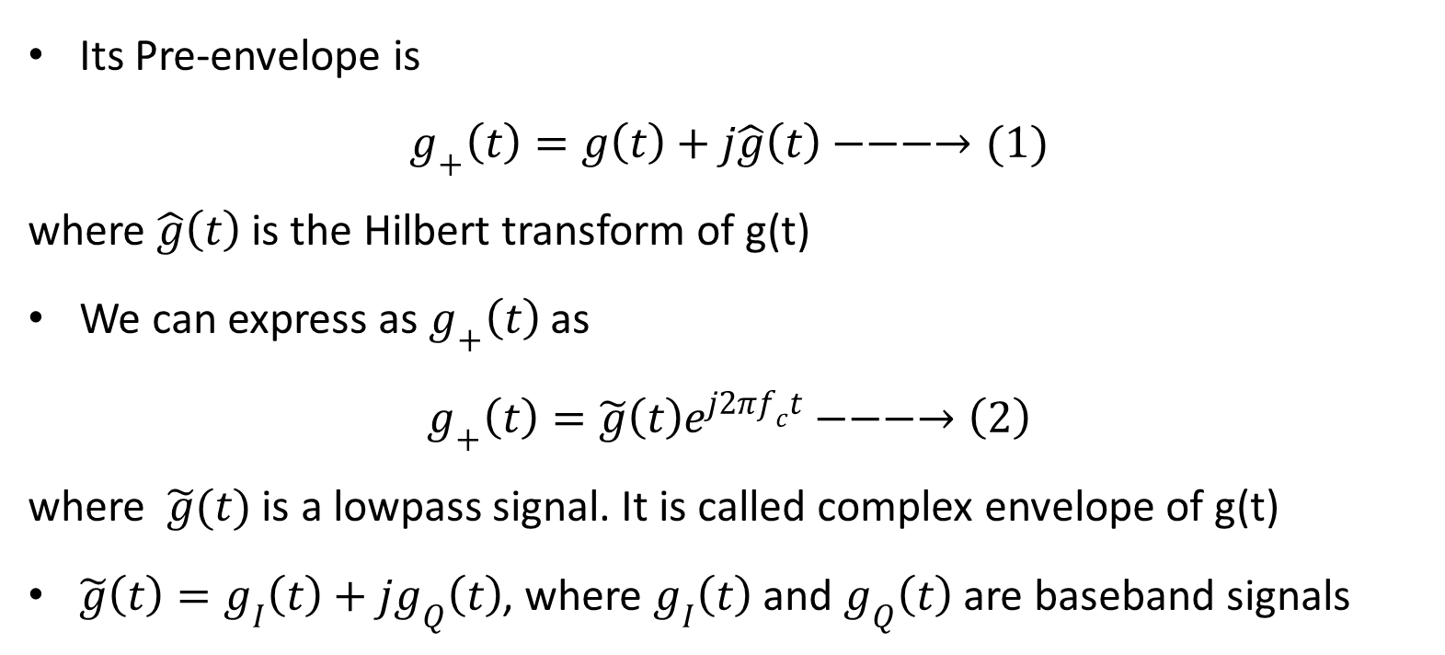
Canonical representation of bandpass signals
Pre-Envelope
Its Pre-envelope is
$$g_{+}\left(t\right)=g\left(t\right)+j\hat{g}\left(t\right)−−−→(1)$$
where $\hat{g}\left(t\right)$ is the Hilbert transform of g(t)
We can express as $g_{+}\left(t\right)$ as
$$g_{+}\left(t\right)=\tilde{g}\left(t\right)e^{j2πf_{c}t}−−−→\left(2\right)$$
where $\tilde{g}(t)$ is a lowpass signal. It is called complex envelope of g(t)
$\tilde{g}\left(t\right)=g_{I}\left(t\right)+jg_{Q}\left(t\right)$, where $g_{I}\left(t\right)$ and $g_{Q}\left(t\right)$ are baseband signals

Slide 54
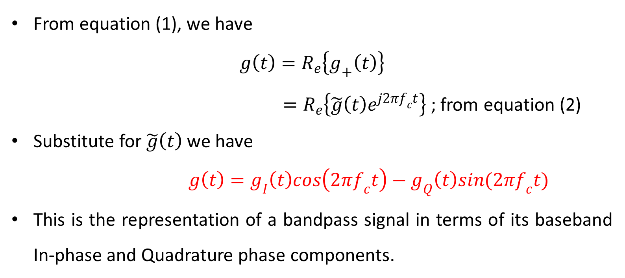
Canonical representation of bandpass signals
Pre-Envelope
From equation (1), we have
$$g\left(t\right)=R_{e}\left\{g_{+}\left(t\right)\right\}$$
$=R_{e}\left\{\tilde{g}\left(t\right)e^{j2πf_{c}t}\right\}$ ; from equation (2)
Substitute for $\tilde{g}\left(t\right)$ we have
$$g\left(t\right)=g_{I}\left(t\right)cos\left(2πf_{c}t\right)−g_{Q}\left(t\right)sin(2πf_{c}t)$$
This is the representation of a bandpass signal in terms of its baseband In-phase and Quadrature phase components.

Slide 55
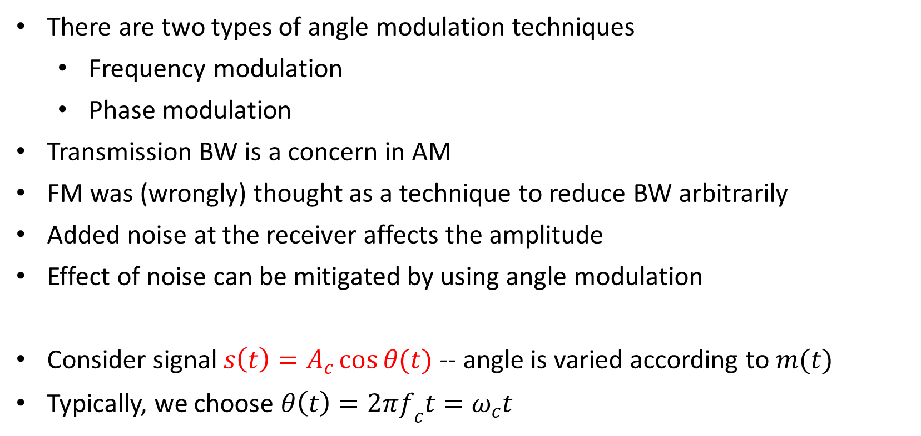
ANGLE MODULATION
Types and Details
There are two types of angle modulation techniques
Frequency modulation
Phase modulation
Transmission BW is a concern in AM
FM was (wrongly) thought as a technique to reduce BW arbitrarily
Added noise at the receiver affects the amplitude
Effect of noise can be mitigated by using angle modulation
Consider signal $s\left(t\right)=A_{c}\cos{θ(t)}$ -- angle is varied according to $m(t)$
Typically, we choose $θ\left(t\right)=2πf_{c}t=ω_{c}t$

Slide 56


ANGLE MODULATION
Phase Modulation
The expression for a phase modulated signal (“similar” to AM) is given by
$$s\left(t\right)=A_{c}\cos{[2πf_{c}t+k_{p}m(t)]}$$
Here, $k_{p}$ is called as phase sensitivity (rad/V)
If there are discontinuities in $m(t)⇒$ Discontinuities in phase of modulated signal $⇒$ Unwanted high frequency components
To over the above disadvantage, frequency modulation is used
Note that the instantaneous frequency $f_{i}\left(t\right)=\frac{1}{2π}\frac{dθ_{i}(t)}{dt}$
$$θ(t)$$

Slide 57


ANGLE MODULATION
Frequency Modulation
Instantaneous frequency of carrier is modulated by the message signal
The instantaneous frequency is modelled as $f_{i}\left(t\right)=f_{c}+k_{f}m(t)$
Here, $k_{f}$ is the frequency sensitivity (Hz/V)
Recall that the frequency is the rate of change of phase
$$θ\left(t\right)=2π\int_{0}^{t}{f_{i}\left(τ\right) dτ}=2πf_{c}t+2πk_{f}\int_{0}^{t}{m\left(τ\right) dτ}$$
Therefore, the modulated signal is given as
$$s\left(t\right)=A_{c}\cos\left\{2πf_{c}t+2πk_{f}\int_{0}^{t}{m\left(τ\right) dτ}\right\}$$
Maximum frequency deviation/shift: $Δf=\max\left|f_{i}\left(t\right)−f_{c}\right|=k_{f}\max{|m(t)|}$
$$θ(t)$$

Slide 58

PHASE MODULATION
Single Tone Modulation
We consider $m\left(t\right)=A_{m}\cos{(2πf_{m}t)}$ -- a sinusoidal signal
It can be seen that $s\left(t\right)=A_{c}\cos{[2πf_{c}t+k_{p}A_{m}\cos{(2πf_{m}t})]}$
For illustration, plotting phase variation is difficult; hence we work with instantaneous frequency, since it is easier to plot/analyze
The instantaneous frequency can be derived to be
$$f_{i}\left(t\right)=f_{c}+\frac{k_{p}}{2π} \frac{dm(t)}{dt}=f_{c}−k_{p}A_{m}f_{m}\sin{(2πf_{m}t)}$$
From above, note that the maximum frequency shift
$$Δf=k_{p}A_{m}f_{m}=βf_{m}$$
Here, $β=k_{p}A_{m}$ is the maximum phase shift

Slide 59

Frequency MODULATION
Single Tone Modulation
We consider $m\left(t\right)=A_{m}\cos{(2πf_{m}t)}$ -- a sinusoidal signal
It can be seen that
$$s\left(t\right)=A_{c}\cos\left\{2πf_{c}t+2πk_{f}\int_{0}^{t}{A_{m}\cos\left(2πf_{m}τ\right)dτ}\right\}$$
This can be further simplified as $s\left(t\right)=A_{c}\cos\left\{2πf_{c}t+\frac{k_{f}A_{m}}{f_{m}}\sin{(2πf_{m}t)}\right\}$
Therefore, maximum frequency shift $Δf=k_{f}A_{m}$
Parameter $β=\frac{k_{f}A_{m}}{f_{m}}=\frac{Δf}{f_{m}}$ is defined as the modulation index for FM
Also, $β$ is the maximum phase deviation for FM
Narrowband FM: $β≪1$ Wideband FM: $β≫1$

Slide 60




RELATION Between fm and pm
Following the Definitions of $s\left(t\right)$ and $f_{i}(t)$
$$\frac{d}{dt}(.)$$
FM
Generator
$$m(t)$$
PM Wave
$$\int_{0}^{t}{(.)}$$
PM
Generator
$$m(t)$$
FM Wave

Slide 61


RELATION Between fm and pm
Time-Domain Waveforms

Slide 62

FREQUENCY MODULATION
Narrowband FM
Once again, we consider $m\left(t\right)=A_{m}\cos{(2πf_{m}t)}$ -- a sinusoidal signal
Recall that $s\left(t\right)=A_{c}\cos\left\{2πf_{c}t+2πk_{f}\int_{0}^{t}{A_{m}\cos\left(2πf_{m}τ\right)dτ}\right\}$
Since $β≪1$ for narrowband FM, we use the following approximations
$$\cos\left[β\sin\left(2πf_{c}t\right)\right]≈1, \sin\left[β\sin{(2πf_{c}t)}\right]≈β\sin{(2πf_{c}t)}$$
To simplify $s(t)$ as
$$s\left(t\right)=A_{c}\cos{(2πf_{c}t)}+\frac{A_{c}β}{2}\cos\left(2π\left(f_{c}+f_{m}\right)t\right)−\frac{A_{c}β}{2}\cos\left(2π\left(f_{c}−f_{m}\right)t\right)$$
Comparing with single tone AM equation, which was
$$s\left(t\right)=A_{c}\cos{(2πf_{c}t)}+\frac{A_{c}μ}{2}\cos\left(2π\left(f_{c}+f_{m}\right)t\right)+\frac{A_{c}μ}{2}\cos\left(2π\left(f_{c}−f_{m}\right)t\right)$$

Slide 63















Narrowband FM
Spectrum and Comparison with AM
$$|S(f)|$$
$$\left\lfloor S(f)\right.$$
$$π$$
$${A_{c}}/2$$
$$f_{c}−f_{m}$$
$$f$$
$${A_{c}β}/4$$
$${−(f}_{c}−f_{m})$$
$$f$$
$$−π$$
$${−f}_{c}$$
$$f_{c}−f_{m}$$
$$f_{c}$$
$$f_{c}+f_{m}$$
In AM, sideband are in phase with the carrier
In NBFM, the LSB has an offset of $π$ radians with respect to carrier
BW for both AM and NBFM are $2f_{m}$

Slide 64
THANK YOU
Dr. Sanjeev G.
Department of Electronics and
Communication Engineering
sanjeevg@pes.edu
+91 80 2672 1983 Extn 838

