Slide 1
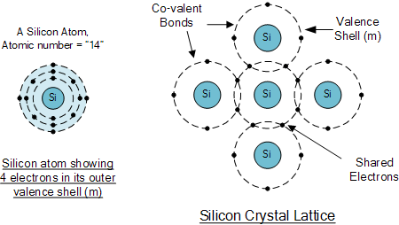
A little bit about physics (1)

Slide 2
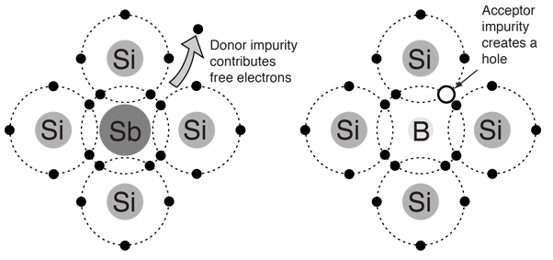

Slide 3
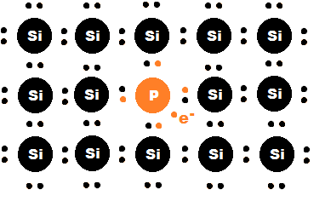
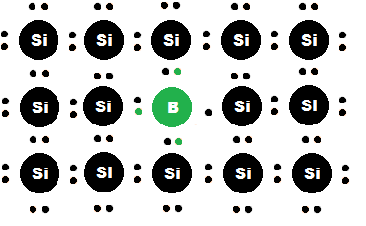
A little bit about physics (2)
Barron, phosphorus, and silicon
N-type P-type

Slide 4
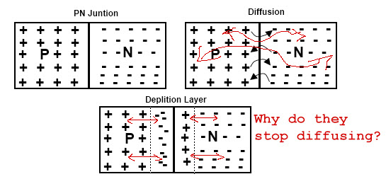
PN junction

Slide 5
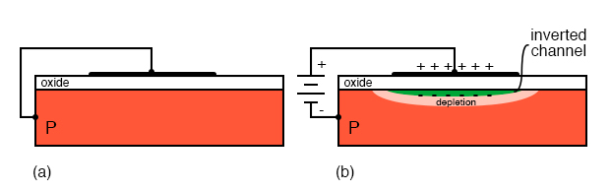
Just a little bit of Electrical (1)

Slide 6
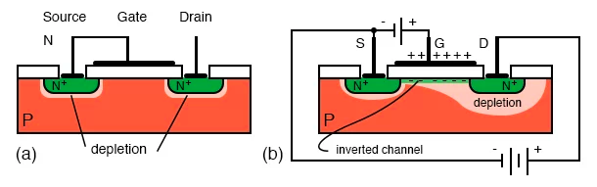
Just a little bit of Electrical (2)

Slide 7
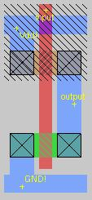

Complementary metal–oxide–semiconductor (CMOS) ”Inverter (NOT) ”

Slide 8
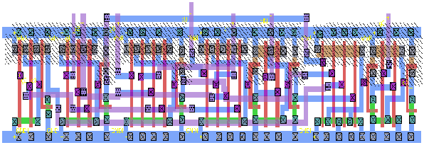
Carry lookahead adder; computing carry

Slide 9
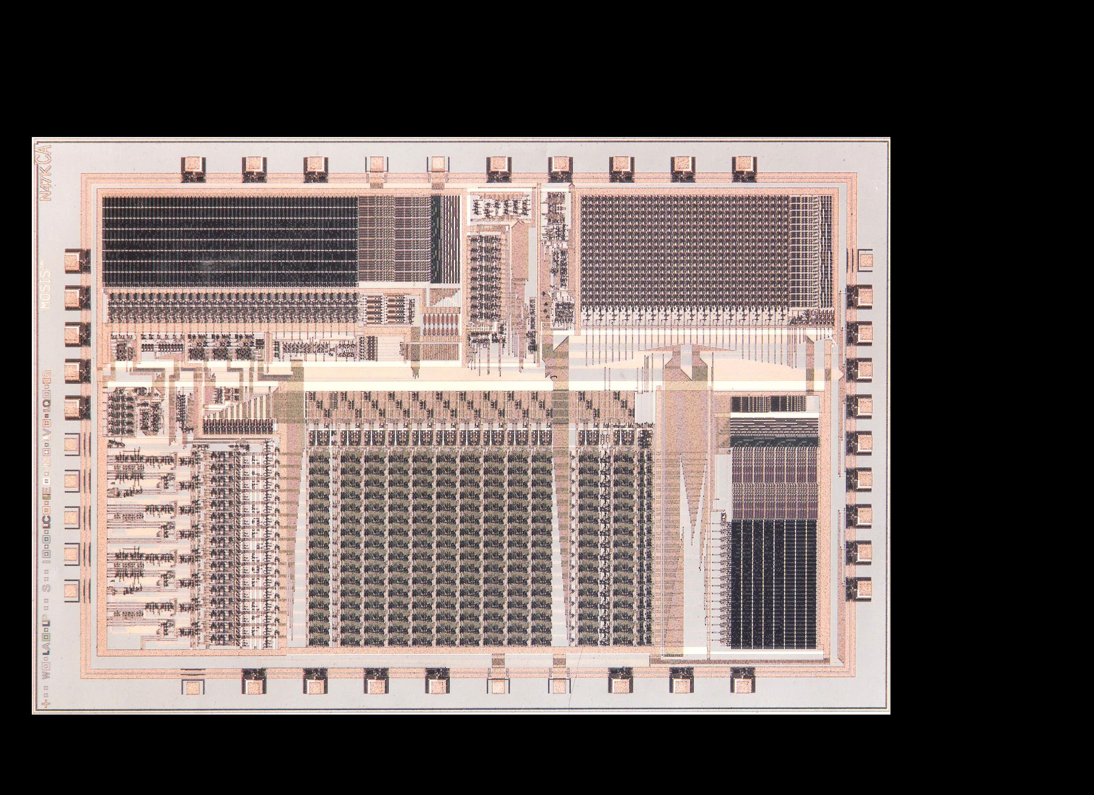
16 bit microcontroller

Slide 10
16 bit microcontroller (my part)

Slide 11
Hand designing is terrible, we use HDL today.
module ALU_32_bit(a, b, operation, Result);
input [31:0] a;
input [31:0] b;
input [1:0] operation;
output [31:0]Result;
reg [31:0] Result;
always@(a or b or operation)
begin
case (operation)
2'b00: Result = a & b; // AND
2'b01: Result = a | b; // OR
2'b10: Result = a + b; // addition
2'b11: Result = a - b; // subtraction
endcase
end
endmodule

Slide 12
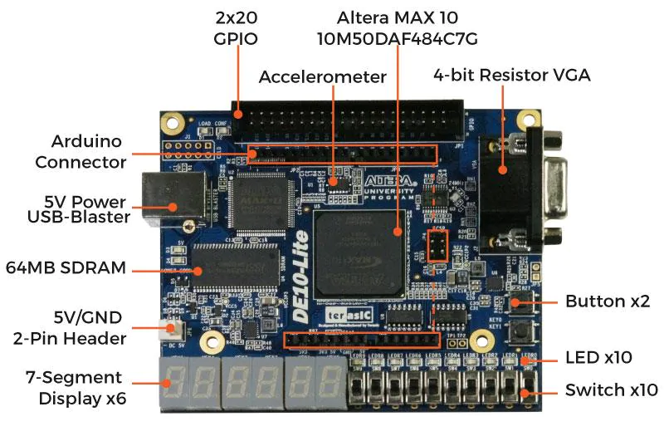
FPGA

Slide 14
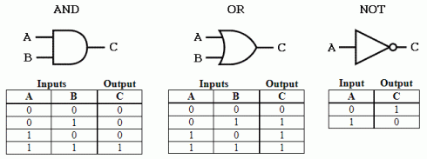
Boolean logic and gates

Slide 15
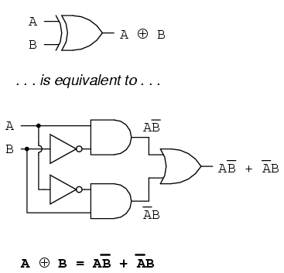
There are only AND, OR, and NOT on semiconductor chips.

Slide 16
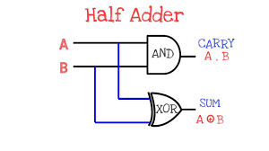
0+0 = 0 and carry 0
0+1 = 1 and carry 0
1+0 = 1 and carry 0
1+1 = 0 and carry 1

Slide 17
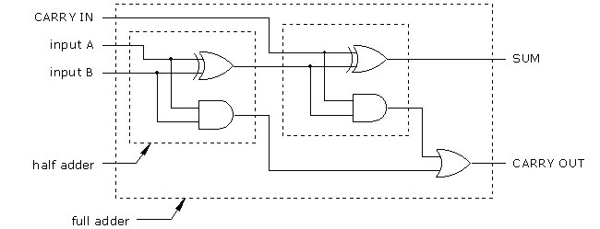
CarryIN | 0 | 0 | 0 | 1 | 1 | 1 | 1
InputA | 0 | 1 | 1 | 0 | 0 | 1 | 1
inputB | 1 | 0 | 1 | 0 | 1 | 0 | 1
SUM
CarryOut
Quesstion:
Carry in =1, input A = 1, input B = 0,
SUM = ?, CARRY OUT = ?

Slide 18
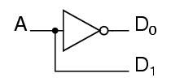
 | A=0 | A=1
D0
D1

Slide 19
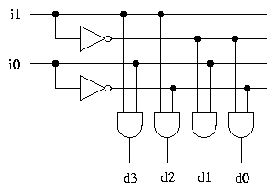
if (( j0 == 1 ) && (j1 = 0 ))
d3,d2,d1,d0 => ?

Slide 20
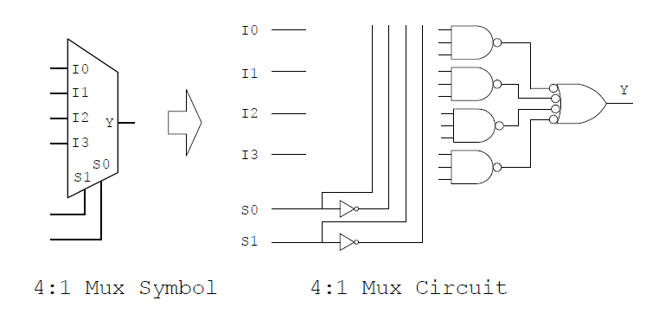
Home work #2
Connect lines to implement the truth table
Lines connected
Lines not
connected
Truth Table
s0 | s1 | Y
0 | 0 | I0
0 | 1 | I1
1 | 0 | I2
1 | 1 | I3

