Slide 1
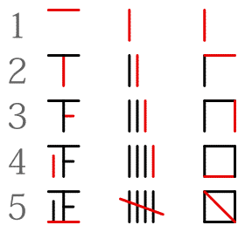
Tally numerals

Slide 2
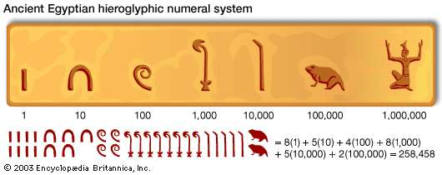
semi – positional numbers (1)

Slide 3
semi – positional numbers (3)
一、二、三、四、五、六、七、八、九、十、
1, 2, 3, 4, 5, 6, 7, 8, 9, 10,
二百三十七分八厘
2X100 + 3x10+7 + 7x0.1 + 8x0.01
= 236.78 (positional)
一 10^0
十 10^1
百 10^2
千 10^3
万 10^4
億 10^8
兆 10^12
京 10^16
垓 10^20
………
極 10^48
無量大数10^88
一 10^0
分 10^−1
厘 10^−2
毛 10^−3
糸 10^−4
忽 10^−5
微 10^−6
繊 10^−7
沙 10^−8
…...
虚空10^−20
清浄10^−21

Slide 4
Positional numbers are coefficients
Base is b:
...+ □ * b³ + □ * b² + □ * b¹ + □ * b⁰ • + □ * b⁻¹ + □ * b⁻² + □ * b⁻³ + ...
Decimal example: (base is 10)
734.25 = 7 * 10² + 3 * 10¹ + 4 * 10⁰ • + 2 * 10⁻¹ + 5 * 10⁻²
Binary example: (base is 2)
111.110 = 1 * 2² + 1 * 2¹ + 1 * 2⁰ • + 1 * 2⁻¹ + 1 * 2⁻²
= 4 + 2 + 1 • 0.5 + 0.25

Slide 5
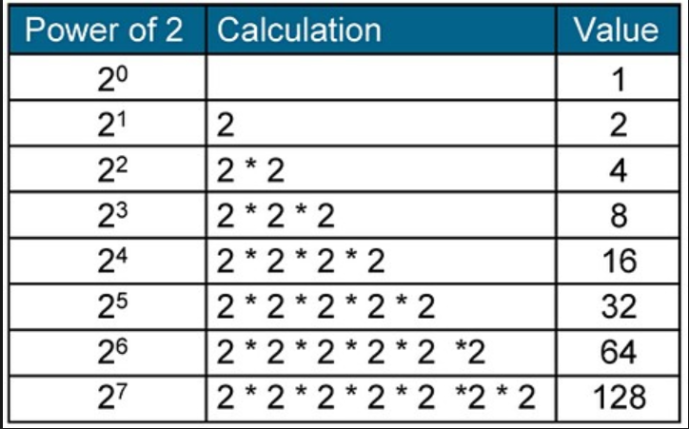
Positional number (binary-1)
Just in case ….

Slide 6
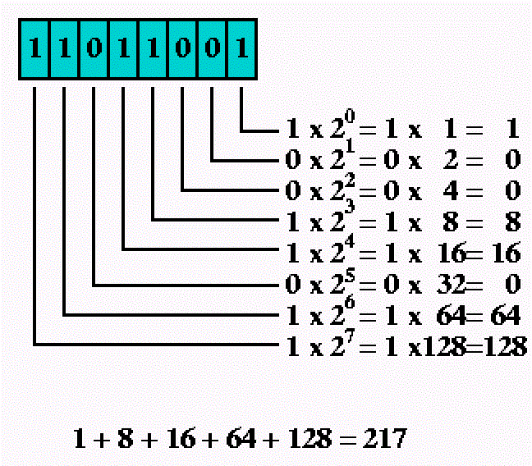
Positional number (binary 2)

Slide 7


Positional numbers(hexadecimal 1)
… + □ * 16³ + □ * 16² + □ * 16¹ + □ * 16⁰ • + □ * 16⁻¹ + ...
Why base 16?
Grouping 4 binary bits yields numbers from 0 to 15 (16 numbers)
0000 0001 0010 0011 0100 ………. 1100 1101 1110 1111
0 1 2 3 4 C D E F

Slide 8
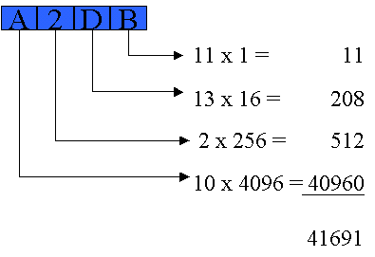
Positional numbers(hexadecimal 2)

Slide 9
Positional number arithmetic
If you counted up all the way to the largest number of one digit, you would use the next digit cell.
8+1 = 9
9+1= ???? → There is one ten. 1*10 + 0 = 10 (decimal)

Slide 10
Binary number arithmetic
Only two symbols: 0 and 1. The largest is 1.
0+0 = 0
0+1 = 1
1+1 = carry 1 and sum 0 => 10 (This is 2 in decimal.)
Just like 9+1 = carry 1 and sum 0 => 10 (ten in decimal)

Slide 11
Just a practice
What is
00110
+ 10010
--------------------

Slide 12
Now, a little bit on
Complement arithmetic:
Perform subtraction by addition
for finite digit numbers.
(STOP the video, and coffee break)

Slide 13
9’s complement
A and B are complement if A+B = 9.
1 + 8 = 9
2 + 7 = 9
3 + 6 = 9
…

Slide 14
10’s complement
A + B = 10
1 + 9 = 10 (1 + 8 = 9, 9’s complement)
2 + 8 = 10 (2 + 7 = 9, 9’s complement)
3 + 7 = 10 (3 + 6 = 9, 9’s complement)
…..

Slide 15
How do you find 9’s complement
It is a finite digit number. Let’s make it 2 digit.
The largest number of 2 digit is 99.
Suppose A = 12.
A+B=99, So, B = 99 - A = 99 – 12=87.
That is, the largest number – A = 9’s complement of A.
REMEMBER, we are in a finite digit world.

Slide 16
Largest number + 1 = ?
99 + 1 = 100, but in our two digit world,
99 + 1 = 00 because no where to store the carry.
So, if A+B = 99, then A+B+1 = 00.
A+B+1 = A+(B+1) = 00, thus, (B+1) is 10’s complement of A.
(B+1) = 00 – A

Slide 17
Continuing on ...
(B+1) is 10’s complement of A. And, A+B = 99. then A+B+1 = 00
A+(B+1) = 00, thus, (B+1) is 10’s complement of A.
To find 10’s complement of A:
1. Find A’s 9’s complement (which is B).
2. Add 1 to B.

Slide 18
Analogously …..
Assume a 4 binary digit
Find 2’s complement of 0110
First, find 1’s complement of 0110
Largest number – 0110 = 1111 – 0110 = 1001
This happens to be the same as flipping bits!
Add 1 to 1001 = 1001 ← this is a mistake, should be 1010 !
Now the famous flip bits and add 1.

Slide 19
So, binary subtraction can be done using addition. In fact, there is no add circuit on a CPU.
110 – 011 (6 - 3)decimal
= 110 + 100 + 1
= 110 + 101
= 011

Slide 20
Signed and unsigned numbers???
It is up to a programmer (and a compiler, which is written by a programmer).
CPU just add two numbers and tells you carry happened or not, over flow happened or not, under flow happened or not.

Slide 21
But, let’s talk about signed, unsigned
Assume a 3 bit world:
Signed Unsigned
0 000 0 What happens if we do
1 001 1 010 + 110?
2 010 2
3 011 3 010 + 110 = 000. Thus,
4 100 -4 we interpret 110 as -2.
5 100 -3
6 110 -2
7 111 -1

Slide 22

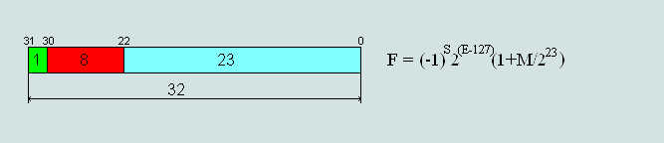
Floating point numbers

Slide 23
Example
Step 1: binary translation of 9.25 = 1001.01
Step 2: normalization
1001.01 = 1001.01 * 2^0
100.101 * 2^1 // That is 1001.01 * 1/2 * 2
10.0101 * 2^2 // That is 1001.01 * 1/4 * 4
1.00101 * 2^3 // That is 1001.01 * 1/8 * 8
Step 3: exponent = e – 127 = 3, so e = 130 (=10000010b)
Step 4: formula
(-1)^s * 2^(e-127) * [1.]m
= (-1)^0 * 2^(10000010b -127d) * [1.]00101
s=0; m = [1.]00101
Step 5: IEEE representation s would be 1 if -9.25.
0 10000010 00101 00000000000000000

Slide 24
Home Work #1
Convert following Decimal numbers to IEEE.
5.75 and -11.5
-0.25 and 0.75
Hint: To normalize, you need to shift the number to left.

Slide 25
Now, it is a tea time...

