Slide 1
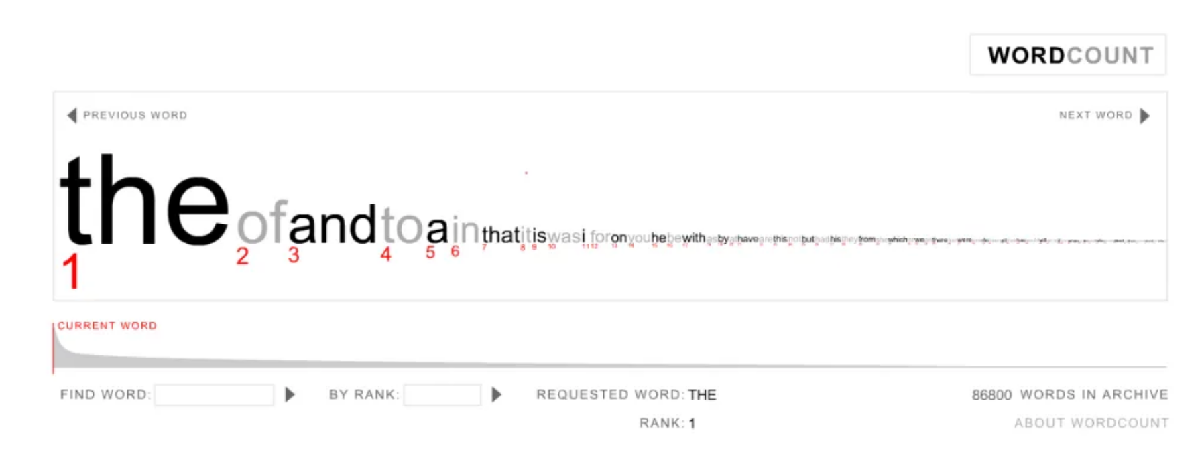
Frequency of Words in a Language
Jacob Heglund
Department of Aerospace Engineering
12/9/20

Slide 2
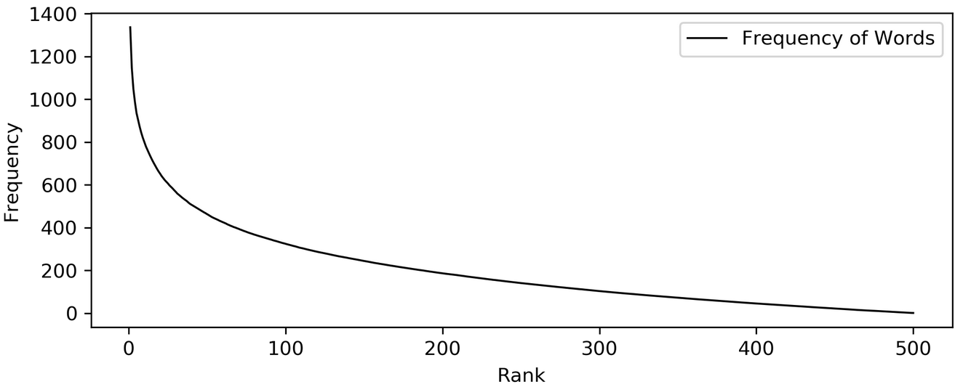
This presentation focuses on connections between the frequency of words in natural languages and Polya’s Urn
f(x) = (A/x)^{n}
Notes:
It was observed that the frequency of many natural languages follow a trend like 1/n

Slide 3
Polya’s Urn has nice statistical properties that make it relevant to this course
Draw 1 ball from the urn IID uniformly
Return 2 balls of the same color to the urn
Clearly the model’s future state only depends on the previous state (Markovian)

Slide 4
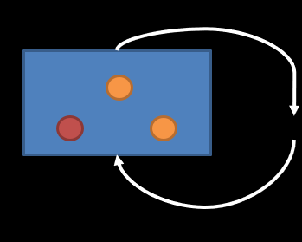
We hypothesize that the Polya’s Urn model can be used to generate a distribution that follows Zipf’s law
Key insight: Interpret the ball colors as different words in a language

Slide 5
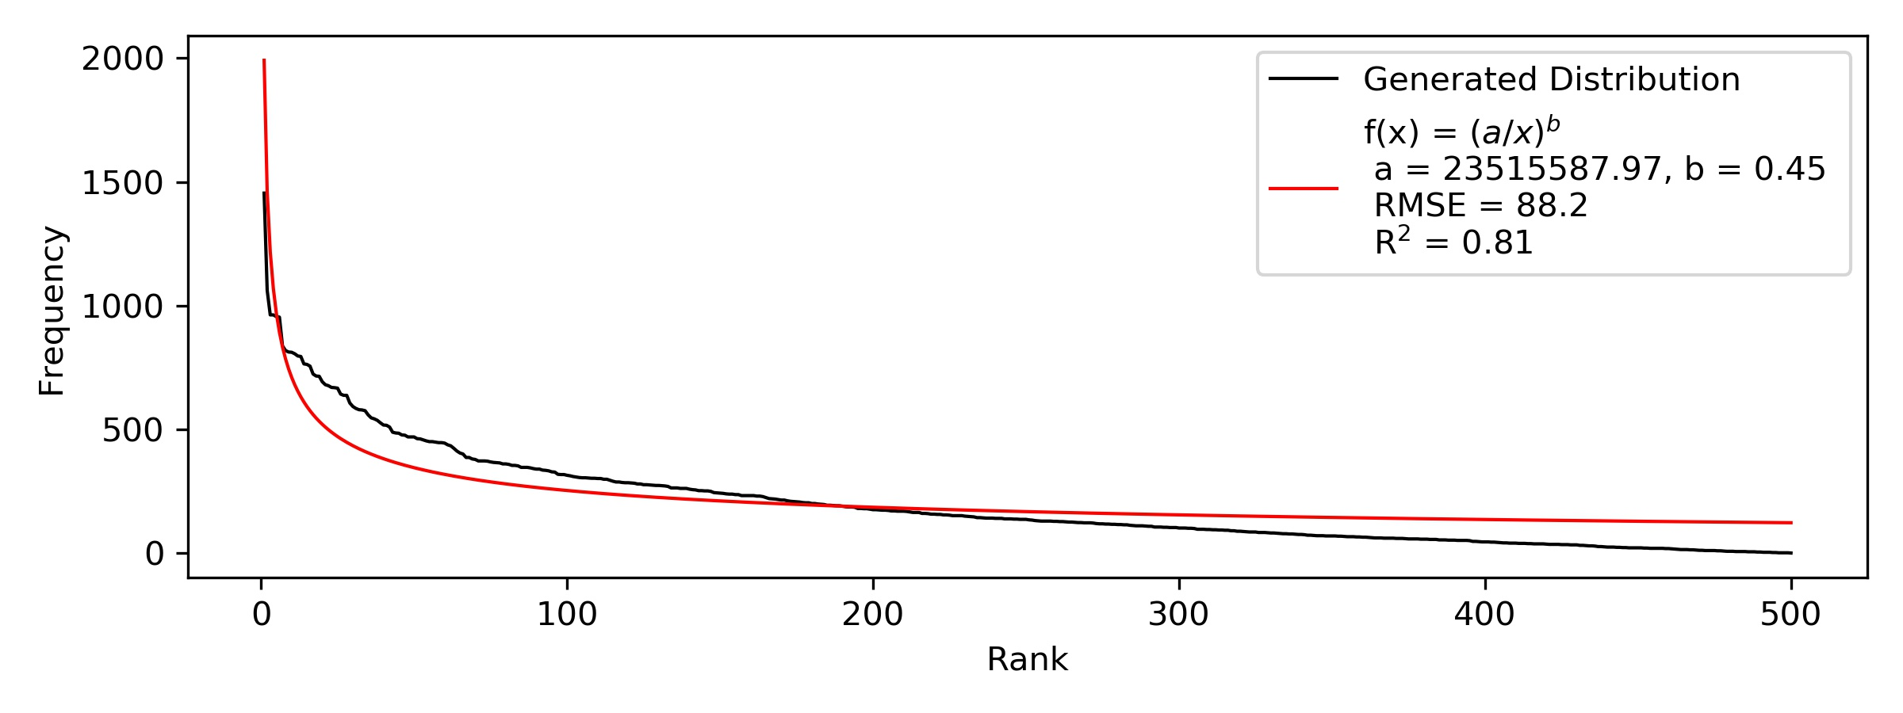
We run Polya’s Urn for a 500-word language, sampling 100,000 times

Slide 6
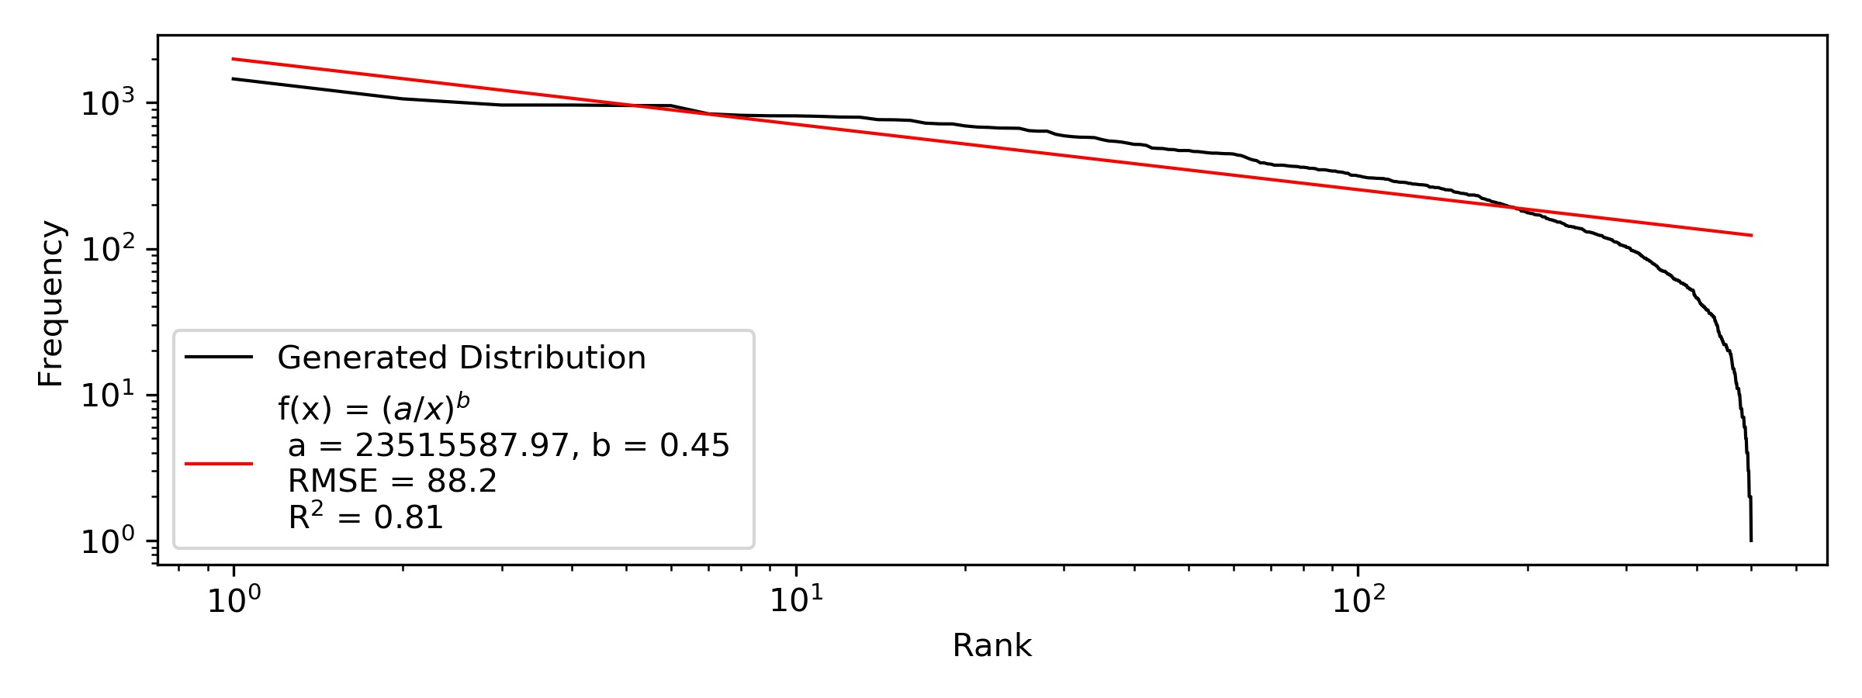
We run Polya’s Urn for a 500-word language, sampling 100,000 times

Slide 7
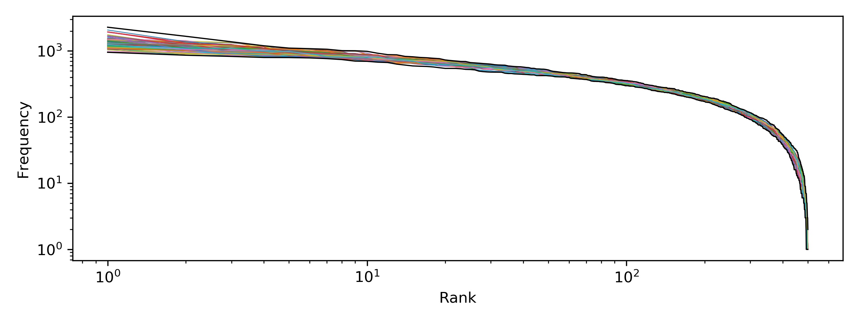
To understand distributional properties, we now run the same test 100 times

Slide 8
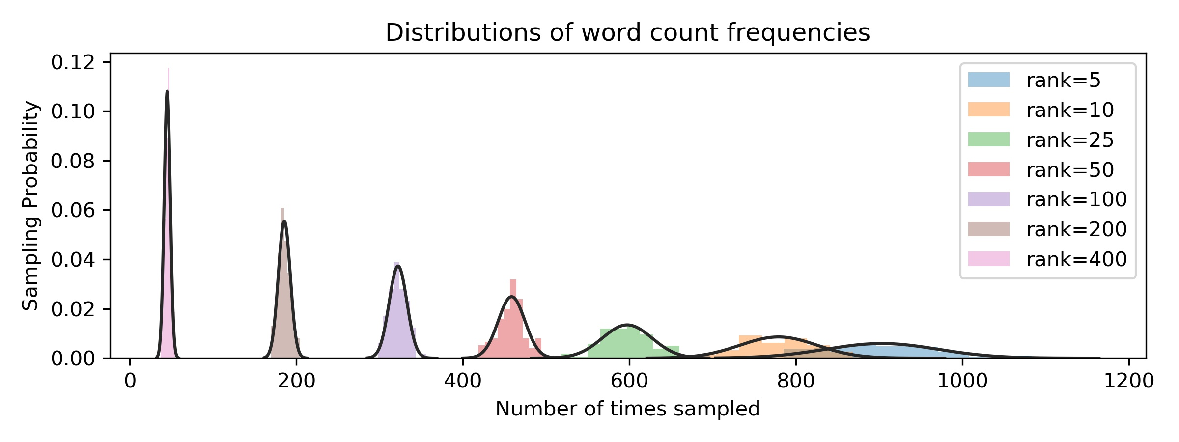
To understand distributional properties, we now run the same test 100 times
Across runs experimental runs, frequencies converge to normal distributions

Slide 9
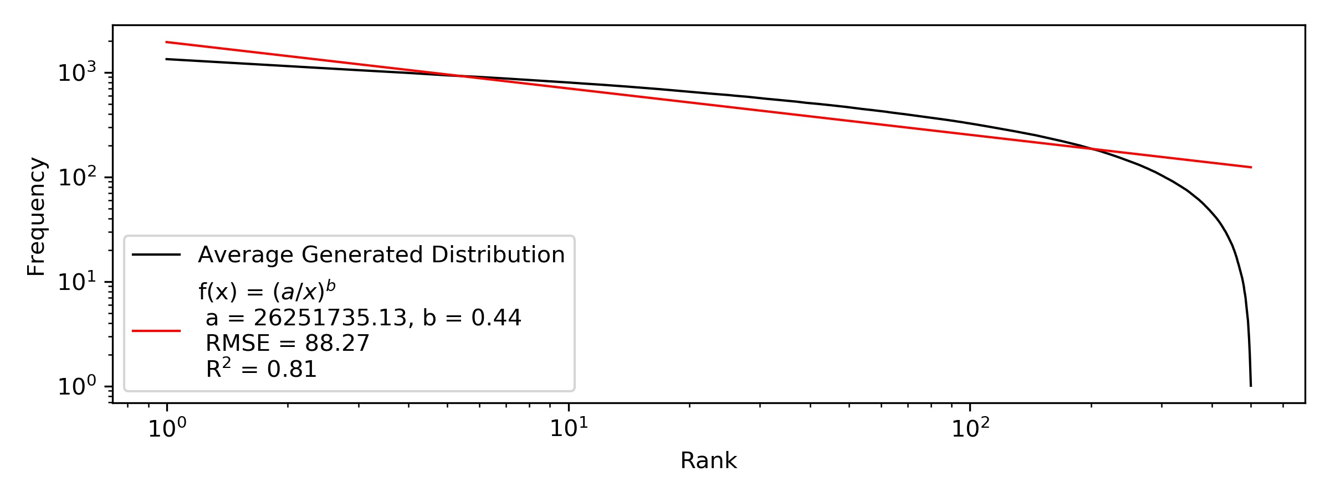
We fit a model to the average generated distribution over 100 trials

Slide 10
Polya’s urn can be useful in modelling frequency of words
Natural language can be understood as having a “preference” for certain words (“the”, “of”, “and”, etc.)
Polya’s urn is useful because it captures some (but not all!) aspects of preference, which helps us analyze real-world phenomena
Future Work (Engineering / Utilitarian Viewpoint)
How can we use this knowledge to improve the material condition of people on this planet?

Slide 11
In summary, the frequency of words in natural languages can be reasonably modelled by Polya’s Urn
Questions?

