Slide 1
LG Security Specialist Team2
Gate System (CCTV)

Slide 2
Team Charter
Role | Description | Name
Program manager | Manage the project schedule & requirements and documentation | Gigwan Lee Heejung Jeoung
Architect | Responsible for the system architecture | Wonwoo Kim
Implementation (server) | Responsible for the server side (Jetson Nano) implementation | Wonwoo Kim Bokyoung Ku Heejung Jeoung
Implementation (client) | Responsible for the client side, UI. | Ukheon Jeong Gigwan Lee
Security | Responsible for the secure coding & function testing | Bokyoung Ku

Slide 3
Project Schedule
Date | Key milestone | Task | Artifacts | Status
Week1 (5/31 – 6/4) | Security design | Setup R&R Gather requirement Design architecture Risk assessment | SRS document DFD Risk assessment document
Week2 (6/7 – 6/11) | Security design /implementation | Architecture | Design document
Week3 (6/14 – 6/18) | Security implementation | Implementation Integration & Testing Security Evaluation | Source code Test cases document

Slide 4
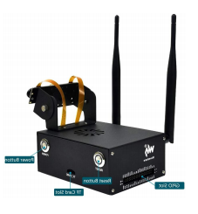
Functional Requirements (I)
Camera & Image Analysis Application
1) Learning Mode
i. Input person name from ‘User Display & System Control Application’ who is in front of camera
ii. Get jpeg images and save them to DB
2) Run Mode
i. Capture jpeg from camera input
ii. Analyze jpeg image and generate recognition result
iii. Send the image and analyzed result to ‘User Display & System Control Application’
3) Test Run Mode
i. Capture jpeg from a video file
ii. Analyze jpeg and generate the recognition result
iii. Send the image and analyzed result to ‘User Display & System Control Application’
4) User Authentication
i. Authenticate the user from ‘User Display & System Control Application’.

Slide 5
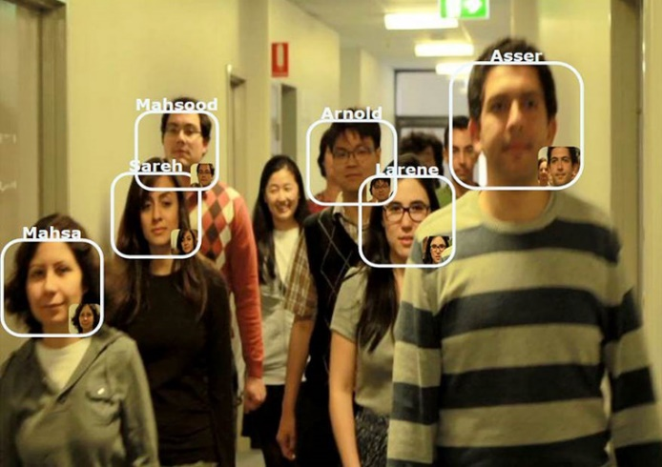
Functional Requirements (II)
User Display & System Control Application
4) User Authentication
i. Input ID and password to authenticate the user.
5) Operational Mode Control
i. Select Learning/Run/Test Run mode
6) Communication Mode Control
i. Select secure(TLS) /non-secure mode (Non-TLS)
ii. Input server IP address and port number
7) Receive Result and Display
i. Display the image received from ‘Camera & Image Analysis Application’
ii. Display recognition result on the image
TEAM 2
IP :
192.168.0.8
ID :
admin
PORT:
8008
PW :
*****
Secure Mode
Learning Mode
Capture
NAME:
Mahsa
Confirm
Run Mode
Test Run Mode
Connect

Slide 6
Security Requirements (SQUARE-Lite)
Agree on Definition
Terms | Definition
TLS | Transport Layer Security TLS is a cryptographic protocol designed to provide communications security over a computer network.
SSL | This secure protocol developed for sending information securely over the Internet.
Sensitive data | Sensitive data is defined as any information that is protected against unwarranted disclosure. Protection of data may be required for legal or ethical reasons, for issues pertaining to personal privacy, or for proprietary considerations. Human data: e.g. health, genetic and personal information, data that may identify a person Ecological data: e.g. location of endangered species or other conservation efforts Confidential data: e.g. trade secrets
PII | Personally Identifiable Information
GSS | Gate System Server (Camera & Image Analysis Application.)
GSC | Gate System Client (User Display & System Control Application.)
Certificate | Electronic credentials that bind the identity of the certificate owner to a pair of electronic encryption keys.
Vulnerability | openness to attack or hurt, either physically or in other ways
Communication Channel | A communication channel refers either to a physical transmission medium such as a wire, or to a logical connection over a multiplexed medium such as a radio channel in telecommunications and computer networking.
Tampering | Any unauthorized modification that alters the legitimate functioning of a system or equipment. It may cause the weakening of the security function provided by the system or damage to the functionality.

Slide 7
Security Requirements
Security Requirements (SQUARE-Lite)
2. Identify Assets and Security Goals
Goals | Contents
Business Goals | Provide a face recognition system to identify employees.
Security Goals | Recognized face images and image analyzed results which is personal/sensitive information must be protected while transmitting on the network.
 | User credential and stored images have to be protected.
 | Security weakness and vulnerabilities after launching the system must be minimized as much as possible.
Assets | Location
Captured face images (PII) | Transmitted over the network ,Stored in the server side storage
Added face images (PII) | Stored in the server side storage
Image analyzed results (PII) | Transmitted over the network
FaceNet trained model files, CNN ( Convolutional Neural Network) trained model files | Stored in the server side storage
User credential | Transmitted over the network ,Stored in the server side storage

Slide 8
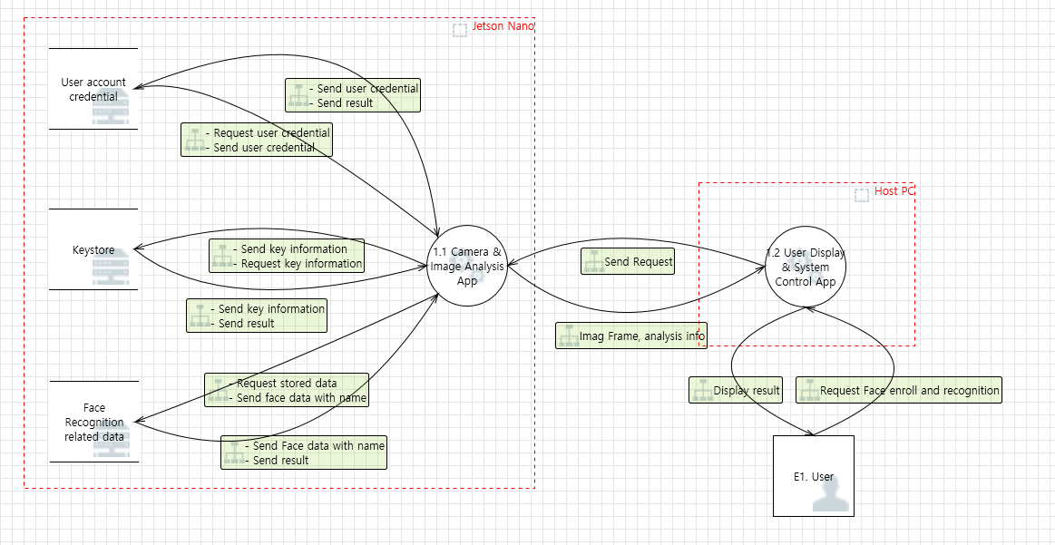
Security Requirements (SQUARE-Lite)
3. Perform risk assessment
: Target area

Slide 9
Threats
Threat Scenario : An unauthorized individual gains access to the GSS thru GSC and tries to add/modify/delete face images. The system detects the malicious behavior and prevents the unauthorized individual’s actions.
Category | Threats | Mitigation
Information Disclosure | The stored face image related data on server side can be disclosed to an unauthorized user. The transmitting data on the communication between server /client can be disclosed to unauthorized user. | Provide encryption on the stored data on server side Provide encrypted the communication channel between server/client
Spoofing, Elevation of Privilege | Unauthorized user can run the program without any restriction. | Provide login functionality for user authentication/authorization
Tampering | Unauthorized user can manipulate the request/response | Validate requests/responses from each peer
Denial of Service | There is a limitation of resources on embedded application. Server application may not work properly due to massive request from clients. | Manage the connection between server/client
Repudiation | No logging feature for tracking the activities of the applications | Add logging on server/client

Slide 10
Security Requirements (SQUARE-Lite)
4. Elicit security requirements
Category | Security Requirements (Level 1) | Security Requirements (Level 2) | Related threat id | Priority (High, Mid, Low)
Information Disclosure | Data transmitted over the network must be protected to prevent information disclosure. | The communication channel must be encrypted when the captured/recognized image and analyzed result are transmitted. | 62, 63, 64, 66 | High
 |  | TLS 1.2 or higher must be applied. |  | High
 | Stored data for face recognition must be handled securely. | Contents of database must be encrypted in AES256. And, the pass phrase must follow the guide of LG SDL. | 117 | High
 |  | The encryption key must NOT be stored as the raw format, and must be protected against the reverse engineering. | 138 | High
 |  | Name as a input of learning mode are allowed only alphabet and digit numbers. Max. length is 16 | 70, 71 | Mid
 |  | Database has the size limitation, not to make system disk overflow. If the database size is near the limitation, server application must warn to the administrator by email or other ways. | 119 | Low
 | Information for network connection must NOT be easily found from the client application. | Client application must hide IP address and port value for the server connection in the source code. | 66 | High
 |  | When client application save the IP address and port for next usage, those information must be hidden. | 66 | Mid
Spoofing, Elevation of Privilege | Only authenticated persons can access the server application service of Jetson Nano with the proper access rights. | Force the user to enter credentials and Provide granting/denying the access to GSC | 69 | High
 |  | User ID and password are allowed only alphabet and digit numbers. Max. length is 16. | 70, 71 | Mid
 |  | Provide limited operating privilege by user accounts. | 69, 70, 71 | Low
 |  | Server application must manage the password for the authentication as the hashed format, and compare the input password from the client application after hashing. | 136 | High

Slide 11
Security Requirements (SQUARE-Lite)
4. Elicit security requirements
Category | Security Requirements (Level 1) | Security Requirements (Level 2) | Related threat id | Priority (High, Mid, Low)
Tampering | Server application must transfer only the requested data to the client application. | Response commands which the server application transfers should contain the same request command type from the client applications. | 64 | Mid
 |  | Whenever the client application receives the response command, client application should check if its command type is the same as the original requested command type. | 64 | Mid
Denial of Service | Server application must always provide the stable services when the client application tries to connect and requests | Server application can prohibit the maximum service connections to provide the stable services. (Max : 1) | 67, 68 | Mid
Repudiation | All server/client application activities should be logged. But the sensitive data must NOT be included in the log. | All activities of the server application must be recorded as the log file, except of the repeatedly transferred message (e.g. ‘RUN’ and ‘Test Run’ mode) - Instead, the started time of the repeatedly transferred message should be recorded without sensitive information. | 65 | Mid
 |  | All activities of the client application must be recorded as the log file, except of the repeatedly received message (e.g. ‘RUN” and ‘Test Run’ mode) - Instead, the started time of the repeatedly transferred message should be recorded without sensitive information. | 76 | Mid
 |  | Any sensitive data (e.g. password) must NOT be recorded into the log file. | X | High
 |  | Logging file has the size limitation, not to make system disk overflow. If the file size is near the limitation, server application must warn to the administrator by email or other ways. | 67, 68 | Low
 |  | Server application must check if the logging file is not a linked file. | X | Low

Slide 12
Architecture Diagram
User Display & System Control Application
Camera & Image Analysis Application
TCP
Network
TCP
⁷⁾ Receive Result and Display
³⁾Transfer Analyzed Result & Image
Secure Connection
Non-Secure Connection
⁶⁾ Communication Mode Control
²⁾Image Recognition
⁵⁾ Operation Mode Control
¹⁾Image Capture from Camera
⁴⁾ User Authentication
⁴⁾ User Authentication
Image DB
User DB
GSC (Gate System Client)
GSS (Gate System Server)

Slide 13
Secure Design
1. Initial SW Architecture
Bbox
TCP Channel
Open/Read/Close
RecvImageTCP.cpp
main.cpp
videoStreamer
(videoStreamer.cpp)
Transmit
JPEG
image
TcpSendImageAsJpeg
(TcpSendRecvJpeg.cpp)
Face Detection & Recognizer
videoStreamer
(videoStreamer.cpp)
TcpSendImageAsJpeg
(TcpSendRecvJpeg.cpp)
Transmit
Image Data
FaceNetClassifier
(FaceNet.cpp)
mtCNN
(mtcnn.cpp)
Transmit
Image Data
NetworkTCP
(NetworkTcp.cpp)
PBox / BBox
(pBox.h)
Pnet_Engine (pnet_rt.cpp)
Rnet_Engine (rnet_rt.cpp)
Onet_Engine
network (network.cpp)
NetworkTCP
(NetworkTcp.cpp)
MTCNN: Face Detector
FaceNetClassifier: Face Recognizer
GSC (Gate System Client)
GSS (Gate System Server)

Slide 14
Secure Design
2. Message Protocol
Functionality | Request (GSC) | Response (GSS)
Authenticates the user and run the mode | request msgId : [seq number] user : [user id] passwd : [user password] mode : [ learn | run | test run] | response msgId : [seq number] result : [ok/nok]
Capture the face image | request msgId : [seq number] mode : [capture] | response msgId : [seq number] result : [ok/nok]
Cancel the capture | request msgId : [seq number] mode : [cancel] | response msgId : [seq number] result : [ok/nok]
Confirm to add the new face image | request msgId : [seq number] mode : [confirm] name : [name] | response msgId : [seq number] result : [ok/nok]
Transmit the video stream |  | stream mode : [ learn | run | test run] data length : [length] data : [raw image data]

Slide 15
Secure Design
3. Message structure
Random Seed
+ Sequence
Message Type
(2 byte)
Message ID
(4 byte)
Mode
(2 byte)
Data Length
(4 byte)
Data - Request, Stream
(1012 byte)
Mode | Value
Learning | 0x3301
Run | 0x3302
Test Run | 0x3303
Capture | 0x3304
Cancel | 0x3305
Confirm | 0x3306
Result OK | 0x3307
Result NOK | 0x3308
Stream | 0x3309
Type | Value
Request | 0x5501
Response | 0x5502
Stream | 0x5503
ID Length
(4 byte)
ID buffer
PWD Length
(4 byte)
PWD buffer
Name Length
(4 byte)
Name buffer

Slide 16
Secure Design
4. Sequence Diagram (Common)
GSC
GSS
TLS Handshake Procedure
(If secure mode selected)
Conditional
1. Click ‘Connect’ button
[request]
msgId : [seq number]
user : [user id]
passwd : [user password]
mode : [ learn | run | test run]
2. Response
[response]
msgId : [seq number]
result : [ok/nok]
Capture
3. Video Stream
[stream]
mode : [ learn | run | test run]
data length : [length]
data : [raw image data]

Slide 17
Secure Design
5. Sequence Diagram (Learning mode)
GSC
GSS
1. Click ‘Capture’ button
request
msgId : [seq number]
mode : [capture]
2. Response
response
msgId : [seq number]
result : [ok/nok]
3-1. Click ‘Cancel’ button
[request]
msgId : [seq number]
mode : [cancel]
Conditional
4-1. Response
[response]
msgId : [seq number]
result : [ok/nok]
3-2. Click ‘Confirm’ button
[request]
msgId : [seq number]
mode : [confirm]
name : [name]
Conditional
4-2 Response
[response]
msgId : [seq number]
result : [ok/nok]

Slide 18
Secure Design
6. Secure SW Architecture
Request/Response logging
Encrypted by AES256 CBC
UI (Dialog)
Logger
Image DB
Image
Crypto module
Request/Response logging
main.cpp
Input Validation
Log-in module
Logger
TLS
videoStreamer
(videoStreamer.cpp)
Signed by Team2 Root CA
Server
Certificate
Encrypted with Passphrase
TCP
Face Detection & Recognizer
Server
Private Key
New message format
System user validator
Command
Encoder/Decoder
FaceNetClassifier
(FaceNet.cpp)
mtCNN
(mtcnn.cpp)
Command
Encoder/Decoder
New message format
Team2 CA
Certificate
User id/pw
Authenticator
PBox / BBox
(pBox.h)
Pnet_Engine (pnet_rt.cpp)
Rnet_Engine (rnet_rt.cpp)
Onet_Engine
network (network.cpp)
TCP
TLS
Using PBKDF2
OpenSSL 1.1.1K
Privilege
Authorization
TCP/TLS
MTCNN: Face Detector
FaceNetClassifier: Face Recognizer
OpenSSL 1.1.1K
Administrator : [ learning | run | Test run]
User : [Run]
GSC (Gate System Client)
GSS (Gate System Server)

Slide 19
Implemented Modules
 | Module | Description
GSC | UI (Dialog) | GUI for GSC
 | Log-in module | Input text values such as user id/password/name are validated by the rule. (only alphabet and digit numbers are allowed, Maximum length is 16 character)
 | Logger | Request/Response messages are logged in files.
 | Command Encoder/Decoder | Message encoding/decoding between GSC / GSS
 | TLS | openSSL 1.1.1k ( Root CA certificate)
GSS | TLS | openSSL 1.1.1k (Root CA + passphrase)
 | System user validator | When the GSS starts, it requires to enter a passphrase
 | User id/pw Authenticator | user id/password authenticator ( uses PBKDF2)
 | Privilege Authorization | The privilege for the operation mode is assigned by the account. Administrator : [ learning | run | Test run] User : [Run]
 | Image Crypto module | Passphrase is used for generating a key for encrypting/decrypting face images. Stored image files encrypted by AES256 CBC.
 | Logger | Request/Response messages are logged in files.
 | Command Encoder/Decoder | Message encoding/decoding between GSC / GSS

Slide 20
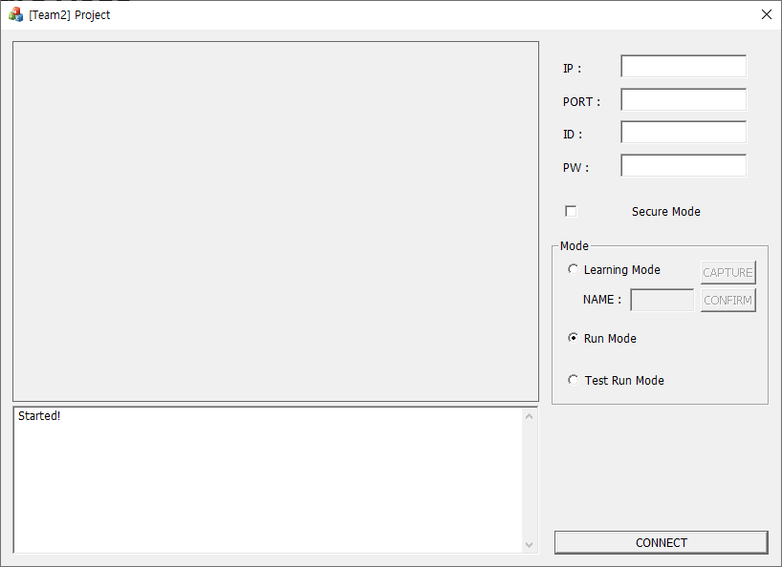
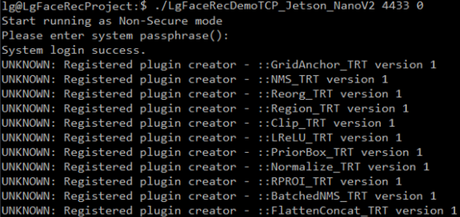
User Guide
GSC (Gate System Client)
GSS (Gate System Server)
1) Input GSS IP and GSS Port
2) Input User ID, Password
> ./LgFaceRecDemoTCP_Jetson_NanoV2 [port] [1|0 (secured or not)]
Show analyzed results
3) Select Secure
or Non-secure mode
4) Select Operation mode
[Learning | Run | Test Run]
Show log/debug messages
5) Connect
Note : when the server is running as secure mode, you need to select secure mode in client, then the system properly works.

Slide 21
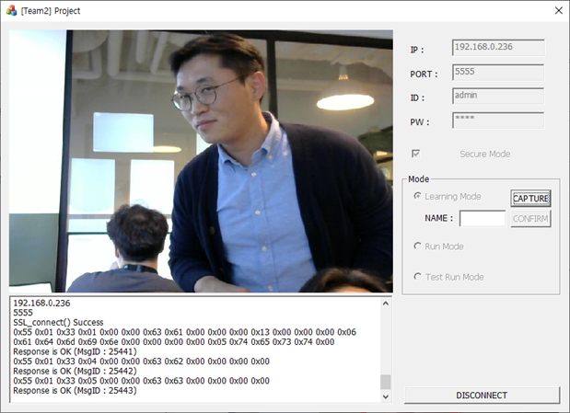
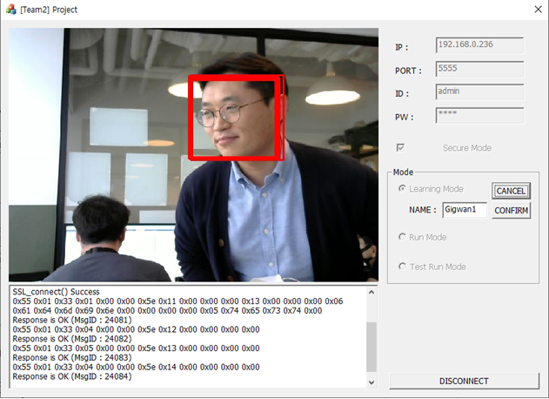
Learning Mode
1) Select Capture
2) Input the name for the captured image
3) Select confirm to add the image

Slide 22
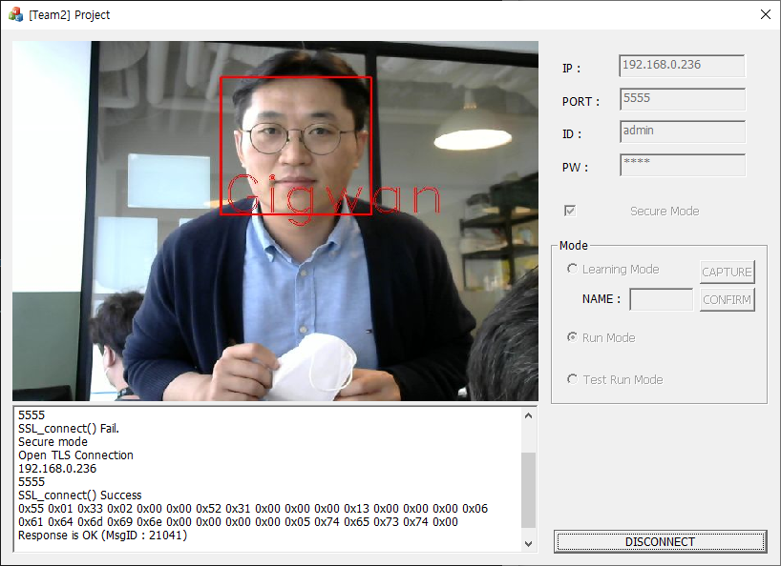
Check the analyzed results
Run Mode

Slide 23
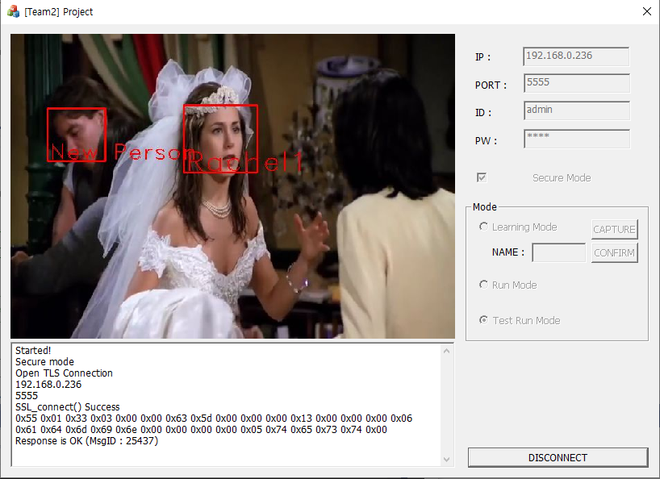
Check the analyzed results of test run mode
Test Run Mode

Slide 24
Security Analysis
By Flawfinder
System | Found | Fixed
GSC | 5 | 5
GSS | 57 | 3
Test Case

