Slide 1
LG Security Specialist Team2
Phase I

Slide 2
Security Requirements
Security Requirements (SQUARE-Lite)
Goals | Contents
Business Goals | Provide a face recognition system to identify employees.
Security Goals | Recognized face images and image analyzed results which is personal/sensitive information must be protected
 | User credential and stored images have to be protected.
 | Security weakness and vulnerabilities after launching the system must be minimized as much as possible.
Assets | Location
Captured face images (PII) | Transmitted over the network ,Stored in the server side storage
Added face images (PII) | Stored in the server side storage
Image analyzed results (PII) | Transmitted over the network
FaceNet trained model files, CNN ( Convolutional Neural Network) trained model files | Stored in the server side storage
User credential | Transmitted over the network ,Stored in the server side storage

Slide 3
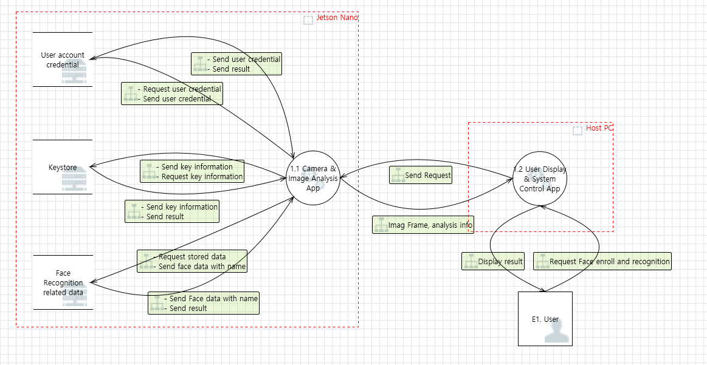
Security Requirements (SQUARE-Lite)
: Target area

Slide 4
Threats
Threat Scenario : An unauthorized individual gains access to the GSS thru GSC and tries to add/modify/delete face images. The system detects the malicious behavior and prevents the unauthorized individual’s actions.
Category | Threats | Mitigation
Information Disclosure | The stored face image related data on server side can be disclosed to an unauthorized user. The transmitting data on the communication between server /client can be disclosed to unauthorized user. | Provide encryption on the stored data on server side Provide encrypted the communication channel between server/client
Spoofing, Elevation of Privilege | Unauthorized user can run the program without any restriction. | Provide login functionality for user authentication/authorization
Tampering | Unauthorized user can manipulate the request/response | Validate requests/responses from each peer
Denial of Service | There is a limitation of resources on embedded application. Server application may not work properly due to massive request from clients. | Manage the connection between server/client
Repudiation | No logging feature for tracking the activities of the applications | Add logging on server/client

Slide 5
Security Requirements (SQUARE-Lite)
Category | Security Requirements (Level 1) | Security Requirements (Level 2) | Related threat id | Priority (High, Mid, Low)
Information Disclosure | Data transmitted over the network must be protected to prevent information disclosure. | The communication channel must be encrypted when the captured/recognized image and analyzed result are transmitted. | 62, 63, 64, 66 | High
 |  | TLS 1.2 or higher must be applied. |  | High
 | Stored data for face recognition must be handled securely. | Contents of database must be encrypted in AES256. And, the pass phrase must follow the guide of LG SDL. | 117 | High
 |  | The encryption key must NOT be stored as the raw format, and must be protected against the reverse engineering. | 138 | High
 |  | Name as a input of learning mode are allowed only alphabet and digit numbers. Max. length is 16 | 70, 71 | Mid
 |  | Database has the size limitation, not to make system disk overflow. If the database size is near the limitation, server application must warn to the administrator by email or other ways. | 119 | Low
 | Information for network connection must NOT be easily found from the client application. | Client application must hide IP address and port value for the server connection in the source code. | 66 | High
 |  | When client application save the IP address and port for next usage, those information must be hidden. | 66 | Mid
Spoofing, Elevation of Privilege | Only authenticated persons can access the server application service of Jetson Nano with the proper access rights. | Force the user to enter credentials and Provide granting/denying the access to GSC | 69 | High
 |  | User ID and password are allowed only alphabet and digit numbers. Max. length is 16. | 70, 71 | Mid
 |  | Provide limited operating privilege by user accounts. | 69, 70, 71 | Low
 |  | Server application must manage the password for the authentication as the hashed format, and compare the input password from the client application after hashing. | 136 | High

Slide 6
Security Requirements (SQUARE-Lite)
Category | Security Requirements (Level 1) | Security Requirements (Level 2) | Related threat id | Priority (High, Mid, Low)
Tampering | Server application must transfer only the requested data to the client application. | Response commands which the server application transfers should contain the same request command type from the client applications. | 64 | Mid
 |  | Whenever the client application receives the response command, client application should check if its command type is the same as the original requested command type. | 64 | Mid
Denial of Service | Server application must always provide the stable services when the client application tries to connect and requests | Server application can prohibit the maximum service connections to provide the stable services. (Max : 1) | 67, 68 | Mid
Repudiation | All server/client application activities should be logged. But the sensitive data must NOT be included in the log. | All activities of the server application must be recorded as the log file, except of the repeatedly transferred message (e.g. ‘RUN’ and ‘Test Run’ mode) - Instead, the started time of the repeatedly transferred message should be recorded without sensitive information. | 65 | Mid
 |  | All activities of the client application must be recorded as the log file, except of the repeatedly received message (e.g. ‘RUN” and ‘Test Run’ mode) - Instead, the started time of the repeatedly transferred message should be recorded without sensitive information. | 76 | Mid
 |  | Any sensitive data (e.g. password) must NOT be recorded into the log file. | X | High
 |  | Logging file has the size limitation, not to make system disk overflow. If the file size is near the limitation, server application must warn to the administrator by email or other ways. | 67, 68 | Low
 |  | Server application must check if the logging file is not a linked file. | X | Low

Slide 7
Architecture Diagram
User Display & System Control Application
Camera & Image Analysis Application
TCP
Network
TCP
⁷⁾ Receive Result and Display
³⁾Transfer Analyzed Result & Image
Secure Connection
Non-Secure Connection
⁶⁾ Communication Mode Control
²⁾Image Recognition
⁵⁾ Operation Mode Control
¹⁾Image Capture from Camera
⁴⁾ User Authentication
⁴⁾ User Authentication
Image DB
User DB
GSC (Gate System Client)
GSS (Gate System Server)

Slide 8
Implemented Modules
Request/Response logging
Encrypted by AES256 CBC
UI (Dialog)
Logger
Image DB
Image
Crypto module
Request/Response logging
main.cpp
Input Validation
Log-in module
Logger
TLS
videoStreamer
(videoStreamer.cpp)
Signed by Team2 Root CA
Server
Certificate
Encrypted with Passphrase
TCP
Face Detection & Recognizer
Server
Private Key
New message format
System user validator
Command
Encoder/Decoder
FaceNetClassifier
(FaceNet.cpp)
mtCNN
(mtcnn.cpp)
Command
Encoder/Decoder
New message format
Team2 CA
Certificate
User id/pw
Authenticator
PBox / BBox
(pBox.h)
Pnet_Engine (pnet_rt.cpp)
Rnet_Engine (rnet_rt.cpp)
Onet_Engine
network (network.cpp)
TCP
TLS
Using PBKDF2
OpenSSL 1.1.1K
Privilege
Authorization
TCP/TLS
MTCNN: Face Detector
FaceNetClassifier: Face Recognizer
OpenSSL 1.1.1K
Administrator : [ learning | run | Test run]
User : [Run]
GSC (Gate System Client)
GSS (Gate System Server)

Slide 9
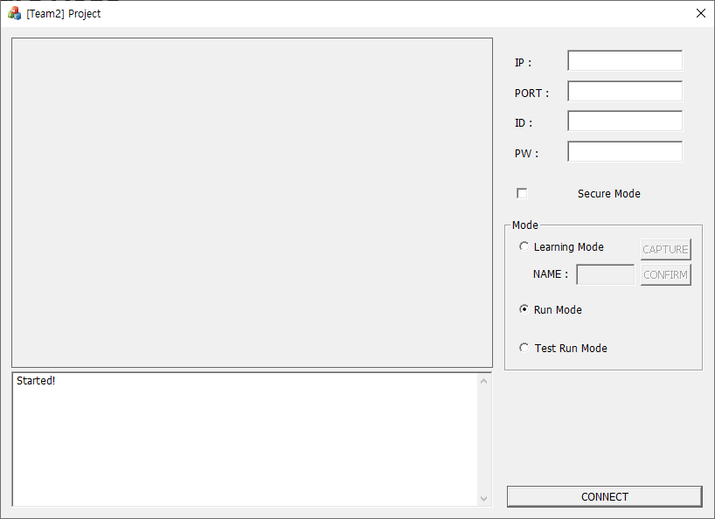
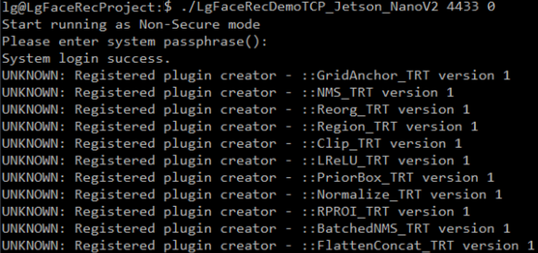
User Guide
GSC (Gate System Client)
GSS (Gate System Server)
1) Input GSS IP and GSS Port
2) Input User ID, Password
> ./LgFaceRecDemoTCP_Jetson_NanoV2 [port] [1|0 (secured or not)]
Show analyzed results
3) Select Secure
or Non-secure mode
4) Select Operation mode
[Learning | Run | Test Run]
Show log/debug messages
5) Connect
Note : when the server is running as secure mode, you need to select secure mode in client, then the system properly works.

Slide 10
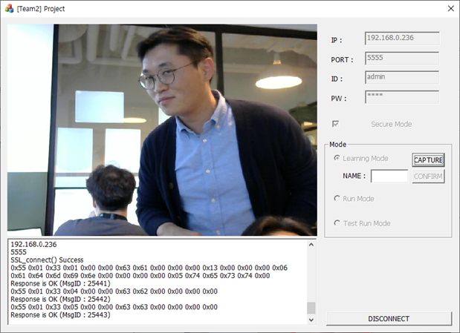
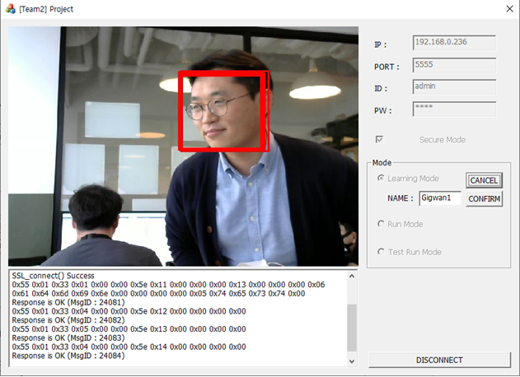
Learning Mode
1) Select Capture
2) Input the name for the captured image
3) Select confirm to add the image

Slide 11
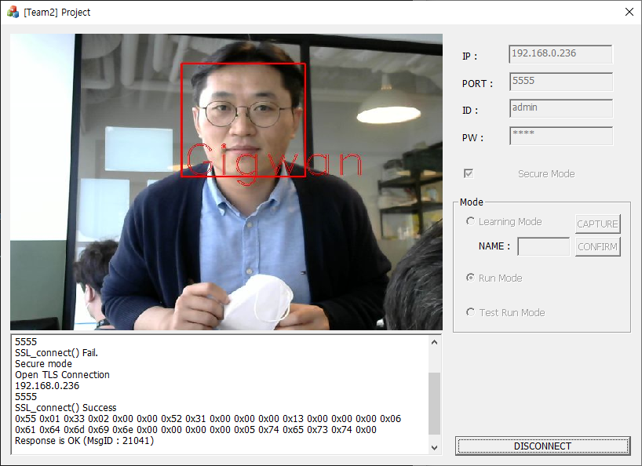
Check the analyzed results
Run Mode

Slide 12
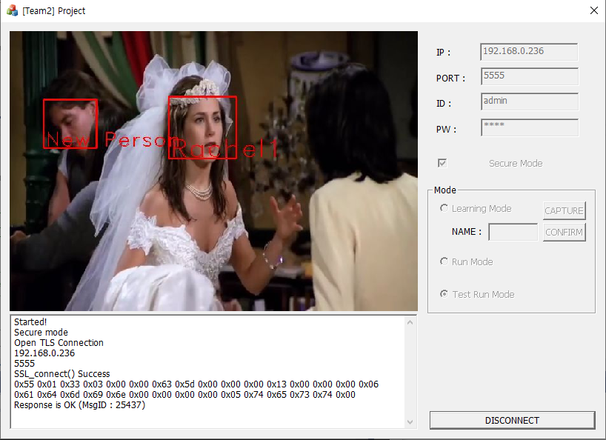
Check the analyzed results of test run mode
Test Run Mode

Slide 13
Security Analysis
By Flawfinder
System | Found | Fixed
GSC | 5 | 5
GSS | 57 | 3
Test Case

