Slide 1
How to build the client application (vcpkg and openssl for Visual studio)
Step 1 : Vcpkg is a great package manager for C++ provided by Microsoft. It greatly simplifies the acquisition and installation of third-party libraries on Windows, Linux, and macOS.
From a command prompt you would do this:
> git clone https://github.com/microsoft/vcpkg.git
Once you’ve cloned the repository into a local folder, change into that folder and issue the following command to build the executable (vcpkg.exe):
> bootstrap-vcpkg.bat
Now you’ve built the executable you can use it to integrate vcpkg into your build environment (such as Visual Studio 2019 with English Language Pack). From the command line do this:
> vcpkg integrate install
And then, you would install OpenSSL on your computer so you can integrate it into your C++ programs. You would do something like this:
> vcpkg install openssl:x64-windows

Slide 2
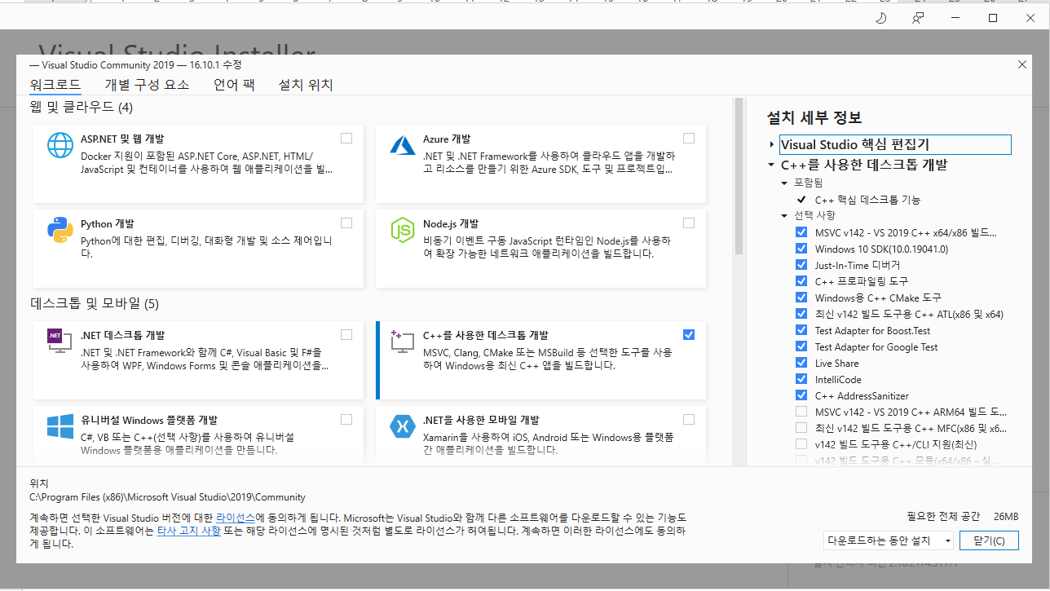
How to build the client application (MFC Library)
Step 2 : MFC libraries are required for this project
Install them from the Visual Studio installer (Individual Components tab) for any toolsets and architectures being used. Please refer to the image below:

