Slide 1


Slide 2

Merrill Lynch
Welcomes You
UMC, Inc.
401(k) Plan
©September 2005 Merrill Lynch, Pierce, Fenner & Smith Incorporated.
Published in the U.S.A. Member, Securities Investor Protection Corporation (SIPC).
Notes:
Introduction
Who you are
Brief background on Merrill Lynch
What you plan to discuss
– the Stantec Consulting Inc. 401(k) Plan
– New investment options
– New products and services

Slide 3
Why Save?

Slide 4

What Does this Number
Mean to You?
54,750
$273,750
Do you have your meals covered?
This example assumes a couple spends 25 years in retirement and consumes three meals a day at a cost of $5 per meal.
Notes:
What does this number mean to you? (pause)
It is the number of meals a retired couple will eat over 25 years in
retirement, assuming they eat 3 meals each day. That’s 54,750 meals.
And this is the cost of those meals, assuming each meal costs
only $5. $273,750!
Do you have your meals covered?
And this is just one expense, what about housing, transportation,
insurance, medical? And of course, let’s not forget about hobbies, birthday and holiday presents for friends and family, and recreation.
So, you might be thinking, 25 years in retirement? Who’s going to
spend 25 years in retirement?

Slide 5

How Long Will
Retirement Last?
We’re retiring earlier...
Median
Retirement Age¹
67.3
(1950 - 1955)
61.5
(2000 - 2005)
Life
Expectancy²
78.9
(1950)
83.1
(2001)
Years in Retirement
11.6 years
21.6 years
…and living longer.
¹ For both men and women combined.
Source: Facts from EBRI, 2001.
² At 65 years for both men and women and all races combined.
Source: Health, United States, 2003.
Notes:
How long will retirement last?
Americans, on average, are retiring sooner. Between the years 1950 and 1955, the median retirement age was 67.3. During 2000-2005, that age was 61.5.
And we’re living longer. In 1950, the life expectancy at age 65 was 78.9, for both men and women and all races combined. In 2001, that age was 83.1.
These two facts mean that the average number of years in
retirement went from 11.6 years for someone retiring in 1950 to 21.6
years for someone retiring in 2001. And that’s just the average.
So, many of you can expect to spend many more years in retirement.

Slide 6

How Will You Pay for It?
Sources of retirement income have changed.
More will have to come from YOU.
Asset
Pensions
Income
Other
18%
16%
3%
Earnings
24%
Social
Security
39%
Pensions includes both government and private.
Source: Fast Facts and Figures about Social Security, Social Security Administration, Office of Research, Evaluation and Statistics, SSA Publication Number 13-11785, June 2003.
Notes:
Statistics have shown that most people will need approximately 70%-80% of their pre-retirement income to sustain their current lifestyle in retirement. This slide provides an estimate of where the average 65-year-old retired person is getting his or her income. According to this source, Social Security provides less than half of income for retirees.
What do you think these numbers will look like when you retire?

Slide 7

How Much Should You Save?
Financial professionals say that in retirement,
you’ll need between
70%
and
80%
of your pre-retirement income just to
maintain your current lifestyle.
Notes:
The answer is: save as much as you can.
Industry professionals indicate that, in order to maintain a comfortable retirement, one should have saved somewhere between 70% and 80% of their pre-retirement income per year. This amount not only needs to keep up with inflation, but it also needs to last for your whole retirement, which could be decades.
This 70% to 80% is to maintain your current lifestyle. Many retirees’ lifestyles change when they retire. Retirees may be healthier today than in past decades. Hobbies and recreational activities are generally more frequently enjoyed because one has more time in retirement to do the things he/she enjoys. This is more like living a better lifestyle than maintaining one’s “current” lifestyle. A better lifestyle, depending on preferred activities, could be more expensive.

Slide 8
Reality Check:
54% of Americans are confident they have saved enough for retirement, yet 40% of respondents said they have less than $15,000 in total retirement savings.
The Merrill Lynch 2005 Retirement Survey
Notes:
Obviously, there’s a gap between perception and reality. One way to help close that gap is by participating in the Stantec Consulting Inc. 401(k) Plan

Slide 9
Why a 401(k) Plan?
Notes:
Now, let’s take a look at WHY and HOW a 401(k) Plan can make it easier to save more for retirement.

Slide 10
Saving Made Simple
Pay yourself first with automatic payroll deduction…
Easy way to take advantage of tax benefits...
Portability rules ensure you never
have to leave your savings behind…
Free money with the company match*…
*Subject to eligibility and vesting schedule
Notes:
Your 401(k) plan allows you to pay yourself first through automatic
payroll deduction. Paying yourself first is a critical aspect of saving
for any long-term goal, like retirement. Too often, people say they
will save what ever is left at the end of the month. The problem with
this approach is that we have usually spent all our money by the end
of the month, and we have no idea where a significant portion of that money went.
By taking advantage of the tax benefits in your 401(k) plan, you allow
more of your money to work for you instead of sending it to the IRS (keep in mind, that taxes are due upon withdrawal). We’ll discuss this point in more detail in a few minutes.
Also, the new portability rules ensure that you never have to leave your
savings behind. Whether you have saved in a 401(k) plan, a 403(b),
or a government plan you can roll that into an Individual Retirement
Account (IRA) and maintain all the tax benefits of those plans. Merrill
Lynch can help you with any of your savings goals, whether they be
for retirement,with an IRA or a Roth IRA, or education, with the new
529 education savings plans.

Slide 11
How Much Does it Cost to Save $2,000?
$2,667
$2,000
After-tax savings
Pre-tax savings
Assumes 25% tax bracket and $2,000 is invested into a taxable account and a pre-tax account. Taxes will be due on the taxable account upon withdrawal.
Notes:
One of the big reasons to save in your 401(k) plan, is that it costs less
of your gross salary.
Because you don’t have to pay taxes on your contributions until you take distributions, at retirement for example, saving $2,000 on a pre-tax basis cost $2,000 of your gross salary. Taxes are due upon withdrawal. You may owe a 10% tax penalty If you take a withdrawal prior to age 59 1/2.
Since you have to pay taxes before money is saved on an after-tax basis, it will cost you the $2,000 over the year plus any taxes paid. Assuming you are in the 25% tax bracket, saving $2,000 after tax will cost you $2,667 from your gross income”
________________________________________________________
Back-up math:
$2,667 earned income
x (1-.25) assuming 25% tax bracket
$2000.25
round to $2,000

Slide 12

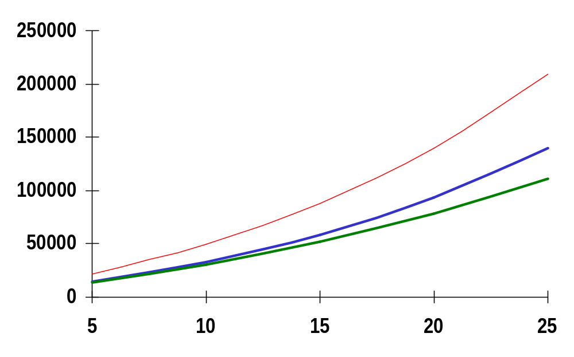
Growth Potential With Company Match
Hypothetical Tax-Deferred Growth w/ Company Match
$209,237.68
Hypothetical Tax-Deferred Growth
$139,491.79
Hypothetical Taxable Growth
$111,214.35
This hypothetical illustration assumes a salary of $40,000; a 6% contribution rate; and a 6% annual rate of return, compounded monthly, for both the Taxable and Tax-deferred accounts. The tax-deferred growth example with company match also assumes a company match of 50% for every dollar contributed up to 6% of eligible compensation. This company match example is being shown for illustrative purposes only. Your employer may match a different portion of your contributions. The taxable account assumes a 25% flat tax rate. Changes in tax rates and tax treatment of investment earnings (e.g., lower minimum tax rates on capital gains and dividends) may impact the comparative results. Please consider your personal investment horizon and income tax brackets, both current and anticipated, when making an investment decision as these may further impact the results of the comparison.
Hypothetical results are for illustrative purposes only and are not meant to represent the past or future performance of any specific investment vehicle. Investment return and principal value will fluctuate and when redeemed the investment may be worth more or less than their original cost. Taxes are due upon withdrawal. If you take a withdrawal prior to age 59½, you may also be subject to a 10% tax penalty.
Notes:
A great benefit of a 401(k) plan is that any earnings on the investments in your account are not taxed until you withdraw the money. These earnings have the potential to compound over time. After 25 years, this tax-deferred growth could add up.
This hypothetical example assumes that Randi makes $40,000 a year, contributes 6% of pay, and earns a 6% annual rate of return, compounded monthly.
After 25 years, her taxable account could grow to $111,214.35. (The taxable example assumes a 25% flat tax rate).
But if invested in a tax-deferred 401(k), under the same assumptions, her account could grow to $139,491.79. And when company matching contributions are added in, her account could grow to $209,237.68. This example assumes a company match of 50% for every dollar contributed up to 6% of eligible compensation. Your company’s matching contributions may vary. Keep in mind that taxes are due upon withdrawal. You may also be subject to a 10% tax penalty if you take a withdrawal prior to age 59 1/2.
Of course, your investments are unlikely to grow 6% each and every year. A more realistic example would show that some investments rise in some years and decline in others.
And when you do begin to take money out of your account, Merrill Lynch can help you determine the distribution option that’s appropriate for your situation.

Slide 13
Saver’s Tax Credit
Possible federal income tax credit of up to 50% on the first
$2,000 you contribute to the plan
Married Filing Joint Head of Household All Other Filers Saver’s Tax Credit
$0-$30,000 $0-$22,500 $0-$15,000 50% of contribution
$30,001-$32,500 $22,501-$24,375 $15,001-$16,250 20% of contribution
$32,501-$50,000 $24,376-$37,500 $16,251-$25,000 10% of contribution
Over $50,000 Over $37,500 Over $25,000 Credit not available
This example is for illustrative purposes only and was developed using the Internal Revenue Service’s 2004 tax tables. For more information about tax savers credit, please consult a tax advisor.
Notes:
And, as you can see, the Tax Savers Credit could help you save on your tax bill next April 15.

Slide 14
Eligibility & Enrollment
Eligibility
  Eligible after you reach age of 18.
Enrollment
  Complete Enrollment and Beneficiary Forms during quarterly open enrollment.
  Contact Merrill Lynch to enroll in the Plan:
    Benefits OnLine®: www.benefits.ml.com.
    Interactive Voice Response System: (800) 229-9040.
Notes:
Read slide.

Slide 15

Contributions
Pre-tax contributions between 1% and 75% of eligible compensation on a pre-tax basis (subject to IRS limits)
Catch-up contributions
UMC discretionary match
Rollovers
Notes:
Read slide and add:
If you are already contributing to the Plan and want to increase your contribution, you may do so online via Benefits OnLine, www.benefits.ml.com, or by phone by calling (800) 229-9040

Slide 16
Maximum Employee Plan Contributions
Year
Participants Under 50
Participants
50 and Over
2005
2006
$14,000 $18,000
$15,000 $20,000
Please note that employer match contributions do not count towards the maximum annual plan contribution limit.

Slide 17

Vesting
Employee contributions are always 100% vested
The matching contributions that your employer makes, plus any earnings they generate, vests as follows:
Years of Service
Less than 1
1
2
Vesting Percentage
0%
50%
100%
Notes:
Your right to your account balance — which includes the right to take the assets when you leave the company — is called vesting.
Read slide.

Slide 18
Employer Contributions
Discretionary match for all eligible employees
  50% of salary deferrals and your catch-up contributions up to 6% of your compensation per pay period
Notes:
Optional (This slide and next could be used together, if company offers fixed and discretionary matches.)
Read slide.

Slide 19
Are You Ready?
Notes:
Next, we’ll talk about ways you can put your company plan to work for you.

Slide 20
Invest Wisely
Notes:
Let’s start with discussing invest wisely.

Slide 21
Investing in Mutual Funds
Offers diversification
Stated investment objective
Professional management by objective
Notes:
A mutual fund makes investing simple. Mutual funds:
Own a collection of investments, for example stocks, bonds, and cash equivalents to meet a common objective. That objective might be stability, income, growth, or some combination of these.
In selecting mutual funds, investors should understand the objectives of the funds. These objectives should be in line with the investors’ objectives. Understanding how the portfolio manager intends to meet the objective of the fund is important for the investors to know, because this will help the investors evaluate the fund with respect to the investors’ risk tolerance.
Even though someone may be invested in one mutual fund they are actually invested in dozens or maybe even hundreds of different investments.

Slide 22
The Three Asset Classes
Cash Equivalents
  Liquidity
  Relative safety of principal
  Current interest
Bonds
  Debt instrument (i.e., loans)
  Pay a fixed amount of interest at regular intervals over a certain period of time
  Bond prices fluctuate as interest rates change
Stocks
  Ownership in a company
Notes:
Cash equivalents offer liquidity and relative safety of the principal investment. In exchange for these benefits, the returns on Cash equivalents is low. These are relatively safe for short-term objectives but for long-term goals they can be dangerous because they may not even outpace inflation.
Although a money market fund seeks to preserve the value of your investment at $1 per share, it is possible to lose money by investing in a money market fund. A money market fund is neither insured nor guaranteed by the Federal Deposit Insurance Corporation or any other government agency.
Bonds are debt instruments, loans, to governments or corporations. These loans will pay a specific interest over a set amount of time. But, if they are sold, the value may be less or more depending upon whether interest rates have changed. If interest rates rise, the value of existing bonds, generally, declines. If interest rates fall, their value generally rises.
Stocks are the most volatile. They represent partial ownership in a company. They offer the greatest potential for long-term returns but their prices may fluctuate drastically every day that the market is open. Stocks are dangerous for short-term goals because of the market fluctuation, but in the long-term they offer the greatest potential for returns.

Slide 23
Returns Before and After Inflation
1925-2003
Before Inflation
After Inflation
12%
10.4%
10%
8%
7.2%
6%
5.4%
Compound Annual Return
4%
3.7%
2.3%
2%
0.7%
0%
Stocks
Bonds
Cash Equivalents
Results shown are based on indexes, are illustrative and assume reinvestment of income and no transaction costs or taxes. Past performance is no guarantee of future results. Index sources: Stocks—Standard & Poor's 500®, which is an unmanaged group of securities and is considered to be representative of the stock market in general; Bonds—20-year U.S. Government Bond; Cash—U.S. 30-day Treasury Bill; Inflation—Consumer Price Index. Direct investment cannot be made in an index. Used with permission. ©2003 Ibbotson Associates, Inc. All rights reserved. [Certain portions of this work were derived from the work of Roger G. Ibbotson and Rex Sinquefield.]
Notes:
Returns before and after Inflation 1925–2003
Comparing the returns of different asset classes both before and after inflation is helpful in understanding why it is so important to consider inflation when making long-term investment decisions.
This image illustrates the compound annual returns of three asset classes before and after considering the effects of inflation. Over 78 years (from the time period December 31, 1925 through December 31, 2003), inflation dramatically reduced the returns of stocks, bonds, and cash.
The darker color bars represent the nominal, or unadjusted, returns of each asset class without taking inflation into account.
The lighter color bars illustrate the real, or inflation-adjusted, returns of each asset class. Real returns reflect purchasing power. For example, if you invested in cash equivalents in 1925, the money you earned over the period provided you with very little purchasing power.
Notice that cash equivalents and bonds, after adjusting for inflation, barely kept pace with the rise in prices over these 78 years.
Note: Information shown is illustrative and is not indicative of any specific investment.

Slide 24
Stocks, Bonds, Cash Equivalents, and Inflation
1925–2003
Ending
Wealth
Average
Return
$20,000
Small company stocks
$10,000
Large company stocks
$10,954
12.7%
Government bonds
$2,285
10.4%
$1,000
Treasury bills
Inflation
$100
$61
5.4%
$18
3.7%
$10
$10
3.0%
$1
$.10
1925
1935
1945
1955
1965
1975
1985
1995
2003
Hypothetical value of $1 invested at year-end 1925. Results shown are based on indexes and are illustrative; they assume reinvestment
of income and no transaction costs or taxes. Past performance is no guarantee of future results. Index sources: Small Company Stocks—represented by the fifth capitalization quintile of stocks on the NYSE for 1926–1981 and the performance of the Dimensional Fund Advisors, Inc. (DFA) U.S. Micro Cap Portfolio thereafter; Large Company Stocks—Standard & Poor’s 500®, which is an unmanaged group of securities and considered to be representative of the stock market in general; Government Bonds—20-year U.S. Government Bond; Cash—30 day U.S. Treasury Bill; Inflation—Consumer Price Index. Direct investment cannot be made in an index. Used with permission. ©2003 Ibbotson Associates, Inc. All rights reserved. [Certain portions of this work were derived from the work of Roger G. Ibbotson and Rex Sinquefield.]
Notes:
Stocks, Bonds, Cash Equivalents, and Inflation® 1925–2003
A 78-year examination of past capital market returns provides historical insight into the performance characteristics of various asset classes.
This graph illustrates the hypothetical growth of a $1 investment in four traditional asset classes, as well as inflation, over the time period December 31, 1925 through December 31, 2003.
Large and small company stocks have provided the largest increase in wealth over the past 78 years. The fixed-income investments provided only a fraction of the growth provided by stocks.
As illustrated in this image, stocks produced greater returns and a higher ending wealth value than that of fixed-income investments. However, these higher returns are associated with much greater volatility (or risk). Furthermore, small company stocks may be subject to more market risk than large company stocks.
Note: Information shown is illustrative and is not indicative of any specific investment.

Slide 25
Why Is Diversifying Important?
Research has shown that on average, approximately
90%
of the movement of an investor’s portfolio from quarter to quarter is due to the market movement of the asset classes chosen and not the funds selected.*
*Source: “Does Asset Allocation Policy Explain 40%, 90%, or 100% of Performance?” by Roger G. Ibbotson and Paul D. Kaplan, was published in the January/February 2000 edition of the Financial Analysts Journal. The study analyzed monthly data from 94 U.S. balanced mutual funds over the period 1988 through 1998 and quarterly data from 58 U.S. pension plans from 1993 through 1997.
Notes:
Why Is Diversifying Important?
Industry studies agree that asset allocation is the most important factor of the overall, long-term portfolio performance — not market timing and not investment selection. In fact, these studies have shown that approximately 90% of a portfolio’s overall return is determined by the asset allocation.

Slide 26
Four Steps of Investing
Identify your investment profile
Choose your investment mix
Select your investment options
Monitor your investments
Notes:
The four basic steps to investing.
Read slide.

Slide 27
For more complete information on the investment options, including their management fees and other charges and expenses, please consult the prospectuses and other comparable documents. Investors should carefully consider the investment objectives, risks, charges and expenses before investing. This, and additional information about the investment options, can be found in the prospectuses, which can be obtained by calling Merrill Lynch at (800) 229-9040. Please read these documents carefully before investing.
Notes:
You can always call or go online to get additional investment information.
Merrill Lynch can be reached via phone at (800) 229-9040. or online at www.benefits.ml.com.

Slide 28
GoalManagerSM Portfolio Rebalancing Service
Makes investing simple and convenient
It gives you these important advantages:
  Simple Sophistication
  Diversified Investing
  Automatic Rebalancing
3 portfolio models to choose from
GoalManager is a service mark of Merrill Lynch & Co., Inc.
Notes:
The GoalManager Portfolio Rebalancing Service was created to simplify the complex investment process for you.
Bullet Highlights:
The GoalManager Portfolio Rebalancing Service and asset allocation tool offers the following advantages:
• Simple Sophistication — GoalManager makes diversified investing simple though selection of pre-mixed portfolio models.
• Diversified Investing — GoalManager offers a diversified approach to investing, putting the power of asset allocation to work for your plan.
• Automatic Rebalancing — With GoalManager’s rebalancing feature, the model’s original asset mix will maintained over the long-term, even during periods of market volatility.

Slide 29
Step 4: Monitoring Your Investments
Portfolio Rebalancing
  The process of restoring your investment positions to your original asset allocation
Notes:
GoalManager is an asset allocation and rebalancing tool designed to make sophisticated investment decisions simple:
5 portfolio models that are pre-selected by your employer
Consist of investment options from the Stantec Consulting, Inc. (401) Plan.
Portfolio models are rebalanced periodically.

Slide 30
Picture Retirement
How will you spend your time?
Where will you live?
How will your family relationships change?
Notes:
Don’t just read slide — try to engage audience members in discussing their plans for retirement. Maybe start out by saying what you’ll do? (“I’ll finally have enough time to golf AND get all my yard work done…how many of you like the sound of that?” or “We have children in Wisconsin and Florida — so I know where I’ll be spending my winters…What about you...”)

Slide 31



What Does Retirement Mean to You?
Three out of four Americans view retirement as a chance to travel and relax.
The Merrill Lynch 2003 Retirement Survey
Notes:
As you can see, three out of four Americans view retirement as the time to…
Take it easy and relax…
Perhaps to spend time with loved ones.
Travel to new places, or to their favorite places that they have only had limited time to visit.
Many, however, have not considered the obligations they may need to meet in retirement, like paying for the long-term care of themselves or a loved one. Wherever you want to go — or whatever you want to do — Merrill Lynch can show you where you can go for help.

Slide 32
What Does Retirement Mean to You?
FINANCIAL FREEDOM
is the bottom line!
The Merrill Lynch 2003 Retirement Survey
Notes:
NOTE TO PRESENTER: To continue engaging the audience, ask them what financial freedom means to them, this will get the audience members thinking about how to achieve whatever it is that financial freedom means to them.
Would you agree that the common factor in what we’ve been talking about is “financial freedom”?
Everyone wants to be able to do what they want to do, and to have the resources to meet challenges.

Slide 33
Maximize Your Benefits Package
Save as much as you can
Get paid to save with your company match
Take advantage of the tax benefits
Set your goals and invest wisely
UMC, Inc. and Merrill Lynch
can help!
Notes:
[Use with plans that HAVE A MATCH]
Read slide.
If you want to boil it all down to one thing, it’s this: Planning.

Slide 34

Keeping You Informed
Quarterly statements
Confirmations
Benefits OnLine®
Personalized communications
Benefits OnLine is a registered service mark of Merrill Lynch & Co., Inc.
Notes:
Merrill Lynch will keep you informed about your progress in several different ways. At present, changes in your account are communicated to you through your quarterly statements, confirmations and Benefits OnLine. We are also developing personalized communications to help keep you informed in the future.

Slide 35
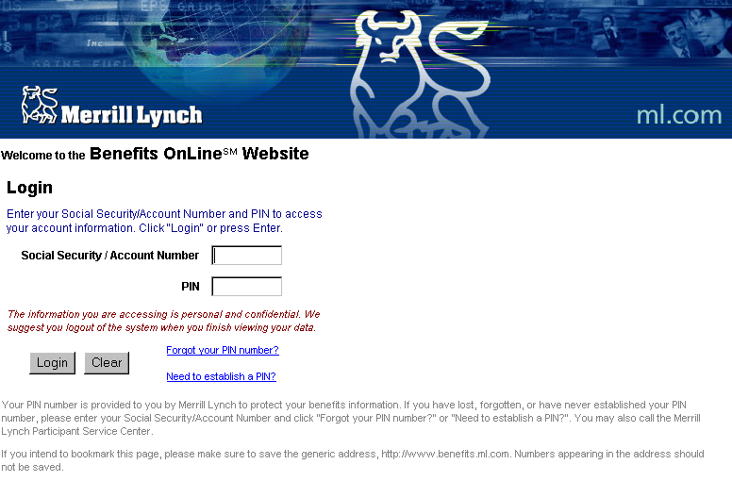
Benefits OnLine® www.benefits.ml.com
Enter your SSN and PIN
Reset your PIN
Notes:
All you need to get online is your Social Security number and a Personal Identification Number, or PIN. If you have lost or forgotten you PIN, you can click on “I forgot my PIN” and you will be prompted for your email address. A new PIN will immediately be emailed to you.If you chose to request a new PIN by telephone, it will be mailed to your primary address.

Slide 36

Home
  Account Balance, Enroll (for eligible employees)
Account
  Transactions, Statements, Transaction History
Plan Information
  Plan Documents / Forms, MyFuture, My Information
Investments
  Fund Performance, Fund Prospectuses, Investment Choices, Market Data
Planning / Education
  Financial Planning Calculators, Investor’s Toolkit,
  Retirement Strategies
Notes:
Online you can monitor your accounts after you enroll
by checking your account balance, making transactions, checking plan
information, reviewing investment information on each of your investment
options, and receiving additional educational materials, including calculators
to help in your planning.
Merrill Lynch’s web site for participants is award winning in 2001 as the
Best of the Web from P&I. It really is informative and easy to use.

Slide 37
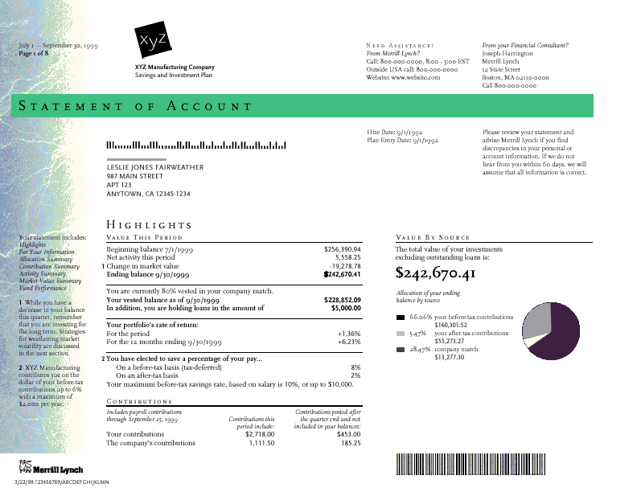
Account Statement
Available at www.benefits.ml.com
SAMPLE
Notes:
You can view your Statements of Account online. If you’d like, we can send
you an e-mail when new statements are available, allowing you to see
your statements before they arrive at your home.

Slide 38
Merrill Lynch Retirement Service Representatives
(800) 229-9040
Retirement Service Representatives
  Available Monday - Friday, 8:00 AM to 7:00 PM (ET) on all days that the New York Stock Exchange is open
Interactive Voice Response (IVR) System
  Available virtually 24 hours a day, seven days a week
  Speech-enabled access
  Personal identification number (PIN) required for transactions
Notes:
Speech-Enabled Interactive Voice Response (IVR) System:
You can access the IVR System by entering your Social Security number
and PIN, then speak your selections. Simply speak the name of the
investment option or transaction you need, such as stock quotes, requesting
fund information, initiating a funds transfer, or redirecting investment choices.
It’s quick and it’s easy!
The toll-free IVR is available virtually 24 hours a day, seven days a week,
including holidays.
Participant Service Representatives:
Representatives are available Monday through Friday from 8 a.m. to
7 p.m. (ET) on all business days that the New York Stock Exchange is
open. Just call (800) 229-9040. You will need your Social Security number to access your account.

Slide 39
Act Now!
Identify your investment profile
Choose your investment mix
Select your investment options
Monitor your investments
www.benefits.ml.com
(800) 229 - 9040
Notes:
Enroll today.
Follow the four steps we discussed:
1. Identify your investment profile
2. Choose your asset allocation or investment mix
3. Select your investment options based upon your investment mix
4. And monitor your investments.

Slide 40
Open Discussion
and Questions
Benefits OnLine is a registered service mark of Merrill Lynch & Co., Inc.
GoalManager is a service mark of Merrill Lynch & Co., Inc.
©September2005 Merrill Lynch, Pierce, Fenner & Smith Incorporated.
Published in the U.S.A. Member, Securities Investor Protection Corporation (SIPC).

