Slide 1
Building a Testbed for Evaluating Privacy Enhancing Technologies (PETs)
Jacob Daniel Halsey

Slide 2
Background
The REPHRAIN: (National Research Centre on Privacy, Harm Reduction and Adversarial Influence Online) group are undertaking research into Privacy Enhancing Technologies.
They need a way to easily and automatically generate a testing environment, which can be used to simulate a wide range of these technologies.
This project will attempt to prototype automated testbed using virtualization (Linux KVM + Open vSwitch), from which a researcher can capture and investigate network traffic produced by an application / protocol spanning multiple virtual devices.

Slide 3
Aims
To produce a simple and lightweight (minimal overhead), testbed platform.
Support testing various architectures / network topologies, including client/server and peer-to-peer applications.
Support simulating mobile apps – both prebuilt and signed, or source code available (they differ in our ability to programmatically automate them).
Support a high level of automation – such that working with large test environments (100s of VMs) becomes feasible.

Slide 4
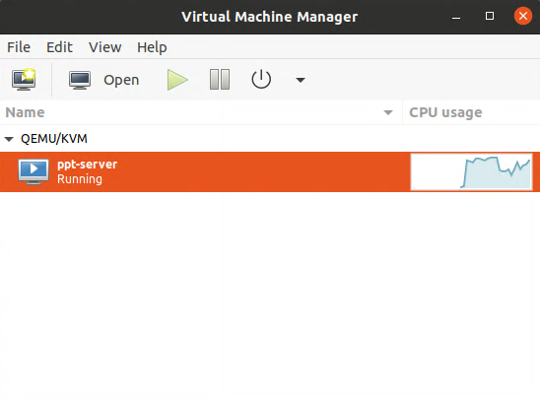
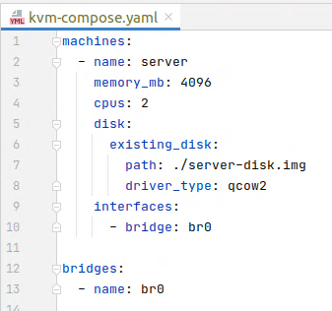
The Implementation: kvm-compose
kvm-compose is a CLI tool I have developed for Linux using Rust (and the libvirt library) that takes in a custom configuration file format describing a test environment, and can create or destroy it (with up/down subcommands).
$ kvm-compose up
→
This is the first step of automating a testbed:
From a simple configuration file kvm-compose will deal with the conversion to a relatively complex libvirt domain configuration XMLs (for KVM), and create the virtual machines.
It will also create and connect the virtual machines up to a virtual network

Slide 5
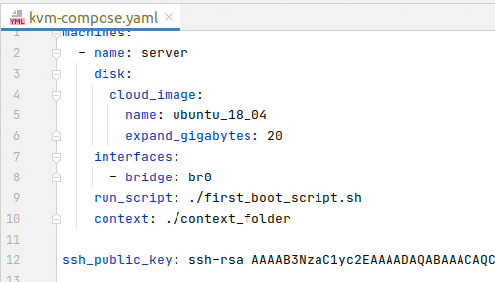
Cloud-init, Scripting, Context etc.
Now we can create virtual machines… but that still leaves a lot of work with regard to creating the disk images, and installing the applications.
What if we use cloud-init to automatically initialize new virtual machines? The NoCloud datasource option uses a clever system of attaching a specifically formatted virtual disk, and passing flags via the SMBIOS serial number of the VM.
What happens now?
The Ubuntu cloud image will be downloaded (once and then cached), copied, and expanded with 20G free space.
At boot the machine will auto configure its hostname to match the machine name in the configuration file.
Our SSH public key will be injected into the instance, allowing remote access.
Files in the context folder will be copied in at /etc/nocloud/context.
An arbitrary run_script will be run once on the first boot.

Slide 6
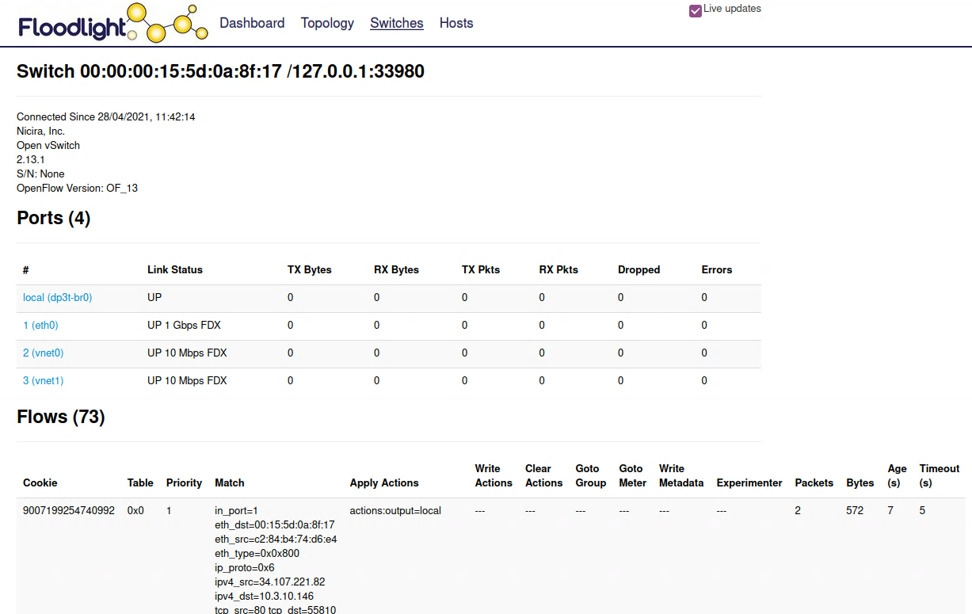
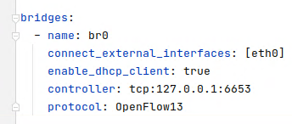
SDN
Because I am using Open vSwitch – the bridges can also easily be linked up to an SDN controller (such as Floodlight), enabling more advanced network management.

Slide 7
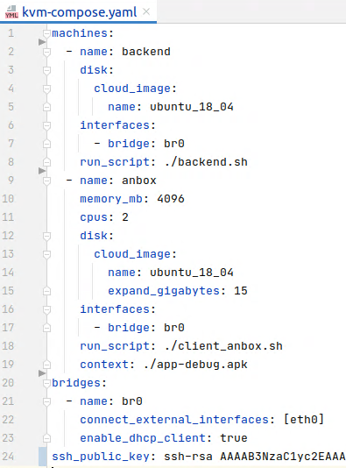
Example: Swiss COVID-19 App (DP3T)
backend.sh is a script that installs maven, clones the dp3t server github, and launches it as a service.
client_anbox.sh is a script that installs Anbox (an Android emulation platform)
The app-debug.apk Android app (compiled with our backend as the API URL) is transferred in at /etc/nocloud/context/app-debug.apk
A researcher can just run kvm-compose up and have a test environment automatically created, with a running server, and app ready to launch.
Network traffic can be captured and inspected on the host using the ovs-tcpdump tool

Slide 8
Future
I will look at further automating the process of simulating apps, so that it is easier to run many all at once - I.e. using some sort of scripted / headless android simulator.
Adding more example deployment usages of the testbed, such as the Signal app / protocol.
Conduct tests and make any necessary ease of use improvements for running deployments with a very large number of virtual machines.
Add support for more complex captures such as memory dumps.

Slide 9
(End)

