Slide 1
Driftr
Jacob Ryan, Daniel Lehman, and Davis Nygren

Slide 2
The Problem
Legal car racers need a way to meet one another and schedule racing events.
Carrier pigeons are extinct and technology has not yet filled this hole.

Slide 3
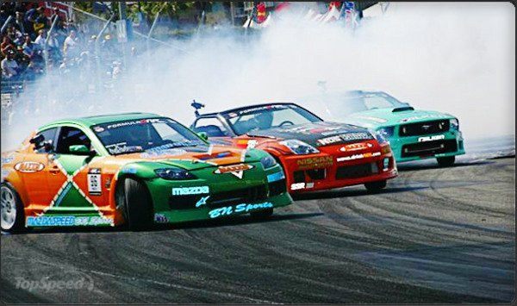
The Solution
Drifter is a website that will match people with similar preferences for the purpose of professional driving excursions on closed courses.

Slide 4
Design
Tables
Event
Event Participant
Friend
Location
Preferences
User
Vehicle

Slide 5
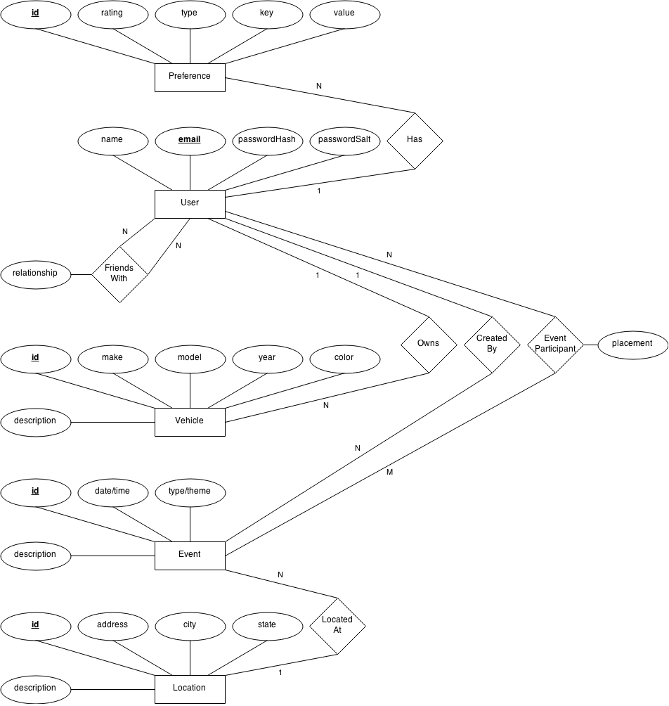

Slide 6
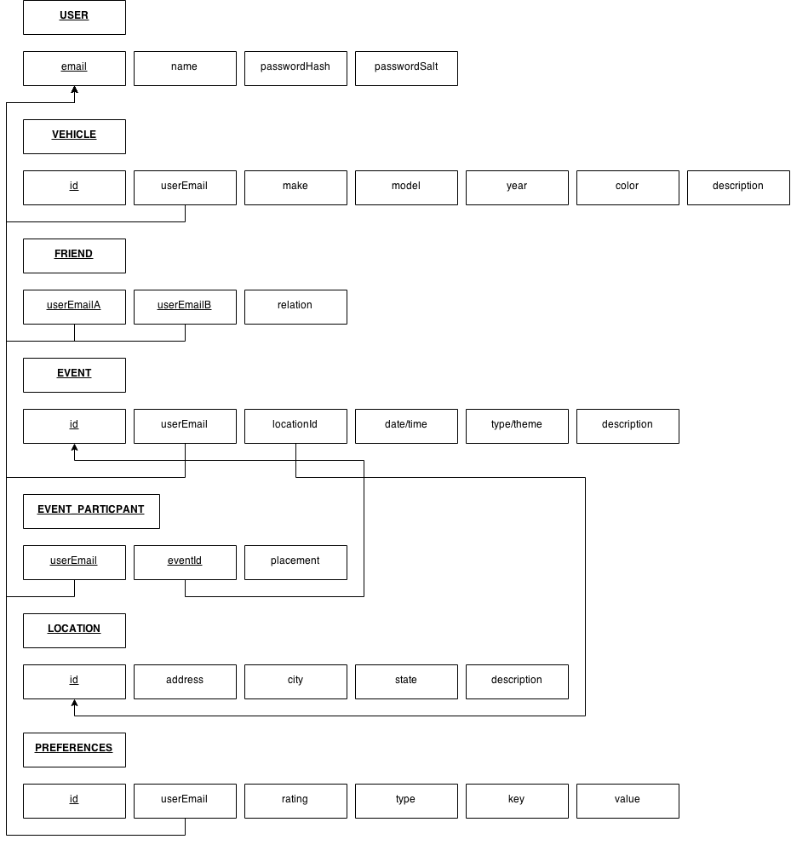

Slide 7
Challenges
C# code connecting properly to database
Sorting events based on preferences
Using appropriate and consistent data types
Determining which sproc’s were needed for the project
Finding meeting times that were convenient for everyone

Slide 8
Lessons Learned
C# is magic
Bootstrap is nice
Putting good effort into planning the ER diagram and relationships paid off later in the design

Slide 9
Demo
driftr

