Slide 1
Machine Learning Approaches to Better Utilize HM450K Data in Cancer Analysis
Sam Coleman and Jacob Tye
Notes:
Presentation
50 points; 8-10 minutes; during the last week
Present your work to the class, focusing less on the technical details of your code and more on the problem, its significance, how you approached solving it, the challenges you faced, and the interesting aspects and limitations of your results. Your presentation will be graded as follows:
Organization (20%)
Clarity (20%)
Completeness (covering all aspects of the project) (45%)
Time Management (15%)

Slide 2
Problem
One of the most important factors in determining patient outcome in cancer is the time to diagnosis.
Unfortunately, there are many cancer types in which early testing or screening is impossible.
Methylation dysregulation is a hallmark of many cancers.
We propose to utilize various machine learning methods to:
1. Predict Tumor / Normal status from Illumina 450k methylation data
2. Identify subtypes in Breast Cancer from their 450k methylation status

Slide 3
Significance
Methods for the early diagnoses of cancer are limited.
Methylation offers a unique avenue for the detection of cancer due to the abnormal methylation patterns displayed in cancerous cells.
The Illumina 450k methylation panel is commonly used and can be collected through a blood draw.
For these reasons, the use of methylation data for the early diagnosis of cancer is an active area of research.

Slide 4
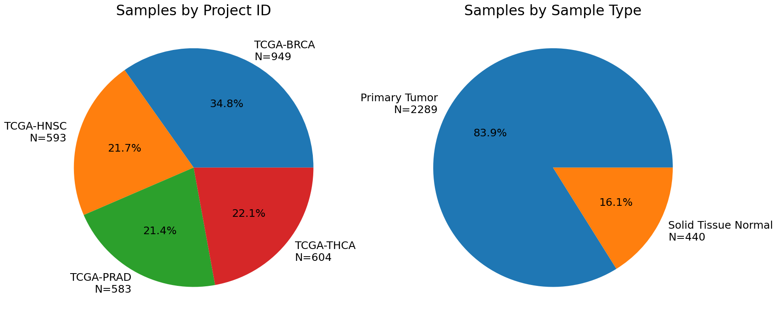
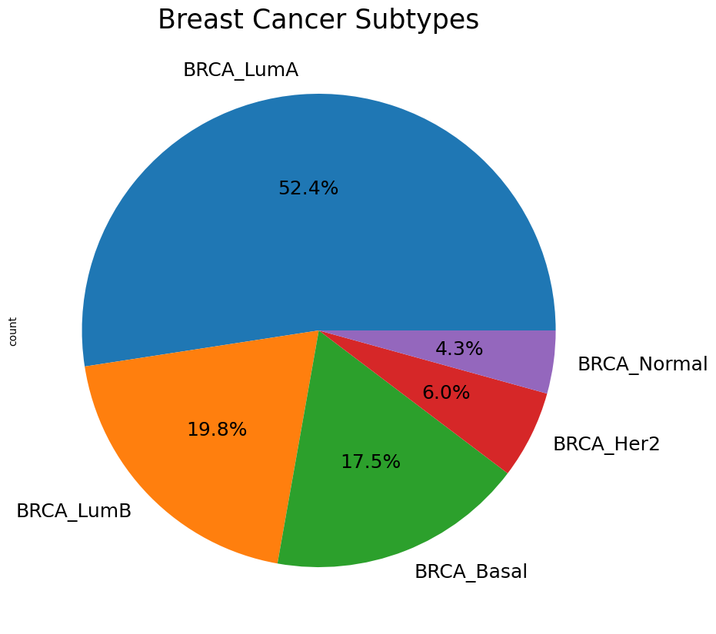
Dataset
Publicly available data was sourced from TCGA and cBioPortal
5 Tissue Types n = 2729:
1. Breast Cancer (BRCA) n = 769
2. Head and Neck Squamous Cell Carcinoma (HNSC) n = 523
3. Thyroid Cancer (THCA) n = 499
4. Prostate Cancer (PRAD) n = 498
5. Normal Healthy Tissue n = 440
Filtered CpG loci to those found in all datasets and containing data in 80% or more samples n = 238,284
Subtype Classification data for BRCA was also collected
Luminal A n = 366
Luminal B n = 138
Basal-like n = 122
Her2 n = 42
Normal-like n = 30

Slide 5
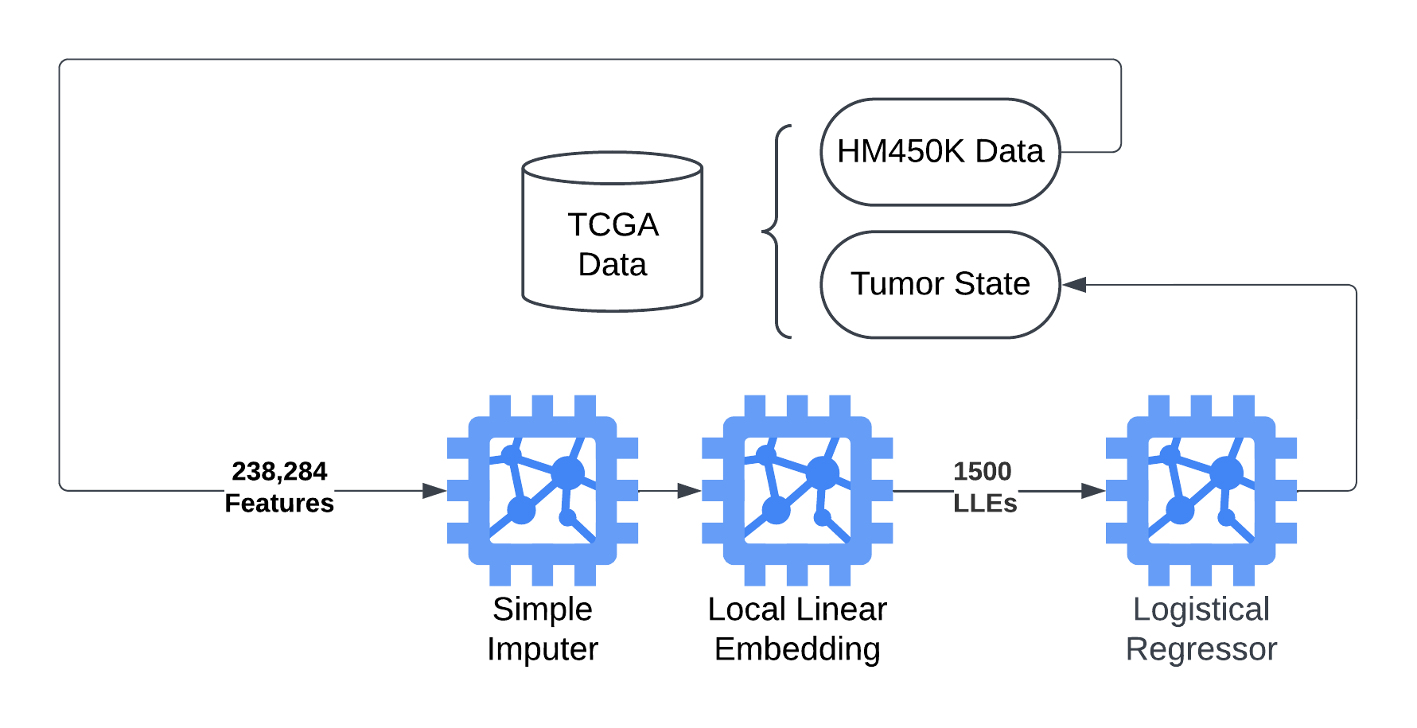
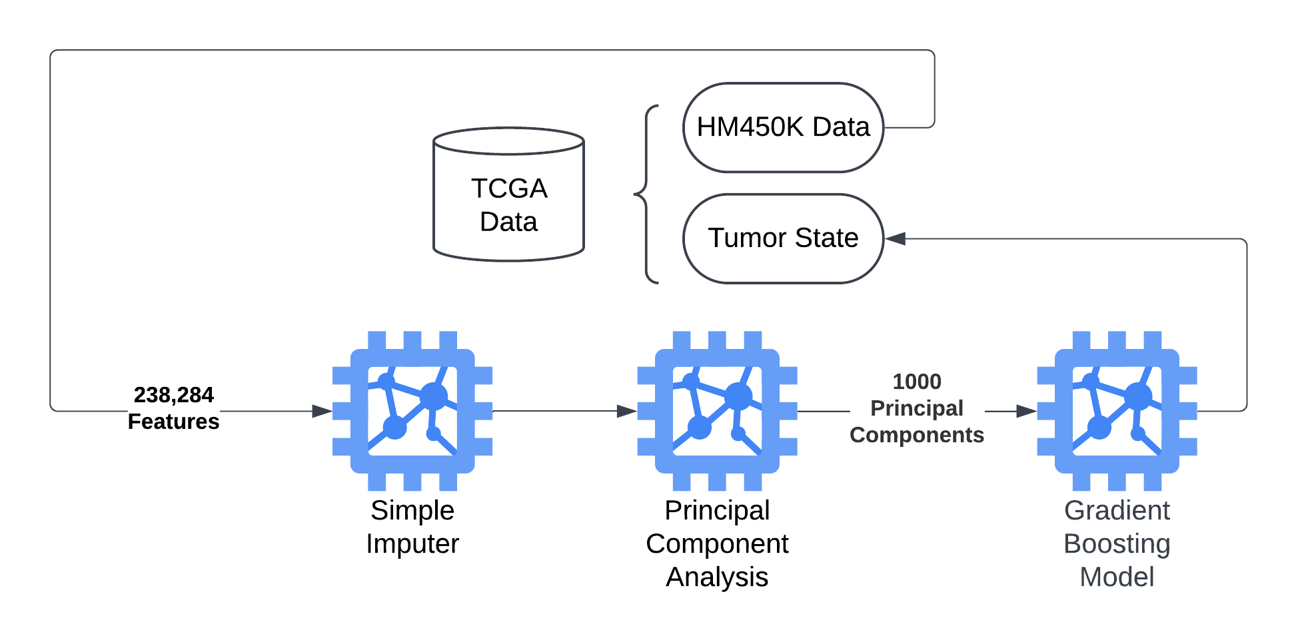
Problem 1: Predicting Tumor State
Solution 1.1
Locally Linear Embedding with Logistical Regression
Solution 1.2
Principal Component Analysis with Gradient Boosting

Slide 6
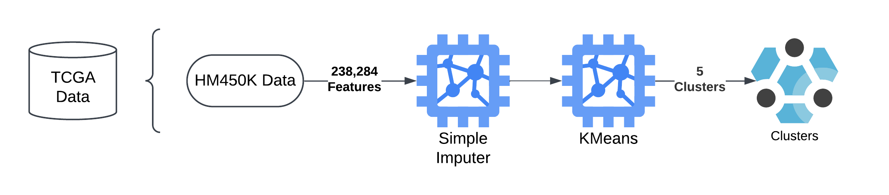
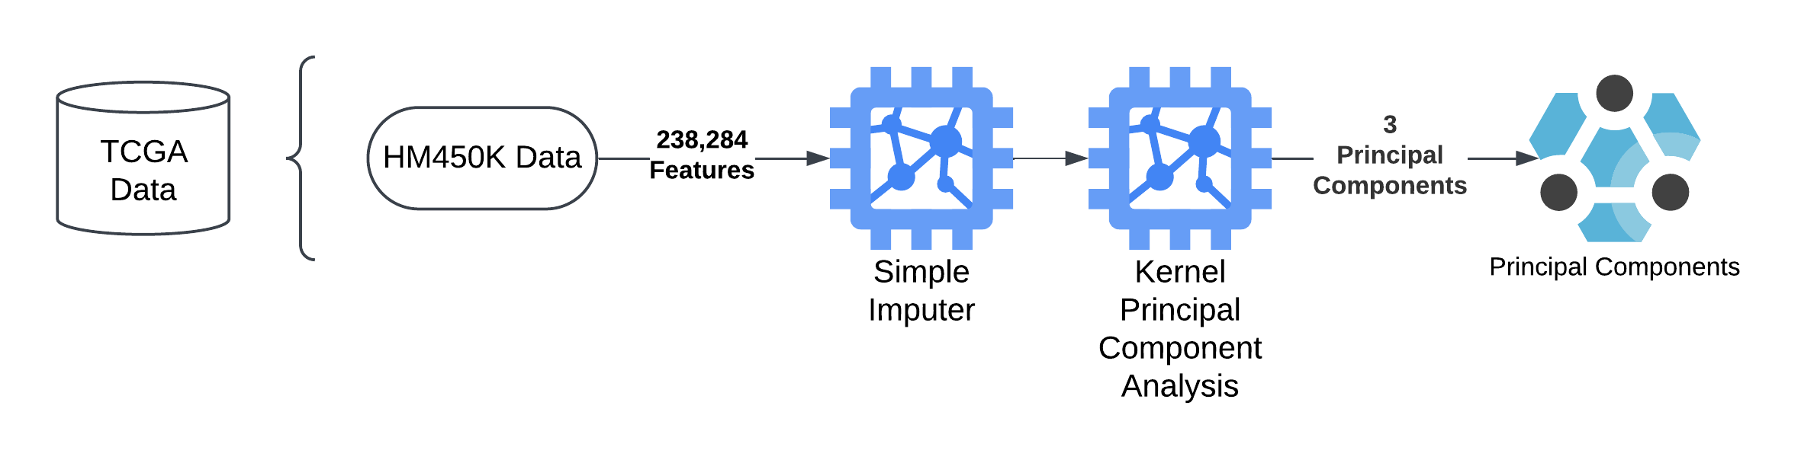
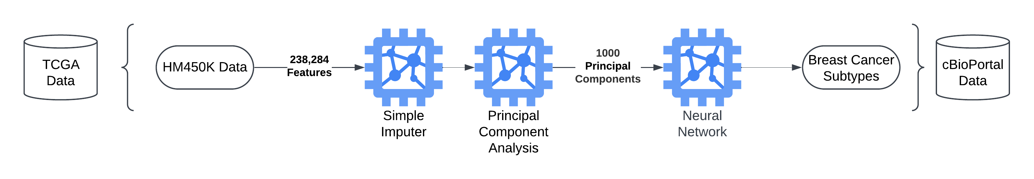
Problem 2: Identification of Breast Cancer Subtypes
Solution 2.1
K-Means Clustering to Identify Subtypes
Part 1: Clustering
Part 2: Data visualization
Solution 2.2
Principal Component Analysis with Neural Network Classification

Slide 7
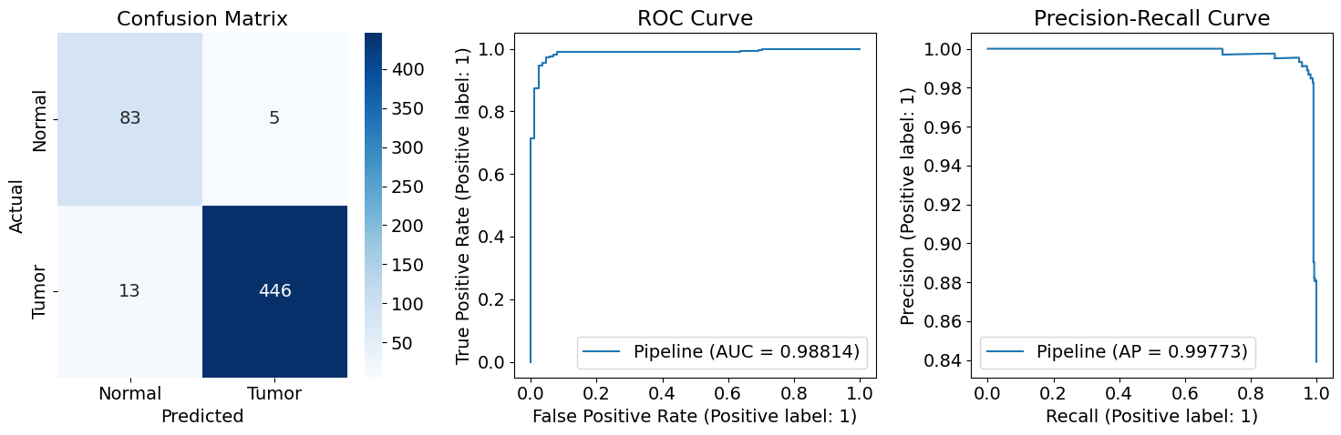
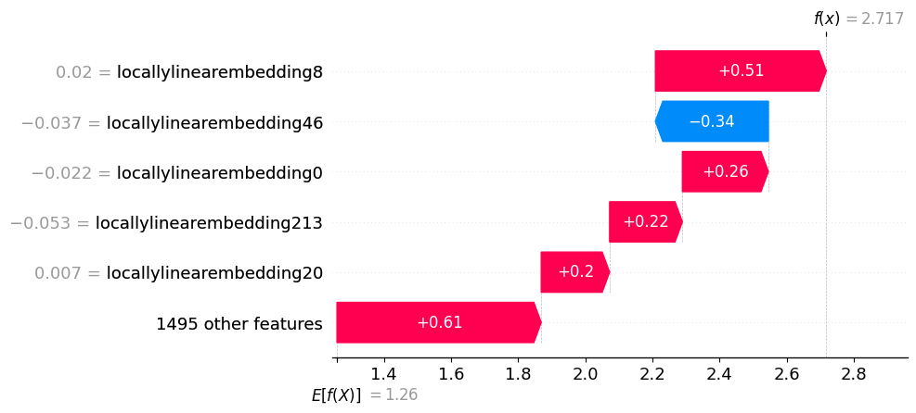
Solution 1.1 Results
Locally Linear Embeddings with Logistical Regression for Tumor/Normal Classification
Pipeline performed with high accuracy and was able to classify samples into normal vs tumor
SHAP for whole model was impossible due to memory so we performed it on the LLE reduced dataset
 | precision | recall | f1-score | support
Normal | 0.86 | 0.94 | 0.90 | 88
Tumor | 0.99 | 0.97 | 0.98 | 459
accuracy |  |  | 0.97 | 547
macro avg | 0.93 | 0.96 | 0.94 | 547
weighted avg | 0.97 | 0.97 | 0.97 | 547

Slide 8
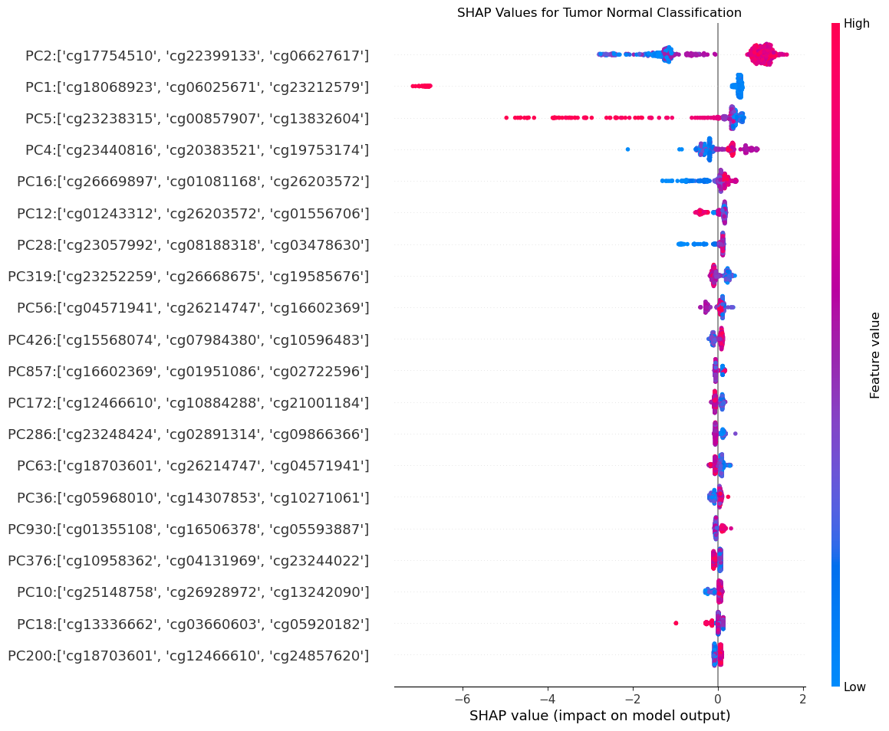
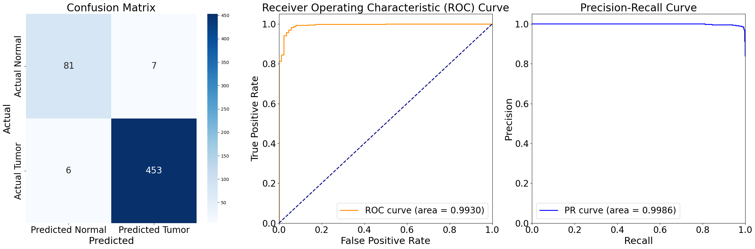
Solution 1.2 Results
Principal Component Analysis with Gradient Boosting for Tumor/Normal Classification
 | precision | recall | f1-score | support
Normal | 0.93 | 0.92 | 0.93 | 88
Tumor | 0.98 | 0.99 | 0.99 | 459
accuracy |  |  | 0.98 | 547
macro avg | 0.96 | 0.95 | 0.96 | 547
weighted avg | 0.98 | 0.98 | 0.98 | 547

Slide 9
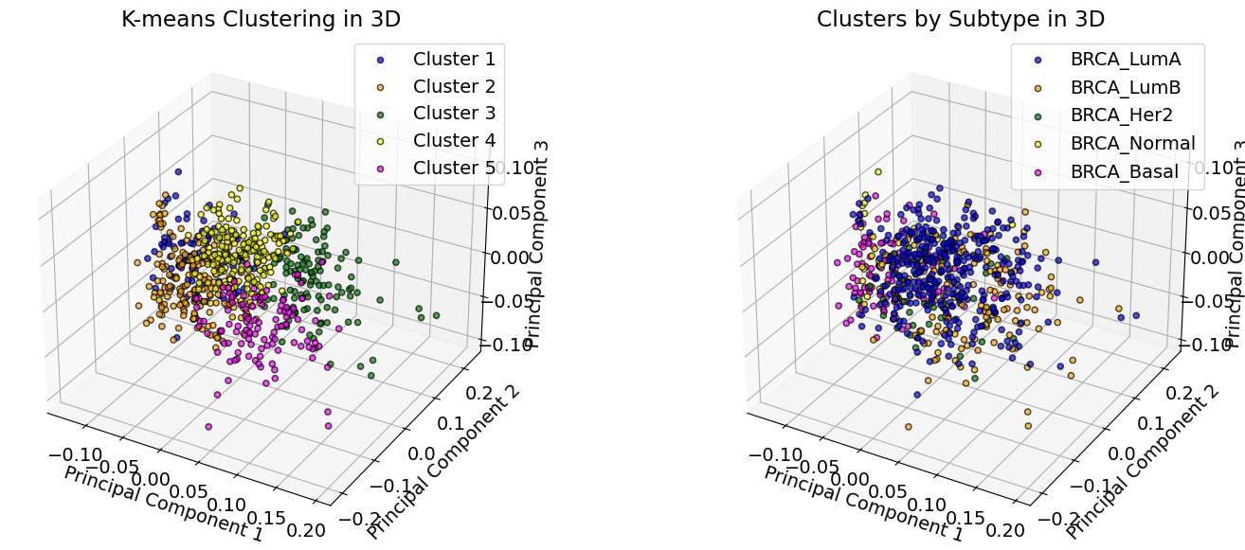
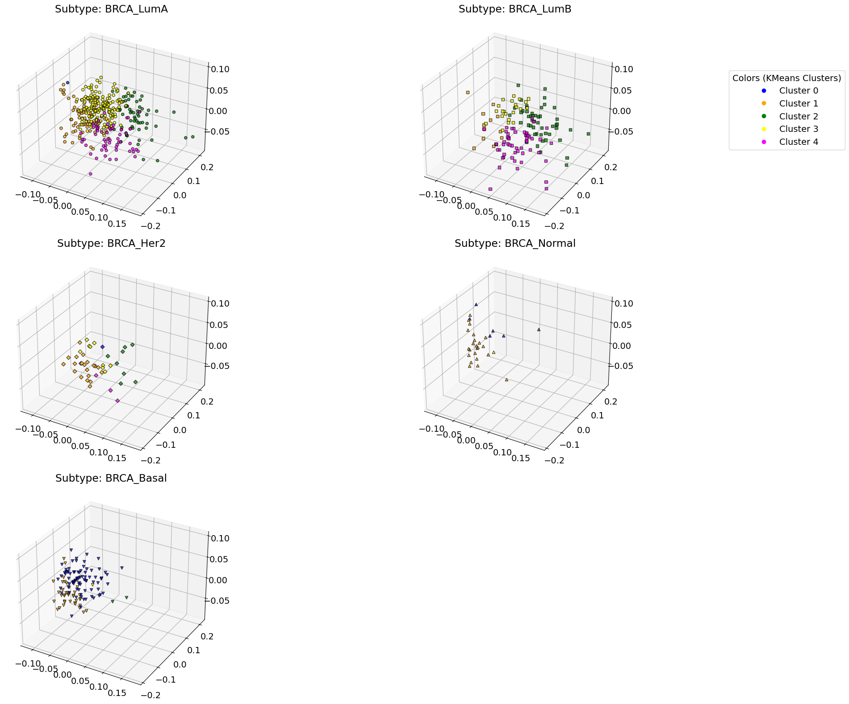
Solution 2.1 Results
K-means Unsupervised Clustering for Breast Cancer Subtype Identification
Attempted to identify 5 distinct clusters
Visualization using KPCA highlights common patterns within cancer types, but very little separation
When compared with known subtypes, the NMI values was only 0.2902
Notes:
Luminal A and B cluster a lot in Clusters 3, 4, and 5 while they are almost non existent in the other 2 clusters
Basal-like clusters a lot in Clusters 1 and 2 highlighting
Illustrates distinct methylation signatures among cancer types

Slide 10
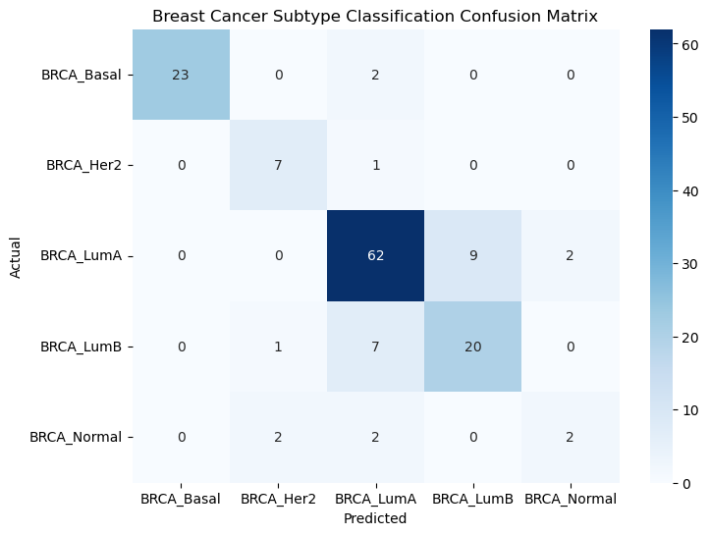
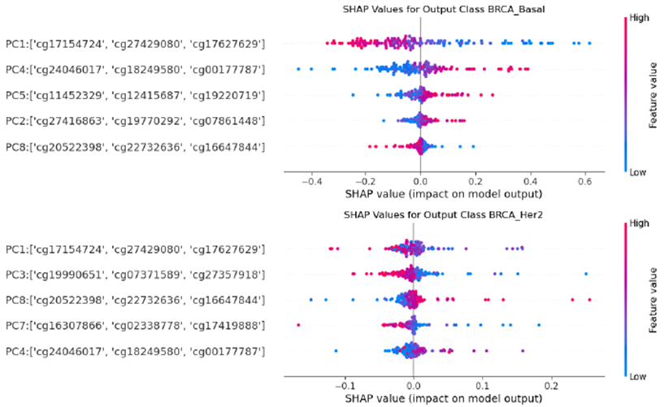
Solution 2.2 Results
Principal Component Analysis with Neural Network Classification for Breast Cancer Subtype Predictions
 | precision | recall | f1-score | support
BRCA_Basal | 1 | 0.92 | 0.96 | 25
BRCA_Her2 | 0.7 | 0.88 | 0.78 | 8
BRCA_LumA | 0.84 | 0.85 | 0.84 | 73
BRCA_LumB | 0.69 | 0.71 | 0.7 | 28
BRCA_Normal | 0.5 | 0.33 | 0.4 | 6
accuracy |  |  | 0.81 | 140
macro avg | 0.75 | 0.74 | 0.74 | 140
weighted avg | 0.81 | 0.81 | 0.81 | 140

Slide 11
Limitations
Our breast cancer dataset was small (only 698 samples) especially for HER2 and Normal-like breast cancer (N=42 and N=30 respectively)
Due to the high dimensionality of our dataset, we were not able to run SHAP on our entire pipelines and had to resort to interpretability based on reduced components such as PCA and LLE
Attempted to solve by:
Removing imputing from pipeline
Removing dimensionality reduction from pipeline
Reducing the number of features to HM27 CpGs

Slide 12
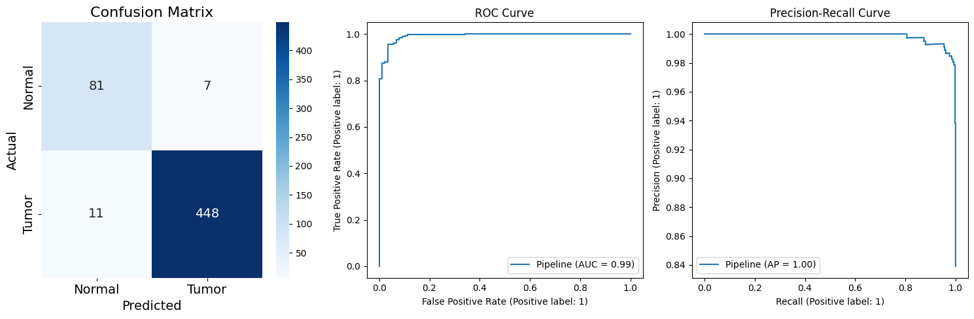
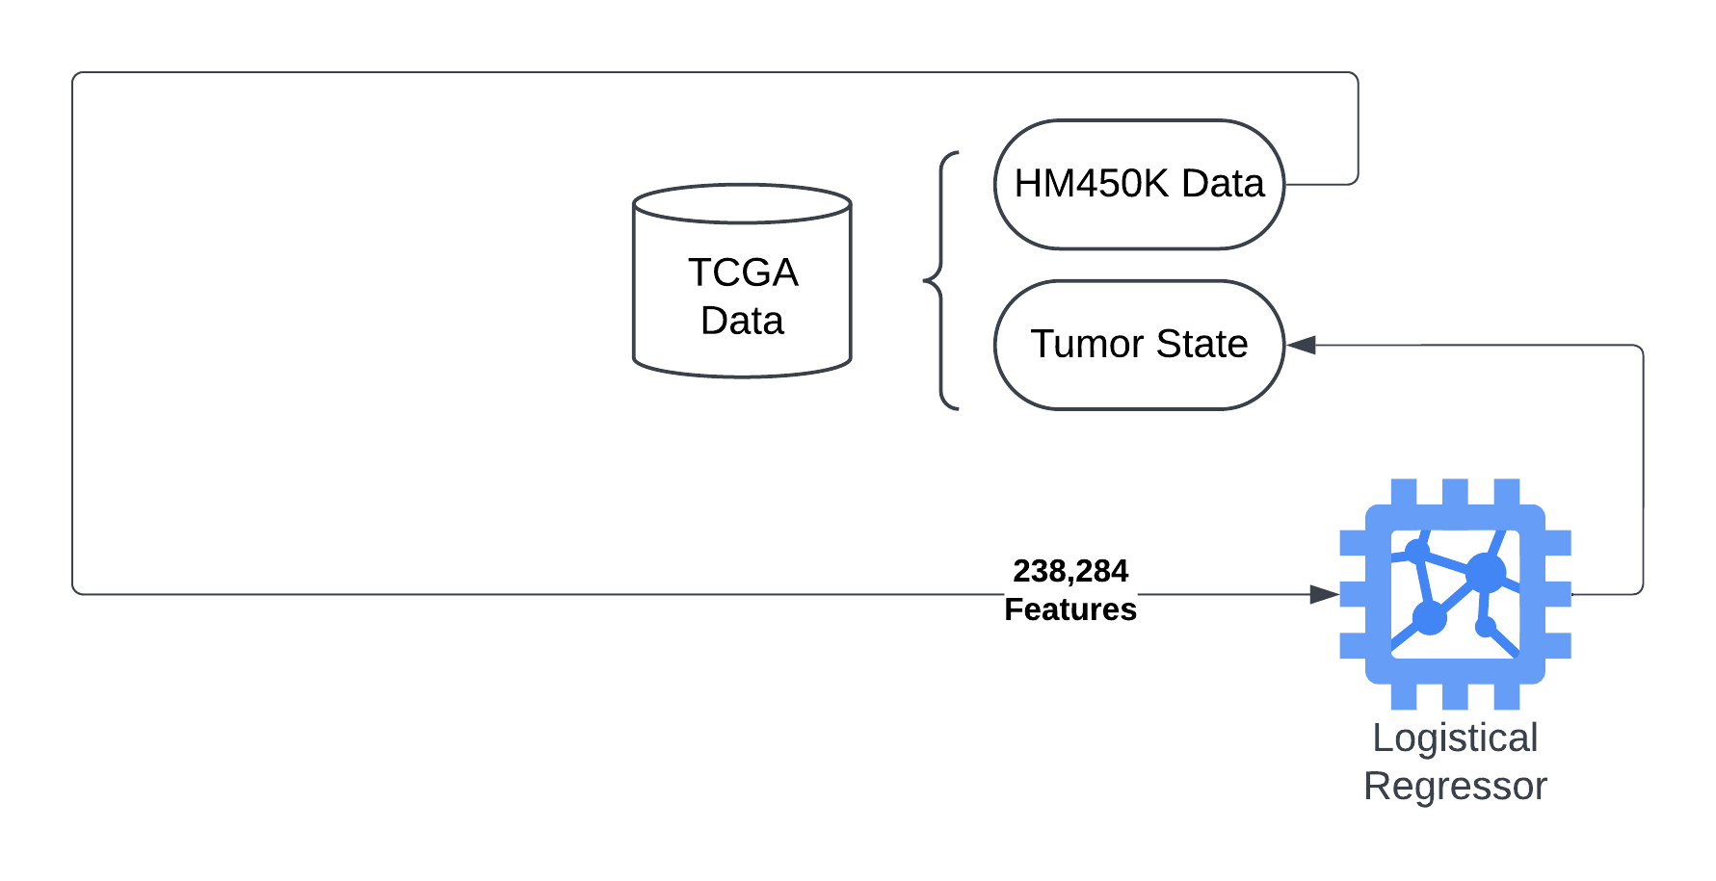
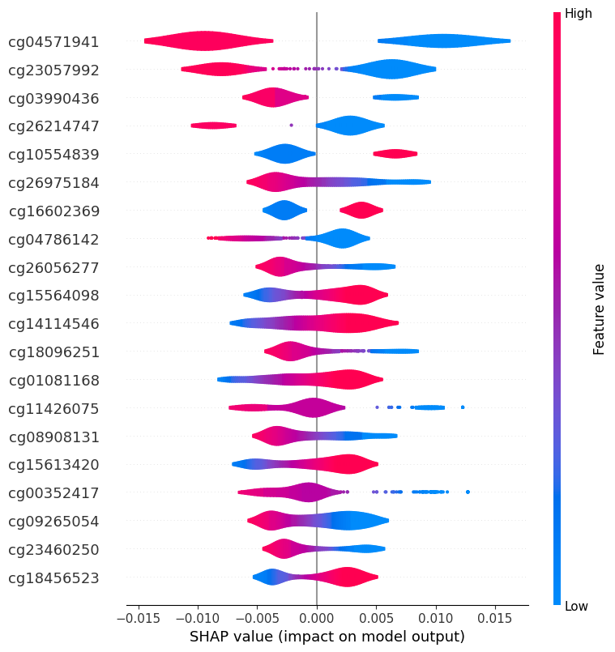
No Ideationally Reduction Alternate Solution
Logistical Regression for Tumor/Normal Classification
 | precision | recall | f1-score | support
Normal | 0..88 | 0.92 | 0.90 | 88
Tumor | 0.98 | 0.98 | 0.98 | 459
accuracy |  |  | 0.97 | 547
macro avg | 0.93 | 0.95 | 0.94 | 547
weighted avg | 0.97 | 0.97 | 0.97 | 547
Notes:
Jacob

Slide 13

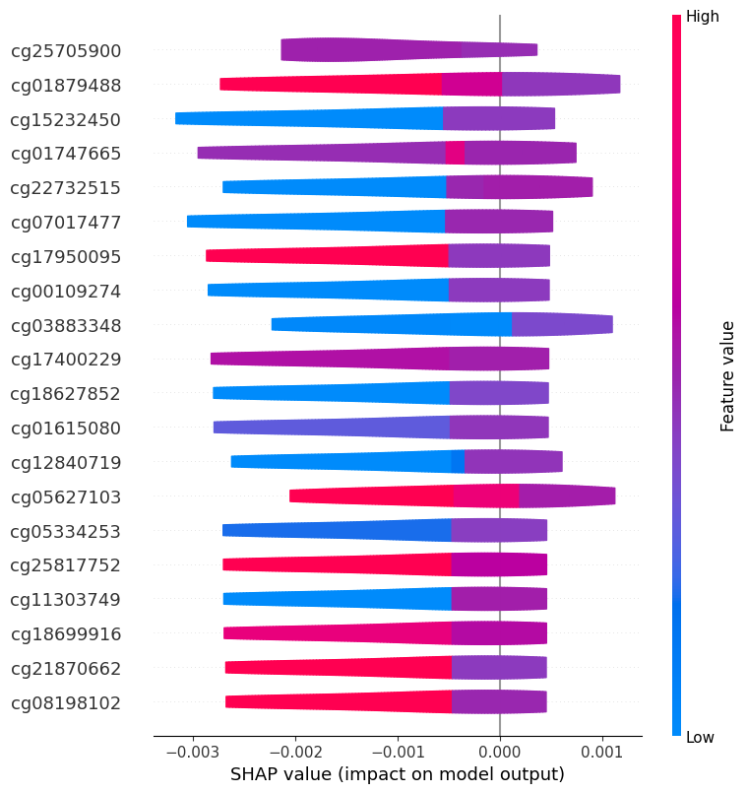

HM27 Alternate Solution
Locally Linear Embeddings with Logistical Regression for Tumor/Normal Classification
Reduced the number of used features from 238,284 – 22,601
Utilized the same pipeline as Solution 1.1
 | precision | recall | f1-score | support
Normal | 1.00 | 1.00 | 1.00 | 38
Tumor | 1.00 | 1.00 | 1.00 | 517
accuracy |  |  | 1.00 | 555
macro avg | 1.00 | 1.00 | 1.00 | 555
weighted avg | 1.00 | 1.00 | 1.00 | 555
Notes:
Jacob

Slide 14
Discussion
Our machine learning methods performed well when classifying samples as tumor / normal. (Accuracy > 0.97).
This suggests there could be potential for methods that are focuses on the early diagnosis of cancer based on methylation.
Additional datasets are required for validation and to ensure against overfitting despite the efforts made.
The identification of BRCA subtypes was more challenging with a wider gap in performance between supervised and unsupervised methods.
The unsupervised clusters did not align well with previously established subtypes. More exploration into the characteristics of these unsupervised clusters could provide biological insight
The supervised method mostly struggled in correctly classifying Luminal A and B samples. This could be reflecting a greater deal epigenetic heterogeneity within these subtypes.

Slide 15
Conclusion
Goal: Use methylation data and machine learning to classify tumor status and breast cancer subtypes.
Tumor Classification: Achieved >97% accuracy with two different pipelines.
Subtype Classification: Highlighted challenges of epigenetic heterogeneity (unsupervised NMI score = 0.29, supervised NMI score = 0.58).
Machine learning pipelines have great potential to accurately diagnose tumors in patients, but using pipelines for identifying tumor subtypes may need more sophisticated models in the future.
To be usable, dimensionality reduction may not be necessary, or alternative means of interpretability may need to be explored when utilizing methylation data.

