Slide 1
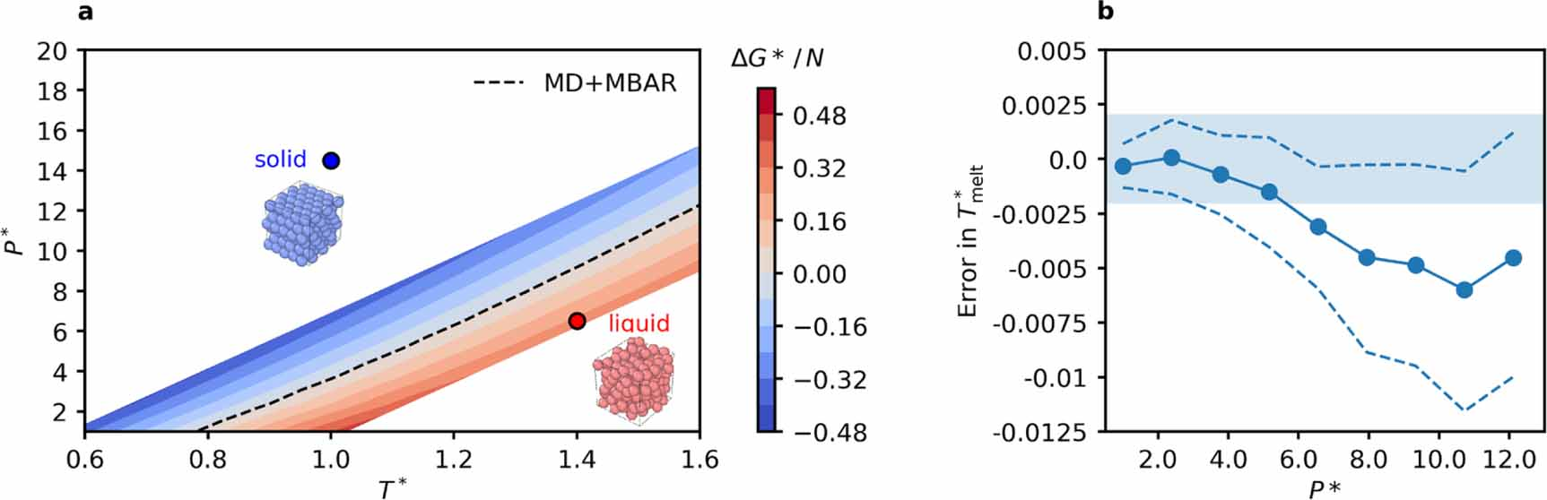


Generative Models in Chemical Physics:
Normalizing Flows and Boltzmann Generators
$$T$$
$$T^{−1}$$
Philippe Baron
G4, Panagiotopoulos Group
March 3rd, 2026

Slide 2
Part I
What are Normalizing Flows and how are they Constructed?

Slide 3
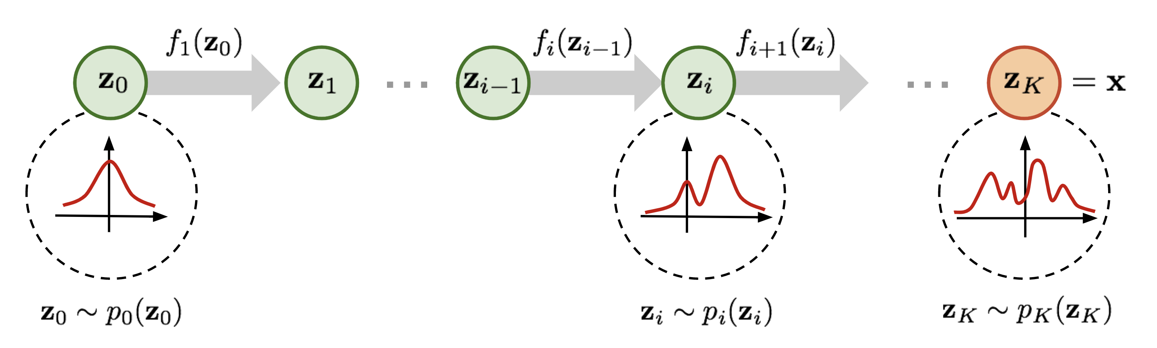


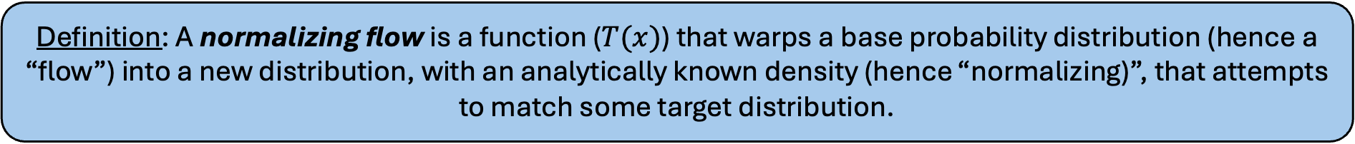


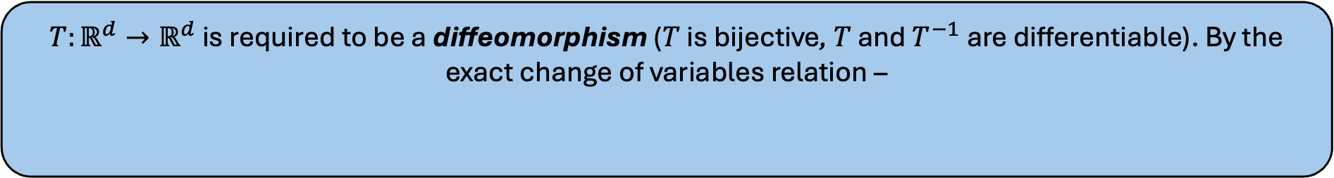








What is a Normalizing Flow?
Definition: A normalizing flow is a function ($T(x)$) that warps a base probability distribution (hence a “flow”) into a new distribution, with an analytically known density (hence “normalizing)”, that attempts to match some target distribution.
$$x\sim ℙ_{0}(x)$$
$$y=T(x)\sim ℙ_{n}(y)$$
$$T\left(x\right)={{(T}_{n}∘…∘T}_{2}∘T_{1})\left(x\right)$$
$$T_{1}$$
$$T_{2}$$
$$T_{3}$$
$$T_{n−1}$$
$$T_{n}$$
$$…$$
$$ℙ_{1}(x_{1})$$
$$ℙ_{2}(x_{2})$$
$$ℙ_{n−1}(x_{n−1})$$
$T:ℝ^{d}→ℝ^{d}$ is required to be a diffeomorphism ($T$ is bijective, $T$ and $T^{−1}$ are differentiable). By the exact change of variables relation –
$ℙ_{n}\left(y\right)=$ $ℙ_{0}\left(x\right){\left|\det{𝒥_{T}}\left(x\right)\right|}^{−1}=ℙ_{0}(T^{−1}(y))\left|\det{𝒥_{T^{−1}}}(y)\right|$
[1] G. Papamakarios et al. 2021. Normalizing flows for probabilistic modeling and inference. J. Mach. Learn. Res. 22, 1, Article 57.

Slide 4
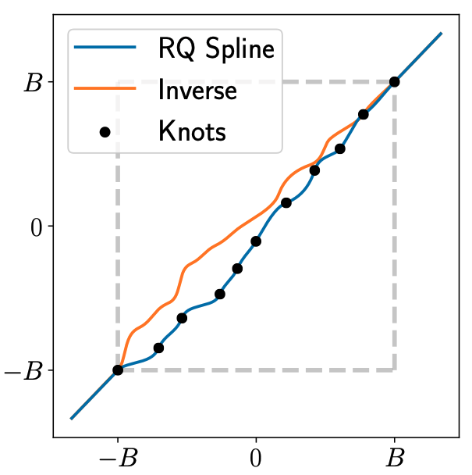













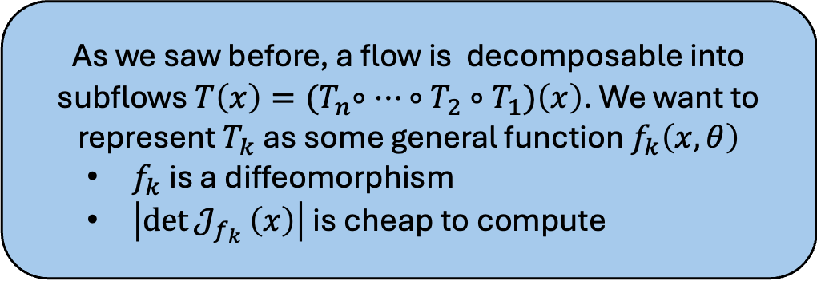






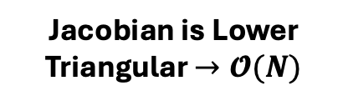
How are Normalizing Flows Constructed?
As we saw before, a flow is decomposable into subflows $T\left(x\right)={{(T}_{n}∘…∘T}_{2}∘T_{1})\left(x\right)$. We want to represent $T_{k}$ as some general function $f_{k}\left(x,θ\right)$
$f_{k}$ is a diffeomorphism
$\left|\det{𝒥_{f_{k}}}\left(x\right)\right|$ is cheap to compute
Diffeomorphic
Transformer
$$x_{1}^{′}$$
$$x_{2}$$
Group A (Transformed)
$$x_{1}$$
$$x_{3}^{′}$$
$$x_{1},x_{3}, …,x_{d}$$
$$x_{2}$$
$$τ\left({\left\{x_{i}\right\}}_{i∈A} |ψ\right)$$
$$x_{4}$$
$$=f_{k}\left(x,θ\right)$$
$$x_{3}$$
Group B (Conditioned)
$$…$$
$$x→$$
$$x_{4}$$
$$x_{2},x_{4}, …$$
$$ψ$$
$$x_{d}^{′}$$
Jacobian is Lower Triangular $→𝓞(N)$
$$…$$
$$ψ=C\left({\left\{x_{j}\right\}}_{j∈B},θ\right)$$
$$x_{d}$$
Conditioner
Unconstrained
[1] G. Papamakarios et al. 2021. Normalizing flows for probabilistic modeling and inference. J. Mach. Learn. Res. 22, 1, Article 57.

Slide 5

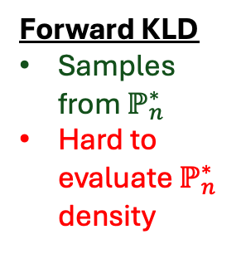

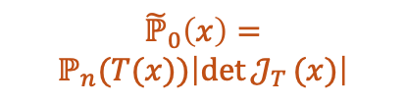
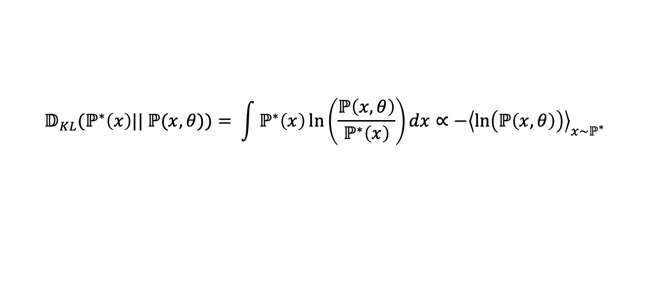

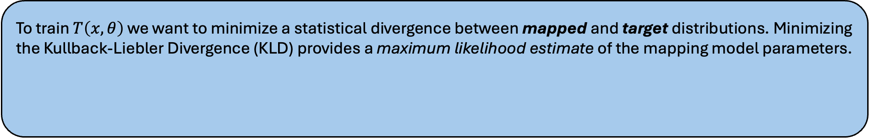




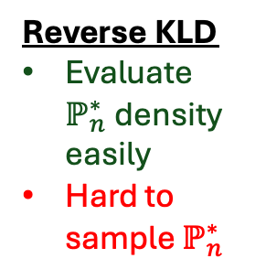
How are Normalizing Flows Trained?
To train $T\left(x, θ\right)$ we want to minimize a statistical divergence between mapped and target distributions. Minimizing the Kullback-Liebler Divergence (KLD) provides a maximum likelihood estimate of the mapping model parameters.
$$𝔻_{KL}(ℙ^{∗}\left(x\right)|| ℙ(x,θ))= \int{ℙ^{∗}\left(x\right)\ln\left(\frac{ℙ\left(x,θ\right)}{ℙ^{∗}\left(x\right)}\right)dx}∝{−\left\langle \ln\left(ℙ\left(x,θ\right)\right)\right\rangle }_{x\sim ℙ^{∗}}$$
$$𝔻_{KL}\left(ℙ_{0}^{∗} \left(x\right)||{\tilde{ℙ}}_{0}\left(x,θ\right)\right)$$
$$𝔻_{KL}\left(ℙ_{n}^{∗} \left(y\right)||{\tilde{ℙ}}_{n}\left(y,θ\right)\right)$$
Reverse KLD
Evaluate $ℙ_{n}^{∗}$density easily
Hard to sample $ℙ_{n}^{∗}$
$${\tilde{ℙ}}_{0}\left(x\right)=$$
$$ℙ_{n}(T(x))\left|\det{𝒥_{T}}(x)\right|$$
$${\tilde{ℙ}}_{n}\left(y\right) =$$
$$ℙ_{0}(T^{−1}(y))\left|\det{𝒥_{T^{−1}}}(y)\right|$$
Forward KLD
Samples from $ℙ_{n}^{∗}$
Hard to evaluate $ℙ_{n}^{∗}$ density
$$ℙ_{0}^{∗} (x)$$
$$ℙ_{n}^{∗} (y)$$
[1] G. Papamakarios et al. 2021. Normalizing flows for probabilistic modeling and inference. J. Mach. Learn. Res. 22, 1, Article 57.
$$T(x)$$
$$T^{−1}(y)$$

Slide 6
Part II
How can Normalizing Flows be used in Statistical Mechanics?

Slide 7
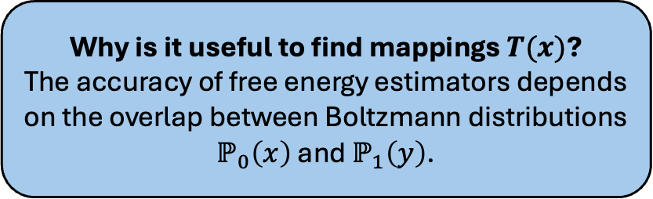

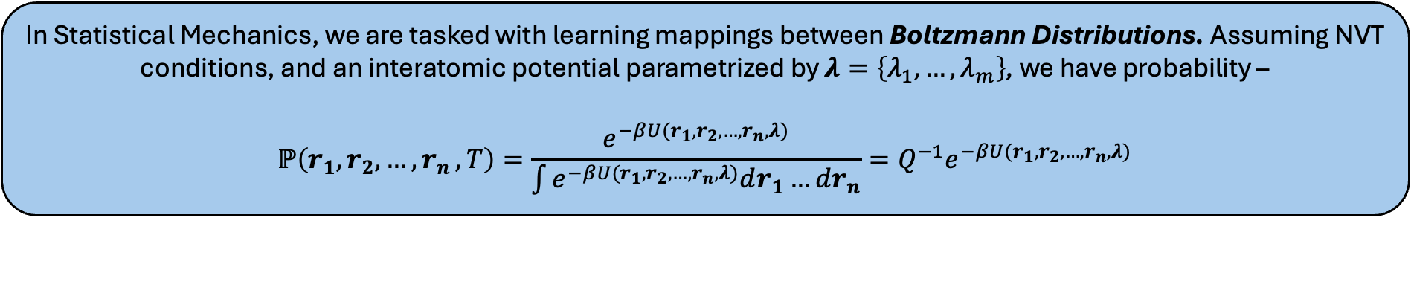
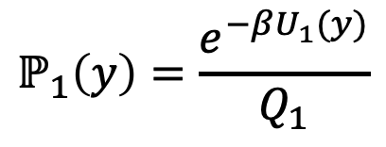
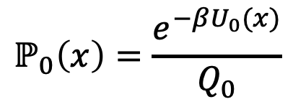



Bijective Maps Between Boltzmann Distributions
In Statistical Mechanics, we are tasked with learning mappings between Boltzmann Distributions. Assuming NVT conditions, and an interatomic potential parametrized by $λ=\left\{λ_{1},…,λ_{m}\right\}$, we have probability –
$$ℙ\left(r_{1},r_{2},{…, r}_{n}, T\right)=\frac{e^{−βU(r_{1},r_{2},{…, r}_{n},λ)}}{\int{e^{−βU(r_{1},r_{2},{…, r}_{n},λ)}dr_{1}…dr_{n}}}=Q^{−1}e^{−βU(r_{1},r_{2},{…, r}_{n},λ)}$$
State 0
State 1
$$ℙ_{0}\left(x\right)=\frac{e^{−βU_{0}(x)}}{Q_{0}}$$
$$y=T(x)$$
$$ℙ_{1}\left(y\right)=\frac{e^{−βU_{1}(y)}}{Q_{1}}$$
$$T:ℝ^{3N}→ℝ^{3N}$$
Why is it useful to find mappings $T(x)$?
The accuracy of free energy estimators depends on the overlap between Boltzmann distributions $ℙ_{0}\left(x\right)$ and $ℙ_{1}\left(y\right)$.
$$T$$
$$T^{−1}$$

Slide 8

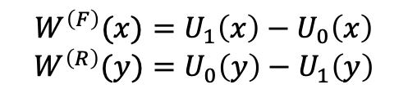
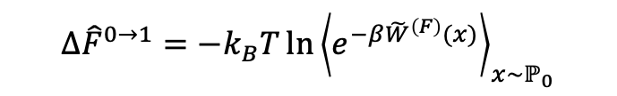

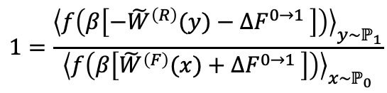





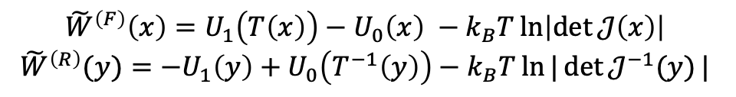
Targeted Free Energy Estimation
The overlap between Boltzmann distributions is determined by the overlap of 1D distributions of the “work of infinitely fast switching” between ensembles
$W^{\left(F\right)}(x)=U_{1}\left(x\right)−U_{0}\left(x\right)$
$$W^{\left(R\right)}(y)=U_{0}\left(y\right)−U_{1}\left(y\right)$$
$${\tilde{W}}^{\left(F\right)}\left(x\right)=U_{1}\left(T\left(x\right)\right)−U_{0}\left(x\right) −k_{B}T\ln\left|\det{𝒥\left(x\right)}\right|$$
$${\tilde{W}}^{\left(R\right)}(y)={−U}_{1}\left(y\right)+U_{0}\left(T^{−1}\left(y\right)\right)−k_{B}T\ln{|\det{𝒥^{−1}(y)}|}$$
$$\underset{→}{x→T(x)}$$
(“Mapped”) Crooks Fluctuation Theorem:$\frac{ℙ_{0}\left(\tilde{W}\right)}{ℙ_{1}\left(−\tilde{W}\right)}=e^{β\left(W−ΔF\right)}$
This implies that the forward and reverse mapped work distributions intersect at $W=ΔF$.
$$ΔF$$
Targeted FEP (TFEP)
$$ℙ_{1}\left(−W\right)$$
“Good” Mapping
$$∆{\hat{F}}^{0→1}=−k_{B}T\ln{{\left\langle e^{−β{\tilde{W}}^{\left(F\right)}(x)}\right\rangle }_{x\sim ℙ_{0}}}$$
“Perfect” Mapping
$$ℙ_{1}\left(−\tilde{W}\right)$$
Targeted BAR (TBAR)
$$ℙ_{0}\left(\tilde{W}\right)$$
$$1=\frac{{\left\langle f\left(β\left[{−\tilde{W}}^{\left(R\right)}(y)−∆F^{0→1} \right]\right)\right\rangle }_{y\sim ℙ_{1}}}{{\left\langle f\left(β\left[{\tilde{W}}^{\left(F\right)}(x)+∆F^{0→1} \right]\right)\right\rangle }_{x\sim ℙ_{0}}}$$
$$ℙ_{0}\left(W\right)$$
Relevant Overlap
$$W$$
If $T(x)$ is a “ (near) perfect” mapping between ensembles, we refer to $T\left(x\right)$ as a Boltzmann Generator
[1] A. M. Hahn & H. Then. 2009. Using bijective maps to improve free energy estimates. Phys. Rev. E. 79.

Slide 9
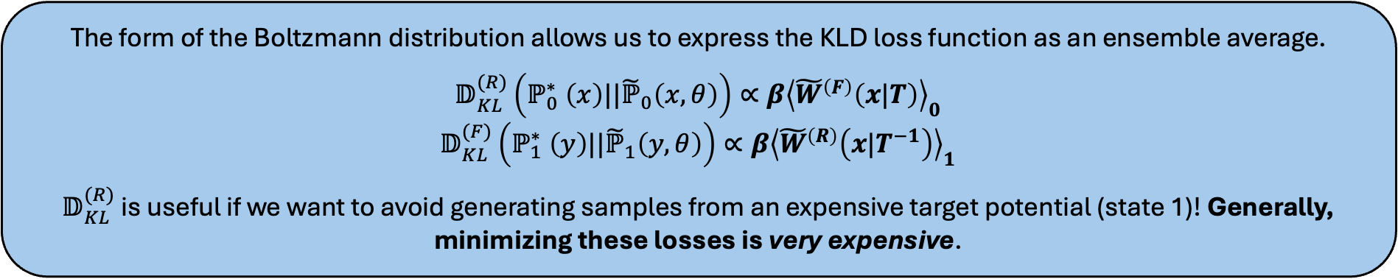

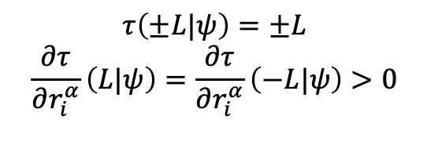

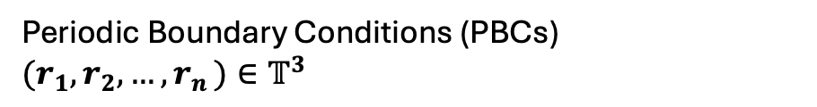
Training & Constructing Normalizing Flows in Chemical Physics
“Boltzmann Generators” must obey the symmetries present in the molecular simulations.
1
Rigid translations
$$90°$$
( + )
2
Reflections / Rotations from Octahedral group
1
2
3
Particle permutation invariance
4
Periodic Boundary Conditions (PBCs) $(r_{1},r_{2},{…, r}_{n})∈𝕋^{3}$
3
4
$$τ\left(±L|ψ\right)=±L$$
$$\frac{∂τ}{∂r_{i}^{α}}\left(L|ψ\right)=\frac{∂τ}{∂r_{i}^{α}}\left(−L|ψ\right)>0$$
$$\left\{ψ_{2},ψ_{n},…,ψ_{1}\right\}=C\left(x_{2},x_{n},…,x_{1},θ\right)$$
The form of the Boltzmann distribution allows us to express the KLD loss function as an ensemble average.
$$𝔻_{KL}^{(R)}\left(ℙ_{0}^{∗} \left(x\right)||{\tilde{ℙ}}_{0}\left(x,θ\right)\right)∝β{\left\langle {\tilde{W}}^{\left(F\right)}\left(x|T\right)\right\rangle }_{0}$$
$$𝔻_{KL}^{(F)}\left(ℙ_{1}^{∗} \left(y\right)||{\tilde{ℙ}}_{1}\left(y,θ\right)\right)∝β{\left\langle {\tilde{W}}^{\left(R\right)}\left(x|T^{−1}\right)\right\rangle }_{1}$$
$𝔻_{KL}^{(R)}$ is useful if we want to avoid generating samples from an expensive target potential (state 1)! Generally, minimizing these losses is very expensive.
[1] P. Wirnsberger et al. 2020. Targeted free energy estimation using learned mappings. J. Chem. Phys. 153, 144112.

Slide 10
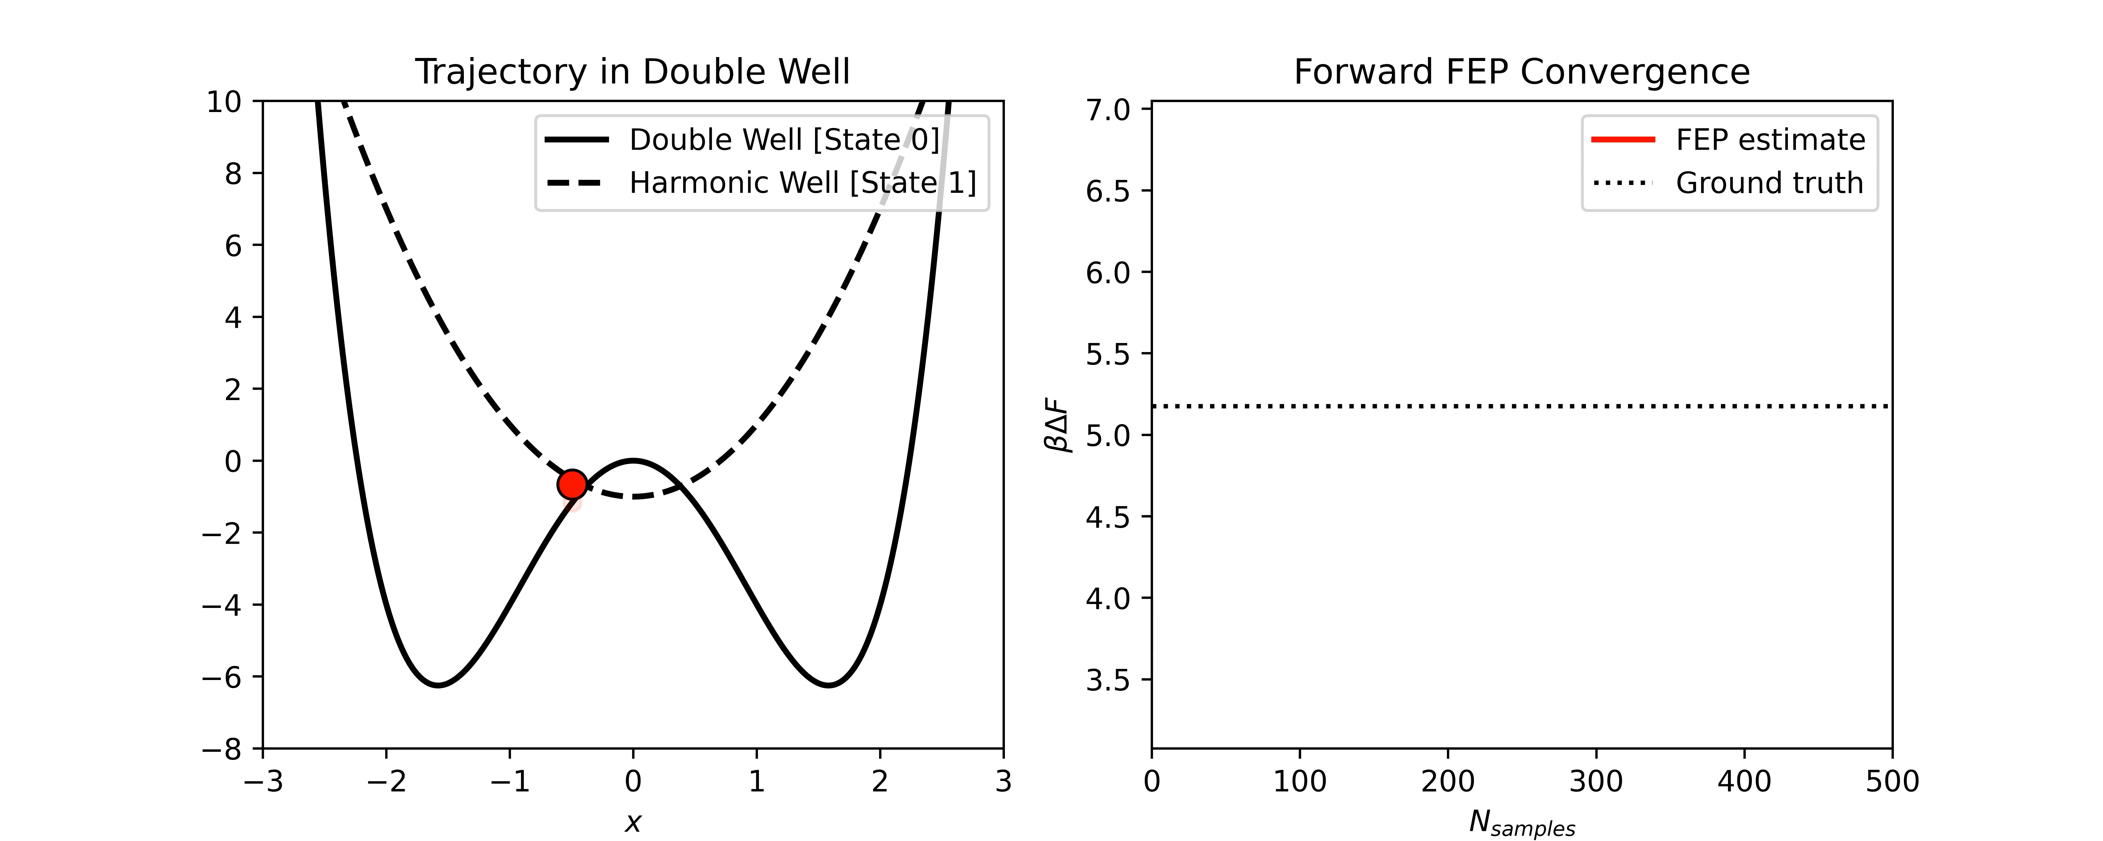
One-Dimensional Toy Problem (Setup)
1-Dimensional Toy Problem: Can we accelerate the estimation of the free energy difference between a free particle existing under a double well ($u=ax^{4} −bx^{2}$) and a harmonic well potential ($u=kx^{2}$)?

Slide 11
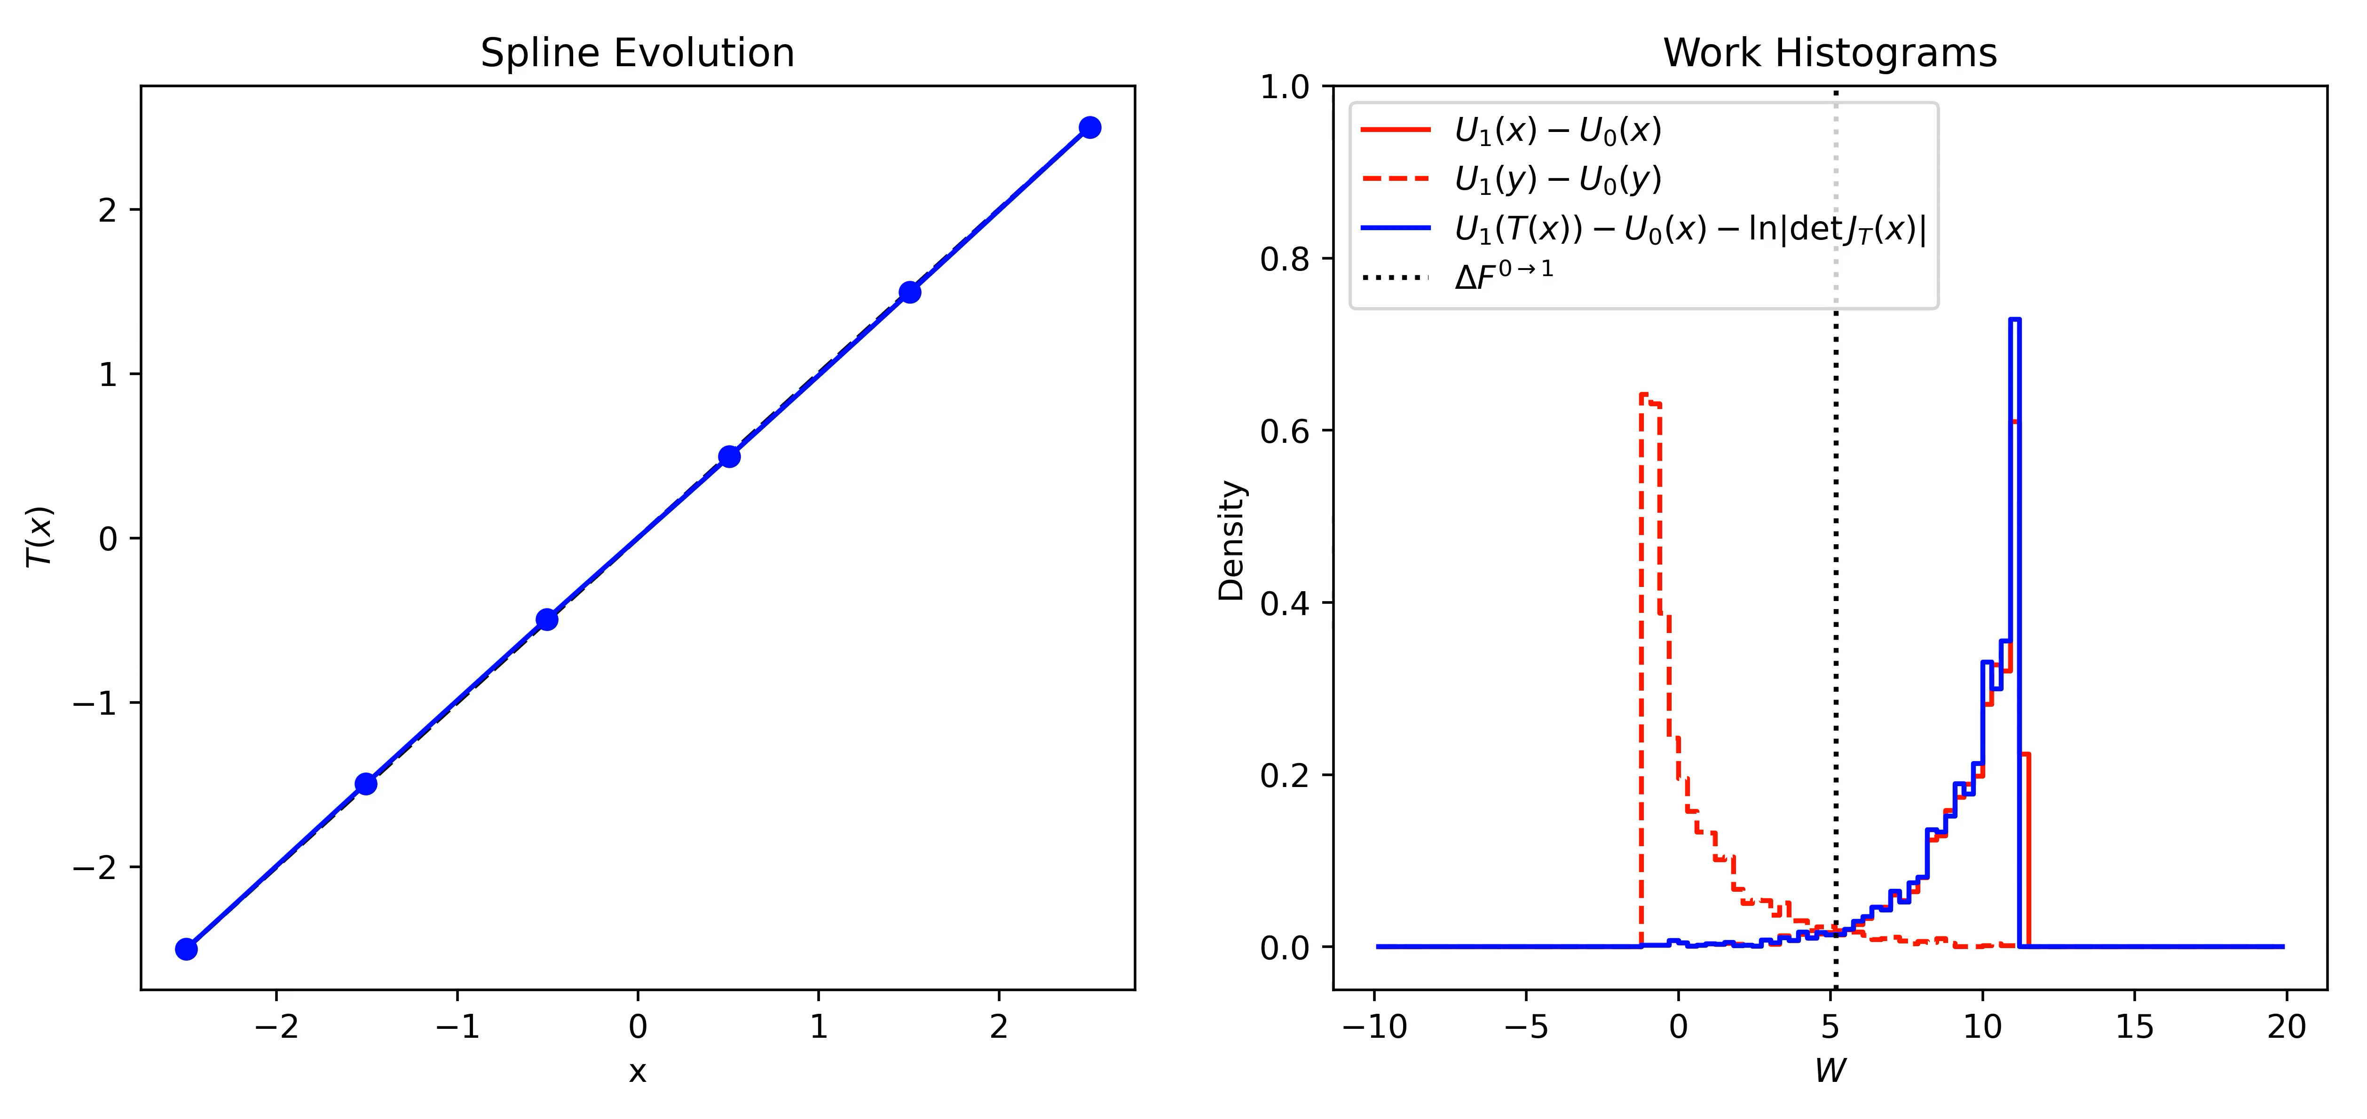
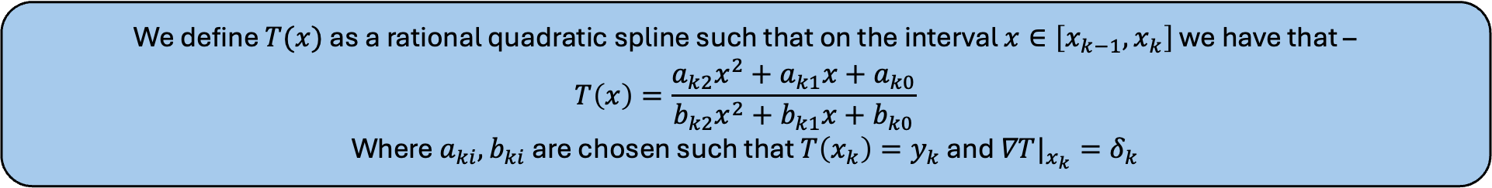
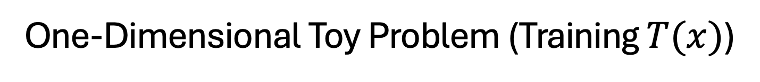
One-Dimensional Toy Problem (Training $T(x)$)
We define $T(x)$ as a rational quadratic spline such that on the interval $x∈\left[x_{k−1},x_{k}\right]$ we have that –
$$T\left(x\right)=\frac{a_{k2}x^{2}+a_{k1}x+a_{k0}}{b_{k2}x^{2}+b_{k1}x+b_{k0}}$$
Where $a_{ki},b_{ki}$ are chosen such that $T\left(x_{k}\right)=y_{k}$ and $∇T|_{x_{k}}=δ_{k}$

Slide 12
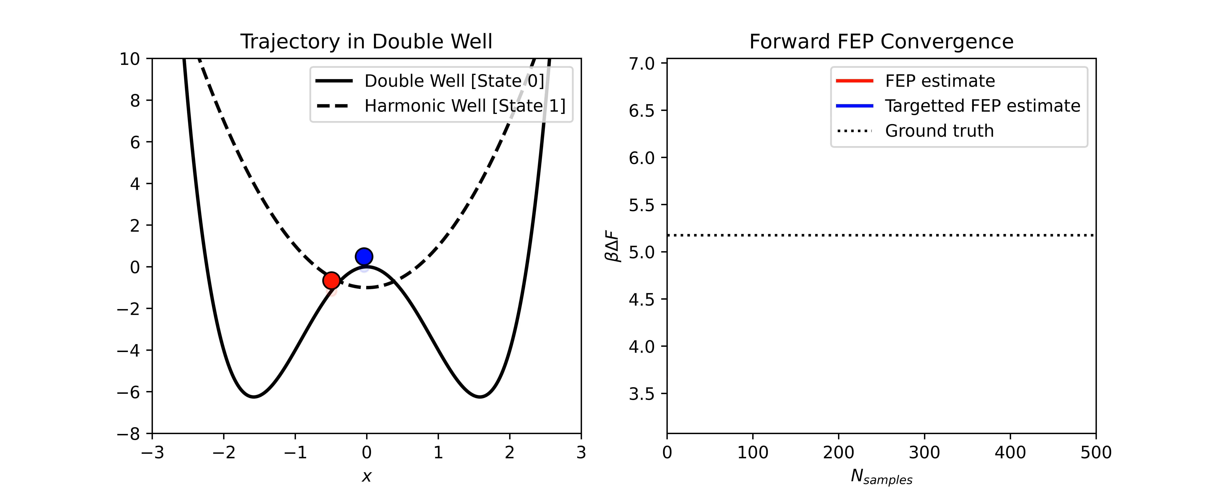
One-Dimensional Toy Problem (Results)
Our optimal map leads to the convergence of our TFEP estimator in a single sample. We have constructed a true Boltzmann Generator!

Slide 13
Part III
Application to Chemical Physics Research:
Efficient mapping of phase diagrams with conditional Boltzmann Generators
[M. Schebek, M. Invernizzi, F. Noé, and J. Rogal, 2024 Mach. Learn.: Sci. Technol.]

Slide 14
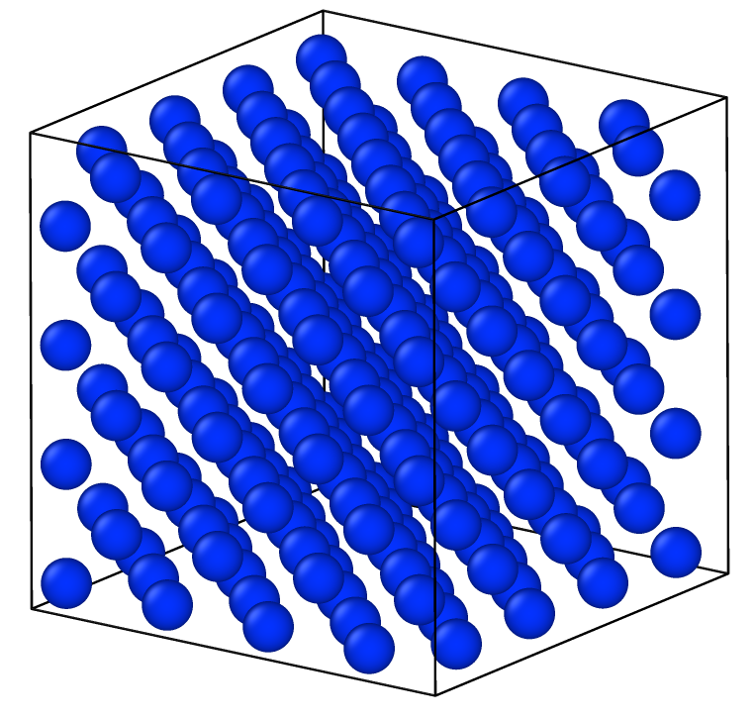
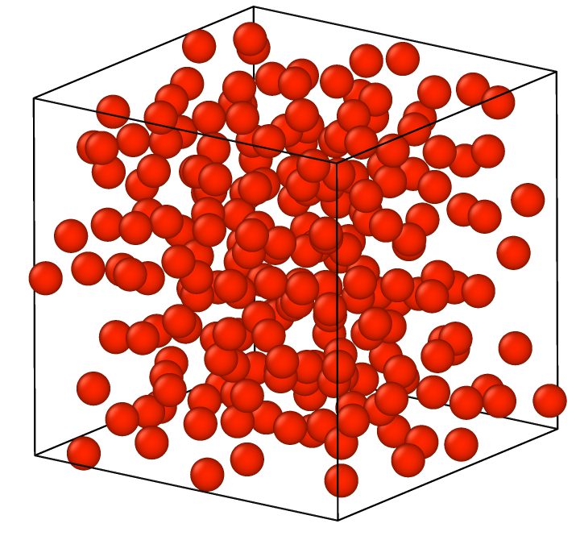

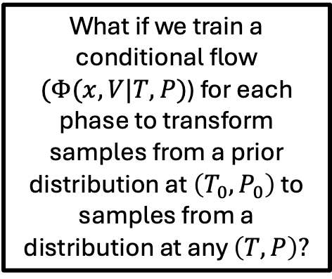
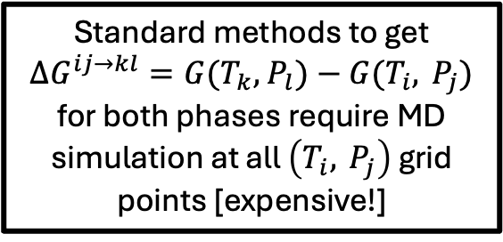







Phase Coexistence Line Prediction
Under NPT conditions, phase coexistence occurs (say between phases $a$ and $b$), at points $(T,P)$where their Gibbs Free Energies are equal ($G^{a}\left(T,P\right)=G^{b}\left(T,P\right)$)
It is of great interest to be able to draw such coexistence lines in the $(T,P)$plane.
$$P$$
$$Φ^{sol}(x,V|T,P)$$
Standard methods to get
$∆G^{ij→kl}=G(T_{k},$ $P_{l})−G(T_{i}, P_{j})$ for both phases require MD simulation at all $\left(T_{i}, P_{j}\right)$ grid points [expensive!]
$$P_{l}$$
What if we train a conditional flow $(Φ(x,V|T,P)$) for each phase to transform samples from a prior distribution at $\left(T_{0},P_{0}\right)$ to samples from a distribution at any $\left(T,P\right)?$
$$Φ^{liq}(x,V|T,P)$$
$$P_{j}$$
$$T$$
$$T_{i}$$
$$T_{k}$$
[1] M. Schebek et al. 2024. Efficient mapping of phase diagrams with conditional Boltzmann Generators. Mach. Learn.: Sci. Technol. 5 045045.

Slide 15
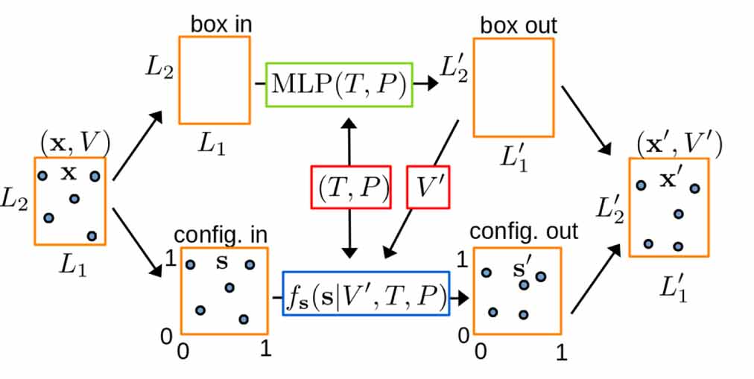
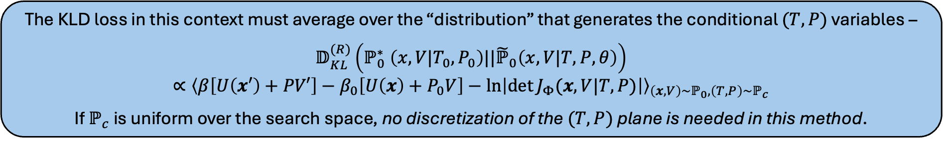


Conditional Boltzmann Generator Architecture
The conditional Boltzmann generator transforms samples $\left(x,V\right)→\left(x^{′},V^{′}\right)=Φ(x,V|T,P,θ)$, serving as an alternative to NPT simulation. $\left(x,V\right)$ are generated from NPT simulation at reference state $\left(T_{0},P_{0}\right)$.
$$ℙ_{0}\left(x,V | T_{0},P_{0}\right)\sim$$
$${\sim ℙ}_{1}\left(x′,V′ | T,P \right)$$
The KLD loss in this context must average over the “distribution” that generates the conditional $(T,P)$ variables –
$$𝔻_{KL}^{(R)}\left(ℙ_{0}^{∗} \left(x,V|T_{0},P_{0}\right)||{\tilde{ℙ}}_{0}\left(x,V|T,P,θ\right)\right)$$
$∝{\left\langle β\left[U\left(x′\right)+PV′\right]−β_{0}\left[U\left(x\right)+P_{0}V\right]−\ln\left|\det{J_{Φ}(x,V|T,P)}\right|\right\rangle }_{\left(x,V\right)\sim ℙ_{0},\left(T,P\right)\sim ℙ_{c}}$
If $ℙ_{c}$ is uniform over the search space, no discretization of the $(T,P)$ plane is needed in this method.
[1] M. Schebek et al. 2024. Efficient mapping of phase diagrams with conditional Boltzmann Generators. Mach. Learn.: Sci. Technol. 5 045045.
Notes:
$$r_{1}^{x}$$

Slide 16
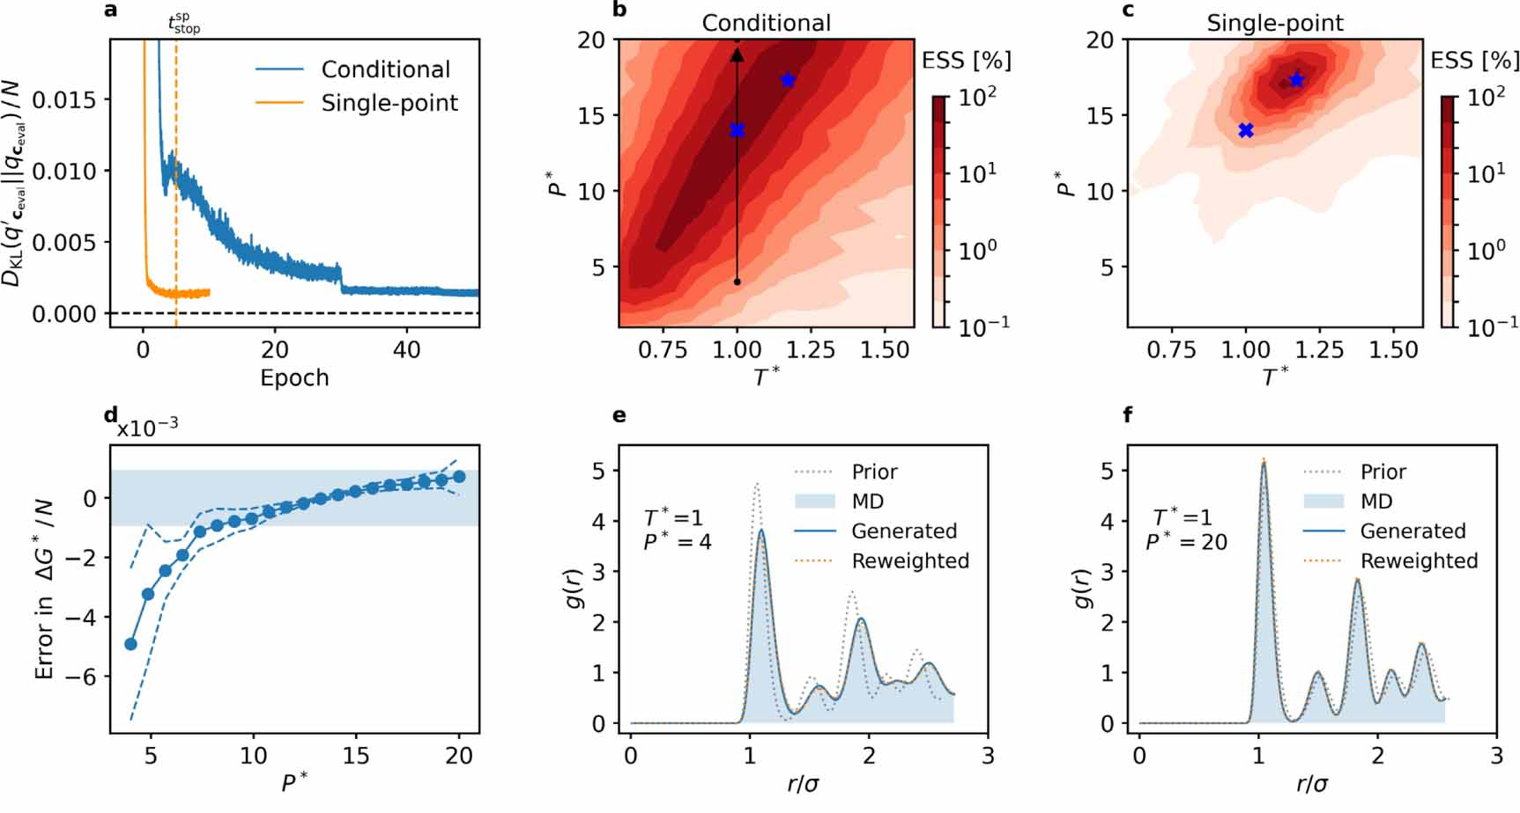
Results – Training of Single-Point vs. Conditional Generators
What is a better strategy - training a Boltzmann Generator (BG) to produce samples at a single point or throughout a continuous $(T,P)$ region?
The authors compare these two approaches for a 180 particle, FCC Lennard-Jones Crystal.
[1] M. Schebek et al. 2024. Efficient mapping of phase diagrams with conditional Boltzmann Generators. Mach. Learn.: Sci. Technol. 5 045045.

Slide 17
Results – Phase Diagram of 180 LJ Particles
The authors then use samples generated from a conditional Boltzmann Generator (CBG) to compute the solid-liquid coexistence line for 180 Lennard-Jones particles.
The CBG approach achieves very similar results and uncertainties to the MD+MBAR method, while the authors claim their results with the CBG required 5 times less energy evaluations.
[1] M. Schebek et al. 2024. Efficient mapping of phase diagrams with conditional Boltzmann Generators. Mach. Learn.: Sci. Technol. 5 045045.

Slide 18
Open Questions / Food for Thought
How can we improve the efficiency/effectiveness of Boltzmann Generators for systems with large numbers of particles?
We can efficiently map between systems at different temperature and pressure – can we map from an ideal gas state to liquid configurations?
Is there a way to efficiently generate mappings “on-the-fly” for any new system encountered? On the other hand, can we construct a BG “foundation model”?
Does a mapping need to be “fully-expressive” to improve free energy estimates?

