Slide 1
Entropy-SGD: biasing gradient descent into wide valleys
P. Chaudhari, A. Choromanska, S. Soatto, Y. LeCun, C. Baldassi, C. Borgs, J. Chayes, L. Sagun, and R. Zecchina, Journal of Statistical Mechanics: Theory and Experiment, 124018 (2019).
Izzie Furrick | Rosen Research Group | 13 October 2026

Slide 2
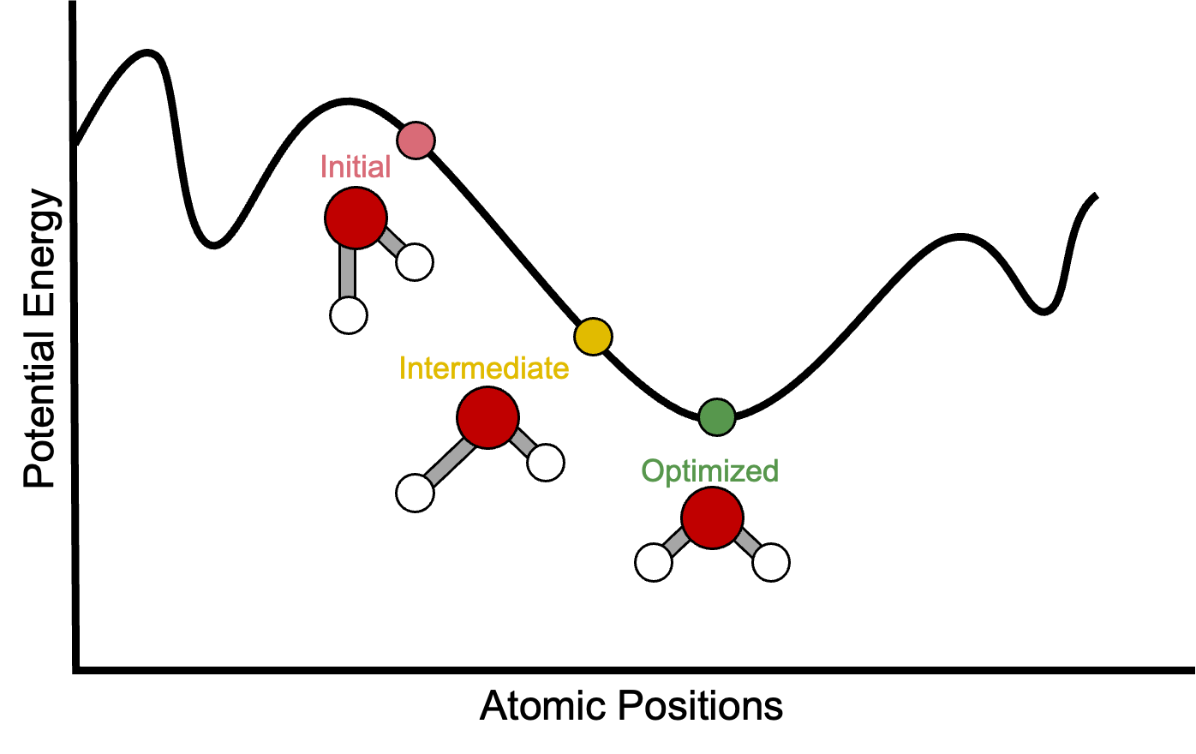
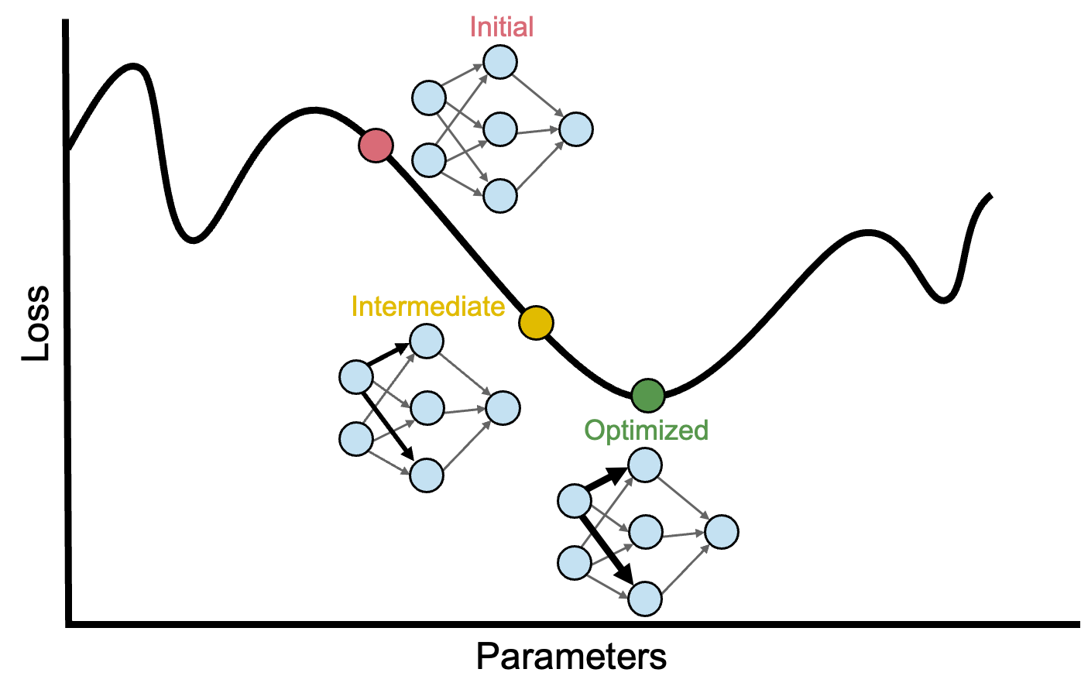
Geometry Optimization as an Analogy for Neural Network Training
The goal of these two processes is the same—optimize an objective over a high dimensional space
  Geometry optimization adjusts atomic coordinates to reduce the potential energy of a structure
  Neural network training adjusts network weights to reduce the loss function

Slide 3
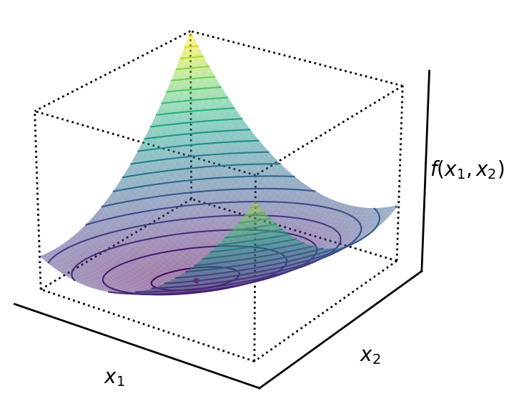
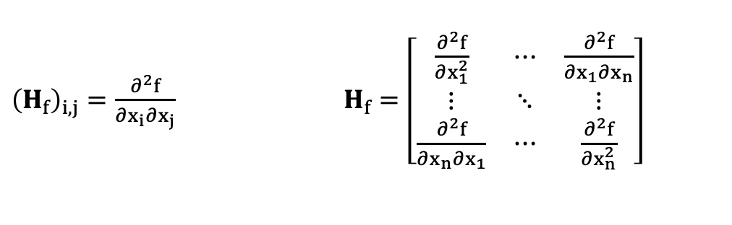
Hessian Matrix Describes Local Curvature
The Hessian is a matrix of second-order partial derivatives of a scalar-valued function
${\left(H_{f}\right)}_{i,j}=\frac{∂^{2}f}{∂x_{i}∂x_{j}}$ $H_{f}=\left[\begin{matrix}\frac{∂^{2}f}{∂x_{1}^{2}} & ⋯ & \frac{∂^{2}f}{∂x_{1}∂x_{n}} \\ ⋮ & ⋱ & ⋮ \\ \frac{∂^{2}f}{∂x_{n}∂x_{1}} & ⋯ & \frac{∂^{2}f}{∂x_{n}^{2}}\end{matrix}\right]$
A stable local minimum has a positive-semidefinite Hessian matrix
  All eigenvalues are greater than or equal to zero
  Positive eigenvalues indicate upward curvature, zero eigenvalues indicate flatness
1
How does the Hessian of a trained neural network look?
1. Gundersen, G. Understanding positive definite matrices. https://gregorygundersen.com/blog/2022/02/27/positive-definite/.

Slide 4
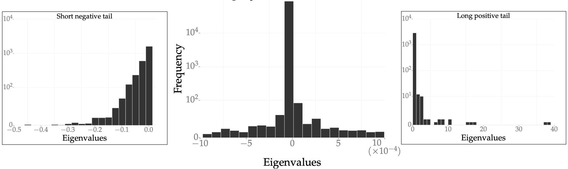
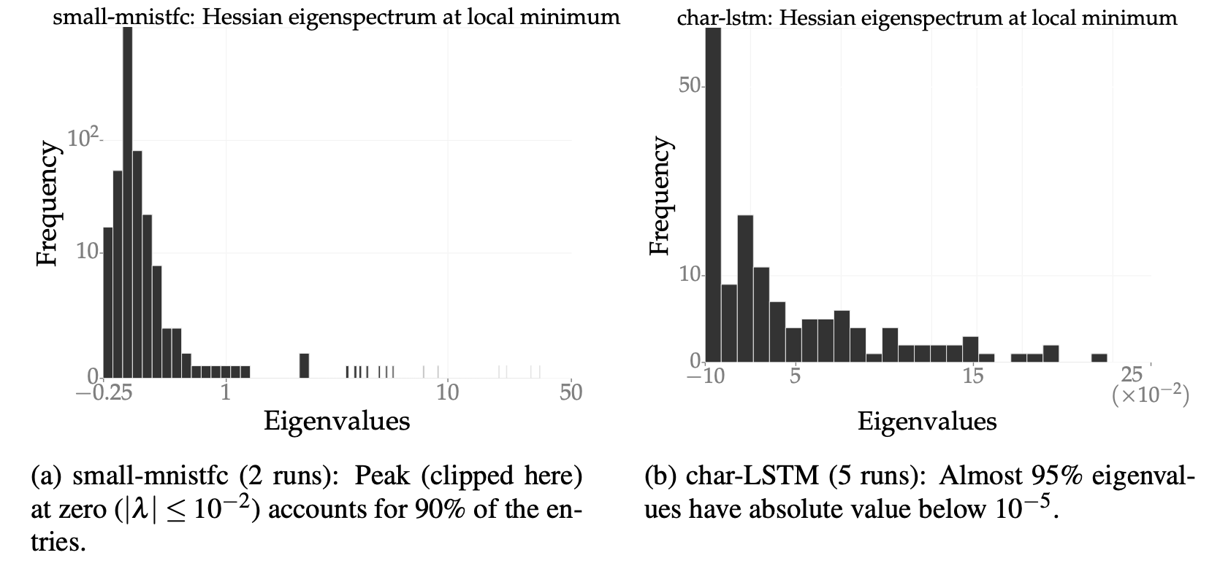
The Eigenspectrums of Trained Neural Network Hessians
Share Key Qualitative Properties
Convolutional Neural Network trained on MNIST
Three key features:
A large number of directions (~94%) have near-zero eigenvalues
Positive eigenvalues have a long tail
Negative eigenvalues decay rapidly
Fully Connected Neural Network
trained on MNIST
Long Short-Term Memory Network
trained for Text Generation
Trends are shared across a variety of architectures, datasets, sizes, and optimization algorithms
Local minima that generalize well and are discovered by gradient descent like in wide valleys of the energy landscape

Slide 5
Benefits of a “Wide Valley” Parameter Set:
Analogy to Statistical Mechanics
Consider a rigid box split down the middle by a partition with four distinguishable gas molecules distributed inside. Assume the total thermal energy of the system is fixed regardless of where the molecules sit
Macrostate 1: All four molecules on the left side
Macrostate 2 can be realized by more distinct molecular arrangements giving it greater multiplicity and entropy
Analogously, in a neural network training landscape, a wide valley has many nearby parameter configurations with similarly low loss. Small changes in the parameters still yield good performance giving the region higher local entropy
Models that are less sensitive to precise parameters learned during training may generalize better to new, unseen data
Can we modify SGD to actively seek these wider valleys?
Macrostate 2: Two molecules on the left, two molecules on the right

Slide 6
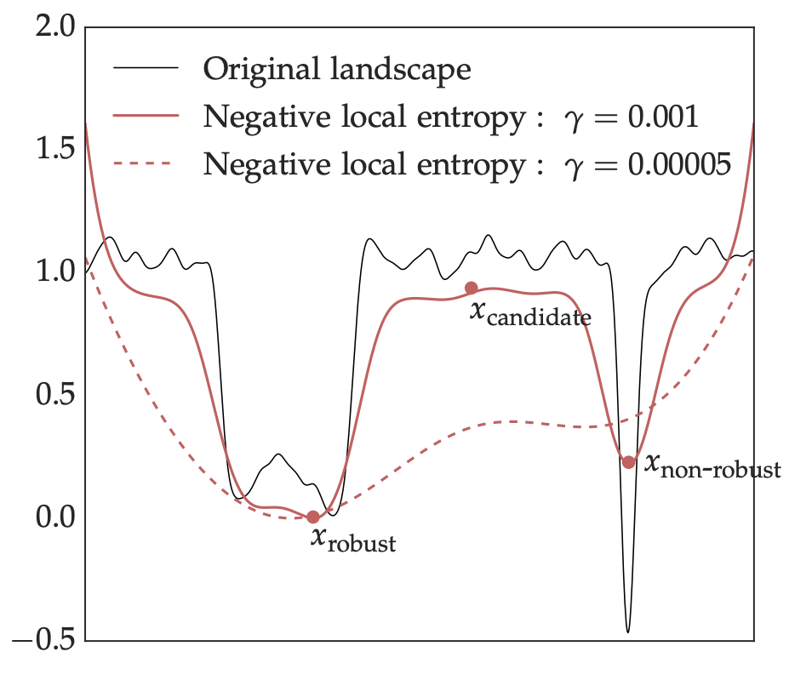
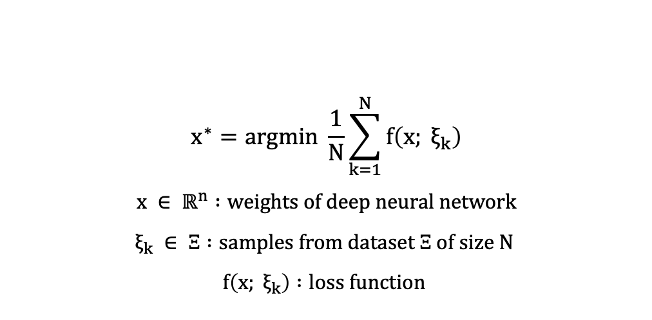
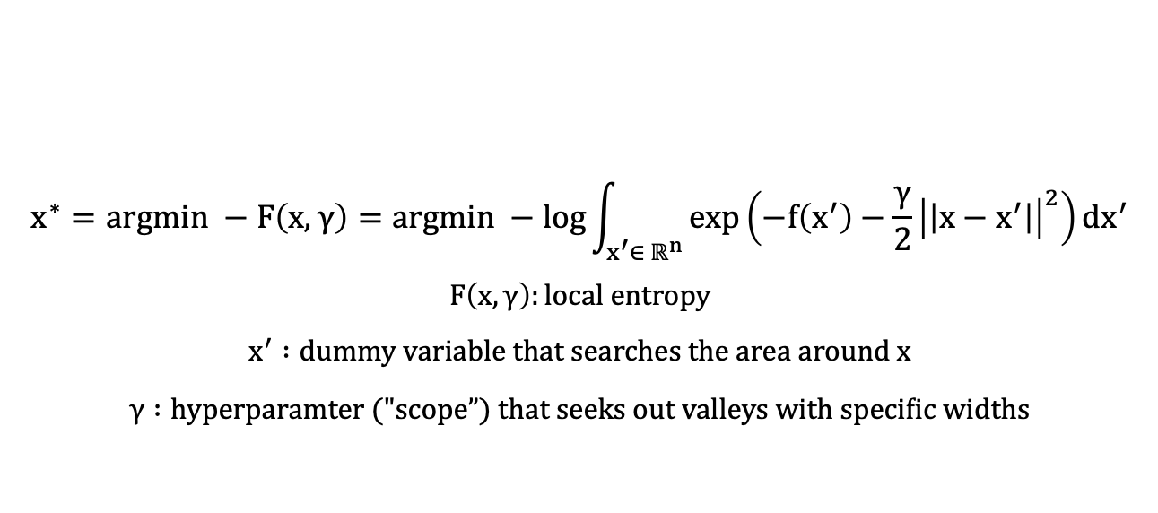
Modifying SGD to Account for Local Entropy
The original optimization problem for SGD:
$$x^{∗}=argmin \frac{1}{N}\sum_{k=1}^{N}{f\left(x; ξ_{k}\right)}$$
$$x ∈ ℝ^{n} :weights of deep neural network$$
$$ξ_{k} ∈ Ξ :samples from dataset Ξ of size N$$
$$f\left(x; ξ_{k}\right) :loss function$$
The Entropy-SGD algorithm instead solves:
Favors parameter
configurations with low loss
Favors parameter configurations
close to the
current point
$$x^{∗}=argmin −F\left(x, γ\right)=argmin −log\int_{x^{′}∈ ℝ^{n}}^{ }{\exp\left(−f\left(x^{′}\right)−\frac{γ}{2}{\left|\left|x−x^{′}\right|\right|}_{ }^{2}\right)dx^{′}}$$
$$F\left(x,γ\right):local entropy$$
$$x^{′} :dummy variable that searches the area around x$$
$$γ :hyperparamter ("\text{scope}”) that seeks out valleys with specific widths$$
The algorithm itself consists of two SGD nested loops. The inner loop computes the gradient of the local entropy while the outer loop updates the model weights

Slide 7

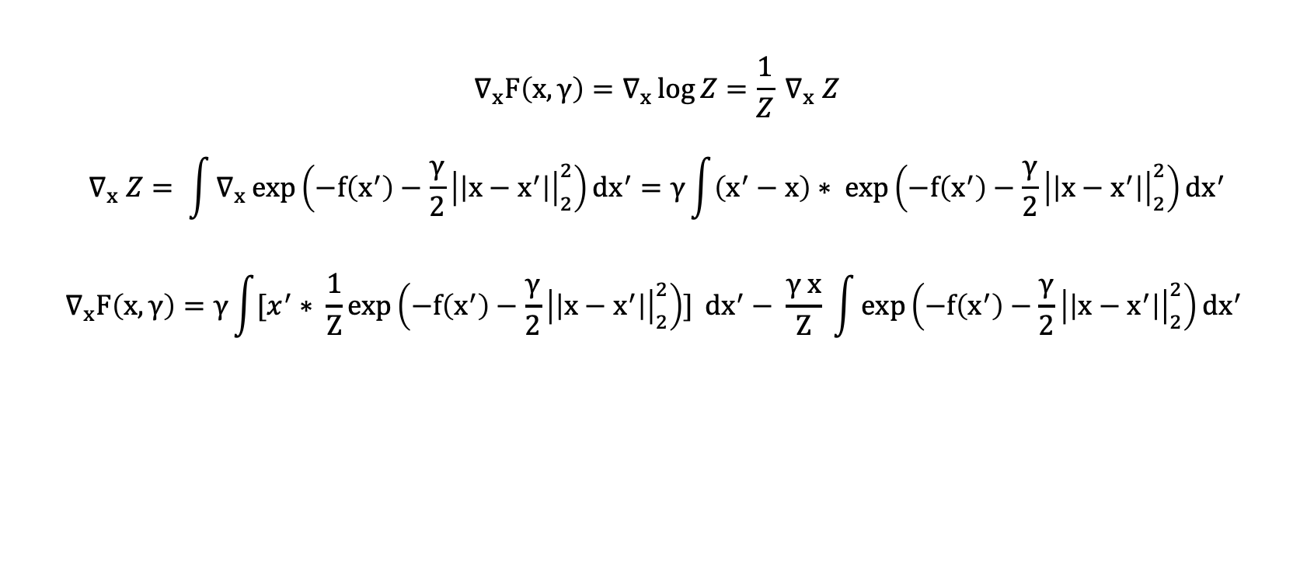

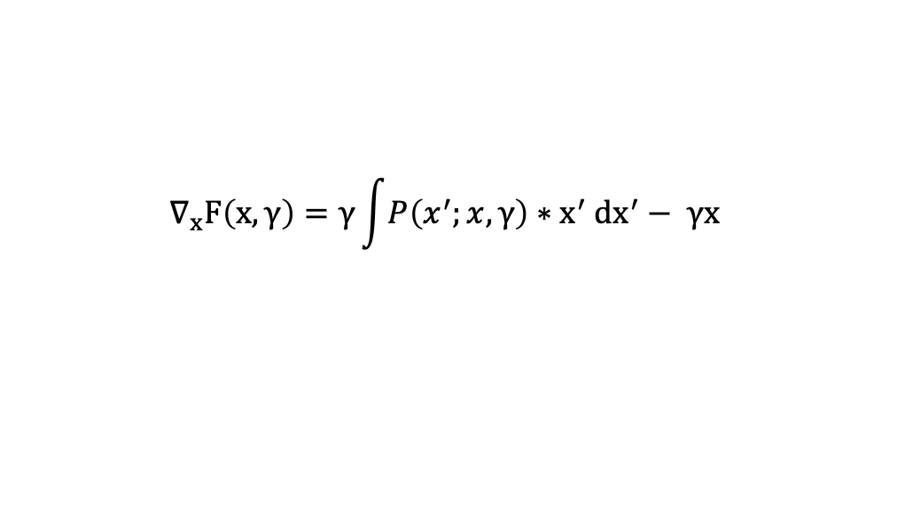


The Gradient of Local Entropy Depends on the Expectation of x’
The gradient of the local entropy (with respect to the current parameters of the neural network, x) tells the algorithm in which direction to move the parameters to increase local entropy (minimize –F, double negative)
$$∇_{x}F\left(x,γ\right)=∇_{x}\log{Z}=\frac{1}{Z} ∇_{x} Z$$
$$∇_{x} Z= \int{∇_{x}}\exp\left(−f\left(x^{′}\right)−\frac{γ}{2}{\left|\left|x−x^{′}\right|\right|}_{2}^{2}\right)dx^{′}=γ\int{\left(x^{′}−x\right)∗ exp}\left(−f\left(x^{′}\right)−\frac{γ}{2}{\left|\left|x−x^{′}\right|\right|}_{2}^{2}\right)dx^{′}$$
$$∇_{x}F\left(x,γ\right)=γ\int{[x^{′}∗ \frac{1}{Z}exp\left(−f\left(x^{′}\right)−\frac{γ}{2}{\left|\left|x−x^{′}\right|\right|}_{2}^{2}\right)]} dx^{′}− \frac{γ x}{Z} \int{\exp\left(−f\left(x^{′}\right)−\frac{γ}{2}{\left|\left|x−x^{′}\right|\right|}_{2}^{2}\right)dx^{′}}$$
$$P(x^{′};x, γ)$$
$Z$: Partition Function
$$∇_{x}F\left(x,γ\right)=γ\int{P\left(x^{′};x,γ\right)∗x^{′} dx^{′}− γx }$$
$$<x^{′}>:Expectation Value of x^{′}$$
Approximate
using a Markov chain Monte-Carlo algorithm
Hard to compute due to high dimensionality and continuous parameters
$$∇_{x}F\left(x,γ\right)=γ \left(<x^{′}>−x\right)$$

Slide 8
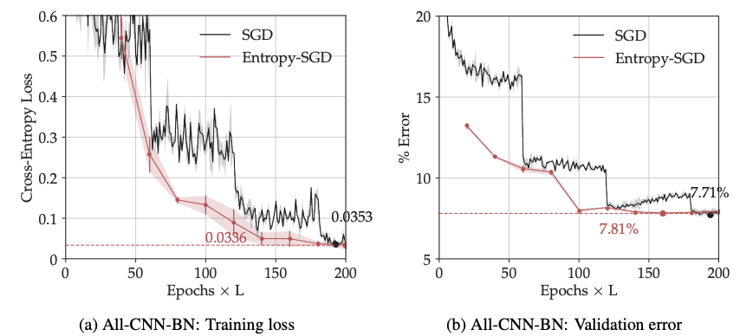
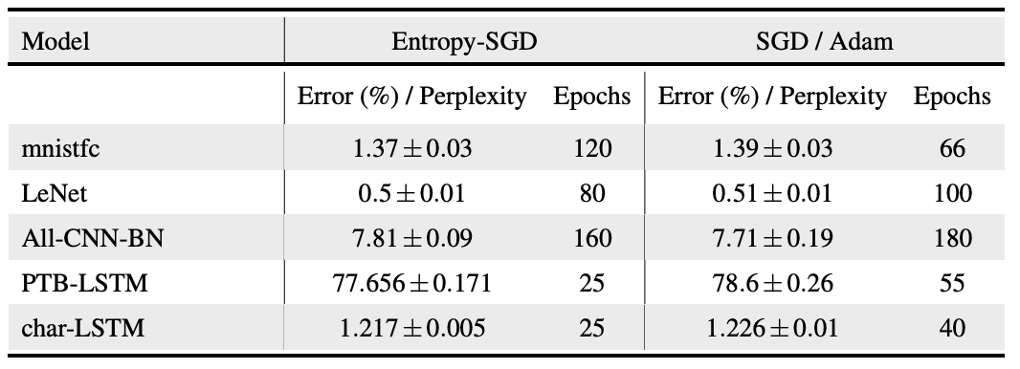

Entropy-SGD Performance
CIFAR-10 dataset: 60,000 32x32 color images used to train ML and computer vision algorithms
For Entropy-SGD (red), almost no plateauing of training loss seen which indicates additional smoothness of the local entropy landscape
Both algorithms achieved comparable validation errors
  SGD: 7.71% in 200 epochs
  Entropy-SGD: 7.81% in 160 epochs
LSTM model trained to perform character-level prediction of War and Peace
Similar performance for other model architectures/datasets

Slide 9
Conclusions
Entropy-SGD favors wide valleys in the loss landscape by maximizing local entropy rather than simply minimizing loss at a single parameter configuration
Entropy-SGD results in validation (generalization) errors comparable to SGD, but always with lower loss on the training set
  Rough, wide valleys favored by Entropy-SGD are located deeper in the landscape
  SGD presumably gets stuck in local minima located higher in the landscape
Entropy-SGD trains faster than SGD for recurrent networks, but gets only minor time gains for CNNs

