Slide 1
MLIP Journal Club: Foundation Models
8/27/25
Paper – UMA: A Family of Universal Models for Atoms
Presentation – Wesley Oliver

Slide 2
Agenda
Brief review of paper
Short demonstration
Further discussion

Slide 3


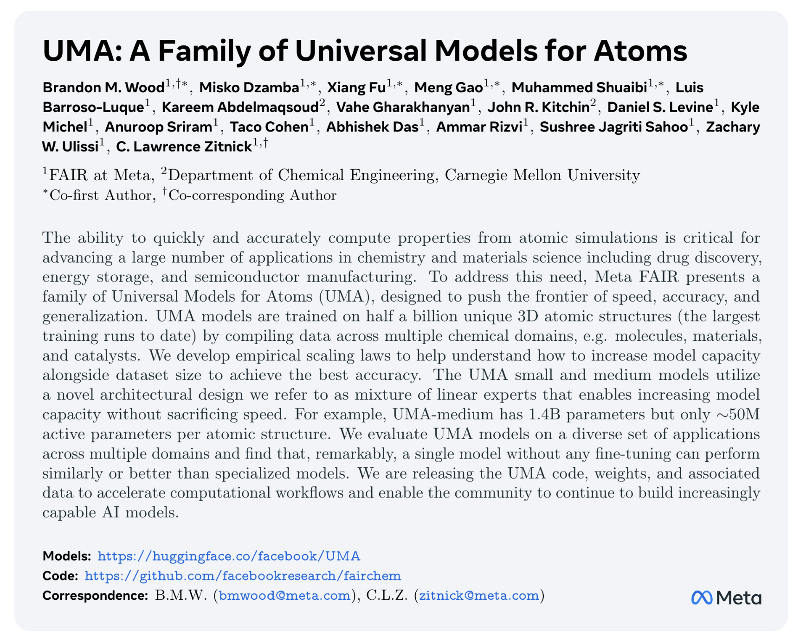
Paper by Wood and FAIR team at Meta

Slide 4
Foundation models are extremely general purpose MLIPs
One model to rule them all
Capable of performing across different elements and “tasks” (ideally well, but this is hard)
  Materials
  Catalysts
  Molecules
UMA is Meta’s attempt at creating a foundation model

Slide 5
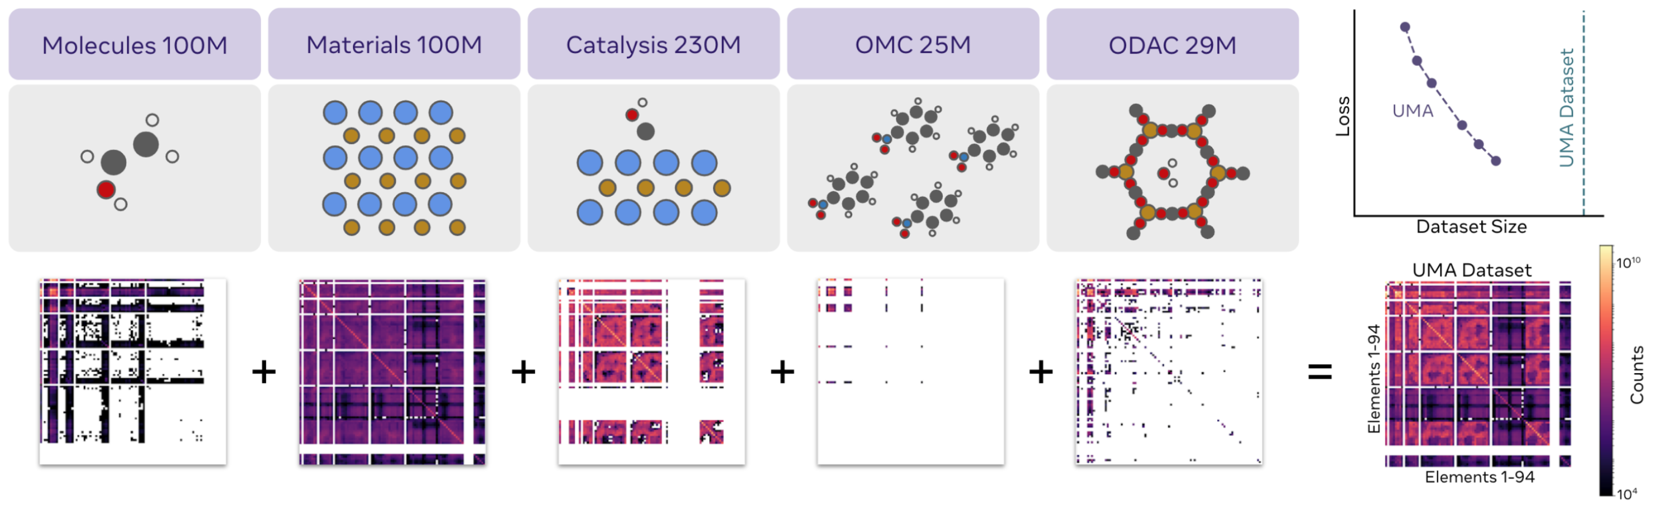
UMA is trained on a large and diverse chemical dataset
Three model sizes
  Small (S), medium (M), and large (L)
Training data containing ~500 million atomic systems across five “tasks”
omol
Molecules
omat
Inorganic Materials
oc20
Catalysis
omc
Molecular Crystals
odac
MOFs

Slide 6
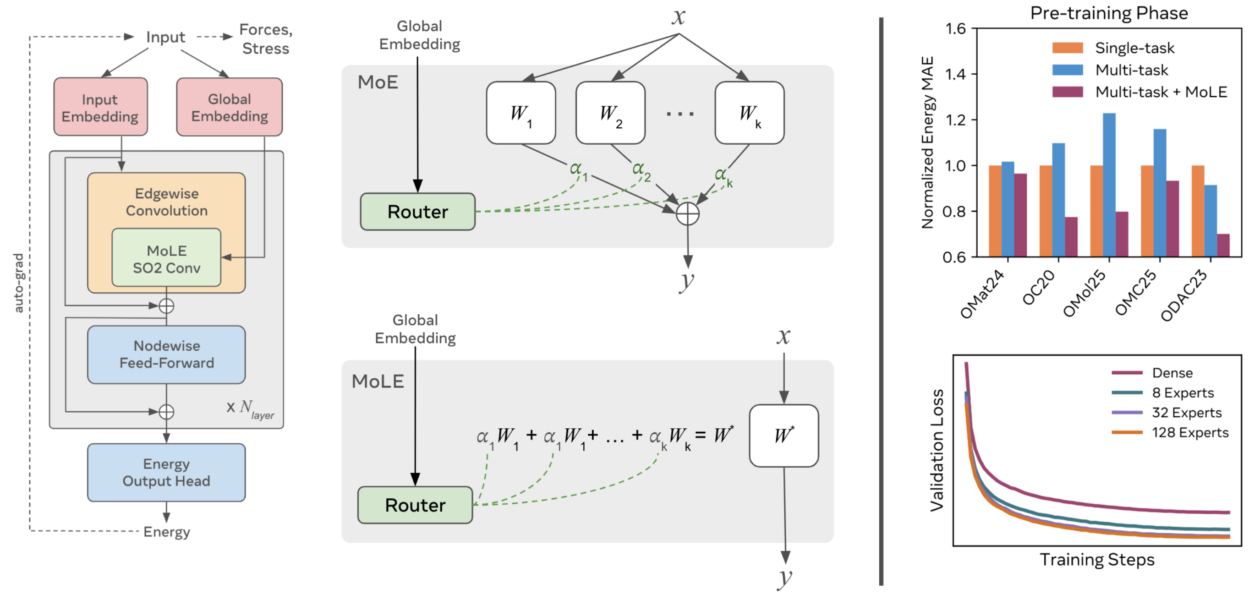
UMA model architecture follows that of eSEN (graph-NN) with some key modifications
On top of eSEN inputs of positions and atomic numbers, UMA takes…
  Charge
  Spin
  DFT “task”
Uses a Mixture of Linear Experts (MoLE)
  Allows for scaling of parameters without scaling of inference cost
Two step training
  Train on forces directly
  Refine for on conserving forces for energy conservation

Slide 7

Mixture of Experts and Linear Experts (MoE and MoLE): A Hack Explanation
$k$ experts have weights $W_{k}$
In Mixture of Experts (MoE), output is a “sparse weighted combination” of weights $W_{k}$ given by $α_{k}$
  Potentially discontinuous
  Does not preserve equivariance

Slide 8

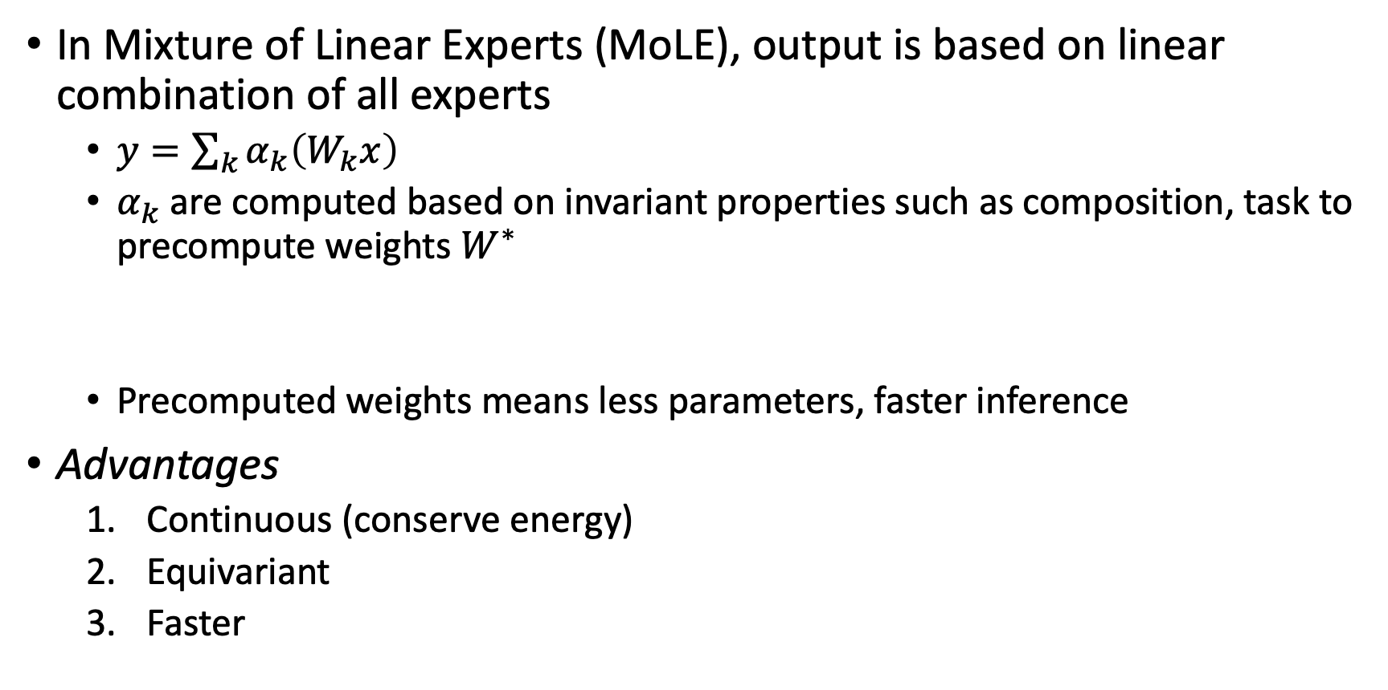
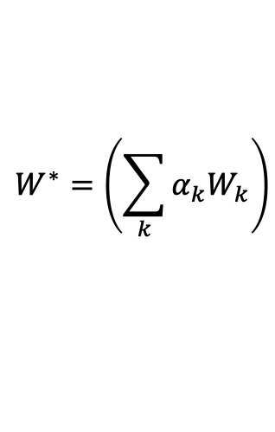
Mixture of Experts and Linear Experts (MoE and MoLE): A Hack Explanation
In Mixture of Linear Experts (MoLE), output is based on linear combination of all experts
  $y=\sum_{k}{α_{k}\left(W_{k}x\right)}$
  $α_{k}$ are computed based on invariant properties such as composition, task to precompute weights $W^{∗}$
  Precomputed weights means less parameters, faster inference
Advantages
  Continuous (conserve energy)
  Equivariant
  Faster
$$W^{∗}=\left(\sum_{k}{α_{k}W_{k}}\right)$$
$$y=W^{∗}x$$

Slide 9
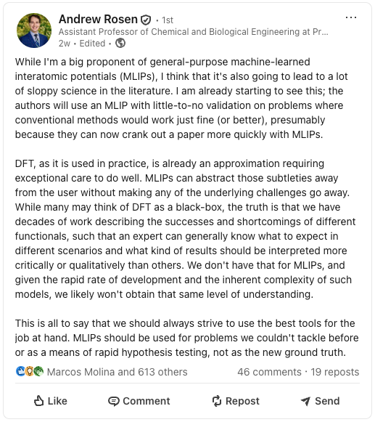
Point of discussion
How important is choice of “task”?
  Between “tasks” only certain functionals are appropriate
  Within a “task”, what are tradeoffs between functionals?
  Prof. Rosen’s recent comment on LinkedIn
Property calculation
  The ability to calculate other properties seems highly relevant and an advantage over classical MD
Notes:
I’m no DFT expert, or even really a novice. However, one key point that the authors discuss is the idea of “tasks” and it is an important part of inference and training in this model.

Slide 10
Multi-task training can offer benefits over single-task training
For UMA-S, multi-task training is worse for dense models, but better with MoLE
Improvement is limited beyond a certain number of “experts”

Slide 11
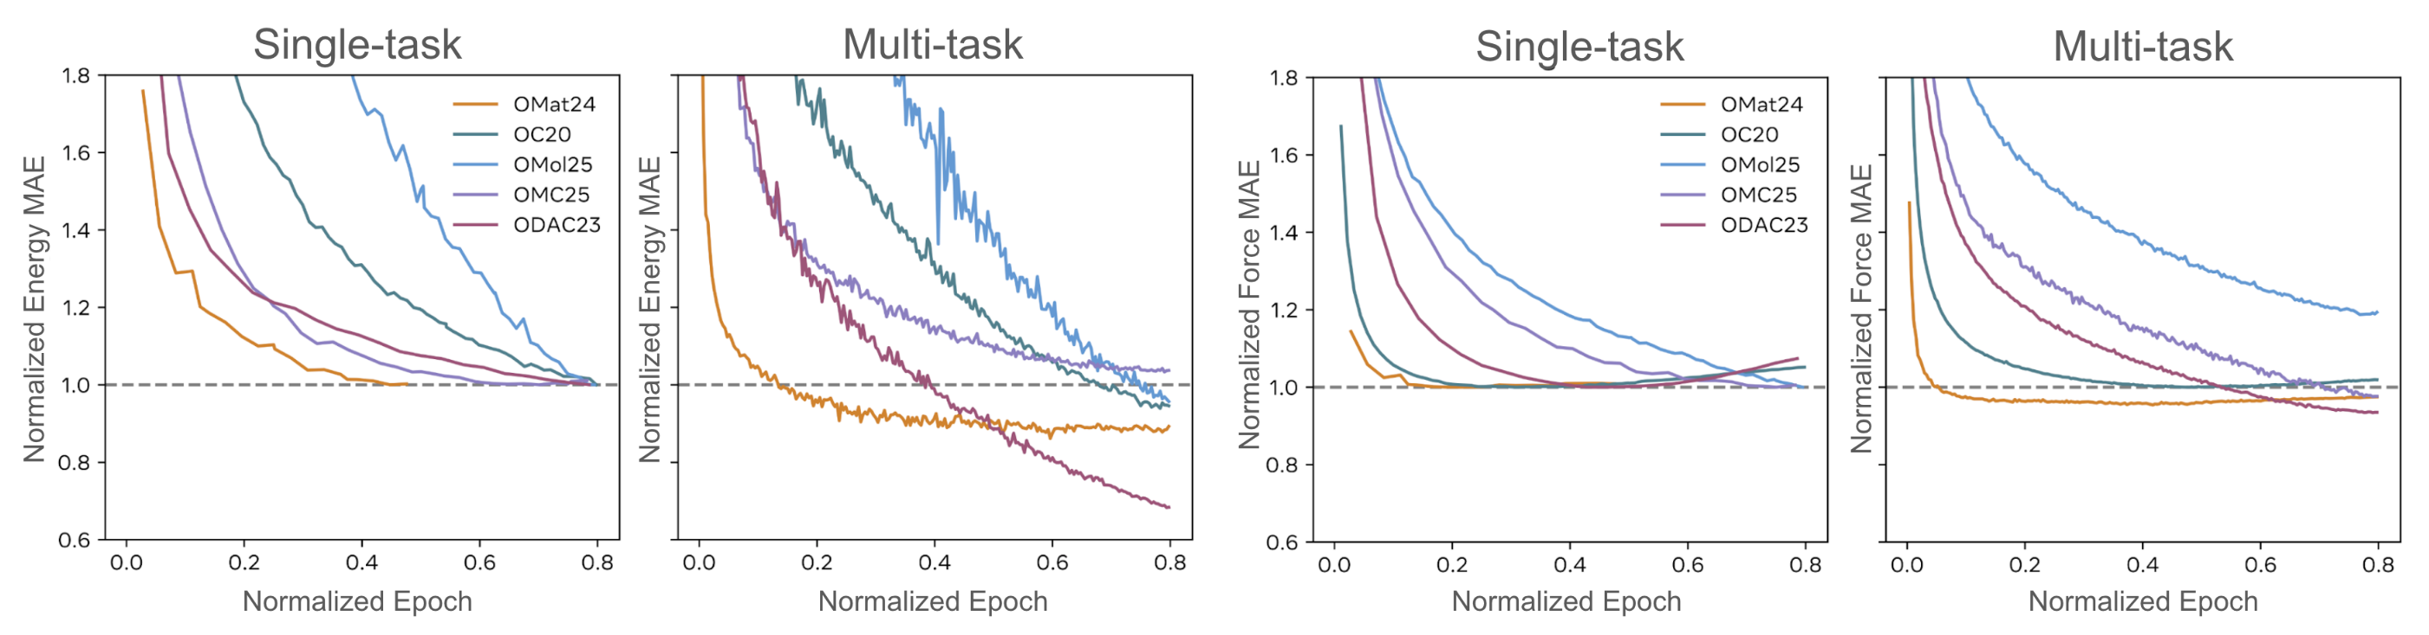
For large models, multi-task training improves model accuracy
Training UMA-L (large, dense model)
Improvement in mean absolute error (MAE) for energies during multi-task training over single-task training

Slide 12
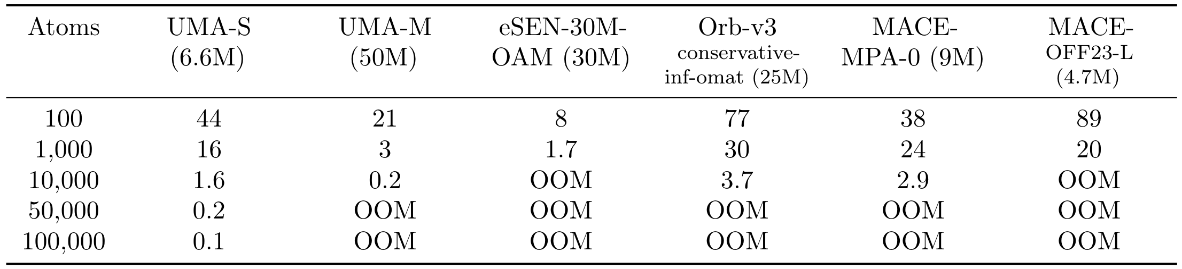
Inference times are good compared to other models when factoring in accuracy
Inference speeds shown (in steps per second) are for 6Å cutoff and ~50 neighbors within that cutoff on an H100 80GB GPU
For more context, UMA-S is getting 1.4 ns/day with 1000 atoms
  GROMACS simulation I ran got 190 ns/day with 33480 atoms on 32 cpus
  Claude says an AIMD simulation of 1000 atoms would get anywhere from 0.1-2 ps/day on a GPU
Notes:
Only model that really comes close in performance to UMA-M is eSEN, which is much slower.

Slide 13
Point of discussion
Speed of models
  What are the best use cases for these models given their speed?
Are these models really pushing the pareto front of speed/resources and accuracy?
  Training budget uses equivalent 48 H100s (tiger3 capacity) for ~5 days
  Training data is an additional cost
Good
Speed & resources
Accuracy
Notes:
There are three costs associated with the model that I am referencing when I talk about speed/resources.
Training data generation
Training
Inference
One advantage is the centralization of resources. One person doing this for their own research almost definitely doesn’t make sense. At a certain scale, probably. Therefore, how many people have to use the model for it to make sense as an investment of resources?

Slide 14
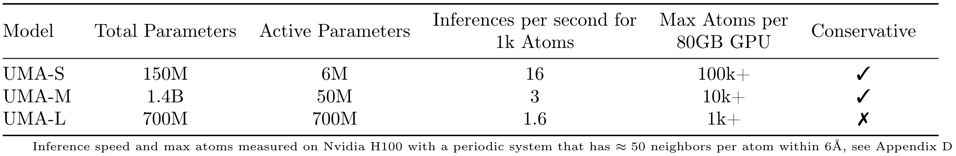
Models and training data are publicly available
Models have different stated purposes
  UMA-S: “aims to strike a balance between accuracy and efficiency and is suitable for computationally intensive applications such as long molecular dynamics simulations”
  UMA-M: “most general-purpose model of the family” and “more accurate and can be used as a DFT surrogate for relaxations or vibrational analysis as well as for molecular dynamics”
  UMA-L: “highly accurate DFT surrogate and is intended as a proof-of-principle to help understand scaling behavior and to demonstrate the limits of what is currently feasible”
Good
Speed & resources
Accuracy

Slide 15
Short demonstration
Andrew Rosen’s group website has a great tutorial on how to get started with UMA
  You will probably have to download some additional PyTorch related modules
1024 Si atoms for 1000 timesteps
  Should take ~5 mins according to their table

Slide 16
Points of discussion
Speed of models
  Are these things ever going to be practical for MD use?
Property calculation
  The ability to calculate other properties seems highly relevant and an advantage over classical MD
How important is choice of “task”?
  Between “tasks” only certain functionals are appropriate?
  Within a “task”, what are tradeoffs between functionals? (Prof. Rosen’s recent comments on LinkedIn)?
Are these models really pushing the pareto front of speed and accuracy?
  Training budget alone uses resources equivalent to occupying all of tiger3 for 45 days

