Slide 1
When Does Depth Matter For In-Context Learning? Adaptive Inference in Deep Transformers
From Ravin Raj
Chem ML Journal Club

Slide 2
In-context learning
What is 2~3?, 5. What is 3~7?, 10. What is 4~2, 6. What is 4~3?
(x1, y1), (x2, y2), (x3, y3), …, (xn, ?)
The model needs to learn from the context without updating its weights

Slide 3
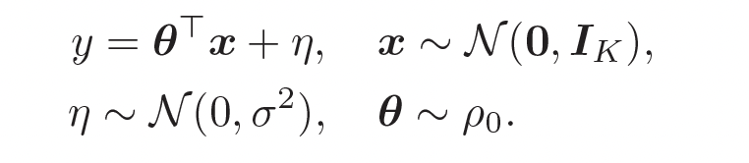
In-context learning
The task is always to linearly project x
The projection needs to be inferred from data

Slide 4
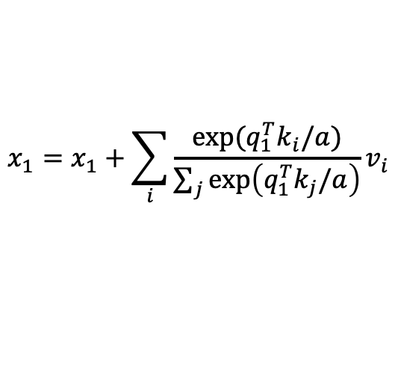
Transformer
$$x_{1}=x_{1}+\sum_{i}{\frac{\exp{(q_{1}^{T}k_{i}/a)}}{\sum_{j}{\exp\left(q_{1}^{T}k_{j}/a\right)}}}v_{i}$$
Query matrix
q1
MLP
MLP
MLP
MLP
x1
Attention
score
Key matrix
k2
MLP
MLP
MLP
MLP
x2
value matrix
v2
Attention
x1
x2
x3
x4

Slide 5


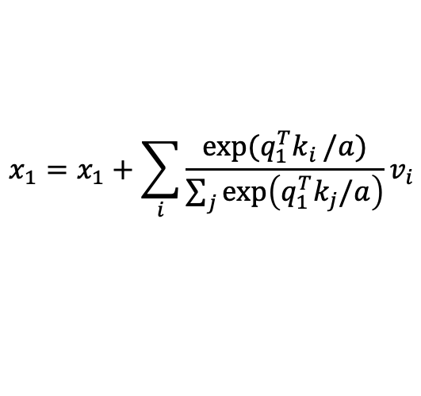
Transformer
query
Bok choy: Who ate me
$$x_{1}=x_{1}+\sum_{i}{\frac{\exp{(q_{1}^{T}k_{i}}/a)}{\sum_{j}{\exp\left(q_{1}^{T}k_{j}/a\right)}}}v_{i}$$
Key:
Moritz: a person
Ate: an act
Bok choy: an object
Ytd: a time
Score:
Large
Small
Small
Small
Query matrix
q1
x1
Value:
Moritz: Moritz
…
score
Key matrix
k2
I’m a veggie, and Moritz ate me
x2
value matrix
v2
Moritz ate a bok choy ytd.
Bok choy is a popular type of Chinese cabbage with crisp white or green stems and tender green leaves

Slide 6
Role of transformer in in-context learning
Copy/paste
“Gradient descent”
Function vector
MLP
MLP
MLP
MLP
Attention
x1
x2
x3
x4

Slide 7
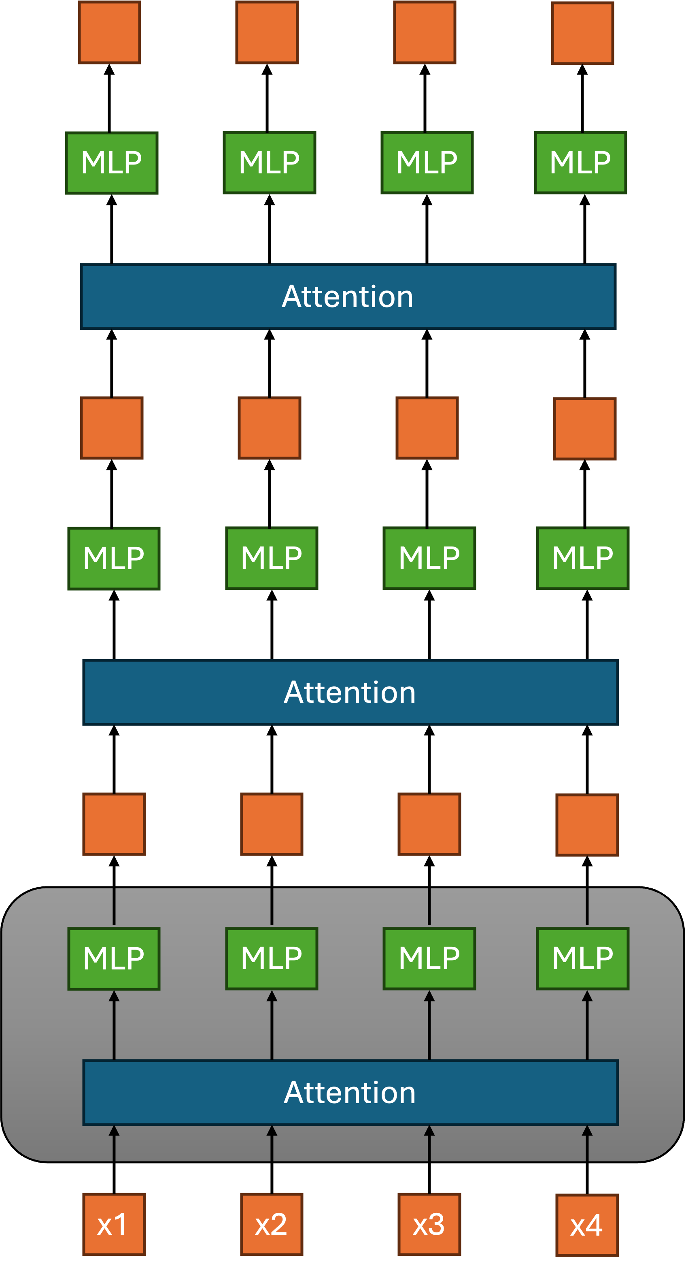
Is the transformer depth important?
Query matrix
q1
x1
k2
Key matrix
x2
v2
value matrix

Slide 8
Intuition
Deep models can analyze the context step by step
Adaptive inference:
  First layer look at context, and tell second layer where to pay attention to next, second layer look, and tell third layer …

Slide 9
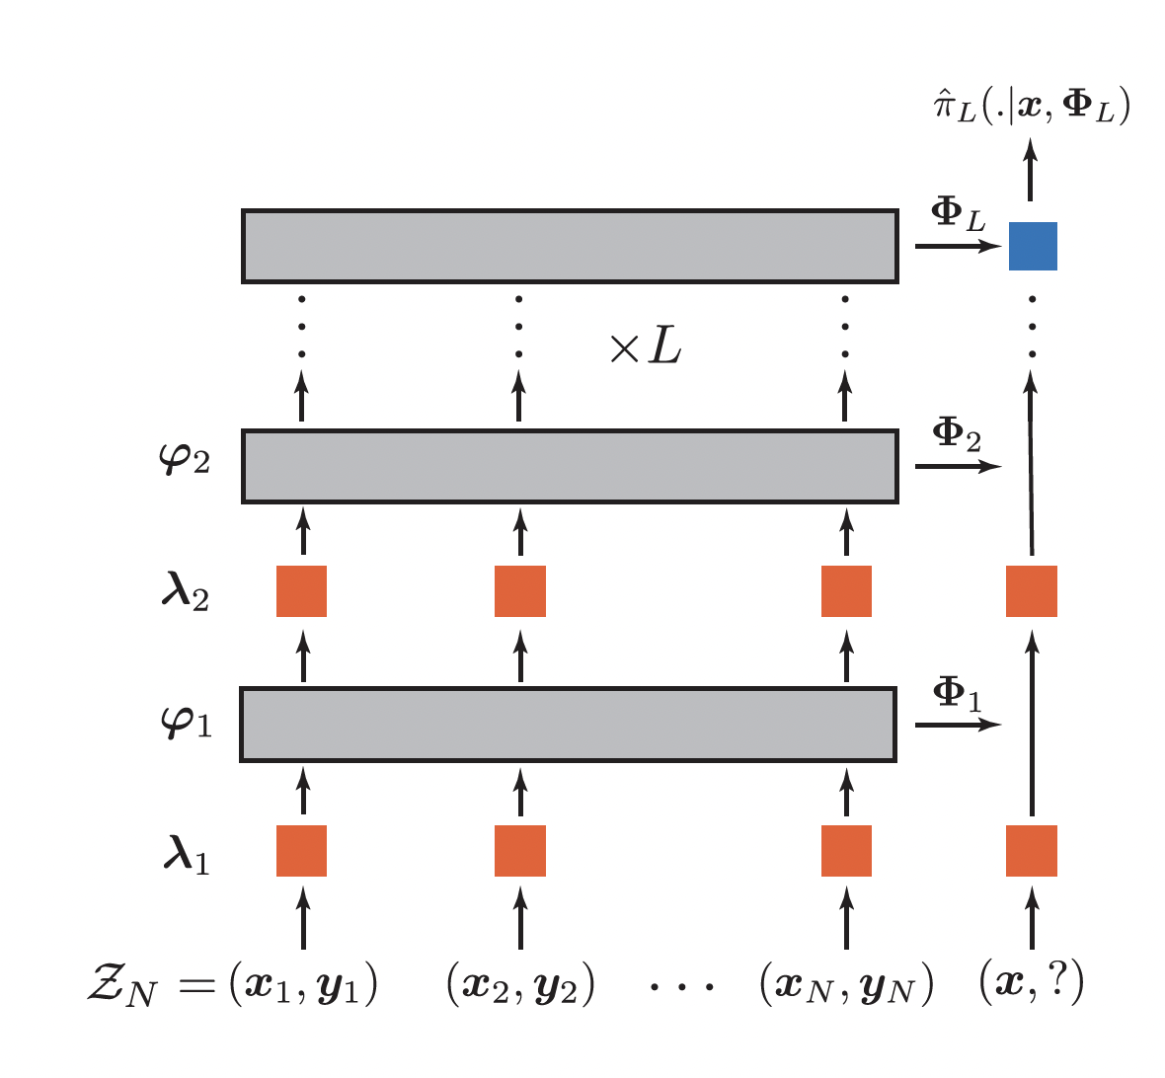
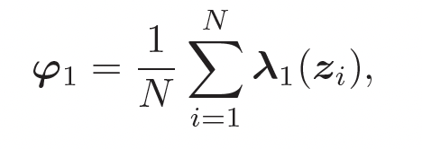
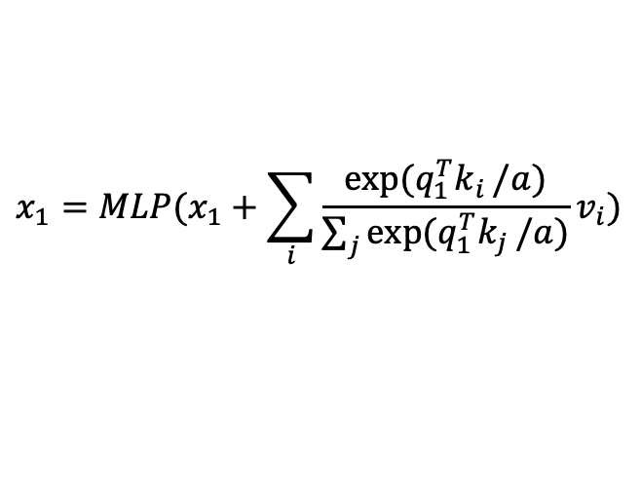
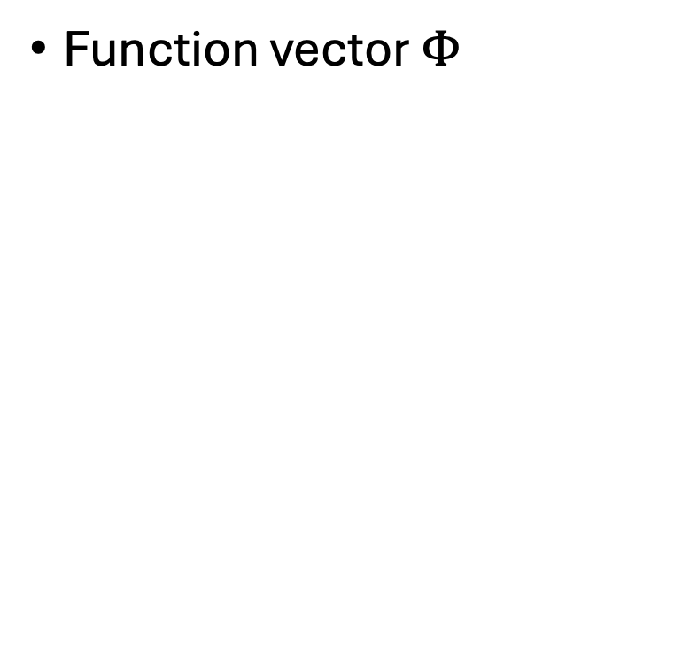
Proposed architecture
Function vector $Φ$
Learned embedding for each token
$$x_{1}=MLP(x_{1}+\sum_{i}{\frac{\exp{(q_{1}^{T}k_{i}}/a)}{\sum_{j}{\exp{(q_{1}^{T}k_{j}}/a)}}}v_{i})$$

Slide 10
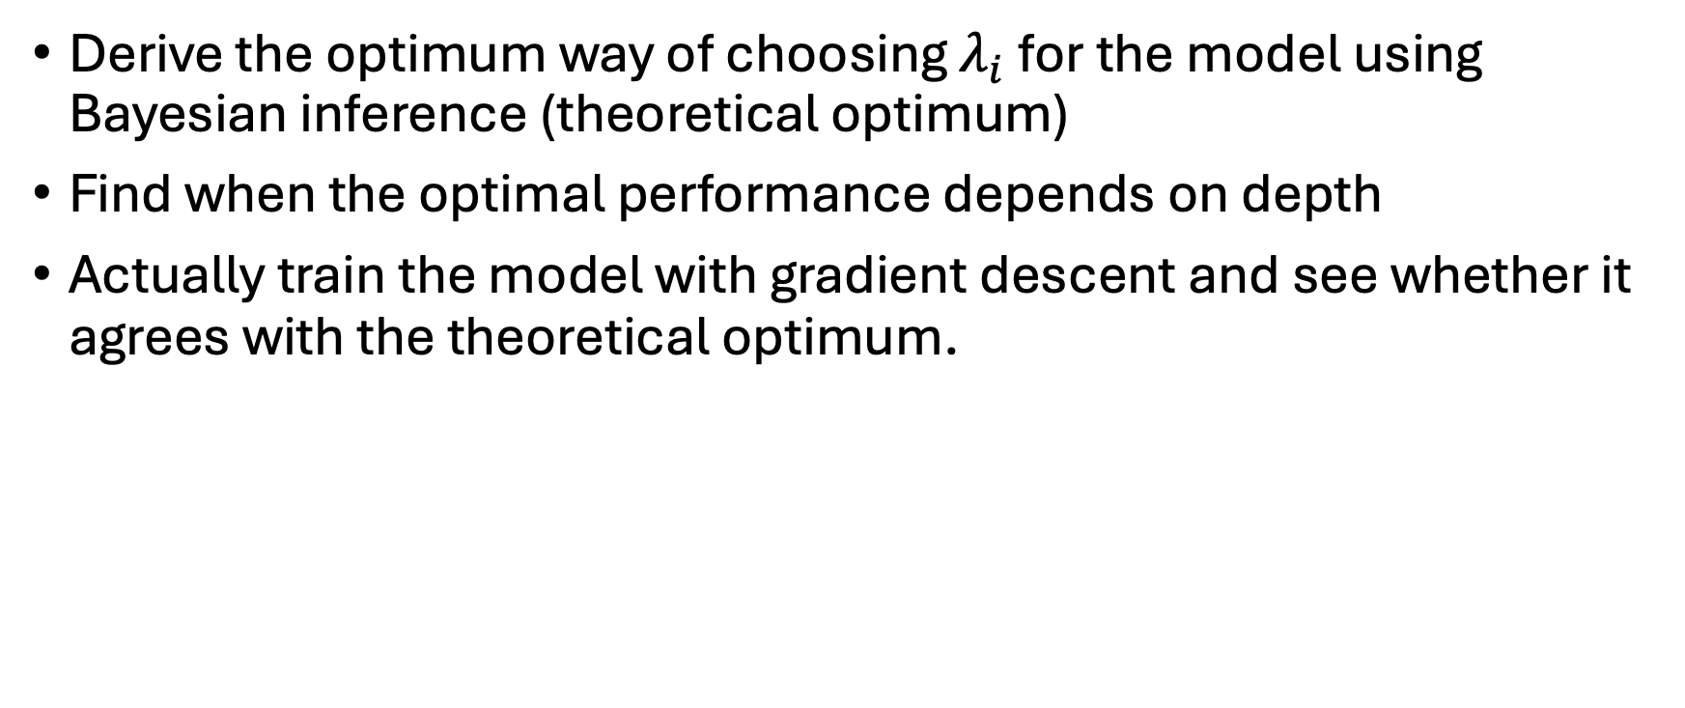
Approach
Derive the optimum way of choosing $λ_{i}$ for the model using Bayesian inference (theoretical optimum)
Find when the optimal performance depends on depth
Actually train the model with gradient descent and see whether it agrees with the theoretical optimum.

Slide 11
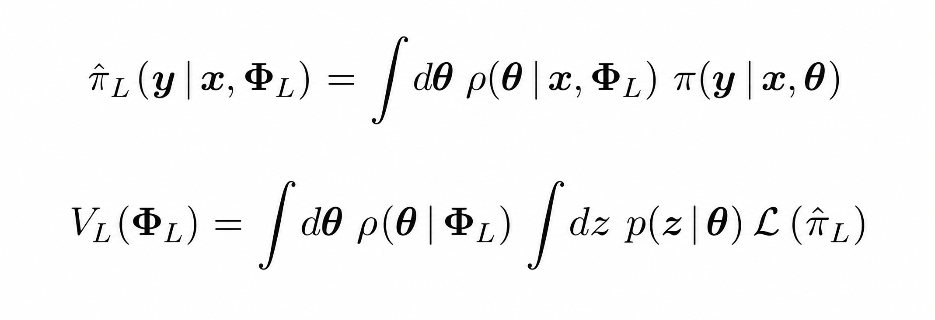
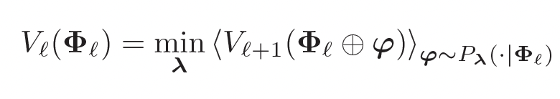
Bayesian inference

Slide 12

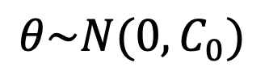
Two priors over $θ$
Gaussian prior: depth does not matter
Tree prior: depth does matter
$$θ\sim N(0, C_{0})$$
>0

Slide 13
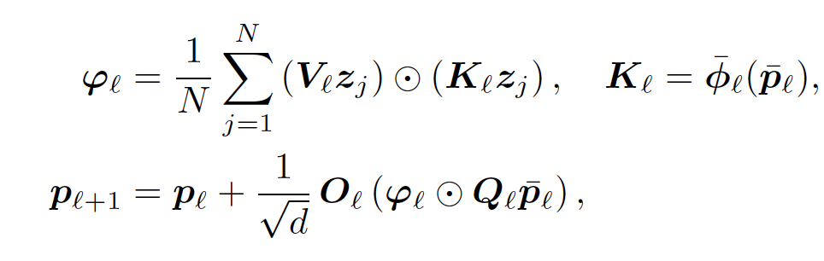
Implementation

Slide 14
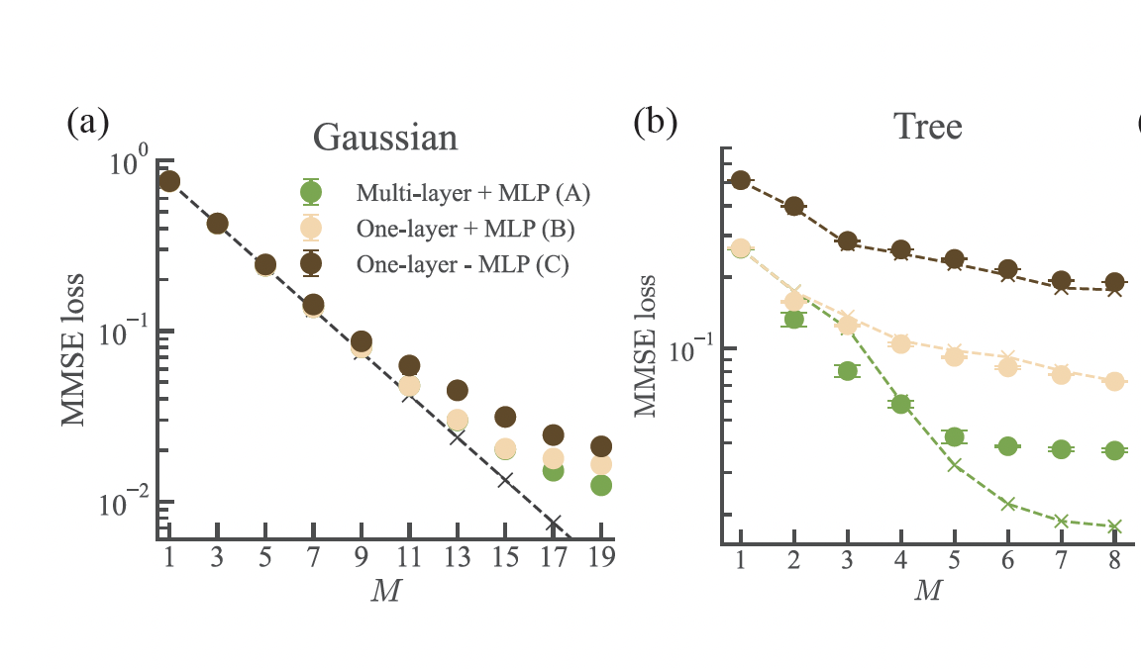
Results

Slide 15
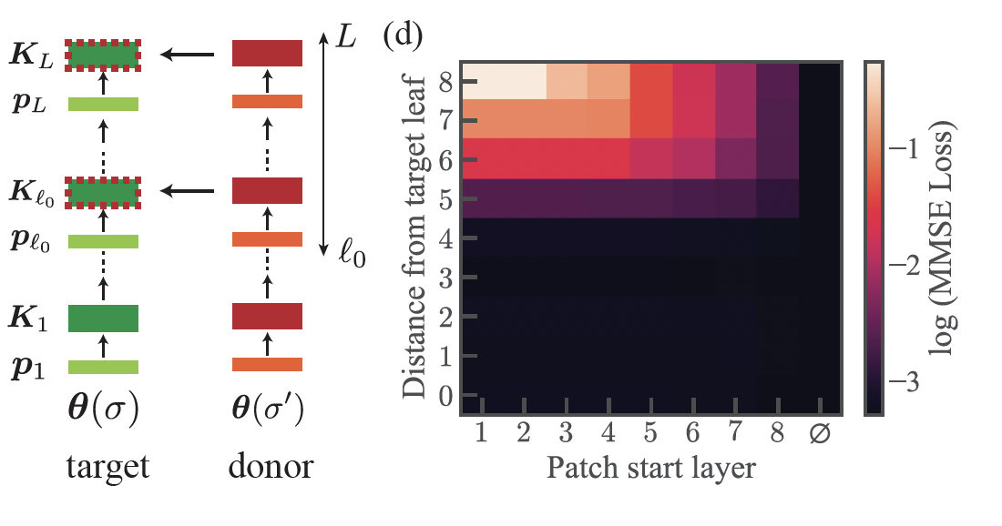
Patching experiment

Slide 16
Discussion
Deep transformers implement inference as a distributed, adaptive, layerwise procedure
Function vectors + MLP: where to measure next
Attention: performs measurement (pull information from context)

