Slide 1
Jamming Transition as a Paradigm to Understand the Loss Landscape of Deep Neural Networks
See: M. Geiger, S. Spigler, S. d'Ascoli, L. Sagun, M. Baity-Jesi, G. Biroli, and M. Wyart, Phys. Rev. E 100, 012115 (2019).
Sam Dawley · Princeton University · 09/22/2026
Notes:
* Today's paper takes an idea from soft-matter physics, the jamming of particles, and uses it to describe the loss landscape of deep neural networks.
* Part 1 introduces jamming.
* Part 2 builds a neural network from scratch and shows that it jams.
[end by ~0.5 min]

Slide 2
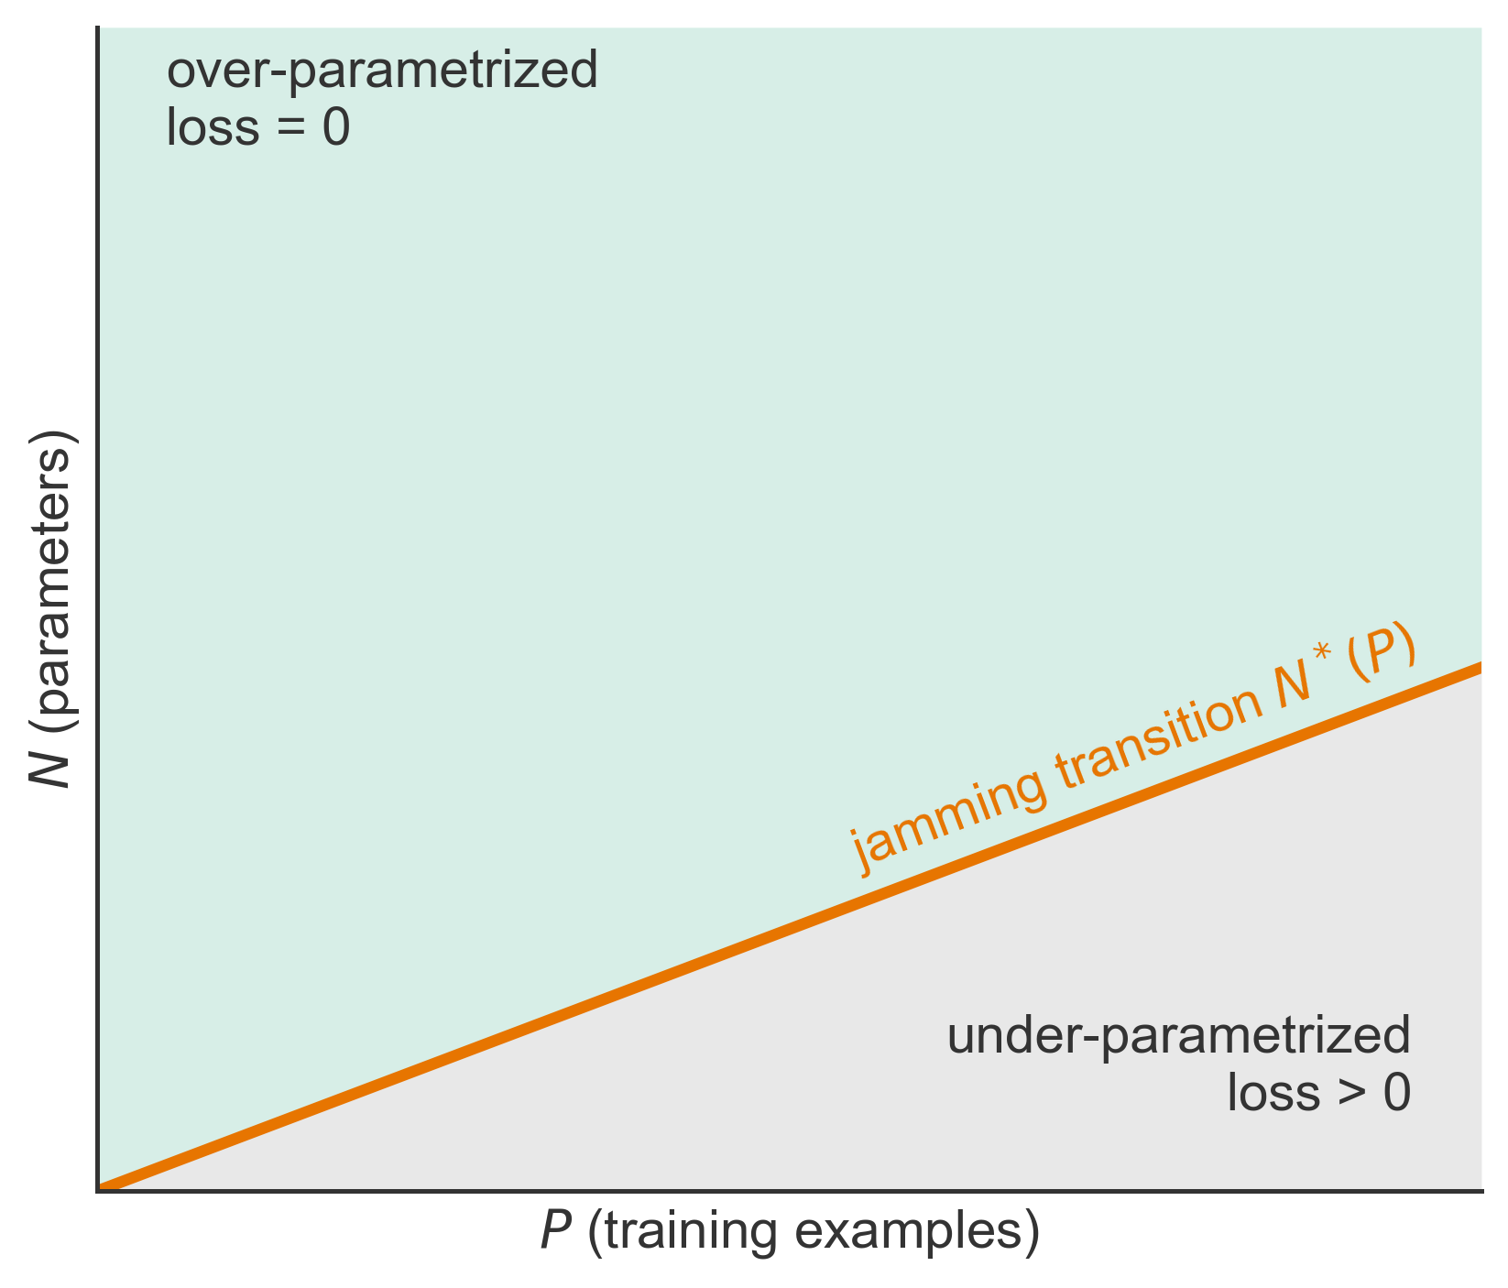
Two Puzzles About Deep Networks
• Training walks downhill on a non-convex loss in N dimensions, yet rarely gets stuck: why?
• Does depth help a network fit its data?
• Claim: a sharp transition in the (P, N) plane, like the jamming transition
Adapted from Geiger et al., PRE 100, 012115 (2019), Fig. 1
2
Notes:
* A network has N parameters and is trained on P examples by descending a loss function.
* That loss is non-convex, so naively we expect training to get stuck in poor minima, yet in practice large networks fit their training data.
* Paper argues that a sharp line N*(P) separates networks that can fit all data from networks that cannot, this line behaves like the jamming transition.
Q: Hasn't it already been shown that there are no bad minima?
Only for shallow or extremely over-parameterized networks. This paper gives a counting argument for deep networks, and it also says where the guarantee stops holding.

Slide 3
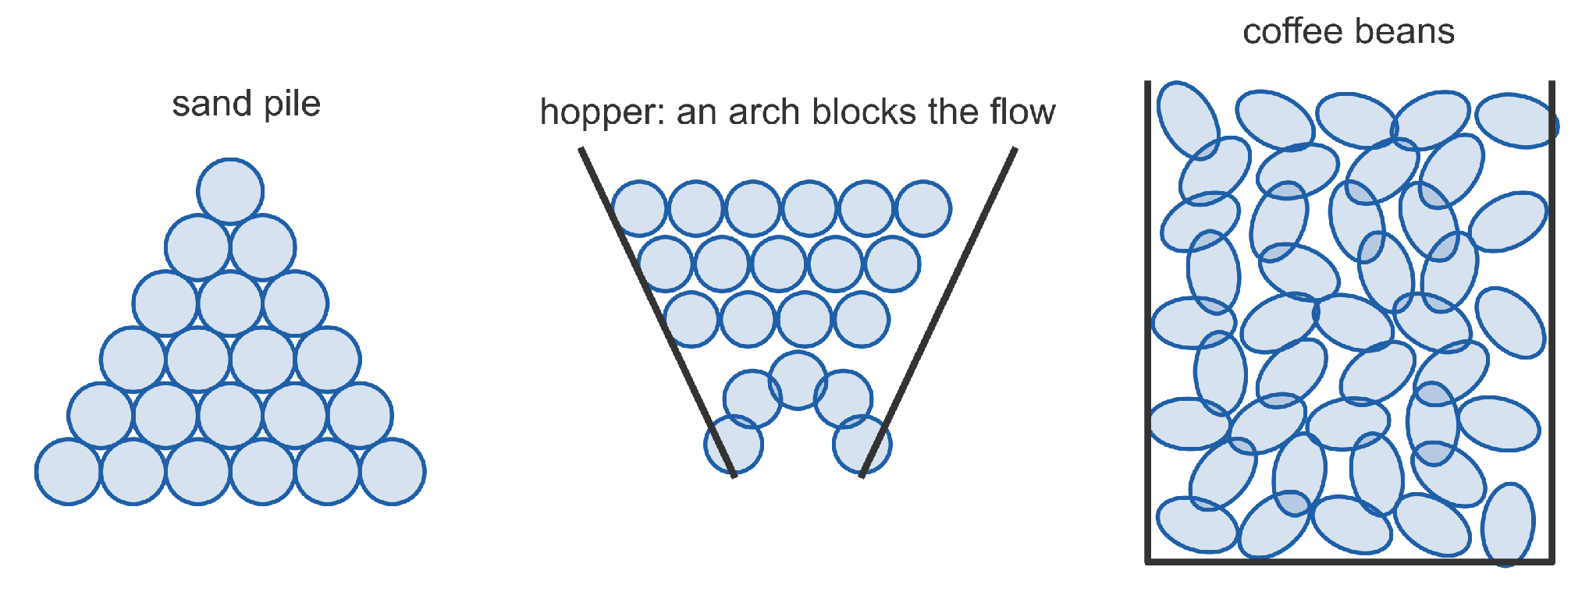
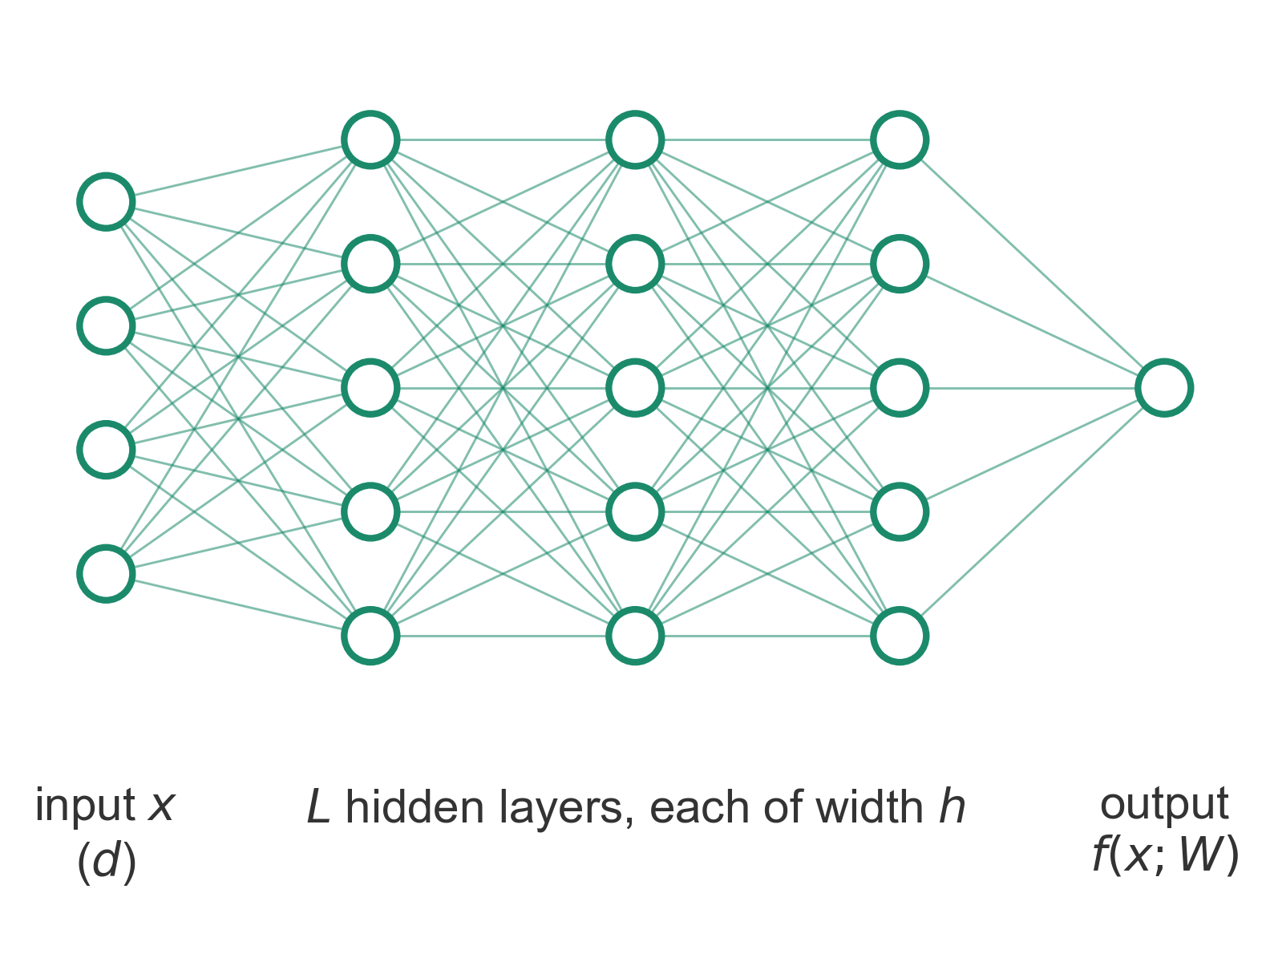
Roadmap
Part 1
What is the
jamming transition?
Part 2
When can a
network fit data?
3

Slide 4
Part 1
What is the Jamming Transition?
Spherical jamming → Constraint counting → Elliptical jamming → Vibrational spectra
Notes:
* Part 1 needs no background beyond undergraduate mechanics.
* We will end with a short list of numbers and shapes to look for in deep networks.

Slide 5
Jamming: Rigidity Without Cooling
• Sand, a clogged hopper, coffee beans: no temperature, solid
• Control knob: packing fraction φ = (particle volume) / (box volume)
• Above a critical φ_{J}, particles cannot move without overlapping
↔ networks: data per parameter P/N plays the role of φ
5
Notes:
* Jamming is how athermal particles such as grains, foams, and emulsions become rigid.
* There is no temperature: the only control is how densely the particles are packed.
* Below a critical packing fraction the particles can rearrange freely; above it they are stuck.
* Keep φ in mind: in Part 2 the ratio P/N will play its role (Table I).
Q: Is jamming the same as the glass transition?
No. Jamming happens at zero temperature and is driven by density: particles are stuck because there's no room. The glass transition is thermal slowdown. They're related (jamming sits at the zero-temperature, zero-stress corner of the jamming phase diagram) but they're different transitions.
[end by ~4.5 min]

Slide 6
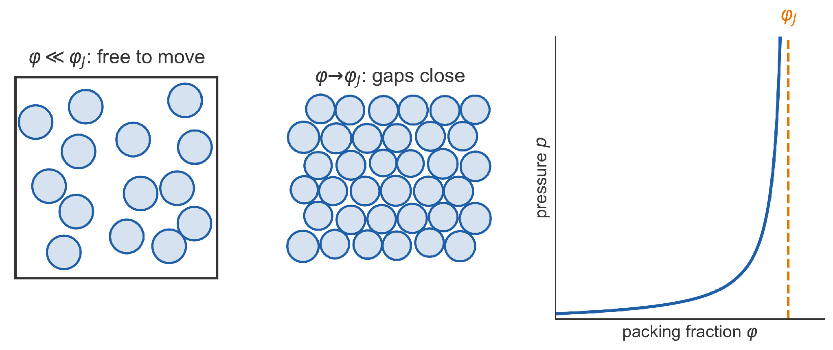
Hard Spheres: Jamming From Below
• Hard spheres cannot overlap: U = 0 or ∞
• As φ → φ_{J}, gaps close and particles can barely move
• Pressure diverges at φ_{J}
↔ over-parameterized networks: zero loss, like U = 0
6
Notes:
* Hard spheres are the simplest model: infinitely stiff, so the energy is either zero or infinite.
* Compressing toward φ_J, the free space around each particle shrinks, and the pressure diverges roughly as 1/(φ_J − φ) (free-volume argument).
* Below φ_J every configuration without overlaps has zero energy, just as an over-parametrized network reaches zero training loss.
[end by ~5.5 min]

Slide 7
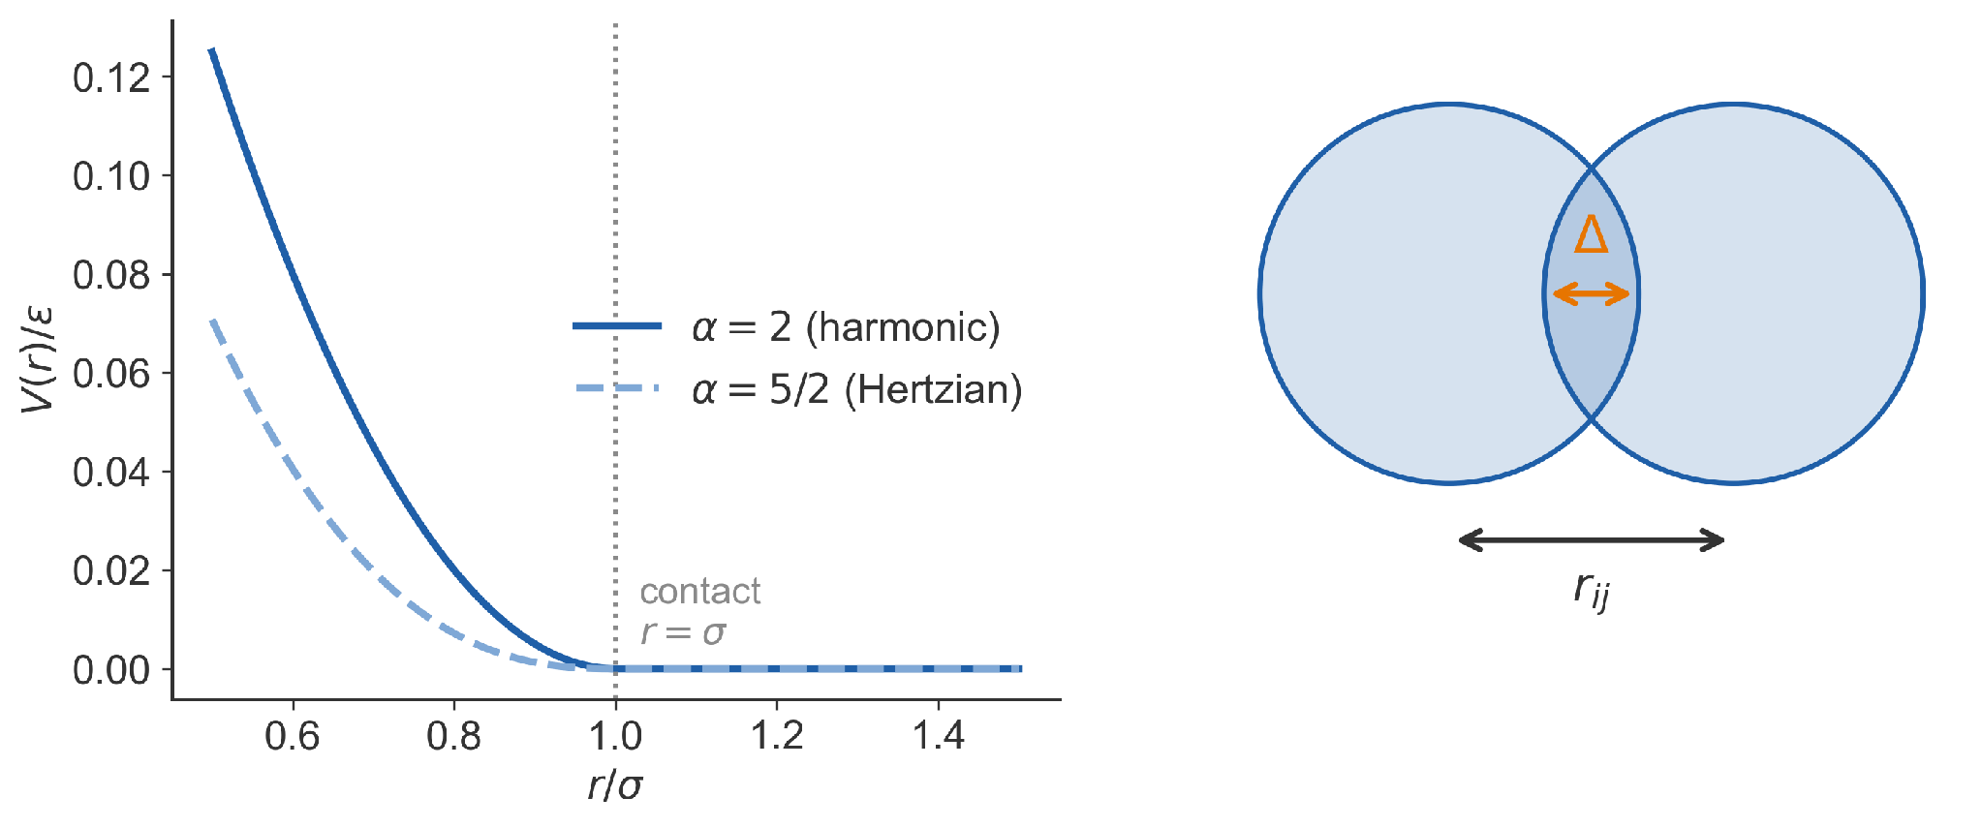
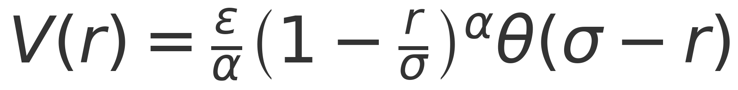
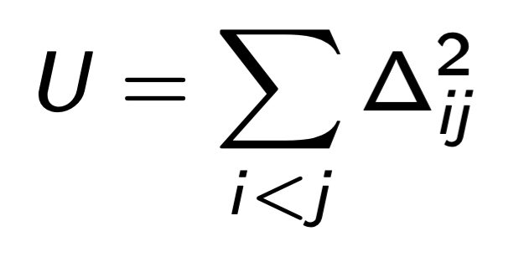
Soft Spheres: A Finite-Range Repulsion
• Overlap Δ_{ij} = 2R − r_{ij}; energy only if Δ_{ij} > 0
• Zero beyond contact: a finite-range interaction
↔ hinge loss is finite-range too
7
Notes:
* Soft spheres may overlap, at an energy cost that grows with the overlap Δ.
* The harmonic case α = 2 is exactly the energy used in the paper, U = Σ ½Δ² over contacts (Eq. 1); Hertzian α = 5/2 describes elastic balls.
* The key feature is finite range: particles that do not touch do not interact at all.
2. For soft spheres, temperature is a real axis that we deliberately set to zero. Once contacts cost ε, the state depends on both φ − φ_J and T/ε. Our whole discussion is the T = 0 slice. "Athermal" here means we chose T = 0, which is a stronger statement.
3. Why that slice is the right one for the analogy: Training minimizes the loss by descent; the paper's hinge-loss runs use full-batch ADAM, so there's no noise in the dynamics. The loss plays the role of U, and there is no term playing the role of kT — which is why Table I has no temperature row.
4. What temperature would correspond to: the natural candidate is noise in the training dynamics: minibatch stochasticity, or the learning rate. Geiger et al. note that the transition's location depends mildly on the dynamics — ADAM versus SGD, batch size, learning-rate schedule — and say this mirrors packings, where the protocol shifts φ_c without changing the critical behaviour near it. So dynamical noise moves the transition point in both systems but doesn't change the universality class, which is the same role a small temperature plays.
4b. SGD noise isn't a true thermal bath — it isn't isotropic and doesn't satisfy detailed balance — so "SGD noise is a temperature" is an analogy, not an identity.
[end by ~6.5 min]

Slide 8
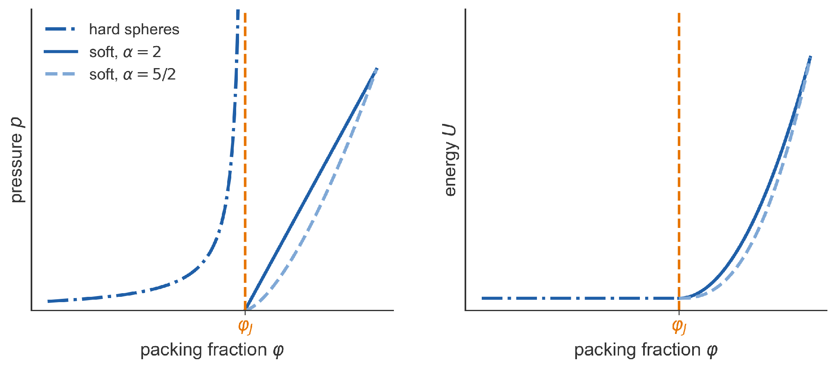
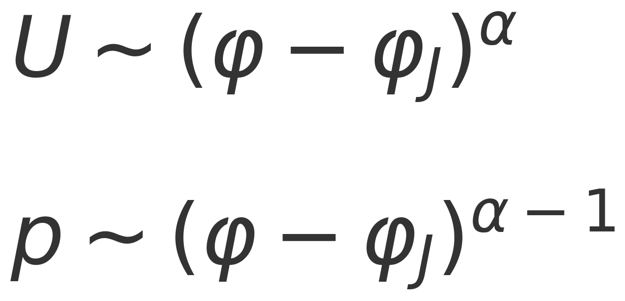
Two Routes, One Jamming Point
• Hard spheres: p → ∞ as φ → φ_{J} from below
• Soft spheres: U, p → 0 as φ → φ_{J} from above
• Same point and contacts; α only sets exponents
Scaling: O'Hern, Silbert, Liu, and Nagel, PRE 68, 011306 (2003)
↔ network loss vanishes at N*, like U at φ_{J}
8
Notes:
* Hard spheres approach jamming from below, where pressure diverges; soft spheres approach from above, where energy and pressure vanish.
* Both meet at the same jammed state. Above φ_J, U ~ Δφ^α and p ~ Δφ^(α−1); the elastic moduli also scale with α-dependent powers.
* Those exponents are trivial consequences of the potential.
* The structural criticality, meaning the contact counting and the force and gap exponents coming up, is the same for hard and soft spheres.
* The genuine change of universality class is spheres versus ellipses.
Q: Why the harmonic potential?
½Δ² over contacts is exactly the squared-hinge loss, so the analogy is literal rather than loose. Changing α only changes the "trivial" exponents of U and p.
[end by ~8 min]

Slide 9
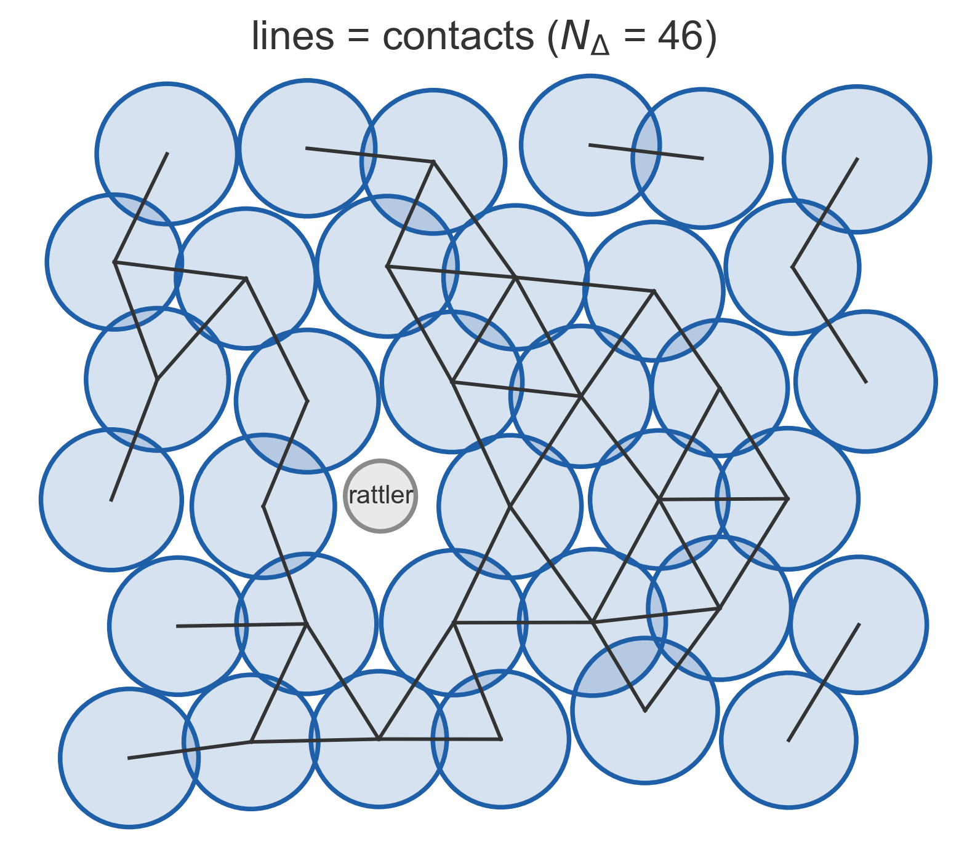
Contacts Are Constraints
• Each contact Δ fixes one distance: |x_{a} − x_{b}| = 2R and Δ_{ab} = 2R - |x_{a} − x_{b}|
• N_{Δ} equations in N unknowns: solutions need N_{Δ} ≤ N at jamming
• N excludes rattlers (gray) and global translations
Counting: [49] Tkachenko and Witten, PRE 60, 687 (1999), Sec. II
↔ each training datum imposes one constraint
9
Notes:
* N_Δ contacts → N_Δ equations for the N=Md particle coordinates → N_Δ ≤ N otherwise positions are overdetermined.
* Each such condition removes one dimension from the space of solutions, so N_Δ constraints in N degrees of freedom leave an (N − N_Δ)-dimensional family, which exists only if N_Δ ≤ N (Eq. 2).
* N counts only relevant degrees of freedom (remove rattlers and global translations)
* This assumes independent constraints, which holds for disordered packings.
Q: Compressed packings have more than 2d contacts per particle. Doesn't that contradict N_Δ ≤ N?
No. The counting holds at jamming, where contacts are exact tangencies. Above φ_J soft spheres overlap and gain contacts, and the excess grows continuously with compression.

Slide 10
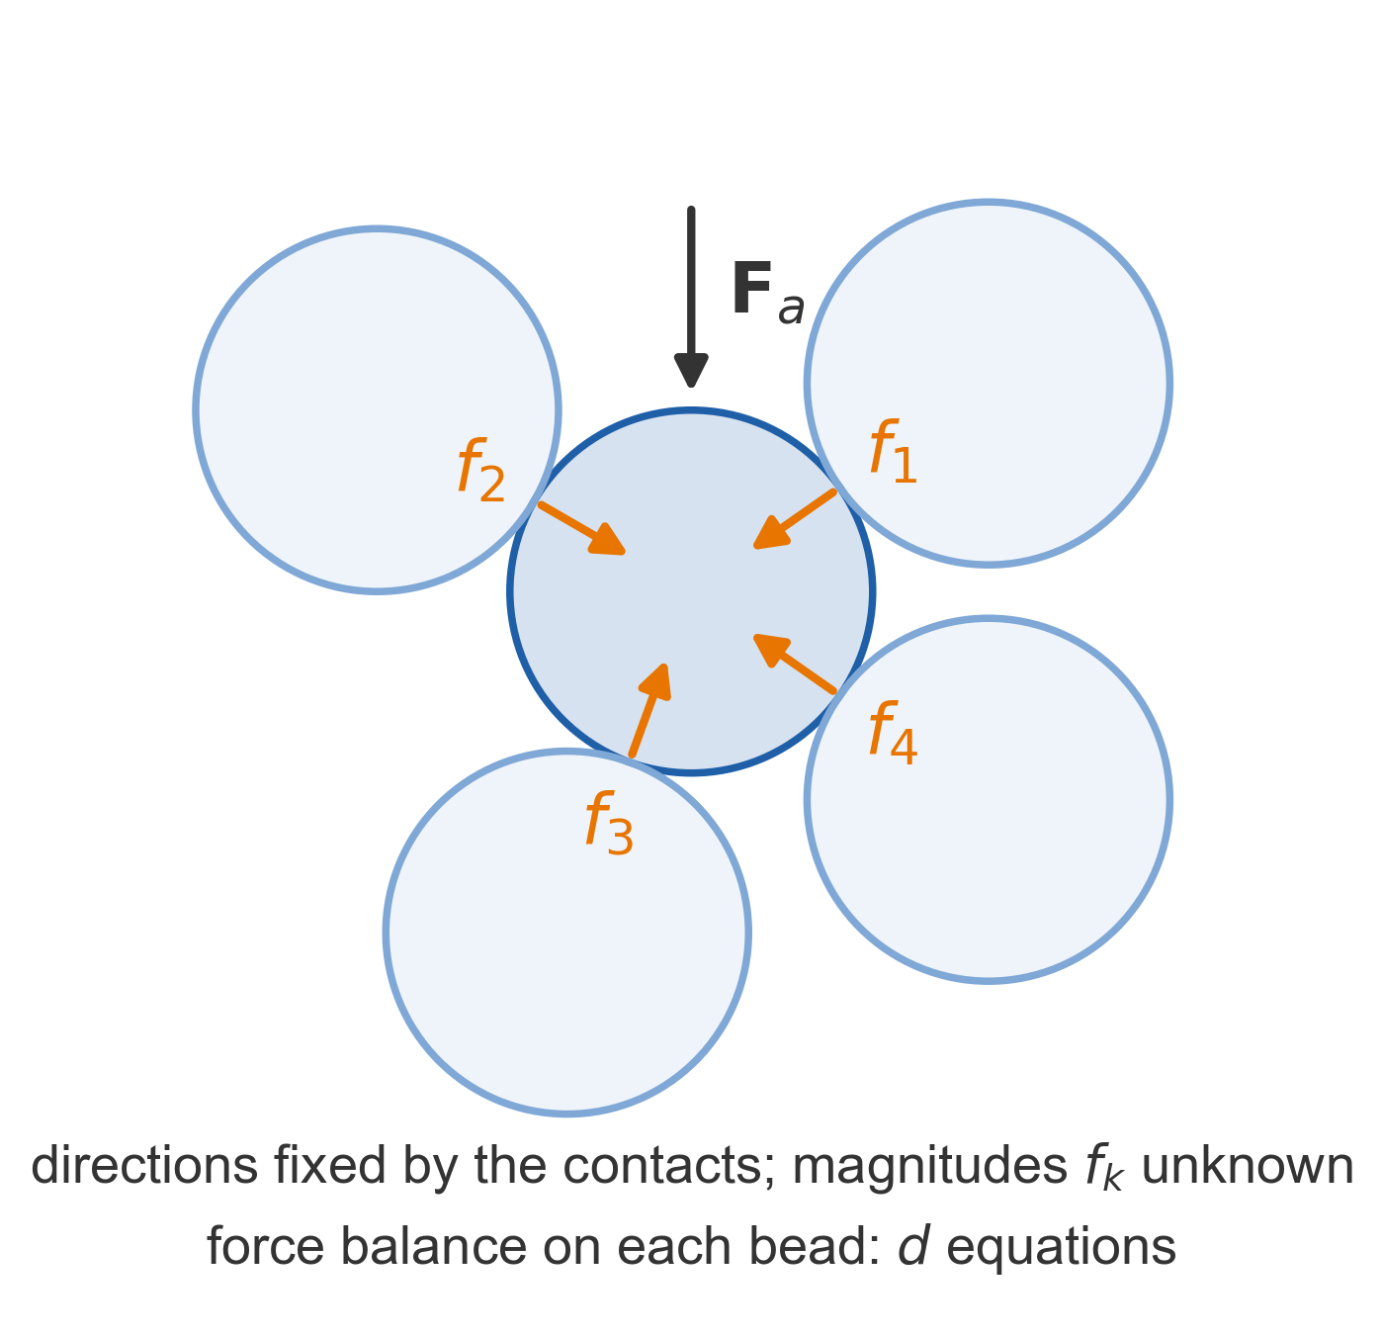
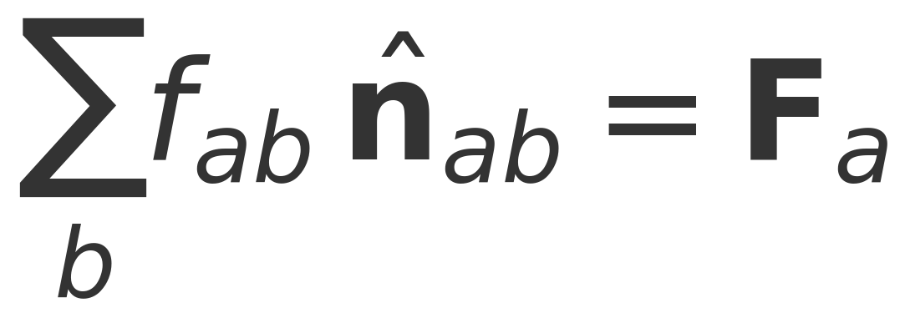
Stability: Spheres Need Enough Contacts (Force Balance)
• Stable: contact forces balance external load
• d force-balance equations per bead, N in all; unknowns: N_{Δ} forces
• Solvable only if N_{Δ} ≥ N;
↔ same Hessian split for the loss ↔ ~ Fisher information
10
Counting: [49] Tkachenko and Witten, PRE 60, 687 (1999), Sec. II
Notes:
* Each bead gives d force-balance equations, N=Md in total.
* The unknowns are the N_Δ contact-force magnitudes: their directions are fixed by the geometry, along the line of centres.
* With fewer unknowns than equations a generic load could not be balanced, so stability requires N_Δ ≥ N.
Q: What about friction?
Friction adds tangential force unknowns, so frictional packings can be stable with fewer contacts than 2d. Tkachenko & Witten note that friction also restores ordinary elastic force transmission. The squared hinge is the frictionless case: networks have no analogue of friction here.
Q: Does the force-balance count need forces to be repulsive?
No. Replacing contacts with springs that can pull as well as push leaves the count unchanged. It depends only on how many unknowns there are, not their sign.

Slide 11
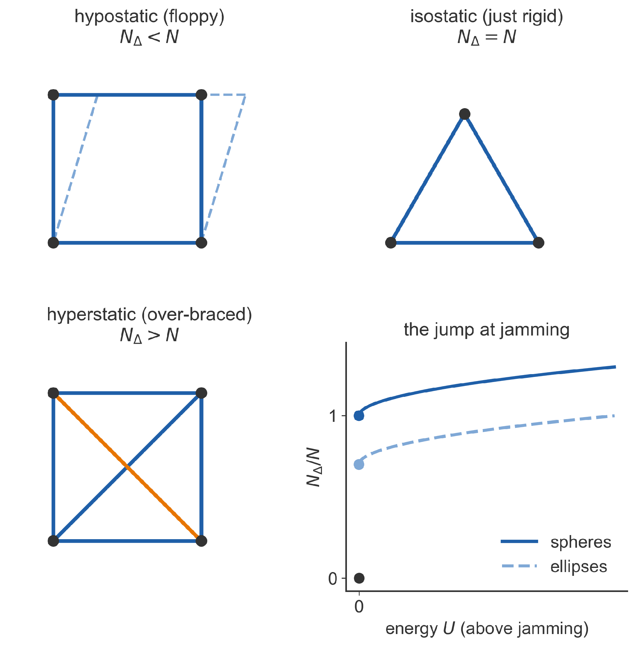
Hypostatic, Isostatic, Hyperstatic
• Spheres: N_{Δ} ≤ N and N_{Δ} ≥ N, so isostatic: N_{Δ} = N
• At φ_{J}, N_{Δ}/N jumps from 0 to a finite value
• Spheres jump to 1; other shapes can jump lower
Adapted from Geiger et al., PRE 100, 012115 (2019), Fig. 2(f)
↔ networks: count unsatisfied data per parameter
11
Notes:
* Too few bars and the frame is floppy (hypostatic); just enough and it is rigid with no redundancy (isostatic); more and some bars are redundant (hyperstatic).
* For spheres, the counting and stability bounds pin the jammed packing to isostaticity, observed numerically.
* Hallmark of jamming is discontinuous jump of N_Δ/N as the energy becomes positive
Q: Is N_Δ = N exact?
It holds on average for large systems. Finite packings have O(1) corrections from rattlers, global translations and boundary conditions.
Q: Does hypostatic mean unstable?
No. The floppy motions cost nothing at quadratic order but are blocked at higher order by the particles' curvature. This is Donev, Connelly, Stillinger & Torquato, PRE 75, 051304 (2007); check before quoting, since it isn't in the deck.

Slide 12
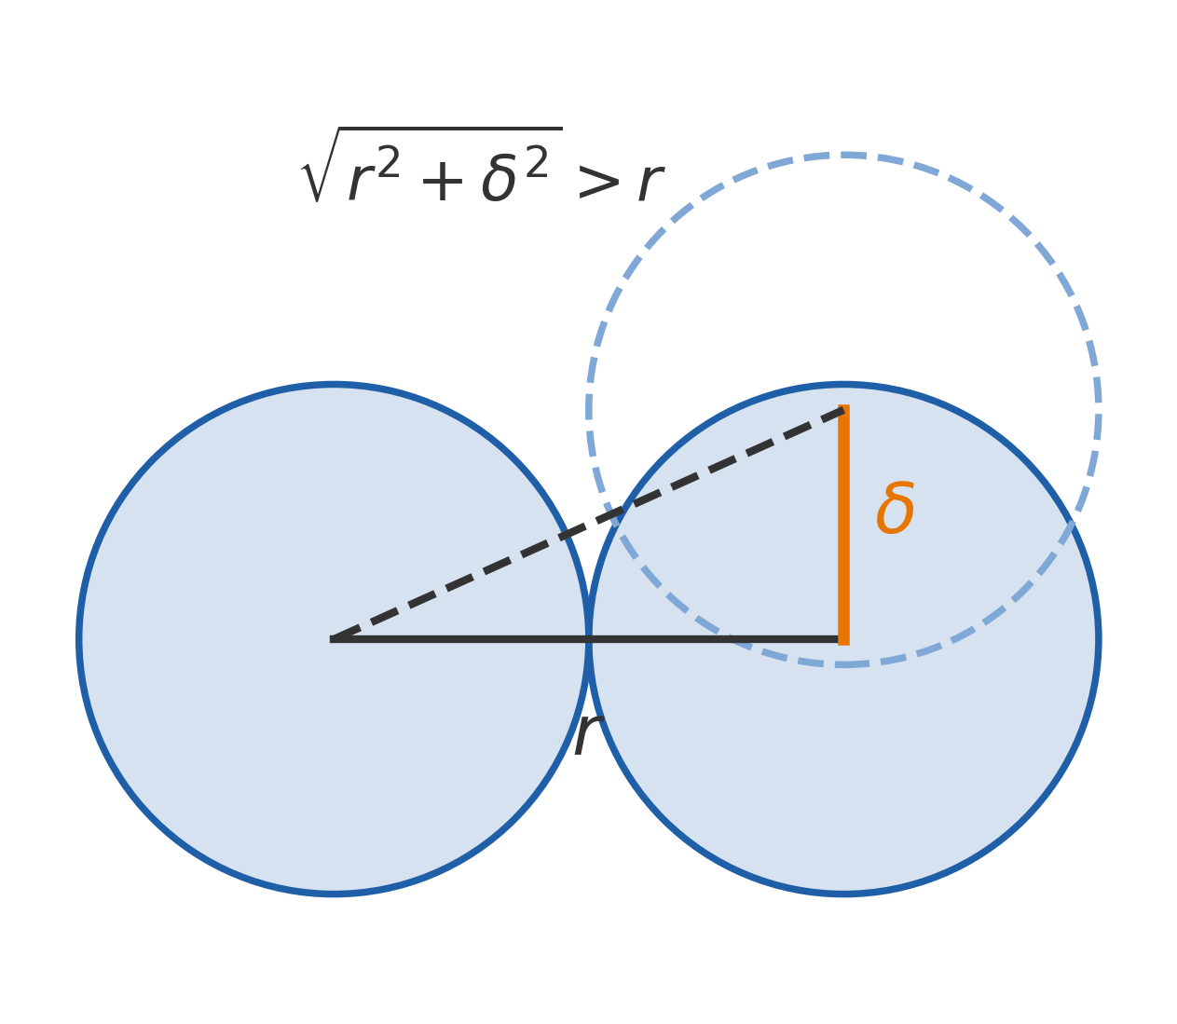
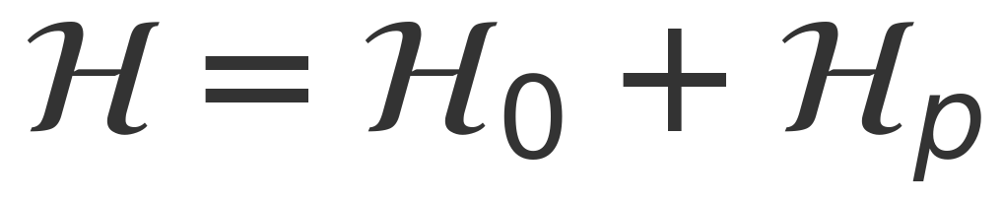
Stability: Spheres Need Enough Contacts (Dynamical Matrix)
• H₀: “stiffness”, stretching contacts; PSD, rank ≤ N_{Δ}
• H_{p}: “pre-stress”; sideways motion lengthens distances; NSD
• Floppy modes of H₀ would be unstable: N_{Δ} ≥ N
↔ same Hessian split for the loss ↔ ~ Fisher information
10
Notes:
* Stable packing needs a PSD Hessian, which splits into two pieces: H_0 is a sum of N_Δ rank-one terms, so it has at least N − N_Δ zero modes.
* “Stiffness” term is positive semidefinite (eigenvalues \geq 0): penalizes contacts along their line of centers.
* “Pre-stress” term is negative semidefinite (eigenvalues \leq 0) for repulsive, compressed contacts: lowers the energy for sliding transverse to contacts.
* For spheres H_p is negative definite: moving a particle sideways increases its distance to a neighbor, relaxing the compression.
* Any zero mode of H_0 would therefore be unstable, so stability requires N_Δ ≥ N.

Slide 13
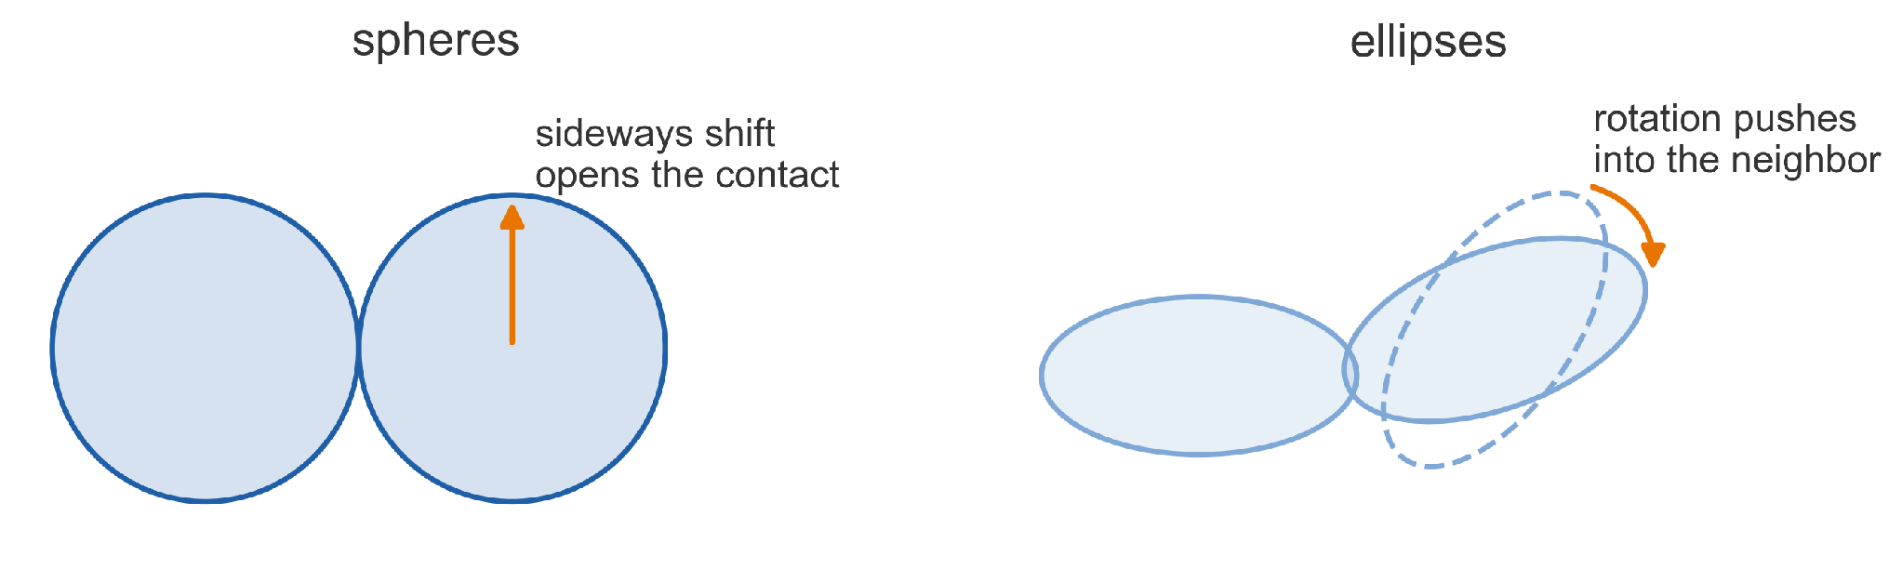
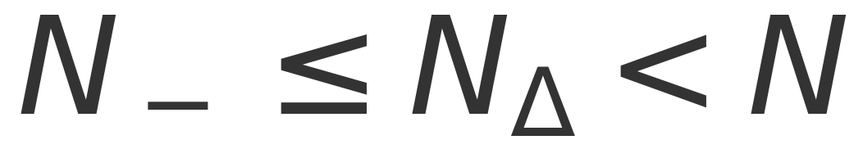
Ellipses Can Be Stable With Fewer Contacts
• Rotating an ellipse can push into its neighbor: H_{p} has both signs
• Only its N₋ negative directions need covering: N_{Δ} ≥ N₋
• Ellipses jam with N_{Δ} < N: hypostatic
↔ deep networks will jam like ellipses
12
Notes:
* For ellipses the stability argument breaks: rotations can bring surfaces closer, so H_p is no longer negative definite
* Stability now only requires that the kernel of H_0 avoids the N_− negative directions of H_p, giving N_Δ ≥ N_−
* Ellipses therefore jam hypostatically, with N_Δ/N < 1
Q: Why doesn't the sphere argument force ellipses to N_Δ = N?
Ellipses can also rotate, and rotating one can push it into its neighbour. So H_p has positive directions as well as negative ones, and only its N₋ negative directions need contacts to stabilize them. That allows N_Δ < N.
[end by ~13.5 min]

Slide 14
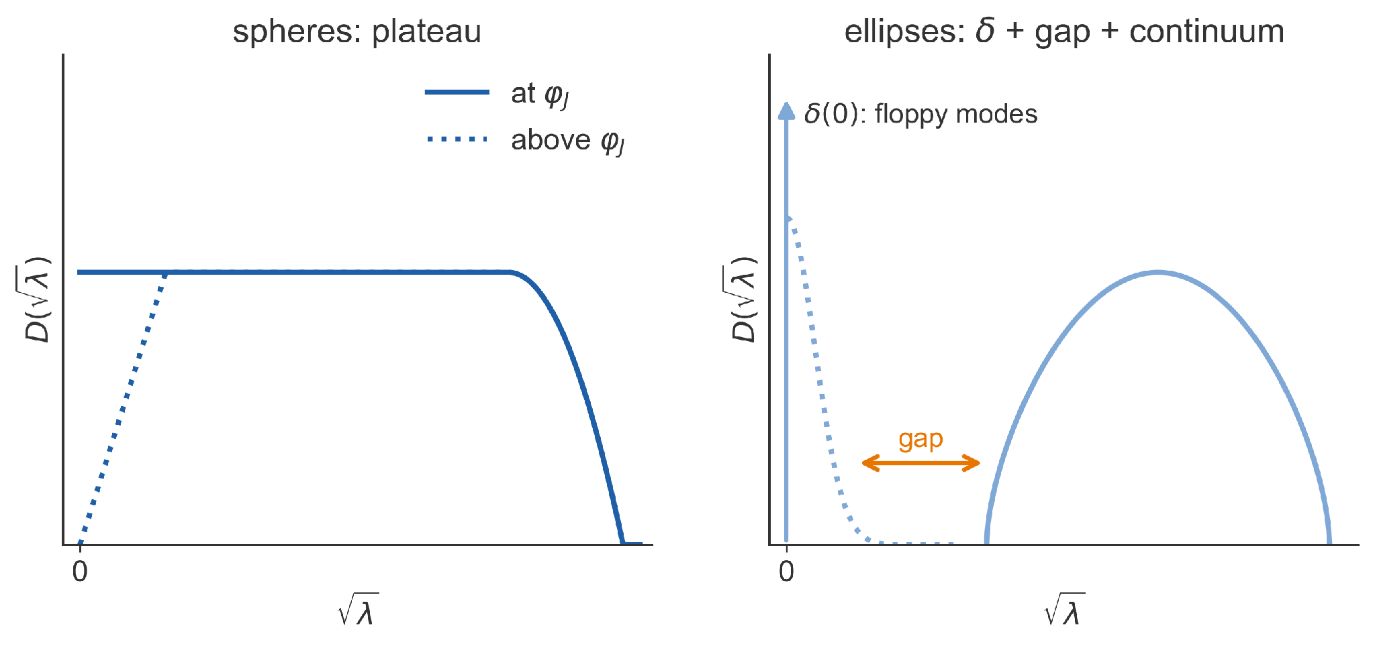
Fingerprint in the Vibrational Spectrum
• Spheres: flat density of modes down to λ → 0
• Ellipses: a δ-peak of weight 1 − N_{Δ}/N (floppy modes), a gap (mean-field args), followed by a continuum
• Above φ_{J}: a scale λ ~ √U appears (dotted)
• Universality class from the spectrum without counting contacts: plateau = isostatic; spike + gap = hypostatic.
↔ the same test is applied to the loss Hessian
Adapted from Geiger et al., PRE 100, 012115 (2019), Fig. 2(g,h)
13
Notes:
* The Hessian's eigenvalue spectrum, the vibrational density of states, distinguishes the classes.
* Isostatic spheres show a plateau extending to zero frequency.
* Hypostatic ellipses show a delta function at zero with weight 1 − N_Δ/N, the kernel of H_0, then a gap, then a continuum.
* Moving above jamming, H_p switches on and introduces a scale proportional to the typical overlap, √U, which broadens the delta peak.
Q: Why is the spike's weight 1 − N_Δ/N?
H₀ is a sum of N_Δ rank-one terms, so it has at least N − N_Δ zero eigenvalues; dividing by N gives the fraction. At φ_J the overlaps vanish, so H_p → 0 and those zero modes are exactly zero.
Q: If ellipses have floppy modes, why are they stable?
The floppy motions cost nothing at quadratic order but are blocked at higher order by the particles' curvature.
Q: Why √λ rather than λ on the axis?
It's frequency, the physical vibrational variable,

Slide 15
Two Universality Classes
 | Spheres | Ellipses
Constraints at jamming | N_{Δ}/N = 1 (isostatic) | N_{Δ}/N < 1 (hypostatic)
Pre-stress term H_{p} | negative definite | both signs
Spectrum at jamming | plateau to λ → 0 | δ(0) + gap + continuum
Above jamming | scale λ ~ √U | δ-peak broadened by √U
Hard spheres same (class) as soft spheres • Spheres different (class) as ellipses
Into which class do DNNs fall?
14
Notes:
* Everything in the right column follows from H_p having both signs.

Slide 16
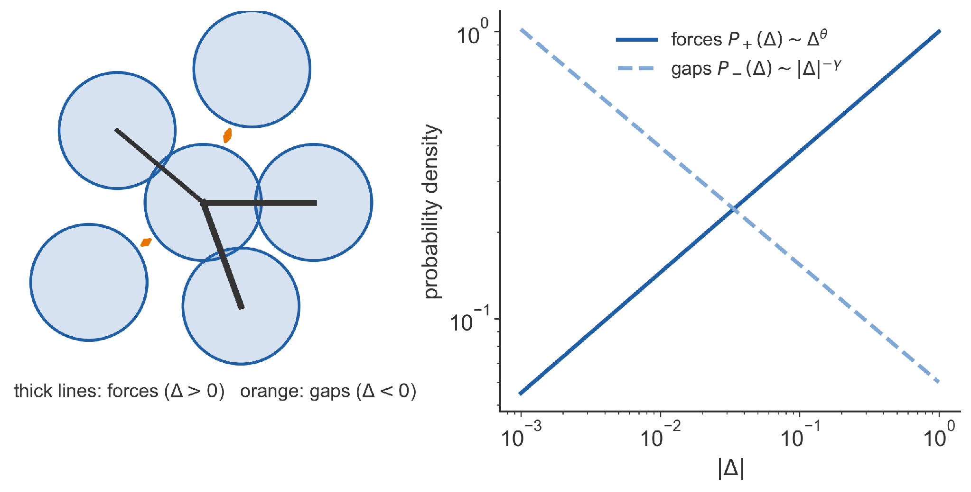
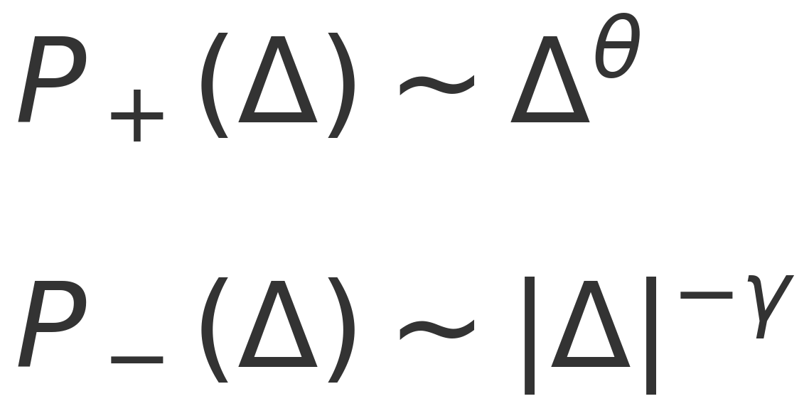
Forces and Gaps
• Δ > 0: contacts carrying force; Δ < 0: gaps to near-contacts
• Both distributions are power laws near φ_{J}
• Many weak forces and small gaps: tiny pushes change the contacts
↔ Δ > 0: unsatisfied data; Δ < 0: satisfied data
15
Notes:
* Beyond the Hessian, the distributions of positive overlaps (forces) and negative overlaps (gaps) carry information.
* Near jamming both are critical: P-positive vanishes as a power θ at small force, and P-negative diverges with exponent γ at small gaps
* An abundance of weak contacts and nearly closed gaps → the packing is always close to changing its contact network.
Q: Why do many weak forces and small gaps imply avalanches?
A tiny perturbation can break a weak contact or close a small gap. Because the packing has no spare contacts, that change spreads to its neighbours, so rearrangements cascade with no typical size.

Slide 17
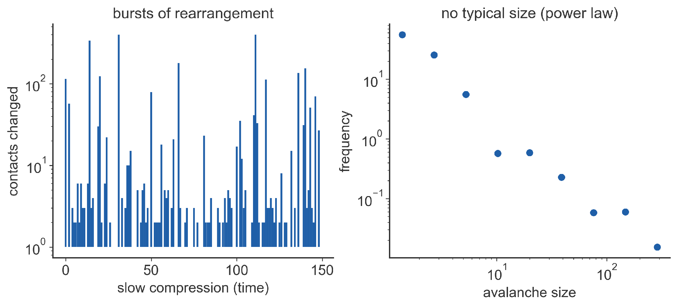
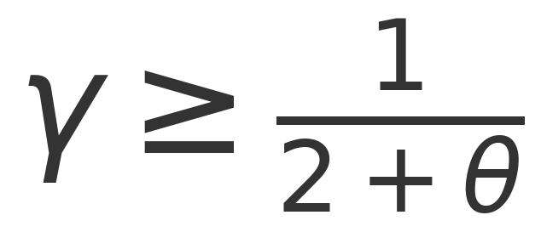
Marginal Stability and Avalanches
• Stability requires γ ≥ 1/(2 + θ); jammed packings saturate it
• θ = 0.42311…, γ = 0.41269… (exact in infinite dimensions, accurate in 2D and 3D)
• Marginal: bursts of rearrangement and a hierarchical landscape
Geiger et al., PRE 100, 012115 (2019), Sec. II A; Refs. [42, 45, 57]
16
Notes:
* If gaps close too easily relative to how weak the forces are, the packing is unstable, which gives the bound γ ≥ 1/(2 + θ) of Wyart (Ref. [42]). Refs. [42, 57] give two bounds; Ref. I quotes γ ≥ (1 − θ)/2, which the exponents satisfy but do not saturate.
* The bound they saturate is γ ≥ 1/(2 + θ), which is what the slide states.
* Jammed packings sit exactly on the bound: they are marginally stable, respond through power-law avalanches, and have a hierarchical, replica-symmetry-breaking landscape (Ref. [45]).
Q: The paper prints γ ≥ (1−θ)/2. Why does the slide say 1/(2+θ)?
The cited works (Refs. [42, 57]) give two bounds. The quoted exponents satisfy (1−θ)/2 but don't saturate it; they saturate 1/(2+θ): 1/2.42311 = 0.41269.
Q: Are the infinite-dimension exponents right in 2D and 3D?
Ref. I says they "appear accurate even in finite dimensions", citing numerics (Refs. [57, 62]) that agree once localized buckling modes are removed.

Slide 18
Part 1 Cheat Sheet
• Sharp transition at φ_{J}: U = 0 below, U > 0 above
• N_{Δ}/N jumps at φ_{J}: to 1 (spheres) or below 1 (ellipses)
• Spectrum at φ_{J}: plateau (spheres) or δ(0) + gap + continuum (ellipses); scale √U above
• Power laws in (force) P₊ ~ Δ^{θ}, (gap) P₋ ~ |Δ|^{−γ};
(spheres: θ ≈ 0.42, γ ≈ 0.41)
17
Notes:
* Each bullet is a prediction we will test for neural networks in Part 2:
whether there is a sharp transition, the height of the jump, the shape of the Hessian spectrum, and the power laws.

Slide 19
Part 2
When Can a Network Fit Its Data?
(Deep) NNs → Loss landscape → Jamming analogies → Predictions
Notes:
* Part 2 assumes no machine-learning background.
* We first build the network and its loss, then map them onto the particle problem, then go through the paper's results in order.
[end by ~20.5 min]

Slide 20
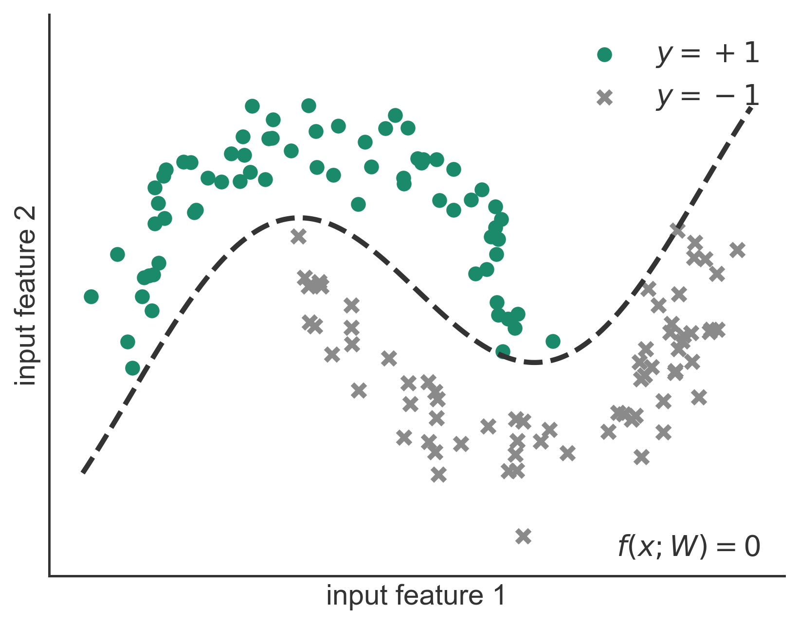
Learning Means Fitting Labeled Examples
• P training examples: input x_{μ} (e.g., an image) and label y_{μ} = ±1
• A network is a function f(x; W) with N parameters W
• Prediction: the sign of f(x_{μ}; W)
↔ examples μ are the analog of particle pairs (ij)
19
Notes:
* Supervised learning in its simplest form is binary classification.
* Each example is an input vector, such as the pixels of an image, with a label plus or minus one.
* The network is a flexible function with adjustable parameters; the sign of its output is the predicted label, and training means choosing the parameters so that the predictions match.
Q: Why binary classification?
The loss then depends only on y·f, which maps directly onto a particle overlap. The paper also shows a multiclass hinge loss matching cross-entropy on CIFAR-10.

Slide 21
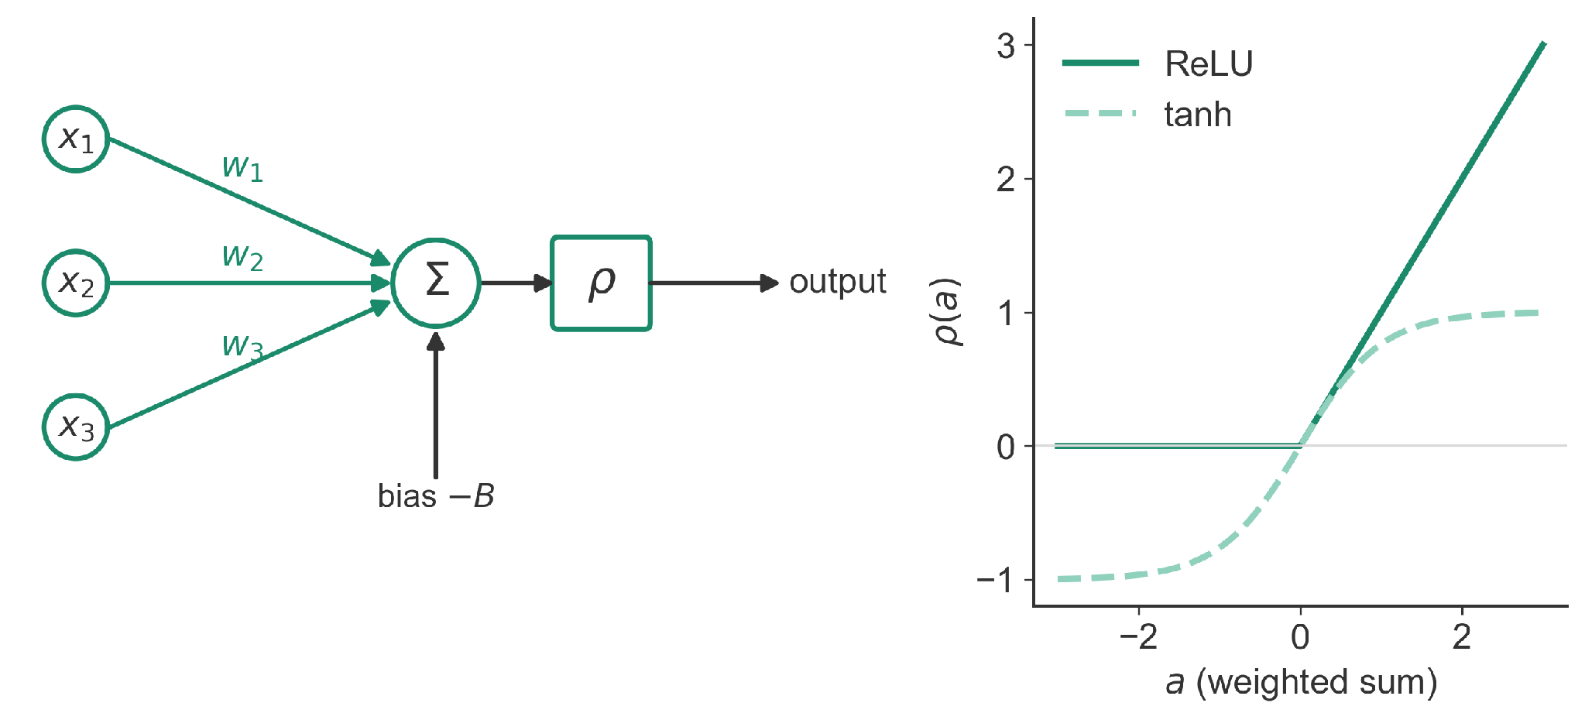
One Neuron
• Weighted sum of inputs minus a bias, then a nonlinearity ρ
• ReLU: ρ(a) = max(0, a); or tanh
• With no hidden layer (the perceptron), learning already jams, like spheres [33, 34]
• How do hidden layers change dynamics, if at all?
[33] Franz et al., SciPost Phys. 2, 019 (2017); [34] Franz and Parisi, J. Phys. A 49, 145001 (2016)
20
Notes:
* A neuron multiplies each input by a weight, adds them up, subtracts a bias, and passes the result through a nonlinear activation function.
* The rectified linear unit, ReLU, is the most common choice; the paper also tests tanh.
* The simplest network, the perceptron, was already shown to jam in the same universality class as spheres (Refs. [33, 34]).

Slide 22
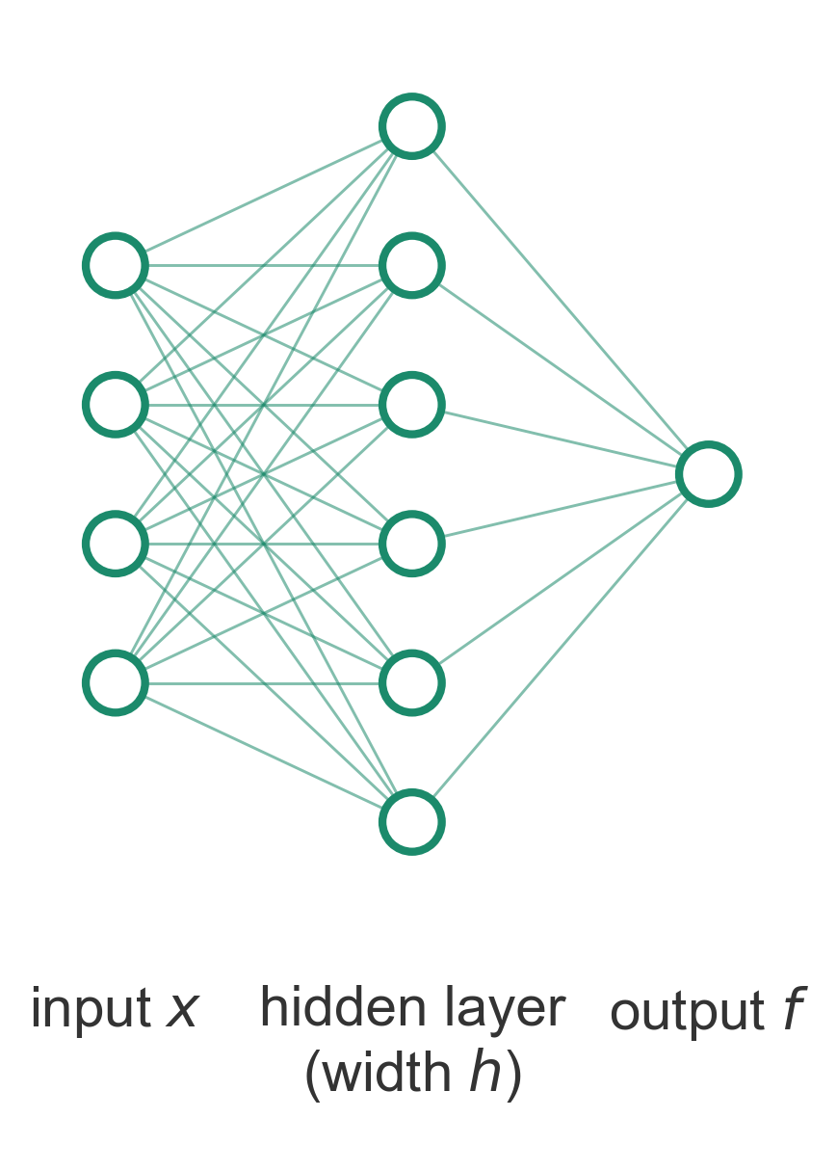
Stacking Neurons: A Network
• Each connection is one weight; each neuron adds one bias
• W = all weights and biases, N in total; these play the role of particle DoFs
• Here: one hidden layer of width h
↔ weights W are the analog of particle positions
21
Notes:
* Wire many neurons together: every line is a separate weight.
* Collect all weights and biases into one long vector W with N entries.
* These N numbers are the degrees of freedom, just as particle coordinates were in Part 1.

Slide 23
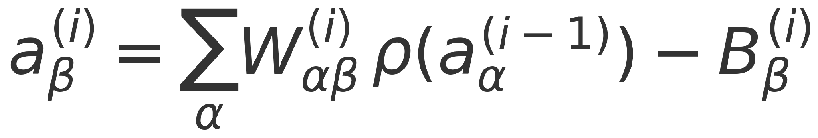
Stacking Layers: A Deep Network
• L hidden layers, indexed by i, each of width h
• N ≈ L h² when the input size d = h
• Output f(x; W) is a single number
• Outputs of the hidden layers:
Adapted from Geiger et al., PRE 100, 012115 (2019), Fig. 3
↔ weights W are the analog of particle positions
21
Notes:
* A deep fully connected network repeats the hidden layer L times
* Each layer's neurons compute weighted sums of the previous layer's activities.
* The paper keeps depth L fixed and varies the width h to change N.

Slide 24
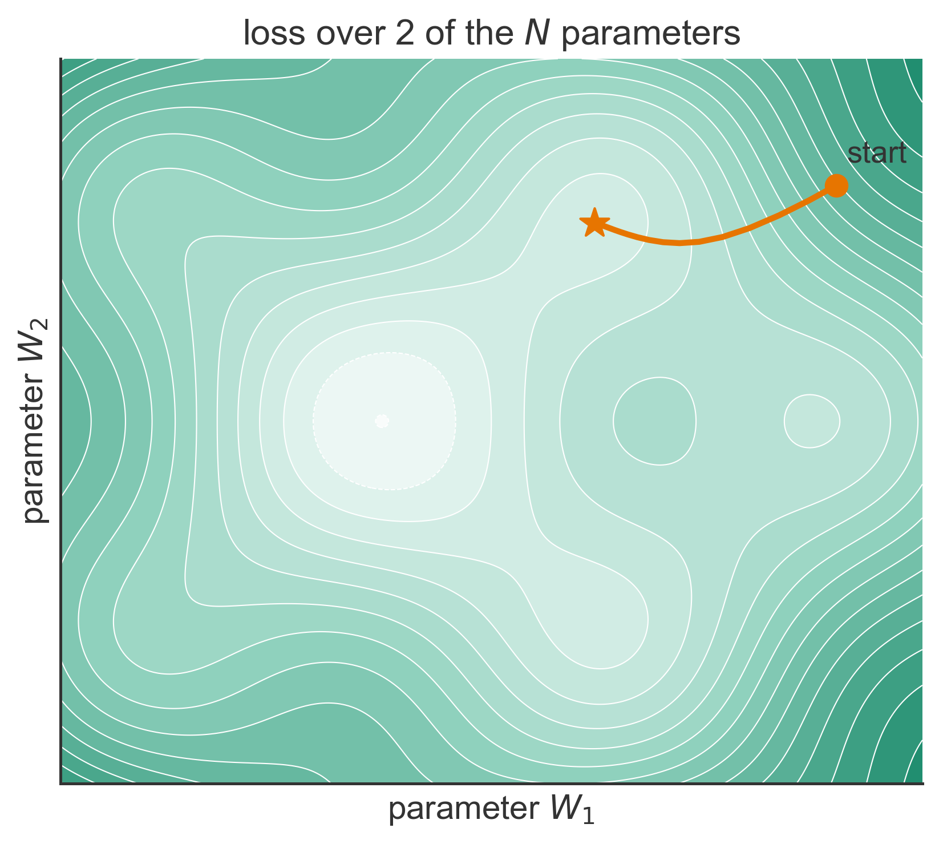
Training: Rolling Downhill
• Loss = average penalty over the P training examples
• Gradient descent: step W against the gradient of the loss
• Non-convex: many valleys. Do we get stuck?
↔ loss is the analog of the energy U; training minimizes energy
22
Notes:
* Training defines a loss, the average over examples of a per-example penalty, and moves the parameters downhill.
* In practice this is stochastic gradient descent or ADAM; the paper uses both
* The landscape lives in N dimensions and is non-convex, which is exactly the situation of a particle packing's energy landscape.
Q: Gradient descent or SGD?
The hinge experiments use full-batch ADAM. The transition's exact location depends mildly on the training dynamics, just as φ_J depends mildly on the packing protocol.

Slide 25
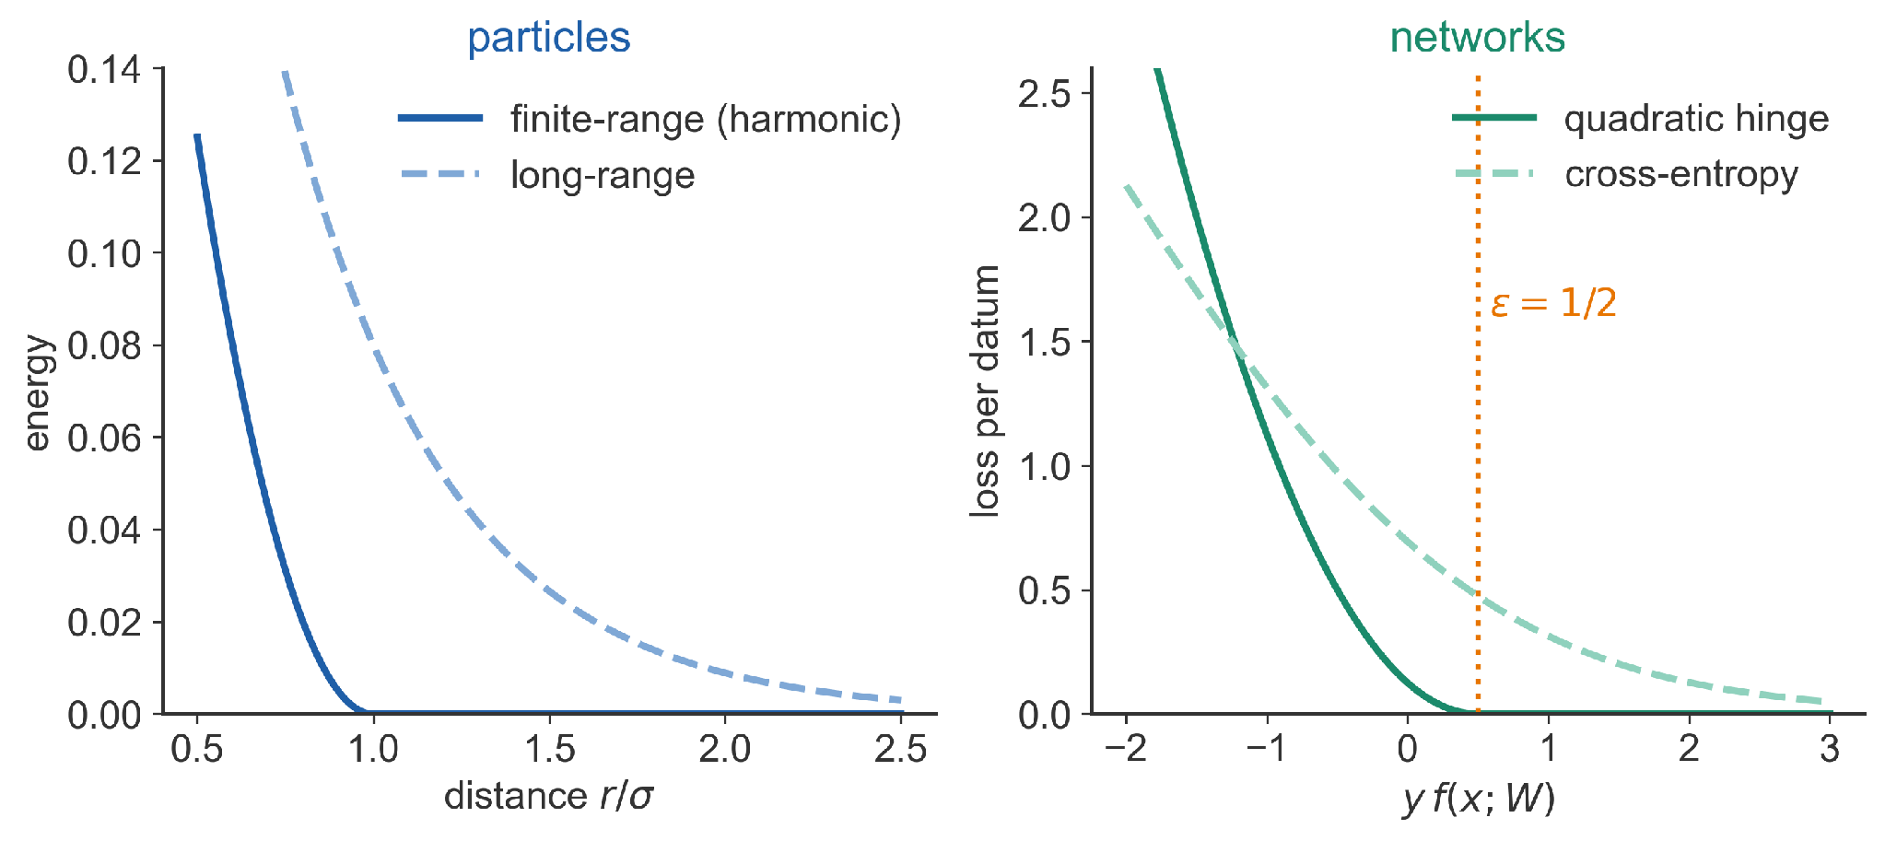
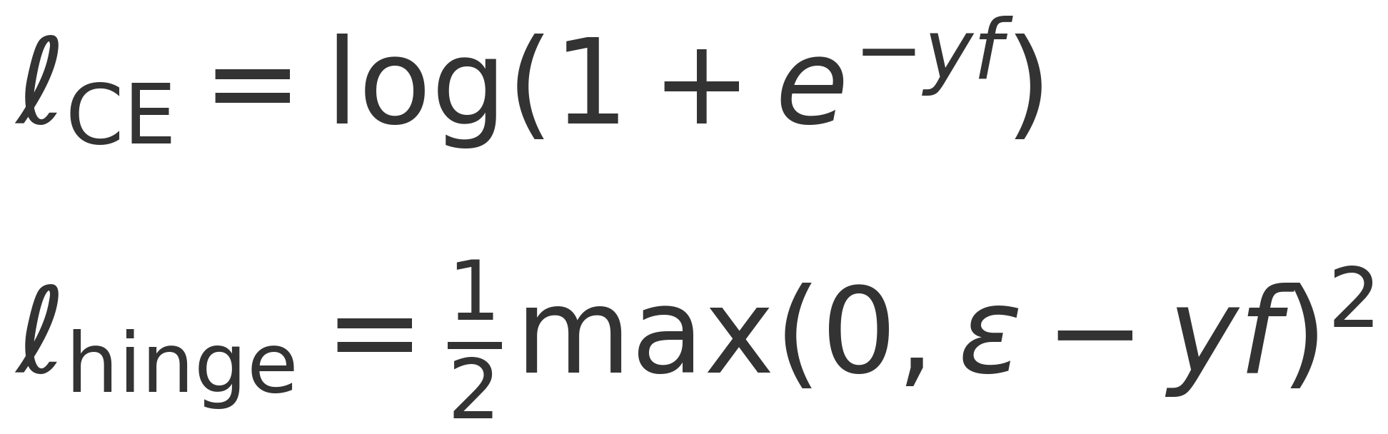
Two Choices of Loss
• Cross-entropy: never exactly zero, a long-range penalty
• Quadratic hinge: zero once y f ≥ ε, a finite-range penalty
• The hinge loss makes the transition sharp
Adapted from Geiger et al., PRE 100, 012115 (2019), Fig. 4
↔ hinge loss is the analog of the finite-range soft-sphere potential
23
Notes:
* Cross-entropy is the standard classification loss; it decays but never reaches zero, like a long-range interaction.
* The quadratic hinge loss vanishes once an example is classified correctly by a margin ε = 1/2, like a finite-range potential that vanishes once particles separate.
* With cross-entropy the weights drift forever and finite training time blurs the transition, so the paper's sharp analysis uses the hinge.
Q: Why the quadratic hinge rather than the ordinary hinge?
½·max(0, ε − yf)² is exactly the harmonic contact energy, and its first derivative is continuous at the margin, so the Hessian is defined there.
Q: Why ε = 1/2?
ε only sets the loss scale: any ε > 0 is equivalent after rescaling the output
Q: Doesn't the hinge loss hurt accuracy?
On CIFAR-10 with a state-of-the-art architecture, three hinge runs gave 3.61–3.82% test error against 3.72% for cross-entropy.
[end by ~26 min]

Slide 26
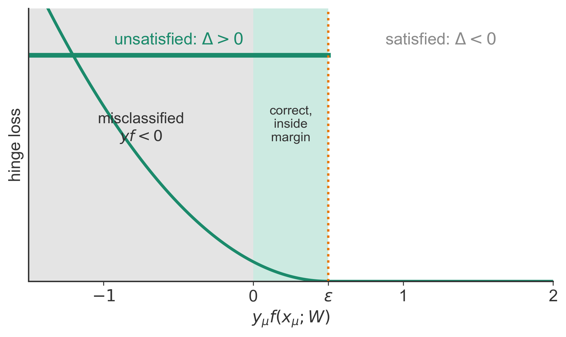
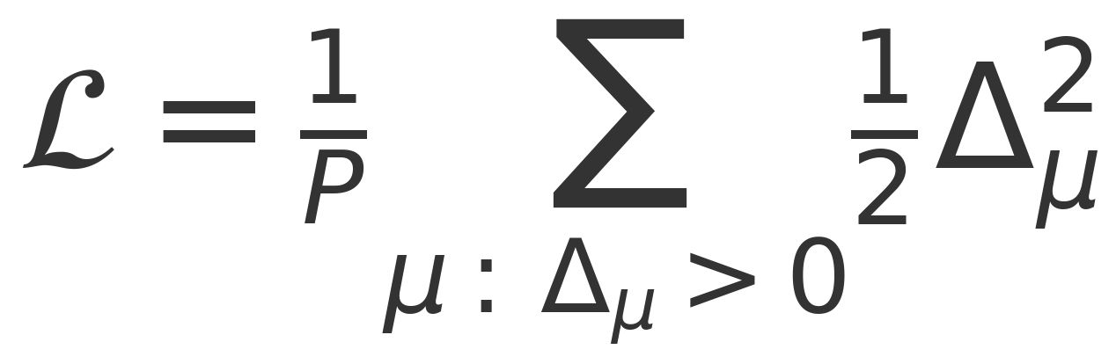
The Hinge Loss Is a Soft-Sphere Energy
• Data overlap Δ_{μ} = ε − y_{μ} f(x_{μ}), N_{Δ} of them
• Δ_{μ} > 0: datum unsatisfied
• Unsatisfied ≠ misclassified
(y f < 0)
• CIFAR-10 test error: 3.61–3.82% (hinge) vs. 3.72% (cross-entropy)
↔ unsatisfied data are the analog of contacts: N_{Δ} counts both
24
Notes:
* Define the overlap of example μ as ε minus y times f.
* When it is positive the example is unsatisfied and contributes ½Δ² to the loss, which is formally identical to the harmonic soft-sphere energy
* Unsatisfied includes correctly classified examples that sit inside the margin.
* The hinge loss is not a toy: on CIFAR-10 with a state-of-the-art architecture it matches cross-entropy (three hinge runs versus 3.72% for cross-entropy).

Slide 27
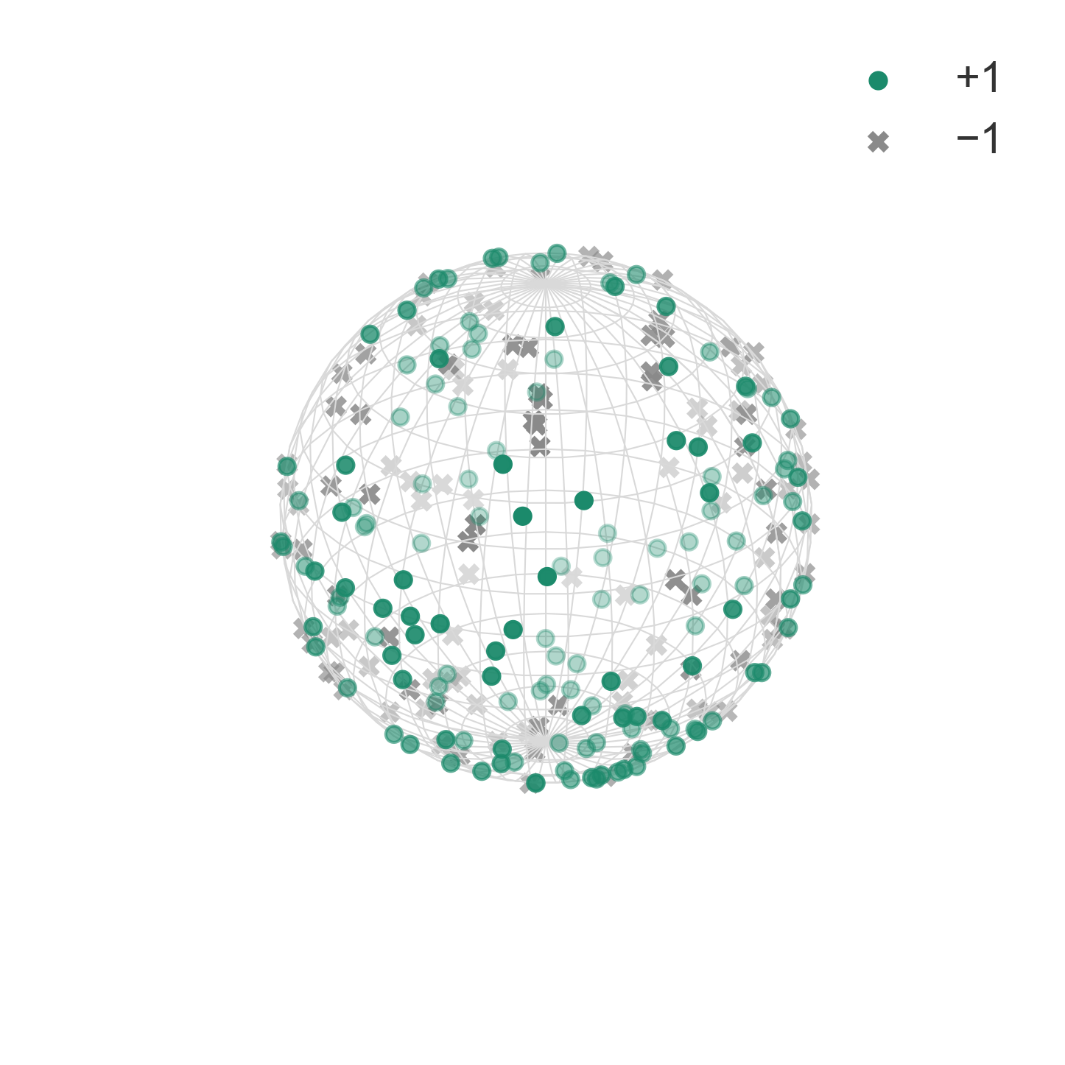
Analogies
Particles |  | Neural networks
Positions of particles (N degrees of freedom) | ↔ | Parameters of the network (N degrees of freedom)
Pairs of particles (ij) | ↔ | Training patterns μ
Energy U | ↔ | Loss
Geiger et al., PRE 100, 012115 (2019), Table I
25
Notes:
* Prior to making predictions, establish dictionary of analogies
* Parameters play the role of particle coordinates, each training example plays the role of a pair of particles that may or may not be in contact, and the loss plays the role of the energy.
Q: What plays the role of particle shape?
The architecture and activation function, because they set the sign structure of H_p. ReLU gives C₀ = ½ and tanh gives C₀ ≈ 0.43. There is no temperature, since training is a zero-temperature descent.

Slide 28
Analogies
Particles |  | Neural networks
Positions of particles (N degrees of freedom) | ↔ | Parameters of the network (N degrees of freedom)
Pairs of particles (ij) | ↔ | Training patterns μ
Energy U | ↔ | Loss
Long-range interaction | ↔ | Cross-entropy (for instance)
Finite-range interaction | ↔ | Hinge loss
Packing fraction φ | ↔ | Data per parameter P/N
25
Notes:
* Second step: the choice of loss is the choice of interaction range, and the ratio P/N is the analog of the packing fraction.
* More data per parameter means a denser, harder-to-satisfy system.
[end by ~28.5 min]

Slide 29
Analogies
Particles |  | Neural networks
Positions of particles (N degrees of freedom) | ↔ | Parameters of the network (N degrees of freedom)
Pairs of particles (ij) | ↔ | Training patterns μ
Energy U | ↔ | Loss
Long-range interaction | ↔ | Cross-entropy (for instance)
Finite-range interaction | ↔ | Hinge loss
Packing fraction φ | ↔ | Data per parameter P/N
Separate two particles | ↔ | Fit a datum
Force distribution | ↔ | Density of unsatisfied patterns P₊(Δ)
Gap distribution | ↔ | Density of satisfied patterns P₋(Δ)
25
Notes:
* Final step: fitting a datum corresponds to separating two particles, and the distributions of unsatisfied and satisfied patterns correspond to force and gap distributions.
* This is Table I of the paper, verbatim apart from formatting.
[end by ~29.5 min]

Slide 30
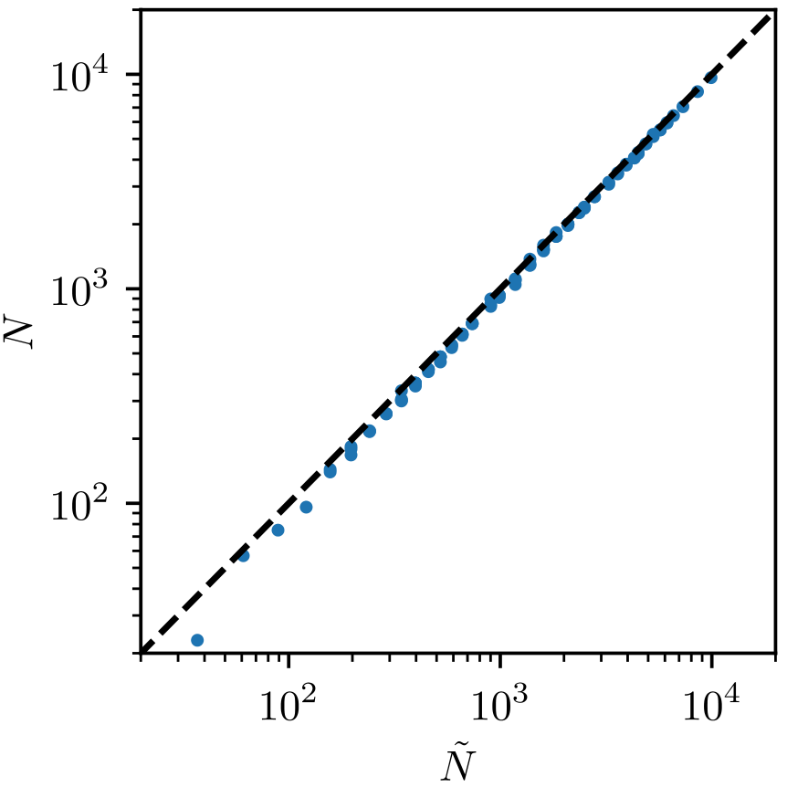
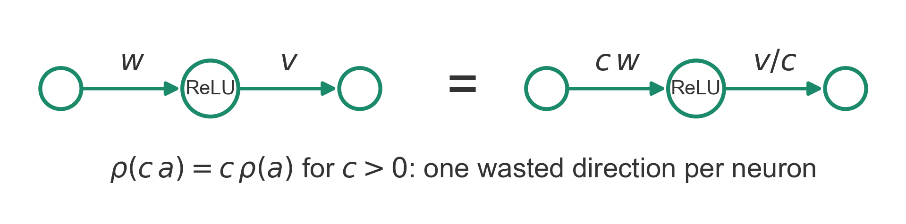
Effective Number of Parameters
N_{eff}
Ñ
• Only directions that change the output count: N_{eff} ≤ N; the rest are zero modes
• N_{eff} < N from: no signal propagation, linear ρ, dead neurons, ReLU rescaling
• Measured (left): N_{eff} ≈ N − (number of hidden neurons); Ñ is total # parameters
Geiger et al., PRE 100, 012115 (2019), Fig. 11 (left)
↔ lost directions analogous to rattlers and global translations
26
Notes:
* Just as rattlers and global translations do not count as degrees of freedom, some parameter directions do not change the network's output.
* N_eff is the dimension of the space of functions reachable by small changes of W (Sec. II B 3, App. A).
* For ReLU, scaling a neuron's input weights up and output weight down leaves the output unchanged, wasting one direction per neuron.
* With proper initialization that is the only loss, so N_eff ≈ N.
Q: How is N_eff measured?
As the rank of the matrix of output gradients ∇_W f, evaluated at each training point plus d nearby points
Columns are directional derivatives of a gradient → rank counts independent ways the function can be changed by moving W = tangent-space dimension; let `N_eff` be the dimension(tangent space) at the current W.
Q: Why subtract the number of hidden neurons?
ReLU rescaling: multiplying a neuron's incoming weights by c and dividing its outgoing weight by c leaves the output unchanged.

Slide 31
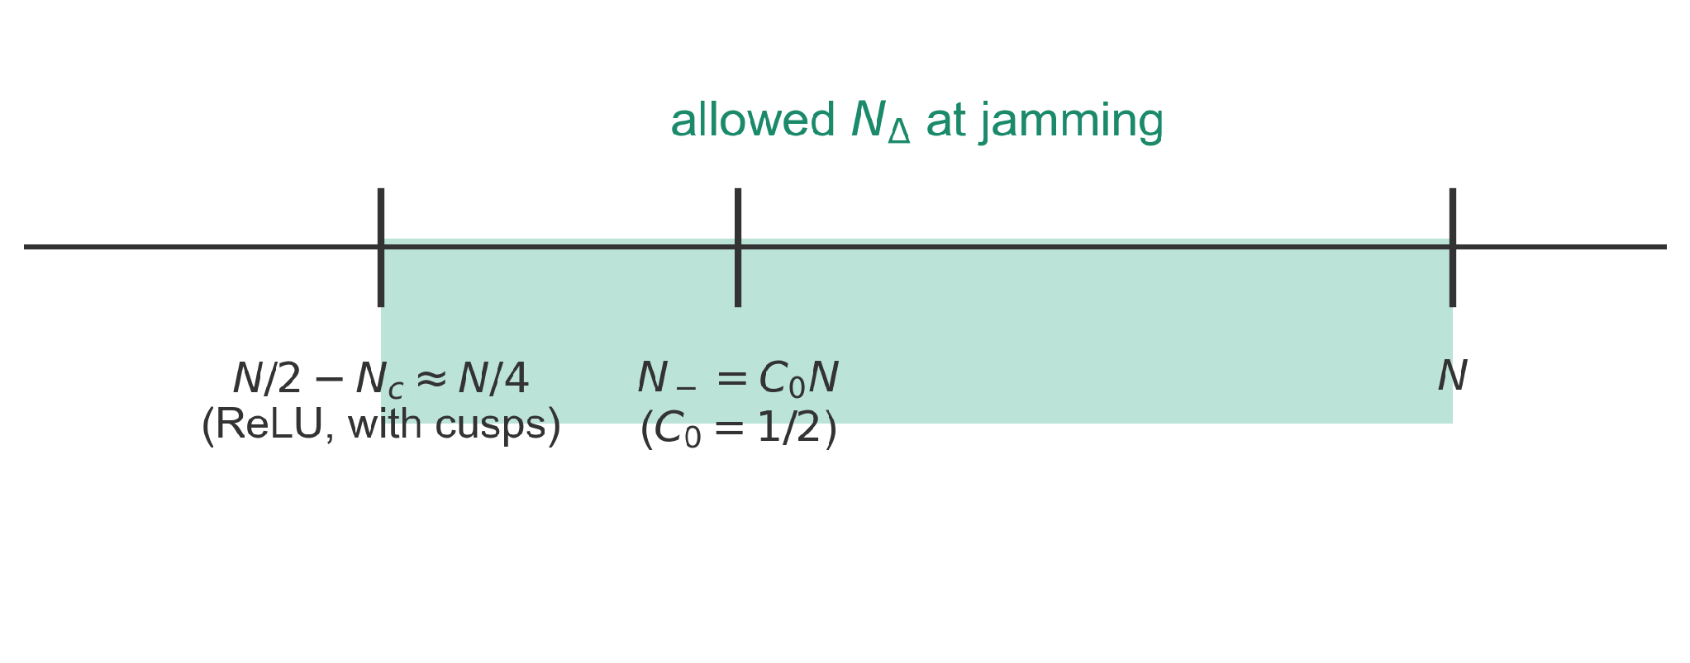
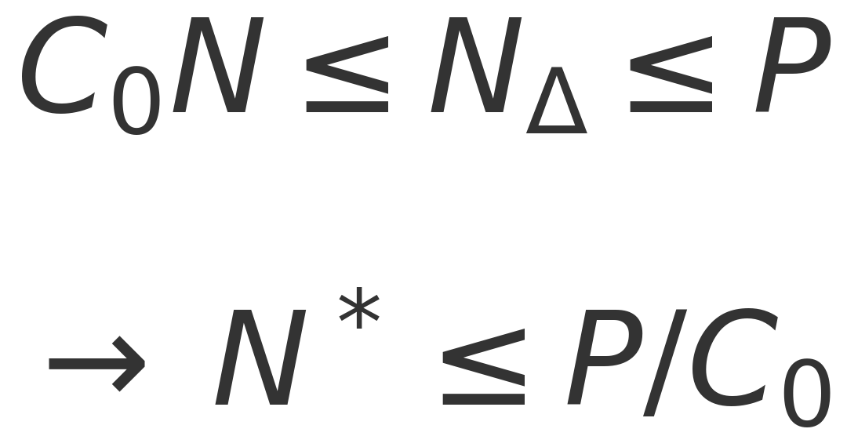
Counting Constraints for a Network
• A minimum with loss > 0 needs N_{Δ} ≥ N₋ = C₀N
• N_{Δ} ≤ P (trivially), so no bad minima when N > P/C₀
• ReLU: C₀ = ½ by a sign symmetry; cusps soften it to ≈ N/4, so N* ≤ 4P
↔ the same counting as for ellipses
27
Notes:
* The particle argument from Part 1 is re-run on a network's loss. It gives an upper bound on where the jamming transition can sit, N* ≤ P/C₀
* The loss Hessian splits into H_0 and H_p exactly as for particles (quadratic hinge loss).
* If a fraction C_0 of H_p's eigenvalues are negative, a stable minimum with positive loss needs at least C_0 N unsatisfied data, but there are only P data: so for N > P/C_0 no such minimum exists
* For ReLU with random data, flipping the sign of the last layer and of the labels shows H_p's spectrum is symmetric, C_0 = ½
* ReLU cusps stabilize N_c ≈ 0.21–0.25 N extra directions, giving N* ≤ 4P; for tanh, C_0 ≈ 0.43.
Q: Why is H_p's spectrum symmetric?
With random labels, flipping the signs of both the last-layer weights and the labels leaves the loss unchanged. That forces the odd traces to vanish, so there are as many negative as positive eigenvalues: C₀ = ½
Q: What are "cusps"?
Directions along which a ReLU's input sits exactly at zero (about 0.21–0.25 N of them). The second derivative is undefined there, so a minimum can sit on a cusp without being Hessian-stable. That weakens the bound from N* ≤ 2P to N* ≤ 4P.

Slide 32
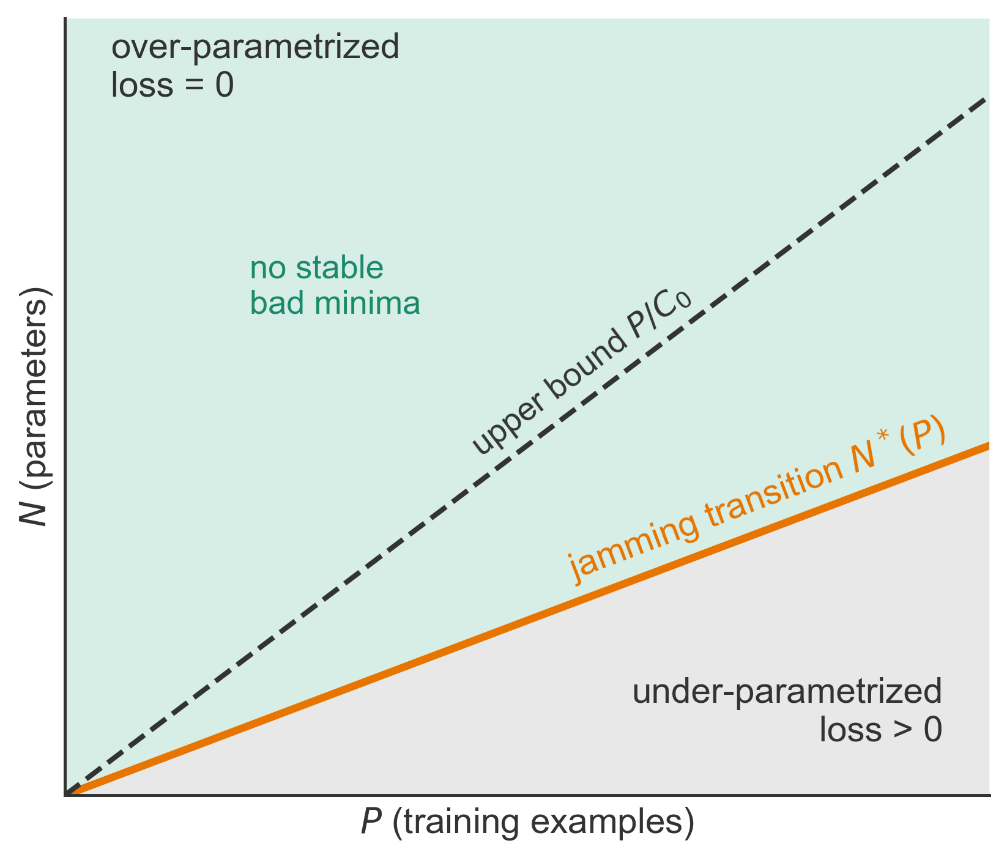
Predictions
• A sharp transition at N*(P) ≤ P/C₀
• N_{Δ}/N jumps at N* to a value below 1: hypostatic, like ellipses
• Hessian at N*: δ(0) + gap + continuum
• Above P/C₀ (above jamming) side: no bad minima
From earlier… | Ellipses
Constraints at jamming | N_{Δ}/N < 1 (hypostatic)
Pre-stress term H_{p} | both signs
Hessian at jamming | δ(0) + gap + continuum
Above jamming | δ-peak broadened by √U
Adapted from Geiger et al., PRE 100, 012115 (2019), Fig. 1
28
Notes:
* These are the four predictions of Sec. II B 6.
* Because H_p has both signs, networks cannot be guaranteed isostatic and should behave like ellipses.
* The rest of the talk tests each prediction numerically.
Q: Does "no bad minima" hold on the whole over-parameterized side?
Only for N > P/C₀, above the dashed line. Between N* and P/C₀ networks reach zero loss in practice, but the counting argument doesn't forbid bad minima there. It also assumes the output responds to all parameters (N_eff ≈ N).

Slide 33
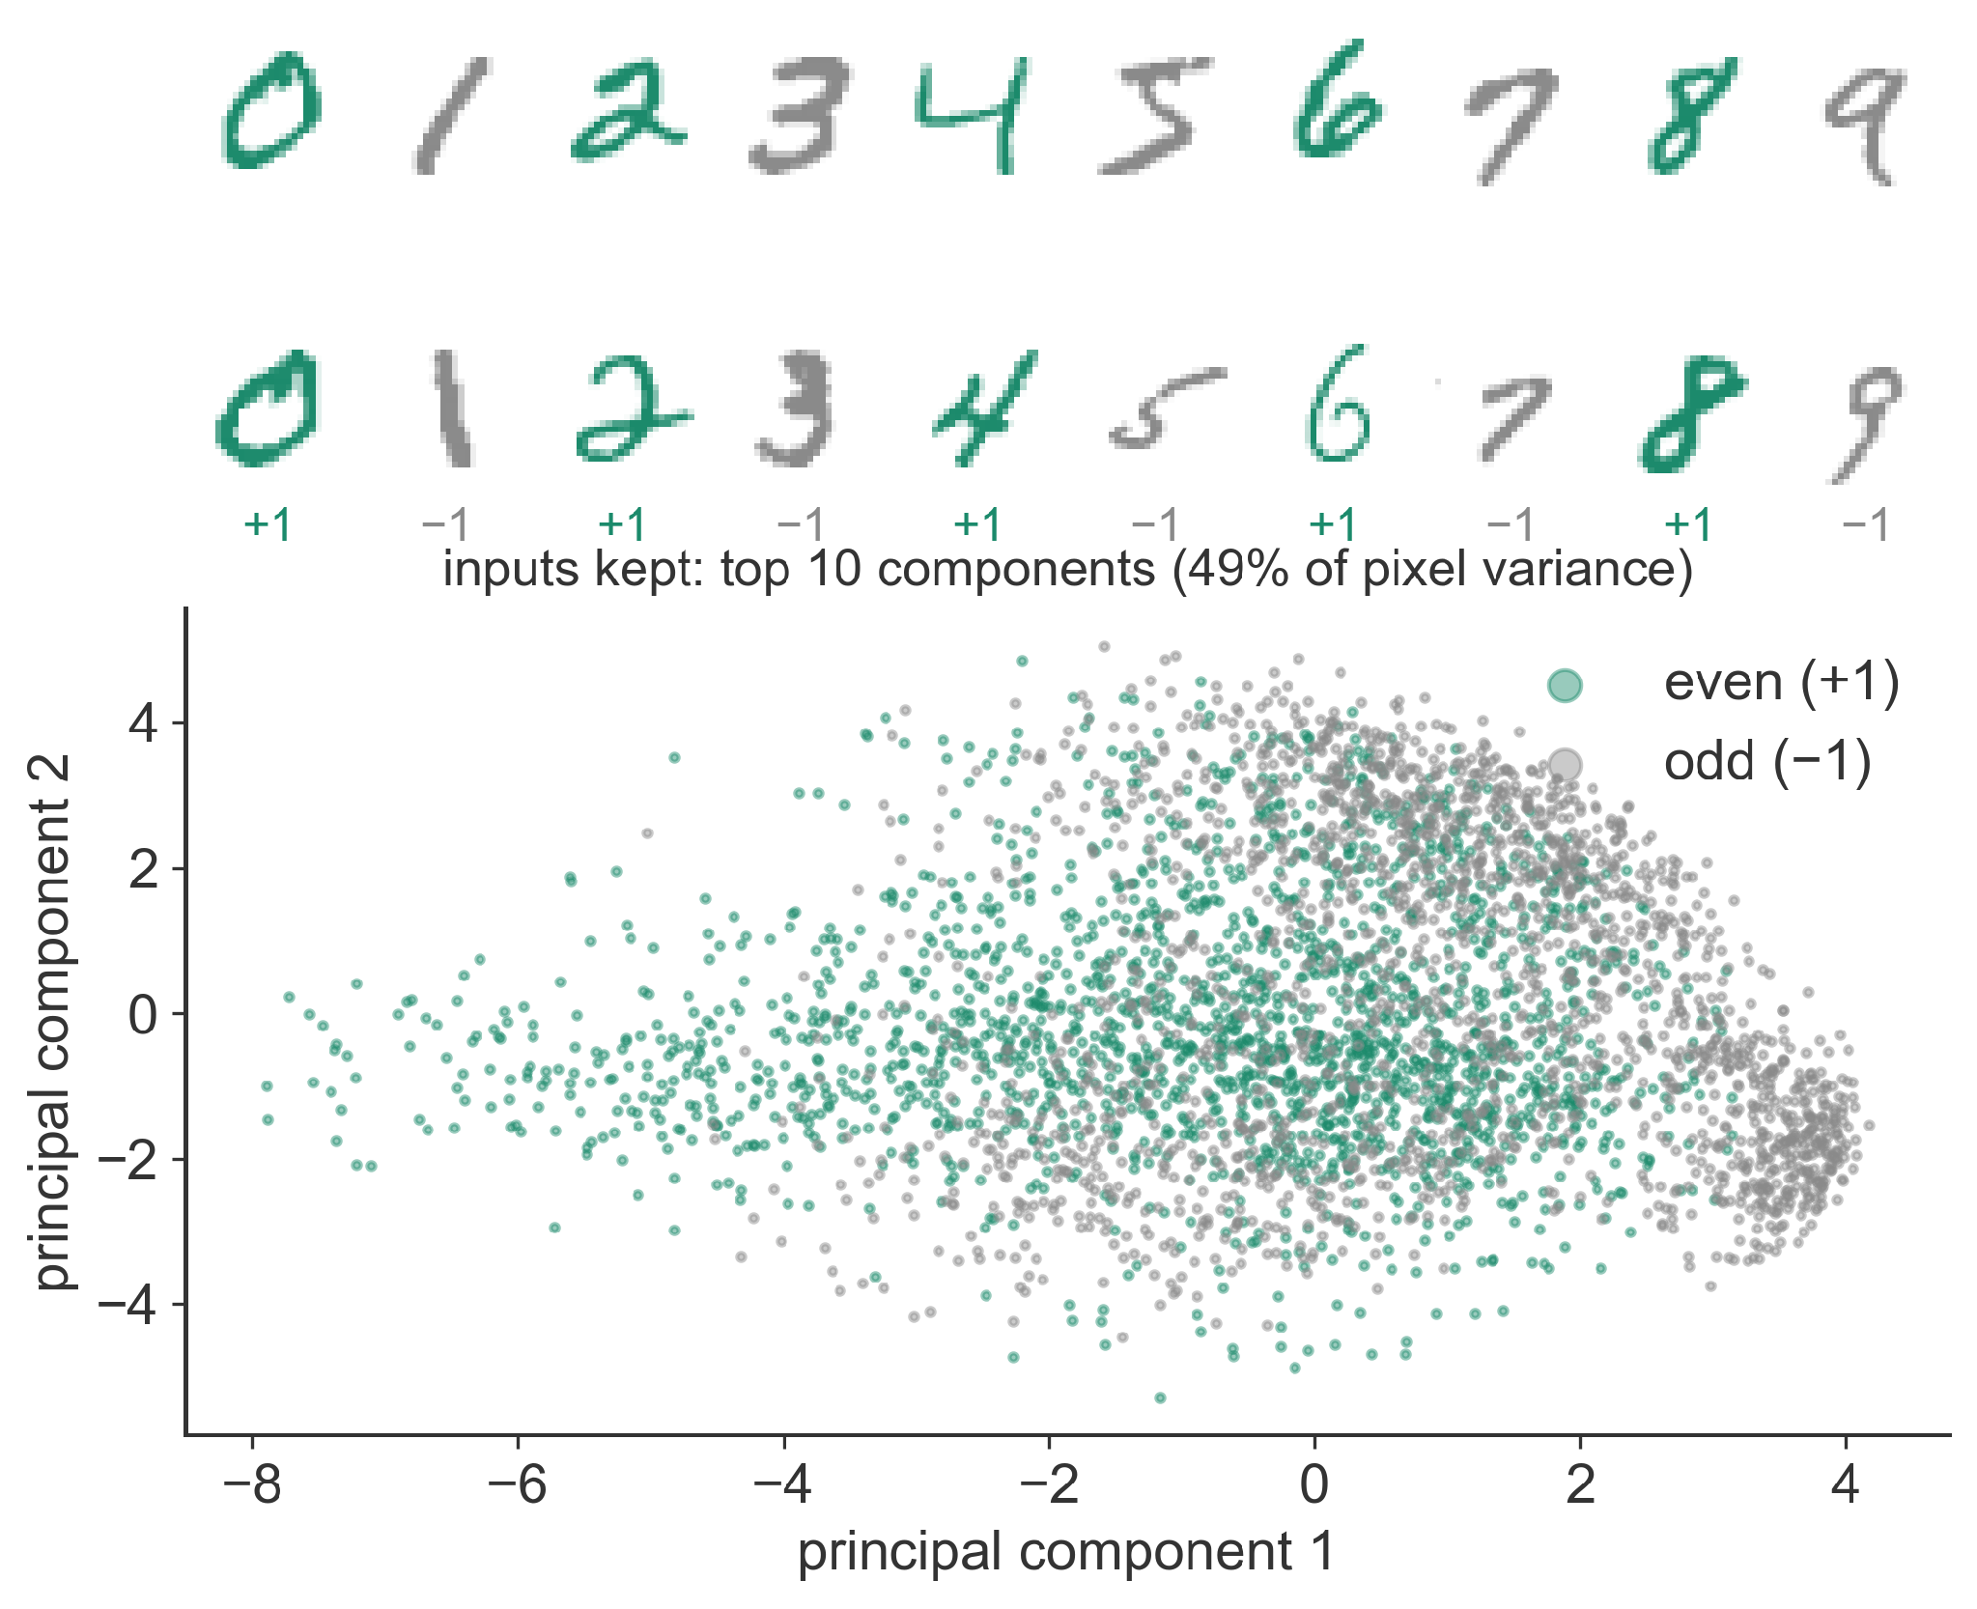
Two Datasets
• Random data: P points on a sphere of radius √d in d dimensions, random labels ±1 (no structure)
• MNIST: 70,000 handwritten digits, 28 × 28 pixels; label +1 for even, −1 for odd
• MNIST inputs reduced to their top d = 10 principal components (PCA)
MNIST: LeCun, Bottou, Bengio, and Haffner, Proc. IEEE 86, 2278 (1998)
29
Notes:
* Random data are the hardest case: there is no structure to exploit, so fitting means memorizing.
* MNIST is the classic handwritten-digit benchmark; the paper groups digits by parity to keep a binary task (Sec. VII).
* To keep the Hessian computable, images are projected onto the 10 directions of largest variance, which barely hurts accuracy (above 90%).
Q: Why reduce MNIST to 10 principal components?
Otherwise most weights would sit in the first layer, and the Hessian needs to stay small enough to compute. Accuracy stays above 90%.
Q: Why random labels?
They're the hardest case: there is no structure to exploit, so fitting them measures pure memorization capacity.
[end by ~34.5 min]

Slide 34
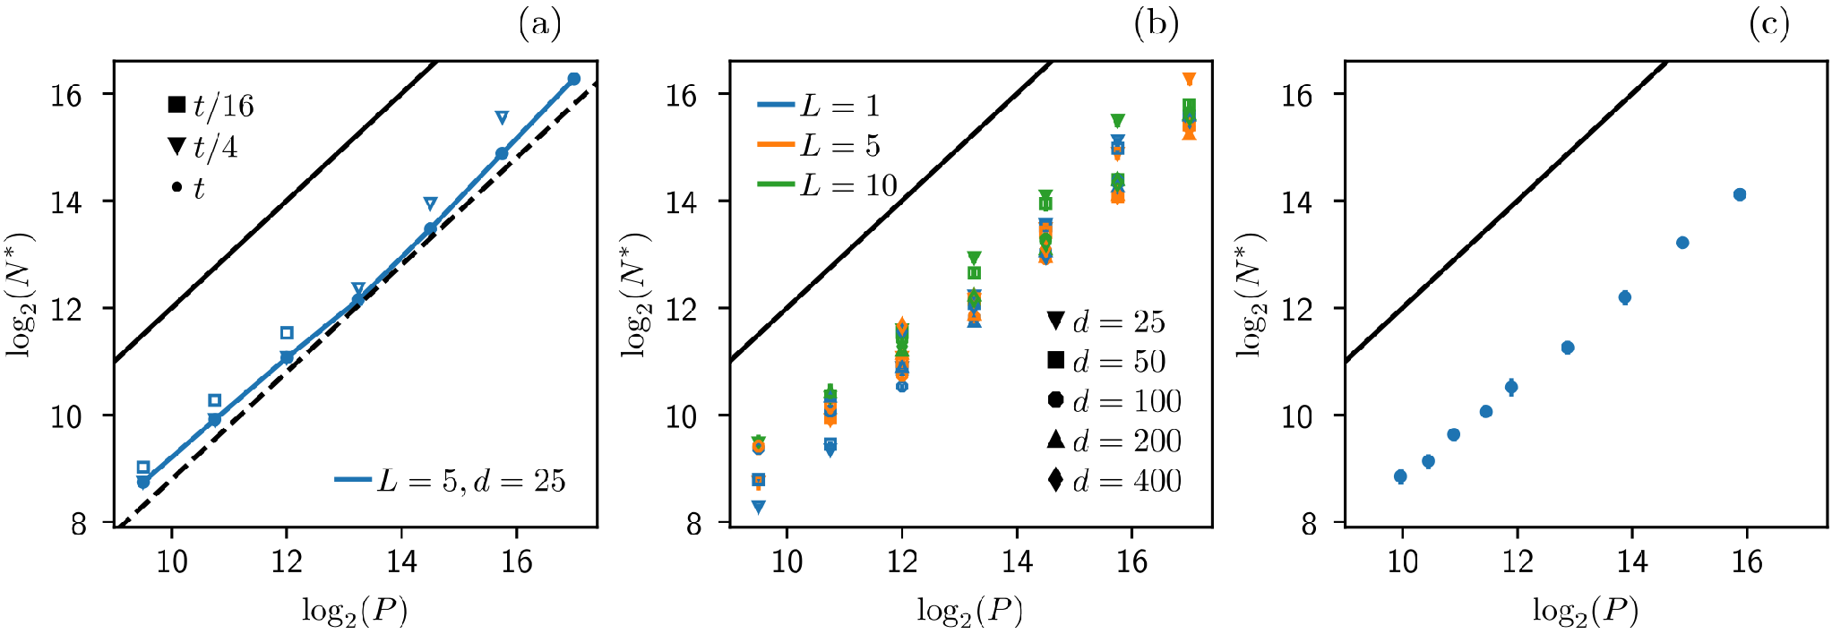
For Random Data, N* ~ P
• Protocol: fix P and depth L, shrink the width h until the network can no longer fit every datum
• Training: (a) N* grows linearly with P, (b) independent of L and input size d
• (c) Hinge loss gives the same line; points lie below the theoretical bound (black)
↔ P/N* is the analog of φ_{J}
30
Geiger et al., PRE 100, 012115 (2019), Fig. 5
Notes:
* Axes are log2 of N* against log2 of P.
* Panel (a), cross-entropy with SGD: short training (open symbols) never finds the transition, long training converges to slope one.
* Panel (b): depths 1 to 10 and input dimensions 25 to 400 collapse onto one line, so depth does not help fit random data.
Q: Why doesn't depth help?
Proofs that depth helps concern networks built by hand, not ones found by gradient descent on realistic data. The authors suggest depth may pay off only in architectures that exploit structure in the data (like CNNs), or by speeding up training.
* Panel (c): the hinge loss with ADAM gives the same result.
[end by ~36 min]

Slide 35
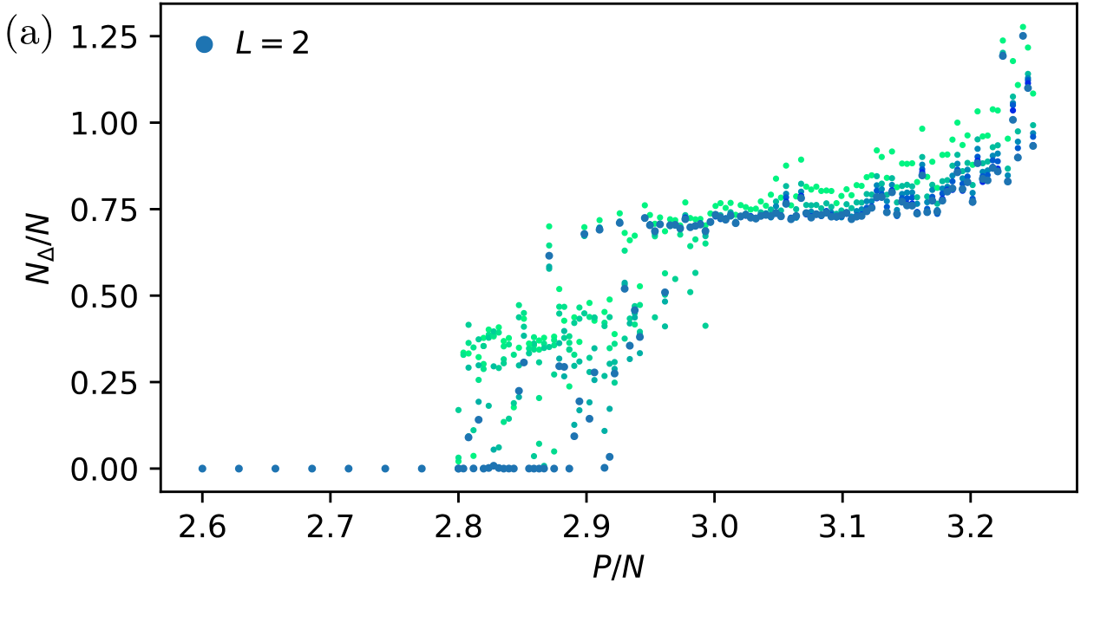
The Number of Constraints Jumps
• N ≈ 8000 fixed, P varied; color = training time (green short, blue long)
• N_{Δ}/N jumps from 0 to ≈ 0.75 at P/N ≈ 2.8–2.9
• Slow convergence near the jump: critical slowing down
Geiger et al., PRE 100, 012115 (2019), Fig. 6(a)
↔ compare the jump of N_{Δ}/N at φ_{J} (slide 11)
31
Notes:
* Now test the discontinuity.
* Networks of depth 2, 3, and 5 with about 8000 parameters are trained for up to ten million steps while P is varied.
* Below P/N ≈ 2.8 every datum is satisfied; above 2.9 roughly three quarters as many data as parameters remain unsatisfied.
* In between, runs are still evolving, the usual slowing down near a critical point.
Q: Why plot against the loss instead of P/N?
Near the transition, finite-size scatter hides the jump when plotted against P/N (the analogue of φ). Plotted against the loss (the analogue of U), the scatter collapses, just as it does for packings.
Q: Why ≈ 0.75 and not 1?
Networks are hypostatic. The stability bound only requires N_Δ/N ≥ C₀ − β ≈ 0.25, where β is the cusp fraction, so any value between 0.25 and 1 is allowed.
[end by ~37 min]

Slide 36
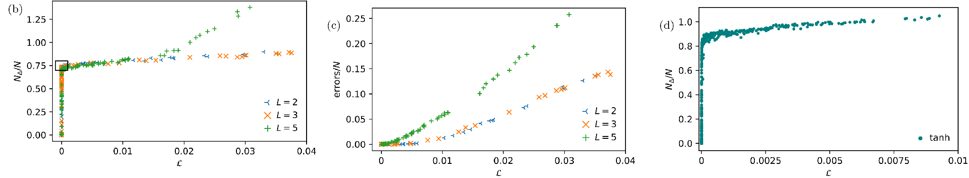
The Transition Is Hypostatic
• Against the loss, the scatter vanishes (b), as for packings plotted against U instead of φ
• Misclassified fraction grows smoothly (c); tanh networks also jump (d)
• Jump ≈ 0.75: below 1 and above the bound 0.25, so hypostatic, like ellipses
Geiger et al., PRE 100, 012115 (2019), Fig. 6(b–d)
↔ loss is the analog of the energy U
32
Notes:
* Plotted against the final loss instead of P/N, the three depths fall on a single curve with a clean jump as the loss goes to zero, just as packing data collapse when plotted against energy.
* Misclassification lags behind: unsatisfied data near jamming are mostly still correct.
* The jump height lies strictly between the stability bound and one, the hypostatic scenario.
[end by ~38 min]

Slide 37
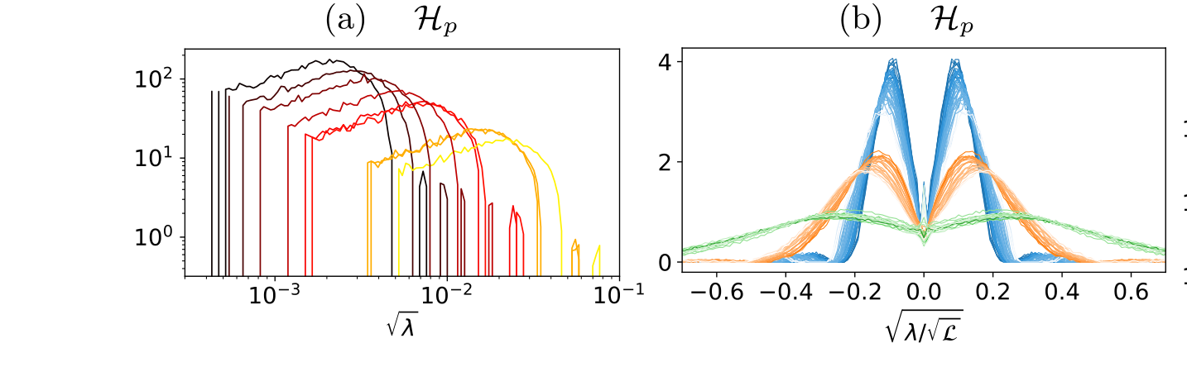
The Pre-Stress Term H_{p}
• Runs just below N* (small loss); ReLU networks of depth L = 2, 3, 5
• Spectrum of H_{p} scales with √(loss) (a → b), as λ ~ √U for particles
• Symmetric in sign: half its modes are negative, so C₀ = ½
Geiger et al., PRE 100, 012115 (2019), Fig. 7(a,b)
↔ λ ~ √U above jamming
33
Notes:
* These Hessians come from the under-parametrized runs closest to the transition, the black box in Fig. 6(b).
* Panel (a): the positive part of H_p's spectrum shifts with the loss.
* Panel (b): rescaling by the square root of the loss collapses the spectra, the analog of λ ~ √U. The symmetry of (b) confirms C_0 = 1/2, the assumption behind the bound on N*.
Q: How can a minimum have negative eigenvalues?
For ReLU networks, the cusps can stabilize directions the Hessian calls unstable, or training may not have fully converged. For tanh, which has no cusps, only 6 tiny negative eigenvalues remain after 10⁸ steps.
Q: Why does H_p's spectrum collapse under λ/√L?
H_p is a sum of terms each weighted by an overlap Δ_μ, and the typical overlap scales like √L (L = the loss).
[end by ~39 min]

Slide 38
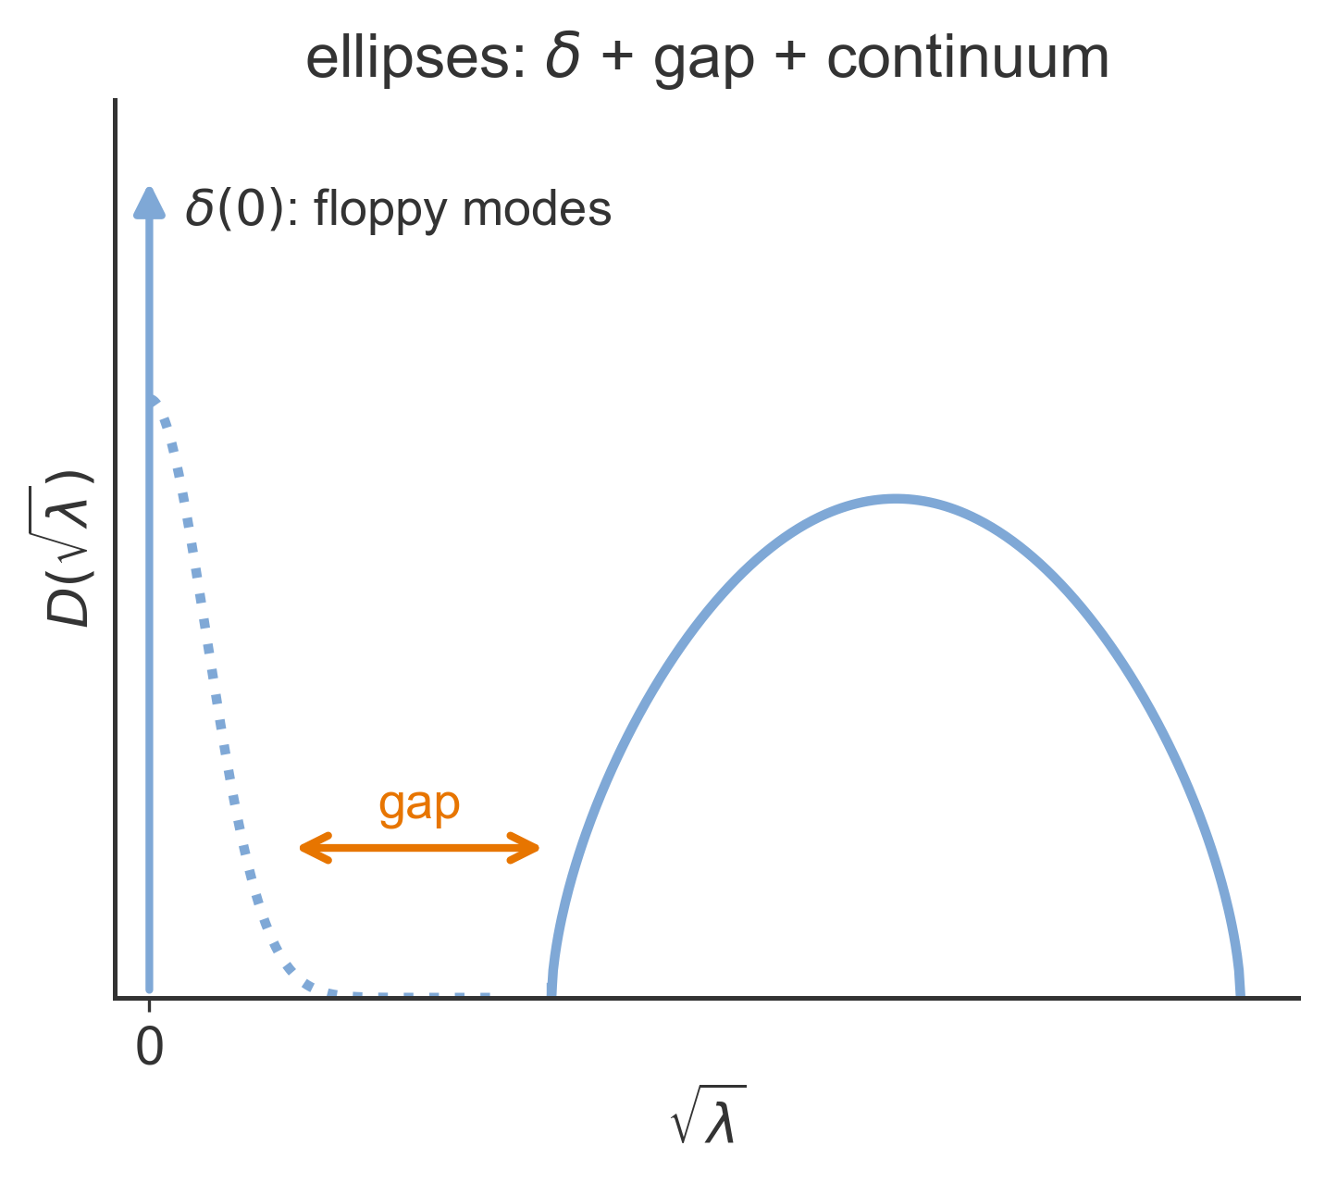
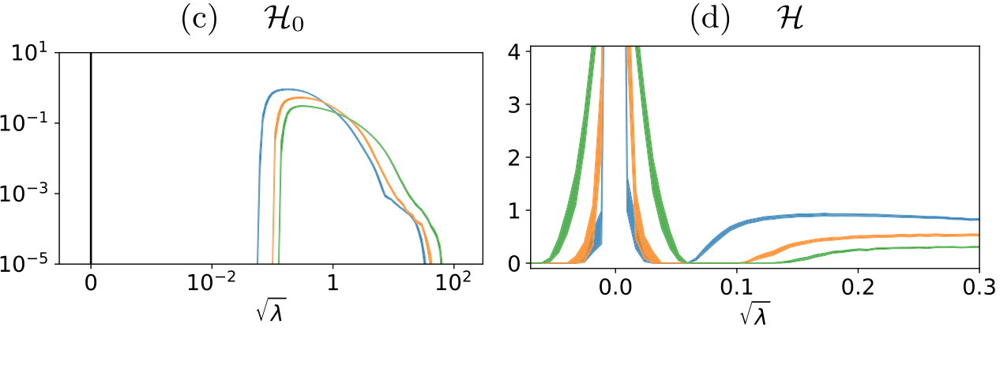
Flat Directions and a Gap
• H₀ (c): δ-peak at 0 with N − N_{Δ} modes, a gap, then a continuum
• Full Hessian H (d): same shape with the δ-peak smeared; ≈ 10% of modes negative (ReLU cusps)
• Right: the ellipse fingerprint from slide 13
Geiger et al., PRE 100, 012115 (2019), Fig. 7(c,d) (left); right: slide 13 sketch
↔ exactly the ellipse class
34
Notes:
* This is the key comparison. H_0 has a delta function at zero holding N − N_Δ flat directions, then a gap, then a continuum: the hypostatic spectrum sketched for ellipses.
* The full Hessian keeps that shape with the peak broadened by H_p. Its negative eigenvalues, about ten percent of N, are allowed because ReLU cusps can stabilize directions the Hessian calls unstable.
[end by ~40 min]

Slide 39
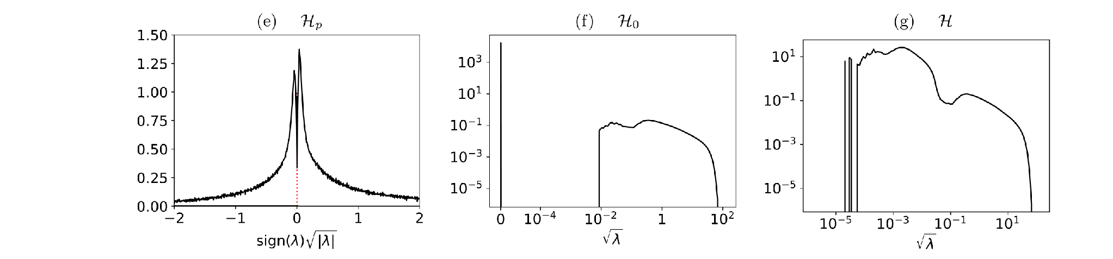
Smooth Activations (tanh)
• H_{p} is no longer symmetric: C₀ ≈ 0.43 (e)
• H₀ again shows δ(0) plus a gapped continuum (f)
• True minima: 11 negative modes after 10⁷ steps, 6 after 10⁸ (N = 2232)
Geiger et al., PRE 100, 012115 (2019), Fig. 7(e–g)
35
Notes:
* With tanh the landscape is smooth, so minima must have no negative eigenvalues.
* Training a tanh network with 11,000 random patterns leaves only a handful of tiny negative eigenvalues, which keep disappearing with more training.
* H_p's sign symmetry is gone, with 43 percent negative modes, but H_0 keeps the hypostatic shape.

Slide 40
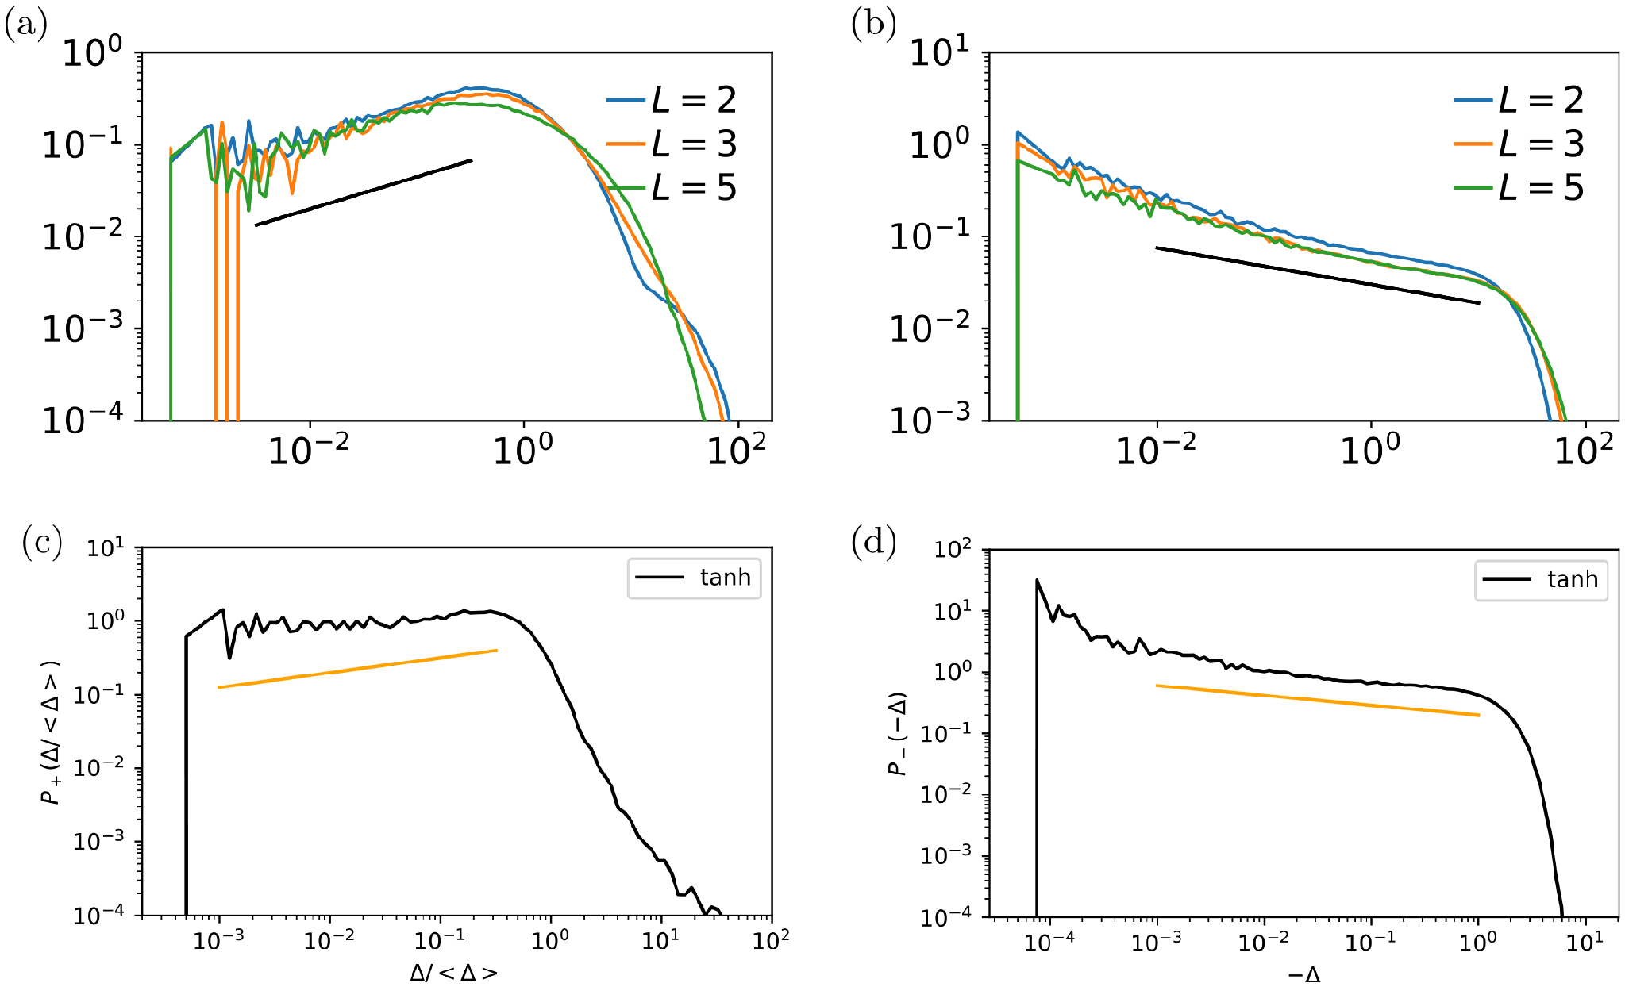
New Critical Exponents
• ReLU: θ ≈ 0.3, γ ≈ 0.2 (a, b), independent of depth
• tanh: θ ≈ 0.2, γ ≈ 0.16 (c, d)
• Spheres: θ ≈ 0.42, γ ≈ 0.41
• Two decades of power law hint at marginal stability and avalanches; no theory yet
Geiger et al., PRE 100, 012115 (2019), Fig. 8
↔ unsatisfied and satisfied data are the analogs of forces and gaps
36
Notes:
* Panels (a) and (c) show overlaps of unsatisfied data, rescaled by the square root of the loss; (b) and (d) show gaps of satisfied data.
* Both follow power laws over about two decades, with exponents that differ from spheres and between activation functions.
* By analogy with packings, this suggests networks near jamming are marginally stable and learn through avalanches, but there is no theory for these exponents yet.
Q: Do the network exponents satisfy the sphere marginality bound?
No. For ReLU, γ ≈ 0.2 is below both 1/(2+θ) ≈ 0.43 and (1−θ)/2 ≈ 0.35. But that bound was derived for isostatic sphere packings, and networks are hypostatic, so it needn't apply. The paper claims only that the power laws suggest marginality and states there is no theory yet. This is the question most likely to come from the physicists in the room.

Slide 41
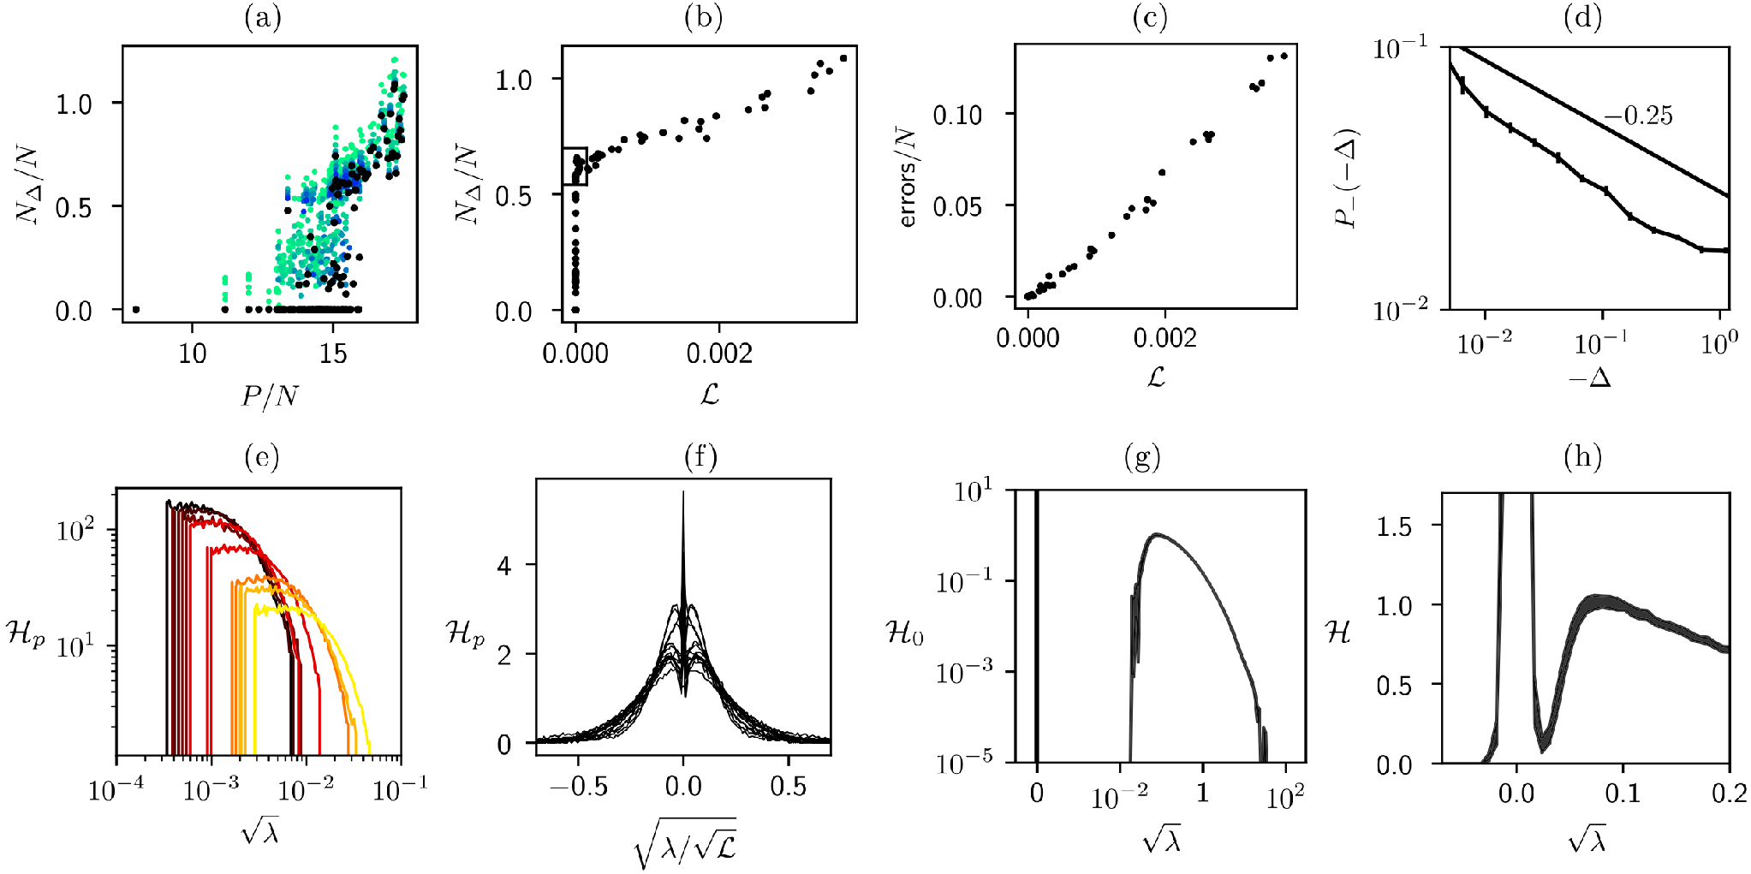
MNIST Jams Too
• N_{Δ}/N jumps again (a, b), to ≈ 0.5 instead of ≈ 0.75: the jump height is not universal
• Same Hessian fingerprints: symmetric H_{p} (f), δ(0) + gapped continuum in H₀ (g)
• Gaps: P₋(Δ) ~ |Δ|^{−γ} with γ ≈ 0.25 (d); here d = 10, h = 30, L = 5
Geiger et al., PRE 100, 012115 (2019), Fig. 9
37
Notes:
* Real images reproduce the whole scenario: a discontinuous jump in unsatisfied constraints, less scatter against the loss, smooth misclassification, and the same Hessian shapes (N = 3900).
* Only the jump height changes, about one half, so it is not universal.
* The gap exponent 0.25 is close to the random-data value; the difference may not be significant.
Q: Is the jump height universal?
No: about 0.5 for MNIST versus about 0.75 for random data.

Slide 42
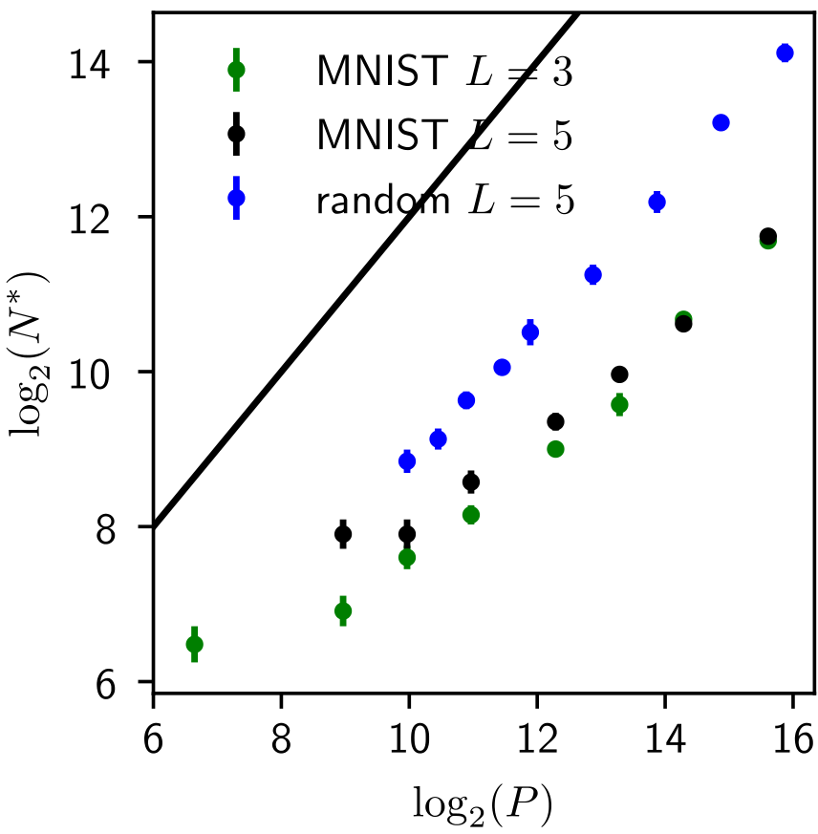
Real Data Need Fewer Parameters
• MNIST: N* far below random data at the same P
• Depth barely matters
• N*(P) may grow sublinearly, or even saturate, for structured data
Geiger et al., PRE 100, 012115 (2019), Fig. 10
38
Notes:
* Where real and random data differ is the location of the transition.
* Structured data can be fitted with far fewer parameters, and the gap widens with P.
* Again, depth does not lower N*. Predicting N*(P) for real data is left open.
Q: Why does MNIST need fewer parameters?
Structure in the data lets a smaller network fit it. N*(P) may grow more slowly than P, or even saturate. The paper leaves predicting N*(P) open.

Slide 43
Conclusions
• No bad minima when over-parameterized: too few constraints (N > P/C₀) to form them
• Depth does not lower N* for fully connected networks (random data and MNIST)
• Deep networks jam in the hypostatic (ellipse) class: jump below 1, δ(0) + gap
• Open: a theory for θ and γ in networks; N*(P) for structured data
• Outlook (Ref. II): test error peaks at N*; early stopping removes the peak
39
Notes:
* Over-parameterized networks do not get stuck because there are not enough constraints to create stable minima, provided the network stays sensitive to all its parameters.
Q: Why does this matter for modern networks, which are hugely over-parameterized?
A: Modern networks sit far above N*, where the counting argument guarantees there are no bad minima. Ref. II shows N* also matters for generalization: test error peaks at N*, and early stopping removes the peak.
* Depth does not reduce the parameters needed to fit data in fully connected networks.
* The follow-up paper (Ref. II) shows the same line N* is where over-fitting is worst.
Q: Is that peak "double descent"?
Yes. Ref. II's cusp is the same phenomenon, and it cites Belkin et al.'s paper on reconciling double descent with the bias–variance trade-off.
[end by ~44.5 min]

Slide 44
Questions
• Can N*(P) for real data be predicted from an effective constraint count
• E.g., rank of the constraint gradients {∇_W Δ_μ} at jamming, or the intrinsic dimension of the data?
• Measure that rank against P for MNIST and for random data; use teacher–student tasks where the complexity of the labelling rule is a tunable parameter.
• Which architectural property switches the universality class — depth, activation, the loss, or the width-to-input ratio?
• Fixed N, compare the perceptron with one- and two-hidden-layer networks under identical loss and training, using two diagnostics: the jump height N_Δ/N (1 for the sphere class, below 1 for hypostatic) and whether H₀ shows the δ(0) + gap signature.
39
Notes:
* Over-parameterized networks do not get stuck because there are not enough constraints to create stable minima, provided the network stays sensitive to all its parameters.
Q: Why does this matter for modern networks, which are hugely over-parameterized?
A: Modern networks sit far above N*, where the counting argument guarantees there are no bad minima. Ref. II shows N* also matters for generalization: test error peaks at N*, and early stopping removes the peak.
* Depth does not reduce the parameters needed to fit data in fully connected networks.
* The follow-up paper (Ref. II) shows the same line N* is where over-fitting is worst.
Q: Is that peak "double descent"?
Yes. Ref. II's cusp is the same phenomenon, and it cites Belkin et al.'s paper on reconciling double descent with the bias–variance trade-off.
[end by ~44.5 min]

Slide 45
Analogies
 | Particles (spheres / ellipses) | Deep networks
Control parameter | Packing fraction φ | P/N
Transition | φ_{J} | N*(P) ~ P (random data)
N_{Δ}/N at the jump | 1 / below 1 | ≈ 0.75 (random), ≈ 0.5 (MNIST)
Class | Isostatic / hypostatic | Hypostatic
Hessian at jamming | Plateau / δ(0) + gap | δ(0) + gap + continuum
Above jamming | Scale √U | H_{p} scales as √(loss)
θ, γ | 0.42, 0.41 (spheres) | 0.3, 0.2 (ReLU); 0.2, 0.16 (tanh)
Geiger et al., PRE 100, 012115 (2019), Secs. IV–VII
40
Notes:
* One slide to leave up during discussion.
* Every row on the right was measured in the paper; every row on the left comes from Part 1.
[end by ~45 min]

Slide 46
References (numbers follow Ref. I)
[I] M. Geiger, S. Spigler, S. d'Ascoli, L. Sagun, M. Baity-Jesi, G. Biroli, and M. Wyart, Phys. Rev. E 100, 012115 (2019).
[II] S. Spigler, M. Geiger, S. d'Ascoli, L. Sagun, G. Biroli, and M. Wyart, J. Phys. A: Math. Theor. 52, 474001 (2019).
[33] S. Franz, G. Parisi, M. Sevelev, P. Urbani, and F. Zamponi, SciPost Phys. 2, 019 (2017).
[34] S. Franz and G. Parisi, J. Phys. A: Math. Theor. 49, 145001 (2016).
[42] M. Wyart, Phys. Rev. Lett. 109, 125502 (2012).
[45] P. Charbonneau, J. Kurchan, G. Parisi, P. Urbani, and F. Zamponi, Nat. Commun. 5, 3725 (2014).
[52] C. S. O'Hern, L. E. Silbert, A. J. Liu, and S. R. Nagel, Phys. Rev. E 68, 011306 (2003).
[57] E. Lerner, G. Düring, and M. Wyart, Soft Matter 9, 8252 (2013).
MNIST: Y. LeCun, L. Bottou, Y. Bengio, and P. Haffner, Proc. IEEE 86, 2278 (1998).
41
Notes:
* Bracketed numbers match the reference list of Ref. I, so they can be looked up there.
* Keep this slide as the backdrop for questions.
[end by ~45 min]

