Slide 1

Big Mountain Resort
Ski Ticket Pricing Strategy
Executive Presentation | Data Science Capstone Project
330
Random Forest
~$9.40
U.S. ski resorts analyzed
Predictive model used
Model avg. error (MAE)

Slide 2



PROBLEM IDENTIFICATION
The Challenge
Big Mountain
At a Glance
New Chairlift Installed
Operating costs increased by $1,540,000 per season — revenue must keep pace.
2,353 ft
Vertical Drop
Is Current Pricing Right?
105
At $81/ticket, is Big Mountain priced correctly given its facilities and the market?
Total Runs
3
Fast Quads
Data-Driven Answer Needed
3,000+ ac
330 U.S. resort records analyzed to determine the fair market ticket price.
Skiable Terrain
$81
Current Ticket Price
2

Slide 3

KEY FINDINGS & RECOMMENDATION
What the Model Tells Us
Current Price
Model Fair Value
Gap
$81
$97.96
+$16.96
▶
per ticket
per ticket
per ticket
Montana's #1
±$9–10 error margin
~$5.9M/yr
potential
Important Caveat
Big Mountain already holds the #1 ticket price in Montana. The $97.96 model value benchmarks against national resorts in Colorado and Utah — a different competitive set. Given the ±$9–10 error margin and unaccounted customer costs (lodging, food, rentals), any price increase should be approached cautiously and validated with customer research before implementation.
3

Slide 4
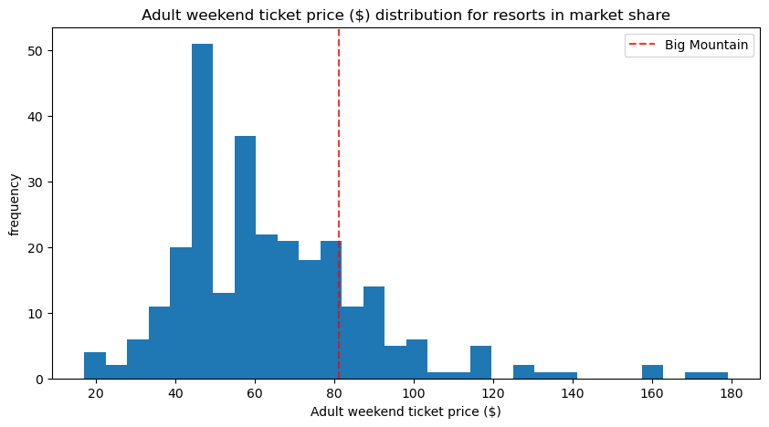
MODELING RESULTS & ANALYSIS
Where Big Mountain Stands Nationally
Ticket price distribution across all 277 U.S. ski resorts — Big Mountain's $81 sits near the national median, not below it.
4

Slide 5
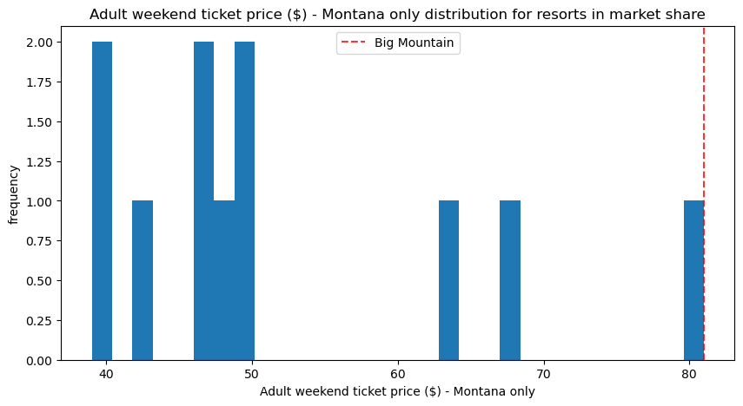
MODELING RESULTS & ANALYSIS
Big Mountain Leads in Its Home Market
Among Montana resorts, Big Mountain already commands the highest ticket price — raising price further risks losing local market share.
5

Slide 6
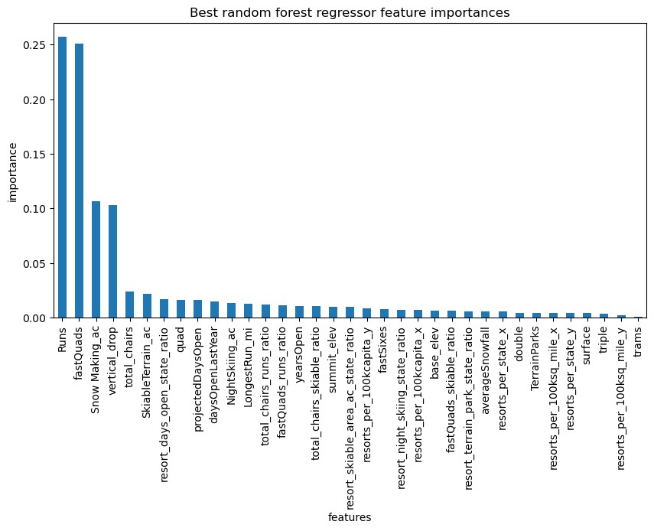
MODELING RESULTS & ANALYSIS
What Drives Ticket Price?
Scenario Summary
Top 5 pricing drivers identified by the Random Forest model.
Scenario: Chair Lift
Price impact: +$2.22
+$2.22
Revenue impact: +$3.9M/yr
Scenario: Close 4–5 Runs
Price impact: < −$1.50
< −$1.50
Revenue impact: Cost savings
Scenario: Snow-Making / Run Length
Price impact: $0.00
$0.00
Revenue impact: Negligible
6

Slide 7
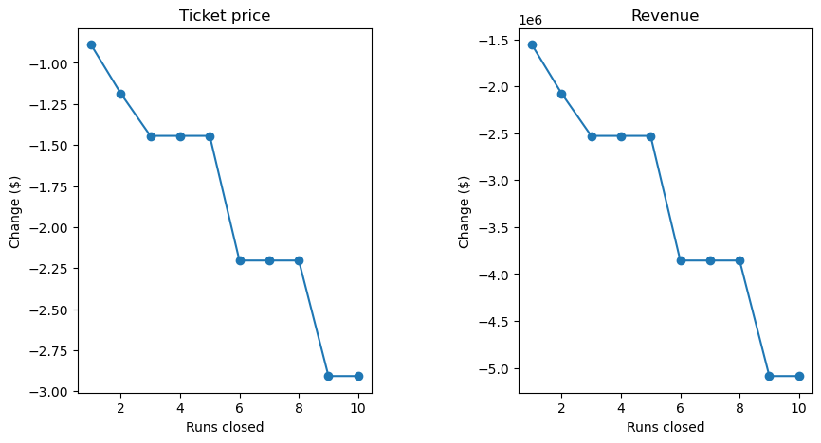
MODELING RESULTS & ANALYSIS
Run Closure — Finding the Safe Threshold
Closing up to 4–5 least-used runs generates cost savings with minimal revenue impact. Beyond 6 closures, the model predicts a sharp price decline.
7

Slide 8


SUMMARY & CONCLUSION
Recommendations
Price Increase — Proceed Cautiously
Close 4–5 Least-Used Runs
The model supports a higher price ($97.96) but given Big Mountain already leads Montana pricing, the ±$9–10 error margin, and unaccounted guest costs, any increase should be validated with customer research first.
Minimal revenue impact at this level. Avoid 6+ closures — the model predicts a sharp ticket price decline beyond that threshold.
Proceed with the New Chairlift
Deprioritize Snow-Making & Run Extensions
Scenario 2 supports a $2.22 price increase worth ~$3.9M in seasonal revenue — well above the $1.54M operating cost increase.
Scenarios 3 and 4 produced zero modeled price impact. These investments should not be prioritized.
Big Mountain Resort | Springboard Data Science Capstone | Model MAE: ~$9.40

