Slide 1
Recipe Site Traffic Prediction
Jacob Paul – Data Scientist Candidate
DataCamp Data Science Certification Project

Slide 2
Project Objective
Goal: Predict whether a recipe will receive high site traffic based on nutritional and categorical features.
Metric: Precision (minimize false positives).
Dataset: 947 records, 8 features.

Slide 3
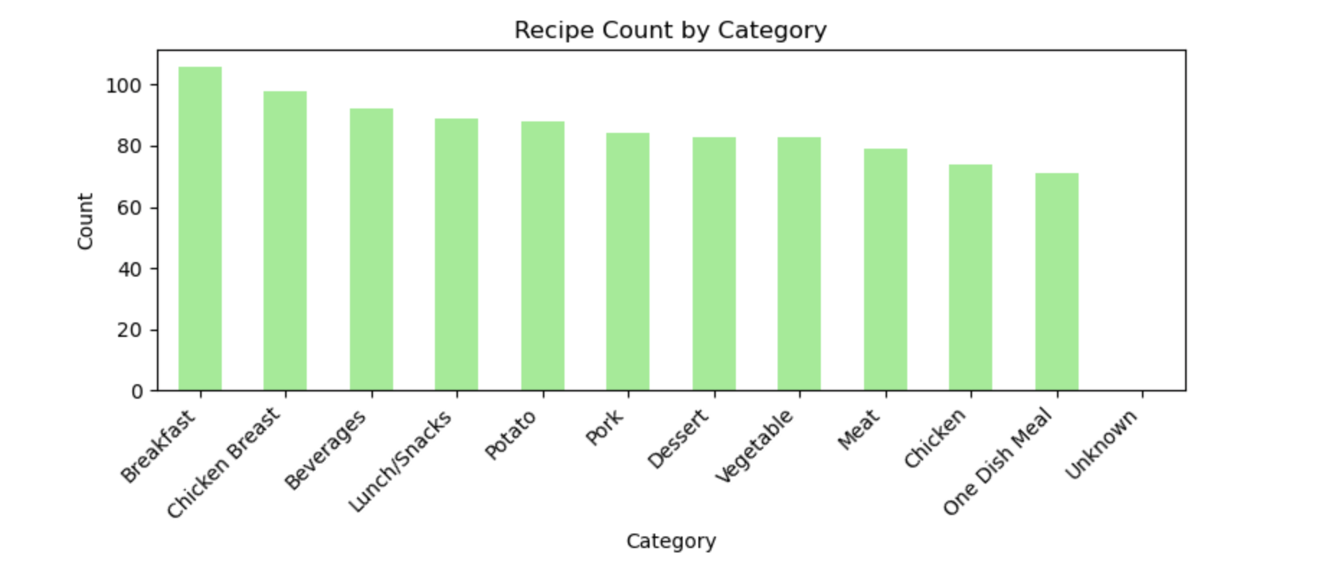
Data Overview
Columns: recipe, calories, carbohydrate, sugar, protein, category, servings, high_traffic.
Data cleaning: handled missing values and removed duplicates.

Slide 4
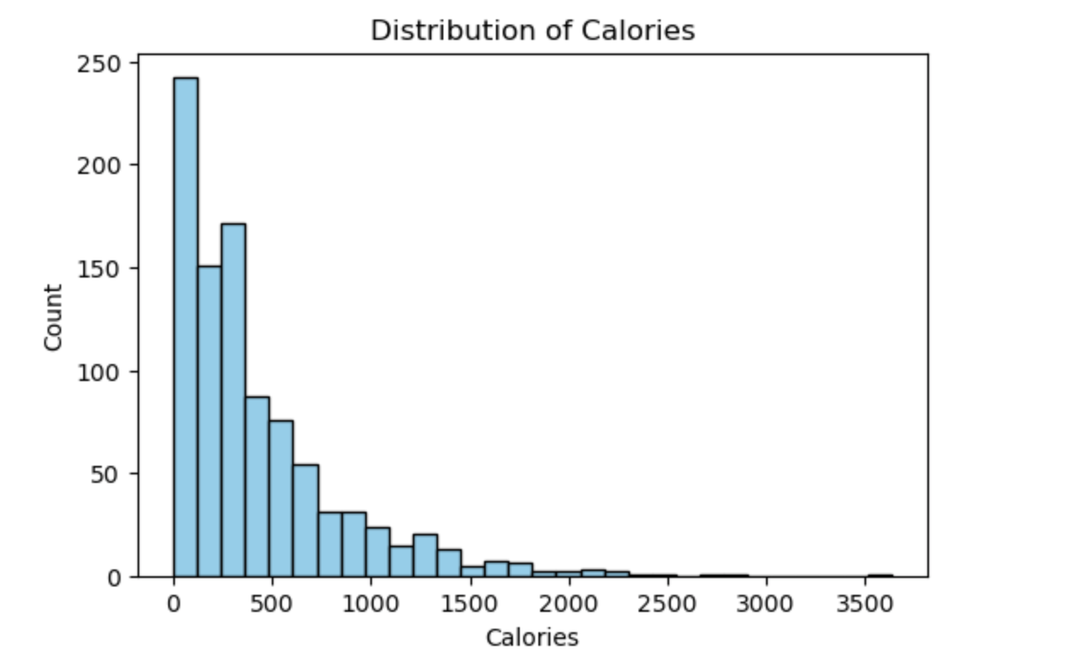
Exploratory Data Analysis – Calories Distribution
Most recipes fall between 0–500 calories.
Some high-calorie recipes (>1500) exist but are less frequent.

Slide 5
Category Distribution
Top categories include Breakfast, Chicken Breast, Beverages, and Lunch/Snacks.
Balanced representation across food groups.

Slide 6
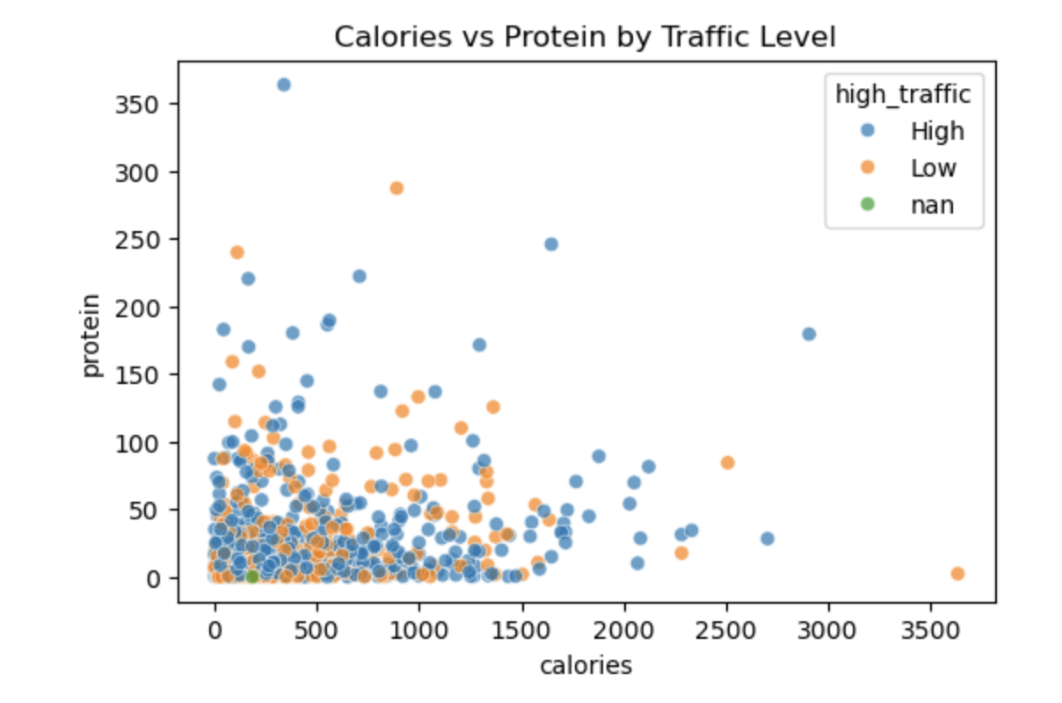
Calories vs Protein by Traffic Level
Scatter plot reveals high-traffic recipes have higher calories and protein content.

Slide 7
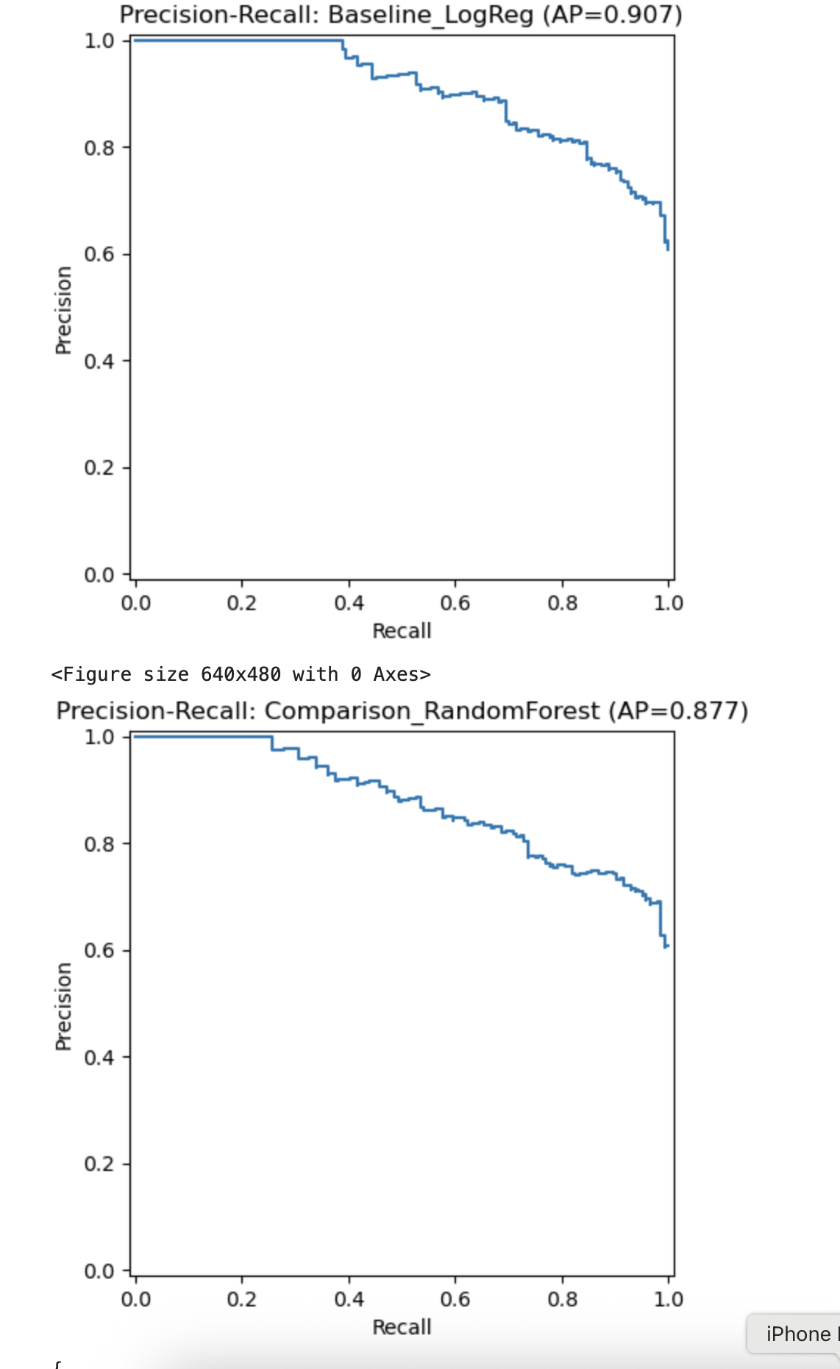
Model Evaluation – Logistic Regression vs Random Forest
Both models trained and evaluated on test data.
Logistic Regression performed best with higher average precision (0.907 vs 0.877).

Slide 8
Performance Metrics
Precision: 0.803
Recall: 0.847
Threshold: 0.311
Best model: Logistic Regression.

Slide 9
Business Metric & Insights
Precision prioritized to reduce false positives.
High-traffic predictions improve homepage engagement.
Recommendations target 0.80 precision threshold.

Slide 10
Recommendations
• Highlight recipes high in protein and calories.
• Focus on categories with strong performance (Meat, One Dish Meals).
• Monitor precision over time and retrain quarterly.
• Future: add user engagement & time-to-make features.

Slide 11
Conclusion
Final Model: Logistic Regression.
Achieved strong predictive accuracy for recipe popularity.
Supports business decisions for recipe curation and content prioritization.

