Slide 1


A Project report on E-Commerce Application
E-Commerce
Jacob John: 16BCE2205
Under the Guidance of
Professor SUREKA S
Visit https://ecommerceosp.000webhostapp.com/ for the live demo.

Slide 2
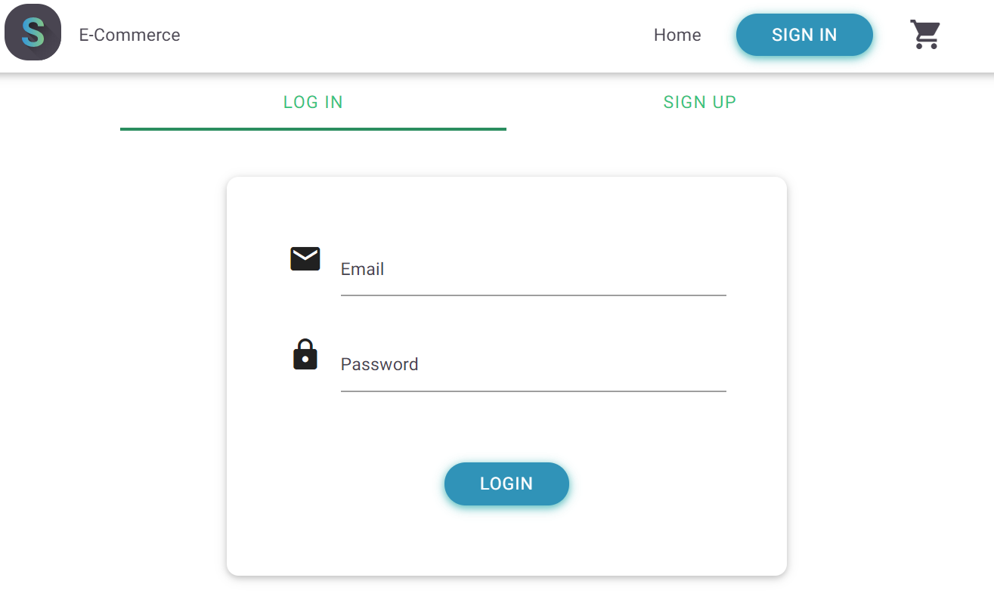
Features of the Project:
User Registration
User login system
Change password
Forgot password
Profile management
system
Shopping cart
Wishlist
Order History

Slide 3




Software Required (Any-one):
LAMP Stack
XAMPP Server
MAMP Server
WAMP Server

Slide 4
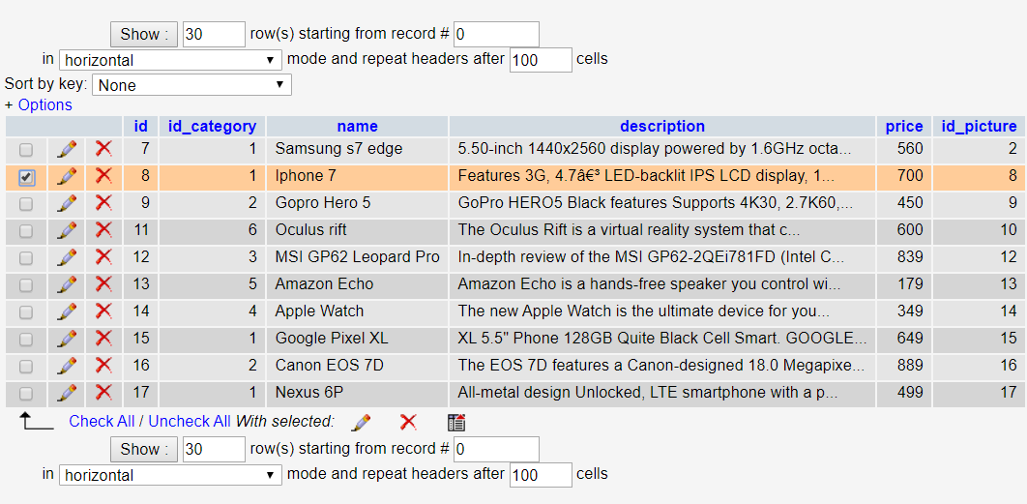
Features of Admin:
Functionality to add and delete products
Display product statistics and stock.
Query, display and delete all users that signed up on the website.
Admin can edit his/her own profile's email address and password.
Logout of the current session.

Slide 5
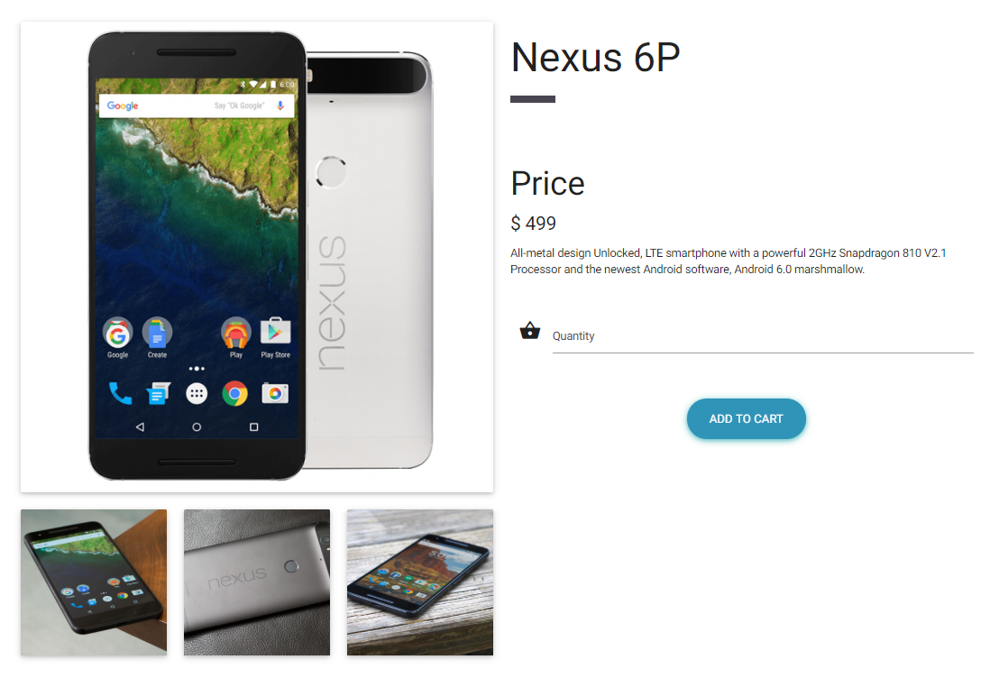
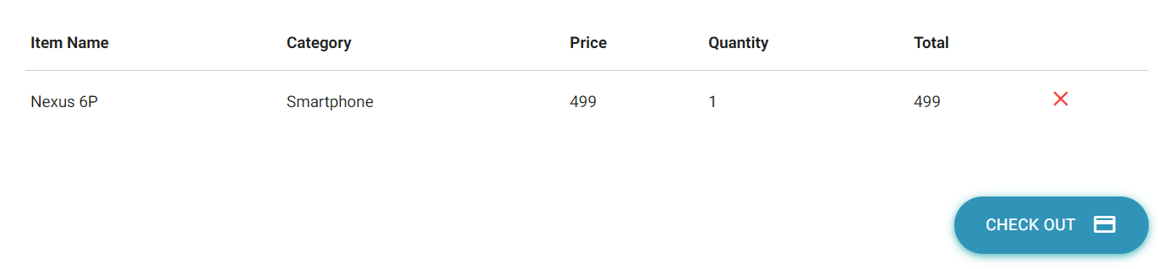
Features of User:
Signing up for a user account
Change e-mail id and password
Add items to a cart/basket prior to purchasing
Generating invoice of all items and printing them in pdf form
Purchasing items and delivering them to a specific address

Slide 6
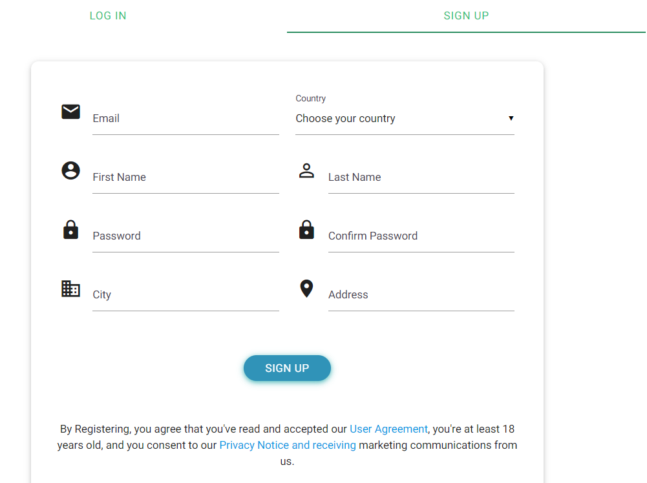
Functional Requirements
Registration
Login
Changes to Cart
Payment
Logout
Report Generation
Review
Orders

Slide 7



Non-functional requirements:
Secure access of confidential data (customer details)
24 x 7 availability
Better component design to get better performance at peak time.
Flexible service-based architecture will be highly desirable for future extension.
Various other non-functional requirements include:
Reliability
Security
Maintainability
Portability
Reusability
Compatibility
Resource Utilization

Slide 8
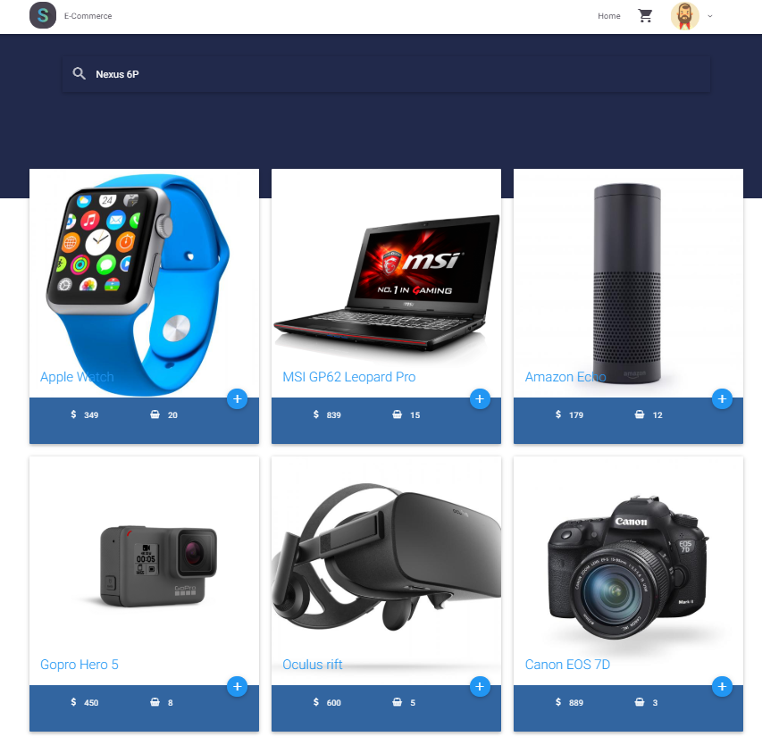
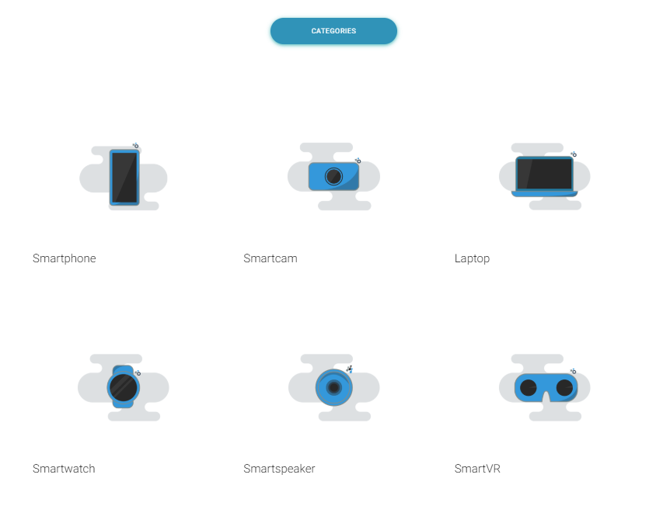
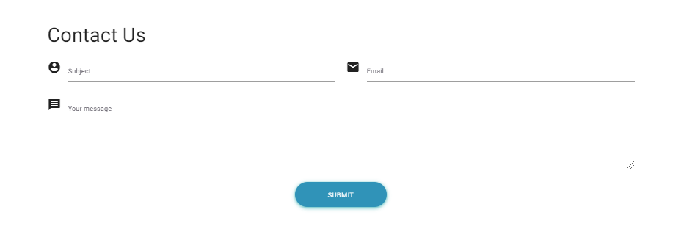
Home Screen (snippets):

Slide 9

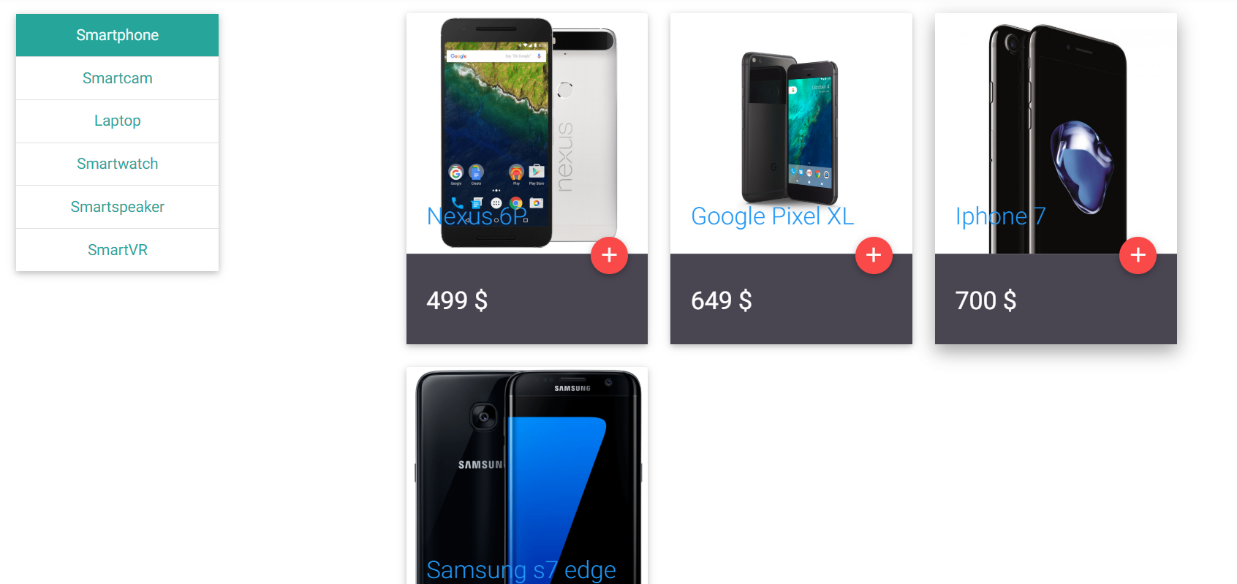
Products:

Slide 10
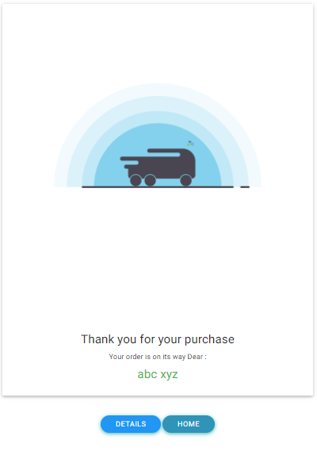
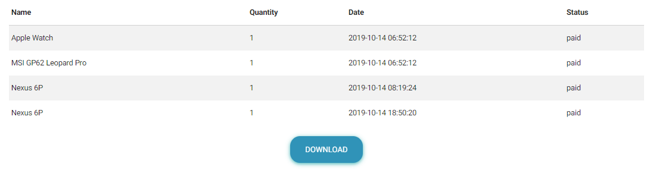
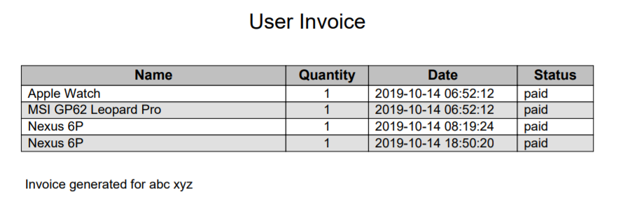
Order Confirmation:
The following confirmation screen will appear once the payment is done

