Slide 1
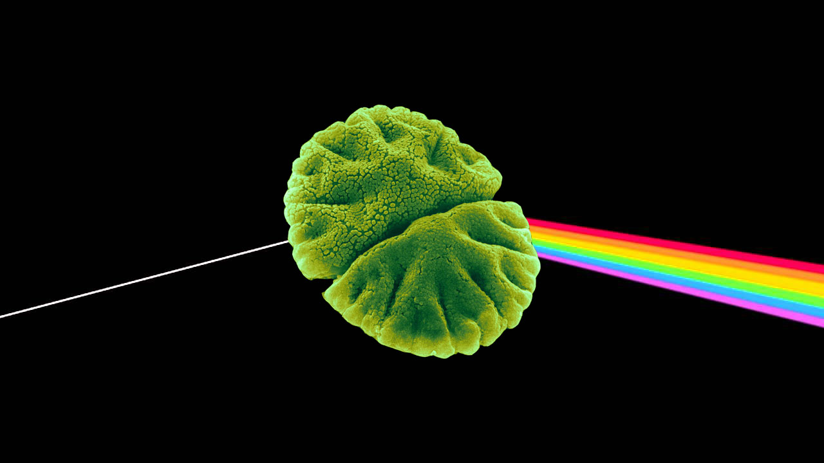
Gaussian Peak Spectra Method
Notes:
https://i.ytimg.com/vi/ByMyh6ALAl8/maxresdefault.jpg
https://images.fineartamerica.com/images-medium-large-5/micrasterias-angulosa-algae-sem-science-source.jpg

Slide 2
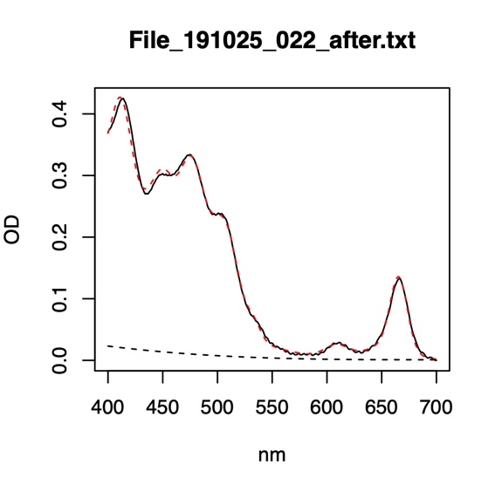
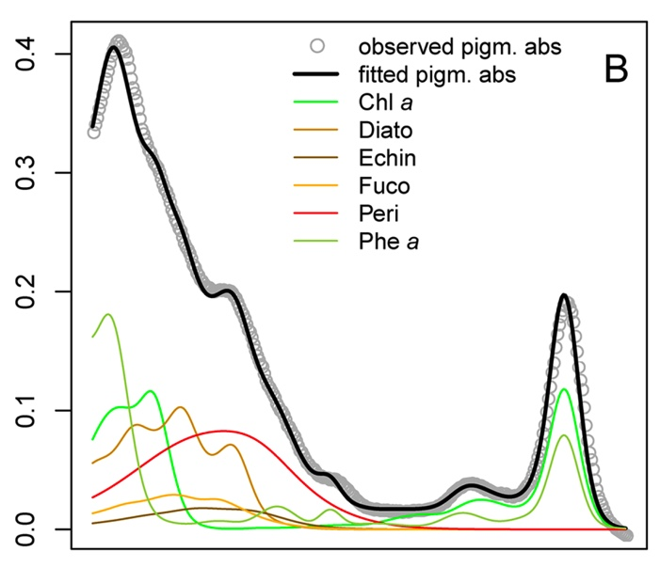
Using Gaussian-Peak-spectra to estimate multiple pigments
Gaussian-Peak-Spectra (GPS) measures a range of wavelengths, from 400 nm to 700 nm
From this range of wavelengths the curve is deconstructed into multiple peaks, based on different pigment’s absorption
Notes:
WW: I would suggest adding a title here, letting people know the overall focus of the presentation. Something like ‘Using Gaussian-Peak-Spectra to estimate multiple pigments’
I think this is a good slide to include as part of the intro to this method. You could just say that this is the output we get from the pigment analysis, which shows that we are measuring at multiple wavelengths.
MEL: Can you add a few words of text to this to help people follow along? Something like…
Measures many wavelengths
Measures many pigments
Spectra are deconstructed into multiple peaks based on what wavelengths different pigments absorb
Also, you don’t need before/after plots here – the before/after bit is not really meaningful for anything except chl-a:pheophytin, which is not the point of your presentation. I would swap out the second plot for a text box explaining the method a bit

Slide 3
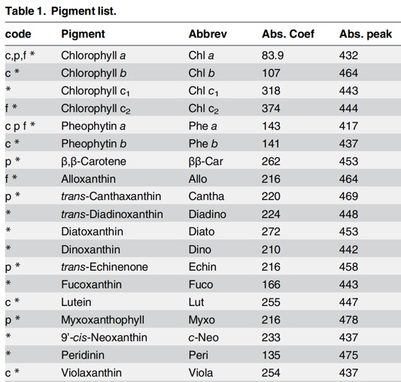
Currently, 19 pigments are extracted through GPS
Pigments can be extracted from different mediums, such as water, sediment and cultures
28 pigments were tested, with 19 of those passing through a Monte Carlo simulation
Notes:
I like the addition of this slide!

Slide 4
Pigment Overlap Between Multiple Methods
The FluoroProbe has three measurements of algae that were compared with GPS:
The total algae measurement of the FluoroProbe was compared to the sum of all pigments captured by GPS
The green algae measurement was compared to the sum of Chlorophyll a and Chlorophyll b measured by GPS
The brown algae measurement was compared to the sum of Myxoxanthophyll, Peridinin, and Fucoxanthin
There could be mismatched pigments or incorrect pigments in the comparison
While not currently part of the method, other pigments such as Phycocyanin could be added
Notes:
WW: I would suggest changing the title slightly to be more specific about the comparison between the FP and GPS. Something ‘Pigment overlap between multiple methods’ and state that we are using the FP data to compare to the GPS estimates
We are digging into how to match others
Match exo and phyco sensors
We want to compare between flora and gps

Slide 5
FluoroProbe
GPS
Notes:
These figures represent a 5.0 m depth at FCR on May 27th. As you can see, the sample was pulled from a well mixed portion of the water column with a maximum of around 8 ugL for an individual pigment. Although the Fluoroprobe is detecting more algae by a magnitude of 10, and detects comparatively more brown algae than the gps did, the general trend between the two shows a great deal of promise.

Slide 6
FluoroProbe
GPS
Notes:
To test that the method holds up over space as well as time, another sample at fcr was analyzed on the same day as the previous slide, May 27th. The sample was taken at a depth of 0.1 m, which has a slightly lower concentration of all algae when compared to the previous depth analyzed, 5.0 m. Both depths analyzed appear to have a relatively diverse mixture of algae with the greens and browns being the highest in concentration. When examining the bar plots, one piece to draw attention to are the y axes, which are similar in proportion to the 5 meter analysis. the general trend looks relatively promising with the green algae columns matching quite well. The gps method however did not pick up any brown algae at all, which is consistent to the trend at 5 meters, but to a greater degree.

Slide 7
FluoroProbe
GPS
Notes:
To really put the two methods to the test, this depth at BVR demonstrates how strain can affect these methods. As you can see in the FluoroProbe downcast, the concentration of algae is much larger, with a cast maximum reaching almost 100 ugL for total concentration compared to the 15 ugL within the FCR samples. The major difference in the sample however, is the lack of homogeneity, with a brown algae concentration eclipsing all other algae’s. The comparison with gps shows that no green algae at all is detected by the fluoroprobe at this depth, while gps detects a mix of high amounts of green and low amounts of brown algae. One conjecture is that algae such as chrysophytes, containing “brown” pigments as well as chlorophyll a, are being classified based on the brown pigments by the fluoroprobe and by the green pigments by the GPS analysis.

Slide 8
Take Homes so far
GPS reports lower concentrations, but overall trends are mostly similar between the methods
Correlation tests will aid in quantifying trends
FluoroProbe tends to report higher brown algae concentrations
Next step to compare with Relative Fluorescence Units (RFU)
Lower concentrations produce more similar trends
More mixed samples produce more similar trends

Slide 9
Future plans for GPS
Use as a check on multiple phytoplankton data streams
FluoroProbe
Phycocyanin sensor
Tailor the method to lab needs
Phycocyanin pigment
Develop a GPS workflow for summer 2020
Weekly sample collections and analysis
Utilize data for a forecasting project

