Slide 1
Unfiltered Plots

Slide 2
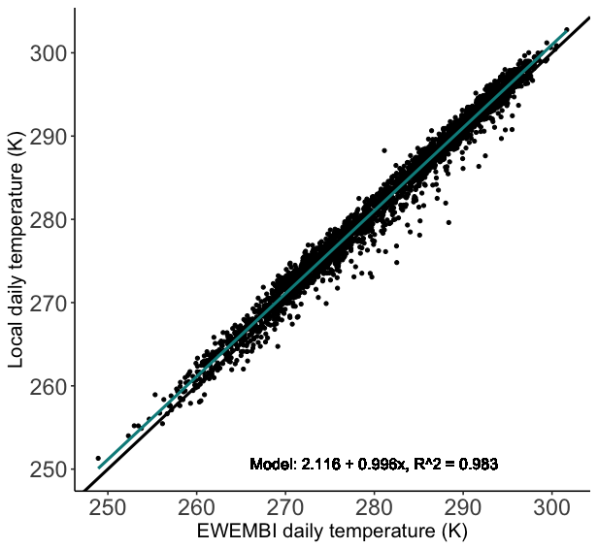
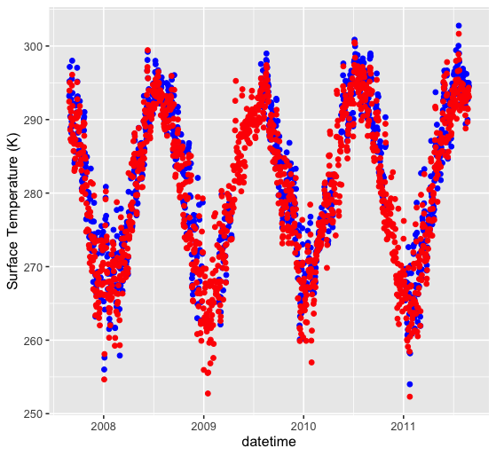
Daily Temperature
EWEMBI
LOCAL

Slide 3
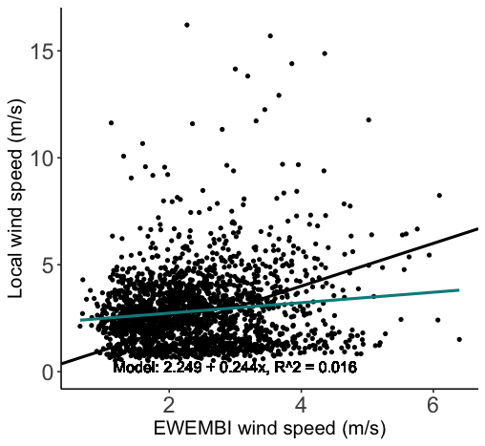
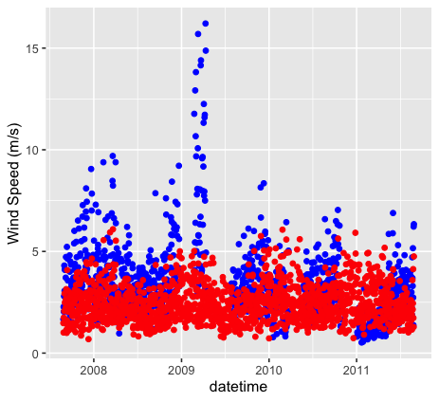
Daily Windspeed
EWEMBI
LOCAL

Slide 4
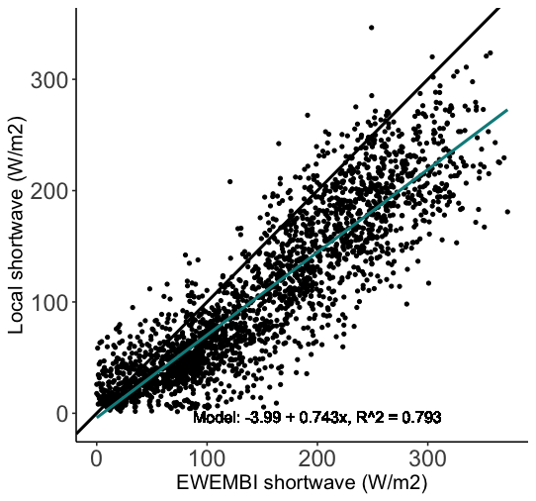
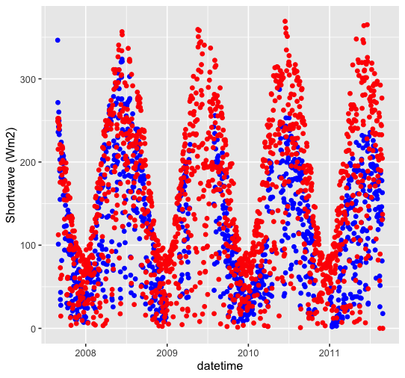
Daily Shortwave
EWEMBI
LOCAL

Slide 5
Filtered Plots (includes location ’loon’ and ‘harbor’)

Slide 6
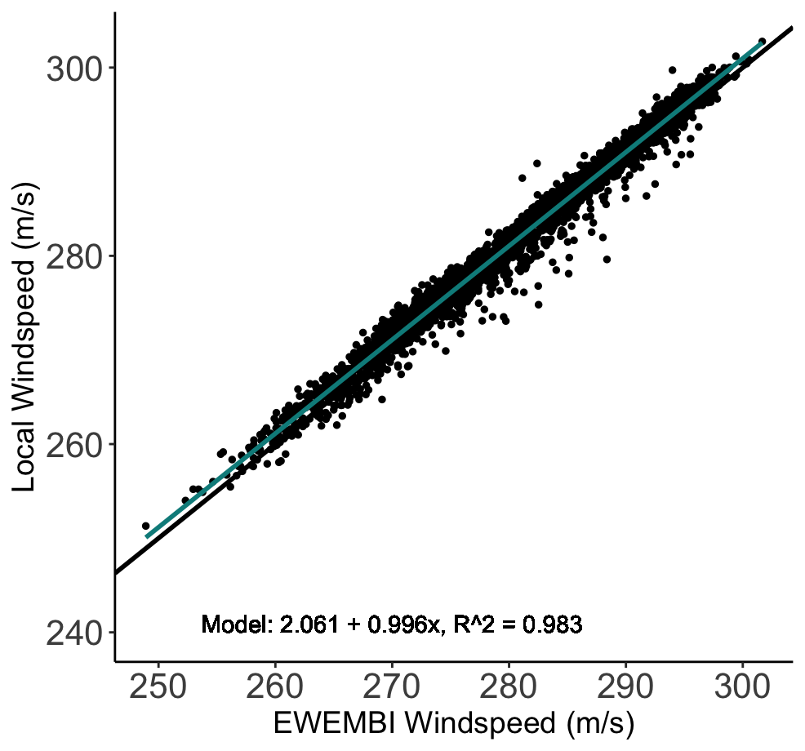
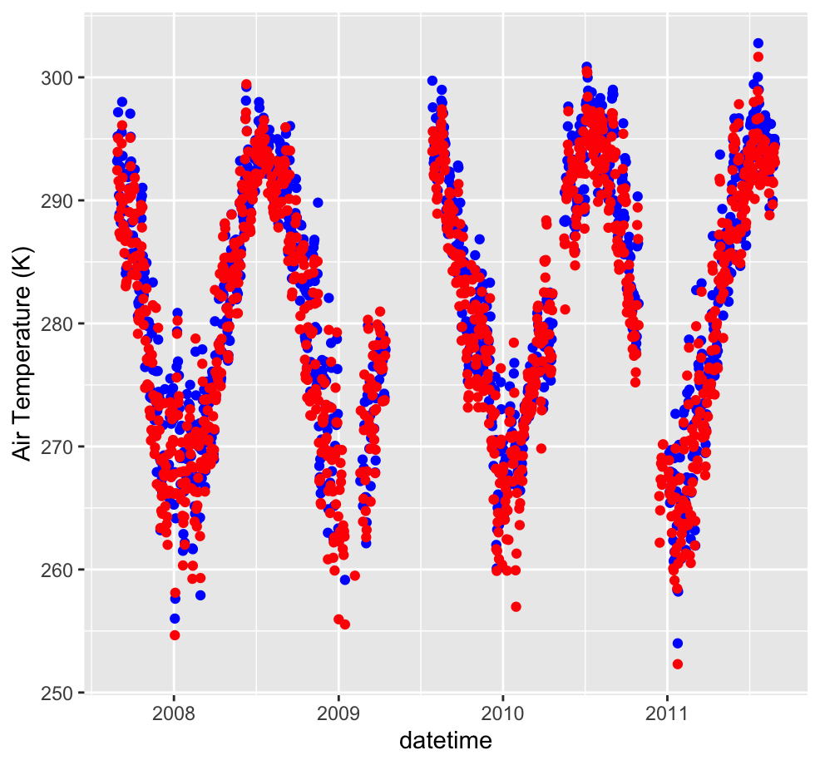
Daily Temperature
EWEMBI
LOCAL

Slide 7
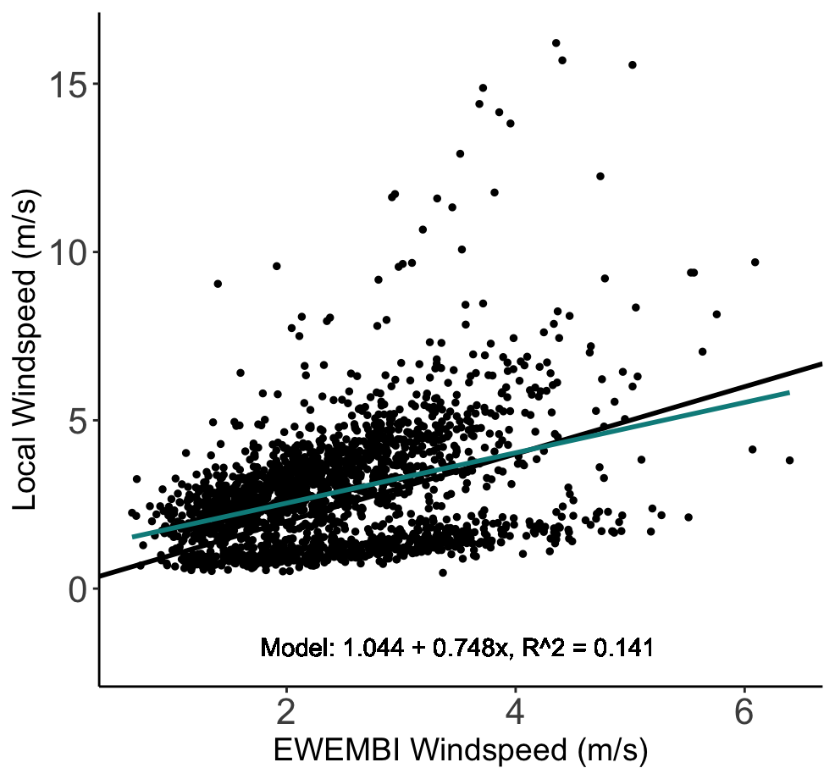
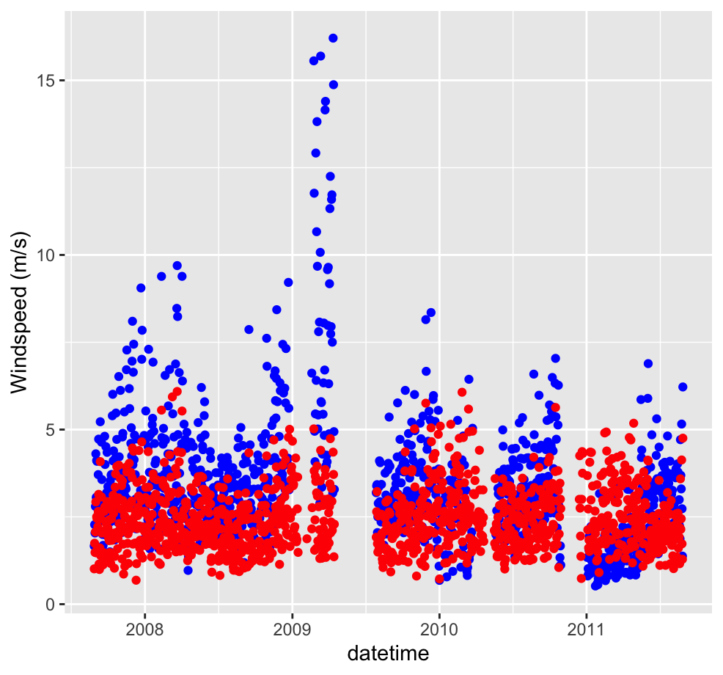
Daily Wind Speed
EWEMBI
LOCAL

Slide 8
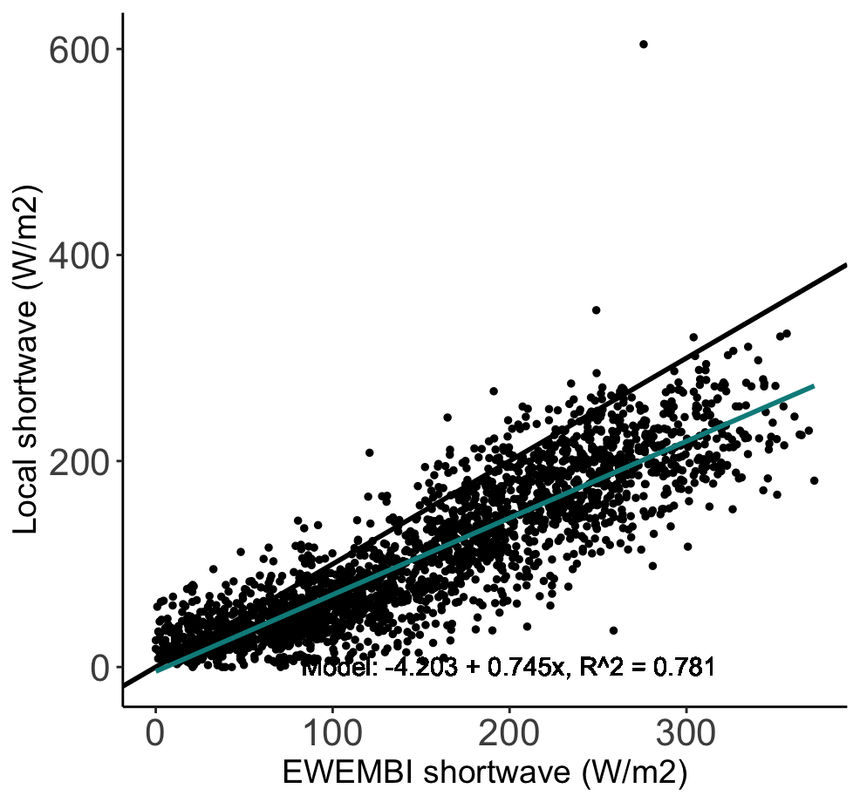
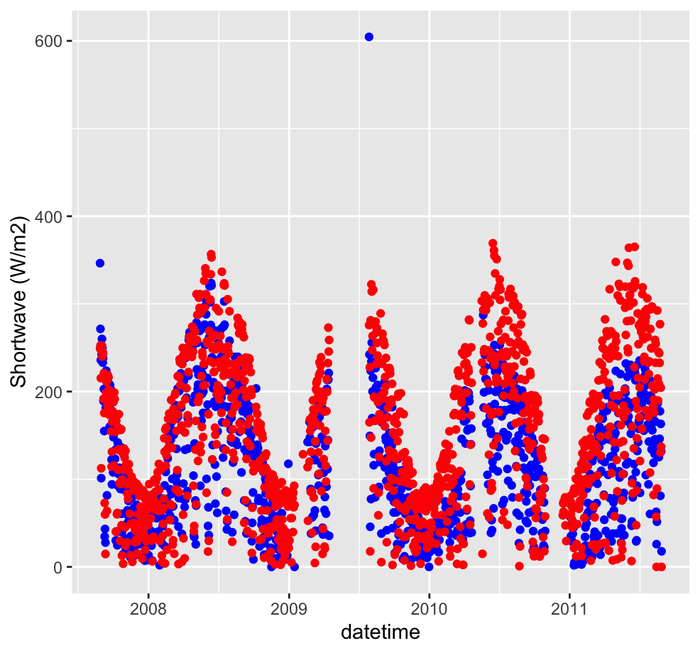
Daily Shortwave
EWEMBI
LOCAL

