Slide 1
All models working on Ensemblr
Integrate climate models. (models from ISIMIP)
Find a good set of years and calibrate
Understand model specific uncertainty by reading extensively into each
1) initial condition uncertainty; 2) boundary conditions uncertainty; 3) process uncertainty and 4) parameter uncertainty.
Climate model uncertainty: generate predictions using CM’s. Uncertainty is 95% interval of percent change in temperature (and ice cover?)
Parameter uncertainty: Use a MCMC approach and make an ensemble. Uncertainty is 95% interval of the ensemble members.
Model process uncertainty: make ensemble based on sample of parameters, make an ensemble model and
Take the 95% interval.
Total forecast uncertainty: propagate from previous three.
Climate scenario uncertainty: Difference in percent change of temperature from each climate model.
Notes:
Start by using one of the RCP’s.
Explore ISIMIP data
Downscaling climate models.
Present – 2199
Use response variable thermocline depth,
Figures

Slide 2
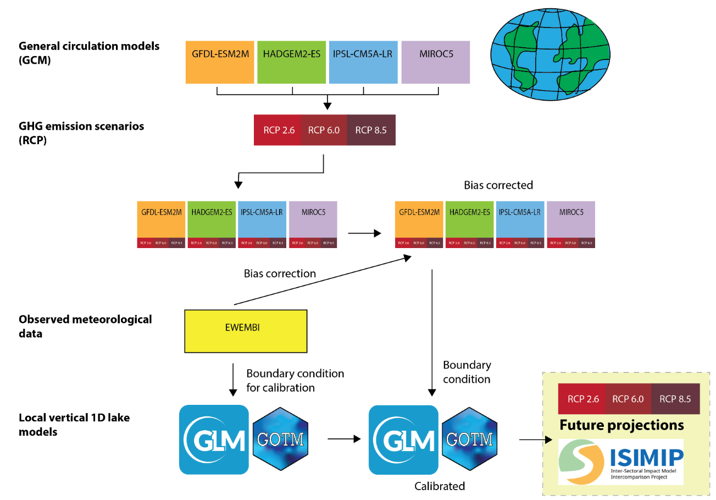
Notes:
Download ewembi data and use that to calibrate Sunapee

