Slide 1
Game of Life
Jacob Evans
Anthony Jones

Slide 2
Game of life
The game of life is a grid of cells where each cell is in the state of being alive or not. The next generation of the game depends on the current generation and the following rules:
Any live cell with fewer than two live neighbors dies, as if caused by under population.
Any live cell with more than three live neighbors dies, as if by overcrowding.
Any live cell with two or three live neighbors’ lives on to the next generation.
Any dead cell with exactly three live neighbors becomes a live cell.

Slide 3
User Statement
Design a game named game of life that will provide the user a grid of cells in which the game will appear to be playing its own self.
Game board consist of a grid of cells for gameplay
Each “alive” cell will be indicated by a full-shaded green cell
Each “dead” cell will be indicated by the default non-shaded white cell

Slide 4
Design
Design using :
HTML – Used as the platform for all content
CSS – Used as the main tool for styling
Javascript – Used as the tool for functions and methods
Jquery – Used a tool for quering

Slide 5
User Interface
The user interface provides a board where the cells live and die
If cell is alive, then its background color is green.
If cell is dead, then its background color is white.
Provides an area at the bottom where the next generation can be incremented by either 1 or 23
3 Control Buttons are implemented
START: Auto-plays the game of life.
STOP: Stops the game.
RESET: Resets the game board for another use.

Slide 6
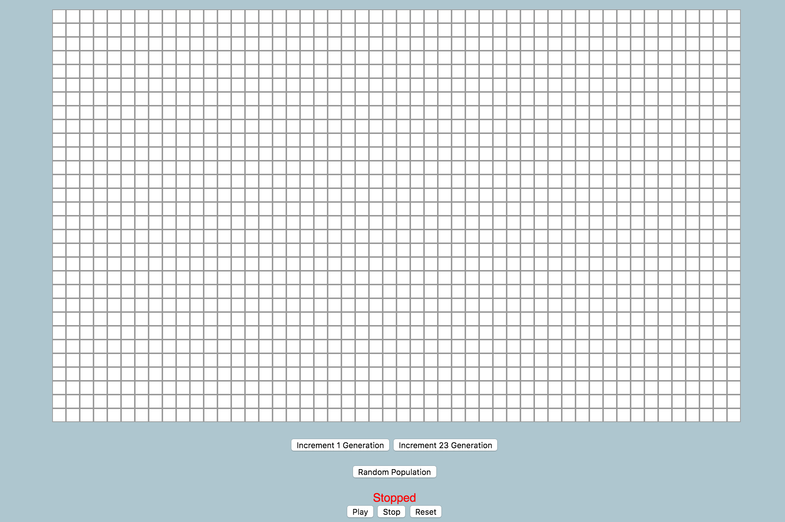
User Interface

Slide 7
Development - Overview
Game of Life was created as a JavaScript Function, and JavaScript’s prototype object was utilized to create a “GameOfLife” object.
jQuery was used to push and pull functionality to the HTML DOM(Document Object Model).
The game used HTML tables to create the board and its cells.
The game JavaScript logic was split into two areas:
Game Controls
Board Creation

Slide 8
Development – Game Controls
The JavaScript Game Control logic contains the following methods:
play();
stop();
reset();
random();
nextGen();
multiGen();
The Game Control logic is attached to buttons on the main HTML page.
The methods play(), stop(), and reset() start the game, stop the game, and reset the board respectively.
The method random() will create a board with randomly chosen population.

Slide 9
Development – Game Controls
The nextGen() method is the main piece of logic that perform the checks on each cell of the game.
It checks each cell for the following criteria:
Any live cell with fewer than two live neighbors dies.
Any live cell with more than three live neighbors dies.
Any live cell with two or more live neighbors lives on to the next generation.
Any dead cell with exactly three live neighbors becomes a live cell.
The multiGen() method runs a for loop of nextGen() to a specified amount. For this project, it will run 23 times. A button on the main HTML page is set up to perform this function.

Slide 10
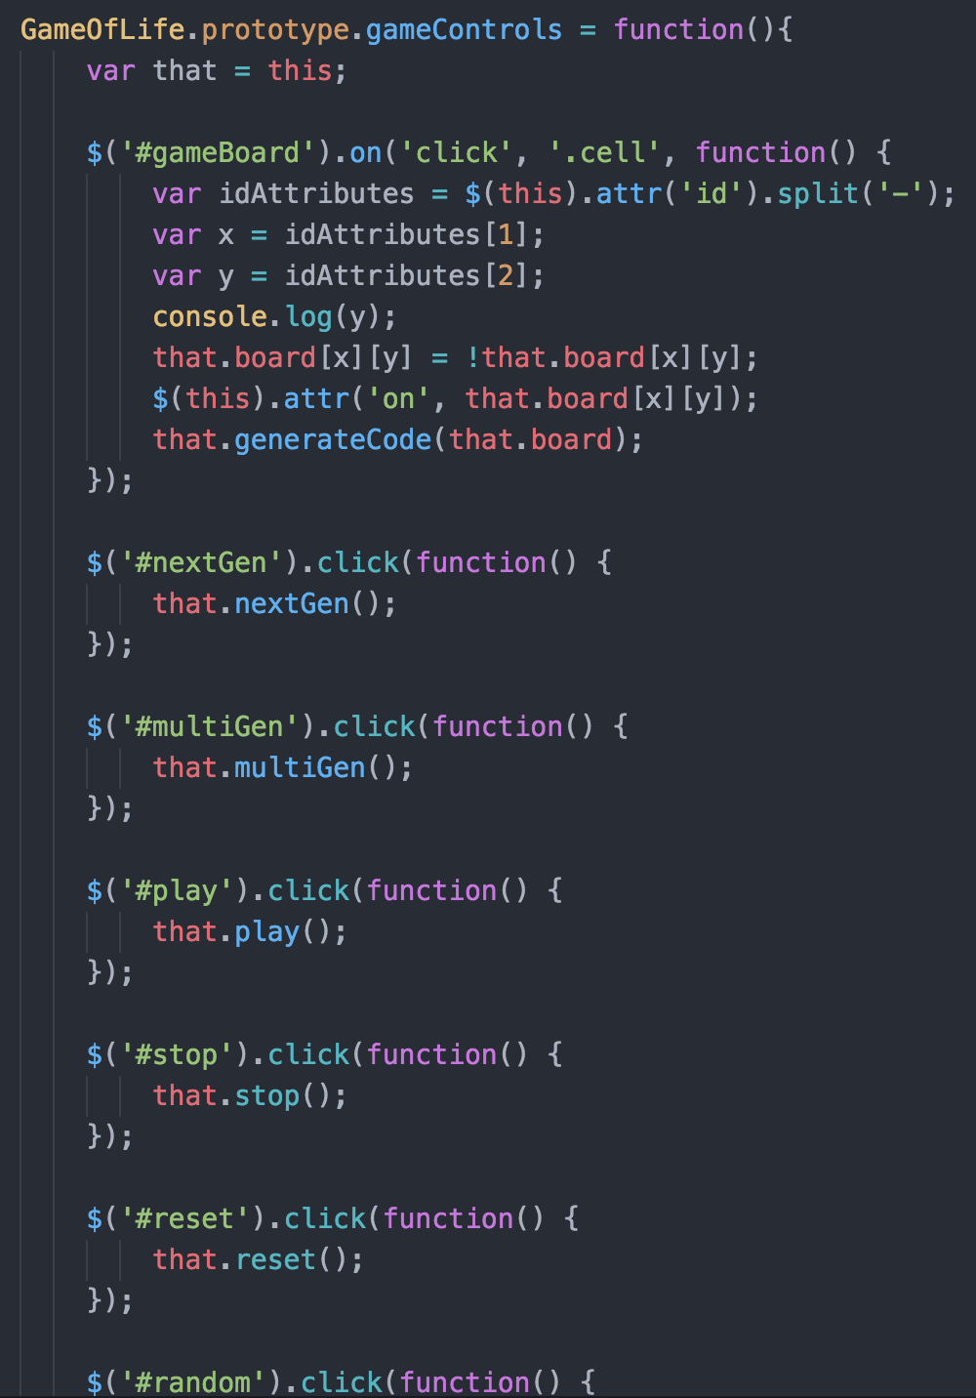
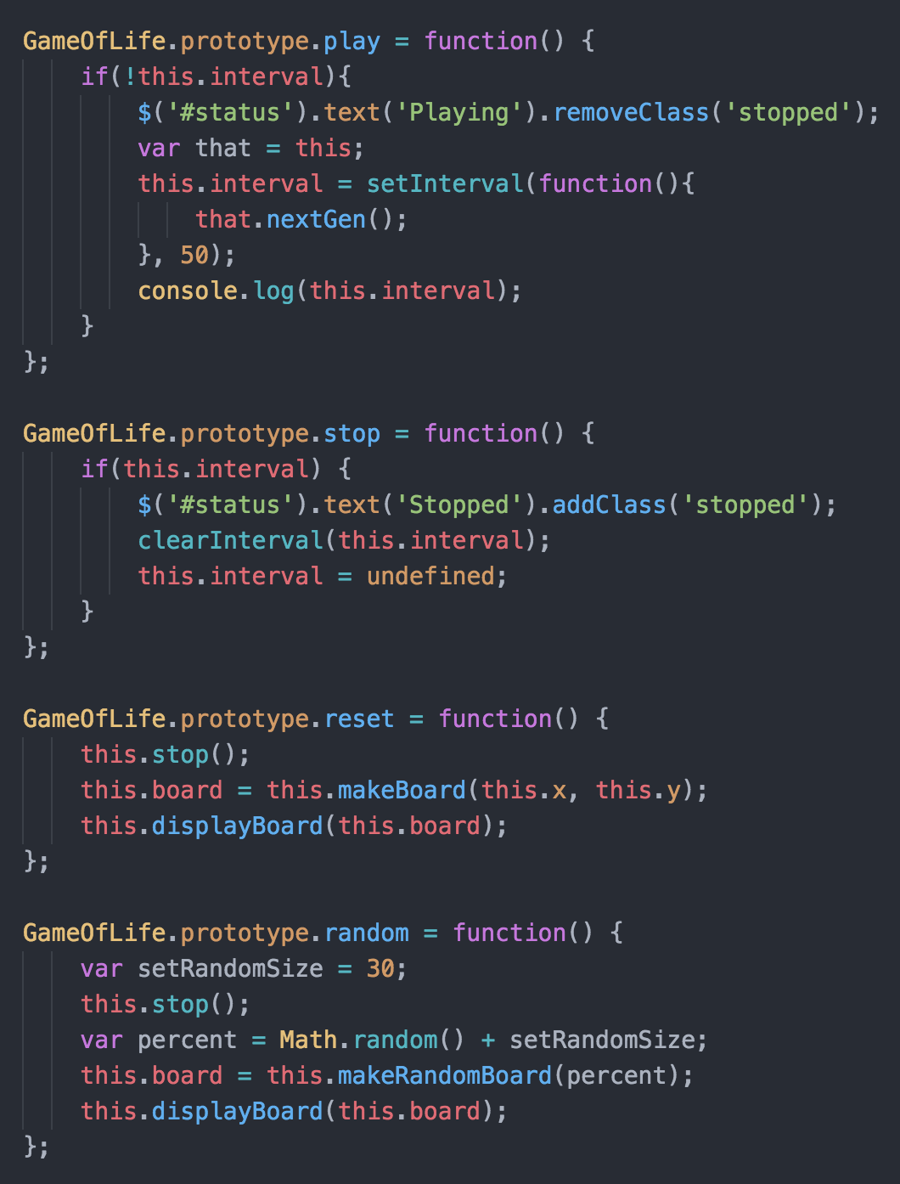
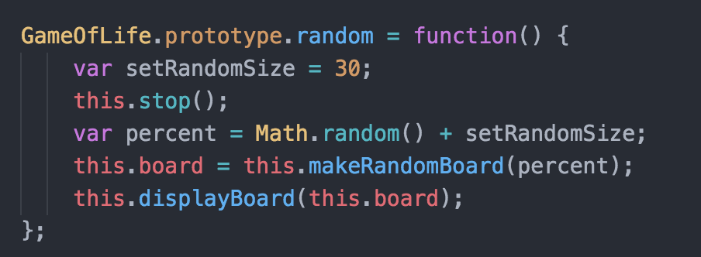
Development – Game Controls

Slide 11
Development – Board creation
The JavaScript board creation logic has the following methods
makeBoard();
makeRandomBoard();
displayBoard();
decodeBoard();
generateCode();
Init();
The init() method just creates the initial board whenever a user first loads the webpage.

Slide 12
Development – Board creation
The decodeBoard() will take what the user has created and create a logical board for the game to use. It will be passed to the makeBoard() method.
The generatateCode() adds functionality to board that was previously created.
The makeBoard() method creates the 2-dimensional array required to store the game board logic.
The makeRandomBoard() method uses the random() method to help create a game board with a randomly chosen population. Each time a user clicks on the random button on the main HTML page, a randomly chosen population will be presented in the board.
The displayBoard() will create the HTML table with each cell in mind. It uses the logic previously made from the makeBoard() method.

Slide 13
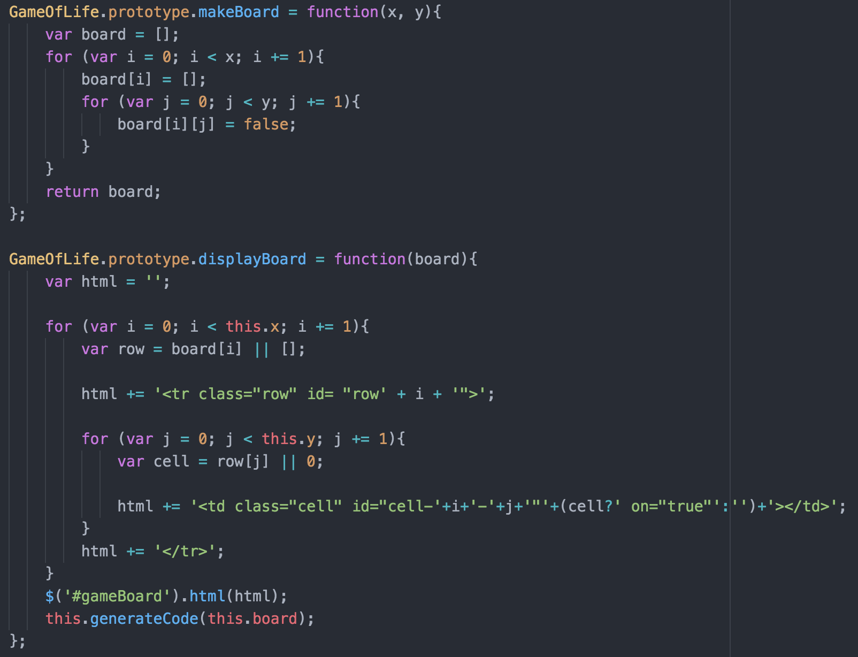
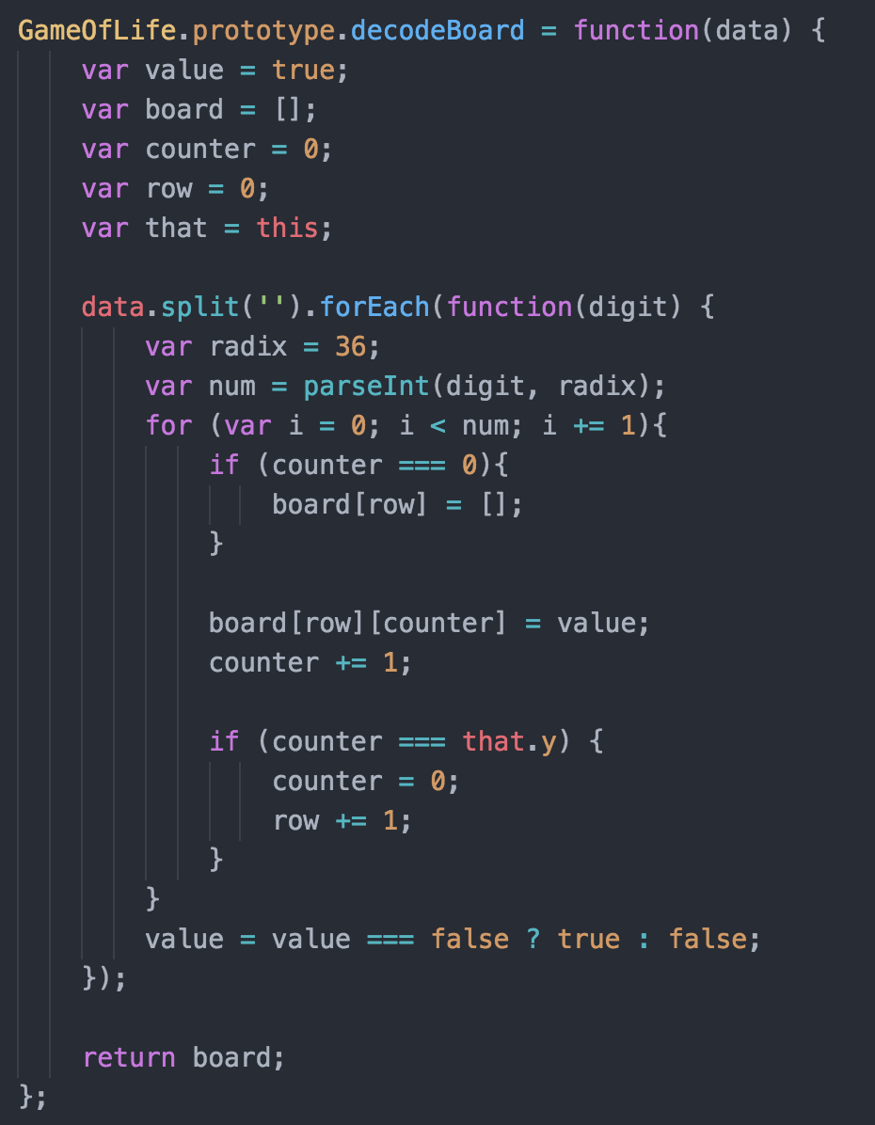
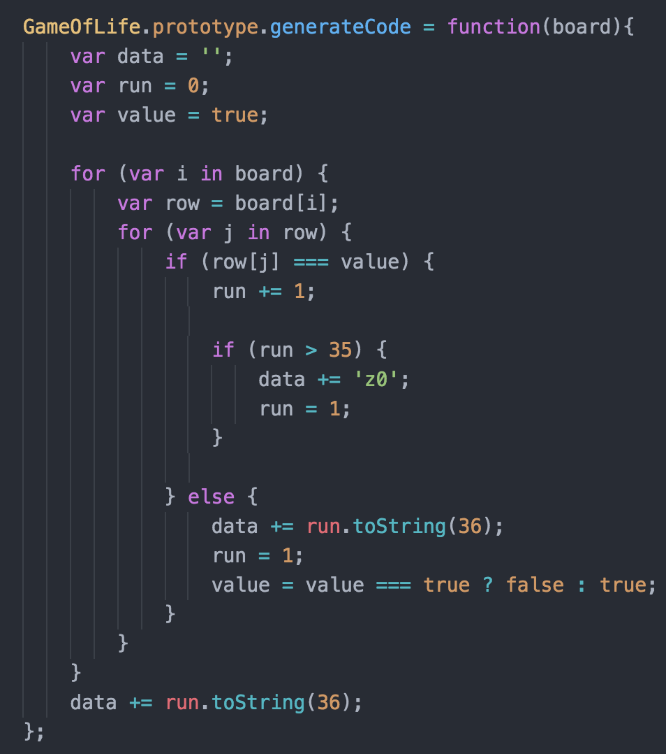
Development – Board creation

Slide 14
Increment Generation
Board must have at least a size of 1 population for any increment generation functionality
When population meets standard, then 4 stated rules begins and game play begins
Shows an instance of the next calculated grid population and positions of alive cells as well as cells that died
Multiple clicks results in multiple grid result instances of that given scenario

Slide 15
iNcrement generation 23
Board must have at least a size of 1 population for for the 23 increment generation functionality
Shows an instance of the next 23 calculated grid population and positions of alive cells as well as cells that died
It works by calling the function 23 times to achieve this effect with the click of a button
Multiple clicks will give results that are in multiples of 23

Slide 16
Random Population
Board can be already populated with alive cells or board can be cleared with no cells alive for the random population to function
Great way to see random simulations of game play with random cells alive and dead
Multiple clicks results in multiple instances of grid population set up scenarios
Performs by using the Math.random function and adding with a predefined constant

Slide 17
Play button
Play button executes and only displays results if there is 1 or more alive cells
Play continues until user clicks the stop button. User can watch the result of gameplay on the grid
Play is resumed by clicking play when the game is in “stopped” mode of operation
After the first click of the play button, subsequent clicks are ignored and execution of gameplay continues

Slide 18
Stop and reset button
Game must be in “Playmode” and multiple alive cells to see the effects of stop
Stop function works by a boolean value. When true, the status of this play interval changes and that interval becomes undefined which internes stops the game play
Reset button works by calling stop function, recreating an new board and displaying it

Slide 19
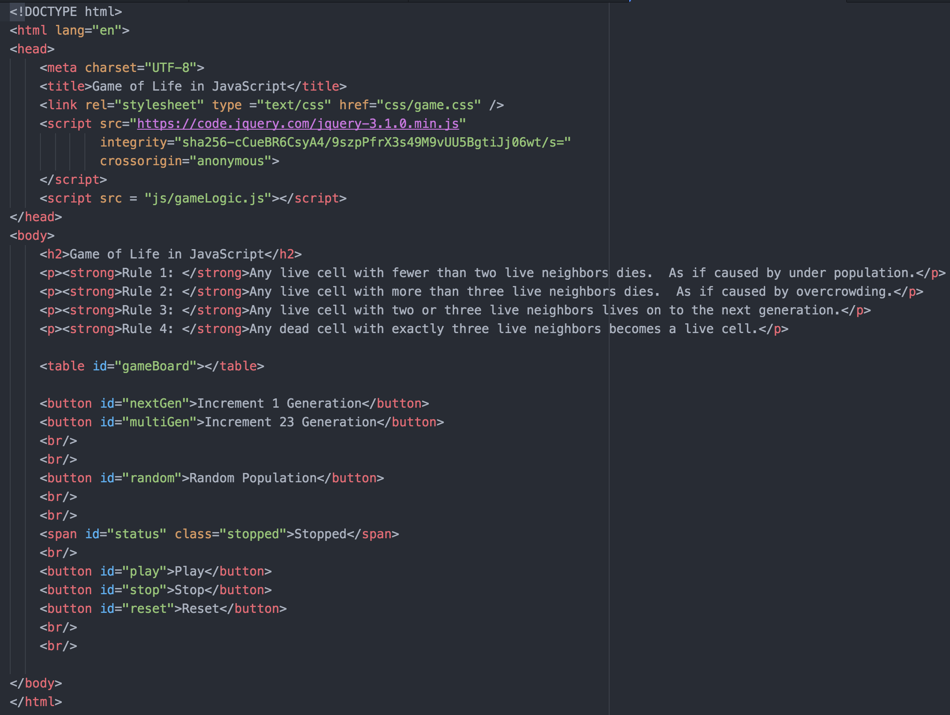
Snippet of code for incrementing in HTML

Slide 20
Testing
Browsers used for testing:
Google Chrome
Apple Safari
Mozilla Firefox
IDE’s used for development:
Github Atom
JetBrains WebStorm

Slide 21
Debugging
Used debugger on Safari’s developer console
Was able to view problems and correct during development
Step through function by function to catch problems and correct
Used online help for debugging problems

