Slide 1
Cookpy
Mark Bernhardt
Andrew Thomson
Jacob Beneski

Slide 2
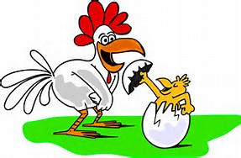
Theme and Design Process
Our base language is Python
Loosely cooking themed
Stack based language with strong ties to math functions

Slide 3
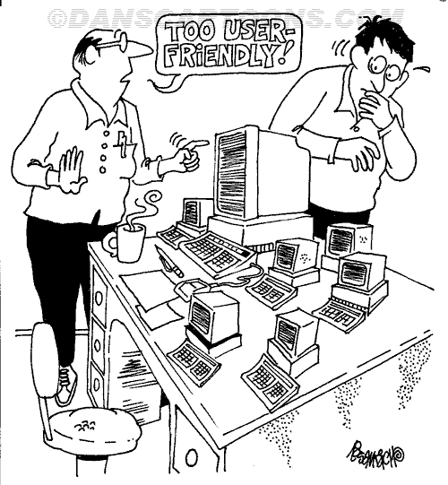
Overview of Features
All basic math functions
Variables
Input and Output
Comments

Slide 4
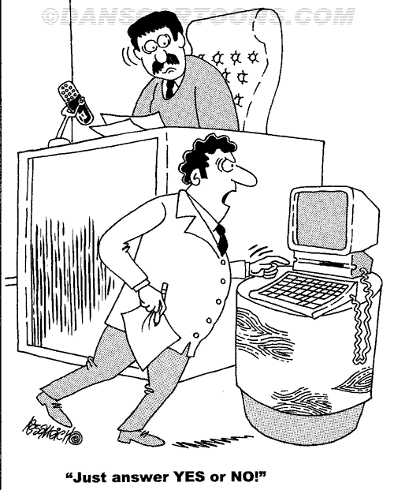
Limitations
No function support
No String support
No loops

Slide 5

Demo
Quick Demo

Slide 6
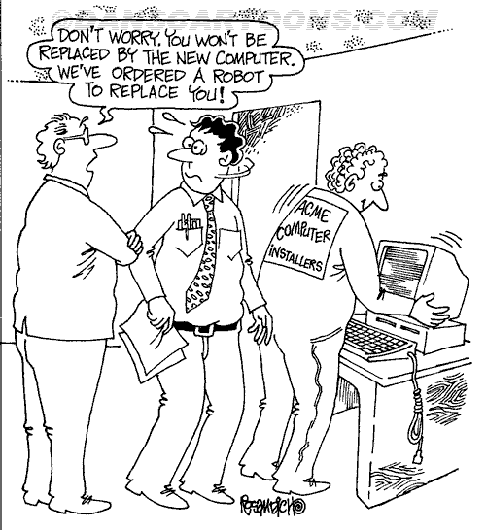
What Next
Add support for Strings
Add support for Functions
Support for loops

