Slide 1
Cookpy
Mark Bernhardt
Andrew Thomson
Jacob Beneski

Slide 2
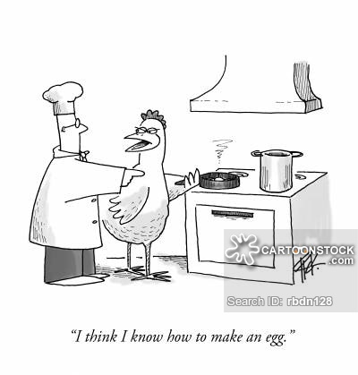
Theme and Design Process
Our base language is Python
Loosely cooking themed
Stack based language with strong ties to math functions
Notes:
We chose python because it is a fast, typeless language that can easily handle file input, math, output and other necessary features. Python was flexible enough to handle what we wanted to do with out language, and made it easy to implement a stack that could handle multiple types of objects. We chose a cooking theme as it is interesting, and something we all enjoy in our group.

Slide 3

Overview of Features
All basic math functions (+,-,/,*)
Global Variables
Input and Output
Comments
Notes:
Cookpy has support for all the basic math functions (+,-,/,* as well as int division) Variables, and input output. Variables can be stored, and recalled on demand, and anything that fits in the stack canbe stored as a variable. We also support comments in the source code.

Slide 4

Limitations
No function support
No flow control
No String support
No loops (for, while, etc.)
No built in debugger
Notes:
We where unable to implement all the features we wanted due mostly to time constraints. We wanted to implement functions and flow control so that the code can run out of order. Cookpy also doesn’t support Strings or other objects than ints and floats. We also don’t have loops or a debugger built in.

Slide 5

Demo
A demonstration
Mix -Add
Skim -Subtract
Serve -Print
Pack -Save A Var
Trash -Delete A Var
And Much More!
Notes:
Hopefully it works!

Slide 6

What To Do Next
Add support for Strings
Add support for Functions
Support for loops
Notes:
If we could continue this project we would add higher level features such as functions, and other object types. We also would implement other features such as a debugger.

