Slide 1
Grounding Language with Points and Paths in Continuous Spaces
Berkeley
N L P
Jacob Andreas and Dan Klein UC Berkeley
Notes:
Today we’re going to talk about grounding natural language with paths through continuous state spaces

Slide 2
Formal grounding
On June 26th, Facebook stock cost $65 per share
quote {
date: 2014-06-26,
stock: FB,
price: $65
}
Notes:
Here’s a problem we’ve done a lot of work on in semantics: given a natural language sentence, say “On June 26th, Facebook stock cost $65 per share”, turn it into something that looks like a database record. Lots of useful things in this framework: IE, simple question answering, even generation.

Slide 3
Perceptual grounding
On June 26th, Facebook stock rebounded after a bruising swoon
?
Notes:
Here’s a related problem that’s less well studied: what do we do with sentences like “On June 26th, Facebook stock rebounded after a bruising swoon.” There’s clearly lots of information in this sentence, but it doesn’t fit neatly into the kind of slot-filling view of semantics that the previous example suggested. Indeed, if we ask someone to explain what this sentence means, they might draw a picture like this:

Slide 4
Perceptual grounding
On June 26th, Facebook stock rebounded after a bruising swoon
Notes:
In classical semantics we build up a logical representation of sentence meaning compositionally, with things like conjunctions, negations and quantifications over the smaller constituents of a sentence. Here there’s a compositional language being used as well, but it’s being used to build up a rich description of a path through a continuous configuration space---here just the real line, on which the price of Facebook shares are moving up and down.

Slide 5
Perceptual grounding
On June 26th, Facebook stock rebounded after a bruising swoon
A after B ➔ A, B
A before B ➔ B, A
rebounded ➔ { sgn(slope) = +1 }
bruising ➔ { sgn(slope) = -1,
abs(slope) = +2.3 }
Notes:
For things like this we probably can’t write down a formal semantic grammar, as we do in mapping from text to logical forms, but
we clearly need some kind of compositional calculus---something to express the idea that
“after” tells us that there are two events, and the first one in the sentence occurred later in time than the second one.
If we instead have “before” the order of the events would have reversed.
The word “rebounded” tells us that the first derivative of our only parameter in this simple configuration space is negative---we’re going up---
while the word “bruising” tells us that we’re going down, and we’re going there fast
==

Slide 6
Continuous spaces everywhere
On June 26th, Facebook stock rebounded after a bruising swoon
A deep red sunset
Keep a little to the left of the post
Beat the eggs gently, until they form stiff peaks
Notes:
This is not just for finance---language describing a location or a traversal through a continuous configuration space comes up everywhere, from visual perception
to navigation
and we’ll eventually need it to handle much harder cases like recipe following
So our goal today is to solve something analogous to the semantic parsing problem for these kinds of examples, so that we can learn to map from language to points and paths in continuous spaces.

Slide 7
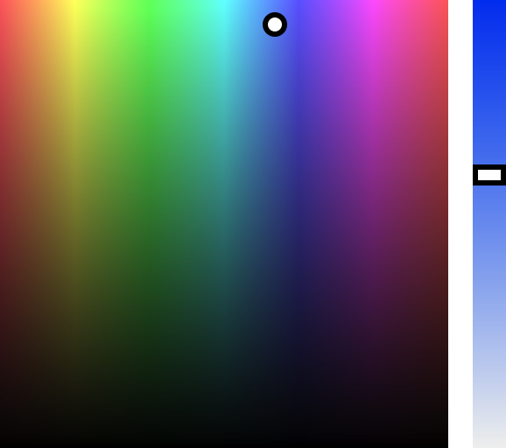
Three tasks
Color
Time series
Navigation
Notes:
We’ll look at three tasks in grounded semantics:
predicting colors from their descriptions,
predicting stock market time series from financial headlines,
and following navigational instructions on a map.

Slide 8
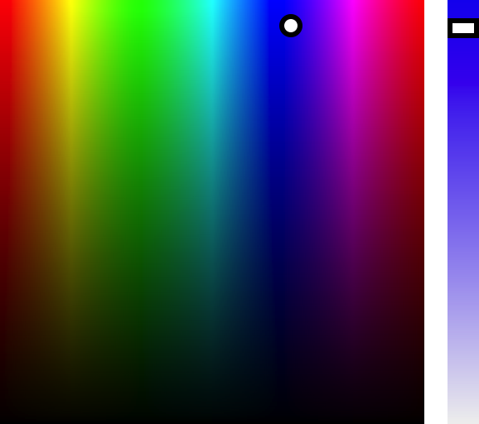
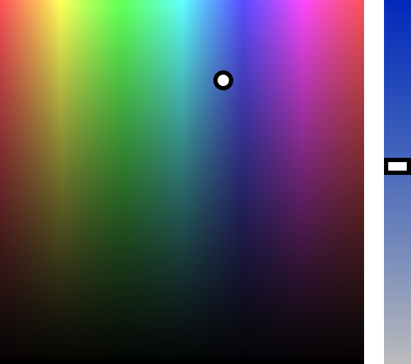
Predicting colors
H
V
S
dark pastel blue
pastel blue
blue
Notes:
Let’s start with the problem of predicting colors given their names.
Might reasonably ask why there’s anything to do here---why this isn’t just a database lookup. Well, for simple colors probably can just use a database, but there’s a reasonably rich compositional language that we use to describe colors,. Easy to build up something you can easily visualize, but named in a way you’ve never heard before.
We can represent any color as a set of three coordinates: a hue, a saturation, and a value, respectively shown as H, S & V on the left-hand plot.
calling something “blue” tells you its hue,
calling it “pastel” changes the saturation,
and calling it “dark” changes the value.
Pedagogically useful, because it lets us address the feature-learning part of this modeling problem without any temporal or event structure.

Slide 9
Regression model
H
V
S
dark pastel blue
pastel blue
blue

Slide 10
Regression model
H
H 216
S 43
V 75
S
V
0
0
-40
0
-37
25
216
80
90
dark
pastel
blue
Notes:
Some more intuition about what’s going on here---One of the consequences of using this kind of linear model is that we have a straightforward interpretation of the composition operation: because we chose a bag-of-words featurization, we can think of each item in the lexicon as being associated with its own (hue, sat, val) triple, and the linear map on the previous slide as just adding them together. So for “dark pastel blue”, for example, we might have that “dark” decreases value, “pastel” decreases saturation but increases value a bit, and “blue” sets hue and a baseline saturation and value appropriately, and we add them all together to get our original vector back.

Slide 11
Regression model
dark
pastel
blue
H
0
0
216
216
S
0
+
-37
+
80
=
43
V
-40
-25
90
75
Notes:
So how do we do this? Recall that we’re trying to predict a point in color space---a three-dimensional vector. One simple model we might propose is just that every word is associated with its own vector, and we add all these vectors together to make our final prediction. So for “dark pastel blue”, for example, we might have that “dark” decreases value, “pastel” decreases saturation but increases value a bit, and “blue” sets hue and a baseline saturation and value appropriately, and we add them all together to get our original vector back. This obviously corresponds to a fairly naïve view of semantics, but it seems like it will capture the behavior we were just looking at.

Slide 12
Regression model
dark
pastel
blue

Slide 13
Regression model
H 216
S 43
V 75
dark pastel blue
{dark, pastel, blue}
Notes:
How do we encode this as a probabilistic model. One easy thing is just to wrote down the following model: first define a set of unigram features on the text.
We’ll call the 3-dimensional vector of color values a random variable V; for a linear model we also need some representation of our text as a vector. The examples we’ve seen so far suggest that a bag of words model might be enough to capture most of the interesting behavior for the color task, so we’ll start there,
and define the random variable T as the vector of indicator features on single words in the color name.
Then we’ll say that the relationship between these two things is just a noisy linear map, parameterized by a matrix \theta. Hopefully you can convince yourself that the rows of \theta correspond to per-word coor parameters, and that prediction works just as we had asked for before. Now, given a set of supervised (name, color) pairs, we want to find the value of theta that maximizes the probability of the observations. This is just linear regression—we’re not doing anything complicated here, but if we have any hope of capturing any kind of interesting behavior with this kind of model, we need the simple case to work.

Slide 14
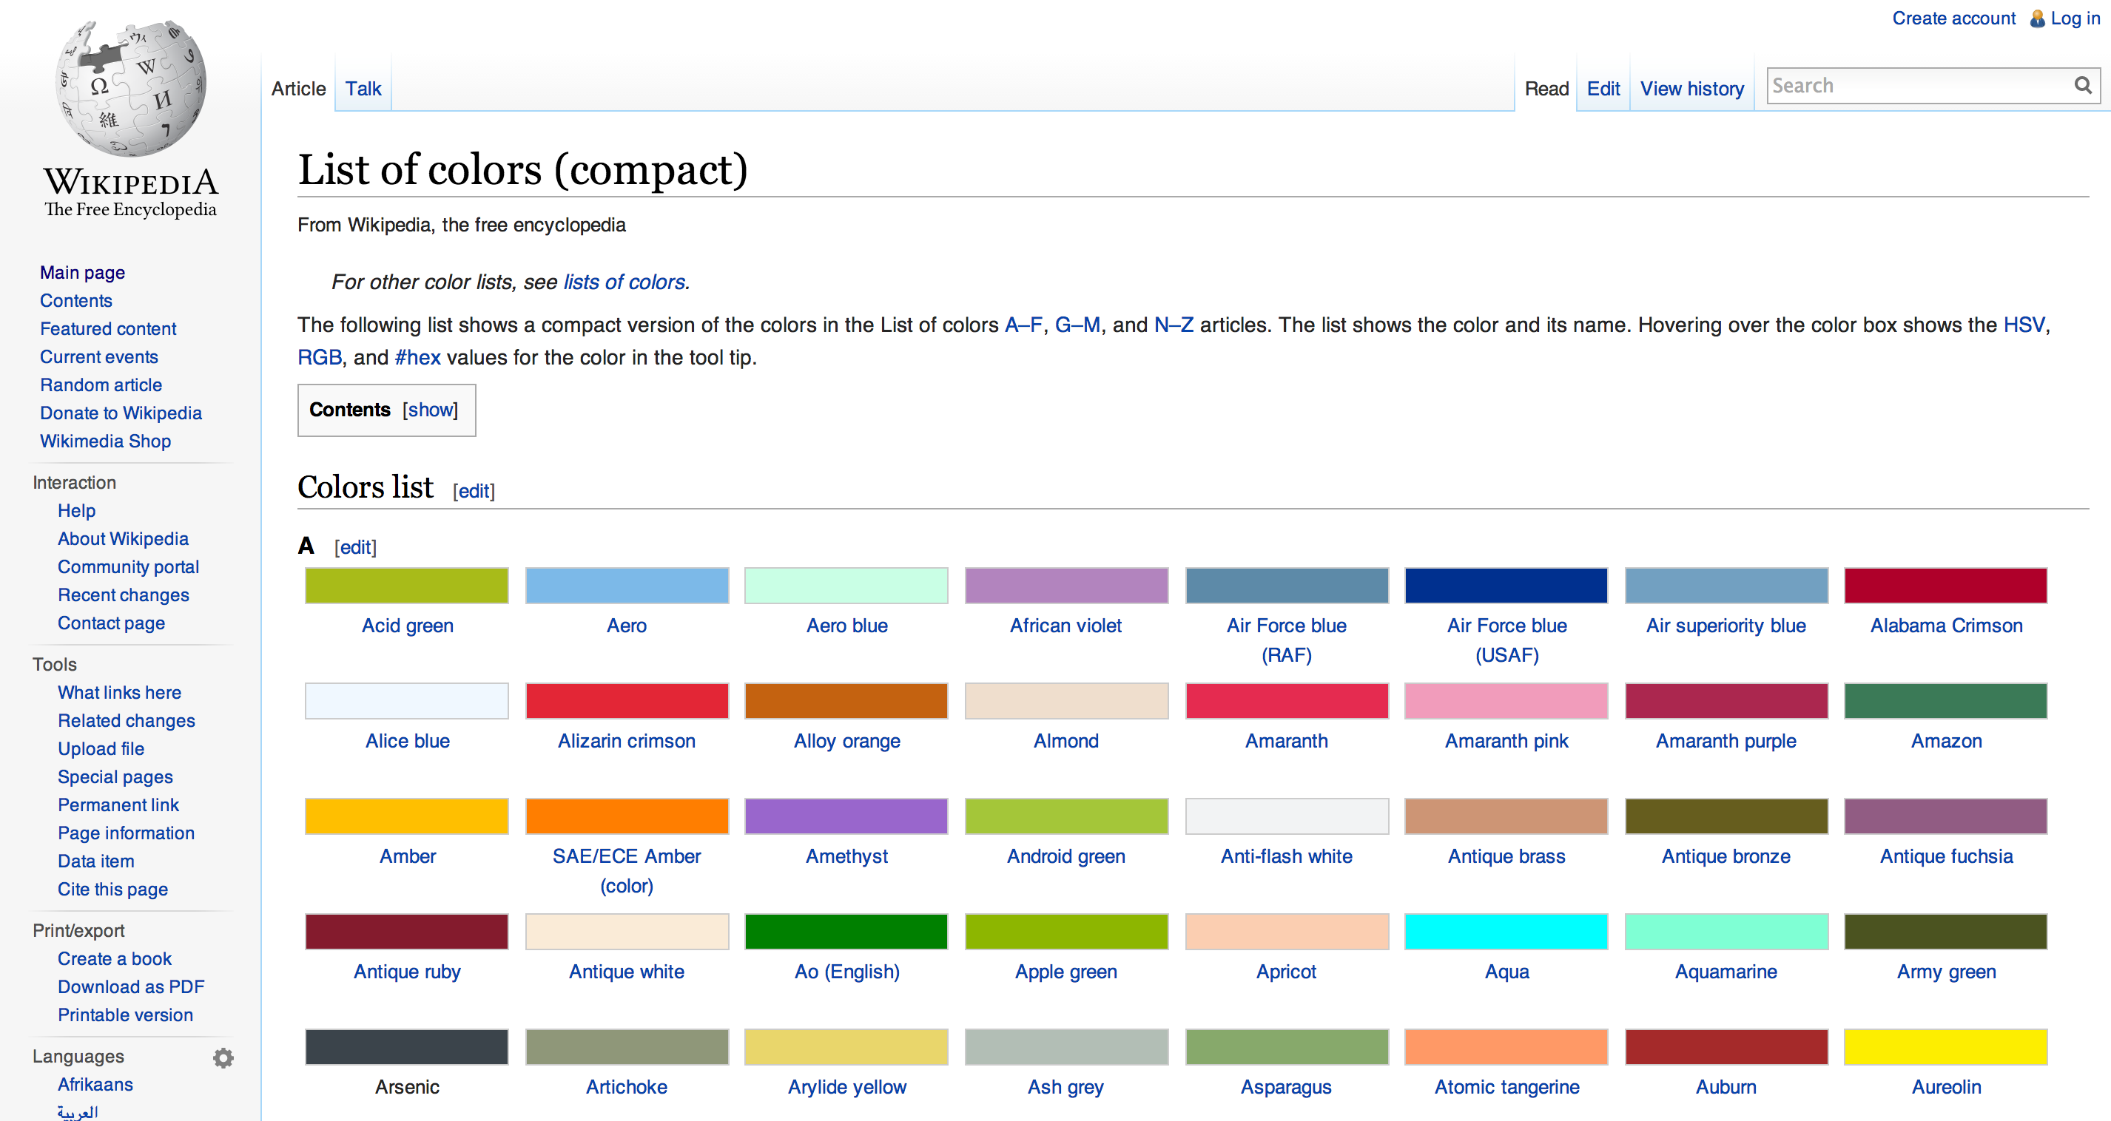
Experiment setup
Notes:
To evaluate this model, we collect a set of about 400 colors from English Wikipedia’s “list of colors”, along with their color-space coordinates. We divide these up into a train and test set, and fit the model on the train set to learn the weight matrix we were just looking at. One way of evaluating is to take the remaining color names, hand them to the model, ask it to make a prediction, then look at how far off our prediction is in color space.

Slide 15
Sample predictions
electric green
pale blue
dark brown
pale green
indigo
Notes:
Here’s a random selection of color names: the big patch shows our model’s prediction, and the small patch shows the reference color from Wikipedia. As you can see, these are basically right, and we seem (at least approximately) to be correctly learning the denotation of words like “pale” and “dark”.

Slide 16
Prediction error
Notes:
We can measure this more precisely by actually looking at the magnitude of the error we make in color space. We normalize all the axes to one, and compare our model with a random baseline, and a baseline which only gets to look at the last word of the name (which almost always denotes a hue). As you’d expect, our full regression model outperforms the random baseline, and outperforms the last-word-only baseline on most axes, and on average. It’s kind of hard to get an intuition for what a magnitude error of .15 means, though. So next, and for the rest of this talk, we’ll look at a slightly different evaluation.

Slide 17
A guessing game
pale blue
Notes:
The setup here is as follows: we present the system with a name, and two colors the name might describe. It makes a prediction based on the name,
and then selects the color from this pair closest to its prediction. We’ll measure the fraction of times this prediction is correct.

Slide 18
A guessing game
Notes:
We compare against the same two baselines; as before, our system is better (that difference is significant). Just for a little more intuition, we forced one of our colleagues to play the same guessing game; this isn’t scientific, but human accuracy on this task seems to be in the ballpark of 86%, so we’re doing well.

Slide 19
Predicting time series
1
2
stocks rebounded
after a bruising swoon
2
1
Notes:
Now that we have evidence that this sort-of-structureless base case can be learned effectively, let’s move to the full structured grounding problem, with the stock example we were looking at earlier. There are a couple of important things to note: talking about paths (richer than points); going to deal with full sentences,
which might describe multiple events;
have to figure out how to order those events in time, since might not correspond to surface order. As we said before, the hope here is we learn how “after” provides information about the ordering of the two events in this sentence, “swoon” and “rebound” tell us about the sign of the change associated with each of those events, and “bruising” tells us about the magnitude of the change.
==
Be clear that we assume time series segmented, but not text

Slide 20
Predicting time series
stocks rebounded
after a bruising swoon

Slide 21
Predicting time series
sgn(slope): -1
abs(slope): 3.1
curvature: 0.5
sgn(slope): 1
abs(slope): 2.7
curvature: -0.1
2
1
{after, a, bruising, swoon}
{stocks, rebounded}
after a bruising swoon
stocks rebounded
Notes:
So let’s start to put together an analog of that little regression model we were looking at earlier, but with event structure. We’ll make a few assumptions about the data: first, that the paths have been temporally pre-segmented into their constituent events (here the “falling” event and the “rising” event), and for ease of presentation we’ll also assume that the input text has been pre-split into spans, each of which only describes a single event. (Just so we’re clear, the model requires the supervised time series to be pre-split into events, but requires no corresponding segmentation of the text. The full model described in the paper is actually capable of doing inference over where those split points are located, but we’ll hide that now for ease of presentation.) So we end up with something like this.
As before, we’ll get a vector representation of each of these spans as a local bag of words; and we’ll do a corresponding thing with each piece of the path, transforming it into a feature-based vector representation which we’ll assume we have an easy way of turning back into a path when we want it. The features we pick are simple and largely domain-independent, parameterizing things like curvature, and the sign and magnitude of the change along each axis.
As before, we’ll create random variables for both kinds of vectors.
If we knew the correspondence between text and events, we could just add the same potential into the model as before and treat these as independent classifications, but one of the reasons this problem is interesting is that we don’t have that correspondence, so we have to be a little more clever.
Instead of predicting output variables directly, we’ll associate each span of text with a local prediction variable that we’ll call C, and a corresponding factor; these predictions look like the lines shown in purple. To figure out the mappings from these local predictions to the actual output variables, we’ll also introduce a set of latent alignments A, which take values in the index set of the output variables. We associate these with factors which look at text and their neighboring alignments.
Finally, we’re ready to produce our predictions: we add a final set of factors which encourage each V to look like all of the local predictions it’s aligned to. Here we’re just looking at these factors for the first span, for ease of presentation; in fact we build the whole bipartite graph. So you can see that the second output variable looks like the first span prediction, and the first output variable looks like the second span prediction.

Slide 22
Learning & inference
Need parameters for linear prediction model & log-linear alignment model: easy with EM
For small number of path segments, possible to sum exactly over latent alignments
Otherwise, approximation of your choice
Notes:
We need to learn parameters for this linear predictor, as before, and also for the alignment potentials. What do we do with this graphical model? Bipartite graphs like this are generally intractable to do inference on. If the number of events and spans is small, though, we can reasonably expect to get away with brute-forcing it; otherwise it’s pretty straightforward to do the approximate inference---here we’re just using Gibbs sampling, but this structure is obviously amenable to BP or other variational methods.

Slide 23
Experiment setup
Market rallies
to new highs
Notes:
For our data, we scrape several years’ worth of WSJ “MarketWatch” headlines, and corresponding hourly stock charts. For training and evaluation, we pair each headline with stock market behavior on both the day described, and the day before, so that we can capture multi-day trends. We assume each of the two days corresponds to a separate event.

Slide 24
Sample predictions
Reference
Predicted
[U.S. stocks end lower]₂ [as economic worries persist]₁
U.S. stocks end lower as economic worries persist
Notes:
As before, we can start by looking at some sample predictions from the model.
If we start with the sentence “U.S. stocks end lower as economic worries persist”, the model comes up with the following segmentation, and makes the following prediction. We see here that we can correctly identify that there are multiple events (i.e. that there was a negative change *today*, and also that there was a negative change yesterday), and correctly identify where the evidence for each of those things lives in the input sentence. And as a human this looks like a reasonable prediction. And we’re not so far off the reference.
===
Text first, then prediction, then reference

Slide 25
A guessing game
Notes:
So let’s play the same guessing game as before: here we compare our model to a random baseline, and a baseline which includes the whole regression model, but uses a single fixed alignment rather than summing them out. We beat them both, again the difference is significant, and again for reference here’s the human accuracy on this task, which is around 70%.

Slide 26
Peeking at parameters
sgn(slope)
abs(slope)
rise
0.27
-0.78
swoon
-0.57
0
sharply
-0.22
0.28
Notes:
It’s also instructive to look at the parameters the model learns, and verify that they correspond to our intuitions about the problem. Here they do: we see that “rise” provides evidence for a positive, but shallow, slope, that “swoon” provides evidence for a negative slope, and that “sharply” prefers a steep slope, and, interestingly, usually a negative one.

Slide 27
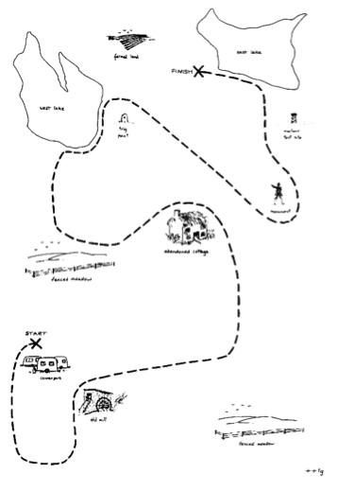
Following instructions
…
and then we're going to turn north again
and immediat-- well a distance below that turning point there's a fenced meadow
but you should be avoiding that by quite a distance
okay so we've turned and we're going up north again
continue straight up north
and then we're going to turn to the west on a curvature right sort of
…
Notes:
We claimed before that this was a pretty general framework for grounded language learning, so we’ll conclude by applying it to another task—here a problem of following navigational instructions previously described in a paper by Vogel & Jurafsky. The corpus looks like this, and you can see that it’s structurally pretty different from what we had before. Now there’s lots of moving around, lots of text, and that text is dialogue (complete with disfluencies etc.) rather than newswire. We use the same graphical model as before, and measure how accurately the model is able to predict transitions between landmarks that appear on the reference map.
We compare to a pair of reinforcement-learning-based systems for solving this task: Vogel’s own, and a policy gradient algorithm due to Branavan et al. It’s worth pointing out that this comparison isn’t exact, because our system is working on a strictly harder version of the problem—the other systems treat this as a discrete problem, and only have to name a landmark and a cardinal direction, while our system is able to move around to arbitrary points in space and has to learn to stay near landmarks.

Slide 28
Navigation results
Notes:
But if we project back onto the discretized version of the state space they use for evaluation, we beat Branavan et al. and come pretty close to Vogel & Jurafsky’s performance. So, as claimed, the model we’ve described seems to generalize pretty well to this completely different task.

Slide 29
Conclusions
New model for predicting grounded representations of meaning in arbitrary real-valued spaces
Beats strong baselines on a diverse range of tasks
Code and data available online at http://cs.berkeley.edu/~jda
Notes:
Financial data online for people to work with

