Slide 1
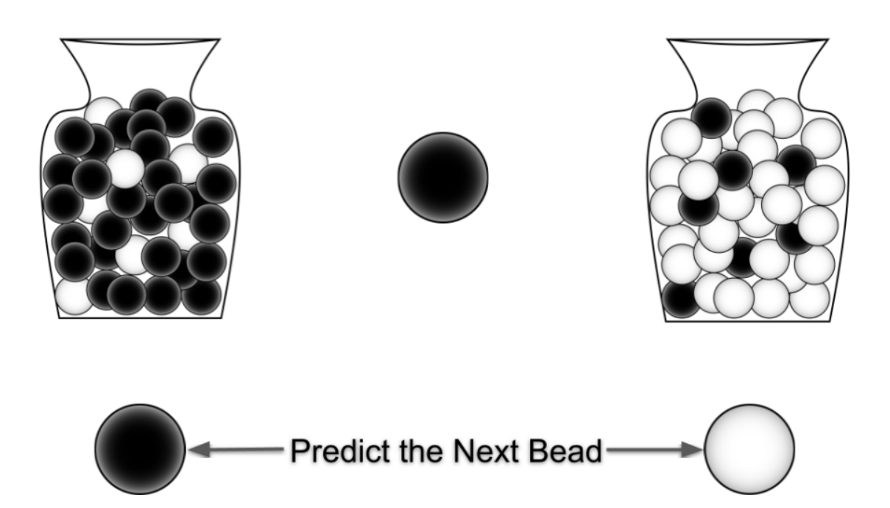
Center bead came from this jar.

Slide 2
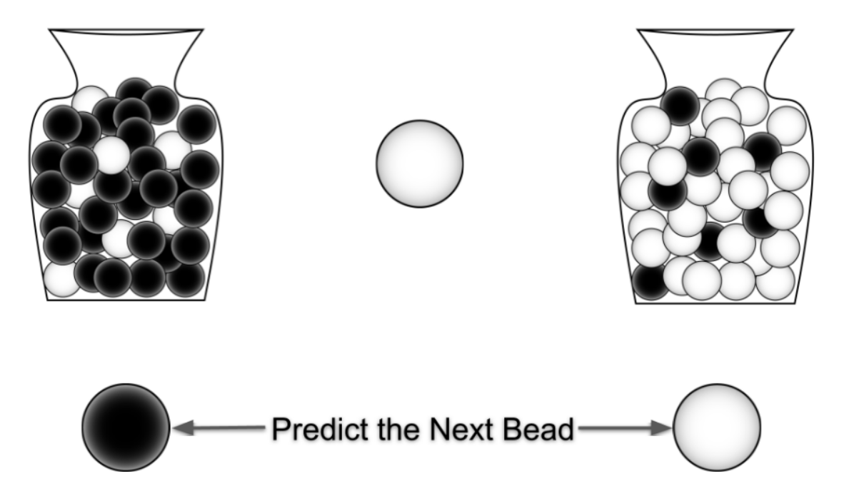
Center bead came from this jar.

Slide 3
Center bead came from this jar.

