Slide 1
Data Analysis Cap
Jacob Baboun

Slide 2
Species File
Species_info.csv
Raw file including species information
Contains strings only
Contains 5824 rows and 4 columns

Slide 3
Endangered Species
Summed and grouped species by status (endangered, in recovery …)
Identified species that need no intervention
Plotted a bar chart to provide a visual for number of species split by status
Identified species category and calculated the numbers of protected vs unprotected species by category

Slide 4
Recommendations
Mammals are the highest more likely to become endangered, while Vacular Plants are the least
The difference between the likeliness to become endangered between mammals and birds is high (low Chi square val), lower with fish and reptiles

Slide 5
Sheep
Yellowstone park has most sheep observations, Great Smokey has the least
We need a sample size of 520 sheep to determine with 90% confidence if the program implemented was able to lower the disease percentage from 15% to 10% at Bryce National Park
We need a total of about 2 weeks to collect the sample size data if we collect data simultaneously from all parks

Slide 6
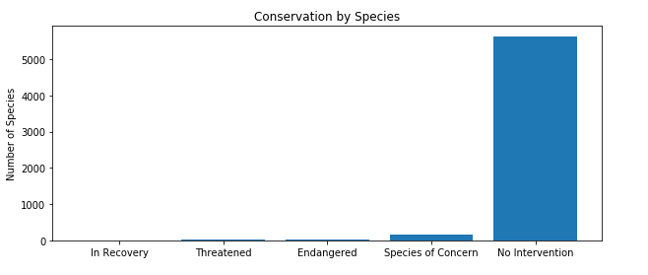

Slide 7
