Slide 1


Slide 2



Slide 3


Indices
- The quick brown fox jumped over the lazy dog
- 3.14
- 15/09/2024
The quick brown fox jumped over the lazy dog
Text embedding
model
Documents
[-0.1, 2.5, …, -1.67]

Slide 4

Search system
Indices
https://www.travelmediagroup.com/the-power-of-facebook-as-a-search-engine-2/
Documents

Slide 5

Recommendation system
Indices
https://www.shopagain.com/blog/product-recommendation-engines-what-is-it-how-it-work/
Documents

Slide 6

RAG system
Indices
https://www.superannotate.com/blog/rag-explained
Documents

Slide 7

RAG system
Indices
https://www.superannotate.com/blog/rag-explained
Documents

Slide 8
3
Create an index

Slide 9
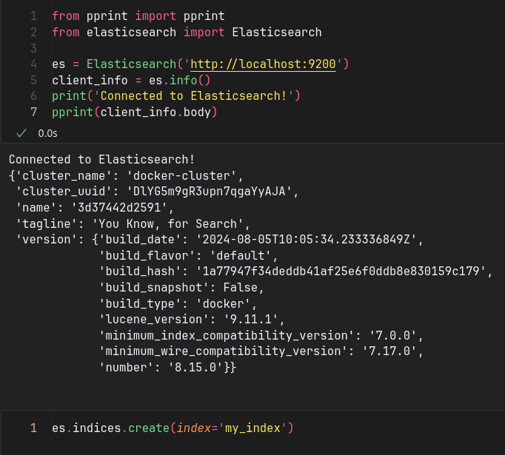
What is an index ?
Name
Price
Description
...
JSON
JSON
Product 1
Product 2
JSON
Product n
Product Index

Slide 10
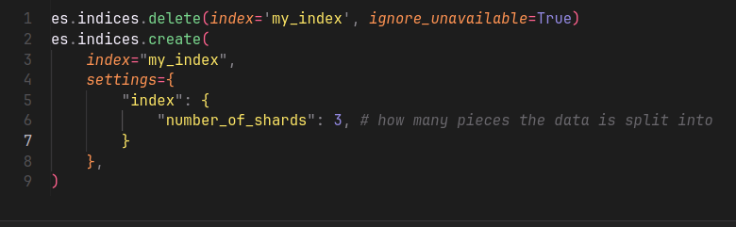
Shards & replicas
Number of shards = 2
Sharding
Product Index
Product Index

Slide 11
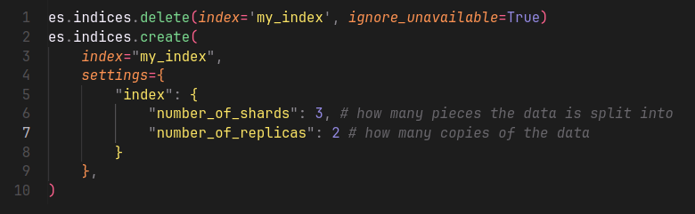
Shards & replicas
Number of shards = 2
Number of replicas = 1
Product Index
duplicate
Product Index

Slide 12
4
Inserting documents

Slide 13
Document
“Name”: “value”
“Price”: “value”
“Description: “value”
...
JSON

Slide 14
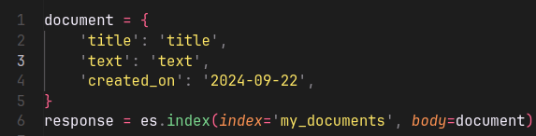
Document
insertion
mapping
Field | Type
created_on | date
text | text
title | text
JSON
X100
my_index
🛈 This process is called mapping and can be done automatically or manually. By default, ElasticSearch does it automatically.

Slide 15
5
Field data types

Slide 16
Field data types
insertion
mapping
Field | Type
created_on | date
text | text
title | text
JSON
X100
my_index

Slide 17

Field data types
Common types
Binary
  Accepts a binary value as a Base64 encoded string.
  Is not searchable and is not stored.
  Use _source (i.e., document) to get the data back.
Read more
encoding
IVBORw0KGgoAAAANSUhEUgAAAOEAAADhCAIAAADiVBORw0KGgoAAAANSUhEUgAAAOEAAADhCAIA….
Base64 representation

Slide 18
Field data types
Common types
Binary
Boolean (True / False)
Numbers (long, integer, byte, short, etc)
Dates
Keyword (IDs, email addresses, status codes, zip codes, etc)
Read more

Slide 19
Field data types
Objects types (JSON)
Object
Read more
{
"region": "US",
"manager": {
"age": 30,
"name": {
"first": "John",
"last": "Smith"
}
}
}
JSON
indexation
{
"region": "US",
"manager.age": 30,
"manager.name.first": "John",
"manager.name.last": "Smith"
}

Slide 20
Field data types
Objects types (JSON)
Object
Flattened
  Efficient for deeply nested JSON objects.
  Hierarchical structure is not preserved.
Nested
  Cases where you have array of objects.
  Maintains relationship between the object’s fields.
Read more

Slide 21
Field data types
Objects types (JSON)
Flattened / Nested object example
{
"group": "fans",
"user": [
{
"first": "John",
"last": "Smith"
},
{
"first": "Alice",
"last": "White"
}
]
}
Read more
JSON
indexation
{
"group" : "fans",
"user.first" : [ "alice", "john" ],
"user.last" : [ "smith", "white" ]
}

Slide 22
Field data types
Text search types
Text
  Used for full-text content.
  Examples: Body of an email or the description of a product.
Read more
analyzer
Structured format that’s optimized for search.
Unstructured format

Slide 23
Field data types
Text search types
Text
  Used for full-text content.
  Examples: Body of an email or the description of a product.
Completion
Search as you type
Annotated text
Read more

Slide 24

Field data types
Spatial data types
Geo point
Geo shape
Point (Cartesian point)
Shape (Cartesian geometry)
Read more

Slide 25
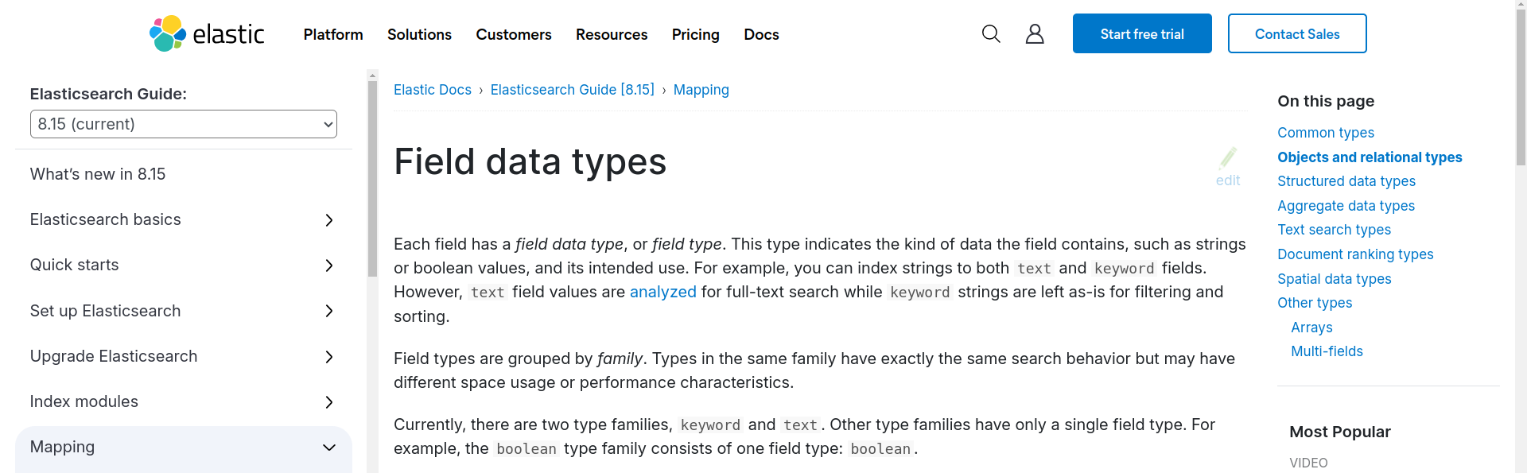
Field data types
Read more

Slide 26
6
Delete documents

Slide 27
Delete documents
JSON
id=1
my_index
Read more
JSON
id=2
JSON
id=3
<index>
<id>
DELETE

Slide 28
Delete documents
JSON
id=1
my_index
Read more
JSON
id=2
JSON
id=3
my_index
1
my_index
4
DELETE
DELETE
❌

Slide 29
7
Get document

Slide 30
Get documents
JSON
id=1
my_index
Read more
JSON
id=2
JSON
id=3
<index>
<id>
GET

Slide 31
Get documents
JSON
id=1
my_index
Read more
JSON
id=2
JSON
id=3
my_index
1
my_index
4
GET
GET
❌

Slide 32
8
Count documents

Slide 33
Count documents
JSON
my_index
Read more
JSON
JSON
🛈 The query parameter is used to match certain criteria
<index>
<index>
<q>
COUNT
COUNT

Slide 34
9
The exists API

Slide 35
The exists API
JSON
my_index
Read more
JSON
JSON
<index>
<index>
<id>
client.indices.exists
client.exists
🛈 This checks if an index exists in ElasticSearch.
🛈 This checks if a document exists in an index.

Slide 36
10
Update document

Slide 37
Update documents
Documents exists in the index
JSON
id=1
Read more
my_index
id=2
JSON
🛈 The update operation follows these steps:
Get the document.
Update it (e.g. Add a new field, remove a field, or update a field)
Re-index the result.
<index>
<id>
UPDATE

Slide 38
Update documents
But how do you update the document?
insertion
“book_id”: 1
“book_name”: “A book”
Read more
JSON
my_index
id=1
3
UPDATE
get
Document
update
my_index
script = {
“book_id” = 2
}
1
1
2

Slide 39
Update documents
Document doesn’t exist
JSON
id=1
Read more
my_index
id=2
JSON
🛈 The update operation can create the document if it doesn’t exist
Add the values you want to insert.
Set doc_as_upsert to true.
<index>
id=4
UPDATE

Slide 40
11
Bulk API

Slide 41
The bulk API
JSON
Index
my_index
Read more
JSON
Index
Update
Delete
Each operation (index, update, delete) makes a separate API call.
The bulk API performs multiple operations in one API call. This increases indexing speed.
...

Slide 42
The bulk API - Syntax
action and metadata\n
  optional source\n
action and metadata\n
  optional source\n
…
action and metadata\n
  optional source\n
🛈 The source is required for:
update
index
create
Read more
🛈 The action can be one of the following:
index
create
update
delete

Slide 43
The bulk API - Example
response = es.bulk(
operations=[
{
"index": {
"_index": "test",
"_id": "1"
}
},
{
"field1": "value1"
},
{
"delete": {
"_index": "test",
"_id": "2"
}
},
{
"create": {
"_index": "test",
"_id": "3"
}
},
{
"field1": "value3"
},
{
"update": {
"_id": "1",
"_index": "test"
}
},
{
"doc": {
"field2": "value2"
}
}
],
)
🛈 The source is required for:
update
index
create
Read more
Action
Source

Slide 44
12
The search API – Part 1

Slide 45
The search API
JSON
id=1
Read more
my_index
id=2
JSON
You use the search API to build:
Search engines
Recommendation systems
Real-time dashboards
Log data analysis
...

Slide 46
The search API
SEARCH
<index>
my_index
index_1,my_index
index*
_all
Read more

Slide 47
The search API
SEARCH
<index>
q
Use it for simple searches.
Uses the Lucene syntax.
Read more

Slide 48
The search API
SEARCH
<index>
q
Read more
query
Use it for complex, structured queries.
Uses the Query DSL language.
Default value is match all.

Slide 49
The search API
SEARCH
<index>
q
Read more
query
timeout, size, from
Timeout:
  The maximum time to wait for a search request to complete.
  Time units (seconds, milliseconds, days, etc) .
Size:
  Defines the number of hits (documents) to return.
  Default value is 10. Max value is 10000.

Slide 50
The search API
SEARCH
<index>
q
Read more
query
timeout, size, from
from:
  Starting point from which to return search results (pagination) .
  Useful if you want to implement skip functionality.

Slide 51
13
The search API – Part 2

Slide 52
The search API – Query DSL
SEARCH
<index>
q
Read more
query
Query DSL is used to create complex, structured queries.
Query DSL consists of two types of clauses:
  Leaf clauses (match, term, or range)
  Compound clauses (bool)
🛈 Query DSL means Query (Domain Specific Language)

Slide 53
The search API – Query DSL
Leaf clauses
match:
  Is used to perform full-text search.
  Returns documents that match a provided text, number, date, or bool.
  The field must be mapped to a text data type.
term:
  Returns documents that contain an exact term in a provided field.
  The field must be mapped to a keyword data type or a numeric/date type.
  Example usage : product ID, book ID, username, etc.
range:
  Returns documents that contain terms within a provided range.
Read more

Slide 54
The search API – Query DSL
Example for match query:
response = es.search(
index="my_index",
body={
"query": {
"match": {
"description": "A description."
}
}
}
)
Read more

Slide 55
The search API – Query DSL
Example for term query:
response = es.search(
index="my_index",
body={
"query": {
"term": {
"product_id": "PRODUCT_12345"
}
}
}
)
Read more

Slide 56
The search API – Query DSL
Example for range query:
response = es.search(
index="my_index",
body={
"query": {
"range": {
"publication_date":
{
"gte": "2023-01-01",
"lte": "2023-12-31"
}
}
}
}
}
)
Read more

Slide 57
The search API – Query DSL
Compound clauses
bool:
  Combines multiple queries using boolean logic:
    must, filter, should, must_not.
  The field must be mapped to a text data type.
Read more

Slide 58
The search API – Query DSL
Example for bool query:
response = es.search(index="my_index", body={
"query": {
"bool": {
"must": [
{
"match": {
"title": "Elasticsearch"
}
}
],
"filter": [
{
"term": {
"status": "published"
}
}
],
"should": [
{
"match": {
"tags": "search"
}
}
],
"must_not": [
{
"term": {
"deleted": True
}
}
]
}
}
)
Read more

Slide 59
The search API – Query DSL
Example for bool query:
response = es.search(index="my_index", body={
"query": {
"bool": {
"must": [
{
"match": {
"title": "Elasticsearch"
}
}
],
"filter": [
{
"term": {
"status": "published"
}
}
],
"should": [
{
"match": {
"tags": "search"
}
}
],
"must_not": [
{
"term": {
"deleted": True
}
}
]
}
}
})
Read more
Keeping documents where title is equal to Elasticsearch

Slide 60
The search API – Query DSL
Example for bool query:
response = es.search(index="my_index", body={
"query": {
"bool": {
"must": [
{
"match": {
"title": "Elasticsearch"
}
}
],
"filter": [
{
"term": {
"status": "published"
}
}
],
"should": [
{
"match": {
"tags": "search"
}
}
],
"must_not": [
{
"term": {
"deleted": True
}
}
]
}
}
})
Read more
Filtering documents with a status of published

Slide 61
The search API – Query DSL
Example for bool query:
response = es.search(index="my_index", body={
"query": {
"bool": {
"must": [
{
"match": {
"title": "Elasticsearch"
}
}
],
"filter": [
{
"term": {
"status": "published"
}
}
],
"should": [
{
"match": {
"tags": "search"
}
}
],
"must_not": [
{
"term": {
"deleted": True
}
}
]
}
}
})
Read more
This match is optional

Slide 62
The search API – Query DSL
Example for bool query:
response = es.search(index="my_index", body={
"query": {
"bool": {
"must": [
{
"match": {
"title": "Elasticsearch"
}
}
],
"filter": [
{
"term": {
"status": "published"
}
}
],
"should": [
{
"match": {
"tags": "search"
}
}
],
"must_not": [
{
"term": {
"deleted": True
}
}
]
}
}
})
Read more
Excluding any document where the deleted field is set to true

Slide 63
14
The search API – Part 3

Slide 64

The search API
Timeout
It sets the maximum duration for a query to execute.
If the search takes longer than the specified time, Elasticsearch will abort the search.
Read more

Slide 65
The search API
Timeout
Sets the maximum duration for a query to execute.
If the search takes longer than the specified time, Elasticsearch will abort the search.
Size
Controls how many search results are returned.
Max value is 10000.
Read more

Slide 66
The search API
Timeout
Sets the maximum duration for a query to execute.
If the search takes longer than the specified time, Elasticsearch will abort the search.
Size
Controls how many search results are returned.
Max value is 10000.
From
Used for pagination.
It tells Elasticsearch how many documents to skip before starting to return results.
Read more

Slide 67
The search API
Aggregations
Performs calculation on the data
Average, max, min, count.
Read more

Slide 68
15
Dense vectors

Slide 69
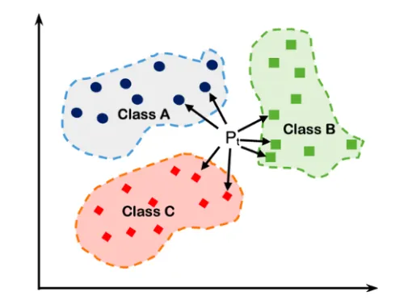
Dense vector field type
Stores dense vectors of numeric values.
Use it if you have few or no zero elements.
Does not support aggregations or sorting.
It is not possible to store multiple values in one dense vector field.
Use kNN search to retrieve the nearest vectors.
Max size of a dense vector is 4096.
Read more
Medium article by Sachinsoni

Slide 70
Dense vector field type
Examples
response = client.index(
index="my-index",
id="1",
document={
"my_text": "example text",
"my_vector": [0.5, 10, 6]
}
)
Read more
response = client.index(
index="my-index",
id="2",
document={
"my_text": "example text 2",
"my_vector": [[0.5, 10, 6], [1, 0, -2]]
}
)

Slide 71
Dense vector field type
Important
You have to manually do the mapping.
Elasticsearch does not automatically infer the mapping for dense vectors.
It needs to know the exact number of dimensions.
Read more
response = es.indices.create(
index="my_index",
mappings={
"properties": {
"sides_length": {
"type": "dense_vector",
"dims": 4
},
"shape": {
"type": "keyword"
}
}
},
)

Slide 72
16
Embedding documents

Slide 73
Embedding documents
Embedding transforms text into numerical vectors.
Deep learning models are used to embed documents.
These models preserve the meaning of the text.
Use cases:
  Recommendation systems
  Retrieval-Augmented Generation (RAG)
Read more
embedding

Slide 74


Embedding documents
Deep learning models
Read more
Closed models.
Paid (Pay what you use).
No hardware required (Cloud).
Open-source models.
Free to use.
Hardware is required (preferably GPU).

Slide 75
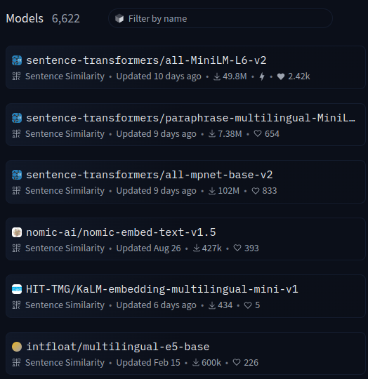

Embedding documents
Embedding size
Size of the dense vector.
Larger sizes yield better embeddings.
Common sizes include 384, 768, 1024.
Read more

Slide 76
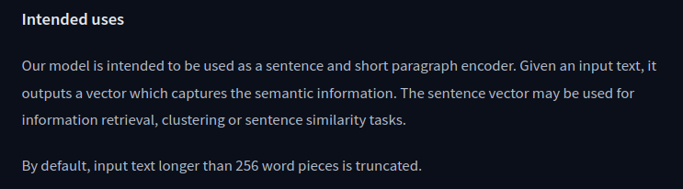
Embedding documents
Input size
Size of the input text that the model can process.
Text will be truncated if it exceeds the model’s capacity.
Common values include 256, 512 tokens.
Read more

Slide 77
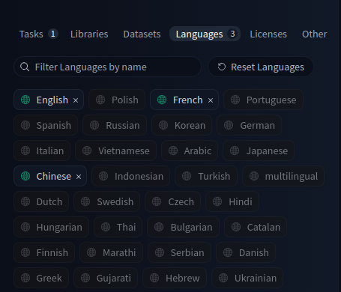
Embedding documents
Text language
Some models can translate specific languages.
Others support multiple languages and are multilingual.
Read more

Slide 78
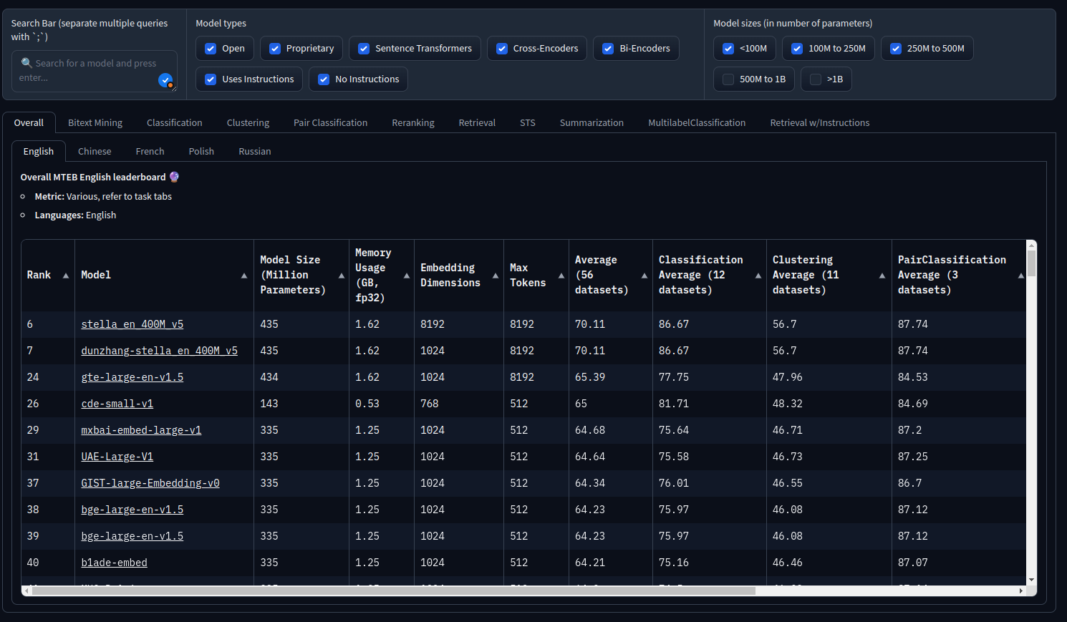
Embedding documents
Massive Text Embedding Benchmark (MTEB)

Slide 79
17
KNN search

Slide 80
k-nearest neighbor (kNN) search
How do we search for embedded documents?
We use the kNN search for fields mapped as dense vectors.
Important, you can’t use the query parameter in this case.
Read more
embedding

Slide 81
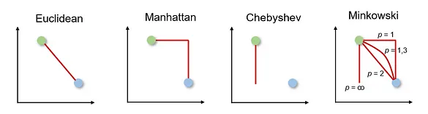
k-nearest neighbor (kNN) search
The kNN algorithm is used for classification and regression tasks.
It classifies new data points by comparing them with the k nearest points from the training data.
Commonly distances metrics: Euclidean, Manhattan or Minkowski.
This algorithm is simple and effective.
Read more
Medium article by Sachinsoni
Medium article by Dancker

Slide 82
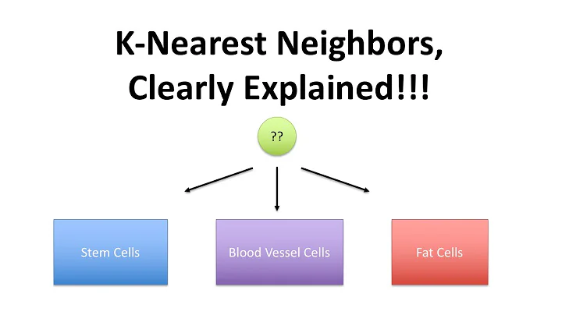


k-nearest neighbor (kNN) search
Watch on

Slide 83
k-nearest neighbor (kNN) search
Example
results = es.search(
knn={
'field': 'embedding',
'query_vector': es.get_embedding(parsed_query),
'num_candidates': 50,
'k': 10,
}
)
🛈 Should be a dense_vector
Read more

Slide 84
k-nearest neighbor (kNN) search
Example
results = es.search(
knn={
'field': 'embedding',
'query_vector': es.get_embedding(parsed_query),
'num_candidates': 50,
'k': 10,
}
)
Read more
🛈 The query should be a vector.

Slide 85
k-nearest neighbor (kNN) search
Example
results = es.search(
knn={
'field': 'embedding',
'query_vector': es.get_embedding(parsed_query),
'num_candidates': 50,
'k': 10,
}
)
Read more
🛈 Retrieves 50 potentially relevant documents before applying distance calculations to select the k best documents.

Slide 86
k-nearest neighbor (kNN) search
Example
results = es.search(
knn={
'field': 'embedding',
'query_vector': es.get_embedding(parsed_query),
'num_candidates': 50,
'k': 10,
}
)
Read more
🛈 Returns up to 10 documents that match your query.

Slide 87
18
Deep pagination

Slide 88

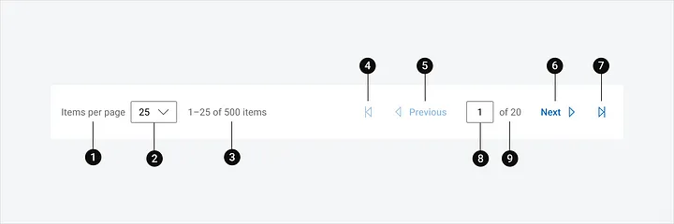
Deep pagination
Indexing / fetching all documents at once is inefficient and slow.
Pagination:
  Retrieves data in small chunks from large indexes.
  Improves performance and efficiency.
  Fast search experience.
  Cost effective.
Read more
x100K
index /
fetch
Medium article by Dayanand

Slide 89
Deep pagination
Pagination methods
from/size: commonly used for paginating smaller datasets.
search_after: offers more efficient deep pagination for large datasets.
Read more

Slide 90
Deep pagination
Pagination methods
from/size: commonly used for paginating smaller datasets.
search_after: offers more efficient deep pagination for large datasets.
Read more
🛈 Note:
from/size is limited to 10k results.
Requires a lot of memory for deep pages.
Not suitable for larger indexes.
size = 8
from = 5
size = 8
from = 0
index
index

Slide 91
Deep pagination
Pagination methods
from/size: commonly used for paginating smaller datasets.
search_after: offers more efficient deep pagination for large datasets.
Read more
new sort values
Sortable fields
timestamp
id
size = 8
sort values
old sort values
size = 8
index
index

Slide 92
Deep pagination
Pagination methods
from/size: commonly used for paginating smaller datasets.
search_after: offers more efficient deep pagination for large datasets.
Read more
🛈 Note:
The search_after method is not constrained by the 10k result limit.
It does not utilize an offset (i.e., the from parameter).
Results must be sorted by fields such as ID or timestamp.
Uses a pointer derived from the sort values of the last document on the previous page.
This approach prevents the skipping of documents.
It is particularly beneficial for handling larger indexes.

Slide 93
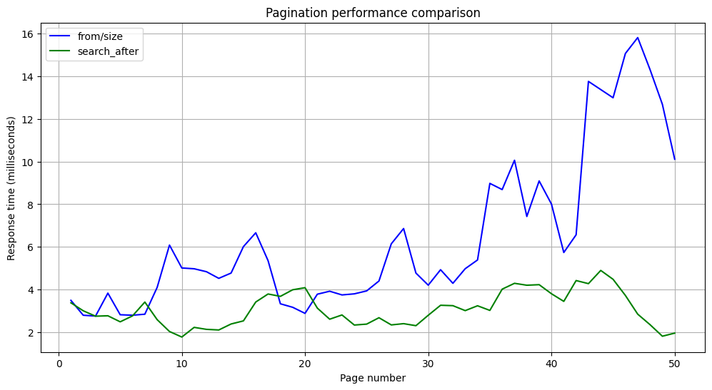
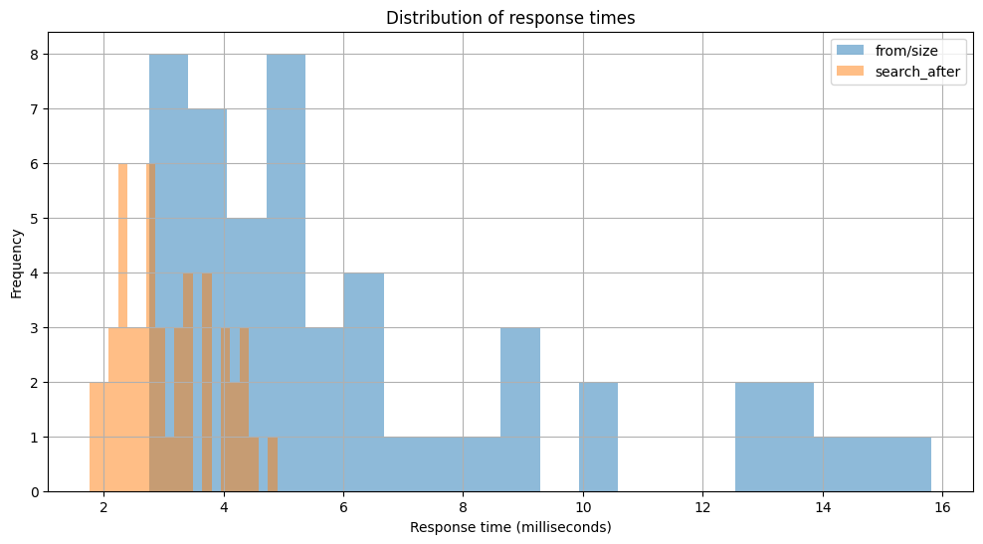
Deep pagination
Comparison
Below are the results obtained after attempting to retrieve 10,000 documents using the following parameters (size = 200, iterations = 50)
Read more

Slide 94
Deep pagination
Comparison
 | from/size | search_after
Average time (ms) | 6.417 | 3.072
Maximum time (ms) | 15.812 | 4.896
Minimum time (ms) | 2.757 | 1.772
Read more
 | from/size | search_after
Performance degradation | 2.9x | 0.58x
🛈 Performance degradation is calculated like this (last page time / first page time)

Slide 95
19
Ingest pipelines

Slide 96
Ingest pipelines
You can perform transformations on data before indexing.
Common transformations: remove fields, lowercase text, remove HTML tags, and more.
Read more
Step 1
Step 2
Step 3
Documents
Ingest pipeline
Target index

Slide 97
Ingest pipelines
We use the ingest API to:
  Create or update a pipeline.
Read more
response = client.ingest.put_pipeline(
id="my-pipeline",
description="A description",
processors=[
{
"set": {
"description": "A description",
"field": "field",
"value": “value”
}
},
{
"lowercase": {
"field": "field"
}
}
],
)

Slide 98
Ingest pipelines
We use the ingest API to:
  Simulate a pipeline.
Read more
response = client.ingest.simulate(
id="my-pipeline",
docs=[
{
"_index": "index",
"_id": "id",
"_source": {
"foo": "bar"
}
},
{
"_index": "index",
"_id": "id",
"_source": {
"foo": "rab"
}
}
],
)
OR
response = client.ingest.simulate(
pipeline={
"processors": [
{
"lowercase": {
"field": "field"
}
}
]
},
...
)

Slide 99
Ingest pipelines
We use the ingest API to:
  Delete a pipeline.
Read more
response = client.ingest.delete_pipeline(
id="my-pipeline",
)

Slide 100
Ingest pipelines
We use the ingest API to:
  Get a pipeline.
Read more
response = client.ingest.get_pipeline(
id="my-pipeline",
)

Slide 101
Ingest pipelines
Pipelines can fail. You can either ignore the failure or handle it.
  If you ignore the failure, the pipeline will skip over the failed steps.
Read more
response = client.ingest.put_pipeline(
id="my-pipeline",
processors=[
{
"rename": {
"description": "A description",
"field": "field",
"ignore_failure": True
}
}
],
)
Step 1
Step 2
Step 3
Ingest pipeline

Slide 102
Ingest pipelines
Pipelines can fail. You can either ignore the failure or handle it.
  Specify custom error-handling steps with on_failure.
Read more
response = client.ingest.put_pipeline(
id="my-pipeline",
processors=[
{
"rename": {
"description": "A description",
"field": "field",
"on_failure": [...]
}
}
],
)
Retry, log error, etc
Step 1
Step 2
Step 3
Ingest pipeline

Slide 103
20
Ingest processors

Slide 104
Ingest processors
Common transformations: remove fields, lowercase text, remove HTML tags, and more.
Read more
Step 1
Step 2
Step 3
Documents
Ingest pipeline
Target index

Slide 105
Ingest processors
Ingest processors by category
Ingest processors are organized into 5 categories.
Read more
Data enrichment
Array/JSON handling
Data transformation
Append
Inference
Attachment
...
For each
JSON
Sort
Convert
Rename
Set
HTML strip
Lowercase / Uppercase
Trim
Split
...
Data Filtering
Pipeline handling
Drop
Remove
Fail
Pipeline

Slide 106
21
Filters in depth

Slide 107
Filters in depth
When searching in Elasticsearch, you can use either query context or filter context.
Read more
Query context
Query
Score
How well does this document match this query clause ?
Filter context
Query
Yes / No
Does this document match this query clause ?

Slide 108
Filters in depth
Why use the filter context ?
  Binary matching.
  No score is needed.
  Filters execute faster than queries (no score is computed).
  Filters consume less CPU resources.
Read more
Filter context
Query
Yes / No
Does this document match this query clause ?

Slide 109
Filters in depth
Use cases
Filters are effective for querying structured data.
Read more
Structured data
Numeric fields
Dates
Boolean values
Keyword fields
...

Slide 110

Filters in depth
Example 1
Read more
response = client.search(
index="phones",
query={
"bool": {
"filter": [
{
"term": {
"color": "black"
}
},
{
"term": {
"brand": "samsung"
}
}
]
}
},
)
Color
AND
Yes/No
Brand

Slide 111
Filters in depth
Example 2
Read more
response = client.search(
query={
"bool": {
"filter": [
{
"term": {
"status": "published"
}
},
{
"range": {
"publish_date": {
"gte": "2015-01-01",
"lte": "2015-02-01"
}
}
}
]
}
},
)
Status
AND
Yes/No
Publish date

Slide 112
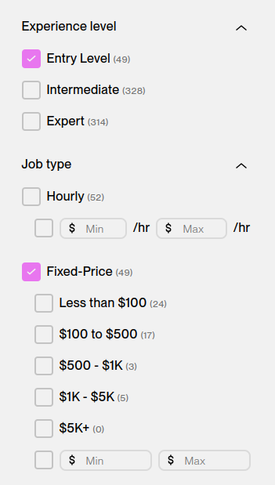
Filters in depth
Post filters
  Applies filters after aggregations are calculated.
  Does not affect aggregations.
  Only filters the search results.
  Let you narrow down what users see without limiting what they can choose from.
Read more

Slide 113
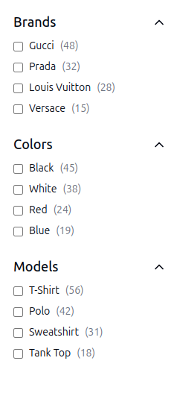
Filters in depth
Example
response = client.search(
index="shirts",
query={
"bool": {
"filter": {
"term": {
"brand": "gucci"
}
}
}
},
...
)
response = client.search(
aggs={
"colors": {
"terms": {
"field": "color"
}
},
"color_red": {
"filter": {
"term": {
"color": "red"
}
},
"aggs": {
"models": {
"terms": {
"field": "model"
}
}
}
}
},
...
)
response = client.search(
post_filter={
"term": {
"color": "red"
}
},
)
Read more

Slide 114
22
SQL search API

Slide 115

SQL Search API
We used Query DSL to search for documents.
An alternative method for searching documents is the SQL Search API.
Read more
Query DSL
my_index
Query
Results

Slide 116
SQL Search API
The SQL search API supports numerous parameters.
Read more
format
cursor
fetch_size
SQL search API
delimiter
filter
page time-out
...
request time-out

Slide 117
SQL Search API
Example
field
Read more
response = client.sql.query(
format="txt",
query="SELECT * FROM library ORDER BY page_count DESC LIMIT 5",
)
size
Index

Slide 118
SQL Search API
The available response formats are:
CSV
JSON
TSV
TXT
YAML
CBOR
SMILE
Binary formats
Read more
response = client.sql.query(
format="txt",
query="SELECT * FROM library ORDER BY page_count DESC LIMIT 5",
)

Slide 119
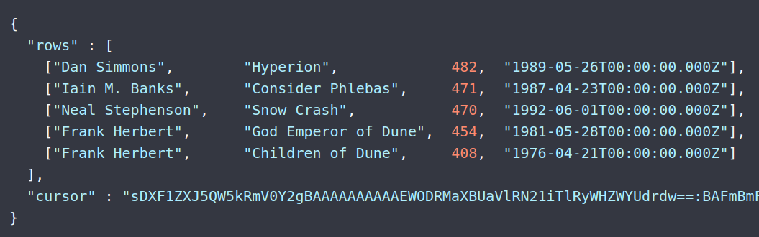
SQL Search API
Pagination
Read more
response = client.sql.query(
format="txt",
cursor="sDHOSBDISBXMLK…",
)
?
SQL Search API
Query
Results
Original example

Slide 120
SQL Search API
Filtering
Read more
response = client.sql.query(
format="txt",
query="SELECT * FROM library ORDER BY page_count DESC",
filter={
"range": {
"page_count": {
"gte": 100,
"lte": 200
}
}
},
fetch_size=5,
)

Slide 121
SQL Search API
SQL Translate API
Read more
response = client.sql.translate(
query="SELECT * FROM library ORDER BY page_count DESC",
fetch_size=10,
)
{
"size": 10,
"_source": false,
"fields": [{"field": "author"}, ...],
"sort": [
{
"page_count": {
"order": "desc",
}
}
],
"track_total_hits": -1
}
SQL Translate API

Slide 122
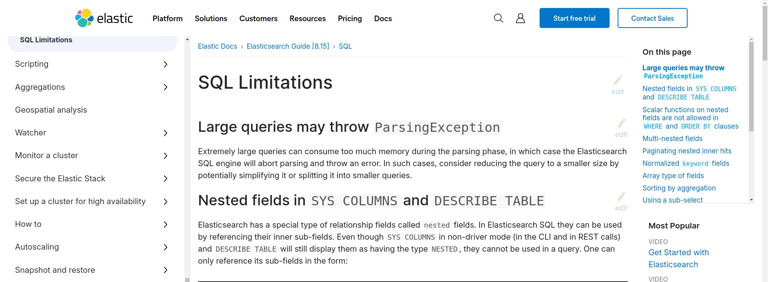
SQL Search API
SQL Limitations
Read more

Slide 123
23
Time Series Data Stream

Slide 124
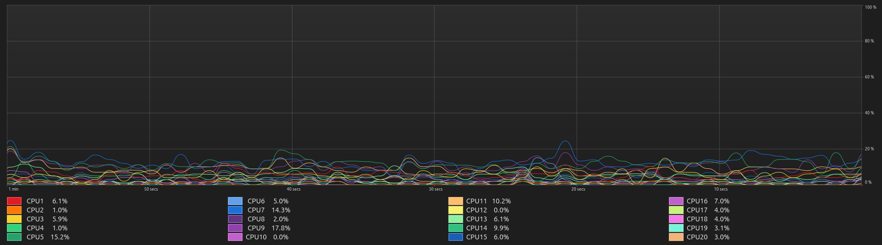
Time Series Data Stream
Time series data refers to data points ordered by time.
Data is collected at regular intervals.
Example: CPU usage over time.
Read more

Slide 125


Time Series Data Stream
Managing time series data is challenging.
  The data can grow rapidly (high frequency measurements)
  How to store this large volume efficiently?
  Deciding which old data to keep and when to delete it.
Read more
VS

Slide 126


Time Series Data Stream
Why use Elasticsearch for time series data?
Elasticsearch can handle massive volumes of data.
Supports real-time data ingestion and querying.
Analyze time-series.
Read more
Original post
Original post

Slide 127
Time Series Data Stream
Time series data structure
Each data point is a document
Each document contains the timestamp field and the data.
Read more
28
26
data
24
22
20
06:00:00
06:00:01
06:00:02
06:00:03
06:00:04
@timestamp
@timestamp

Slide 128
Time Series Data Stream
Index Lifecycle Management (ILM)
ILM automates the rollover and management of indices.
Benefits: Storage optmization, automated data retention, efficient management of index size.
Phases of ILM:
Read more
Hot phase
Warm phase
Cold phase
Delete phase

Slide 129
Time Series Data Stream
ILM visualized
Read more
ILM
Rollover: age = 30 days & size = 50GB
Delete: 90 days
my_index_0001

Slide 130

Time Series Data Stream
ILM visualized
Read more
ILM
Rollover: age = 30 days & size = 50GB
Delete: 90 days
my_index_0001
age = 30
my_index_0002

Slide 131
Time Series Data Stream
ILM visualized
Read more
ILM
Rollover: age = 30 days & size = 50GB
Delete: 90 days
my_index_0001
age = 60
my_index_0002
age = 30
my_index_0003

Slide 132

Time Series Data Stream
ILM visualized
Read more
ILM
Rollover: age = 30 days & size = 50GB
Delete: 90 days
my_index_0001
age = 90
my_index_0002
age = 60
my_index_0003
age = 30
...

Slide 133
Time Series Data Stream
Querying time series data
Read more
{
"query": {
"range": {
"@timestamp": {
"gte": "2024-11-01T00:00:00",
"lte": "2024-11-07T23:59:59"
}
}
}
}
{
"aggs": {
"avg_cpu_usage": {
"avg": {
"field": "cpu_usage"
}
}
}
}

Slide 134
24
Analyzers

Slide 135

Analyzers
Analyzers process text during indexing and searching.
They transform text into tokens.
They make the search process efficient and accurate.
Read more
Term | Document
hello | Document 1
world | Document 1
imad | Document 2
saddik | Document 2
Documents
Image origin

Slide 136
Analyzers
Analyzer components
An analyzer is a combination of 3 components:
  Character filter
  Tokenizer
  Token filter
Read more
Character filters
(min 0)
Tokenizers
(max 1)
Token filters
(min 0)
Analyzer

Slide 137
Analyzers
Built-in analyzers
Provide ready-made options for processing text in various ways.
Each built-in analyzer is designed for specific types of data.
Common analyzers:
Read more
None
None
None
None
Standard Tokenizer
Standard Tokenizer
Whitespace Tokenizer
Lowercase Tokenizer
Lowercase filter &
Stop filter
None
None
Stop filter
Standard Analyzer
Simple Analyzer
Whitespace Analyzer
Stop Analyzer

Slide 138
Analyzers
Phases of analysis
Index time analysis
Read more
Tokenizer
Term
hello
world
imad
saddik
Token filters
Term
hello
world
imad
Documets
Tokens
Filtered Tokens
Term | Document
hello | Document 1
world | Document 1
imad | Document 2
saddik | Document 2
Inverted index

Slide 139
Analyzers
Phases of analysis
Index time analysis
Search time analysis
Read more
Tokenizer
Term
hello
world
imad
saddik
Token filters
Term
hello
world
imad
Query
Tokens
Filtered Tokens
Term | Document
hello | Document 1
world | Document 1
imad | Document 2
saddik | Document 2
Inverted index
Documets

Slide 140

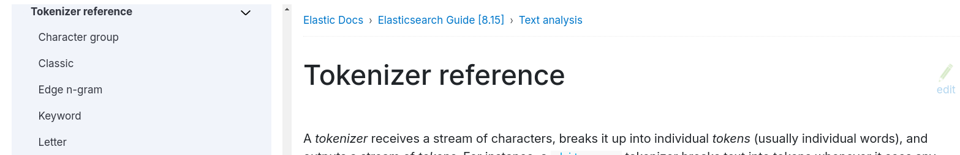
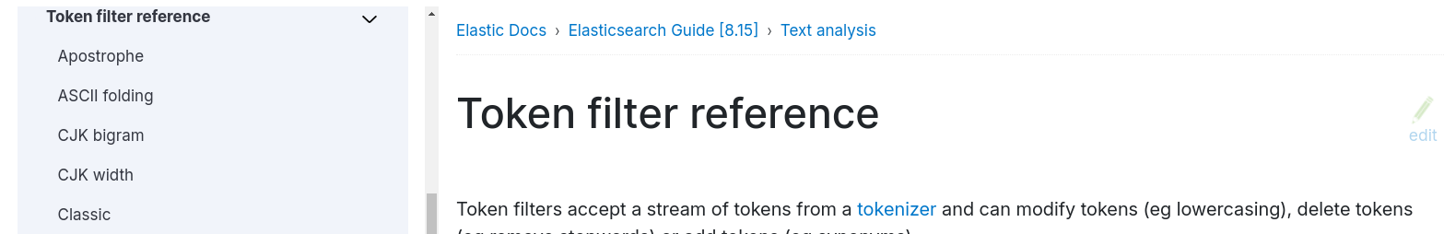
Analyzers
Read more

Slide 141

Analyzers

Slide 142
25
Synonyms

Slide 143


Synonyms
Synonyms help enhance search accuracy.
Useful for matching variations or related terms.
Synonyms are defined using the Solr format.
Read more

Slide 144
Synonyms
Solr format
This is a flexible syntax for defining synonyms.
It uses two different definitions:
  Equivalent synonyms: “term 1, term 2, term 3”
  Explicit synonyms: “term 1, term 2 => term 3”
Read more
car
automobile
Personal computer
PC
race car
voiture
i-pod, i pod
ipod
...
Equivalent terms

Slide 145
Synonyms
Synonyms are used within analyzers.
You can use synonyms in index and search time.
Synonyms are a custom token filter.
Read more
None
Standard Tokenizer
Synonyms filter
Custom Analyzer

Slide 146
26
Common options

Slide 147


Common options
Simplify Elasticsearch management.
Provide features like human-readable output, date math, and filtering.
All Elasticsearch REST APIs support these common options.
Read more

Slide 148
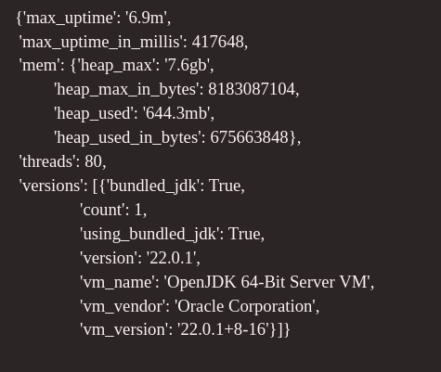
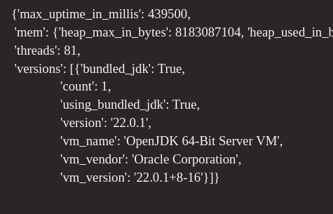
Common options
Human-readable output
Make statistics in a format that humans can understand.
It applies to disk space, memory, time, and other metrics.
Read more
Example
response = es.cluster.stats(human=True)
pprint(response["nodes"]["jvm"])
Before
After

Slide 149

Common options
Date math
Perform math operations on dates.
Operations include: Add, Subtract, Round down to nearest day.
Supported time units: y (years), M (moths), etc.
The expression starts with an anchor date (“now” or a string ending with ||).
Read more
Examples
now := 2024-11-16 11:55:00
now+1h := 2024-11-16 12:55:00
now-1h := 2024-11-16 10:55:00
now-1h/d := 2024-11-16 00:00:00
2024.11.16||+1M/d := 2024-12-16 00:00:00

Slide 150
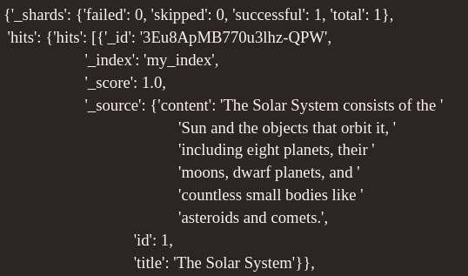
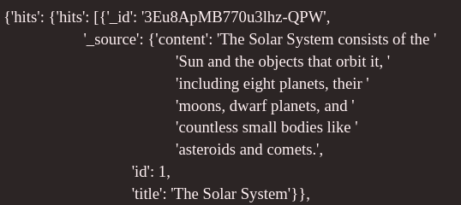
Common options
Response filtering
Inclusive filtering: Specify fields to include.
Exclusive filtering: Remove unnecessary fields.
Combined filtering
Read more
Example
response = es.search(
index=index_name,
body={
"query": {
"match_all": {}
}
},
filter_path="hits.hits._id,hits.hits._source"
)
pprint(response.body)
Before
After

Slide 151
27
Change heap size

Slide 152
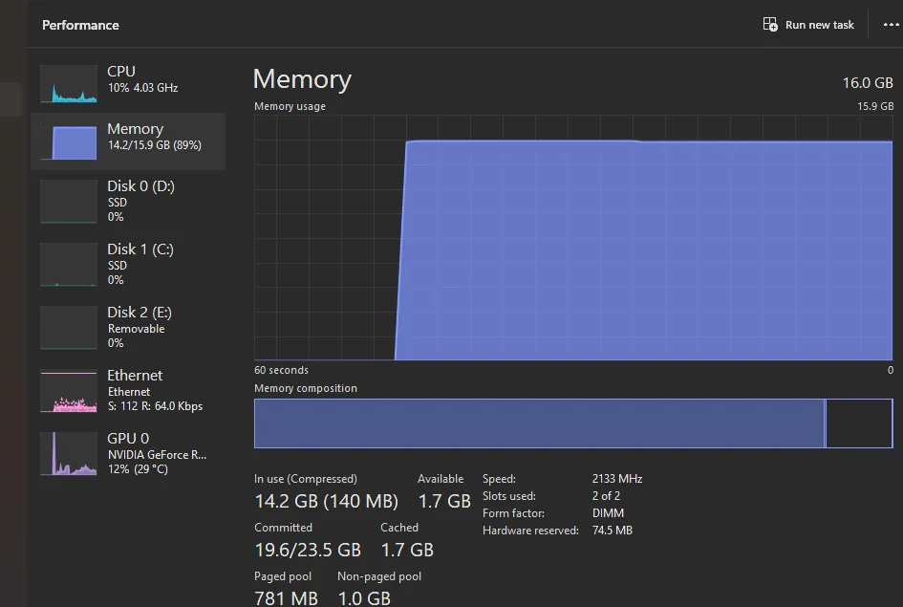
Change heap size
By default Elasticsearch uses 50% of the available RAM.
This can slow down you PC.
You only need 1 or 2GB when dealing with small indices.
Read more

Slide 153

Change heap size
Steps to change the heap size
Start the container.
Read more
sudo docker start elasticsearch

Slide 154
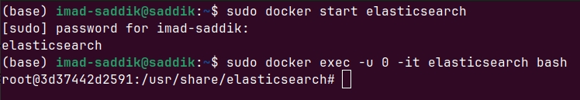
Change heap size
Steps to change the heap size
Start the container.
Go inside the container.
Read more
sudo docker exec -u 0 -it elasticsearch bash

Slide 155
Change heap size
Steps to change the heap size
Start the container.
Go inside the container.
Create the heap.options file inside jvm.options.d folder and add this.
Read more
echo "-Xms2g" > /usr/share/elasticsearch/config/jvm.options.d/heap.options
echo "-Xmx2g" >> /usr/share/elasticsearch/config/jvm.options.d/heap.options
cat /usr/share/elasticsearch/config/jvm.options.d/heap.options

Slide 156
Change heap size
Read more

Slide 157
28
Final project – part 0

Slide 158



Final project – part 0
No more videos on Elasticsearch concepts and APIs.
I'll be focusing on the final project from now on.
The final project will cover most of the topics we've learned in previous videos.
We will be building a website.
Elasticsearch will provide the search functionality.

Slide 159
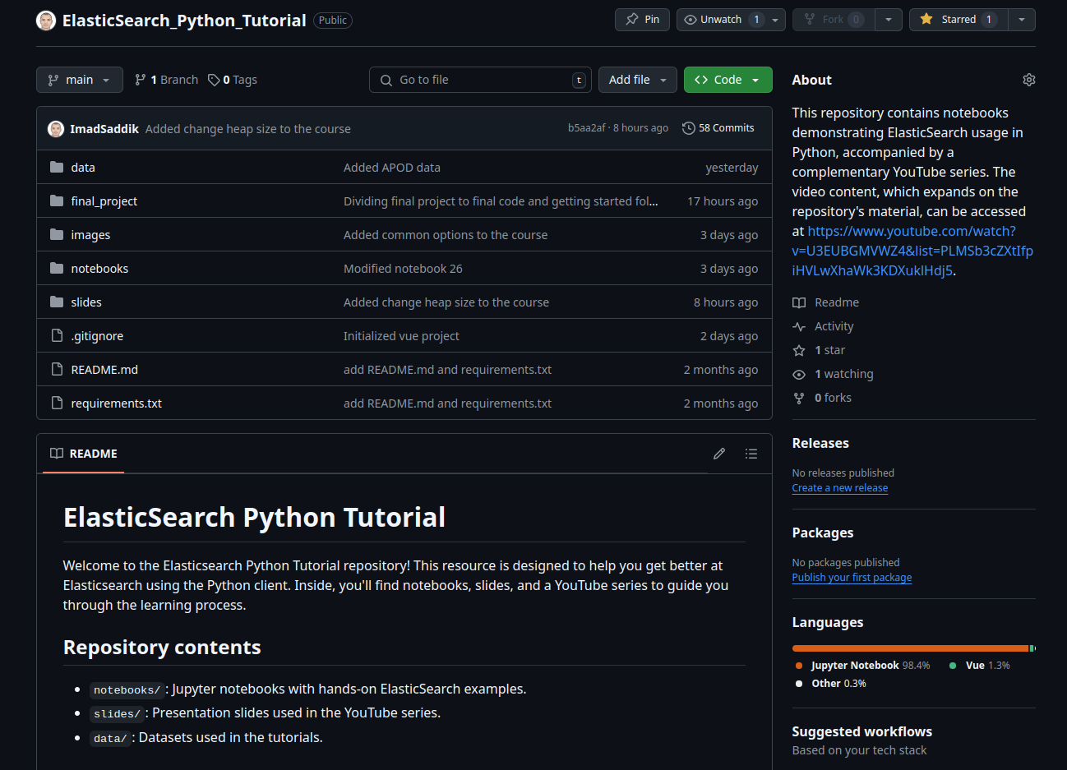

Final project – part 0
Source code

Slide 160
29
Final project – part 1

Slide 161
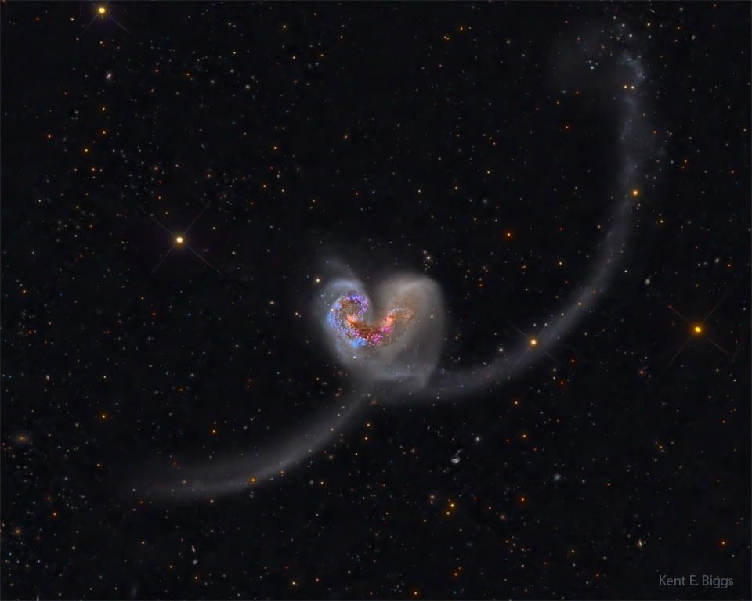
Final project – part 1
Create an index and index documents.
Use size / from when searching.
Perform multi-match queries.
The theme of the final project is Astronomy.
Image credit: Kent E. Biggs

Slide 162
Final project – part 1
Frontend is done for you.
Install dependencies.

Slide 163
Final project – part 1
Install dependencies.
Setup the backend server.
Configure Elasticsearch.

Slide 164
30
Final project – part 2

Slide 165
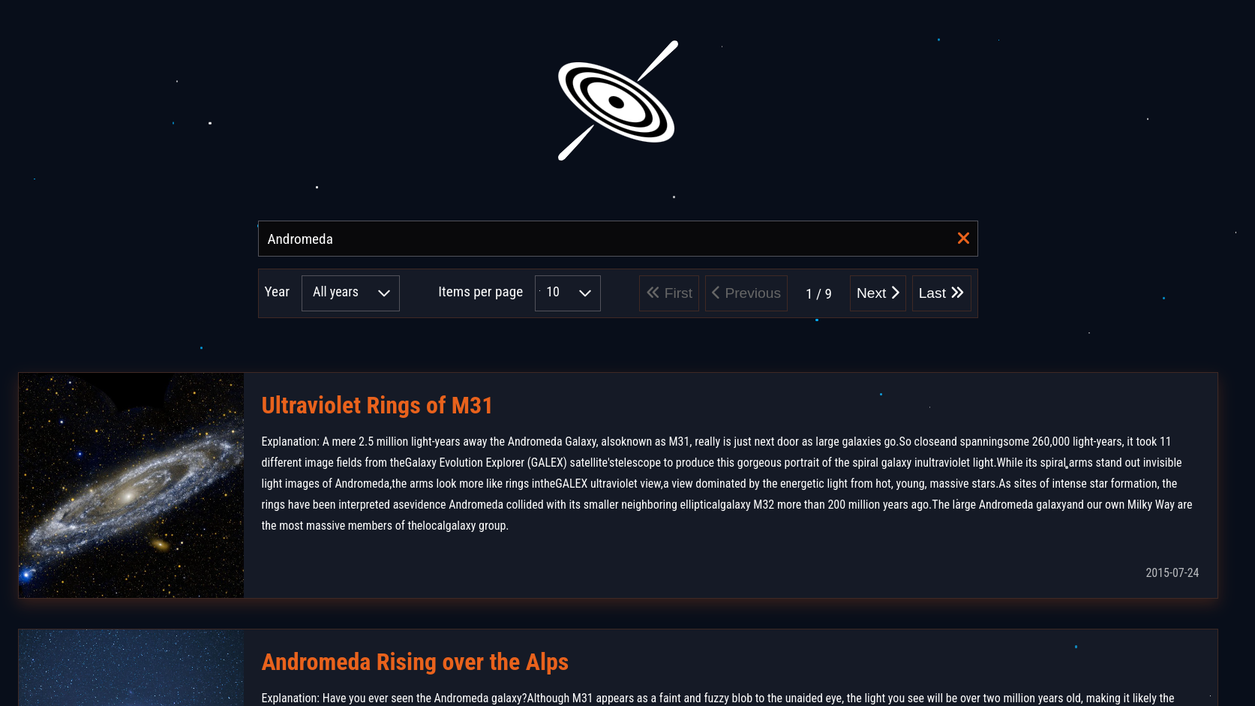
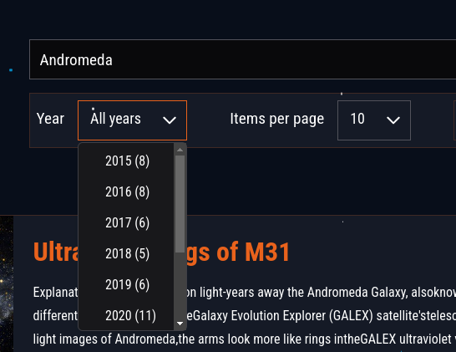
Final project – part 2
Add the pagination controls.
Filter by year.
Use aggregations.

Slide 166
31
Final project – part 3

Slide 167

Final project – part 3
Implement a search as you type feature.
Utilize the N-gram tokenizer.
Standard tokenizer
Andr
N-gram tokenizer
Andr

Slide 168
Final project – part 3
Why use the N-gram tokenizer?
Standard tokenizer
Andromeda
[andromeda]
N-gram tokenizer
Andromeda
[a, an, and, andr, andro, androm, androme, andromed, andromeda]
N = 9

Slide 169
32
Final project – part 4

Slide 170
Final project – part 4
Implement semantic search.
Use an embedding model from HuggingFace.
Use kNN search to find documents.
Medium article by Sachinsoni

Slide 171
33
Final project – part 5

Slide 172
Final project – part 5
Add the raw APOD data.
Contains HTML tags.
{
"date": "2024-11-30",
"title": "<a href=\"ap241130.html\">Winter and Summer on a Little Planet</a>",
"explanation": "<p>\n<b> Explanation: </b> \n\nWinter and summer appear to come on a single night to this\n<a href=\"https://www.instagram.com/camille.niel_photography/p/C270AVzrKcp/?img_index=1\">stunning little planet</a>.\n\nIt's planet Earth of course.\n\nThe\n<a href=\"http://srcematematike.si/2014/03/09/math-behind-tiny-planets/\">digitally mapped</a>,\nnadir centered panorama covers 360x180\ndegrees and is\ncomposed of frames recorded during January and July from the\n<a href=\"https://en.wikipedia.org/wiki/Col_du_Galibier\">Col du Galibier</a> ...
}

Slide 173
Final project – part 5
Add the raw APOD data.
Contains HTML tags.
Use pipelines to remove the HTML tags.
{
"date": "2024-11-30",
"title": "<a href=\"ap241130.html\">Winter and Summer on a Little Planet</a>",
"explanation": "<p>\n<b> Explanation: </b> \n\nWinter and summer appear to come on a single night to this\n<a href=\"https://www.instagram.com/camille.niel_photography/p/C270AVzrKcp/?img_index=1\">stunning little planet</a>.\n\nIt's planet Earth of course.\n\nThe\n<a href=\"http://srcematematike.si/2014/03/09/math-behind-tiny-planets/\">digitally mapped...
HTML Strip
{
"date": "2024-11-30",
"title": "Winter and Summer on a Little Planet",
"explanation": "\n Explanation: \n\nWinter and summer appear to come on a single night to this\nstunning little planet.\n\nIt's planet Earth of course.\n\nThe\ndigitally mapped...
Ingest pipeline

Slide 174
34
Collapse search results

Slide 175

Collapse search results
Collapse is used to show only the best document for each group.
It is useful when many documents are similar.
Read more
Logs
Collapse
Logs
User 1
User 1
Logs
User 2
Logs
User 2

Slide 176
Collapse search results
Example:
response = es.search(
index="my_index",
body={
"query": {
"match": {
"message": "My Universe Hub"
}
},
"collapse": {
"field": "user_id"
},
}
)
Read more
🛈 Important
By default, collapse returns one document for each user.
The returned document has the highest score.
Collapse works with keyword and numeric fields.

Slide 177
Collapse search results
After collapsing the search results, you can use inner hits to show related documents within each group.
This changes the default behavior by giving you a deeper view into each collapsed group.
You can set how many related documents to get per group (using size).
You can also control how these related documents are sorted (using sort).
Read more

Slide 178
Collapse search results
Example:
response = es.search(
index="my_index",
body={
"query": {
"match": {
"message": "My Universe Hub"
}
},
"collapse": {
"field": "user_id",
"inner_hits": {
"name": "most_recent",
"size": 5,
"sort": [ { "@timestamp": "desc" } ]
},
},
}
)
Read more
Name given to the inner hit section in the search reponse
Number of hits (documents) to retrieve per group.
How to sort the document inside the group.

Slide 179
Collapse search results
You can combine collapse with search_after but not scroll.
Example:
response = es.search(
index="my_index",
body={
"query": {
"match": {
"message": "My Universe Hub"
}
},
"collapse": {
"field": "user_id"
},
"search_after": ["idid3647"]
}
)
Read more

